Slide 1
Microsoft Excel
Lecture 10 M.Sc. Goran Noori Saleh

Slide 2
Introduction to Microsoft Excel
Objectives:
To define spreadsheets and explain basic functionality
To introduce the basic features of Excel
Vocabulary
Entering Data
Formatting Data
Precision vs. Display
Operators & Order of Precedence
Notes:
For those of you who have never used Excel or any other spreadsheet software application – many of these techniques and concepts will be new. We have provided both videos and reading to get you up to speed on the basics of these types of software packages and in specific Excel. For those of you whom have used spreadsheet software.. Some of this may be a review.. but perhaps not all. Like last class – it helps to know something about the tools you’re using to understand the types of results.

Slide 3
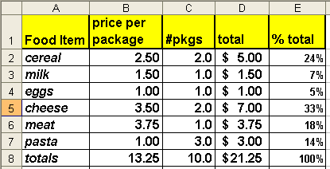
Spreadsheet: Electronic sheet of paper organized by columns & rows
The advantage of an electronic spreadsheet is it allows you to easily change data and have all “related” calculations automatically update..
Notes:
Excel is basically a software package that allows you to easily work with data in a grid-like format using columns and rows to display information. Being ‘electronic’ there are many features that make it easier to use than the pencil and paper version – the most notable is the ability for our spreadsheets to be automatically recalculated if any of the data inputs are later updated – but for this to happen we will need to learn how to properly setup and write spreadsheet formulas

Slide 4
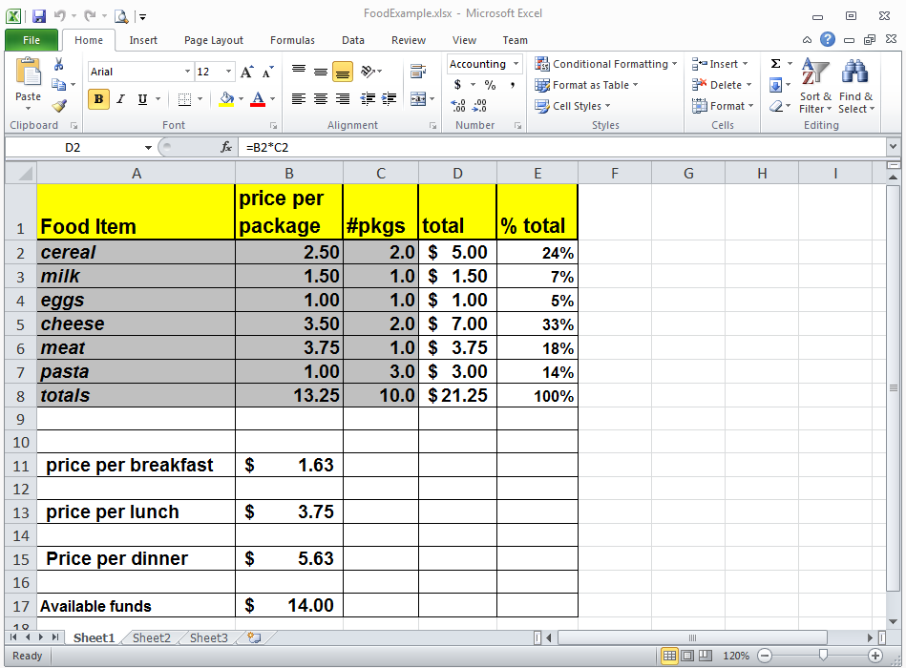
Spreadsheets in Excel are referred to as worksheets. A workbook file may contain may worksheets.
Sizing Buttons
Quick Access
Toolbar
Help Button
Home Ribbon
Ribbon Tabs
Name Box
Formula Bar
Column Letter
Headings
Fx Insert Function Button
Contents of
Active Cell displayed on Formula Bar
Row Numbers
Scroll Bars
Sheet Tabs Insert Worksheet Button
View Buttons Zoom
Notes:
This is a brief overview of the Excel window with the home ribbon displayed. For those not familiar with this version of Excel – I recommend you use the SAM tutorials to catch up – you will be responsible for knowing the terminology presented and being able to correctly identify/use the various worksheet features.
The center of the Excel window is the worksheet and worksheet cells – with the row numbers displayed on the left and column letters above. Just above the column letters are two boxes – the name box which we will use later to give a name to a cell or range of cells – and the formula bar. When you click on a specific cell - the contents of this active cell will be displayed in the formula bar. If the value 5 is typed into the cell this value will appear in the formula bar – however if the value 5 is a result of a calculation – the cells typically displays this value but the formula bar will list the actual formula that was written and is saved to this cell. Notice that just to the left of the formula bar is the FX button – which launches the function wizard – as we will see later.
Just above the name box and formula bar is the ribbon. Which ribbon is displayed will be determined by which ribbon tab is selected.. The tabs are just above the ribbon buttons – seen here is the home ribbon. Each ribbon is further subdivided into common tool groups such as Clipboard, Font, Alignment etc.
Above the ribbon on the left is the quick access toolbar – which you can customize as you see fit – this toolbar is always visible – so regardless of which ribbon is displayed the buttons placed on the quick access toolbar are always one click to use. In a similar manner the sizing buttons for the Excel application window and for the spreadsheet window and the help button are displayed on the upper right hand side.
To maneuver within the spreadsheet you can using the up/down arrow keys – move your mouse or click on the horizontal or vertical scroll bars at the bottom and sides of the worksheet. You can also go from one worksheet to another using the sheet tabs at the bottom. On the bottom right of the worksheet window is the zoom tool to help you easily change the size displayed on your screen w/o impacting the font size used within the spreadsheet – which determines print sizes.

Slide 5
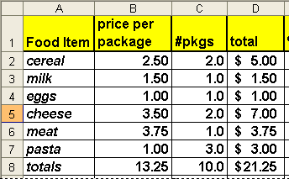
Each box is referred to as a “cell”. Cells may contain Labels, Values or Formulas that result in a value or label. A cell is identified first by its column letter and then by its row number
Columns
Cell D2
Contains
the Formula
= B2*C2
Rows
Labels
Notes:
Again each box is referred to as a cell and the selected cell is referred to as the ‘active cell’ – When a cell is active - its contents will be displayed in the formula bar.
Columns are labeled with letters A,B,C.. At Z they begin again with AA…eventually going to XFD or more. Rows are sequentially numbered from 1 to past 1 million. The number of rows and columns available on the spreadsheet are limited to your computer’s available RAM memory.
Cells are identified first by their column letter and then by their row number. The cell containing the title ‘food item is referred to as cell A1. Cells may contain either labels, values or formulas which result in labels or values. Labels are text such as seen in cell A4 – which contains the word ‘eggs’. Cell B2 contains a value - a number which was directly entered into the cell in this case 2.5.
Cell D2 contains a formula =B2*C2 resulting in the value 5 – the product of the values contained in cells B2 and cells C2 – the resulting value will normally be displayed in the cell, however when this cell is selected the underlying formula will be display in the formula bar.

Slide 6
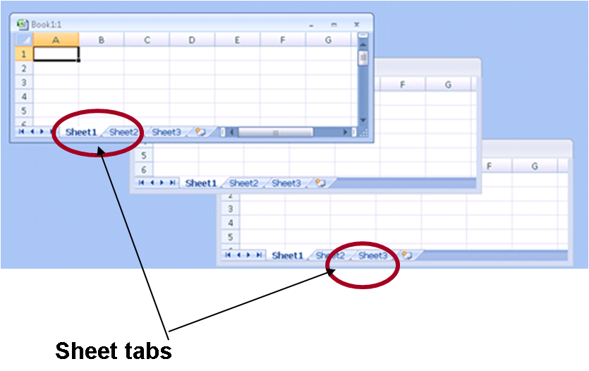
One can also write formulas that refer to cells on other worksheets – Sheetname!Cell-Reference
input!B1*input!B3 + A1
When referencing a cell on the same spreadsheet as the active cell the sheet name is not required.
Sheets may be named and displayed with different colors tabs, The order of the worksheets may be modified as well.
Notes:
A workbook can contain any number of worksheets which can be accessed via the corresponding sheet tab. When working on a single worksheet we address a cell reference by its column letter then row.. Such a A1 or E5.
When working on multiple worksheets we must refer to cells on different worksheets by prefacing their column and row address with a worksheet name. If you were to write a formula on sheet1 – sheet1 is referred to as the active worksheet. Cells referenced on sheet 1 would not require a sheet name, cells referenced on other worksheets would require their sheet name in addition to their row and column address.
For example the formula input!B1*input!B3 +A1 would multiply the value on sheet input in cell B1 with the value on sheet input in cell B3 and then add the value A1 from the active worksheet where the formula is currently being entered. Also note the syntax of cell referencing using sheet names required an exclamation point following the sheet name.
In a few moments we will demonstrate how to insert worksheets, modify the sheet tab names and colors and how to input formulas on our worksheets.

Slide 7
File tab – opens menus for opening and
saving Files, and modifying Excel Options
Quick Access Toolbar can be
customized to include icons to frequently
Used features such as Print Preview
Home Ribbon use to change fonts, justify text, insert
rows etc. Ribbons are organized into Groups of similar tasks
such as the Font group or the Number group. In addition, there
are other ribbons containing groups/buttons for laying out pages
using the review features etc.
Notes:
Here’s a closer look at the home ribbon , tab and quick access toolbar elements. What I suggest – for those who don’t use excel on a daily basis – go in and click on each ribbon tab – look over some of the tool buttons – try them out.
The File tab unlike the other ribbon tabs – launches what is referred to as the backstage view – essentially a menu for saving, opening, closing files and for accessing spreadsheet properties –options that can be modified such as how certain keys work, what language is used, and even spreadsheet security.

Slide 8
Highlight your data, select a Chart type and Edit & its done!
Notes:
Another feature of Excel that is basic to its use is creating graphs – to create a simple chart as seen above – just highlight the data – select the chart from the insert ribbon and its done. Of course we’ll spend some additional time talking about charts later this semester – but if you don’t know how to do a simple one – again use SAM tutorials provided for help.

Slide 9
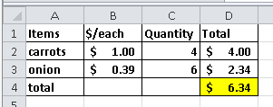
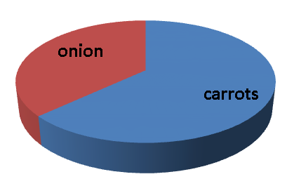
The “Power” of using Spreadsheet Applications
=B2*C2
Each entry can be related to other values by including cell referencing in formulas.
Formula values are automatically updated when a referenced value changes
Formulas can be copied
Charts can be easily generated
Notes:
One of the great advantages of using an electronic spreadsheet is that we can setup formulas that reference cells containing our data. As we saw in the demo, By doing this – if the data is later modified these calculations will be automatically updated. In this example, if the price of carrots in cell B2 was increased from $1 to $2 both cell D2 the total cost of carrots and cell D4 the total cost of all items would be automatically updated.
Another advantage of using an electronic spreadsheet such as Excel, is that it also enables the user to quickly and easily create charts from this data such as the one seen here on this slide. And later on in Excel we will see how we can copy elements of a worksheet – to make them simpler to create
But in order to take advantage of these spreadsheet features we must write formulas correctly. Our formulas serve as basic instructions telling Excel what we want to do.

Slide 10
Formulas
A formula is a sequence of values, cell references and operators that produce a new value.
= E8 + 3*(E10 - E11)
Formulas always start with an equal sign =
In addition a formula can also contain built-in functions like SUM, AVERAGE, IF, COUNTIF, etc. =Sum(A2:A8)*2
Notes:
First lets formally define what a formula is in EXCEL: A Formula is any sequence of values, cell references and operators ..such as addition, subtraction, or multiplication that produce a new value.. Seen here is a formula that will add the contents of cell E8 to 3.
Notice that a formula begins with an equal sign. To alert Excel that you wish to enter a formula and not a label or value – you must preface a formula with an equal sign.
Formulas may also contain functions – which are sort of built in shortcut calculations such as SUM or Average. Using and writing functions will be the topic of future lectures

Slide 11
Things you need to know when writing formulas in Excel
Data precision vs. cell display
Types of operators that can be used
Order of precedence of operators
/ ≤ −
=B2+B3*B1/B8^2
Notes:
What else do we need to know in order to write an Excel formula?
Consider for example if we want to tell Excel to multiply two values and one of the values is the result of a previous subtraction such as multiply 3 by the difference of the values in cells E10 and E11 – (write out words on callout)
How do we tell Excel to multiply two values, and how do we indicate that we want the subtraction performed BEFORE the multiplication.
To understand how write this formula so that we get the desired result we will now learn about the types of operators available in Excel and their representative symbols, and how the order of these operators will affect our resulting values. We will also discuss the difference between Data Precision and Cell Display to see how these will impact what we view on the worksheet.

Slide 12
In order to write Excel formulas we also need to use the correct Operator Symbols
Formulas contain two types of components:
Operators: Operations to be performed
Arithmetic operators: * / + - ^
Relational operators: >, <, <=, >=,< >,=
Operands: Values to be operated on
Addition Operator
= B2 + 5
Operands
Notes:
Formulas are composed of two elements – operators and operands…the values we require and the operations we wish to perform on them.
The Arithmetic operators available to us in Excel include addition – represented by a plus sign, subtraction represented by a minus sign, multiplication represented by an asterisk, division represented by a slash and exponentiation represented by the hat symbol found above the value 6 on most keyboards. (use a callout for this list)
In the example here, the operands B2 and 5 are acted on by the addition operator. To perform this operation, Excel will take the value in cell B2 and add it the value 5.
In addition to arithmetic operators Excel provides relational operators
the greater than relationship is represented by the greater than symbol usually found above the period on the keyboard
The less than relationship is represented by the less than symbol
The greater than or equal to relationship is represented by typing the symbol greater than immediately followed by and equal sign
And the less than or equal to relationship is represented by typing the symbol less than immediately followed by and equal sign
A less than sign followed by a greater than sign represents a ‘not equal to’ relationship
To represent an equal to relationship the equal sign is used as seen here (callout =B2=5) – here the first equal sign indicates a formula will follow and the 2nd indicated that the values B2 and 5 be tested to see if they are equal.
We will be using these relational operators later in this course when we discuss Boolean logic.

Slide 13
Precedence of Operators
( ) Parenthesis is a special operator that forces evaluation of the expression inside it first
Exponentiation (2^3 →8)
Arithmetic operators: Multiplication & Division
Multiplication & Division have equal precedence and are evaluated from left to right
Arithmetic operators: Addition & Subtraction
Addition & Subtraction have equal precedence and are evaluated from left to right
Relational operators have a lower precedence than arithmetic operators
Notes:
Which operation is performed first is prescribed by the order of the precedence rules.. Similar to those you learned in algebra.. Remember the computer is very consistent about applying those rules.. So on a math test if you forgot to write a parenthesis, but you knew what you were doing…you might still end of with the correct answer.. But not here…Excel will only do exactly what you tell it to do!
The prescribed order of operations are as follows:
First are foremost – operations in parentheses will be performed.
Next in order is Exponentiation –
Division and Multiplication follow with equal precedence ..evaluated from left to right..so in the formula =25/5*2 will first divide twenty five by five and then multiply by 2 resulting the value 10 – if you had wanted to perform the multiplication of 5*2 first and then divide 25 by the resulting value 10 to get 2.5 – you would need to include parentheses (use a callout)
Next in order of precedence are the arithmetic operators of addition and subtraction – again they have equal precedence and are evaluated from left to right.
And last to be evaluated will be relational operators such as greater than, or less than.

Slide 14
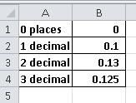
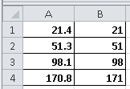
Precision: number of decimal places stored in the computer.
Formatted Display: number of decimal places that appear in a cell
Type in a cell : =1/8 display in cell
What value results for each - if multiplied by 1000?
Does the addition appear to be correct in col B?
Notes:
Displayed on this slide are two sample spreadsheets. Consider the one on the left where the formula = 1 divided by 8 has been placed in cells B1 through B4. Cell B1 has been formatted using the Increase/Decrease decimal toolbar to show zero decimal places and thus 1/8 is displayed as a zero. In cell B2 we show this same value displayed with 1 decimal place, in row 3 with 2 decimal places and finally in row 4 with three decimal places.
What value would result if we write another formula = B1 *100..(put in callout)? At first glance it might seem like the computer would perform the computation zero times 100.. And get a result of zero. But such is not the case. Even though the displayed value in cell B1 is zero.. The actual value stored by the computer is still the calculation of one divided by eight or .125.. Thus the result of this formula would be 12.5.
The difference between the displayed value and the precise value stored in a cell can sometimes cause confusion .. Consider the example in the right box of this slide. Here the identical values were entered in cells a2 to a4 as in cells b2 to b4.. But they are displayed with a different number of decimal places. Upon first glance if you were to add the values in column B.. It seems that the resulting value is just plain wrong.. Adding the ones column we have 1+1+8.. this should give use a zero in the ones column ..eventually resulting in the value 170 not 171. Clearly your boss might think either you don’t know what you’re doing or Excel has some sort of ‘bug’ and just can’t add.
In truth we need to be careful to display appropriate numbers of decimal places when presenting data – and most importantly to be aware that the differences are often attributable to rounding of the displays and not the actual values stored – and thus not cause for panic.

Slide 15
Formatting affects display not the precise value:
Formatting Number Group
Percent Decimal Display
Currency Commas
Notes:
Indeed there are several ways to change a number’s format without actually changing the precise value stored in a cell. In cell E2 for example is the calculation 4 divided 6.34 (show callout =d2/d4) results in the value .63.. When its displayed in percentage format.. The cell will contain the numerals 63 with a percentage sign… however the precise value stored is still .63. if you multiply cell E2 by 100 you will get 63 not 6300. (have call out .63*100 vs. 63*100)
The currency format will display a dollar sign symbol and 2 decimal places.. again w/o changing the precise value stored.
Excel even gives us an option to display commas..

Slide 16
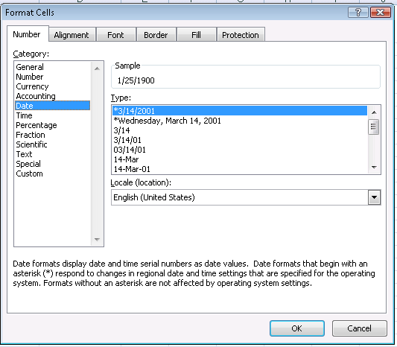
Values can also be used to display dates
Dates are values that can be entered in several formats: January 27, 2013 or 1/27/2013
Excel converts these dates to a numerical representation (1/22/2013 → 41301)
Thus dates may be used in formulas: =A1–B1 will result in the value 5
Note: To do arithmetic calculations with dates if you type =1/27/2013-1/22/2013 directly in a cell it does not interpret it a date – cell references must be used.
Notes:
Excel also has a facility for storing dates.
If you type into a cell ‘1/27/2013’ for example without an equal sign – normally Excel will perceive that this entry is a date and store it as such. In a similar manner if you enter the text february 1, 2013– Excel will also most likely perceive this to be a date. Dates entered in a ‘date format’ are converted into values…based on a precise mathematical formula – where January 1, 1900 is the value 1 and each succeeding day is one more than the previous. This allows us to perform arithmetic operations on dates.. So for example you calculate the date it will be five days from today or the number of days it took to ship an item if you have both the ship date and received date. While these dates are stored as numbers – they can be displayed in a variety of formats which can be specified from the Format Cells Number tab.
Now in cell C1 lets subtract the 2 dates to see how many days lie between them..=b1-a1. You might end up with the value 5 or some strange answer like January 5, 1900 . What is going on? Actually – the precise values of these two displays are actually the same. But somehow Excel decided to display the value as a date – when we actually wanted a number display. In some cases the opposite can happen – if you add 5 days to a specific date – at times you might erroneously get a number instead of a new date. To correct this problem we can modify the cell display.
To change the cell display use the Format menu and select Cells and the Number tab of the dialog box. Then choose the correct display in this case the Number format
Also note that dates cannot be typed directly in a formula. If you write 1/27/2013-1/22/2013 directly into a cell ..the computer will interpret this as 1 divided by 27 divided by 2013.. To subtract these dates you will need to enter each individual date into a cell – say place jan 27 in cell a1 and jan 22 in cell b1 and then write the formula a1-b1!

Slide 17
Walkthrough: Building a Simple Spreadsheet
Entering labels and values
Formatting cells
font, size, style, color, borders, alignment
Numeric Format, Currency, Decimal Places
text wrap, center titles
Column widths, row height
Inserting/Deleting rows and columns and sheets
Writing a simple formula & modify decimal display
Create a simple chart
Sheet tabs
Creating a new worksheets in a workbook (“new sections in a document”, Naming Sheets
Notes:
Create the worksheet similar to the Foods worksheet for this week problems.. Demonstrating each of the feature listed here:
Lets switch now to a new worksheet and begin learning how to enter data, format our cells, insert and delete columns, rows and worksheets as well demonstrate how to write simple formulas.
Use spreadsheet:
Consider the Simple formulas spreadsheet available in your course notes – similar to the one we’ve used in our slides listing food quantities and prices(show original spreadsheet for a moment). Lets try to re-create some of these elements beginning with a new worksheet.
(follow steps) To launch EXCEL click on the start menu and select Excel.. If its not pinned to your menu then select ‘all programs’ ‘microsoft office’ and then excel.
Here is our workbook: Note the ribbons, scroll bars and worksheet tabs.
In cell A1 lets type ‘food item’ - To type in a cell first select it by clicking you mouse in the desired location. When you’re done typing click enter to - the active cell is then changed to the cell below what you’ve just typed. Now lets type cereal then enter, milk, cheese, and meat. (type in make error typing ‘mead’
Unfortunately I’ve incorrectly typed the word ‘meat’ – to correct an error while your still typing you can use the backspace key as seen here.. Or you can use your mouse to highlight parts of the text to delete or type over, or use click between 2 letters to insert text.
One can also create line breaks within a cell wrapping the text to automatically size to the column.. Use the Wrap Text button on the Home ribbon. You wrap the text at a specific point double clickon the cell, which gets you into the edit mode, and then place the cursor where you’d like a new like and typing Alt Enter. Now lets fill in column B - to move to different cells you can use either the mouse or the up/down arrows on your keyboard. In cell B1 lets type price per package, and the values 2.5, 1.5, 3.5, 3.75.
Our new spreadsheet contains may of the elements of the original – but looks completely different.
Shown here are the two worksheets side by side – consider the differences- For one thing the text of the original is larger, darker and in some places italicized. Row 1 is in yellow and the other rows are highlighted in grey. The title in column B seems to extend over the line and doesn’t wrap around as in our original worksheet. All of these elements can be modified using the formatting tools.
First lets change the font size of cell A1 to 12 and bold the text using the Bold button on the Font group of the home ribbon. This ribbon group can be used to italicize, underline, capitalize text. Or to change font or font sizes. The Paragraph group buttons can be used to align the text. Even more options are available by launching the format dialog box from the launch button located at the bottom-right of the ribbon group
Use the fill color button on this same ribbon group to change the cell color to yellow.
Now that we’ve done all of this formatting in cell A1 – will we need to do it again and again for each cell on my worksheet? If you select multiple cells at once you can simultaneously set the formats for all selected cell. But since we didn’t originally do that, we can accomplish this by copying only the cell format in cell A1- without actually copying the contents. A neat tool that will allow you to do this is the format painter..
Click on the cell you wish to emulate, then click on the ‘paintbrush’ toolbar button. One click will let you copy this format to a single selection – double clicking will allow you to copy the format to multiple selections. Here we’ll click once.. Notice the cursor turns into a paintbrush.. Now click on cell B1.. And the format is copied. Note that these formats are not linked – if you later change the format in the original cell.. It will have no affect on any other cells. (demo by changing format)..
By the way to undo an action use the ‘undo’ toolbar button – this is also available from the edit menu.
Now consider the values we typed in column B, notice that on the original worksheet all values contain 2 decimal places and are lined up by their decimal point.
To accomplish this we can again use the tool buttons on the Number group of the Home ribbon. first selecting the range of cells we wish to format – (demo select cells, format, cells, number) then select the , button to select comma style. This automatically provides 2 2 decimal places – and for larger number thousands separators. To increase or decrease the number of decimal places you can also use the increase/decrease decimal buttons or go into the formatting dialog box and select another options.
Another difference between the 2 worksheets is the width of column B and how the title price per package is laid out. Just place your cursor on the column heading line between B and C and drag. To exactly size a column to fit the widest text in that column double click on the line
Notice that when we did this – the title still appears on one line. To wrap the text of the title to fit on multiple lines within a cell – we can again use text wrap button.
Not complete
Now lets add the number of packages in column C – first by typing our label in cell c1, #pkgs, and then by – typing in 2,1,2,1 in cells C2:C5 use the increase/decrease buttons to format the values
To complete the formatting of the new worksheets lets italicize and bold column A (bold, italicize column A), Lets bold bold columns B and C (highlight b2:c5 – click on bold toolbar button). Lets copy the format from column B title to column C title by using the paintbrush and then lets change the background of cells a2:c5 by selecting the entire area and choosing the fill color grey (click on a2:c5, click on fill toolbar button and select grey). Also notice that there are lines on the original spreadsheets. Lets highlight the entire selection and then from the toolbar button borders, select the border – ‘all borders’
One last formatting issue is to adjust the height of column A on our spreadsheet to remove the extra space that was somehow created when we wrapped the text. Row height like column widths can be directly sized from the Format menu – in this case selecting the Row option and then typing in the height. Alternatively one can click on the line below the row number of the row you wish to adjust, and then drag the line up or down until the desired height is obtained.
Now let maximize our current worksheet so that its easier to work with and then input the column title total
To calculate the total price we want to multiply the price per package by the number of packages. If we type 2.5 * 2 – however - if the price were to change to say $3 per package notice that the new price is not reflected into the total – we would need to retype the formula to get a new price
– A better method is to refer to the cells containing the values - remember a formula begins with an equal sign – then you can type in the cell reference such as B2 or just use the mouse to highlight the cell containing the desired value.. (demo)
When we use formulas it is also possible to copy them – to obtain similar values for other cells – we’ll be talking about this in much more detail in the next lecture. Now lets just go ahead and copy the formulas. Lets also go ahead and copy the format from column C using the paintbrush into column D. Since we want column D to also have currency lets highlight cells d2 to d5 and use the currency style toolbar button.
Another thing we can do is total up these values – by summing the cells d2,d3,, through d8 – (type in totals and do sum). Column D is formatted as currency – this can be quickly accomplished by clicking on the currency style toolbar button.
If you look at the original worksheet you will notice that the line for eggs has been omitted from our worksheet. To correct this error we will need to insert a row between milk and cheese.
To insert a row – click on a cell in the row just below where you want the insertion and then select insert row from the menu (demo)
In a similar manner one can insert a column by clicking on the column just to the right of where you want it inserted – and then selecting Insert/Columns from the menu.
Now we can fill the data for eggs, price $1, quantity 1 and total 1.
Note that the current total is 17.25. When total value for eggs of $1 is entered this total of 17.25 does not change to 18.25 as desired.
Lets double click on the cell to take a look at the formula. The formula in cell D7 for Total is =d2+d3+d5+d6. The row references for cheese and meat automatically changed when we inserted a row for eggs– however the row for eggs was not included in this formula! We will need to change the formula to update the total to add cell D4. We’ll see in the next lecture how to make this happen automatically.
One last task we’ll do here is to change the worksheet name. In our original worksheet we named the sheet ‘finished list’. To accomplish this task move the cursor to the active sheet tab (demo) and right click to reveal the tab menu. You can also double click on the tab and type the sheet name in directly – lets also modify the tab color..(demo) and move around the sheet order – placing after sheet 2 (demo).
We’ve now demonstrated many of the basic mechanical skills required to build a spreadsheet lets just end this demonstration by saving our file. To save a file for the first time select file then save as.. This will bring up the save as dialog box where you can maneuver to the desired directory and give your file a name. When re-saving a file you can use the file save menu selection or click on the save toolbar button.
atures listed here.

Slide 18
Microsoft Excel Vocabulary
Notes:
To learn how to write simple formulas and setup simple worksheets – you can get on Excel yourself and try to mimic what we’ve done here.. Our first Excel lab also leads you through several exercises and tutorials that will help you learn the mechanics of using a spreadsheet. It is recommended that you try this out as well as feel comfortable with spreadsheet nomenclature – by reviewing the vocabulary listed here.
In the next lecture several lectures we will cover in more depth how create more complex worksheets and how to copy formulas to model our problem solutions.

Slide 19
Follow-Assignments:
Read the chapters of the Course Notes - 1.1, 1.2 p.1-30
Read ICAPS: pages 1-6, 11-14, 20-27, 37-39, 45-49, 67-71

