Slide 1
INFECTIONS OF THE ORAL CAVITY
L 16 & 17

Slide 2
INFECTIONS OF THE ORAL CAVITY L16
The oral mucosal infections can be caused by
. bacteria,
. virus
. fungi
. In most of the time it is due to imbalance between the individual defense systems and the invading pathogen

Slide 3
BACTERIAL INFECTIONS
Scarlet fever (scarlatina):
Contagious infection most common in children, caused by β-haemolytic streptococci, causes . .severe pharyngitis, tonsillitis
. headache, chills, fever, abdominal pain, vomiting
. enlargement and tenderness of the regional cervical lymph nodes.
. Tonsils and back of the throat may have a whitish coating, or appear red, swollen, and dotted with whitish or yellowish specks of pus.
. The patient usually has a scarlet-skin rash and "strawberry tongue," it has white coating with edematous hyperemic fungiform papillae extending out of the surface like small red knobs

Slide 4
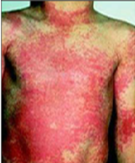
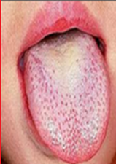
This condition is usually diagnosed by the symptoms, especially if typical rash present. Sometimes a swab from the throat to be tested for streptococcus and this is called a throat culture
Scarlet fever skin rash
Strawberry tongue

Slide 5
Tuberculosis:
. Infectious granulomatous disease caused by mycobacterium tuberculosis which mainly affects the lung and cause pulmonary tuberculosis, but can also affect other organs and causing extra pulmonary tuberculosis.
. Primary lesions of the oral mucosa may occur, but secondary infections with the coughing up of infected sputum from pulmonary tuberculosis are more likely.
. The oral lesions include painless chronic undermined ulcers covered with grayish-yellow slough occur mainly on the tongue.

Slide 6
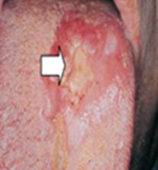
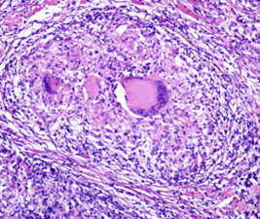
. Tuberculous osteomyelitis and tuberculous lymphadenitis of the cervical lymph nodes are most commonly seen.
. The macroscopic picture reveals presence of granuloma which shows foci of caseous necrosis lined by epithelioid cells, lymphocytes and some multinucleated giant
Tuberculous tongue ulcer. Tuberculous nodule within the tongue with multiple langhans cells.

Slide 7
The diagnosis is by
. Biopsy
. culture of the sputum,
. presence of acid-fast bacilli in sputum smear
. imaging techniques like radiograph of the chest
. and tuberculin test
are most useful in supplementing the diagnosis of tuberculosis.

Slide 8
Leprosy:
Chronic granulomatous infection caused by mycobacterium leprae.
. There are two forms of leprosy which are tuberculoid form and lepromatous form. Tuberculoid lesions are characterized by
. single or multiple macular erythematous eruptions with dermal nerve and peripheral nerve trunk involvement resulting in loss of sensations of the affected skin area

Slide 9
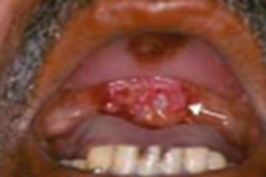
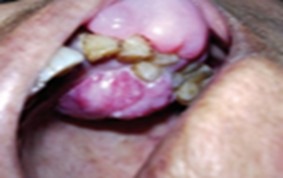
In lepromatous lesions there is a wide spread infection throughout the body, and may affects the soft and hard palate, tongue and anterior gingiva of the maxilla which appears as nodular inflammatory masses with tendency to ulcerate
Diagnosis is done by Ziehl-Neilson test, it is used to detect leprae bacilli in nasal smears and skin scrapings.

Slide 10
Gonorrhea:
. Venereal disease caused by Neisseria gonorrhoea that
. Affects both male and female genitourinary tract which transmitted by sexual intercourse . .Commonly presented by cervicitis, urethritis, and prostatitis.
. Tonsillar and oropharyngeal lesions have been reported particularly in homosexual adults. .Generalized painful erythematous stomatitis
. vesiculation and ulceration with burning and pain during speaking and swallowing can seen as oral manifestations.

Slide 11
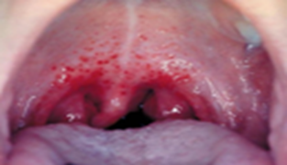
Rapid diagnosis can be done by gram staining of the urethral discharge by collecting the samples using swaps.
Gonorrhea oral lesion.

Slide 12
Syphilis
Sexually transmitted disease caused by Treponema pallidum, acquired or congenital.
Primary stage of acquired type characterized by
. The presence of chancre at the site of inoculation, usually the genitalia and lips.
. It occurs after 3 weeks from the infection as painless ulcer with raised edges and indurated base, with regional lymphoadenopathy.
It consists of ulcerated granulation tissue with dense mononuclear inflammatory cells which heals spontaneously within 3-6 weeks.

Slide 13
Secondary syphilis starts 6-8 weeks after the appearance of the chancre and lasts for 2-10 weeks. Characterized by generalized lymphoadenopathy and skin rash, with oral ulcerations called mucous patches.
Tertiary syphilis starts after 4-7 years from the infection. Gumma consists of a central mass of coagulative necrosis surrounded by granulation tissue infiltrated by chronic inflammatory cells.

Slide 14
Oral lesions occur especially on the hard palate leading to perforation into the nasal cavity. Endarteritis obliterans is the cause of atrophic glossitis which is also a feature of tertiary syphilis.
Hyperkeratosis (syphilitic leukoplakia) frequently seen, and carcinoma of the tongue may develop.
Congenital syphilitic infection is associated with infection of the developing tooth germs of the permanent incisors (Hutchinson`s incisors) and first molars (mulberry molars).
Infection and destruction of the developing nasal bone produces saddle deformity of the bridge and dished face.

Slide 15
Diagnosis is confirmed by dark field microscope, serological tests, or Venereal Disease Research Laboratory Test.
(A) Primary chancre of lip. (B)Secondary mucous patches (C) Tertiary syphilis

Slide 16
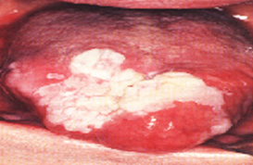
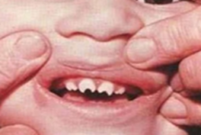
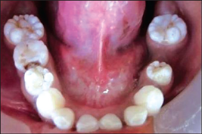
Syphilitic leukoplakia. Hutchinson’s incisors. Mulberry molars.

Slide 17
Actinomycosis
Chronic suppurative poly microbial granulomatous infection caused especially by Actinomyces israelii.
. The soft tissues of the submandibular area and neck are most commonly involved in cervicofacial actinomycosis with development of swelling and multiple sinuses draining pus. . .Granules consisting of tangled meshes of gram positive filaments of actinomyces may be seen clinically as sulfur granules in pus.

Slide 18
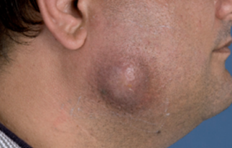
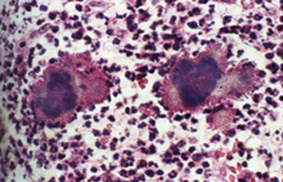
Cervicofacial actinomycosis. purulent exudate compose of neutrophils and calcified bacterial colonies

Slide 19
VIRAL INFECTIONS
Herpangina
. Coxsackie group A viruses are the cause of the disease.
. Coxsackie viruses are RNA viruses.
. It is most commonly seen in young children.

Slide 20
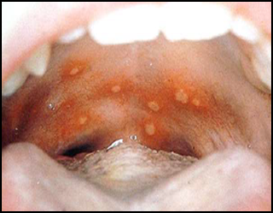
Clinically
. It begins with sore throat, cough, low-grade fever, headache, vomiting, and abdominal pain. .The patients soon exhibit small vesicles which rupture to form crops of ulcers, each showing a gray base and an inflamed periphery on the anterior faucial pillars and sometimes on the hard and soft palates, posterior pharyngeal wall, buccal mucosa; and tongue.
. Ulcers generally heal within 7–10 days.

Slide 21
Hand, foot, and mouth disease :
. It is caused by Coxsackie A16
. Mostly affecting young children.
. It is characterized by the appearance of vesicular lesions of the skin, particularly involving the hands and feet.
. The patients commonly manifest anorexia, low-grade fever, and sometimes lymphadenopathy, nausea, and vomiting.

Slide 22
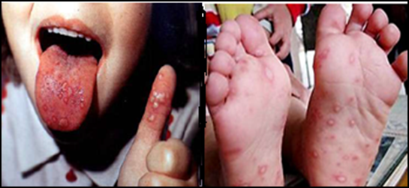
. The most common sites for the oral lesions are the hard palate, tongue, and buccal mucosa, and pharynx, including the tonsils.

Slide 23
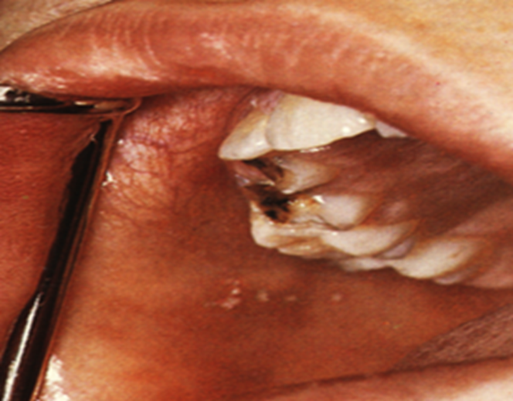
Measles
. Acute contagious viral infection, primarily affecting children, caused by paramyxovirus which is a RNA virus.
. Prodromal symptoms are infection of the entire respiratory tract accompany by the appearance of Koplik’s spots on the buccal mucosa opposite the molar teeth and appear as white spots against an erythematous back ground, frequently occurring two to three days before the cutaneous infection.
Koplik’s spots

Slide 24
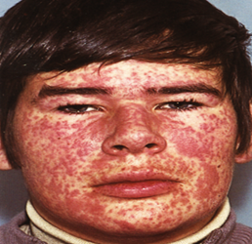
Clinically
Measles characterized by the onset of fever, malaise, cough, and eruptive lesions of the skin and oral mucosa.
. Skin small macules and papules usually begin on the face and spread to the neck, chest, back, and the extremities.
.Within a few days the papules develop into vesicles, they rupture and form ulcers, ulceration of the oral mucosa and pharynx is rather common.

Slide 25
Herpetic stomatitis L17
Herpes simplex viruses (HSV) are DNA viruses of two different types:
type 1 and type 2.
HSV-1 predominantly affects the face, lips, the oral cavity.
HSV-2 usually affects the genitals.

Slide 26
Primary herpetic infection with HSV-1 is a common oral disease, rarely occurs before the age of six months, apparently because of the presence of circulating antibodies in the infant derived from the mother.
The disease occurring in children is frequently the primary attack and is characterized by . .Development of fever, headache, pain upon swallowing.
. regional lymphadenopathy.
.Within a few days, the mouth becomes painful and the gingiva which is intensely inflamed appears erythematous and edematous.
. The lips, tongue, buccal mucosa, palate, pharynx, and tonsils may also be involved.

Slide 27
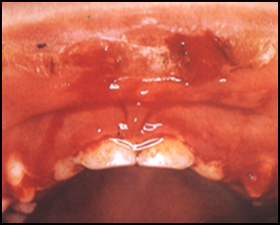
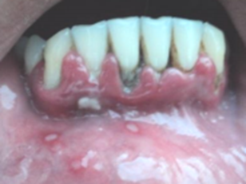
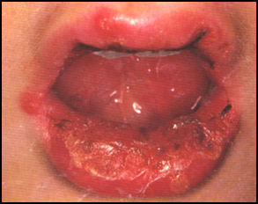
. The lips, tongue, buccal mucosa, palate, pharynx, and tonsils may also be involved.
Primary herpetic gingivostomatitis

Slide 28
. Shortly, yellowish, fluid-filled vesicles develop.
. These vesicles rupture and form shallow, ragged, extremely painful ulcers covered by a gray membrane and surrounded by an erythematous halo.
. It is important to recognize that the generalized marginal gingivitis precedes the formation of the ulcers by several days.
. Circum oral crusting lesions may be seen on the lip.
. Extra oral lesions may also present in the chin as a result of drooling of saliva and on the fingers (herpetic whitlow) as a result of sucking and may be transmitted to eyes.

Slide 29
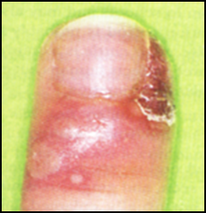
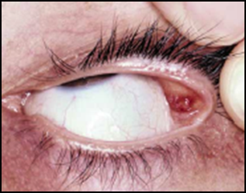
Herpes labialis is the most frequent type of recurrent infection, usually seen in adult patients and manifests itself clinically as
. An attenuated form of the primary disease, recurrent lesions of the fingers or hands and eyes may be encountered.
Herpetic whitlow
Ocular herpes simplex.

Slide 30
.The recurrence is related to reactivation of infection.
.The viruses, once introduced into the body, appear to reside within the regional ganglia, and when reactivation is triggered, spread along the nerves to sites on the oral mucosa and skin where they destroy the epithelial cells and induce the typical inflammatory response with the characteristic lesions of recurrent infect.
. It may develop on the lips (recurrent herpes labialis)
. or intraorally almost develop on the oral mucosa that is tightly bound to periosteum and seldom do they occur on mobile mucosa

Slide 31
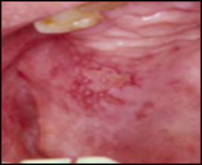
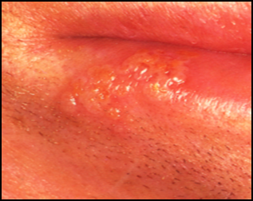
.The lesions are frequently preceded by a burning or tingling sensation and slight soreness at the location in which the vesicles subsequently develop.
. These vesicles are generally small (1 mm or less in diameter), and may coalesce to form somewhat larger lesions, may rupture quickly, leaving a small red ulceration, sometimes with a slight erythematous halo.
. The lesions gradually heal within 7–10 days and leave no scar.
Herpes labialis
Recurrent intraoral infection

Slide 32
Histologically, the herpetic vesicle is an intraepithelial blister filled with fluid.
. The vesicle results from distension and rupture of virally infected epithelial cells by intracellular edema and coalescence of disrupted cells.
. The ruptured infected cells release new viral particles to infect adjacent epithelial cells, they are swollen and have pale eosinophilic cytoplasm and large vesicular nuclei, described as ‘ballooning degeneration.’
. Cytoplasm of the infected cells may be united to forms giant cells.
. The subjacent connective tissue is usually infiltrated by inflammatory cells

Slide 33
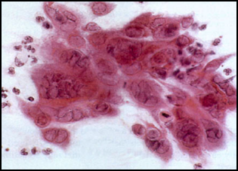
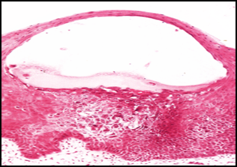
Smear from intact vesicle or scrapings obtained from the base of the recently ruptured lesions demonstrates balloon cells and multinucleated giant cells.
More than that, identification HSV can be demonstrated in the laboratory by isolation of virus in tissue culture.
. The most sensitive and accurate method for diagnosing these lesions is PCR technique.
Virus-damaged epithelial cells with swollen nuclei and marginated chromatin (ballooning degeneration)
Intact herpetic vesicle with virally infected cells in the base

Slide 34
Chickenpox and herpes zoster
Caused by varicella zoster virus, a DNA virus, which causes two distinct lesions known as chickenpox, a primary lesion and a reactivated lesion known as herpes zoster.
. Chickenpox is acute extremely contagious disease usually occurring in children, and is characterized by vesicular rash.
The disease is characterized by the prodromal occurrence of headache, nasopharyngitis, and anorexia, followed by maculopapular or vesicular eruptions of the oral mucosa and skin

Slide 35
. These eruptions usually begin on the trunk and spread to involve the face and extremities. . . Herpes zoster is extremely painful and associated with vesicular eruptions of the skin or mucous membranes in areas supplied by the affected sensory nerves.
. Initially, the adult patient exhibits fever, a general malaise, and pain and tenderness along the course of the involved sensory nerves, usually unilaterally.
. Within a few days the patient has a linear papular or vesicular eruption of the skin or mucosa supplied by the affected nerves, it is typically unilateral.

Slide 36
. Herpes zoster may involve the face by infection of the trigeminal nerve.
.This usually consists of unilateral involvement of skin areas supplied by either the ophthalmic, maxillary or mandibular nerves.
Lesions of the oral mucosa are fairly common, and extremely painful vesicles may be found on the buccal mucosa, tongue, uvula, pharynx, and larynx, they rupture and leave areas of erosions and ulcerations.

Slide 37
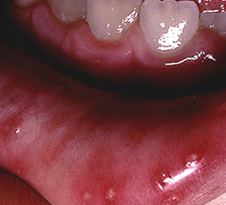
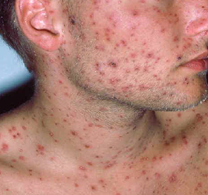
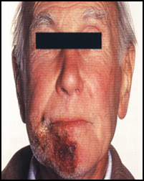
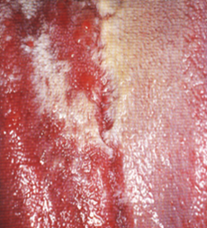
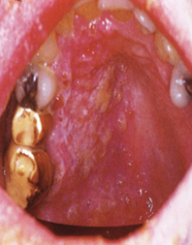
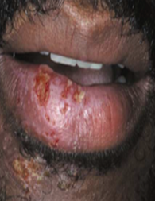
. Oral and skin lesion
Herpes zoster with unilateral distribution.

Slide 38
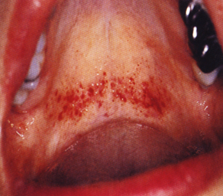
Infectious mononucleosis (glandular fever):
This infection is caused by the Epstein – Barr virus (EBV), a member of the herpes group, predominantly affects teenagers and young adults and is transmitted by contact with saliva.
The disease characterized by:
lymph node enlargement, fever, malaise, with petechial hemorrhages at the junction of the soft and hard palate with ulcerations of oral mucosa.
petechial hemorrhages

Slide 39
Human immunodeficiency virus infection:
. The human immunodeficiency virus (HIV) causes HIV infection.
. This occurs by the transfer of blood, semen, vaginal fluid, breast milk or from mother to child.
. Within these bodily fluids, HIV is present as both free virus particles and virus within infected immune cells.
. Transmission of virus may be followed by infection which is detected by appearance of HIV antibodies in the blood, and most patients remain symptom free for many years (HIV seropositive), but in time may develop persistent generalized lymphadenopathy and may progress to AIDS.

Slide 40
. AIDS is a condition in humans in which progressive failure of the immune system allows life-threatening opportunistic infections and cancers to thrive.
. AIDS is the final stage of HIV infection when the immune system is badly damaged and the patient become vulnerable to opportunistic infections.
. Infection by HIV involve binding of the virus to many target cells, but the binding to CD4 receptor of T-helper lymphocytes plays a major role in the pathogenesis of HIV disease.

Slide 41
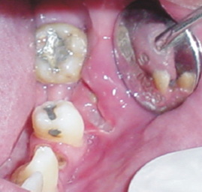
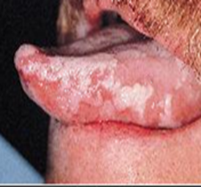
AIDS is characterized by :
lymphadenopathy, persistent pyrexia, diarrhea, weight loss, fatigue, malaise, opportunistic infections, HIV gingivitis and periodontitis, oral necrotic ulcers of unknown etiology, hairy leukoplakia which mostly affect lateral border of tongue, Kaposi’s sarcoma, and non-Hodgkin’s lymphoma.
Oral ulceration and hairy leukoplakia in HIV infected patient.

Slide 42
FUNGAL INFECTIONS
Candidiasis:
. Caused by a yeast-like fungus, Candida albicans, although other species may also be involved.
. It has been shown repeatedly that this microorganism is a relatively common inhabitant of the oral cavity, gastrointestinal tract, and vagina of clinically normal persons.
. When the favorable condition develops, the organism transforms into pathogenic form.

Slide 43
The predisposing factors are:
. Acute and chronic diseases like tuberculosis, diabetes mellitus, and anemia
. Immunodeficiency like AIDS, nutritional deficiency like Fe, vitamin A and vitamin B6 deficiencies, etc
. Prolonged use of antibiotics, corticosteroids, and cytotoxic drugs
. Radiation therapy, poorly maintained dentures, heavy smoking, old age, infancy, pregnancy, and xerostomia.

Slide 44
Pseudo membranous candidiasis :
. It is also known as thrush and it is especially prone to occur in the debilitated or the chronically ill patients or in infants.
. The oral lesions are characterized by :
. Appearance of soft, white, slightly elevated plaques resembling milk curds most frequently occurring on the buccal mucosa and tongue, but also seen on the palate, gingiva, and floor of the mouth.
. The white plaque can usually be wiped away with gauze, leaving an erythematous area.

Slide 45
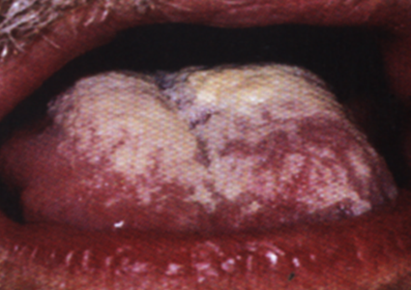
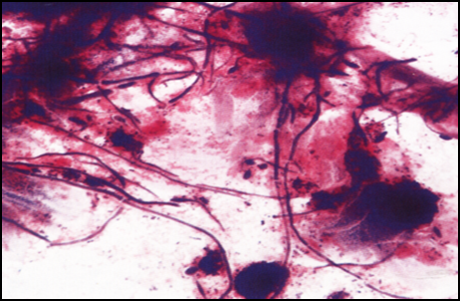
Appropriate stained smears of pseudo membrane reveals tangled masses of fungal hyphae with intermingled desquamated epithelium, keratin, fibrin, necrotic debris, leukocytes, and bacteria.
Pseudo membranous candidiasis of the tongue. Smear from thrush showing tangled masses of long Gram-positive hyphae and occasional yeast cells.

Slide 46
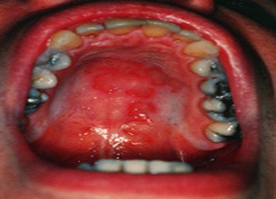
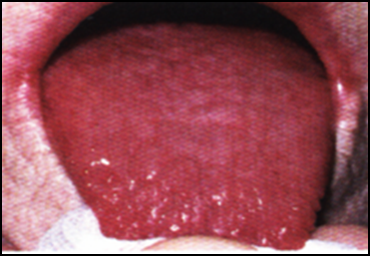
Erythematous candidiasis :
. Also known as antibiotic sore mouth and includes papillary atrophy of the tongue.
. The lesions in this form of the disease appear red or erythematous.
. The redness is due to increased vascularity.
. It is distinguished from erythroplakia by its diffuse border wherein erythroplakia the borders are sharp and well demarcated.

Slide 47
Chronic hyperplastic candidiasis (Candidal leukoplakia)
. The oral lesions consist of firm white persistent plaques which cannot be removed by scraping, usually on the lips, tongue, and cheeks and appear similar to leukoplakia and considered as a premalignant lesion.
. These lesions may be homogeneous or speckled, rough or nodular and having possible premalignant potential.
Leukoplakia, lichen planus and lupus erythematosus may appear similar to chronic hyperplastic candidiasis clinically but may not regress with antifungal treatment as does the chronic hyperplastic candidiasis.

Slide 48
Histologically
.The epithelium shows hyperparakeratosis, acanthosis, and the candidal hyphae seen invade the parakeratin and never penetrate to the deeper layers of prickle cell.
. Acute (neutrophils forming micro abscess) and chronic inflammatory cell are seen in the epithelium and chronic inflammatory cells are seen in the lamina propria.
. Focal absence of the infected parakeratin layer may be responsible for the speckled erythematous appearance of the lesion.

Slide 49
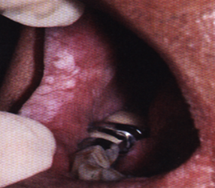
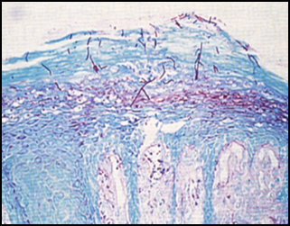
Chronic hyperplastic candidiasis invasion of parakeratin by candidal hyphae

Slide 50
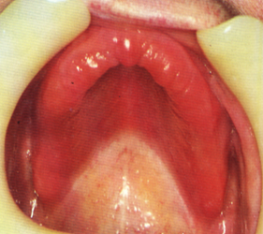
Denture Stomatitis (Chronic atrophic candidiasis)
Diffuse erythema and edema of the denture-bearing area due to continual wearing of often ill fitting denture throughout the night with poor oral hygiene.
Usually asymptomatic except for the soreness and the presenting complaint may be angular stomatitis.
Mandibular mucosa is rarely affected.

Slide 51
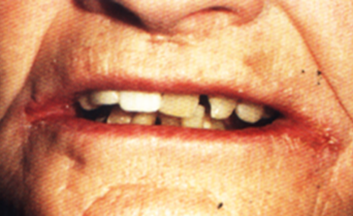
Angular cheilitis
Multifactorial disease characterized by
. Soreness, erythema, and fissuring at the corner of the mouth.
. May be due to candidal infection especially in denture wearers, or bacterial infections like staphylococcus infection, or due to viral infection like HSV infection.
. Nutritional deficiencies are predisposing factors in some patients.

Slide 52
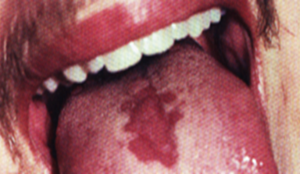
Median rhomboid glossitis
Located just anterior to foramen caecum, rhomboid in shape and devoid of papillae, atrophic and red in color, smooth, nodular or fissured, and usually asymptomatic.
Median rhomboid glossitis.

