Slide 1
Microsoft Word Lecture 7
M.Sc. Goran Noori Saleh

Slide 5
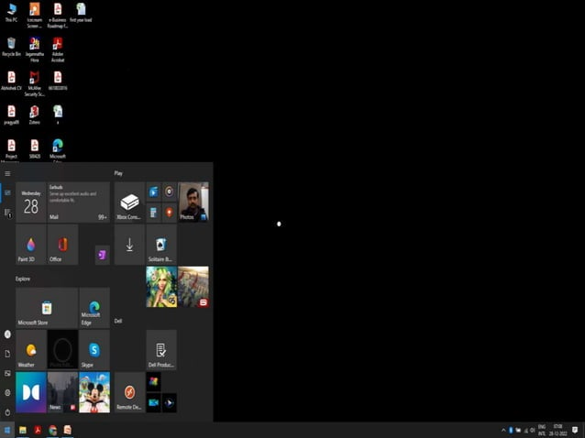

Slide 6
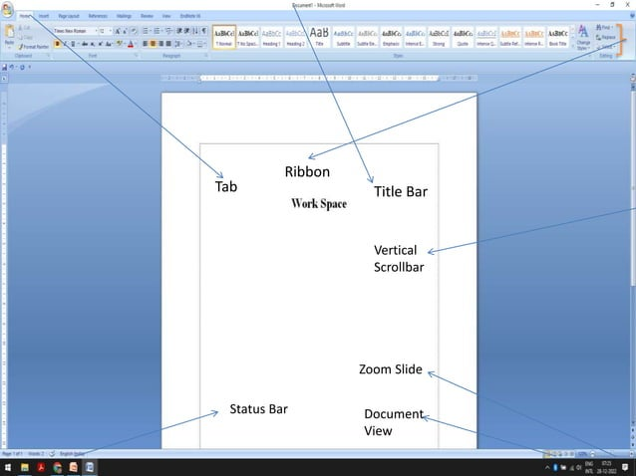

Slide 9
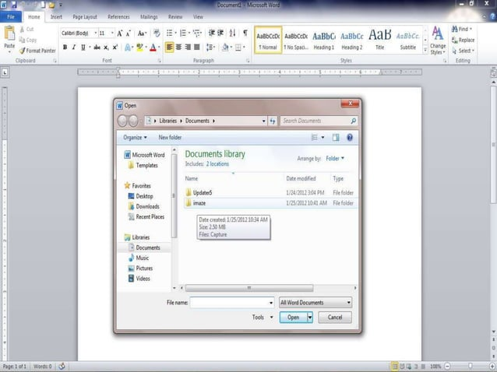

Slide 12
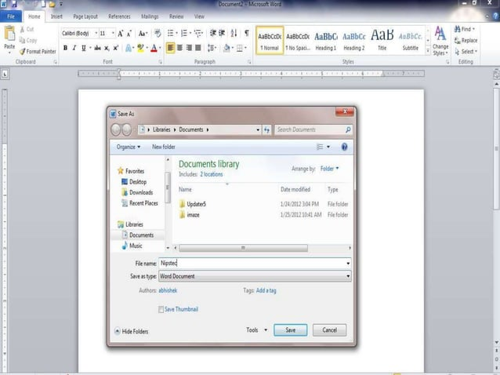

Slide 16
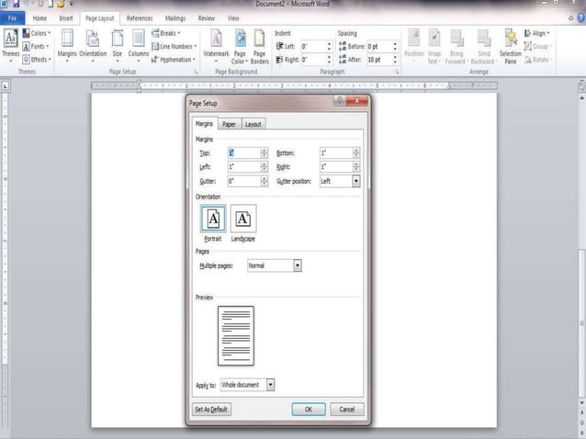

Slide 17
Thank you

