Slide 1
Microsoft Word Lecture 8
M.Sc. Goran Noori Saleh

Slide 5
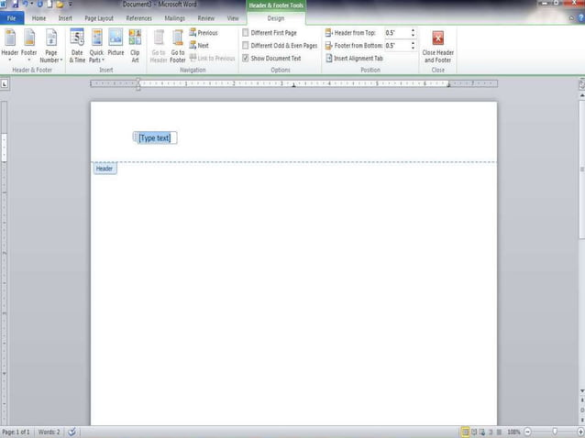

Slide 19
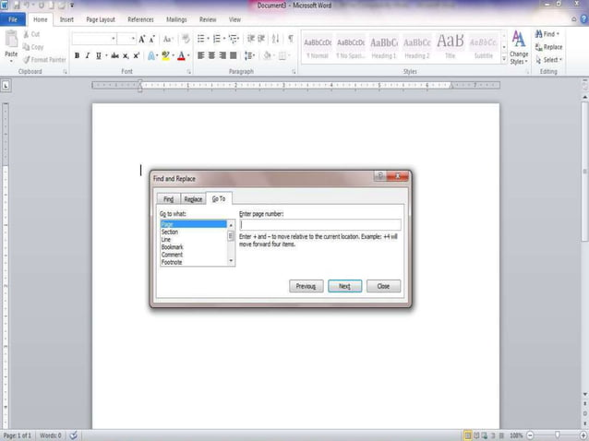

Slide 20
Thank you

