Slide 1
Microsoft PowerPoint
Lecture 9 M.Sc. Goran Noori Saleh

Slide 2
Uses of PowerPoint
Microsoft PowerPoint 2016 is used to create powerful, exciting presentations that will make people sit up and take notice; not used for just making speeches
The new and improved features of PowerPoint 2016 focus on efficient methods of creating professional presentations that incorporate audio/visual effects to reinforce your message through the presentation graphics program.

Slide 3
Getting Started
To access Microsoft PowerPoint 2016 do the following:
Click the Start Button
Click All Programs
Click Microsoft Office, and select Microsoft PowerPoint from the options
You may also access PowerPoint by clicking on the program’s icon from your desktop.
Open an existing PowerPoint file

Slide 4
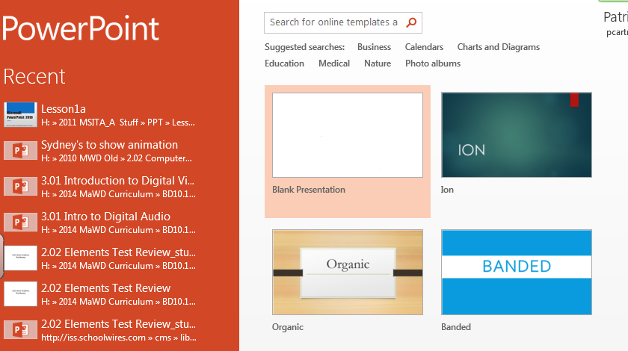
Start a Presentation
The PowerPoint program opens in the Backstage view.
You may add color or graphics to enhance your presentation or choose from one of the templates provided by the software.

Slide 5
Start a Presentation
Quick Access Toolbar:
Located above the File tab, allows the user to customize which actions to create a shortcut to. Such as Undo, Repeat & Save
To Open an existing presentation, click the File tab, and select Open.
You can also access the Save option from this view, and the PowerPoint Options as well.

Slide 6
The Ribbon
Related commands are grouped together among the ribbon depending on the tasks to be performed – called Groups
The individual sections of the ribbon are called TABS. There are several tabs, just as there were several menus in earlier versions of PowerPoint.
The ribbon tabs resemble the older menus, however they are more in tune with how you work.

Slide 7
The Ribbon
Parts of the PowerPoint Ribbon are:
File (Backstage View)
Home
Insert
Design***
Transitions***
Animations***
Slide Show***
Review
View
***Specific to the PowerPoint software

Slide 8
The Window
The filename appears in the Title Bar
Slides/Outline:
Allows you to view all of the slides in your presentation.
Slide: Displays the current slide which you are editing
Notes: Section for speaker notes that correspond to the slide. Allows for minimal number of words on the slide, or simple graphics, which you can elaborate on all the while with the security of having the notes in front of you. Your audience will only see the slides, not your notes.
***Normal View***

Slide 9
The Window
Outline Pane when in Outline View:
Allows you to see an outline view of all of the slides in your presentation.

Slide 10
Changing Text in the Slide/Outline Pane
The Outline Pane allows the user to concentrate on the content of the slide rather than the design aspect of the slide.
Text can be edited in the Outline pane or in the Slide pane by simply moving your cursor to the item you wish to edit and typing your additions.
To change slides in the Slide/Outline Pane, click on the new slide/section you wish to move to.

Slide 11
Views
The different PowerPoint Views Include:
Normal (Default View)
Outline View
Slide Sorter
Notes Page
Reading View
Views and Zoom In/Out

Slide 12
Slide Sorter View
View the presentation in slide sorter view to easily rearrange slides.

Slide 13
Notes Page View
View the notes page to edit the speaker notes as they’ll look when you print them out.

Slide 14
Notes Page (continued)
Speaker notes are a special area in which the speaker can make comments about the presentation. They are not visible in the presentation and are viewed and printed only by the speaker.
Speaker notes can be created in the Notes Pane in Normal View or in Notes Page View.
Entering notes in the Notes Page View allows for one slide to be visible at a time, and it allows for a much larger visible area.

Slide 15
Reading View
View the presentation as a slide show that fits within the window.

Slide 16
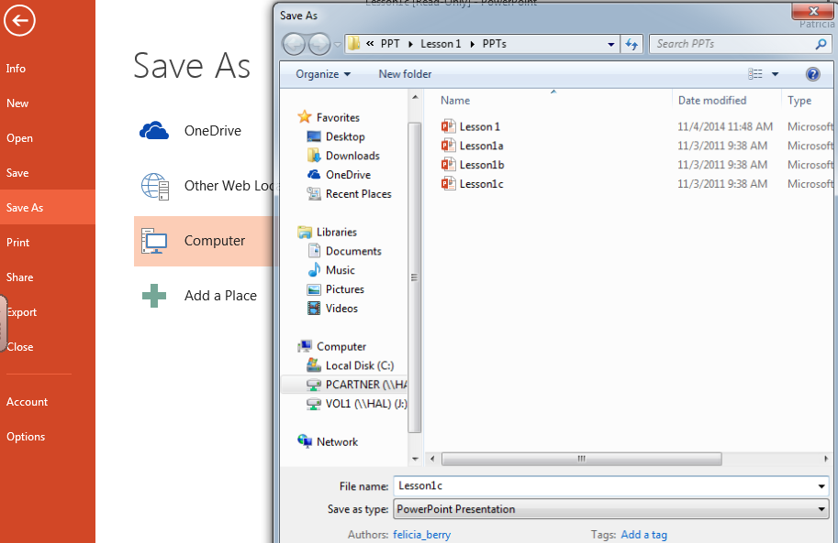
Saving a Presentation
Saving the presentation will allow for future use of the presentation.
The 1st time you save a presentation file the Save As dialog box will be used to assign a storage location and filename.

Slide 17
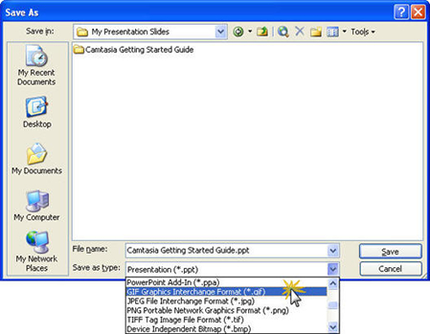
Saving a Presentation
Saving the presentation will allow for future use of the presentation.
All files in PowerPoint 2016 are saved with a .pptx file extension

Slide 18
Saving a Presentation
To save changes to a file that has already been named, you can click the save icon on the Quick Access Toolbar, or under the File tab.
To Save an existing presentation with a new name or new location to create a duplicate, click file and Save As and give the file an alternate name.
The following characters may not be used in the filename:
* Asterisk
? Question Mark
: Colon
The filename appears in the Title Bar

Slide 19
Slide Info
Right click on the thumbnail slides brings up a shortcut menu to choose options related to an individual slide (cut, copy, new slide, duplicate, delete, etc)
New slides can be added using the shortcut CTRL + M

Slide 20
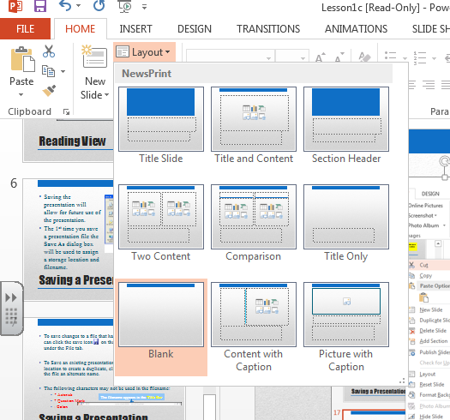
Slide Layouts
Slides Layouts can be changed after you create a slide by using the Layout option in the Slides group

