Slide 1
Immunohistochemistry Microtechniques
Dr. Ahmad H. Ibrahim
Ph.D. Molecular Pharmacology
Email: ahmad.ibrahim@tiu.edu.iq
6th lecture
March 6 -2024

Slide 2
Objectives
1. To Study of Immunohistochemistry
2. To know Types of Micro-techniques
3. To learn about methods of Micro-techniques
4. To learn about Immunohistochemistry Micro-techniques in general and special.

Slide 3
MICROTECHNIQUES
Tissue
Cell
Cytology
Histopathology
Specimen
Biopsy / Autopsy
Body fluids/ Smears from
aspiration or exfoliation
Method
Paraffin / Frozen
Smears / Imprint

Slide 4
Objectives in this lecture
Type of specimen
Steps of paraffin method
Transfer and reception of biopsy specimens
Methods of microtechniques

Slide 5
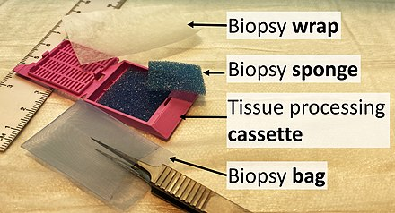
Types of specimens for Histopathological examination

Slide 6
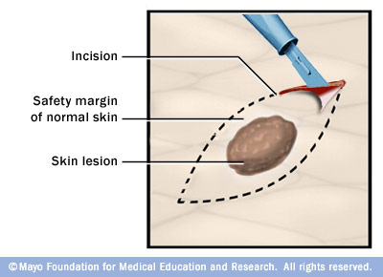
1. Biopsy
It is a piece of tissue or organ taken from the body for histological examination during life.

Slide 7
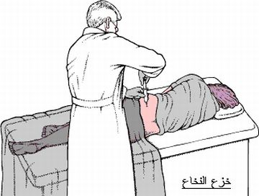
2. Autopsy
It is piece of tissue or organ taken from the body for histological examination after death

Slide 8
Incisional biopsy
Types of biopsy
a portion of the lesion is sampled for diagnostic purposes
Incisional biopsy

Slide 9
Excisional biopsy
the entire lesion is removed, usually with a rim of normal tissue. This procedure used for diagnosis and therapy.
Excisional biopsy
https://www.youtube.com/watch?v=nz29HmaaVwo

Slide 10
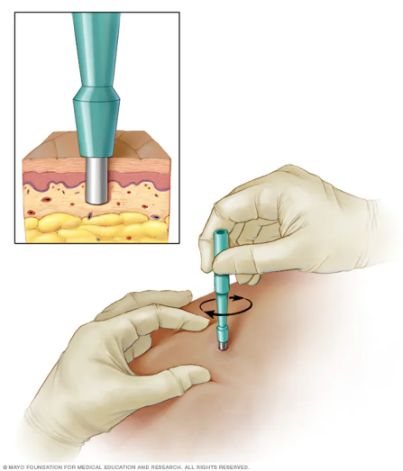
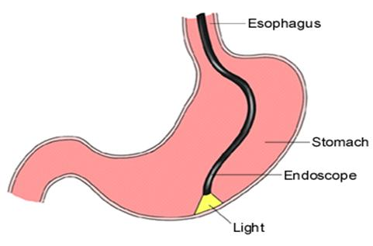
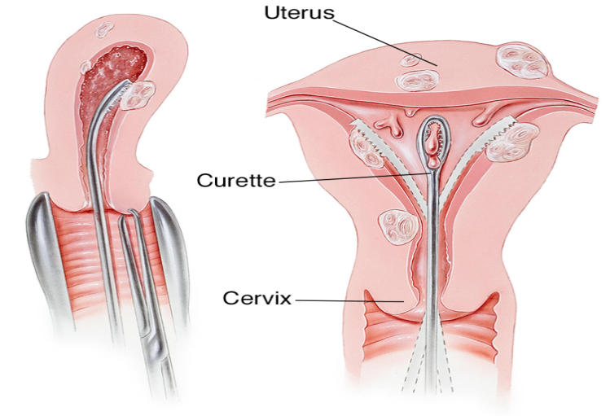
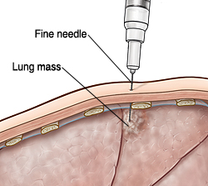
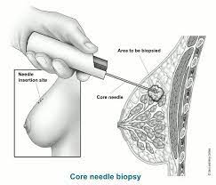
Other types
Endoscopic biopsy: when a piece of tissue taken by endoscopy.
Resection biopsy
Punch biopsy
Core Needle biopsy
Curetting.

Slide 11
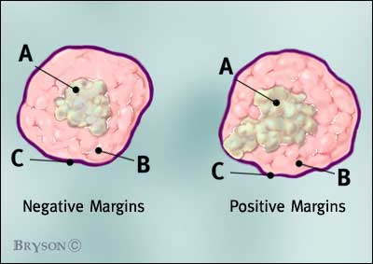

Slide 12
Definitions of surgical margin status.
(A) Negative surgical margin means that the tumor is removed with more than 5 mm of free distances from resection margin.
(B) Positive surgical margin (black arrow) is defined as when tumor cells are found on the resection margin.
(C) Multiple positive surgical margin (black arrows) is defined as when tumor cells are found on more than two points of the resection margins.

Slide 13
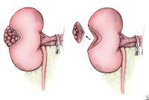

Slide 14
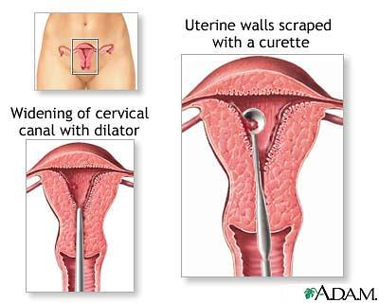

Slide 15
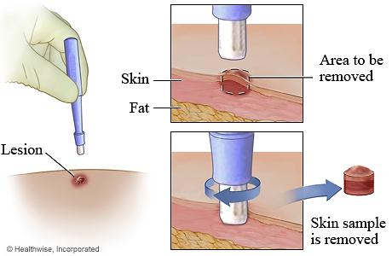

Slide 16
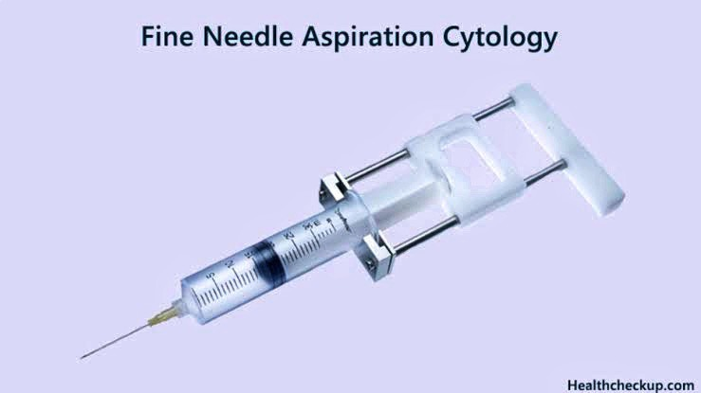
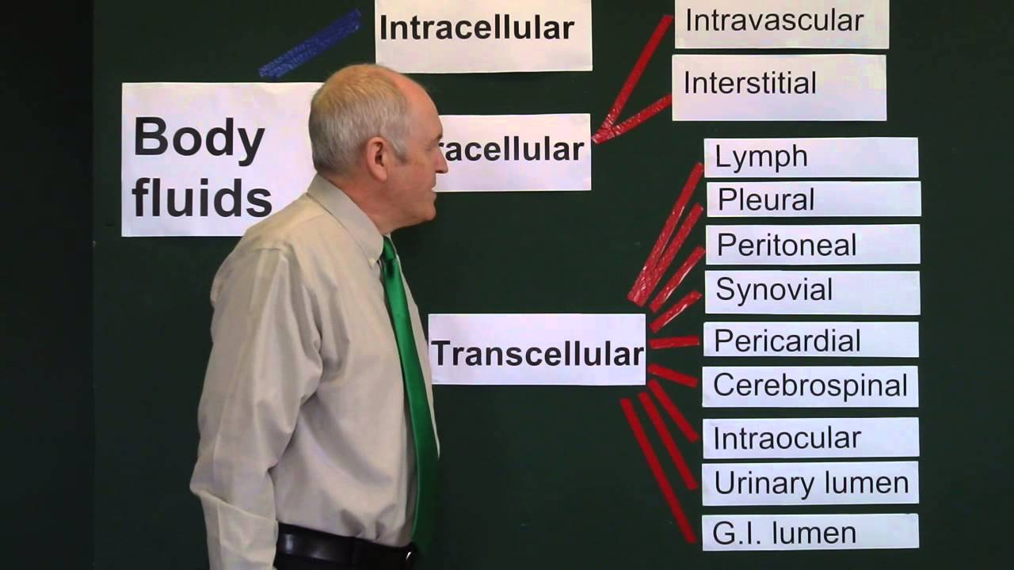
Cytological specimens:
Body fluids
Exfoliative cytology
Fine needle aspiration cytology
Note: Exfoliative cytology
In exfoliative cytology, cells shed from body surfaces, such as the inside of the mouth, are collected and examined. This technique is useful only for the examination of surface cells and often requires additional cytological analysis to confirm

Slide 17
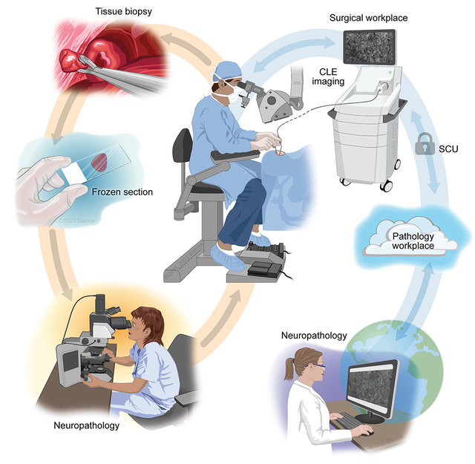
Frozen method:
It is a pathological laboratory procedure to perform rapid microscopic analysis of a tissue specimen using the freezing material.
Figure (on right side ) Schematic illustration of frozen section processing A standard clinical protocol for frozen section processing takes about 20 minutes and includes cryopreservation of tissue samples, sectioning, histological preparation, and evaluation by the pathologist.
Real-time intraoperative surgical telepathology using confocal laser end-microscopy (CLE)

Slide 18
Definition of Paraffin method
It is a method used in preparing a selected portion of tissue for microscopic examination.
The tissue is fixed, dehydrated, and infiltrated by and embedded in paraffin, forming a block that is cut with a microtome into slices 3-5 μm thick which will be ready for different staining methods.

Slide 19
Biopsy
Paraffin method

Slide 20
Reception of specimen
Fixation
Gross pathology
Processing
Embedding
Cutting with Microtome
Mounting
Staining
Cover slip
Reception of specimen
Steps of
Paraffin method

Slide 21
(1) Transfer and reception of biopsy specimens
Proper handling and transfer of biopsy specimens to the laboratory
Identification and reception of specimens
Initial laboratory work

Slide 22
Proper handling and transfer of biopsy specimens to the laboratory

Slide 23
Proper handling and transfer of biopsy specimens to the laboratory
I- Handling
the tissue should be handled gently to prevent crushing.

Slide 24
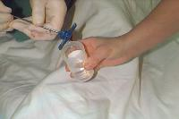
Proper handling and transfer of biopsy specimens to the laboratory
II- Fixation:
Any tissue taken for paraffin method should be fixed with appropriate fixatives in order to prevent autolysis.
Rapid fixation is very essential

Slide 25
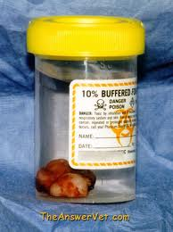
Proper handling and transfer of biopsy specimens to the laboratory
II- Fixation:
Select proper fixative and adequate volume (10X the biopsy size).
The biopsy that floats on a fixative should be covered by a thick layer of gauze.

Slide 26
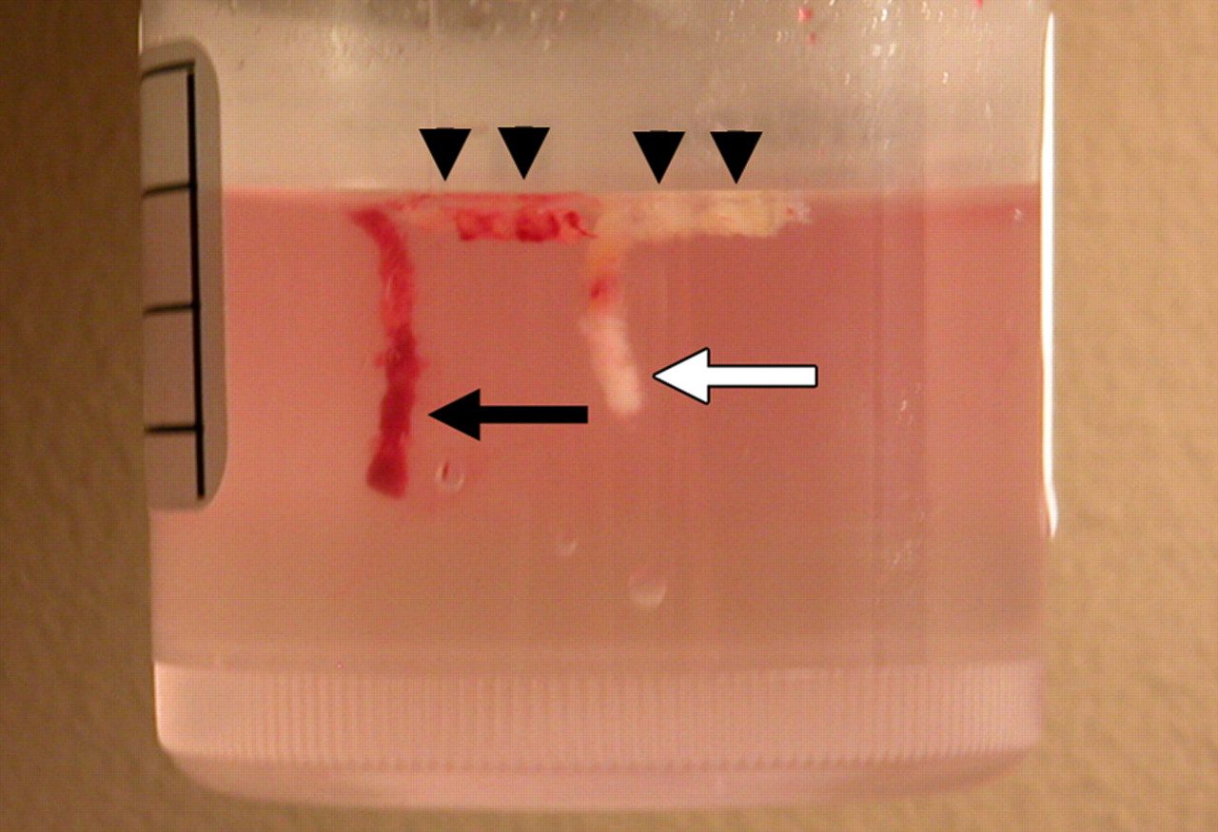

Slide 27
Proper handling and transfer of biopsy specimens to the laboratory
II- Fixation:
In cases of large, flat, heavy specimens that rest on the bottom of the containers, the gauze should be placed between the container bottom and the biopsy.
The biopsy should not be frozen once it has been placed in the fixative solution, for a peculiar ice crystal distortion will result.

Slide 28
Proper handling and transfer of biopsy specimens to the laboratory
II- Fixation:
Situations that we can send the biopsy without fixative:
If the lab is very close to the surgery room
Sending the biopsy for frozen method
Bacteriological examination
Touch imprint cytological examination

Slide 29
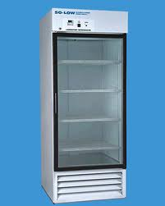
Proper handling and transfer of biopsy specimens to the laboratory
II- Fixation:
If delay is anticipated in the transport of the specimen to lab, or if the fixatives are not available, it is advisable to place the container in a refrigerator at 4° C to slow down autolysis.

Slide 30
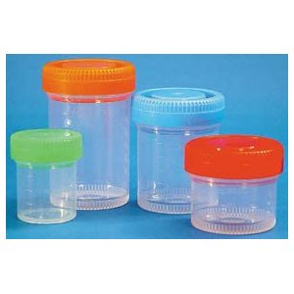
Proper handling and transfer of biopsy specimens to the laboratory
III- Proper container:
The container should have an opening large enough so that the tissue can be removed easily after it has been hardened by the fixation.

Slide 31
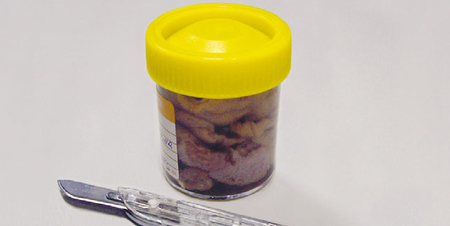

Slide 32
Proper handling and transfer of biopsy specimens to the laboratory
IV- Labelling:
Label the specimen container for identification and avoid mistakes.
Request paper contains clinical data for proper diagnosis.

Slide 33
Useful videos for learning
https://www.youtube.com/watch?v=S01glu4mLXw
https://www.youtube.com/watch?v=66DaMeUR_p4
https://www.youtube.com/watch?v=YyIVY5NHBgU
https://www.youtube.com/watch?v=7CzDEok8Wmo
https://www.youtube.com/watch?v=vfSChpiyyag

Slide 34
Any Question?
The End

