Slide 1
The Cellular Foundation of Life (Part 1)
Biology 1st Grade
Technical English
2023-2024

Slide 2
The Biological Levels of Organization
Atom
Molecule
Organelle
Cell
Organ
Tissues
Ecosystem
Organ System
Organism
Community
Population
Biome
Biosphere

Slide 3
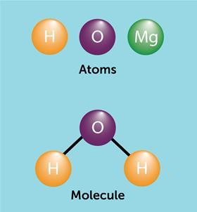
Atom: A unit of matter; the smallest unit of a chemical element.
Molecule: A group of two or more atoms held together by a chemical bond

Slide 4
Organelle: Any of the specialized structures within a cell that perform a specific function. For example, the nucleus is an organelle.
Cell: The smallest structural and functional unit of an organism that contains organelles.
Tissues: A group of similar cells carrying out the same function.

Slide 5
Organ: A structure formed of tissues operating together to perform a common function
Organ System: A group of organs that work together to perform a specific function.
Organism: An individual form of life that is capable of growing and reproducing, and have one or more cells.

Slide 6
Population: A group of individuals of a particular species living in a specific ecosystem at the same time.
Community: A collection of populations living in a specific ecosystem at the same time.

Slide 7
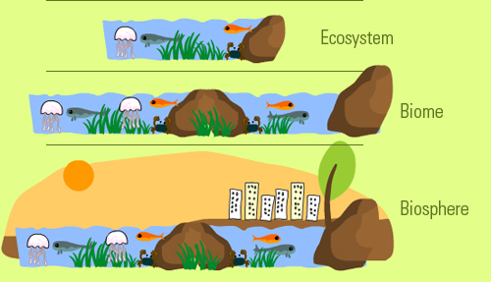
Ecosystem: A system consisting of biotic and abiotic components that function together as a unit.
Biome: Large areas on Earth with similar conditions, such as similar climates and similar living organisms. (Collection of similar ecosystems)
Biosphere: Part of the Earth where living things thrive and live. (Collection of Biomes)

Slide 9
ASSESSMENT
Write the definition of the following terms:
Organelle
Cell
Tissues
What is the difference between:
Population vs. Community
Biome vs. Biosphere
Atom vs. Molecule

Slide 10
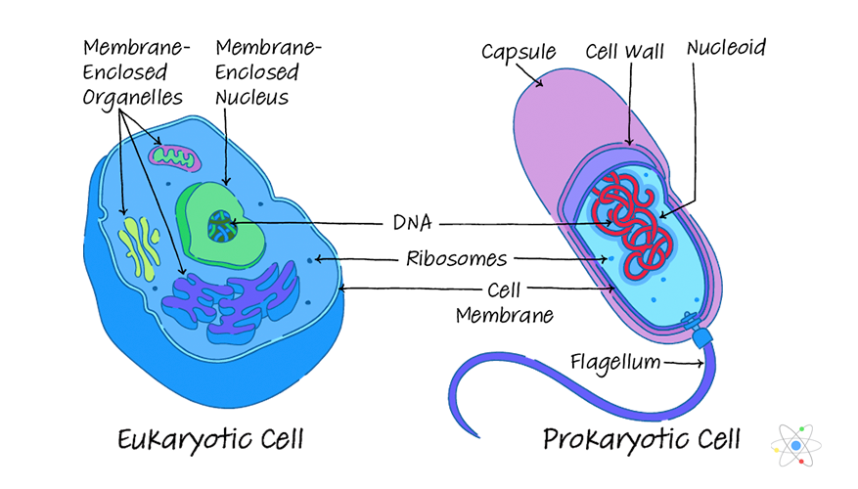
Eukaryote: Organisms whose cells contain a nucleus and other membrane-bound organelles
Prokaryote: Unicellular organisms that lack a nucleus and membrane-bound structures.

Slide 11
Cell Wall: The protective, outer layer of a plant cell.
Cell Membrane: Also called the plasma membrane, is found in all cells and separates the interior of the cell from the outside environment.
Cytoplasm: The gel-like fluid inside the cell
Cytoskeleton: A structure that helps cells maintain their shape and internal organization.
Nucleus: A membrane-bound organelle that contains the cell's genetic material
Nucleolus: A region found within the cell nucleus that is concerned with producing and assembling the cell's ribosomes.
Ribosome: A sphere-shaped structure within the cytoplasm of a cell that is composed of RNA and protein and is the site of protein synthesis
Endoplasmic Reticulum (ER): A network of membranes inside a cell through which proteins and other molecules move.
Rough Endoplasmic Reticulum (RER): Organelle covered in ribosomes and plays a role in the synthesis of proteins.
Smooth Endoplasmic Reticulum (SER): Organelle not covered in ribosomes and plays a role in the production and storage of lipids and steroids.

Slide 12
Golgi apparatus: The organelle that helps process and package proteins and lipid molecules
Vesicle: Organelles that contain a lipid bilayer and transport materials and function in metabolism and enzyme storage
Vacuole: Membrane-bound organelle that removes waste and stores water/nutrients.
Mitochondria: The organelle that generates most of the chemical energy needed to power the cell's biochemical reactions. (Powerhouse of the cell)
Peroxisome: A membrane-bound organelle containing enzymes (such as catalase) which act in oxidative reactions.
Lysosome: A membrane-bound cell organelle that contains digestive enzymes
Chloroplast: An organelle within the cells of plants and certain algae that is the site of photosynthesis

Slide 13
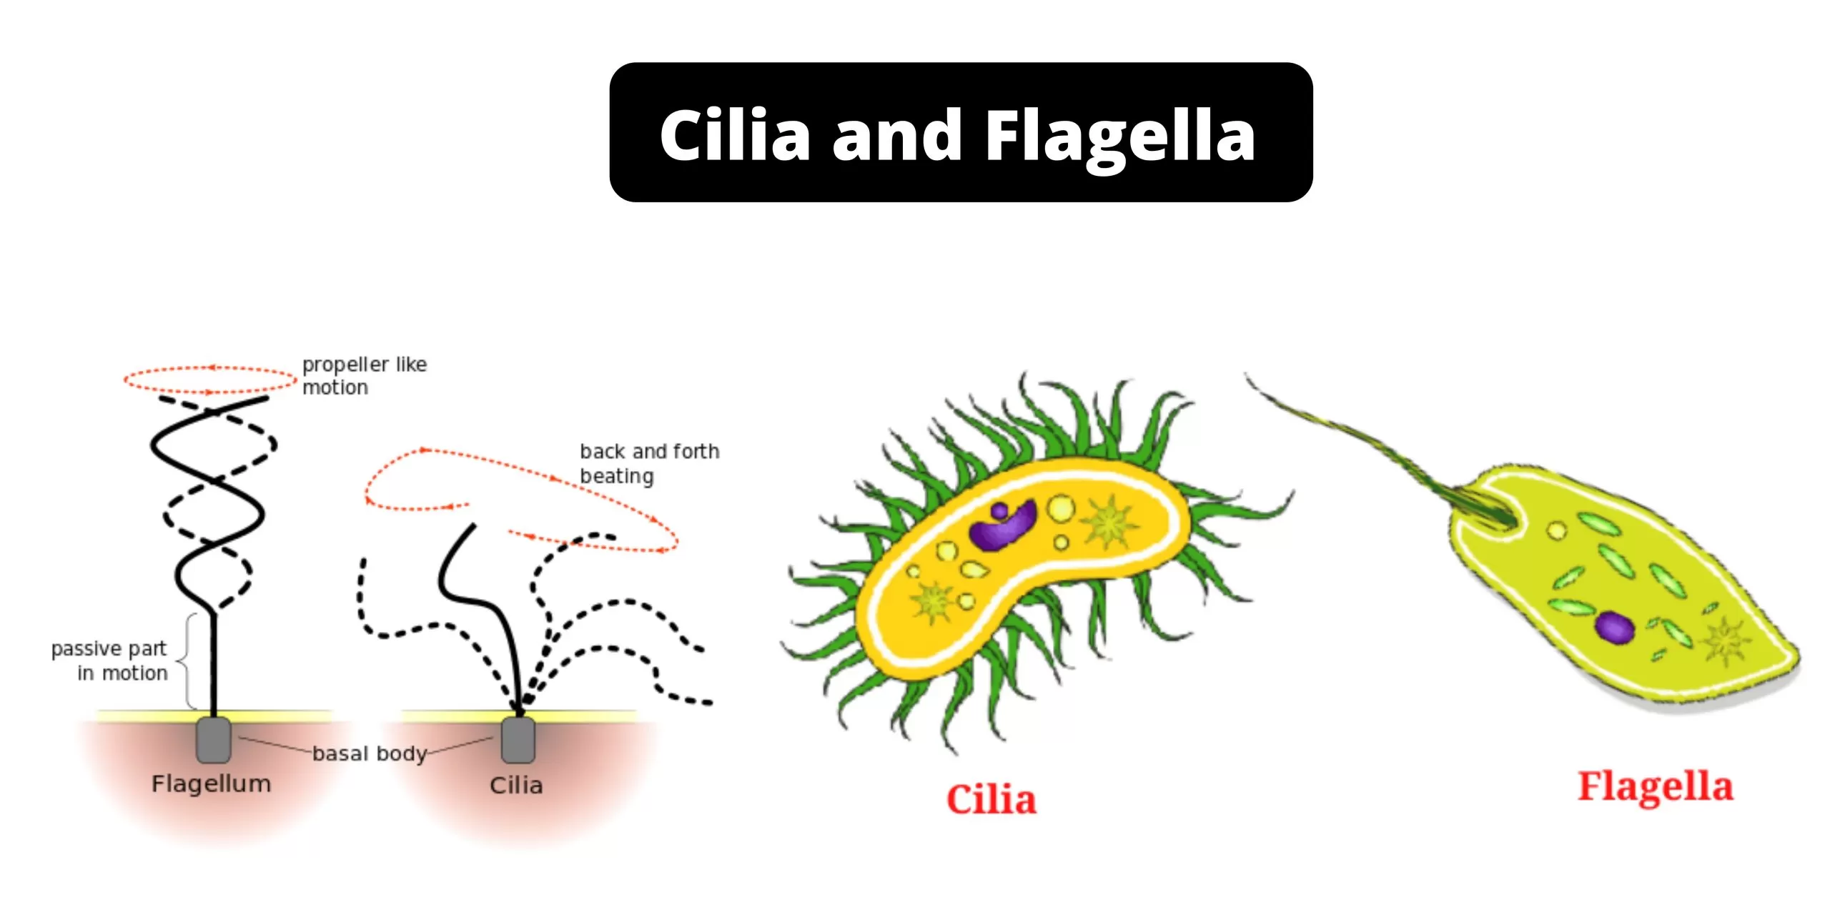
Cilium (plural: cilia): Short, hair like cell organelle extending from the surface of a living cell.
Flagellum (plural: flagella): Long, threadlike cell organelle present on the surface of a living cell.

Slide 14
ASSESSMENT
Circle the correct term:
Unicellular organisms that lack a nucleus and membrane-bound structures are Eukaryotes / Prokaryotes
A structure that helps cells maintain their shape and internal organization is Cytoskeleton / Cytoplasm
A membrane-bound cell organelle that contains digestive enzymes is Peroxisome / Lysosome
The organelle that helps process and package proteins and lipid molecules is Golgi Apparatus / Nucleolus
Define the following:
Vacuole
Nucleus
Ribosome
Cell Membrane
Flagella

Slide 15
Pinocytosis: A cellular process by which fluids are ingested by cells.
Phagocytosis: A cellular process for ingesting and eliminating particles, including foreign substances, microorganisms, and apoptotic cells.
Gap Junction: A type of cell junction in which adjacent cells are connected through protein channels.
Plasmodesmata: Small channels that directly connect the cytoplasm of neighboring plant cells to each other.
Extracellular Matrix: A large network of proteins and other molecules that surround, support, and give structure to cells and tissues in the body

Slide 16
Active Transport: Movement of substances from a region of lower concentration to a higher concentration with the use of energy.
Passive Transport: Movement of substances from an area of higher to lower concentration without the use of energy.
Facilitated Transport: Movement of materials across the plasma membrane with the help of membrane proteins.
Diffusion: The passive movement of molecules or particles from an area of higher concentration to an area of lower concentration.
Osmosis: The transport of water through a semipermeable membrane from an area of high water concentration to an area of low water concentration
Selectively Permeable: A membrane that allows only some substances and molecules to pass into or leave the cell.
Solute: A substance that can be dissolved by a solvent to create a solution.
Solvent: A substance that dissolves a solute, resulting in a solution.

Slide 17
Osmolarity: The measurement of solute concentration of a solution.
Hypertonic: Describes a solution in which extracellular fluid has higher osmolarity than the fluid inside the cell.
Hypotonic: Describes a solution in which extracellular fluid has lower osmolarity than the fluid inside the cell.
Isotonic: Describes a solution in which the extracellular fluid has the same osmolarity as the fluid inside the cell.

Slide 19
ASSESSMENT
Write the difference between the following:
Pinocytosis and Phagocytosis
Gap Junction and Plasmodesmata
Active Transport and Passive Transport
True or False. Correct the False statements.
Hypotonic describes a solution in which extracellular fluid has higher osmolarity than the fluid inside the cell.
Plasmodesmata is a membrane that allows only some substances and molecules to pass into or leave the cell.
Extracellular Matrix is a large network of proteins and other molecules that surround, support, and give structure to cells and tissues in the body

