Slide 1
The Cellular Foundation of Life (Part 2)
Biology 1st Grade
Technical English
2023-2024

Slide 2
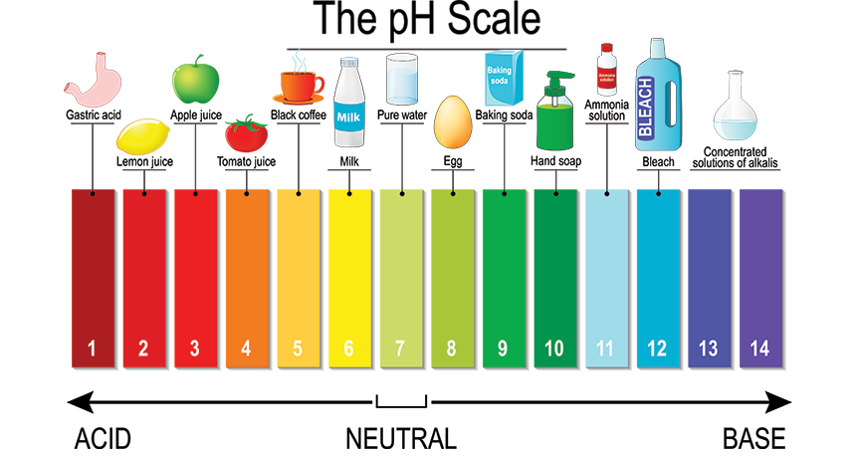
pH: A measure of the concentration of hydrogen ions in the solution.
Acid: A substance that donates hydrogen ions and therefore lowers pH
Base: A substance that absorbs hydrogen ions and therefore raises pH

Slide 3
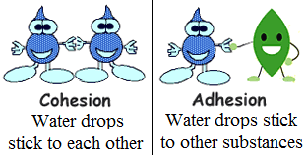
Adhesion: The attraction between different molecules
Cohesion: The attraction between the same molecules
Evaporation: The process where molecules change from the liquid state to the gas state (Vapor)
Hydrophilic: Describes a substance that dissolves in water; water-loving
Hydrophobic: Describes a substance that does not dissolve in water; water-fearing

Slide 4
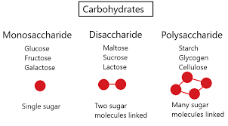
Denaturation: The loss of shape in a protein as a result of changes in temperature, pH, or exposure to chemicals
Amino acid: Molecules that combine to form proteins.
Polypeptide: A long chain of amino acids linked by peptide bonds
Monosaccharide: A single unit of carbohydrates
Disaccharide: A substance that is composed of two molecules of simple sugars linked to each other
Polysaccharide: A long chain of monosaccharides.

Slide 5
Nucleotide: The basic building block of nucleic acids that contain a pentose sugar, a phosphate group, and a nitrogenous base
Nucleic acid: Macromolecules that are made up of nucleotides and carries the genetic information of a cell and instructions for the functioning of the cell
Deoxyribonucleic acid (DNA): A double-stranded polymer of nucleotides that carries the hereditary information of the cell
Ribonucleic acid (RNA): A single-stranded polymer of nucleotides that is involved in protein synthesis
Protein: Large molecules composed of one or more chains of amino acids
Carbohydrate: Sugar molecules that serve as energy sources.
Cellulose: A polysaccharide that makes up the cell walls of plants and provides structural support to the cell

Slide 6
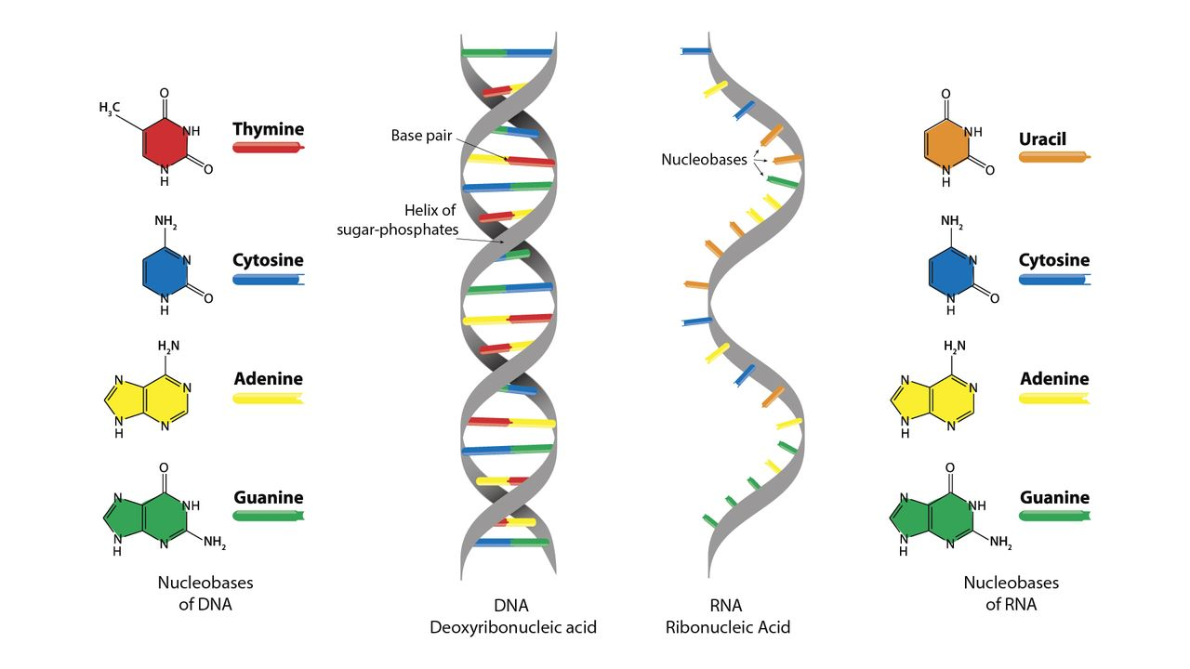

Slide 7
Chitin: A modified polysaccharide that forms the outer skeleton of arthropods and the cell walls of fungi
Enzyme: Proteins that help speed up metabolism, or the chemical reactions in our bodies.
Hormone: Chemical messengers produced by glands sending signals into the bloodstream to various tissues in the body.
Glycogen: The storage form of carbohydrates in animals.
Starch: The storage form of carbohydrates in plants.
Lipids: Substance that is nonpolar and insoluble in water (fats, oils, etc)

Slide 8
Saturated fatty acid: Fatty acids made up of hydrocarbon chains with single bonds
Unsaturated fatty acid: Fatty acids that have one or more double bonds in the hydrocarbon chain
Phospholipid: A type of lipid molecule that is the main component of the cell membrane.
Atomic number: The number of protons in an atom
Mass number: The number of protons plus neutrons in an atom
Element: One of 118 unique substances that cannot be broken down into smaller substances and have a specified number of protons
Isotope: One or more forms of an element that have different numbers of neutrons

Slide 9
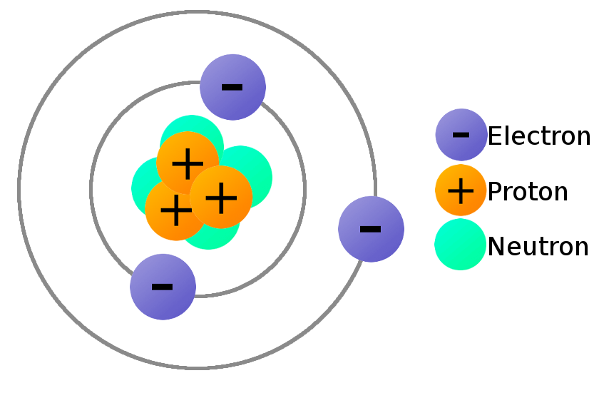
Electron: Negatively charged particles of atoms
Neutron: Uncharged (No charge) particles of atoms
Proton: Positively charged particles of atoms
Electron Transfer: the movement of electrons from one element to another
Ion: An atom or group of atoms that carries a positive or negative electric charge as a result of having lost or gained one or more electrons
Anion: A negative ion formed by gaining electrons
Cation: A positive ion formed by losing electrons

Slide 10
Assessment
1. Explain pH, Acid, and Base to your partner.
2. Write the difference between the following:
Adhesion and Cohesion
Hydrophilic and Hydrophobic
DNA and RNA
Anion and Cation

Slide 11
ATP: (Adenosine Triphosphate) the cell’s energy
Metabolism: All chemical reactions involved in maintaining the living state of the cells and the organism.
Fermentation: Chemical process by which molecules such as glucose are broken down anaerobically. (Occurs in the cytoplasm)
Glycolysis: The process of breaking down glucose for energy. (Occurs in the mitochondria)

Slide 12
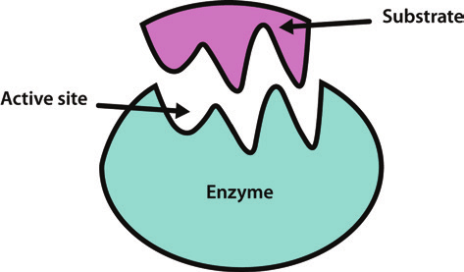
Active site: A specific region on the enzyme where the substrate binds
Substrate: A molecule on which the enzyme acts
Anabolic: Anabolic processes involve the building of larger, complex molecules from smaller, simpler ones.
Catabolic: Catabolic processes break large, biological molecules down into smaller, simpler molecules.

Slide 13
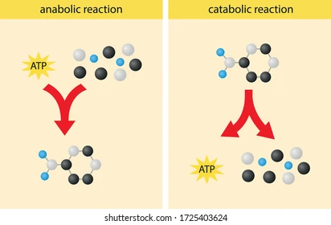

Slide 14
Assessment
True or False. Correct the false statements.
A specific region on the enzyme where the substrate binds is metabolism.
Catabolic processes involve the building of larger, complex molecules from smaller, simpler ones.
Active site is a molecule on which the enzyme acts.
The process of breaking down glucose for energy in the mitochondria is glycolysis.

Slide 15
Autotroph: An organism capable of producing its own food
Heterotroph: An organism that consumes other organisms for food
Photoautotroph: An organism capable of synthesizing its own food molecules, using the energy of light.

Slide 16
Light-dependent reaction: The first stage of photosynthesis where visible light is absorbed to form two energy-carrying molecules (ATP and NADPH)
Photosystem: a group of proteins, chlorophyll, and other pigments that are used in the light-dependent reactions of photosynthesis to absorb light energy and convert it into chemical energy
Calvin cycle: The reactions of photosynthesis that use the energy stored by the light-dependent reactions to form glucose and other carbohydrate molecules
Carbon fixation: The process of converting inorganic CO2 gas into organic compounds

Slide 17
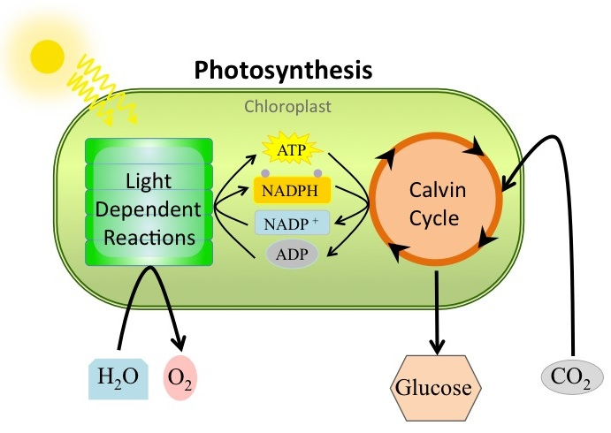

Slide 18
Chlorophyll: The green pigment that captures the light energy that drives the reactions of photosynthesis
Mesophyll: The middle layer of cells in a leaf
Stoma: The opening that regulates gas exchange and water regulation between leaves and the environment. (plural: stomata)
Stroma: The fluid-filled space surrounding the grana inside a chloroplast where the Calvin cycle reactions of photosynthesis take place
Granum: A stack of thylakoids located inside a chloroplast
Thylakoid: A disc-shaped membranous structure inside a chloroplast where the light-dependent reactions of photosynthesis take place using chlorophyll embedded in the membranes

Slide 19
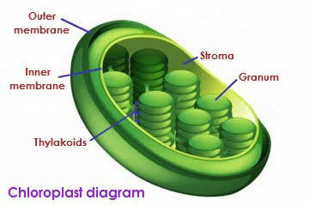

Slide 20
Assessment
Circle the correct answer.
1. A stack of thylakoids located inside a chloroplast stroma / granum.
2. The middle layer of cells in a leaf is mesophyll / chlorophyll
3. An organism capable of producing its own food is heterotroph / autotroph

