Slide 1
Geometric Series
Name of teacher :Dr. Mazin R Khalil
Advanced Mathematics2 –ME212
Semester 4
Week 3
Date: 13/2/2024

Slide 2
Objectives
To teach students the following opinions through out the lecture:
Geometric series
Methods of testing series

Slide 3
Geometric series
A geometric series is the sum of finite or infinite terms of a geometric sequence. For the geometric sequence a, ar, ar², ..., ar^{n-1}, ..., the corresponding geometric series is a + ar + ar² + ..., ar^{n-1} + .... We know that "series" means "sum". In particular, the geometric series means the sum of the terms that have a common ratio between every adjacent two of them. There can be two types of geometric series: finite and infinite. Here are some examples of geometric series.
1/2 + 1/4 + .... + 1/8192 is a finite geometric series where the first tern, a = 1/2 and the common ratio, r = 1/2
-4 + 2 - 1 + 1/2 - 1/4 + ... is an infinite geometric series where the first term, a = -4 and the common ratio r = -1/2

Slide 5
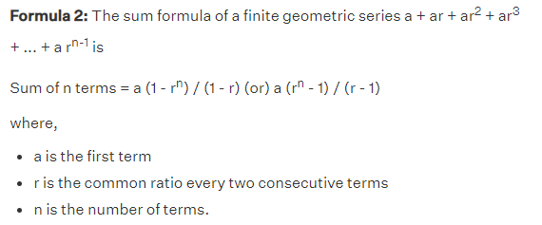
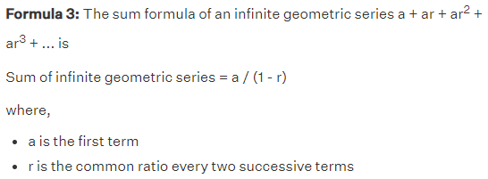

Slide 6
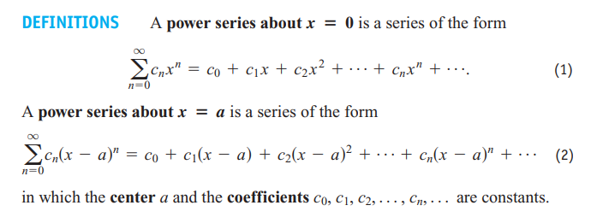

Slide 7
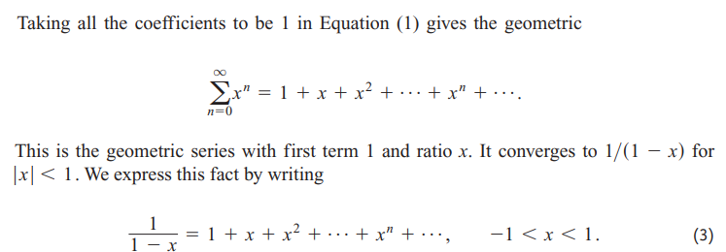

Slide 8
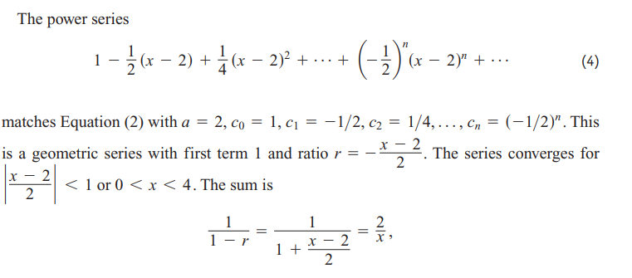

Slide 12
Vector in Space

Slide 13
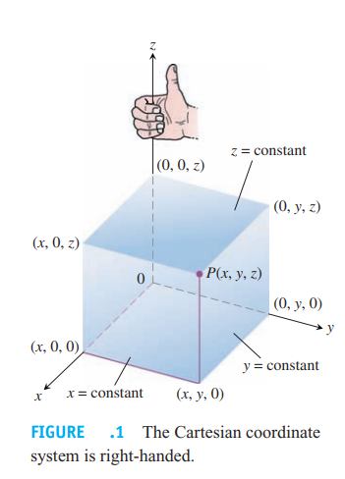

Slide 14
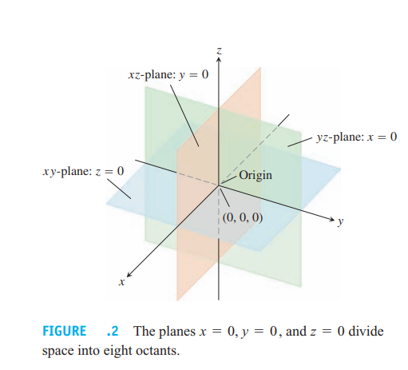

Slide 15
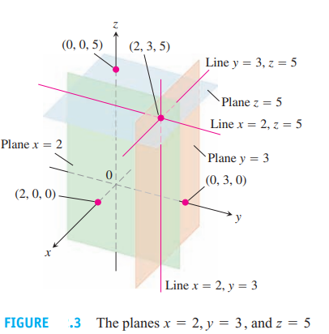

Slide 16
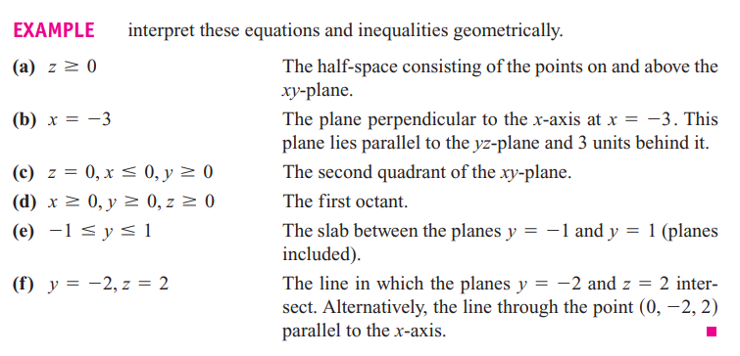

Slide 17
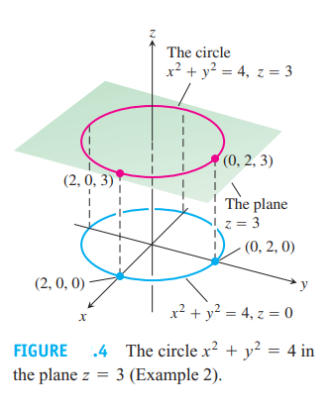

Slide 18
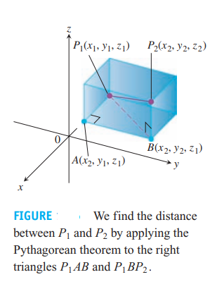

Slide 21
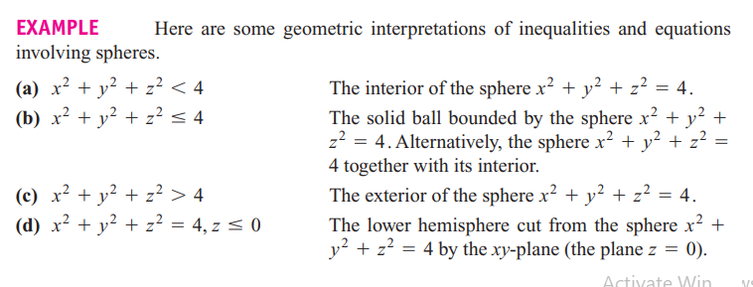

Slide 22
References
1. Thomas' Calculus" 11th edition
2. Calculus Early Transcendental Functions" by Ron Larson and Bruce Edwards

