Slide 1
Cell Division and Genetics
Biology 1st Grade
Technical English
2023-2024

Slide 2
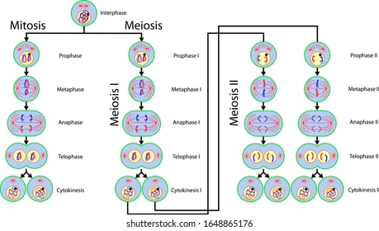
Cell cycle: A series of events that takes place in a cell as it grows and divides.
Meiosis: A process where a single cell divides twice to produce four cells.
Mitosis: A process where a single cell divides into two identical daughter cells.

Slide 3
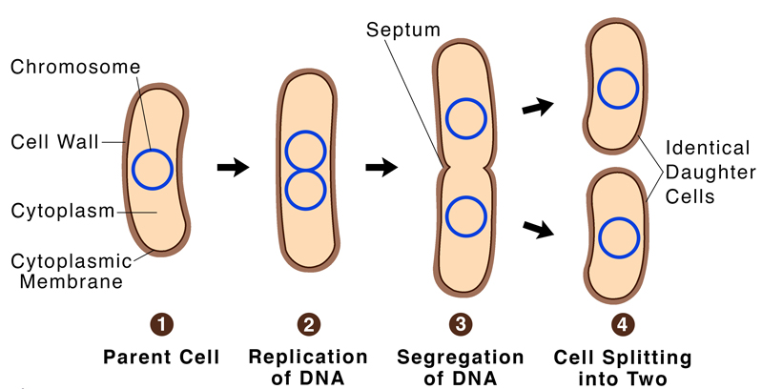
Binary Fission: A type of asexual reproduction where a parent cell divides, resulting in two identical cells.

Slide 4
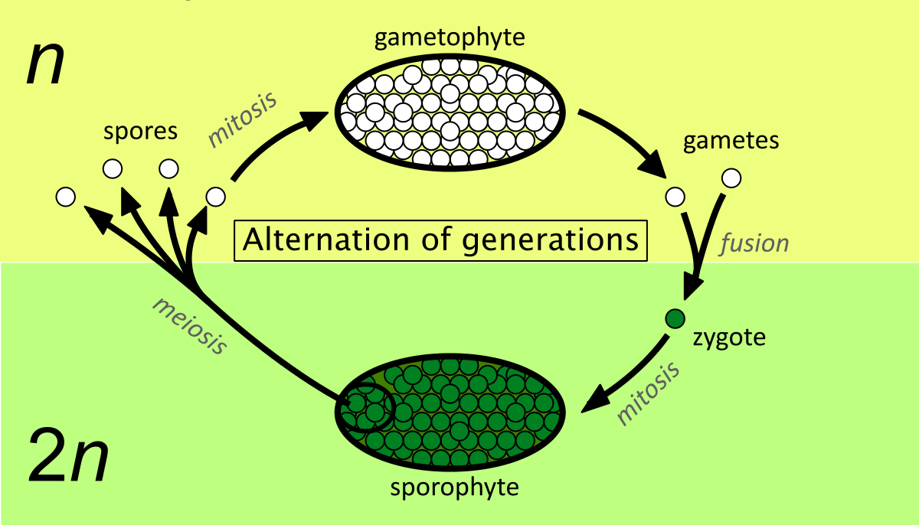
Gametophyte: A multicellular haploid life-cycle stage that produces gametes
Sporophyte: A multicellular diploid life-cycle stage that produces spores

Slide 5
Chromosome: The microscopic threadlike part of the cell that carries hereditary information in the form of genes.
Chromatid: One of two identical halves of a replicated chromosome.
Telomeres: A region at the end of chromosomes for protection
Centromere: a constricted region of a chromosome that separates it into a short arm (p) and a long arm (q).
Homologous Chromosomes: A pair of chromosomes having the same gene sequences.

Slide 6
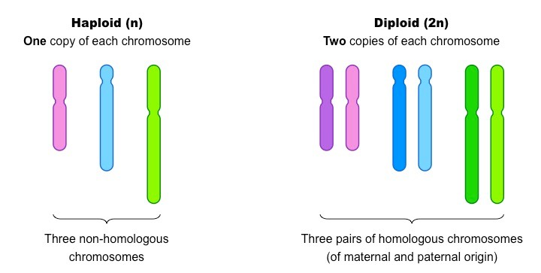
Haploid: Describes a cell, nucleus, or organism containing one set of chromosomes (n).
Diploid: Describes a cell, nucleus, or organism containing two sets of chromosomes (2n).

Slide 7
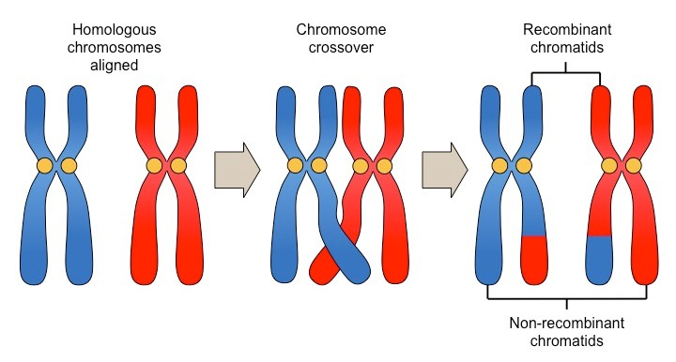
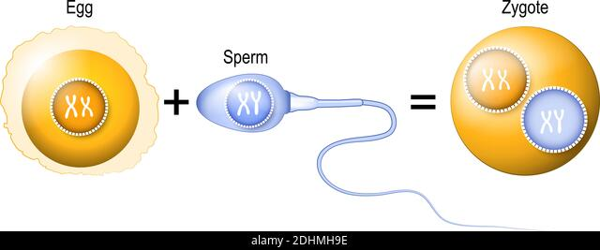
Crossing Over: The exchange of genetic material between homologous chromosomes
Fertilization: The union of the sperm and egg cell

Slide 8
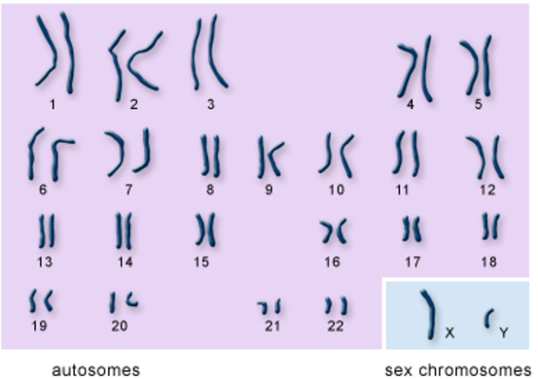
Autosome: Any of the non-sex chromosomes
Somatic Cell: Any cell of the body except sperm and egg cells.
Germ Cell: A specialized cell that produces gametes, such as eggs or sperm.
Gamete: A reproductive cell or sex cell that contains the haploid set of chromosomes.

Slide 9
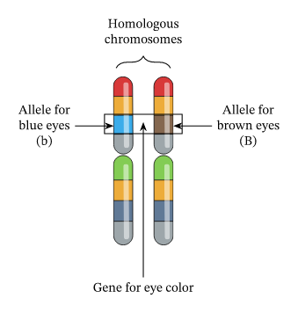
Genome: The complete set of genetic information in an organism.
Gene: The basic physical and functional unit of heredity.
Locus: The position of a gene on a chromosome.
Allele: A variant form of a gene.

Slide 10
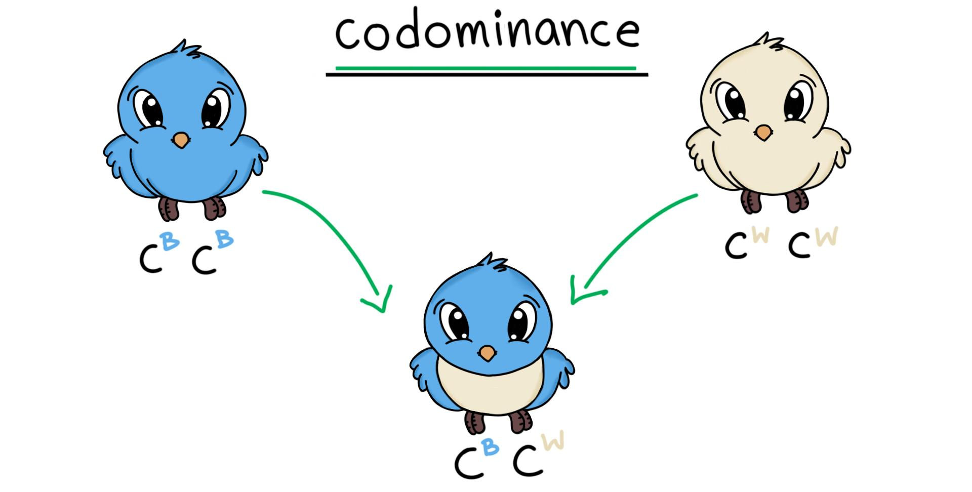
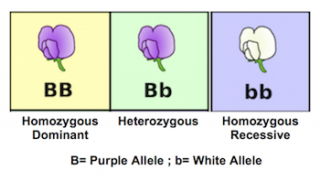
Codominance: in a heterozygote, complete and simultaneous expression of both alleles for the same characteristic
Dominant: Describes a trait that masks the expression of another trait when both versions of the gene are present in an individual
Recessive: describes a trait whose expression is masked by another trait when the alleles for both traits are present in an individual
Heterozygous: Having two different alleles for a given gene on the homologous chromosomes
Homozygous: Having two identical alleles for a given gene on the homologous chromosomes

Slide 11

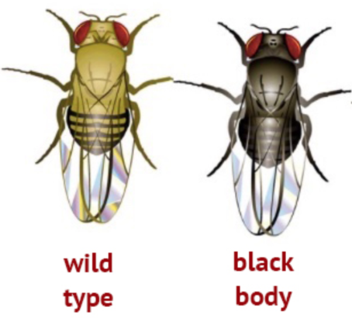
Genotype: The genetic arrangement that makes up the traits that an organism inherited from its parents.
Phenotype: The observable traits expressed by an organism. (Physical characteristics)
Wild Type: The normal, non-mutated version of a gene common in nature.

Slide 12
Assessment
What is the difference between haploid and diploid?
What is the difference between gametophyte and sporophyte?
What is the difference between genotype and phenotype?
What is codominance?
What is the meaning of crossing over?

