Slide 1
Vector in Space and Cross product
Name of teacher :Dr. Mazin R Khalil
Advanced Mathematics2 –ME212
Semester 4
Week 5
Date: 27/2/2024

Slide 2
Objectives
To teach students the following opinions through out the lecture:
Define vectors, operations of the vectors and cross product with some examples about it

Slide 3
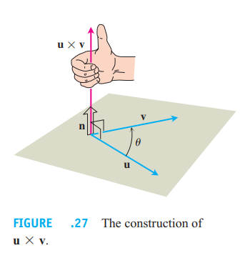

Slide 4
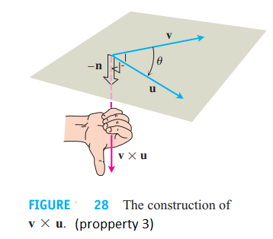

Slide 5
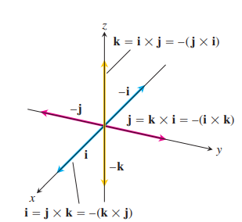
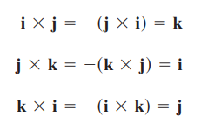

Slide 6
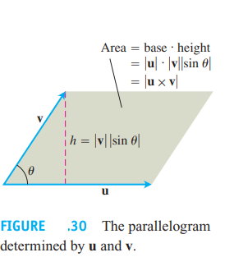

Slide 7
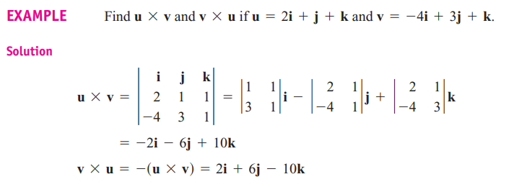

Slide 8
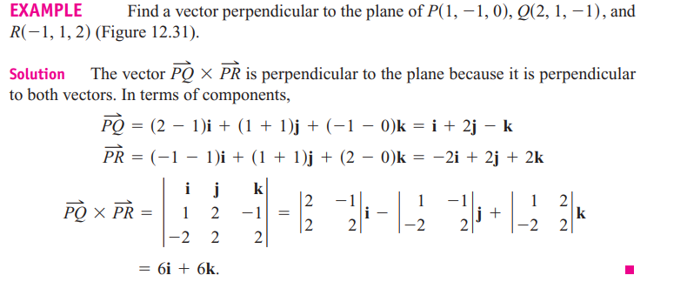
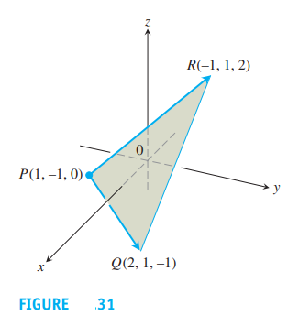

Slide 10
References
1. Thomas' Calculus" 11th edition
2. Calculus Early Transcendental Functions" by Ron Larson and Bruce Edwards

