Slide 1
Functions of several Variables
Name of teacher :Dr. Mazin R Khalil
Advanced Mathematics2 –ME212
Semester 4
Week 5
Date: 27/2/2024

Slide 2
Objectives
To teach students the following opinions through out the lecture:
Function of several variables

Slide 3
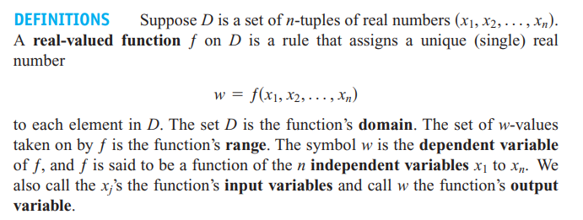

Slide 5
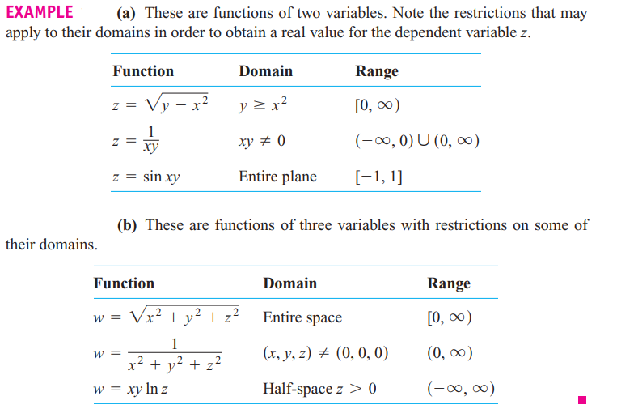

Slide 6
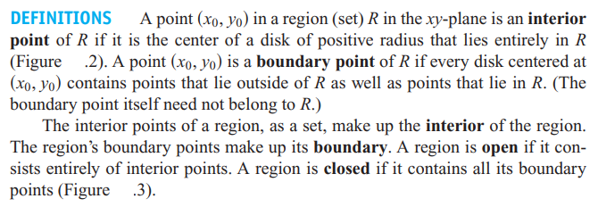

Slide 7
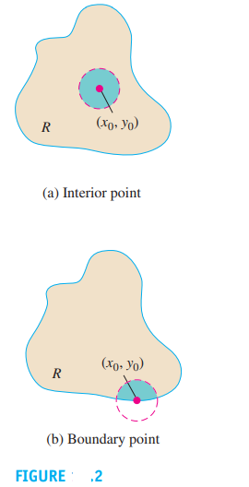
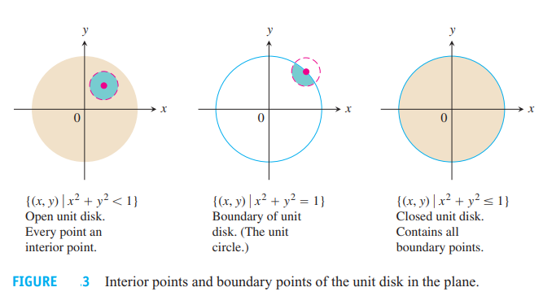
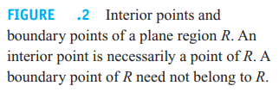

Slide 8
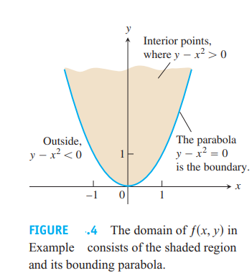

Slide 9
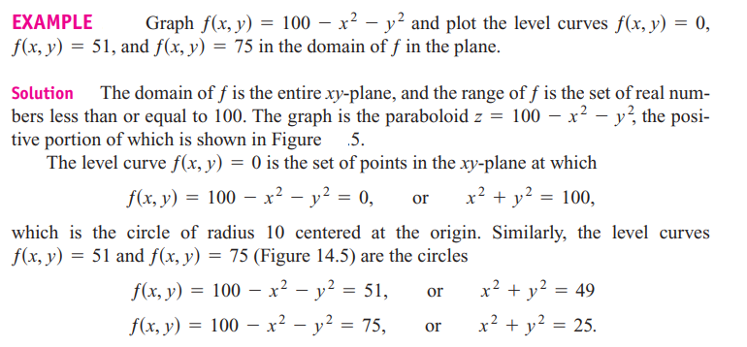

Slide 10
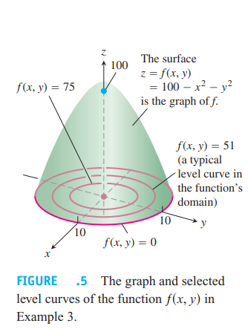

Slide 11
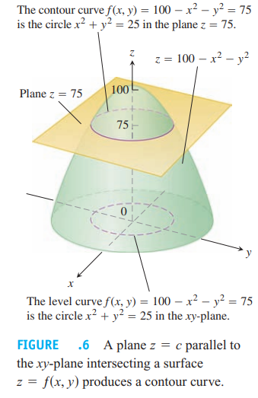

Slide 12
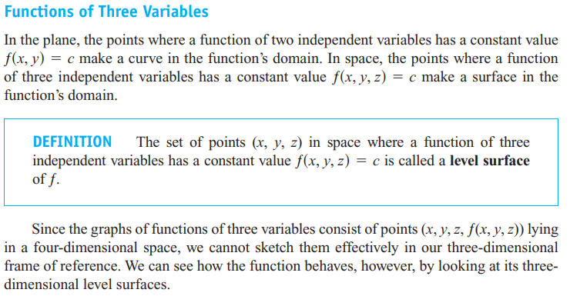

Slide 13
References
1. Thomas' Calculus" 11th edition
2. Calculus Early Transcendental Functions" by Ron Larson and Bruce Edwards

