Slide 1
The Immune System and Disease
Biology 1st Grade
Technical English
2023-2024

Slide 2
Immune System: A complex network of cells, tissues, organs, and the substances they make that helps the body fight infections and other diseases.
Immunity: The body's ability to avoid or not be affected by infection and disease
Innate Immune Response: The first line of defense against invading pathogens.
Adaptive Immune Response: Involves specialized immune cells and antibodies that attack and destroy foreign invaders and are able to prevent disease in the future by memory cells

Slide 3
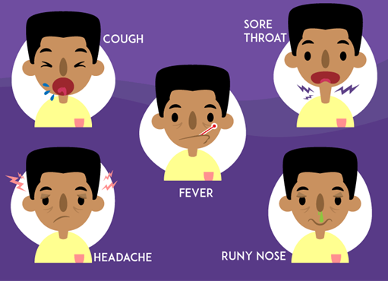
Symptoms: A change in the body which indicates that a disease is present often
Asymptomatic: Showing no symptoms
Contagious: Able to be passed from one individual to another through contact

Slide 4
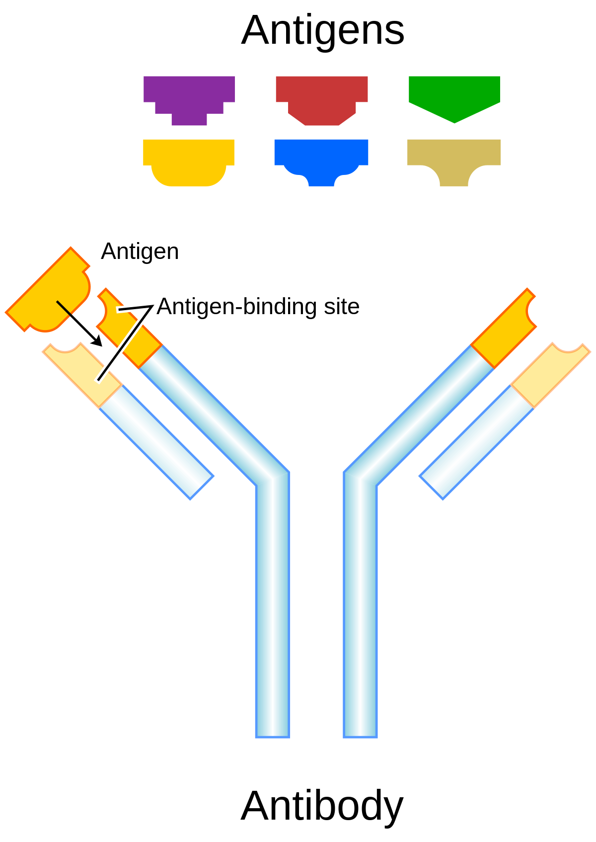
Antigen: Any substance that causes the body to make an immune response against that substance.
Antibody: A protein produced by the body's immune system when it detects harmful substances

Slide 6
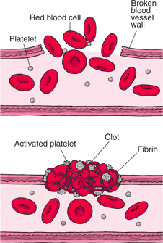
Erythrocytes: Red Blood Cells that transport oxygen to tissues of the body.
Leukocytes: White Blood Cells that help the body fight infection
Lymphocyte: A type of white blood cell that produce antibodies or fight infected cells.
Platelet (Thrombocytes): Small blood cells that help your body form clots to stop bleeding

Slide 7
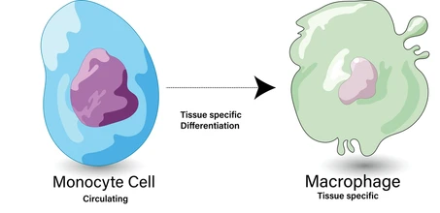
Neutrophil: A type of white blood cell that act as your immune system's first line of defense.
Monocyte: Type of white blood cell that becomes a macrophage after moving to tissues.
Macrophage: Specialized cells involved in the detection, phagocytosis and destruction of bacteria and other harmful organisms

Slide 8
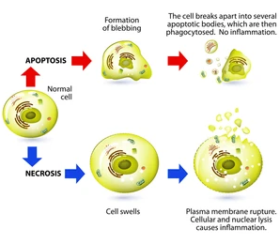
Apoptosis: The process of programmed cell death
Necrosis: Uncontrolled cell death that can occur in response to infection, injury, or lack of blood supply.
Inflammation: The localized redness, swelling, heat, and pain that results from the movement of leukocytes through opened capillaries to a site of infection

Slide 9
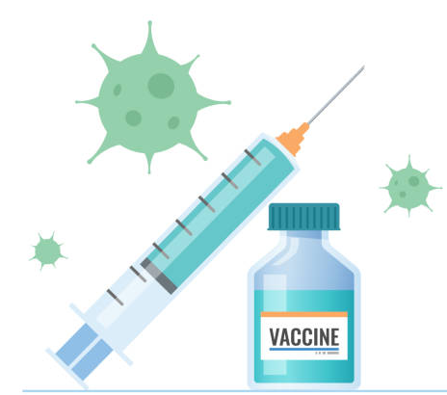
Attenuate: The weakening of a virus during vaccine development
Vaccine: A preparation that is administered to stimulate the body's immune response against a specific infectious agent or disease
Immunization: A process by which a person becomes protected against a disease through vaccination.

Slide 10
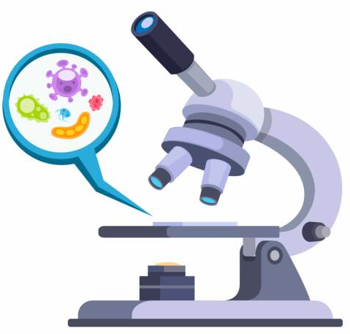
Microorganisms: An organism that can be seen only through a microscope.
Pathogen: A microorganism that causes disease
Viruses: A small infectious agent that can only replicate inside the cells of another organism.
Bacteria: Small single-celled organisms
Fungi: Any of a group of spore-producing organisms
Parasites: An organism that lives on or in a host organism

