Slide 1
Ecology
Biology 1st Grade
Technical English
2023-2024

Slide 2
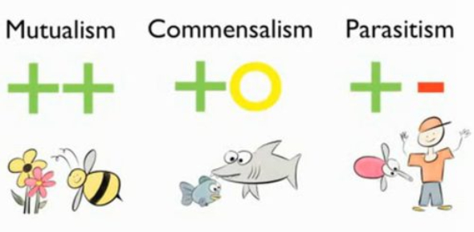
Host: an organism a parasite lives on
Symbiosis: The interaction between two different organisms.

Slide 3
Commensalism: Symbiotic relationship where one member benefits and the other is neither benefited nor harmed.

Slide 4
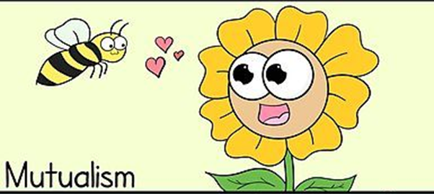
Mutualism: A symbiotic relationship between two species where both species benefit.

Slide 5
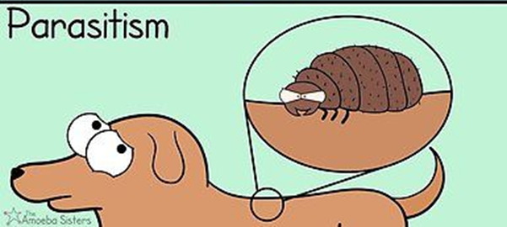
Parasitism: The relationship between different species where one organism lives on or in the other organism and benefits from it by causing some harm

Slide 6
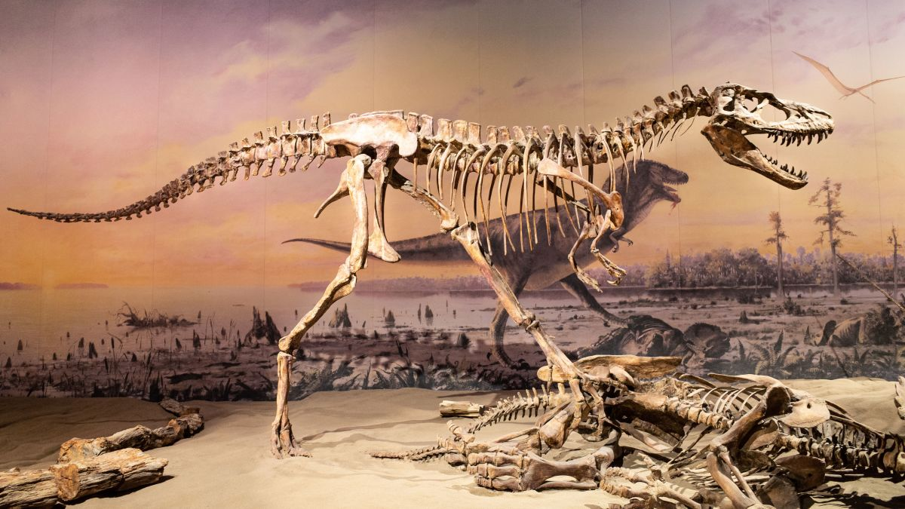
Species: A group of organisms that can reproduce naturally with one another and create fertile offspring.
Extinction: The disappearance of a species from Earth

Slide 7
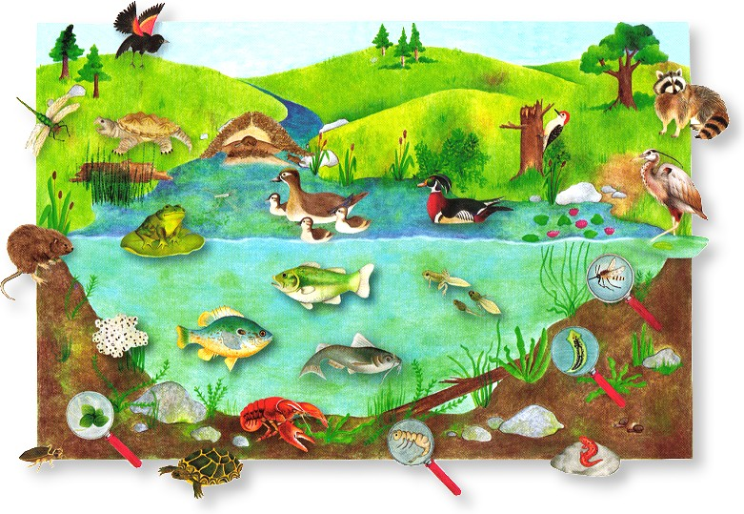
Habitat: Is a place where an organism live
Niche: An organism's role within an ecosystem

Slide 8
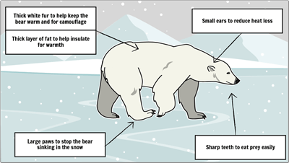
Adaptation: Changes in the form or behavior of an organism during life as a response to environmental stimuli

Slide 9
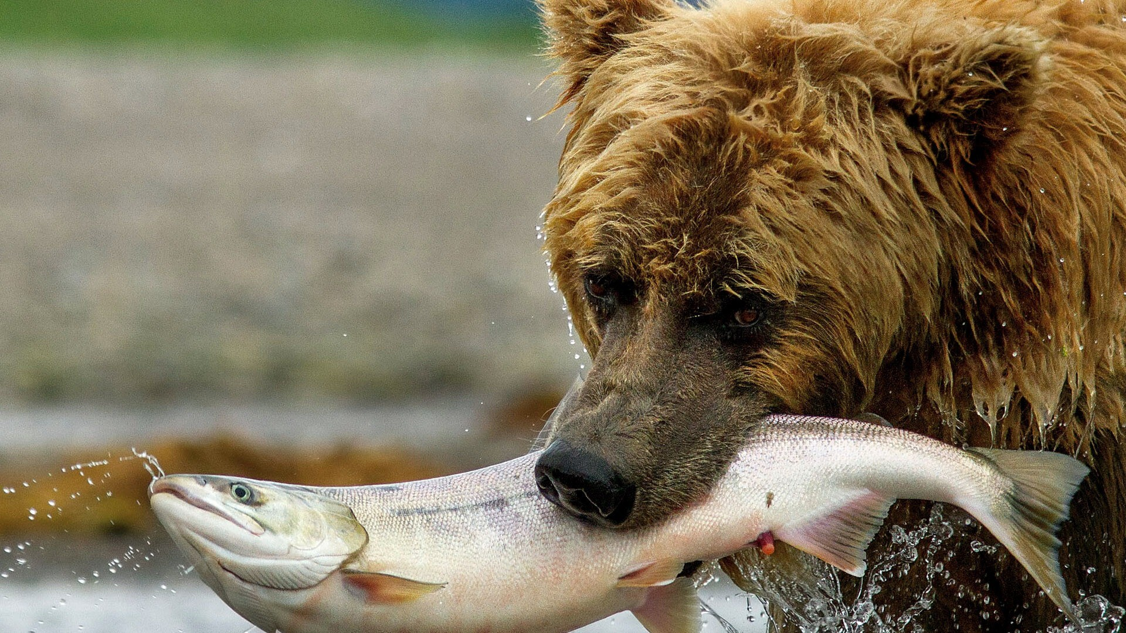
Predator: An organism that consumes other organisms
Prey: An organism consumed by another organism

Slide 10
Producers: Organisms that are able to make their own food
Consumers: Organisms that eat other organisms
Decomposer: An organism that decomposes, or breaks down, organic material such as the remains of dead organisms.

Slide 11
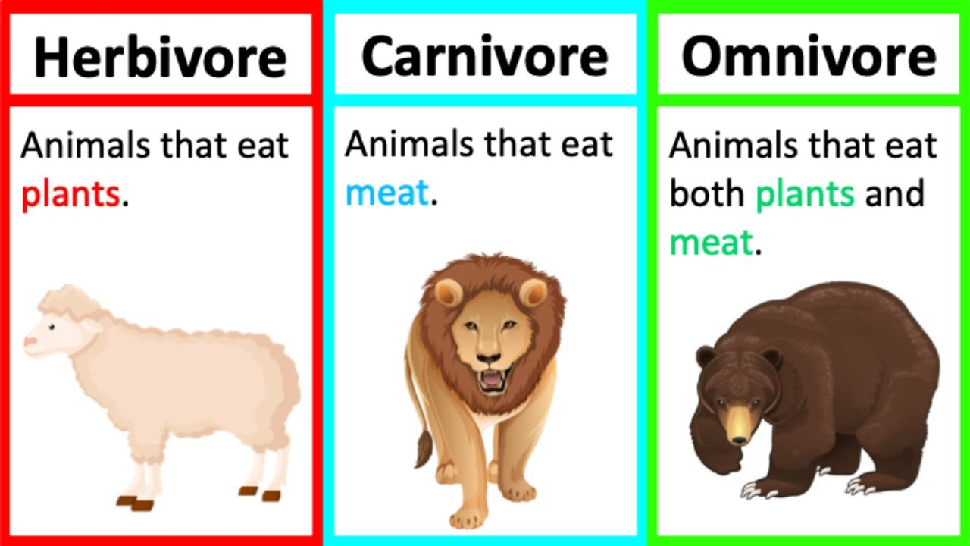
Herbivore: An organism that consumes plants
Carnivore: An organism that consumes meat
Omnivore: An organism that consumes both meat and plants
Detritivore: An organism that takes energy from dead or waste organic matter.

Slide 12
Assessment
Write the definitions of the following terms:
Symbiosis
Commensalism
Mutualism
Parasitism
Extinction
Herbivore
Carnivore
Omnivore

