Slide 1
Lung Volume and Lung Capacity
Asmaa Yaseen Mawlood
Med . Surg Nursing MSc. Student

Slide 2
Chemo video
Chemotherapy Basics (youtube.com)

Slide 4
Partial pressure abbreviations
P = pressure
PO2 = Partial pressure of oxygen
PCO2 = Partial pressure of carbon dioxide
PAO2 = Partial pressure of alveolar oxygen
PACO2 = Partial pressure of alveolar carbon dioxide
PaO2= Partial pressure of arterial oxygen
Paco2= Partial pressure of arterial carbon dioxide
PvO2= Partial pressure of venous oxygen
PvCO2= Partial pressure of venous carbon dioxide
P50 = Partial pressure of oxygen when the hemoglobin is 50%saturated.

Slide 5
Rate and depth of respiration

Slide 7
Characteristic of percussion sound

Slide 8
Normal Breath Sound

Slide 9
Video
Lung Sounds (Normal) Bronchial Bronchovesicular Vesicular | Breath Respiratory Sounds (youtube.com)

Slide 10
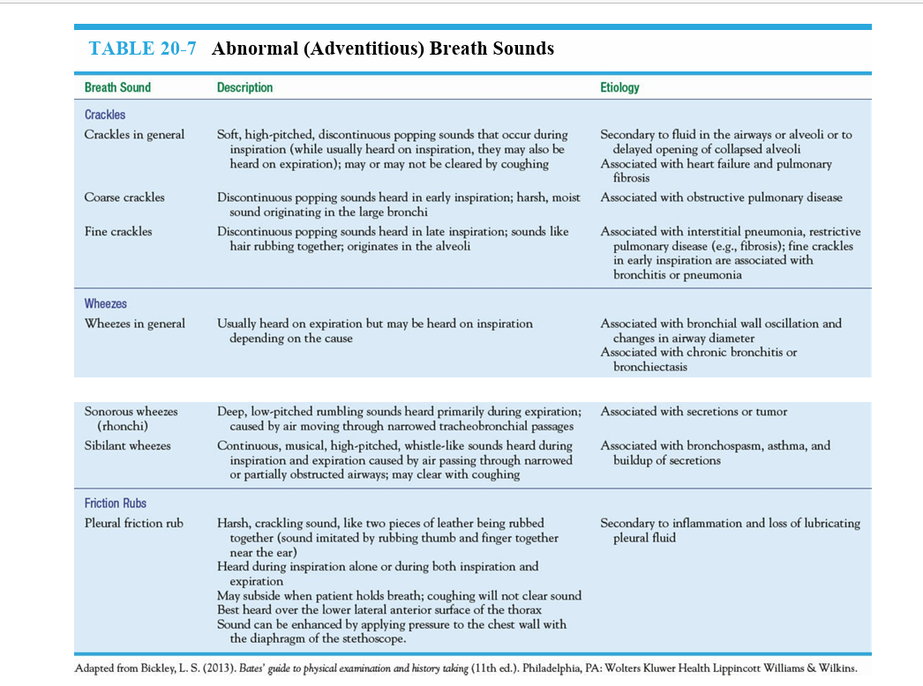

Slide 12
Video
Percussion & Auscultation of the Lungs - OSCE Guide | Clip (youtube.com)

Slide 14
Video
Oxygen Delivery Devices in 5 min (youtube.com)

