Slide 1

Market Segmentation
19th DEC 2023

Slide 2
Table of Content
What is Market Segmentation ……………………………………………………………………….... 1
The Benefits of Market Segmentation ……………………………………………………………… 2
Effective Segmentation ……………………………………………………………………………………. 3
Bases for Segmentation ………………………………………………………………...................... 4
Demographic Segmentation ……………………………………………………………………………. 5
Geographic Segmentation ……………………………………………………………………………….. 7
Psychographic Segmentation …………………………………………………………………………… 9
Behavioral Segmentation ………………………………………………………………………………… 10
References ……………………………………………………………………………………………………… 11

Slide 3

What is Market Segmentation
Market segmentation is the process of identifying market segments and dividing a broad customer base into sub-groups of consumers consisting of current and future prospective customers (Wind et al., 2014).
Market segmentation is a consumer-oriented process which can be applied to any type of market. Dividing or segmenting markets, researchers typically search for shared characteristics such as common interests, common needs, similar demographic profiles or even similar lifestyles (Wind et al., 2014).

Slide 4

The Benefits of Market Segmentation
Market segmentation is customer-oriented. Businesses will be able to identify their customer needs and wants and then decide if it is practical to develop a marketing mix to satisfy those wants and needs (Wind et al., 2014 and Camilleri, M. A. 2018 )
Management can do a better marketing job
Segmentation helps in developing strong positions in spealized market segment.
The management can respond quickly to any changes affecting demand in the market.

Slide 5
Effective Segmentation
Measurable (Size, purchasing power, profiles of segments can be measured).
Accessible (Can be Reached and served through suitable means of distribution of promotion)
Substantial (Segments are profitable enough to serve)
Differential (Segments must respond differently to different elements & programs of marketing mix).

Slide 6
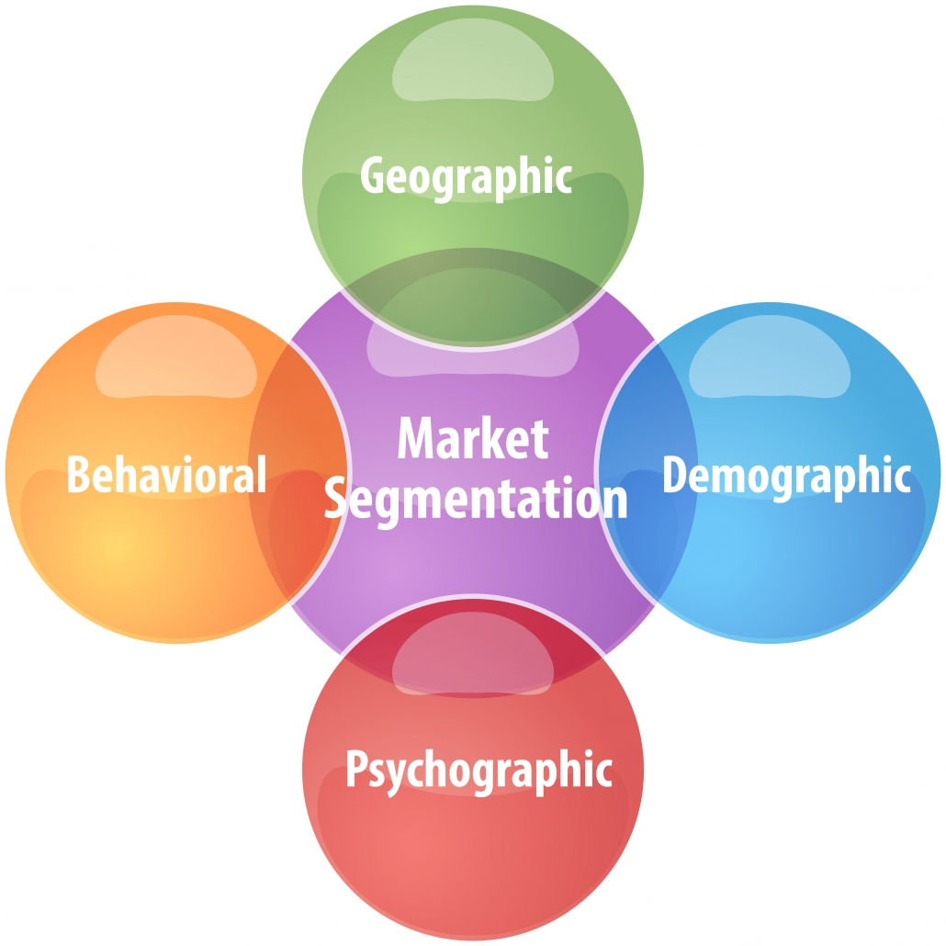
Bases for Segmentation
The traditional variables that are used for market segmentation can be grouped into the following main categories:
Demographic Segmentation
Geographic Segmentation
Psychographic Segmentation
Behavioral Segmentation

Slide 7
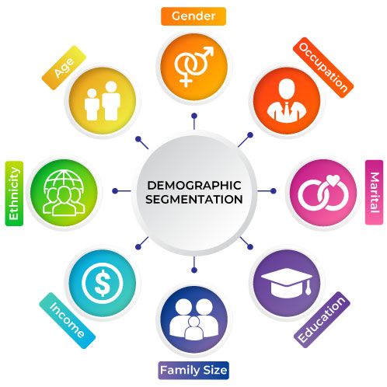
Demographic Segmentation

Slide 8
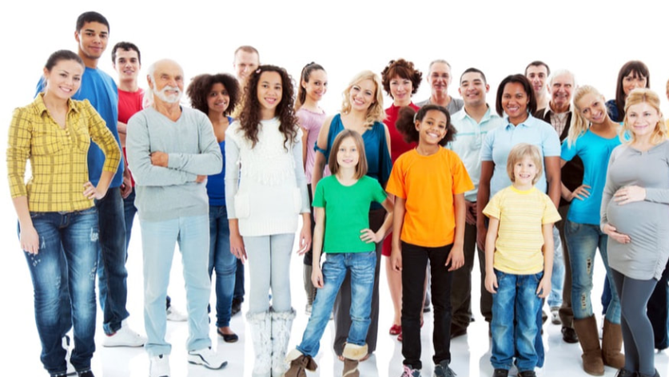
Demographic Segmentation
Demographic segmentation involves dividing the market into groups that are identifiable in terms of physical and factual data” (Camilleri, M. A. 2018 and McDonald & Dunbar, 2013).
The demographic variables include the following
Age (Based on age on can have the 1) Infants 2) Child Market Teen Market 3) Youth Market 4) Middle Aged Market 5)Elders Market
Gender (Based on gender basis, the consumer market may be grouped into female market & male market)
Income & social classes (Upper classes, Middle classes, Lower class)
Occupation (Engineers, doctors, nurses, data analyst,….etc.)
Marital status (Single, Married, divorced,…etc.)
Family size
Race (White, African, Asian, Middle eastern, … etc.)
Religion and nationality (Christian, Muslim, Jewish,… etc., Iraqi, British, Turkish, etc.).

Slide 9
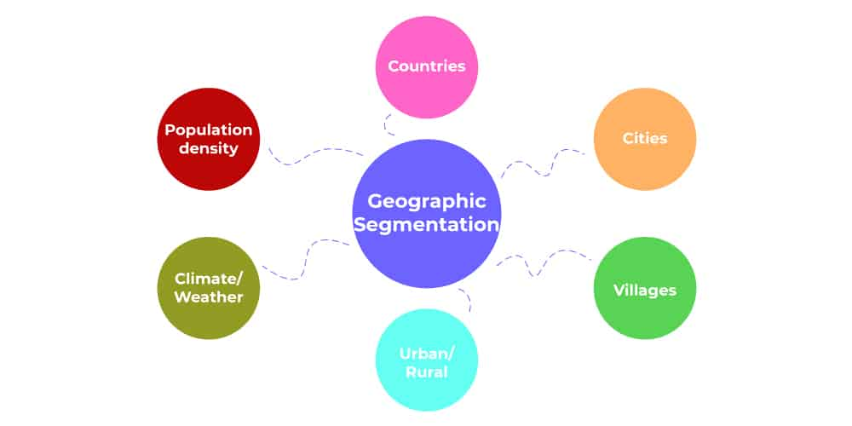
Geographic Segmentation

Slide 10

Geographic Segmentation
Geographic segmentation is based on selecting potential markets according to their locations. This segmentation approach may consider variables such as climate, terrain, natural resources, population density, countries, cities, Villages, and Urban/Rural areas (Camilleri, M. A. 2018).
Climate (Hot, cold, wet, and humid weather)
Cities (Erbil, Sulaymaniyah, Duhok, Baghdad, London, and Kuala Lumpur)
Population Density (Small & big population)
Countries (Iraq, Turkey, Canada, and United Kingdom)
Businesses that operate internationally often segment the market by continents/country/region in the first instance and then go for segmentation on other bases
Businesses that operate within national markets within a country like Iraq often segment the market according to the region, state, district, and urban/rural area in the first instance and then go for segmentation on other bases.

Slide 11
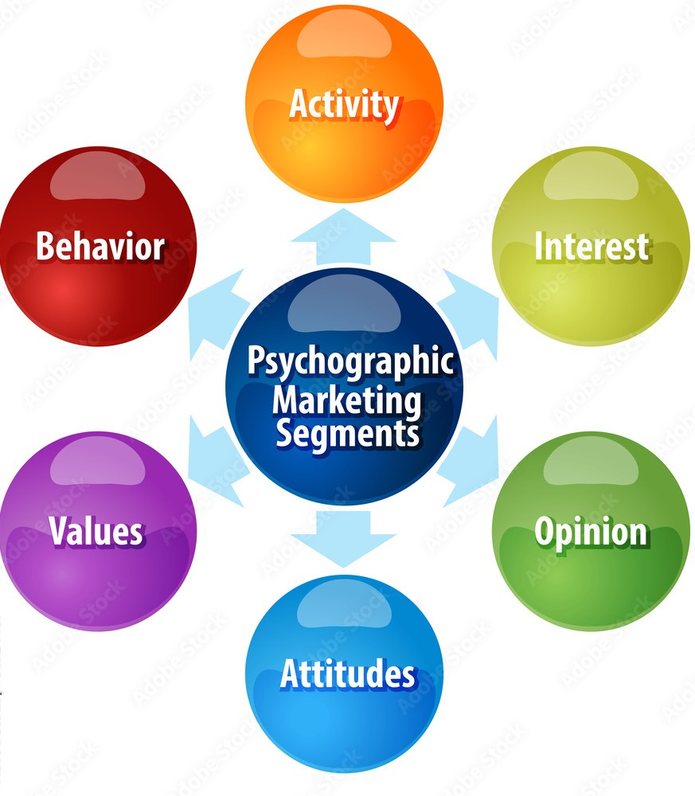
Psychographic Segmentation
Psychographic segmentation can be used to segment markets according to personality or social characteristics activates, values, motives, opinion, interests and lifestyles (Camilleri, M. A. 2018 and McDonald & Dunbar, 2013).
Lifestyle (Knowledge about lifestyle can provide a very rich and meaningful picture of a person)
Activities, Interests, and Opinions (It helps to indicate if the person is interested in outdoor sports, shopping, culture, or reading)
Many companies offer products and services based on beliefs, attitudes, and emotions of their target market.

Slide 12
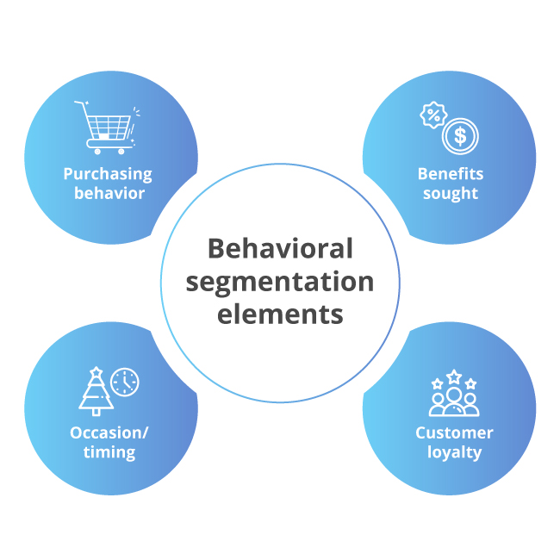
Behavioral Segmentation
Behavioral segmentation is defined as market segmentation based on individual purchasing behaviors. Behavior-based segmentation is prominent with the benefits sought from the product, with the identification of specific buying behavior in terms of shopping frequency and purchase volumes (Camilleri, M. A. 2018 and McDonald & Dunbar, 2013).
Usage occasion (festival occasions)
User Status (Ex-users, first users, regular users, Potential users)
Usage rate (Light, Medium, and heavy user segments)
Loyalty status (purchase frequency, customer loyalty)

Slide 13
References
Camilleri, M. A. (2018). Market Segmentation, Targeting and Positioning. In Travel Marketing, Tourism Economics and the Airline Product (Chapter 4, pp. 69-83). Springer, Cham, Switzerland.
McDonald, M. and Dunbar, I. (2013) Market segmentation: How to do it and how to profit from it. Chichester: John Wiley & Sons.
Wind, Y., Bell, D.R. and Sheth, J.N. (2014) Market segmentation. Los Angeles: SAGE Publications.

