Slide 1
NUTRITION
By
Dr. Muhammad Abdullah Shwani
Assistant professor/Consultant urologist
Kurdistan Higher Council of Medical Specialties (KHCMS)
drmalshwani@mail.com

Slide 2
Caloric Requirement
• Neonates 100 kcal/kg/day.
• Adults 40 kcal/kg/day.
• Adult with catabolism 60 kcal/kg/day.
It is given as:
Carbohydrates 50%.
Fat 30–40%.
Protein 10–15%.
Caloric values:
Carbohydrate 4 kcal/g.
Protein 4 kcal/g.
Fat 9 kcal/g

Slide 3
Indications for Nutritional Support
• Preoperative nutritional depletion.
• Postoperative complications: Sepsis, ileus, and fistula.
• Intestinal fistula: High type wherein output is >500 ml/day. It may be duodenal, biliary, pancreatic, intestinal, etc.
• Pancreatitis, malabsorption, ulcerative colitis, pyloric stenosis.
• Anorexia nervosa and intractable vomiting
• Trauma—Multiple, fasciomaxillary, head and neck.
• Burns.
• Malignant disease.
• Renal and liver failure.
• Massive bowel resection causing small bowel syndrome.

Slide 4
Nutritional need assessment
Body weight.
Upper arm circumference.
Triceps skin fold thickness.
Serum albumin.
Lymphocyte count.
Nutritional requirements: Carbohydrates, fat, proteins, vitamins (includes fat soluble vitamins also), minerals, trace elements.

Slide 5
Methods of Feeding
Enteral. Includes:
By mouth
By Nasogastric tube.
BY enterostomy (Gastrostomy and Jejunostomy).
Parenteral.
ENTERAL: By
Mouth: Requires
• Common sense.
• Cleanliness.
• Compassion

Slide 6
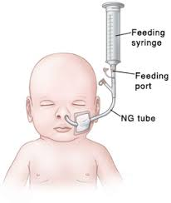
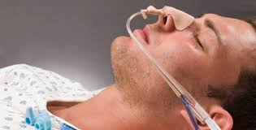
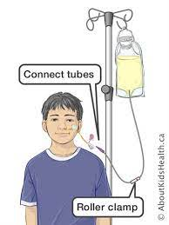
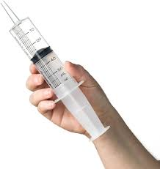
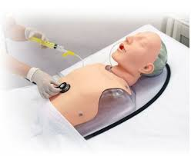
2.By nasogastric tube (NG)
Tube end in the stomach is confirmed by injecting 5 ml of air down the tube and listening through a stethoscope for its bubbling entry into the stomach.

Slide 7
3.By enterostomy
Gastrostomy.
Jejunostomy.

Slide 8
GASTROSTOMY
Indications :
• Severe malnutrition.
• Major surgeries.
• Severe sepsis.
• Trauma.
• Head and neck surgeries.
It is done if feeding is required for more than one month.

Slide 9
Types
Based on duration of use:
• Temporary.
• Permanent.
Based on lining:
• Mucus lined (Permanent).
• Serosal lined (Temporary).
Based on technique:
By open procedure
Percutaneous insertion

Slide 10
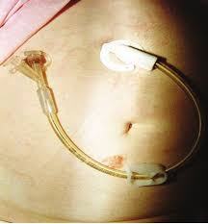

Slide 11
Contraindications
• Previous gastric surgeries.
• Intestinal obstruction.
• Gastric outlet obstruction

Slide 12
JEJUNOSTOMY
Jejunostomy for enteral nutrition becoming more popular because of:
— It’s comfort.
— Easy to do.
— Can be kept for a long time.
— Lesser complication than gastrostomy.
Indications are the same as gastrostomy.

Slide 13
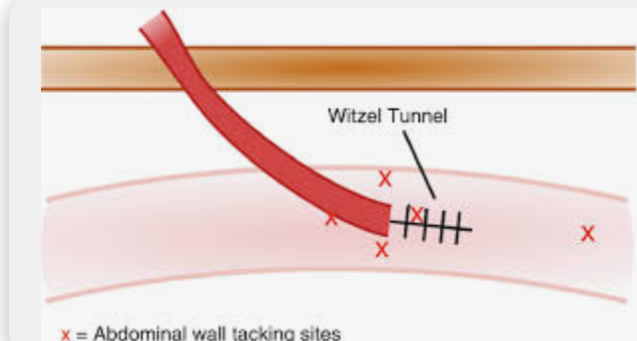
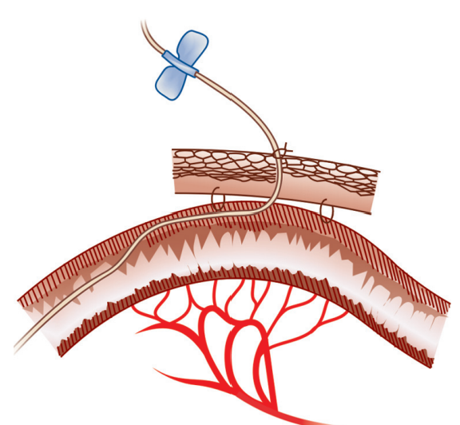
Types
Witzel jejunostomy: The site of placing jejunostomy is 30 cm from duodenojejunal junction.
Needle jejunostomy , using a catheter of small gauge.

Slide 14
Complications of enteral feeding
• Aspiration.
• Wound infection and leak.
• Diarrhea due to rapid feeding or hyperosmolarity.
• Hyperglycemia.
• Hypokalemia.
• Blockage.
• Nausea and vomiting.
• Hyperosmolarity.
• Tube discomfort.
• Cholestasis.

Slide 15
TOTAL PARENTERAL NUTRITION (TPN)
About 5% of hospital admissions require TPN.
Indications :
Failure or contraindication for any enteral nutrition.
High output abdominal fistulas—Duodenal, biliary, pancreatic.
3. Major abdominal surgeries of liver, pancreas, biliary, colonic.
4. Septicemia.
5. Multiple trauma.

Slide 16
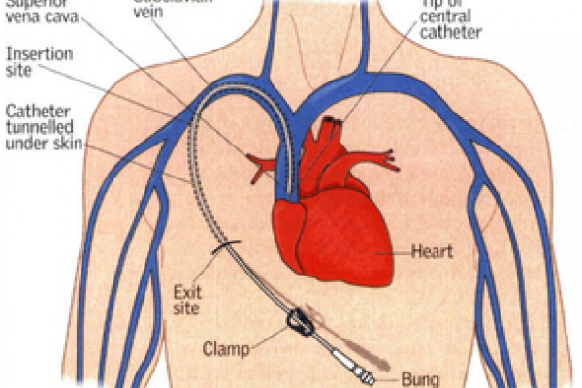
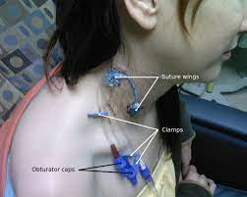
Technique
Using a needle and guidewire a subclavian vein catheter is passed just below the clavicle and fixed securely to the skin.
TPN is given through a central vein and not through a peripheral vein.

Slide 17
Components used in TPN
Carbohydrates.
Fat and amino acids.
Vitamins and trace elements.
The patient should be monitored at regular intervals with body weight, fluid balance, blood glucose, electrolytes, blood urea, LFT, serum calcium, magnesium, phosphate, etc.

Slide 18
Complications
Technical:
Air embolism
Pneumothorax.
Bleeding.
Catheter displacement, blockage.
Infection, sepsis
Thrombosis.
Biochemical:
• Electrolyte imbalance: hyponatremia, hypokalemia, hypophosphatemia.
• Hyperosmolarity.
• Hyperglycemia.
• Dehydration.

Slide 19
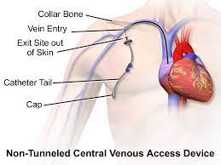
Contraindications
Cardiac failure.
Blood dyscrasias.
Altered fat metabolism

Slide 20
THANK YOU

