Slide 1
PESTEL Analysis
28th Nov 2023

Slide 2
Table of Contents
What is a PESTEL Analysis? …………………………………………………………………. 3
Application of PESTLE Analysis …………………………………………………………………………… 4
PESTEL analysis ………………………………………………………………………………………………… 5
Political Factors …………………………………………………………………………………………………. 6
Economic Factors ………………………………………………………………………………………………. 7
Social Factors …………………………………………………………………………………………………….. 8
Technological Factors ………………………………………………………………………………………… 9
Environmental Factors ………………………………………………………………………………………. 10
Legal Factors …………………………………………………………………………………………………….. 11
References ………………………………………………………………………………………………………… 12

Slide 3
What is a PESTEL Analysis?
A PESTEL analysis is a strategic framework commonly used to evaluate the business environment in which a firm operates.
PESTEL analysis examines the Political, Economic, Social, Technological, Environmental, and Legal factors in the external environment that can affect an organization (KARA, 2018 and Kolter, P and Armstrong, G 2018).

Slide 4
Application of PESTLE Analysis
PESTLE analysis is used by an organization to identify opportunities and threats in the external environment. By analyzing these factors, organizations can develop strategies that align with the external environment (KARA, 2018 and Kolter, P and Armstrong, G 2018).

Slide 5
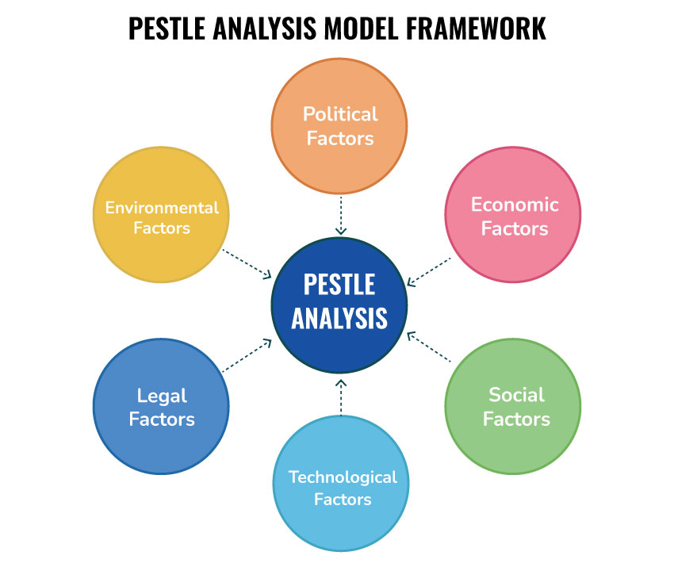
PESTEL Analysis
A PESTEL analysis is an acronym for
P Political Factors
E Economic Factors
S Social Factors
T Technological Factors
E Environmental Factors
L Legal Factors

Slide 6
Political Factors
These determine the extent to which government and government policy may impact on an organization or a specific industry. This would include political policy and stability as well as trade, fiscal and taxation policies too (Corporate Finance Institute 2023). They include.
Corporate taxation
Other fiscal policy initiatives
Free trade disputes
Example: A multinational company closes several facilities in a higher tax jurisdiction in order to relocate operations somewhere with lower tax rates and/or greater state funding and grant opportunities.

Slide 7
Economic Factors
An economic factor has a direct impact on the economy and its performance, which in turn directly impacts on the organization and its profitability (Kolter, P and Armstrong, G 2018). Economic factors include.
Interest rates
“Business cycles and differential economic growth rates around the world”
Inflation
Exchange rate
Raw material costs
Example: Airlines are under the pressure to cope up with the increasing fuel prices. These factors made it difficult to generate profits.

Slide 8
Social Factors
This section focuses on the social environment and identifying emerging trends. This helps a marketer to further understand consumer needs and wants in a social setting (Kolter, P and Armstrong, G 2018). Social factors include.
Changing family demographics
Education levels
Cultural trends
Consumer beliefs
Example: “There are a great number of elderlies in the society. Elderly tends to eat less which may have influence on the sales growth. They are unlikely to go shopping in supermarkets compared with the younger generation” (Rashid, 2023).

Slide 9
Technological Factors
Technological factors focuses on the rate of technological innovation and development that may affect a market or industry (Rashid, 2023). Technological Factors include.
Internet
Developments in Artificial Intelligence (AI)
Automation
Research and Development
Example: “The use of the Internet through online grocery retailing influences on the operation of supermarkets, which shows a slightly growth” (Rashid, 2023).

Slide 10
Environmental Factors
Environmental factors are those that are influenced by the surrounding environment and the impact of ecological aspects. This element is becoming more central to how organizations need to conduct their business (Rashid, 2023). Environmental factors include.
Carbon footprint
Climate change
Government environmental policies and initiatives
Example: Fuel is a very major expenditure of the airline industry and airlines are required to invest more in environmentally friendly and fuel-efficient aircraft (Lufthansa group 2022, Redpath et al., 2017 and Federal Aviation Administration 2015 ).

Slide 11
Legal Factors
Legal factors are those that emerge from changes to the regulatory environment, which may certain industries, businesses within a specific sector. Legal Factors include (Rashid, 2023).
Industry regulation
health and safety legislation
Employment and consumer protection laws
Example. Airlines are made responsible for air crashes or any other type of damage or disaster (Federal Aviation Administration 2016).

Slide 12
References
Engine emissions certification (2016) Engine Emissions Certification | Federal Aviation Administration. Available at: https://www.faa.gov/air_traffic/noise_emissions/emission_certification (Accessed: 27 November 2023).
KARA, E. (2018) ‘A contemporary approach for Strategic Management in tourism sector: Pestel analysis on the city Muğla, Turkey’, Journal of Business Research - Turk, 10(2), pp. 598–608. doi:10.20491/isarder.2018.446.
Kotler, P., Armstrong, G. and Opresnik, M.O. (2018) Principles of Marketing. Singapore: Pearson Education South Asia Pte Ltd.
Lufthansa Group (2022) Climate & environment, Lufthansa Group. Available at: https://www.lufthansagroup.com/en/responsibility/climate-environment.html (Accessed: 27 November 2023).
Pestel analysis (2023) Corporate Finance Institute. Available at: https://corporatefinanceinstitute.com/resources/management/pestel-analysis/ (Accessed: 27 November 2023).
Rashid, C.A. (2023) ‘Pestel analysis and Porter’s five forces as marketing tools to evaluate Morrison’s performance and strategy’, Journal of Global Social Sciences, 4(15), pp. 75–83. doi:10.58934/jgss.v4i15.187.
Redpath, N., O’Connell, J.F. and Warnock-Smith, D. (2017) ‘The strategic impact of Airline Group Diversification: The cases of emirates and Lufthansa’, Journal of Air Transport Management, 64, pp. 121–138. doi:10.1016/j.jairtraman.2016.08.009.
What we do (2015) What we do | Federal Aviation Administration. Available at: https://www.faa.gov/about/mission/activities (Accessed: 27 November 2023).

