Slide 1
Situation analysis I: The 5 Cs (Company, Customers, Competitors, Collaborators, and Climate )
Week 4
31 Oct 2023

Slide 2
Table of Contents
Situational Analysis …………………………………………………………………….. 3
Importance of Situational Analysis ……………………………………………... 5
Situational Analysis Analytical Methods ……………………………………… 6
5Cs analytical Method ………………………………………………………………... 7
Company ……………………………………………………………………………………. 8
Collaborators ……………………………………………………………………………… 9
Customers ………………………………………………………………………………….. 10
Climate or Context ……………………………………………………………………… 12
References …………………………………………………………………………………. 13

Slide 3
Situational Analysis
What is a Situational Analysis?
Situation analysis refers to a phase of strategic planning in which An organization uses analytical tools to assess the current state of a business environment.
A business will often need to perform a situation analysis before embarking on a new initiative, marketing strategy, or business plan.

Slide 4
Situational Analysis
What does Situational Analysis involve?
A situation analysis involves examining the external environmental factors and internal organizational capabilities that impact how a company operates.

Slide 5
Situational Analysis
Why Is Situation Analysis Important?
It helps a business to determine its competitive advantage: a situation analysis helps identifying a businesses' strengths, weaknesses, opportunities for growth, and the obstacles that could be standing in its way.
It helps a business to identify areas of potential growth: Each company has room for improvement. Situation analysis helps a business to clarify those potential areas of growth and provide a framework for setting and achieving goals.
Can improve efficiency and reduce waste: A situation analysis ensures that initiatives, plans, and strategies stay focused on areas that will add value to the organization and reduce the likelihood of redundancies or unproductive tangents.

Slide 6
Situational Analysis
There are different methods typically used to complete a situational analysis:
5Cs Analysis
SWOT Analysis,
PESTEL Analysis
Porter five forces Analysis.

Slide 7
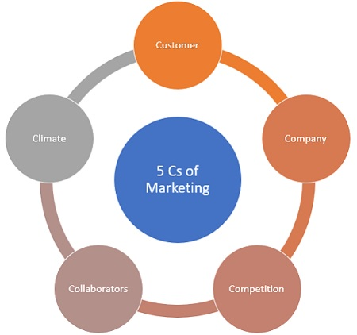
5Cs Analysis
5C Analysis is a marketing framework that is used to analyze the environment in which a business operates. 5C Analysis provides insight into the key drivers of success, as well as the risk exposure to various environmental factors.
The 5Cs Include 5 elements
Company,
Collaborators,
Customers,
Competitors, and
Context or Climate

Slide 8
5C - Situational Analysis
Company
This section focuses on many internal factors that are related to the marketing and sales of our business products and services offered to our customers. Some key elements include:
Competitive advantages. What competitive advantages does our business have? What does our company do better than others? What does our conpany do worse than others?
Brand image. What makes our brand unique or memorable?
Products. Do our products vary from competitors' products? If so, in what ways? What does our business sell or offer? List major product lines or types.
Goals. What are our 1, 3, and 5-year goals for this business?

Slide 9
5Cs Analysis
Collaborators
The collaborators section focuses on every individual or organization that works to create, produce, promote or sell a business products or services. It includes:
Suppliers. Who are our suppliers?
Distributors. Who is our shipping provider? Do we have anyone distributing or selling our products for us?
Business partners. Do we have a partner that helps run our business? Do we have investors or stakeholders?
Service providers. Do we work with any freelancers or contractors?

Slide 10
5Cs - Situational Analysis
Customers
This section focuses on the people who buy your business’ products or services. It involves knowing:
Target audience. Who is our target audience? Is my overall audience growing or shrinking?
Customer behavior. How do our customer make purchase decisions to satisfy their needs, wants, or desires?
Customer motivation. What motivates our customers to purchase (price, quality, convenience, unique product benefit, etc.)?
Communication channels. What are my channels of communication with my customers?
Market size. Is our market growing or shrinking?
Frequency of purchase. What sorts of products or services are sold most/least frequently? How many repeat purchases do my customers make? How important are repeat purchases to my business model?

Slide 11
Competitors
The competitors section focuses on those individuals and organizations to which your company is highly comparable in the market.
Competitor strategies and tactics. What strategies are my competitors using to gain customers? What do our competitors offer that our business don’t?
Competitor strengths. What are each of our competitors' biggest strengths?
Competitor weaknesses. What are each of our competitors' biggest weaknesses?
Emerging competition. Who are our direct competitors in the same market? Which are new or emerging competitors in the market? Which are the established competitors?

Slide 12
5Cs - Situational Analysis
Context or Climate
This section concentrates on external factors that aren't controlled by our own business and influence our business performance. Some elements are:
Laws and Regulations. Are there any new or proposed laws or regulations that may affect our business? If so, how do we plan to address them?
Economic trends. Are there any economic trends that might influence customer shopping behavior?
Social and behavioral trends. Are there any social trends that may affect the things that people buy or the way people buy them?

Slide 13
References
Kotler, P., & Keller, K.L. (2017). Marketing menadžment, 15 izdanje, Data Status, Beograd.
Kotler, P. (2003), Marketing management, 13th ed. India: Prentice hall
Straková, J. et al. (2018) ‘Situational analysis and its role in the process of Strategic Business Management’, Polish Journal of Management Studies, 18(1), pp. 353–364. doi:10.17512/pjms.2018.18.1.26.
Frynas J.G., Mellahi K., 2011, Global strategic management, New York, Oxford University Press Inc.
Mullins, J.W. and Walker, O.C. (2013) Marketing management: A strategic decision-making approach. New York: McGraw-Hill.

