Slide 1
Principle of suturing
By
Dr. Muhammad Abdullah Shwani
Assistant professor/Consultant urologist
Kurdistan Higher Council of Medical Specialties (KHCMS)
drmalshwani@mail.com

Slide 2
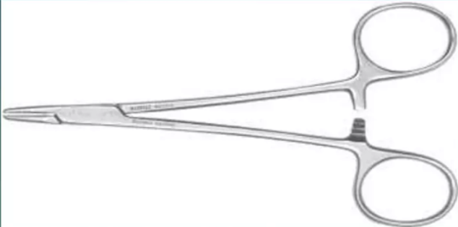
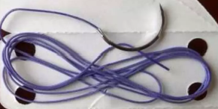
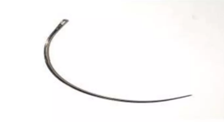
Armamentarium of suturing
Needle holder
A suture needle
Suture material

Slide 3
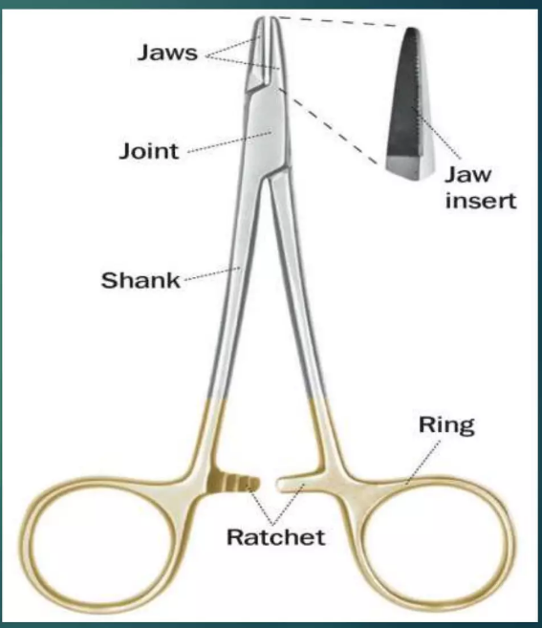
Needle holder
Parts:
Working tip/jaw
Hinge /joint
Shank/body
Catch mechanism/ratchet
Grip area/Ring

Slide 4
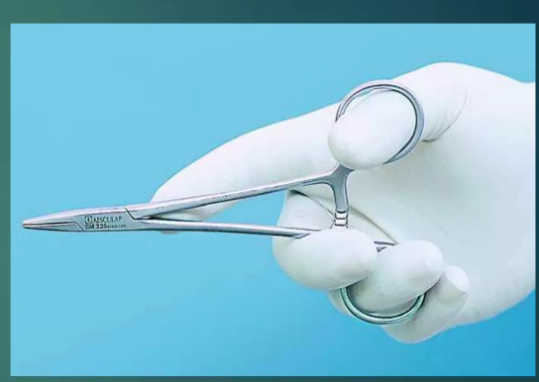
Needle holder
How to hold ?
The needle holder is held with thumb & ring finger through the rings & with the index finger along the length of needle holder to provide stability & control.

Slide 5
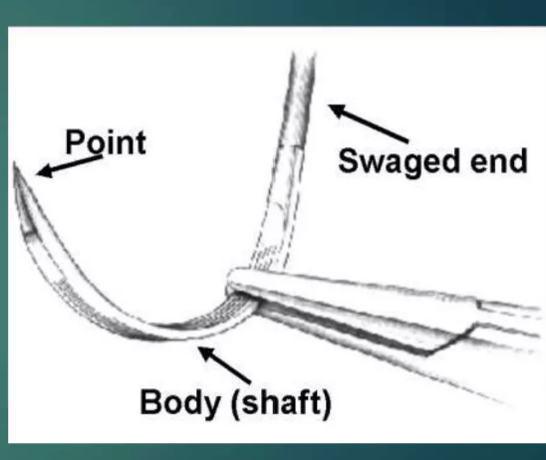
A suture needle
Made up of either SS(stainless steel) or carbon steel.
Parts
Tip/point
Body /shaft
Eye/swaged end

Slide 6
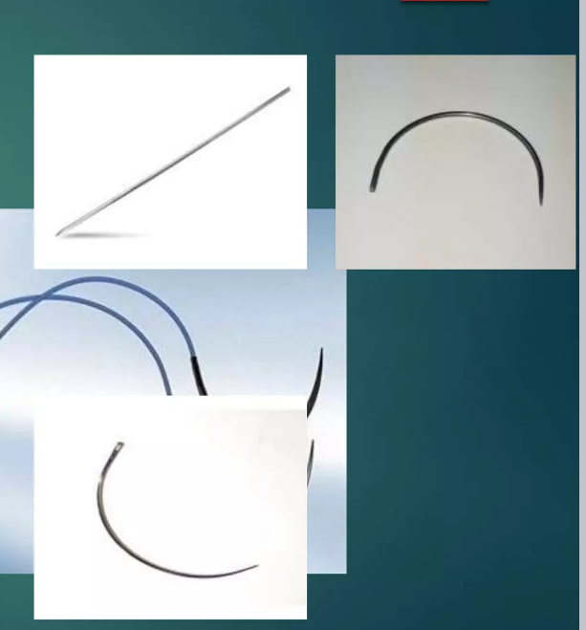
Classification of needle
According to Shape
Straight
Curved
According to the eye:
Eyed needle/Traumatic
Eyeless needle/Atraumatic

Slide 7
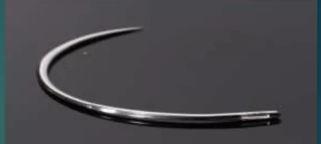
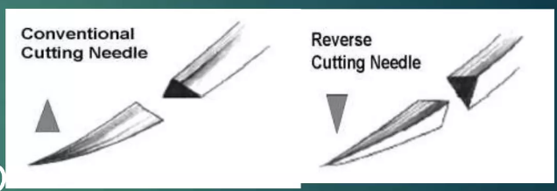
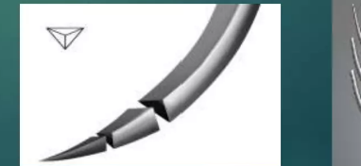
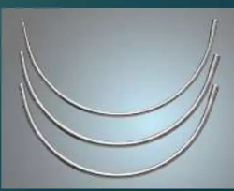
Classification of needle
According to cutting edge
Round body
Cutting body-
Conventional
Reverse cutting
According to its tip
Triangular
Round
Blunt

Slide 8
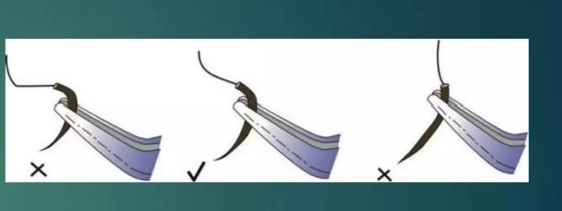
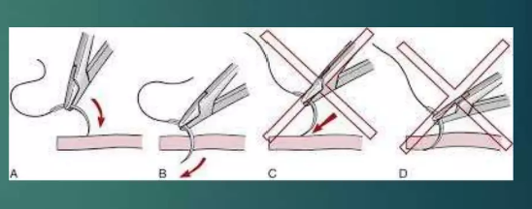
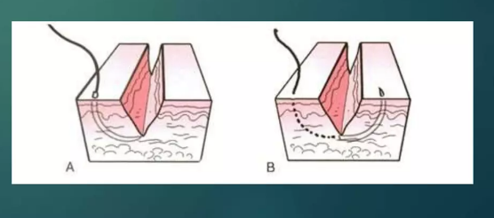
Principle of suturing
The needle should be grasped at approximately 1/3 of the distance from the eye & 2/3 from the point.
The needle should be pierced the tissue perpendicular to its Surface.
The needle should be placed equidistant (3- 4mm) from the incision line.

Slide 9
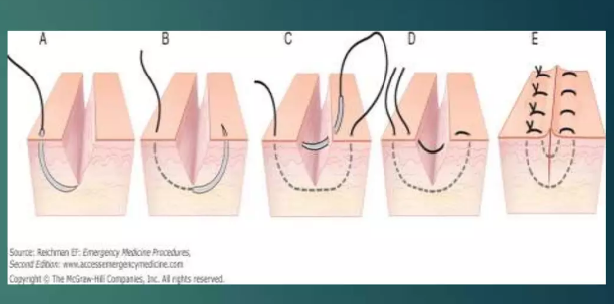
Principle of suturing
The depth of penetration should be equal on both sides of the incision line.
The needle always passes from
The movable tissue to the fixed tissue.
Thinner tissue to the thicker tissue.
Deeper tissue to the Superficial tissue.

Slide 10
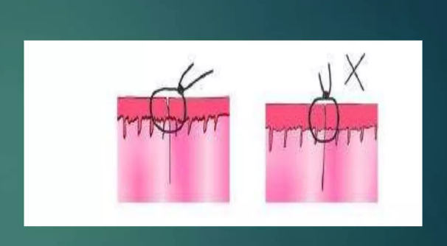
Principle of suturing
The tissue never be closed under tension.
Each suture must be placed 3-4 mm apart from the incision line.

Slide 11
Types of Suturing
Interrupted suture.
Continuous suture.
Mattress suture.
Figure of 8(eight) sutures.
Subcuticular suture.

Slide 12
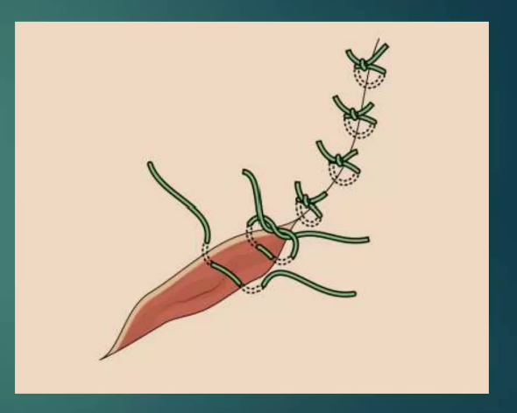
Interrupted suturing
Use
closure of wound after –
Single tooth extraction.
3rd molar extraction.
Biopsy.
Dental implant.

Slide 13
Interrupted suturing
Advantages :
Simple
Performed in urgent situations
Easy to remove
Disadvantage:
Failed to bring all surfaces in contact
Less supportive for healing

Slide 14
Technique for interrupted sutures

Slide 15
Continuous suturing
Continuous sutures are of 3 types
Simple continuous suture.
Locking continuous suture.

Slide 16
Simple continuous sutures
Well-approximated wounds with minimal tension.
Advantage:
Rapid technique for closure.
Even distribution of tension over the suture Line

Slide 17
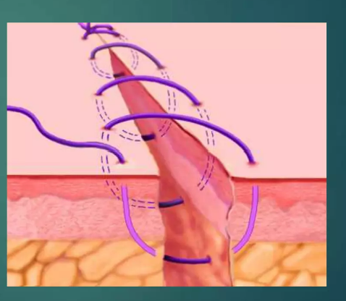
Simple continuous Sutures
Disadvantage:
Shouldn't be used in areas of existing tension.
Not possible to free a few sutures at a time.
When one suture breaks it affects the whole closure.

Slide 18
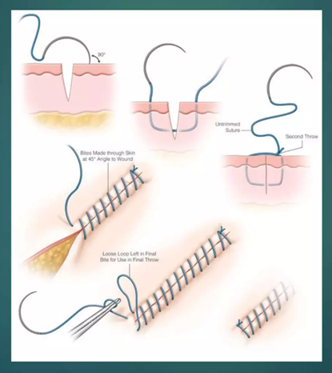
Technique for Simple continuous Sutures

Slide 19
Looking continuous sutures
Uses
Long edentulous areas.
Tuberosities/retromolar areas
Advantage
Avoid the multiple knots of the interrupted Suture

Slide 20
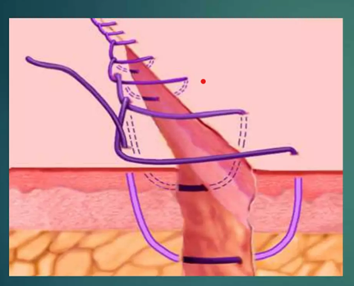
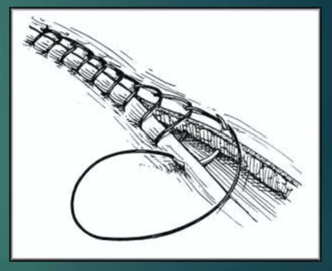
Looking continuous sutures Technique

Slide 21
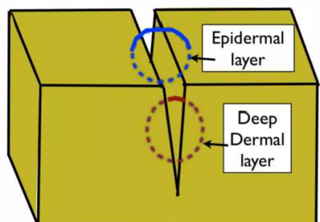
Layered closure
Wounds that involve only the skin are often best closed with a single layer of interrupted suture
In case of deep wounds, tissue should be closed in layers to remove dead space & and confer strength to the wound
The technique of layered closures involves closing the deeper tissues first, usually with a continuous suture & then closing the skin with interrupted sutures.

Slide 22
Mattress sutures
This suture may be-
Horizontal.
Vertical.

Slide 23
Horizontal mattress sutures
Advantage
Provides a broad contact of the wound margin.
Provides a water tight closure
Disadvantage
If improperly used bone necrosis & Wound dehiscence may occur due to limited blood supply.

Slide 24
Horizontal mattress sutures

Slide 25
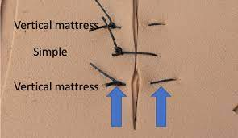
Vertical mattress sutures
It is similar to the horizontal mattress except the depth of penetration, i.e. when the needle is brought back from the second flap to the first, the depth of penetration is more superficial.

Slide 26
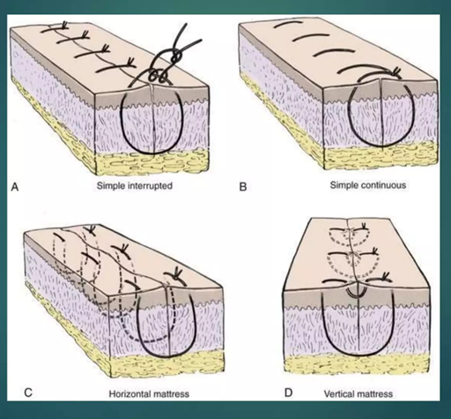
vertical mattress sutures
Uses:
Closing deep wounds abdomen or hip.
Advantage:
decreasing the dead space & providing increased strength.
doesn't interfere with healing
Disadvantage:
Approximation is difficult.

Slide 27
Figure of 8(eight) suture
Most commonly used for extraction socket closure as well as adaptation of gingival papilla around the tooth.

Slide 28
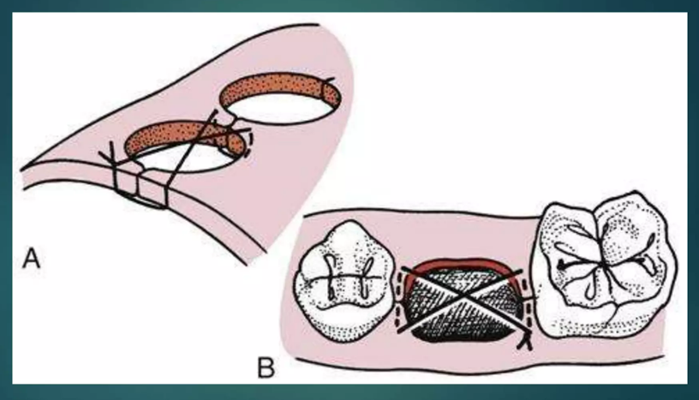
Figure of 8(eight) suture
Advantage
Rapid closure
Disadvantage:
Due to its orientation, it is difficult to remove & it leaves a significant amount of suture threads inside the socket

Slide 29
Subcuticular suture
Usually a running stitch, but can be interrupted
Intradermal horizontal bites.
Allow suture to remain for a longer period of time without the development of crosshatch scaring.
Uses:
Simple, uncomplicated wound

Slide 30
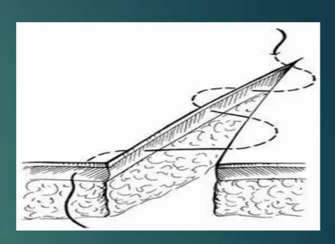
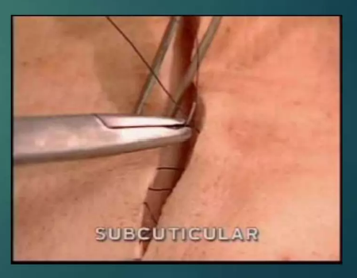
Subcuticular suture
Advantage:
Excellent cosmetic closure.
No stitch to remove.
Disadvantage:
Technically more difficult to master.
Doesn’t hold in thin skin

Slide 31
Surgical Knots

Slide 32
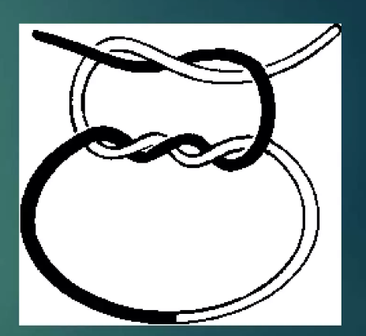
Surgical Knots
Sutured knot has 3 Components
Loop-Created by knot.
Knot- itself which is Composed of a number of tight throws.
Ears-which are the cut ends of the Suture.

Slide 33
Principles of knot tying
Use the simplest knot that will prevent slippage.
Tying the knot as small as possible & Cutting the end of the suture as short as possible to minimize foreign body reaction.
Avoid friction or sawing.
Avoid excessive tension.
Avoid tying sutures too tightly to strangulate the tissues.
Maintenance of traction at one end of the suture after the first loop is thrown.
Placing the final throw at horizontally as possible to keep the knot flat.

Slide 34
Different types of knot
Secure/square knot.
Surgeons knot
Granny's knot/slip knot.

Slide 35
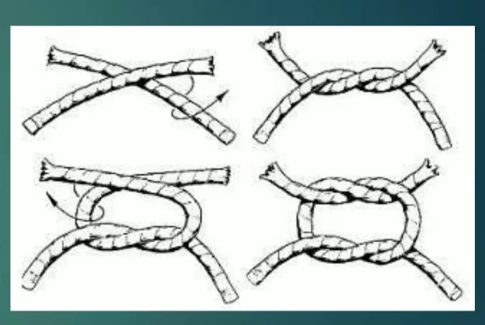
Square knot

Slide 36
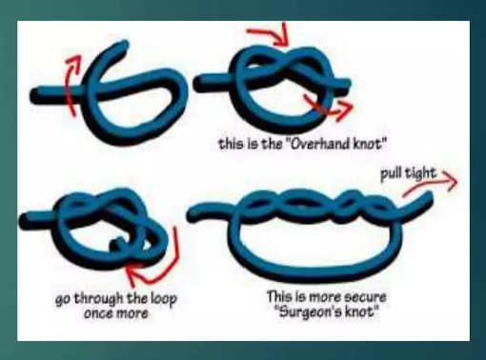
Surgeons knot

Slide 37
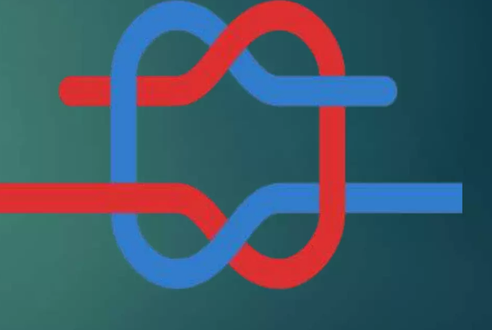
Granny's knot

Slide 38
Overview

Slide 39
Removal of suture
All sutures, being foreign bodies, cause irritation to the tissues & hence have the potential to cause scarring.
Skin sutures are removed as soon as tissue healing allows.
Non-absorbable sutures are best removed from the face after a period of 5-6 days. Tissues such as the scalp may require a longer period(7-10 days).

Slide 40
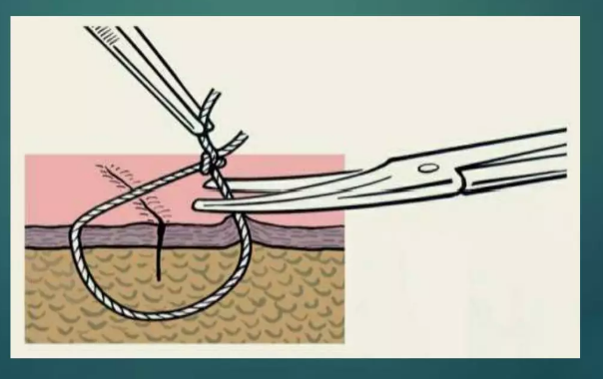
When the sutures should be removed
Face 3-5 days.
Scalp 7-10 days
Lip 3-5.
Chest 10-14 days
Oral cavity 6-8 days.
Abdomen 10-14 days
Neck 5-6 days.
Leg 10-14 days

Slide 41
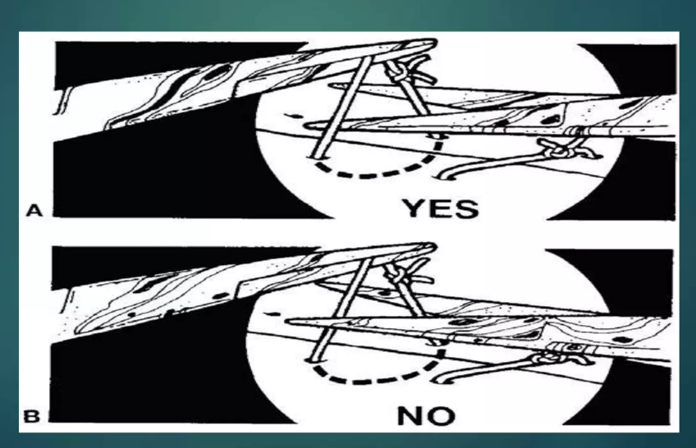
Principle of suture removal

Slide 42
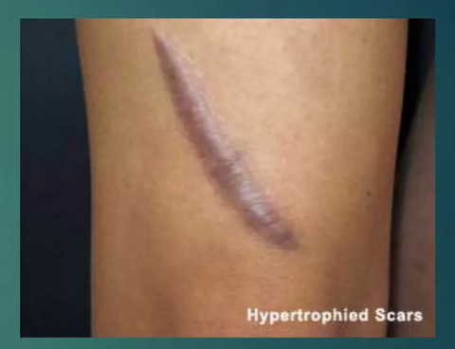
Possible complications of leaving sutures for many days
Sutural abscess.
a Scar or stitch mark
Dermoid cyst.

Slide 43
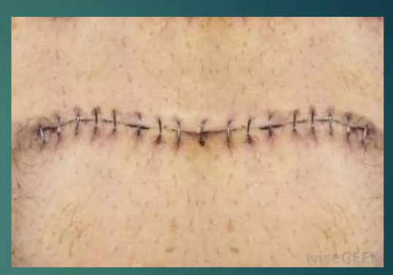
Alternatives to suture
Staples
Tissue adhesives
Tape
Disadvantages:
Not an absolute alternative to mechanical means
More tissue reaction

Slide 44
THANK YOU

