Slide 1
SWOT Analysis
Week 5
7th NOV 2023

Slide 2
Table of Contents
SWOT Analysis ………………………………………………………………………………………………….. 3
SWOT Analysis – Internal Factors ……………………………………….................................. 6
SWOT Analysis – External Factors ……………………………………………………………………… 8
SWOT Analysis – Example ………………………………………………………………………………... 10
References ………………………………………………………………………………………………………. 11

Slide 3
SWOT Analysis
SWOT Analysis is an analysis tool used to evaluate the Strengths, Weaknesses, Opportunities and Threats involved in an organization, a project, plan, program, or any kind of business activities (Kumar C.R et al., 2023)
SWOT Analytical tool is used for strategic planning and strategic management in organizations (Božić V 2023)
SWOT Analysis can be used to effectively build organizational strategy and competitive strategy (Božić V 2023).

Slide 4
SWOT ANALYSIS
SWOT analysis focuses on two organizational Environments factors
First: Internal environmental Factors, in which the organization itself and can control it (Strength and Weakness)
Second: External environmental factors. Factors that are existed outside the organization and can not control it (Opportunity and Threats).

Slide 5
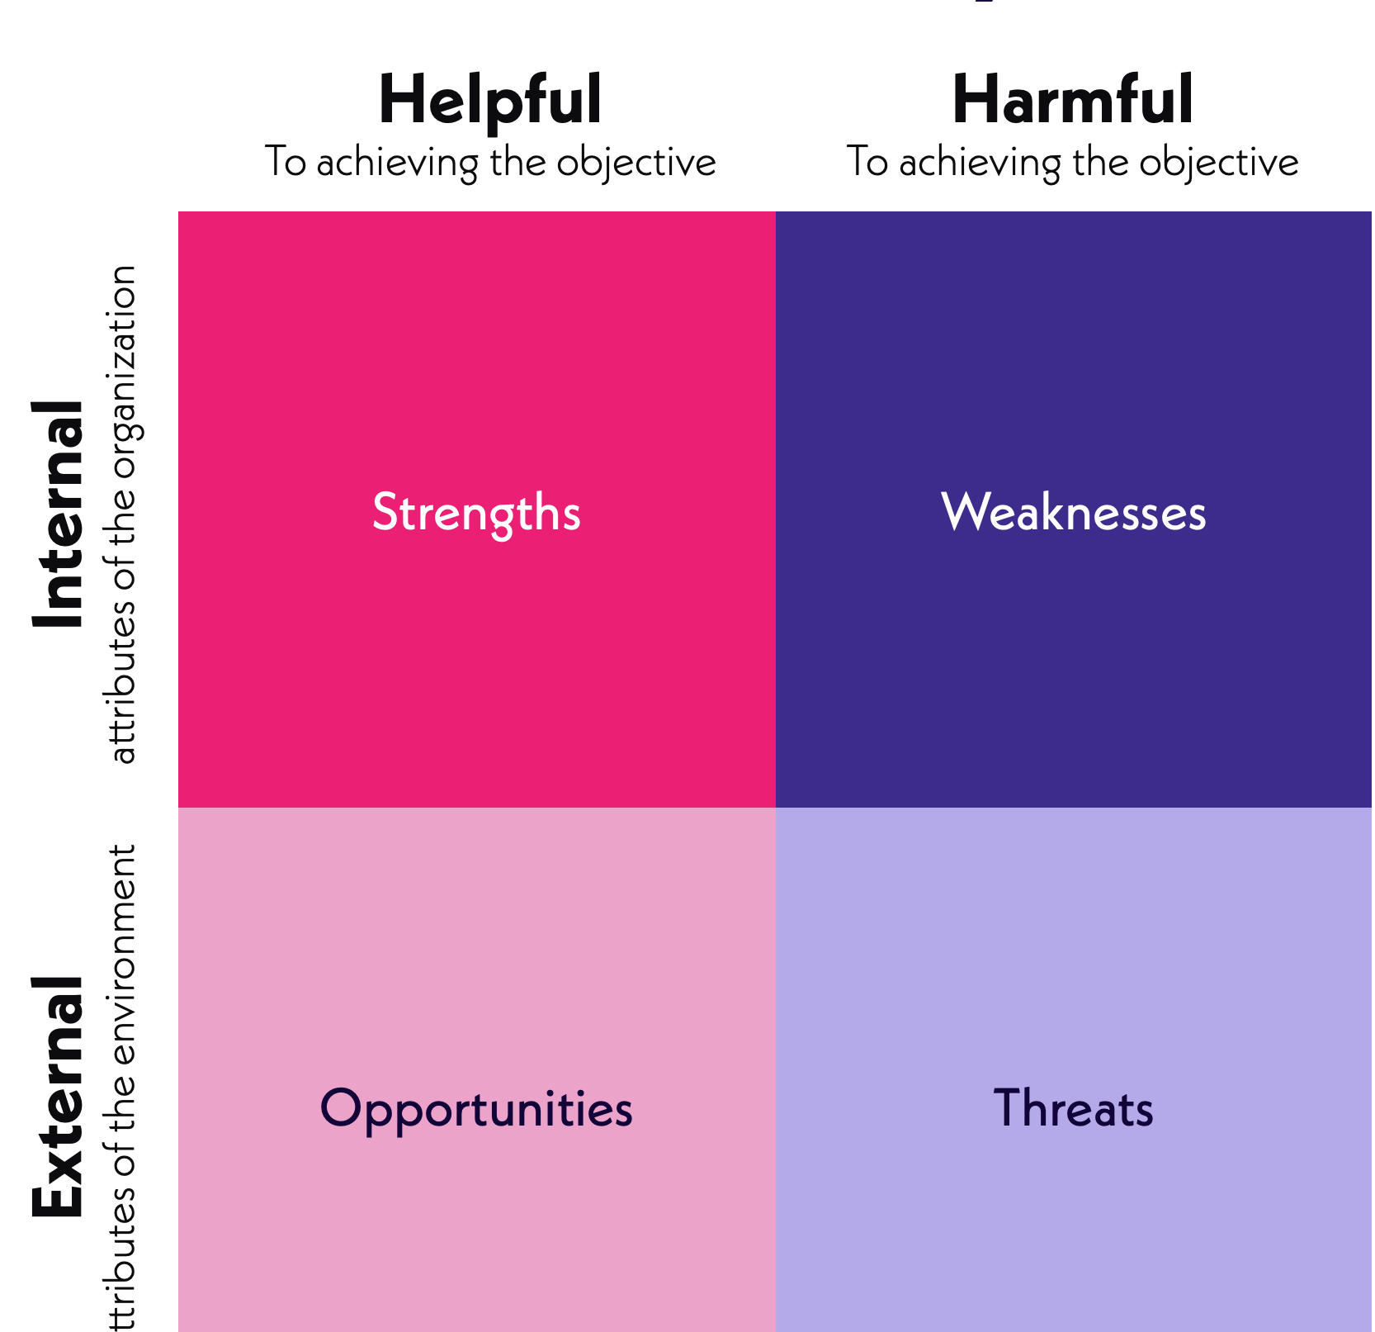
SWOT Analysis
S Strength
W Weakness
O Opportunities
T Threats
SWOT is an acronym for:-

Slide 6
SWOT Analysis – Internal Factors
The Elements of an organization internal environment are Strength and Weakness
Strength: “Strength is the characteristic that adds value to something and makes it more valuable than others. Strength means that something is more advantageous when compared to something else. In this sense, strength refers to a positive, favorable and creative characteristic. Strength at organizational level involves properties and abilities by which an organization gains an advantage over other organizations and competitor organizations that are revealed as a result of the analysis of its internal environment. In other words, organizational strength defines the characteristics and situations in which an organization is more effective and efficient compared to their competitors” (Kumar C.R et al., 2023 and Panteleiev, 2023).

Slide 7
SWOT Analysis – Internal Factors
Weakness: “Weakness refers to not having the form and competency necessary for something. Weakness means that something is more disadvantageous when compared to something else. In this regard, weakness is a characteristic that is negative and unfavorable. Weakness at organizational level refers to the situations in which the current existence and ability capacities of an organization are weaker compared to other organizations and competitor organizations. In other words, organization weakness means the aspects or activities in which an organization is less effective and efficient compared to its competitors” (Kumar C.R et al., 2023).
There are some common internal factors:
Financial resources (funding, sources of income and investment opportunities)
Human resources (employees, volunteers and target audiences)
Current processes (employee programs, department hierarchies and software systems)
Physical resources (location, facilities and equipment)

Slide 8
SWOT Analysis – External Factors
External forces influence and affect every company, organization and individual.
Opportunity: Opportunity is a major favorable situation in the environment within the organization as well as outside of the organization. These arise when an organization can take benefit of conditions in its environment to plan and execute strategies that enable it to become more profitable.
Threats: Threats are considered external elements in the environment that may cause problems for the company and major unfavorable situations in the environment. Threats are out of the organization control.

Slide 9
SWOT Analysis – External Factors
External factors are typically things a company do not control, such as the following:
Economic trends (local, national and international financial trends)
Funding (donations, legislature and other sources)
Demographics
Relationships with suppliers and partners
Political, environmental and economic regulations
Market trends (new products, technology advancements and shifts in audience needs)

Slide 10
SWOT Analysis - Example
Strengths A Company current available resources (Staff, budlings, website, and finance) Strong Brand Image (Qatar Airways, Lufthansa, Apple) Strong Customer Services Strong Financial Support (Support from government) | Weakness lacking resources (Staff shortages, sources of funds) Poor Customer Services (Long wait times, Ignoring customer feedback) Lack of research and information.
Opportunities New emerging technologies (Artificial intelligence) New customer segmentation (Targeting young customers) New targeted markets (Targeting markets internationally & regionally) | Threats Political Conflicts (Russia & Ukraine war) Economic Trends (Inflation) (Rapid change in currency exchange rate – Iraqi dinar against US$) Diseases (Coronavirus) Earthquakes

Slide 11
References
Božić, Velibor. (2023). Objectifying SWOT and PESTLE Analysis in Hospital. 10.13140/RG.2.2.18907.34086.
Kumar C.R, S. and K.B, P. (2023) ‘SWOT analysis’, International Journal of Advanced Research, 11(09), pp. 744–748. doi:10.21474/ijar01/17584.
Panteleiev, V. (2023) ‘Application of SWOT analysis to justify the strategy of Hotel Business Enterprises’, Technology audit and production reserves, 1(4(69)), pp. 14–19. doi:10.15587/2706-5448.2023.274918.

