Slide 1
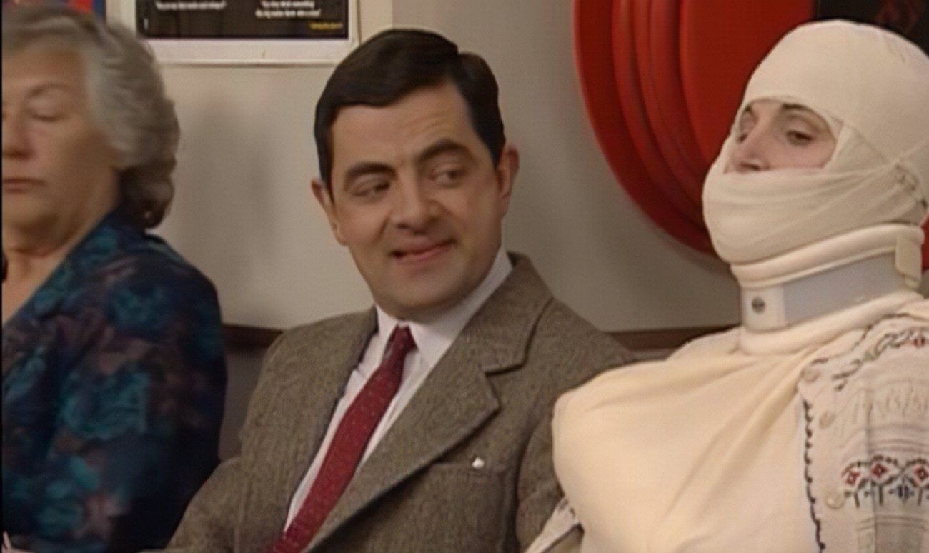
The Patient in a Cast
Asmaa Yaseen
Medical Surgical Nursing II – Lab

Slide 2
Casts
A cast is a rigid external immobilizing device that is molded to the contours of the body.
The cast must fit the shape of the injured limb correctly to provide the best support possible.
A cast is used to immobilize a reduced fracture, to correct or prevent a deformity (e.g., clubfoot, hip displacement), apply uniform pressure to underlying soft tissue, or support and stabilize weakened joints.

Slide 3
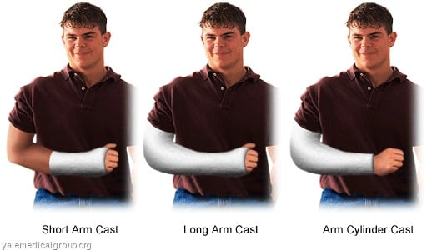
Casts can be divided into three main groups:
Arm casts, leg casts, and body or spica casts:
Short-arm cast: Extends from below the elbow to the palmar crease, secured around the base of the thumb. If the thumb is included, it is known as a thumb spica or gauntlet cast.
Long-arm cast: Extends from the axillary fold to the proximal palmar crease. The elbow usually is immobilized at a right angle.

Slide 4
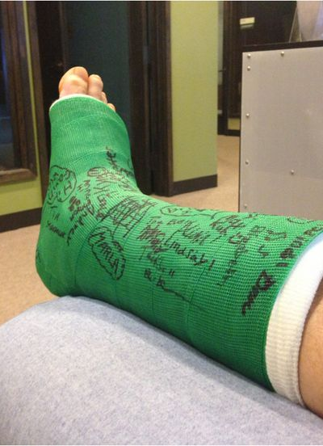
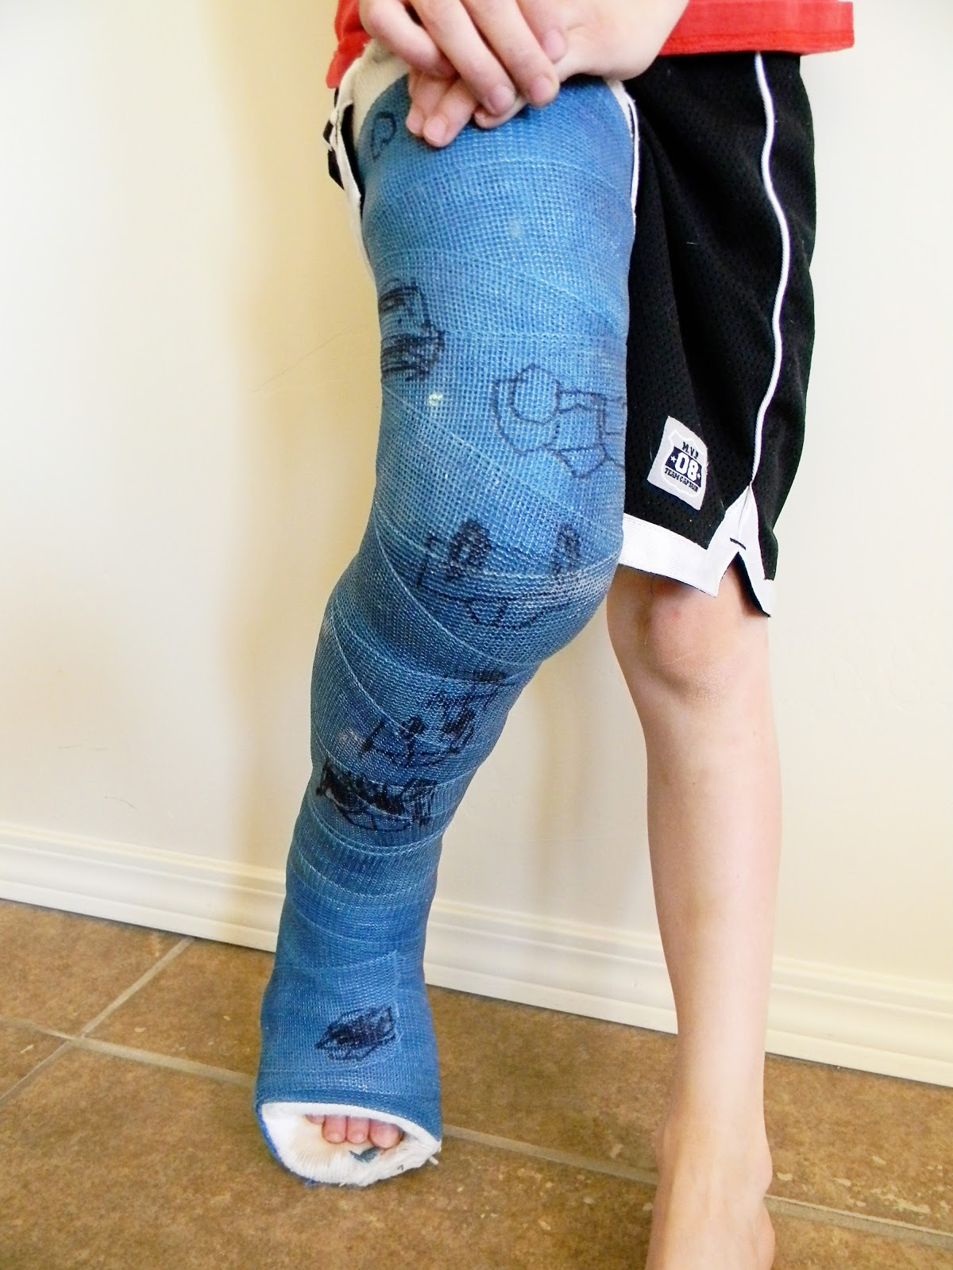
Con.
Short-leg cast: Extends from below the knee to the base of the toes. The foot is flexed at a right angle in a neutral position.
Long-leg cast: Extends from the junction of the upper and middle third of the thigh to the base of the toes. The knee may be slightly flexed.

Slide 5
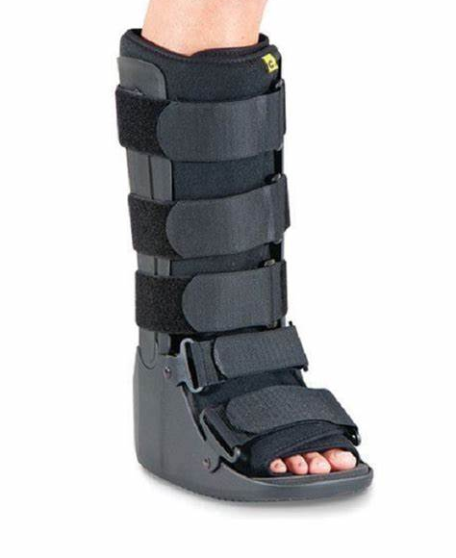
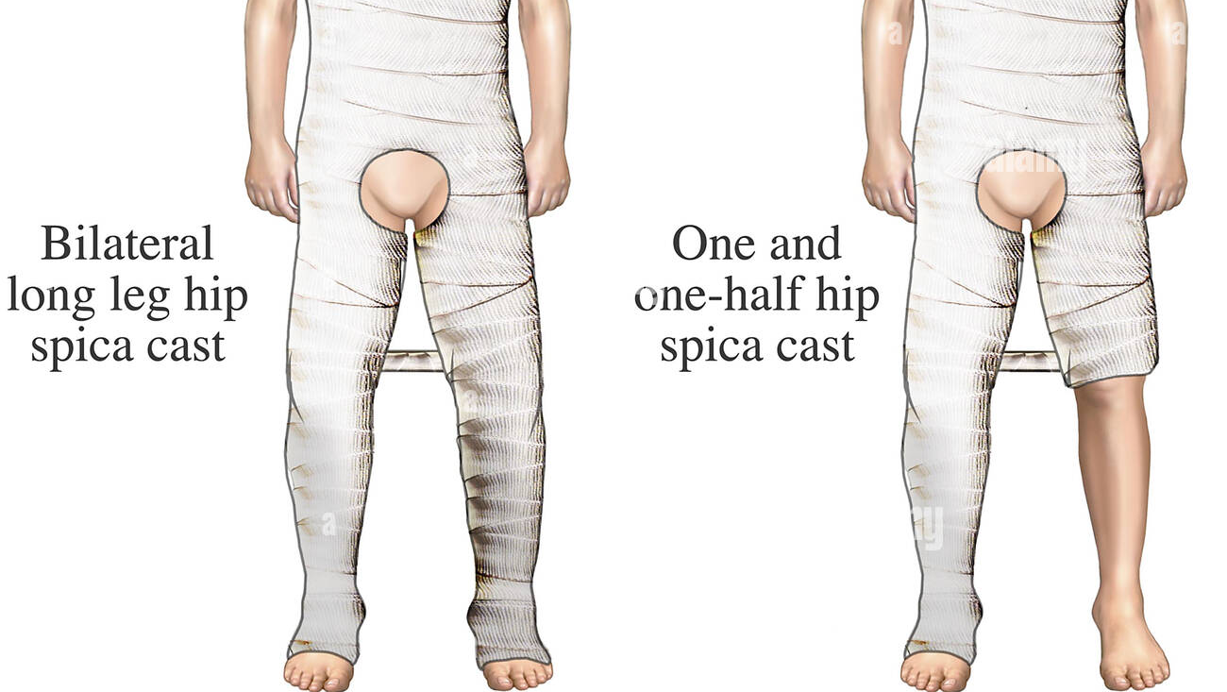
Con.
Walking cast: A short- or long-leg cast reinforced for strength Body cast: Encircles the trunk Shoulder spica cast: A body jacket that encloses the trunk, shoulder, and elbow
Hip spica cast: Encloses the trunk and a lower extremity. A double hip spica cast includes both legs.

Slide 6
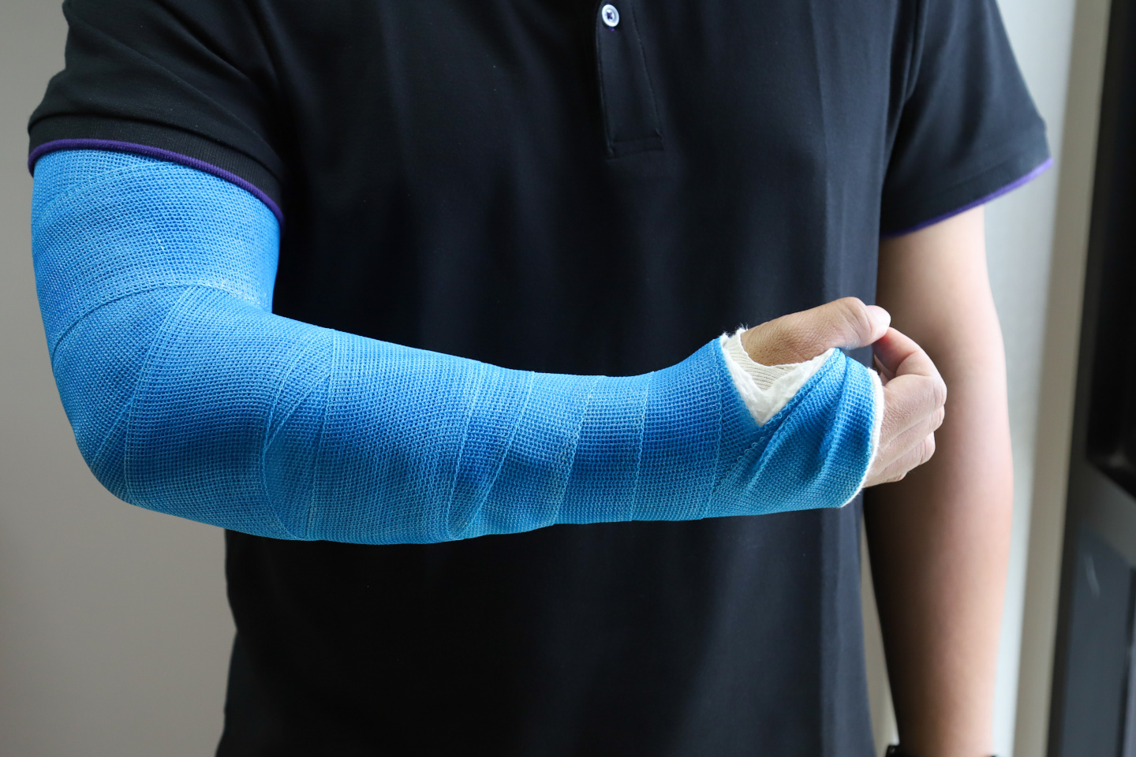
Fiberglass Casts
Fiberglass casts are composed of polyurethane resins that have the versatility of plaster but are lighter in weight, stronger, water resistant, and more durable than plaster.
In addition, fiberglass casts facilitate radiographic imaging better than plaster (AAOS, 2015a) and have the benefit of reaching full rigidity within 30 minutes of application.

Slide 7
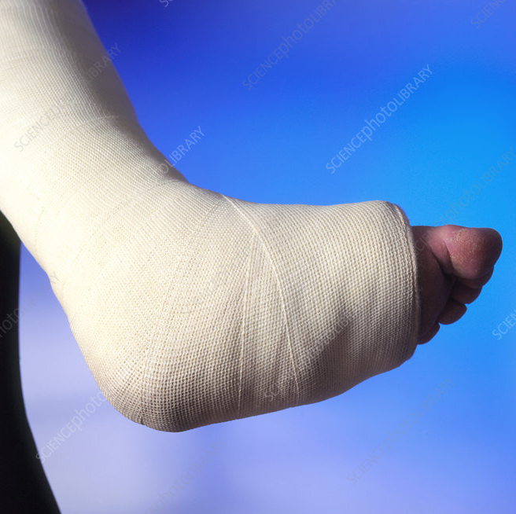
Plaster Casts
Casts made of plaster of Paris are less costly and achieve a better mold than fiberglass casts; however, they are heavy, not water resistant, and can take up to 24 to 72 hours to dry post application.

Slide 8
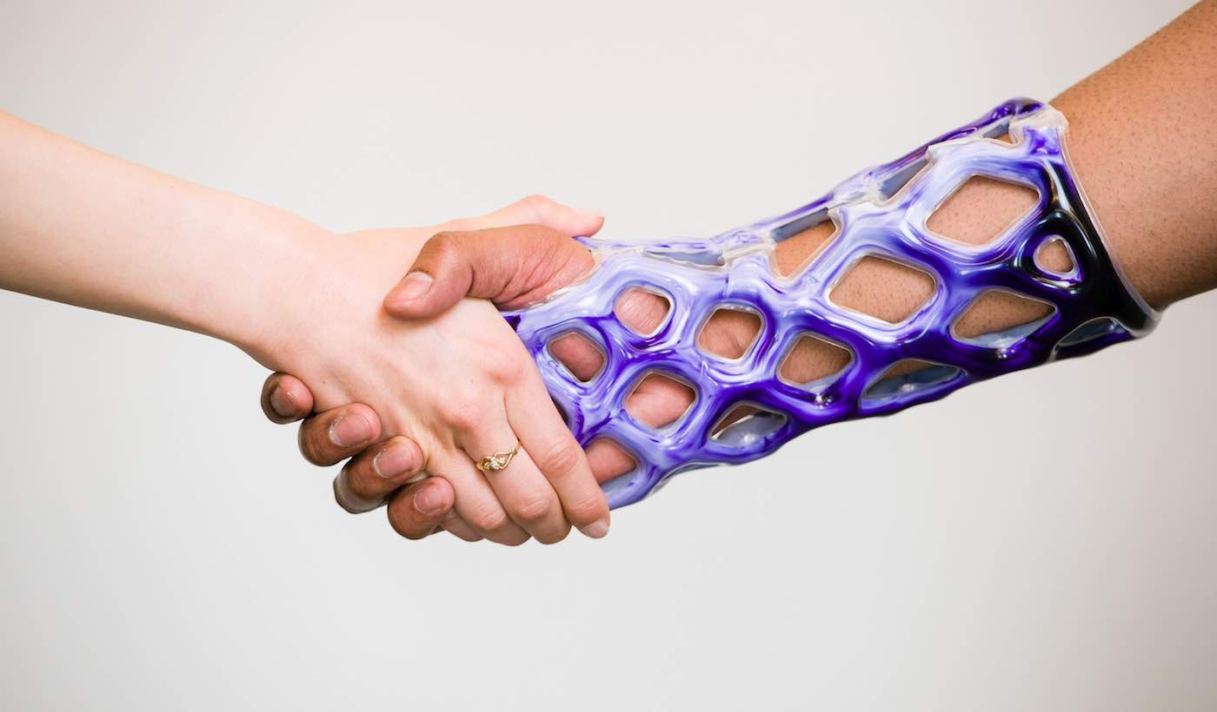
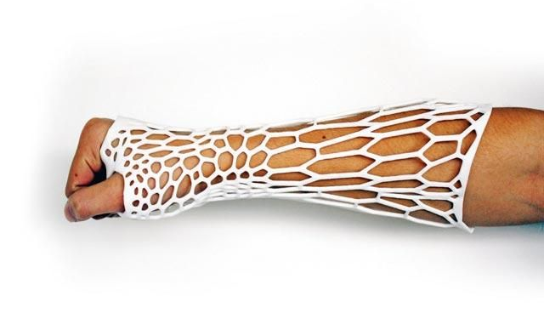
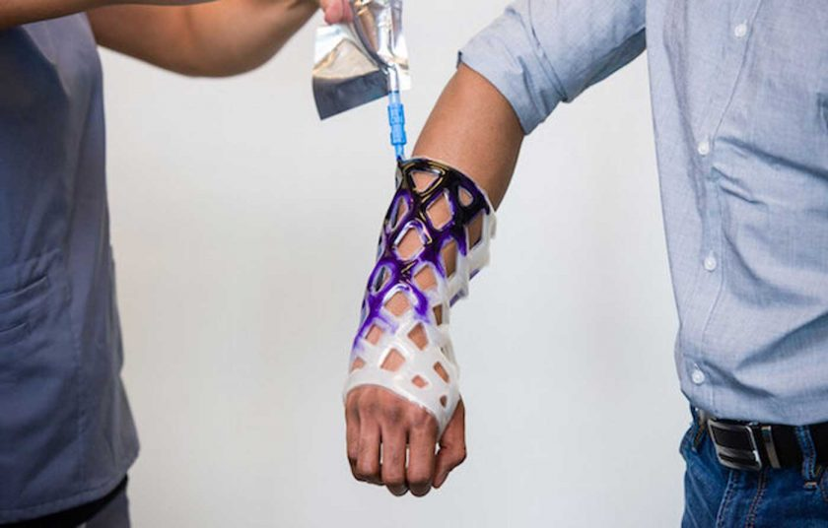
Cast21

Slide 9
Nursing Management of a Patient in a Cast
Before the cast is applied, the nurse completes an assessment of the patient’s general health, presenting signs and symptoms, emotional status, understanding of the need for the device, and condition of the body part to be immobilized.

Slide 10
Con.
Physical assessment of the part to be immobilized must include a thorough assessment of the skin and neurovascular status (i.e., neurologic and circulatory functioning), including the degree and location of swelling, bruising, and skin abrasions.

Slide 11
Con.
To promote healing, any skin lacerations and abrasions caused the fracture must be treated before the cast is applied.
The nurse thoroughly cleanses the skin and treats it as prescribed.
The patient may require a tetanus booster if the wound is dirty and if the last known booster was given more than 5 years ago.
Sterile dressings are used to cover the injured skin.
If the skin wounds are extensive, an alternative method (e.g., external fixator) may be chosen to immobilize the body part.

Slide 12
Con.
Assessments are performed at least every hour for the first 24 hours and every 1 to 4 hours thereafter to prevent neurovascular compromise related to edema and/or the device.

Slide 14
Monitoring and Managing Potential Complications
Such as :
compartment syndrome,
pressure ulcer formation,
and disuse syndrome.

Slide 15
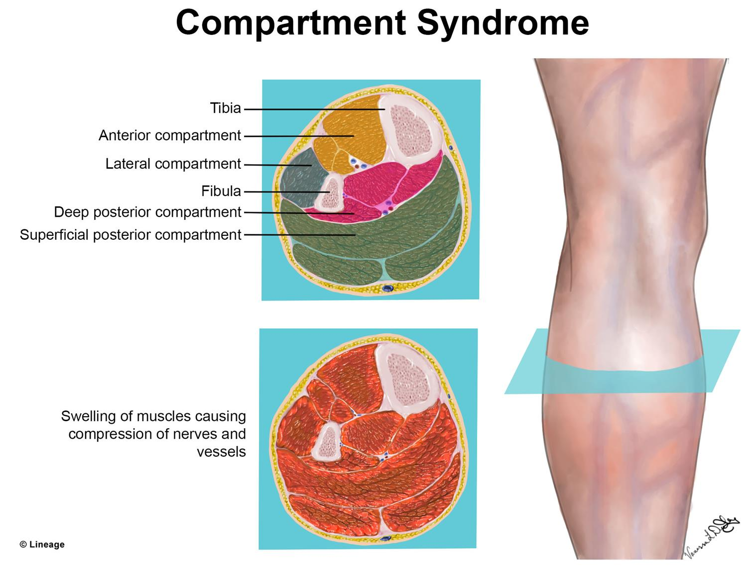
Compartment Syndrome
Compartment syndrome—the most serious complication of casting and splinting—occurs when increased pressure within a confined space (e.g., cast, muscle compartment) compromises blood flow and tissue perfusion (Alisangco et al., 2016).
Ischemia and potentially irreversible damage to the soft tissues within that space can occur within a few hours if action is not taken.

Slide 16
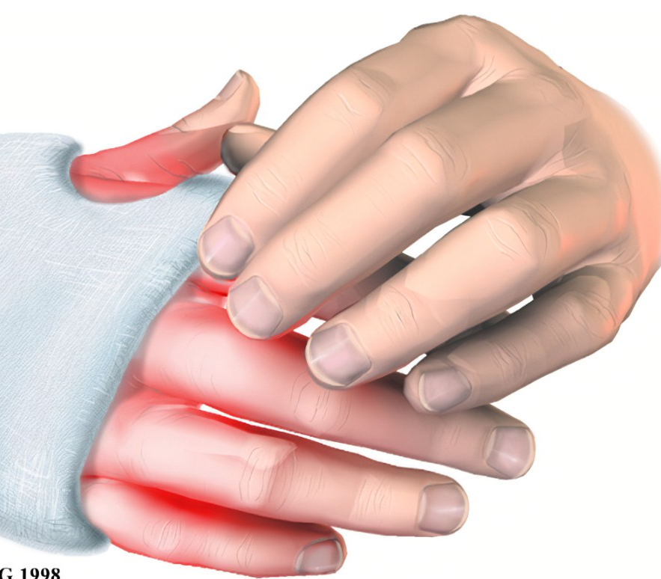
Pressure Ulcers
Casts or splints can put pressure on soft tissues, particularly if they are inappropriately applied, causing tissue anoxia and pressure ulcers. Lower extremity sites most susceptible are the heel, malleoli, dorsum of the foot, head of the fibula, and anterior surface of the patella.

Slide 17
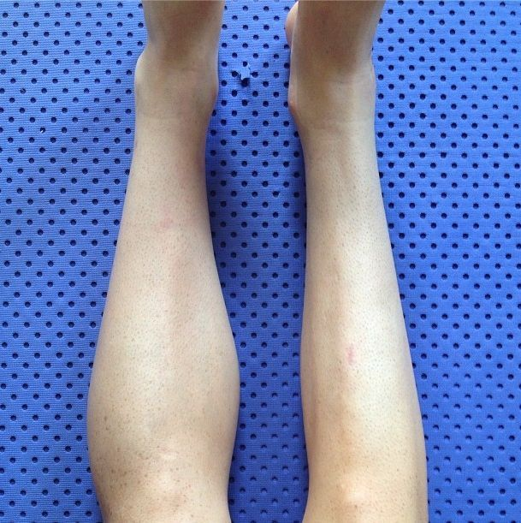
Disuse syndrome
Immobilization in a cast, splint, or brace can cause muscle atrophy and loss of strength, and can place patients at risk for disuse syndrome, which is the deterioration of body systems as a result of prescribed or unavoidable musculoskeletal inactivity.

Slide 19
