Slide 1
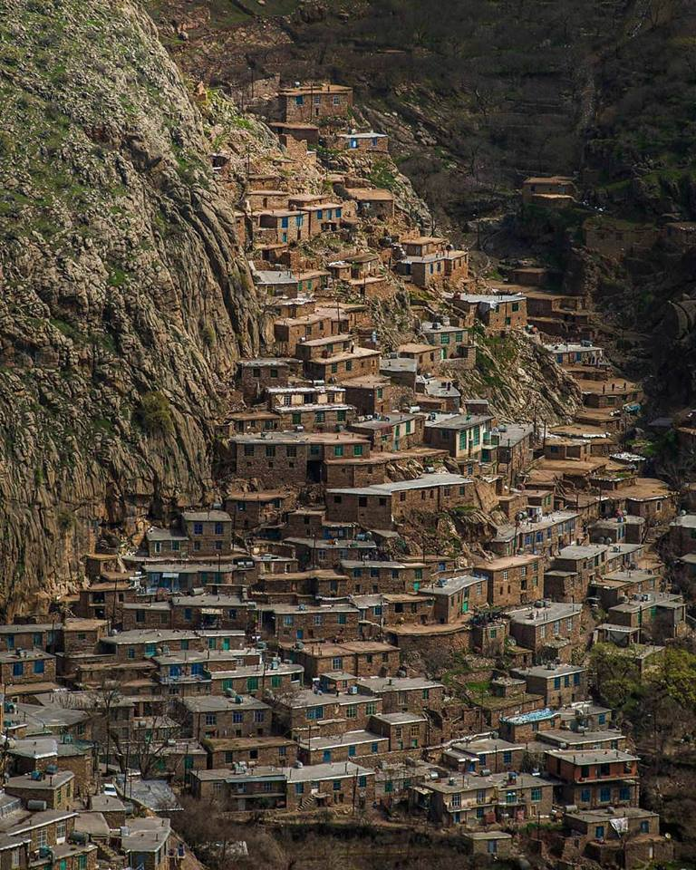
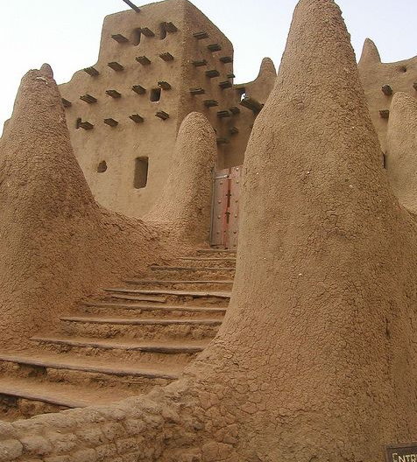
Tishk International University (TIU) Vernacular architecture
Vernacular Architecture
Lecturer : Darbaz Pirot
2023-2024
Lecture 1: Introduction to Vernacular Architecture

Slide 2
Lecture 1: Introduction to Vernacular Architecture
The word Vernacular : Derivations and Definitions
The contrast: Vernacular and the Architect
Benefits of vernacular architecture
Factors influencing vernacular architecture
Summary (homework)

Slide 3
The word : vernacular
Etymology of Vernacular
The term "vernacular" originates from the Latin word "vernaculus," meaning "domestic" or "native," initially used in ancient Rome to describe things related to the home or homeland. Its meaning evolved over time.
In language, it refers to the everyday speech of ordinary people, distinct from formal or classical language.
In architecture, it denotes traditional building styles and techniques specific to a region or community.
Therefore, "vernacular" comes from Latin and has special meanings in both language and architecture.

Slide 4
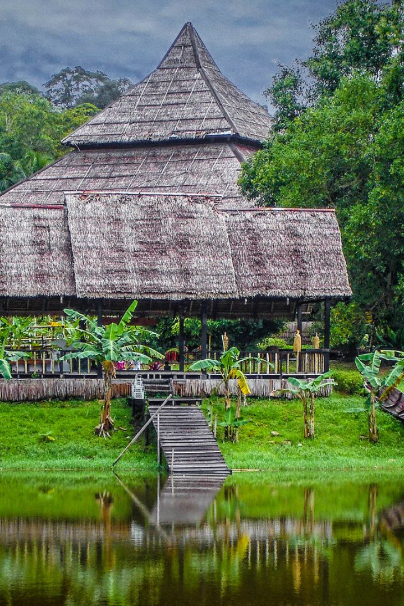
The word : Vernacular Architecture
The terms vernacular, folk, traditional, common, ordinary, popular, and indigenous (Orginal) architecture are used interchangeably.
"Vernacular architecture refers to the type of architecture that is indigenous to a specific time or place, not imported or copied from elsewhere."
It is architecture that is passed down from person to person, generation to generation, particularly orally.

Slide 5
Norman Foster's Definition of Vernacular Architecture
Norman Foster definition of vernacular architecture:
“Vernacular architecture is an architectural style that is designed based on local needs, availability of construction materials and reflecting local traditions, vernacular architecture did not use formally schooled architects, but depend on the design skills and tradition of local builders”

Slide 6
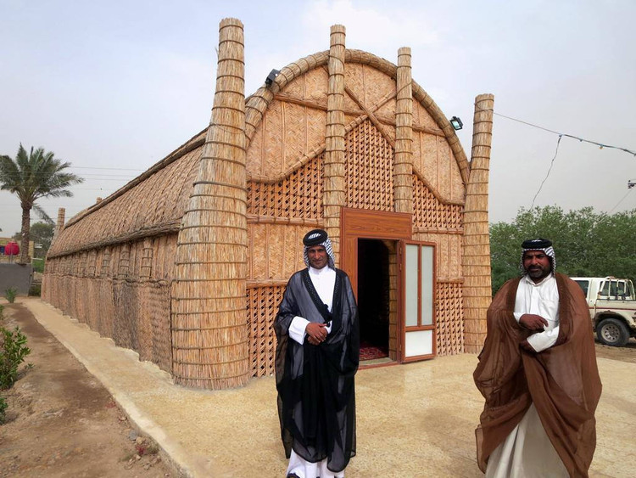
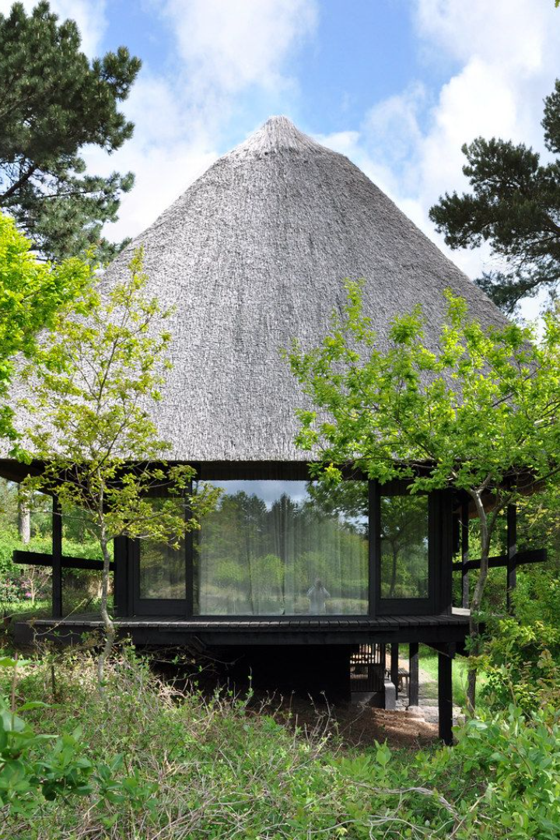
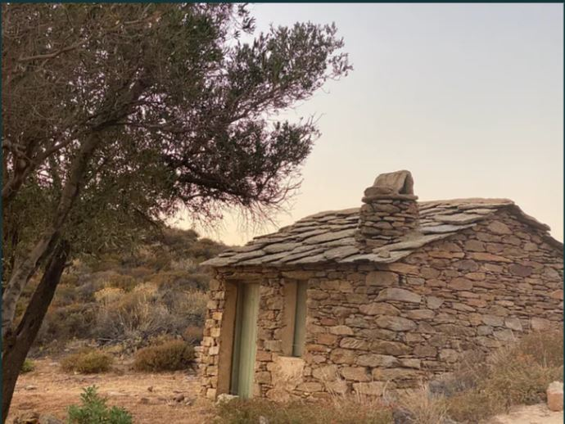
Difference Between Vernacular Architecture
and Architecture
The vernacular architecture is constructed by individuals who are not professionally trained in building arts.
Architecture created by professional architects is typically not categorized as vernacular. This term is commonly associated with residential structures.

Slide 7
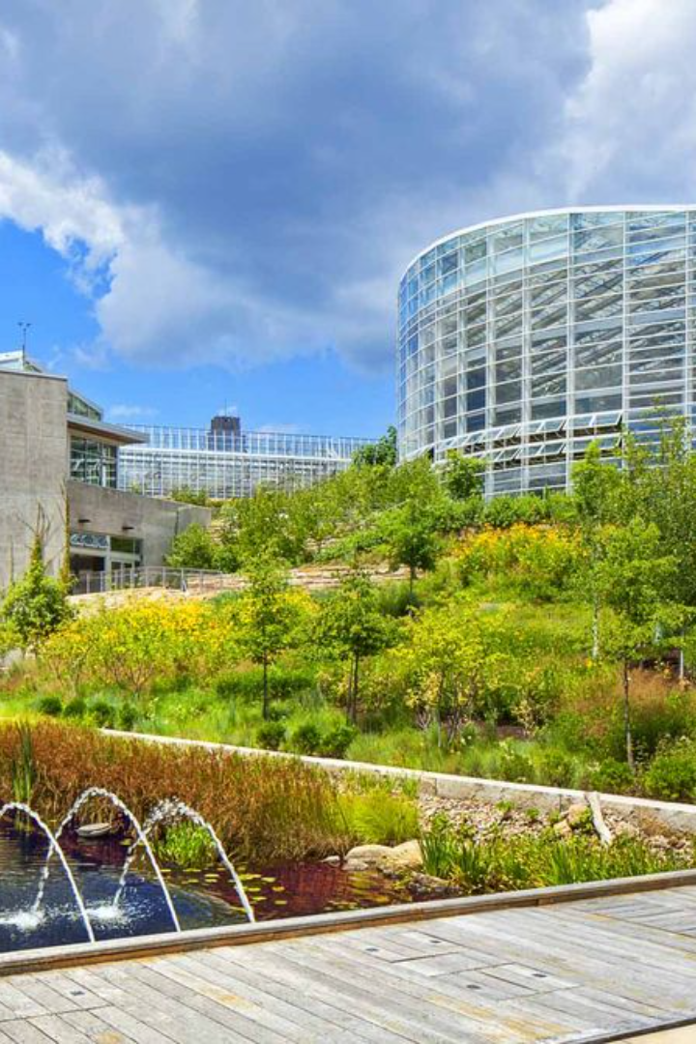
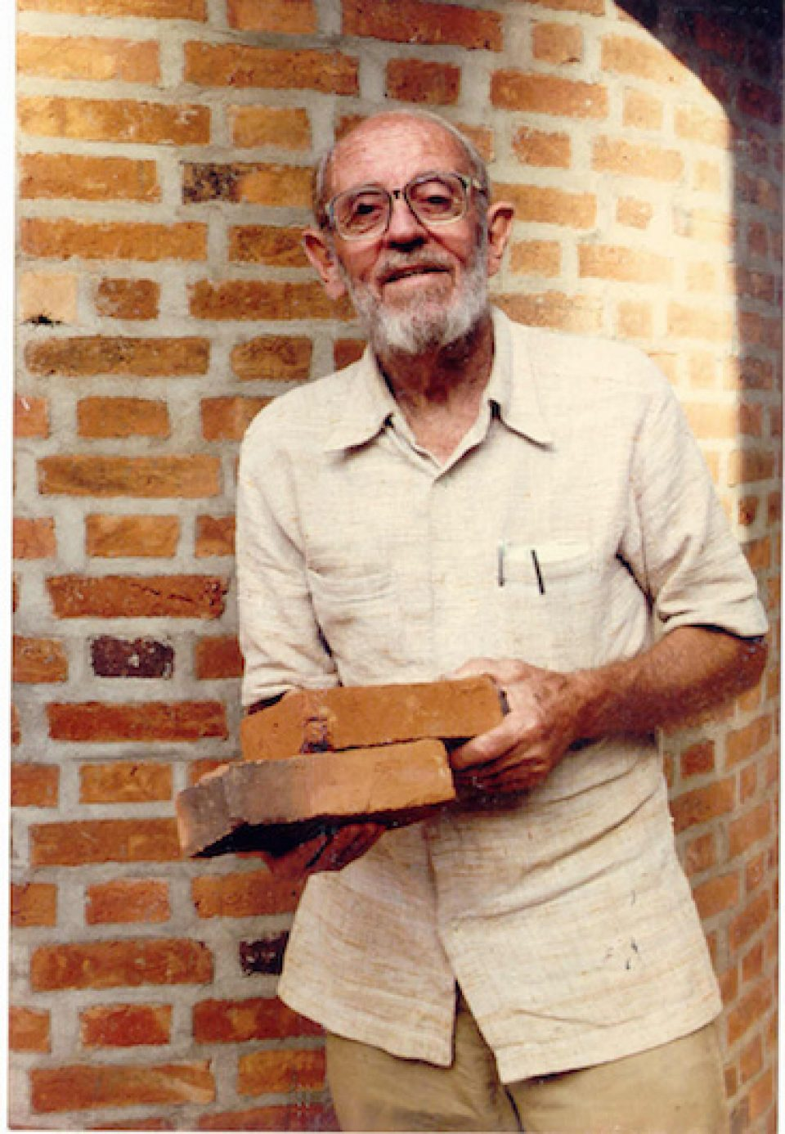
Laurie Baker,
“The use of local materials with consideration to local climate and participation of the people leads a holistic or comprehensive design approach”.

Slide 8
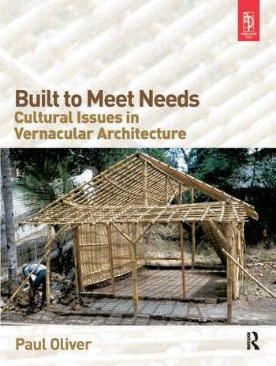
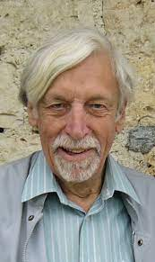
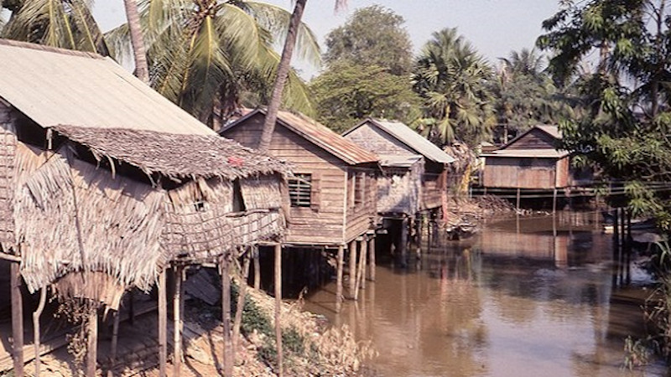
PAUL OLIVER
PAUL OLIVER
“It is the architecture of the people, and by the people, but not for the people.”
Paul Oliver describes vernacular architecture as being organically created by local communities to meet their own practical needs and cultural values, rather than external or commercial demands. It's a key part of architectural heritage, preserving unique traditions and local identities.

Slide 9
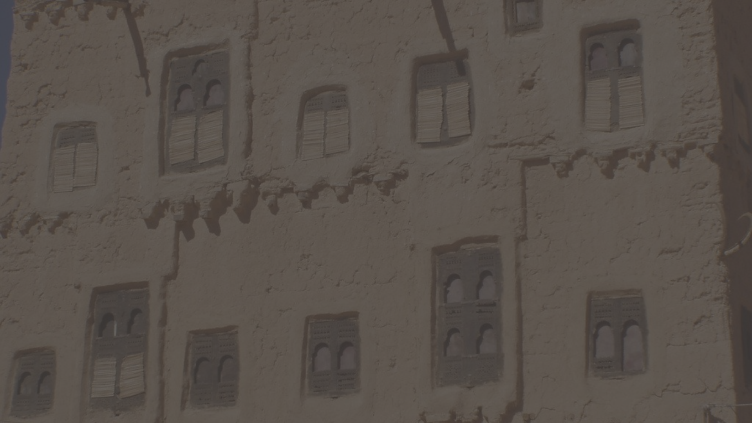
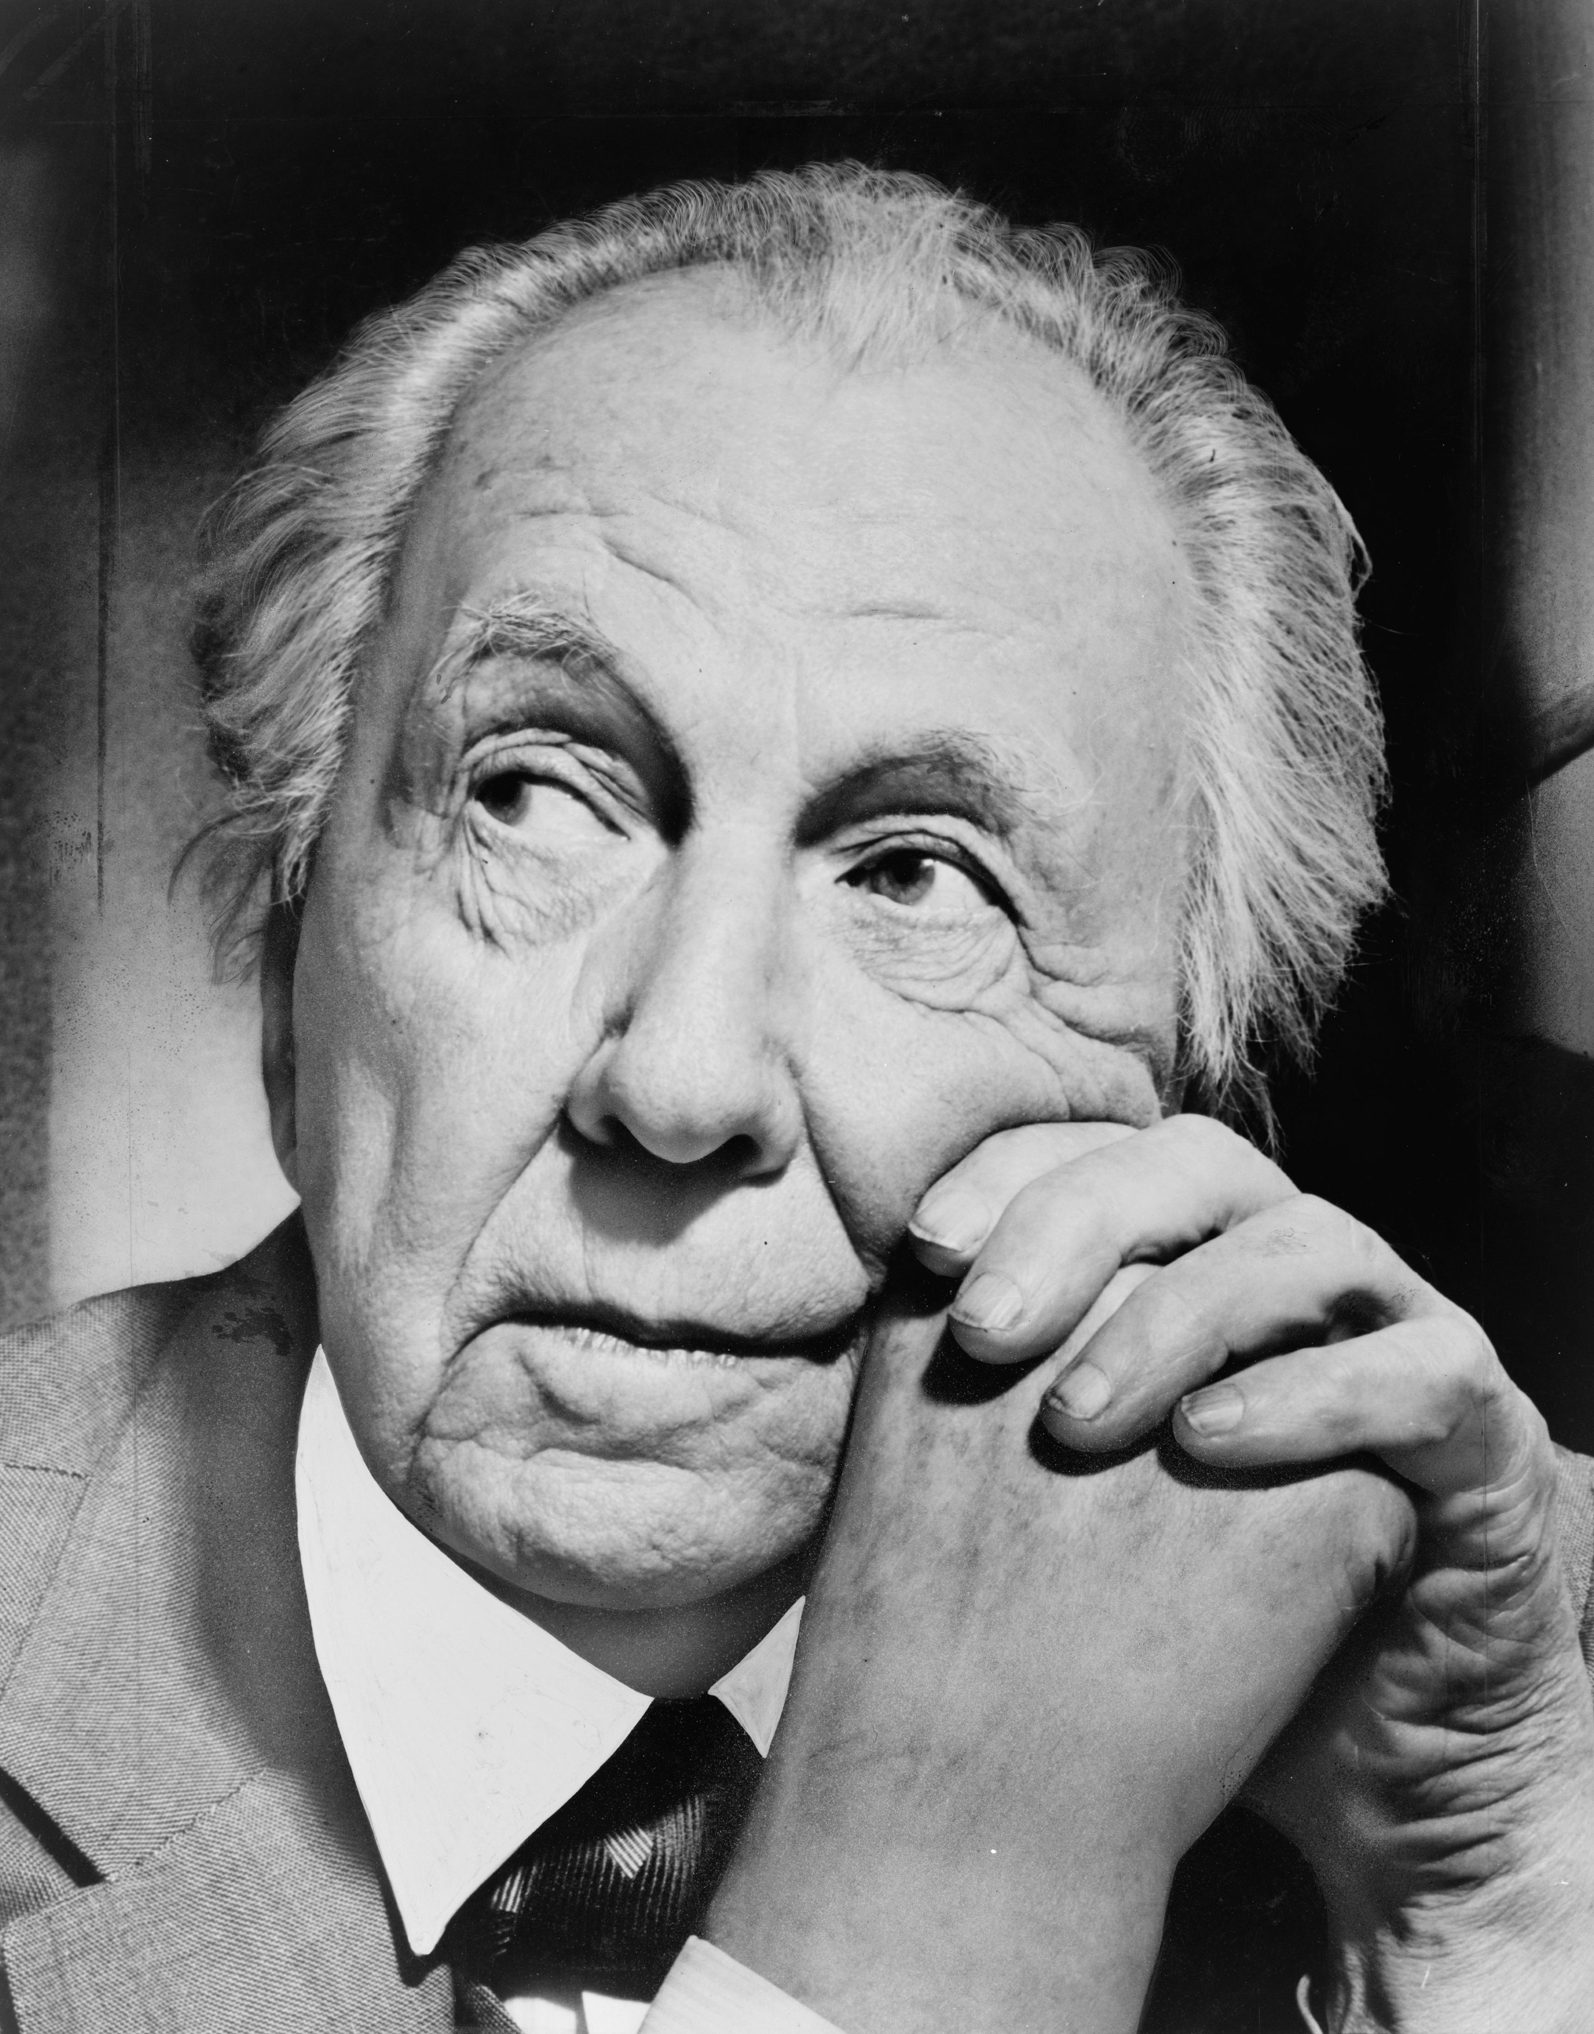
RONALD BRUNSKILL
RONALD BRUNSKILL "
“It is a building designed by an amateur without any training in design”
Frank Lloyd Wright described folk buildings as structures naturally developed based on people's needs, designed to blend with the environment by those who knew how to do so using their local understanding and skills.

Slide 10
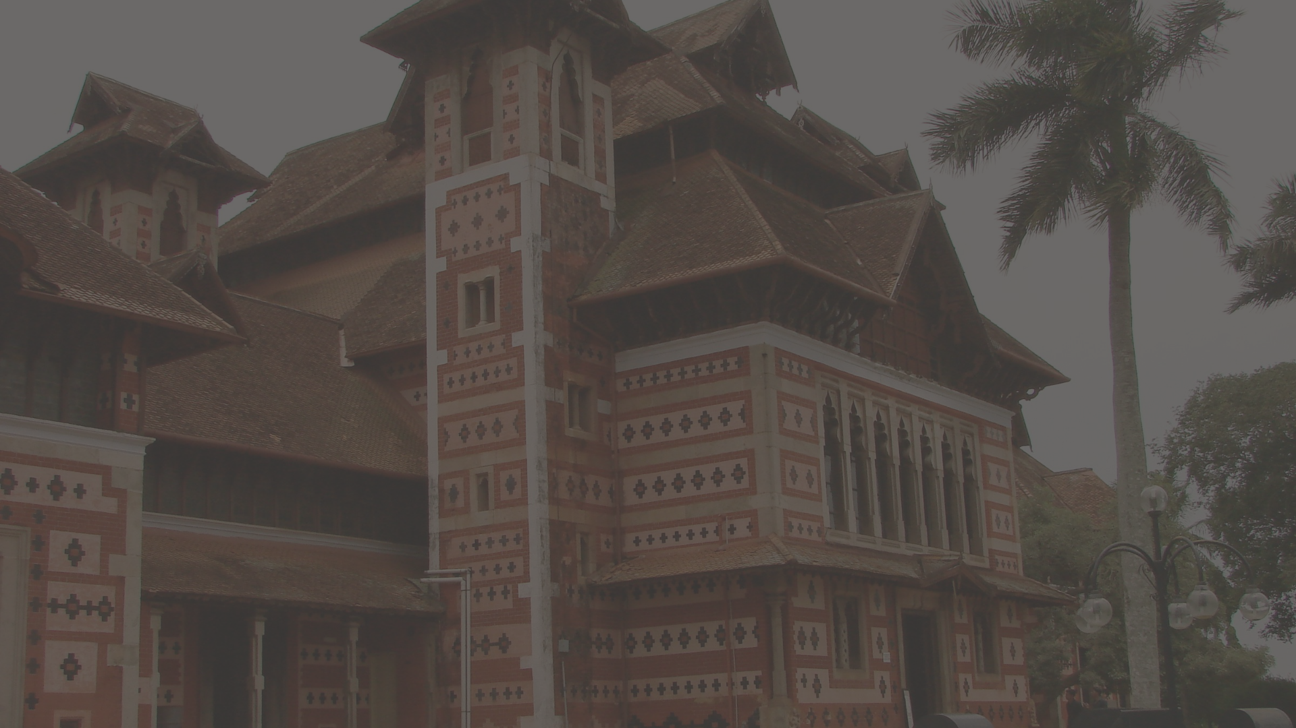
Vernacular Architecture
Vernacular architecture is a type of local or regional construction, utilizing traditional materials and resources from the area where the building is situated, reflecting local traditions and years of trial and error.
Consequently, This type of building design is closely connected to its surroundings. It takes into account things like the landscape, climate, and local customs.
For this reason, they are unique to different places in the world, becoming even a means of reinforcing an identity.

Slide 11
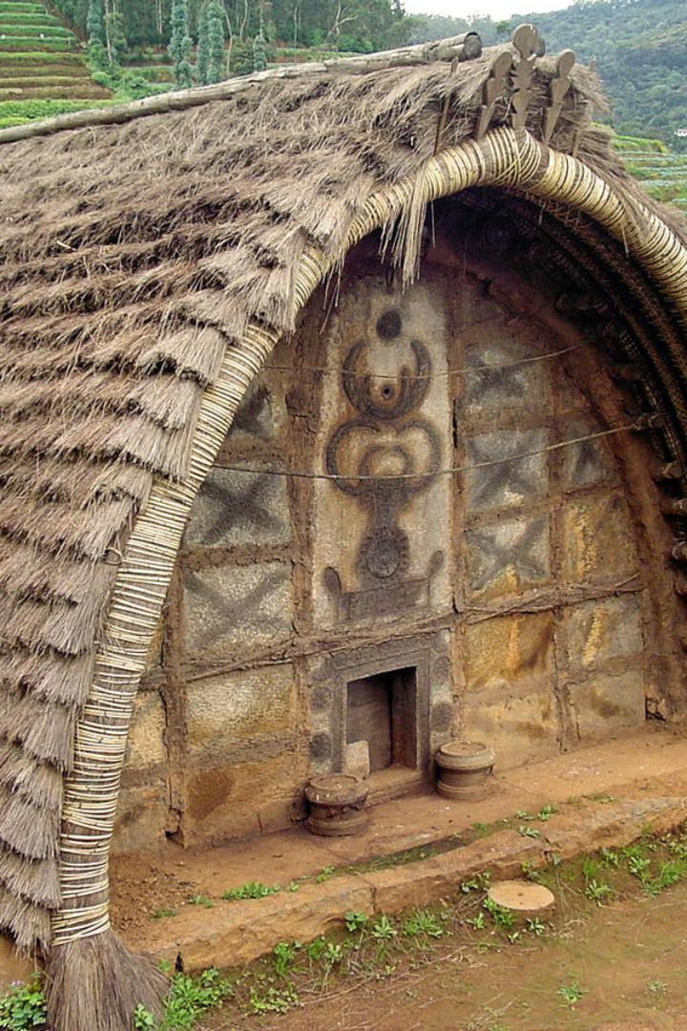
Architecture Without Architects
The basis of vernacular is that it responds to several contextual aspects: Climate, Place, Culture, Materials, Local skills, Maintenance, Durability and Metaphysical aspects.

Slide 12
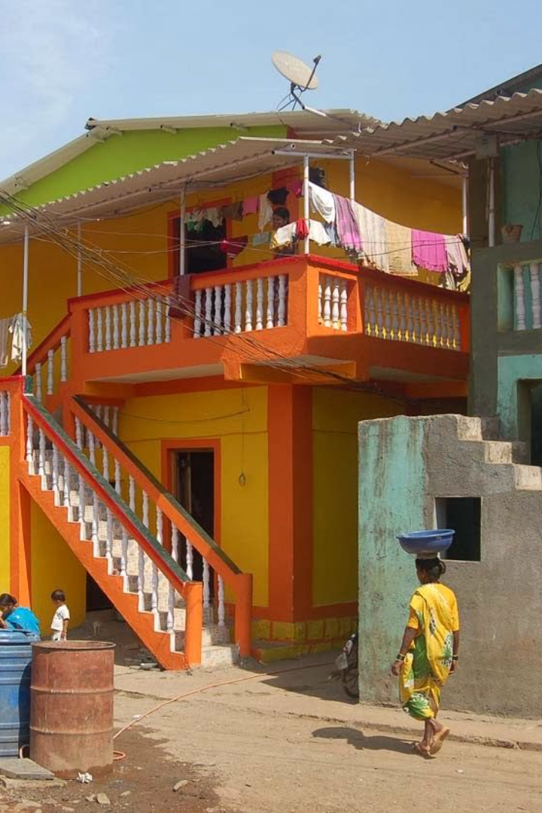
Vernacular architecture vs. Traditional architecture
Vernacular architecture should not be mixed up with what is often called "traditional" architecture, although they are related. Traditional architecture, which is a broader term, usually doesn't fall under the category of "vernacular."
Vernacular architecture is a specific part of traditional architecture. It focuses on building styles that are naturally adapted to and shaped by the culture and environment of a particular area. These styles are often informal and developed out of the local community's needs and ways of living.
Therefore, while all vernacular architecture falls under the traditional category, not all traditional architecture is vernacular.

Slide 13
Benefits of Vernacular Architecture
Using local knowledge and traditions to our advantage.
Using local materials and resources, which makes them energy-efficient and sustainable.
Providing essential link between humans and the environment in which they live.
They can be designed specifically with the local climatic conditions in mind, and often
perform well.

Slide 14
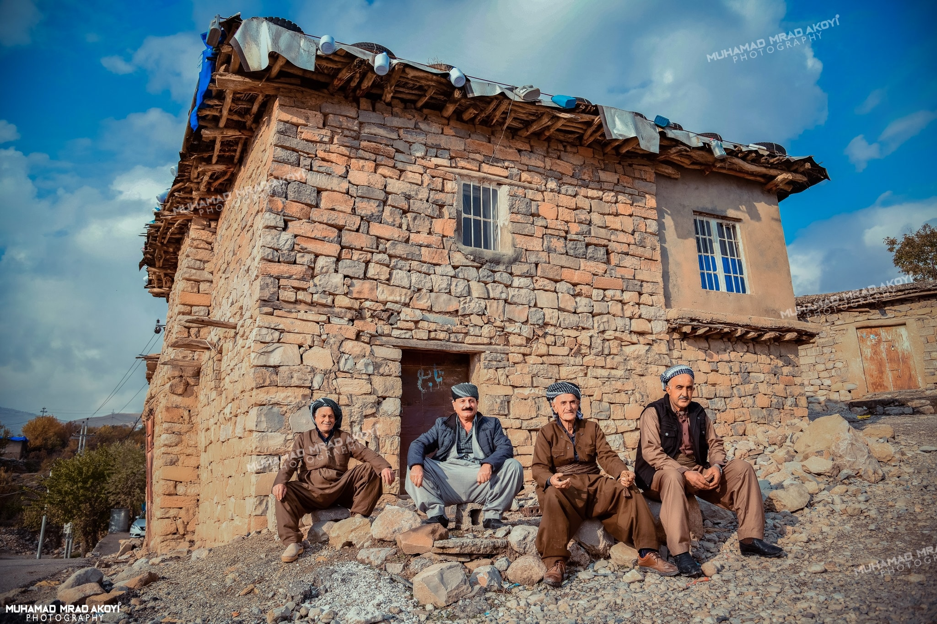
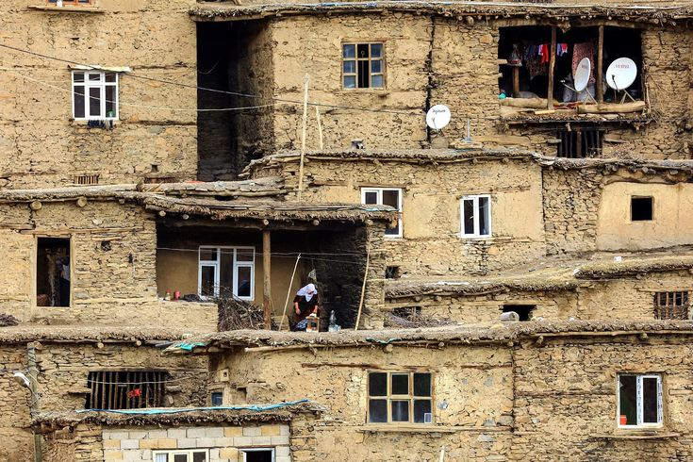
Factors influencing vernacular architecture
Vernacular architecture is influenced by a great range of different aspects of human behaviour and environment, leading to differing building forms for almost every different context; even neighboring villages may have different approaches to the construction and use of their dwellings with significant similarities in structural forms.

Slide 15
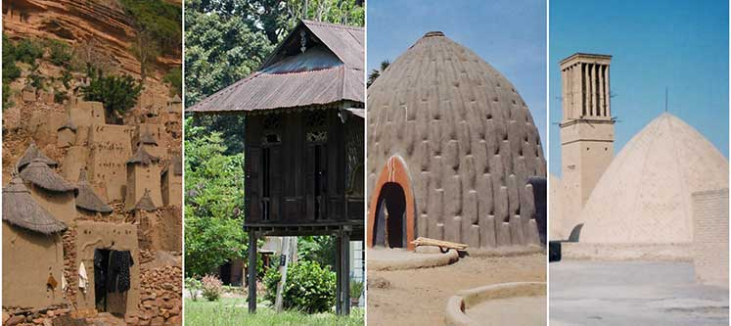
Factors influencing vernacular architecture
The design of buildings is strongly affected by how people live and use their homes. Family size, how space is used, cooking, and how people interact shape the size and layout of houses.
Local customs and beliefs also influence how buildings look, as people often decorate them in traditional ways. Different types of shelters are used in different seasons and places. Vernacular architecture is known for its variety of designs in similar situations, all influenced by culture.

Slide 16
Factors influencing vernacular architecture
We can summarize all the factors that have been derived from human behavior and the environment, as follows
Climatic and geological.
Tangible resources or physical resources such as Local construction materials technology adopted.
Intangible resources such as society and the culture
The localized and the way of life need

Slide 17
Homework For Next week
Every group Should prepare presentation about the topic the have

