Slide 1
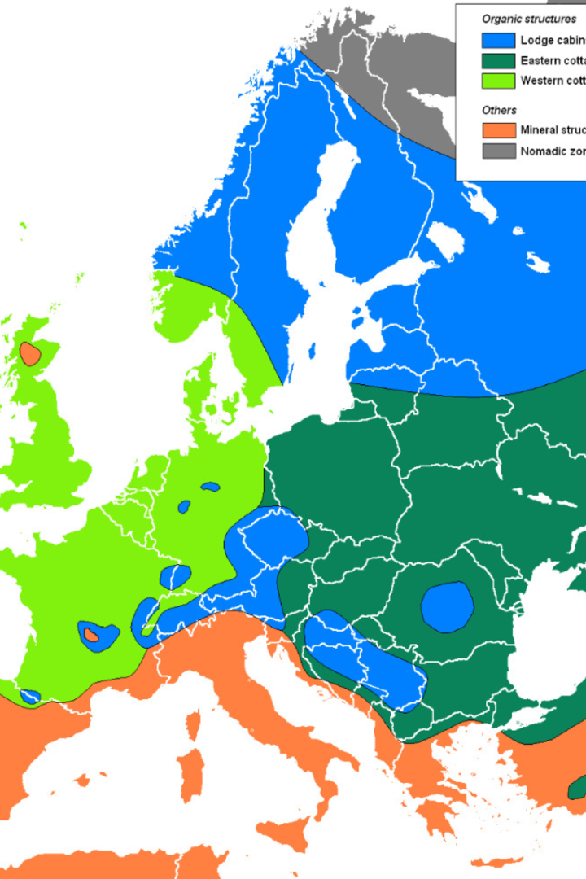
Tishk International University (TIU) Vernacular Architecture
Lecturer : Darbaz Pirot
2023-2024
Lecture 2: Vernacular Architecture Across the Globe

Slide 2
Outlines
Vernacular architecture across the world
Vernacular architecture in Europe
Vernacular architecture in Africa
Vernacular architecture in Australia
Vernacular architecture in South America
Vernacular architecture in North America
SS

Slide 3
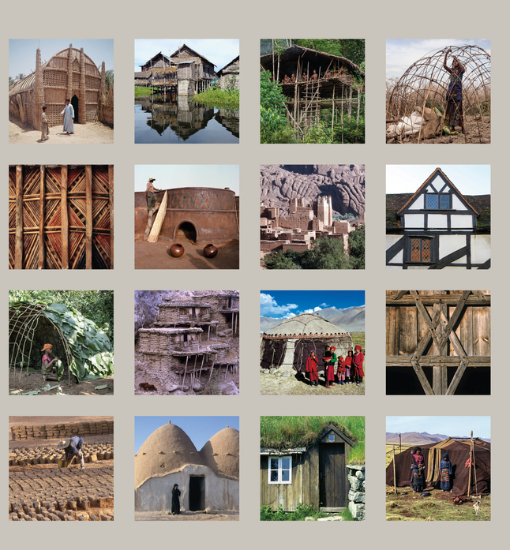
Vernacular Architecture Across the Globe
Exploring the unique characteristics of vernacular architecture within various continents, from the traditional structures in Europe, Africa, and Australia, to the indigenous designs found in South and North America.
Additionally, when we look closely at the traditional building styles in this countries, we can see how the buildings are influenced by the materials available in the area and the cultural background of the people who built them.

Slide 4
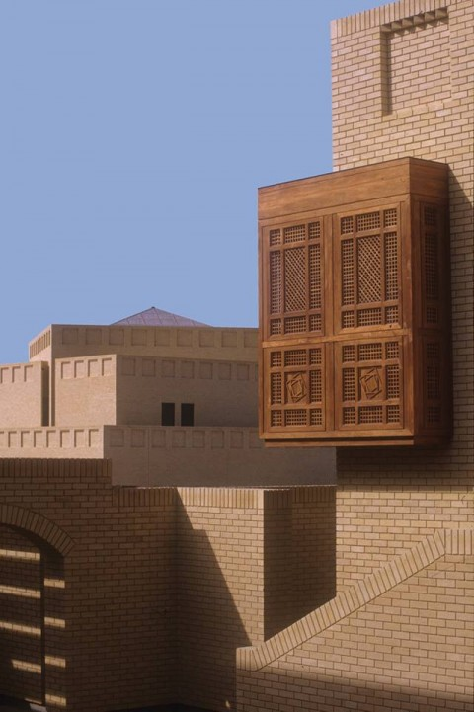
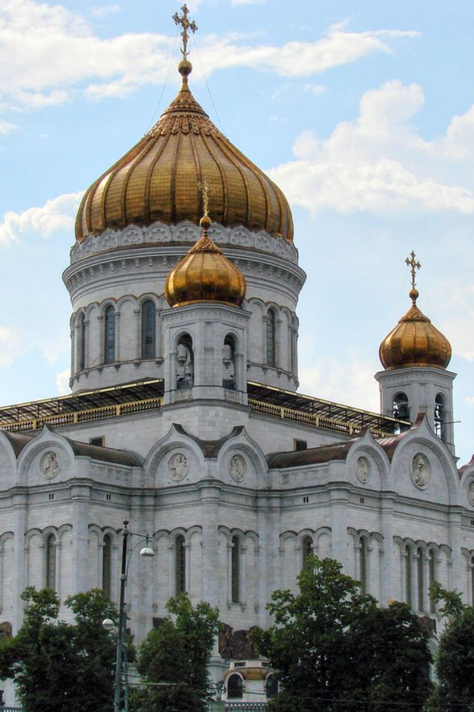
Vernacular Architecture Across the World
Vernacular architecture naturally fits into its surroundings. It changes over time to reflect the specific qualities of the local area, like the weather, culture, available building materials, technology, and the knowledge gained from many years of people living and building together in that community.
It is this evolution that gives rise to the Uniqueness of vernacular architecture in each region across the globe, with every area showcasing a particular set of characteristics that define its indigenous architectural practices.

Slide 5
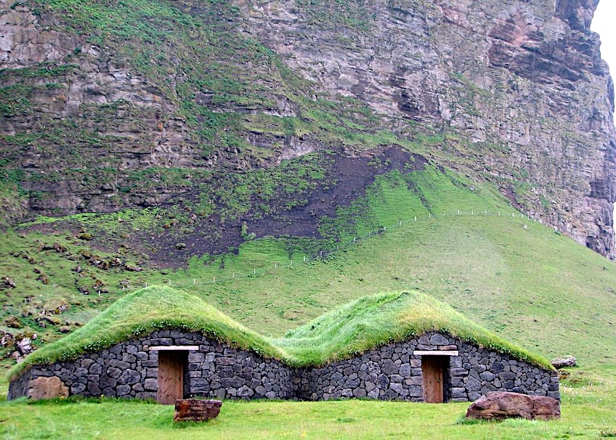
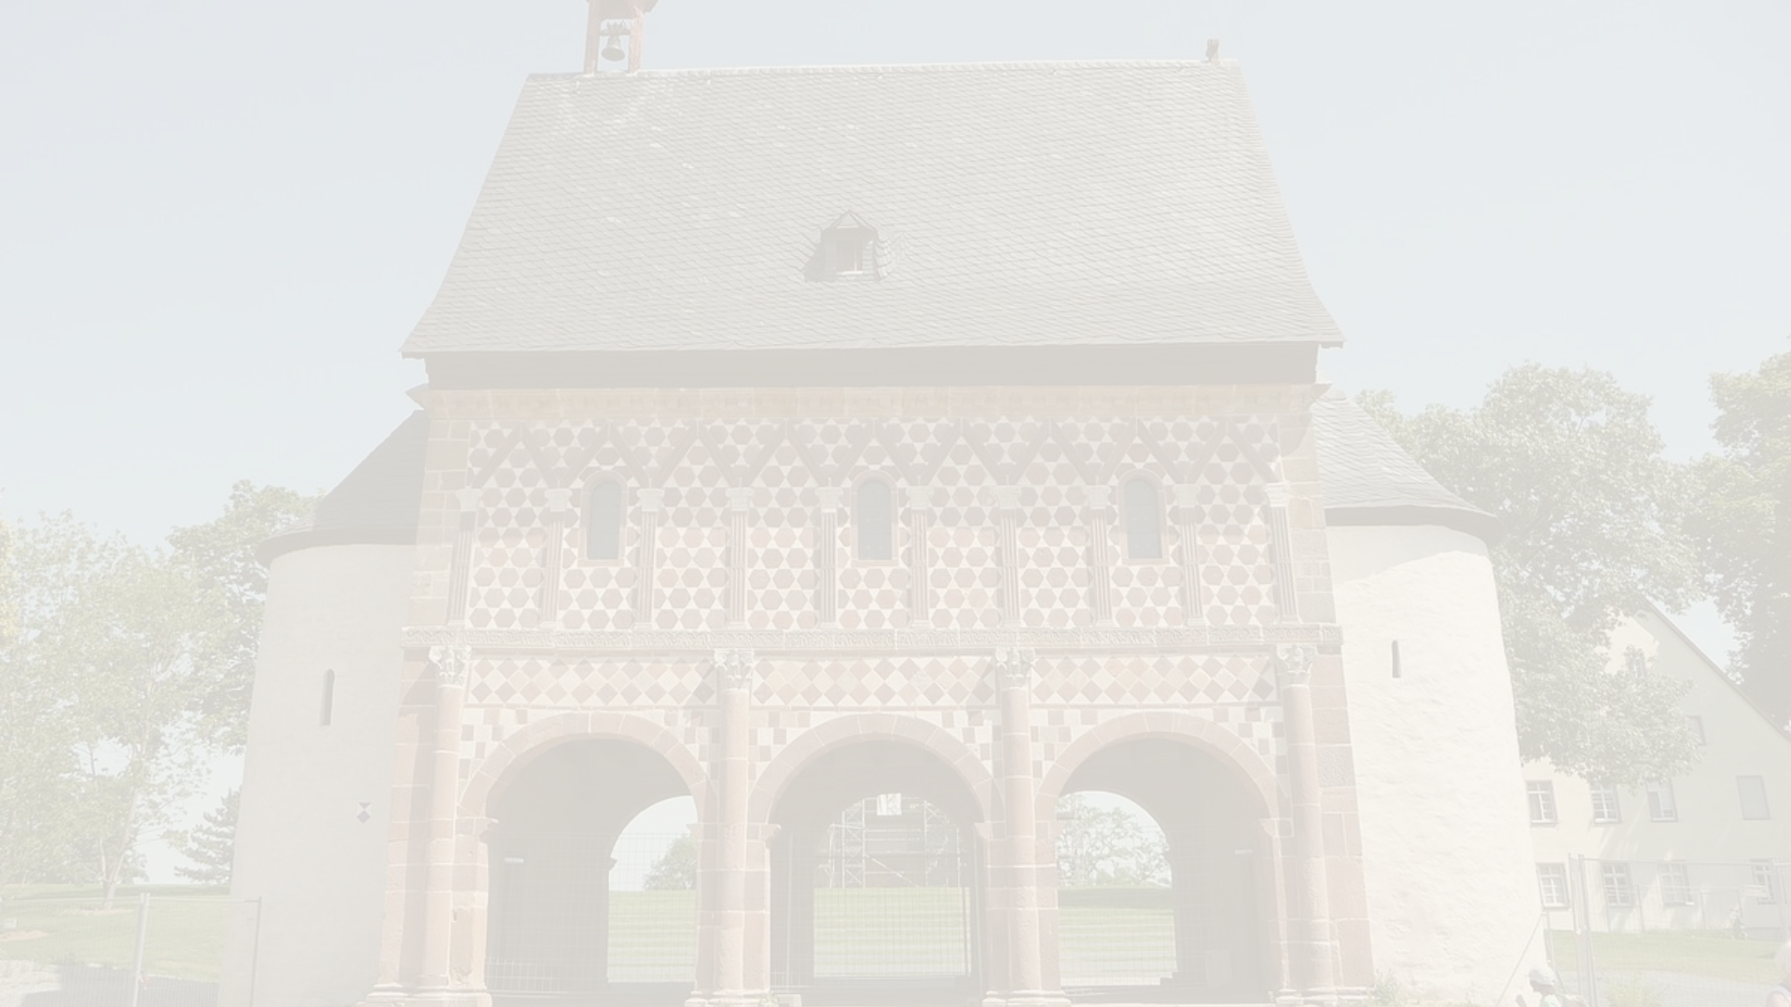
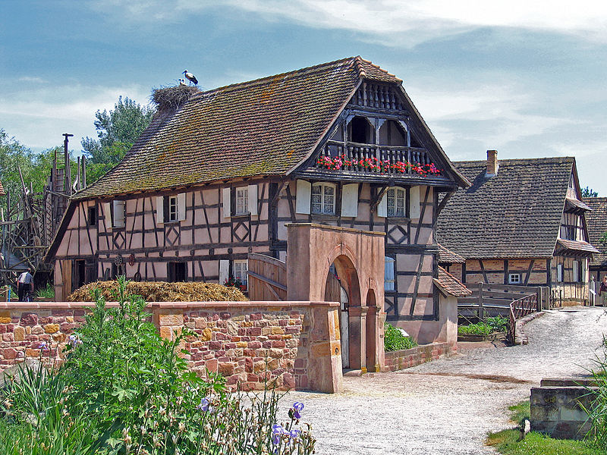
Vernacular architecture
in Europe
Vernacular architecture: The traditional and indigenous building styles that are specific to a region in Europe.
Europe's diversity: Europe's vernacular architecture
reflects its cultural diversity and history.

Slide 6
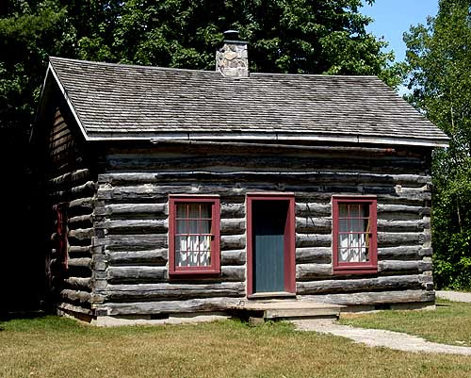
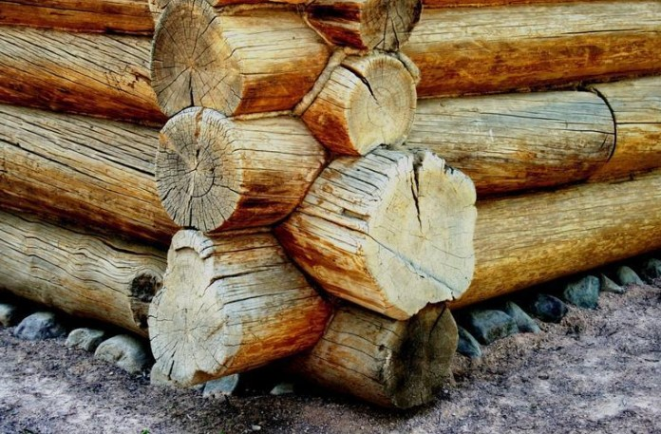
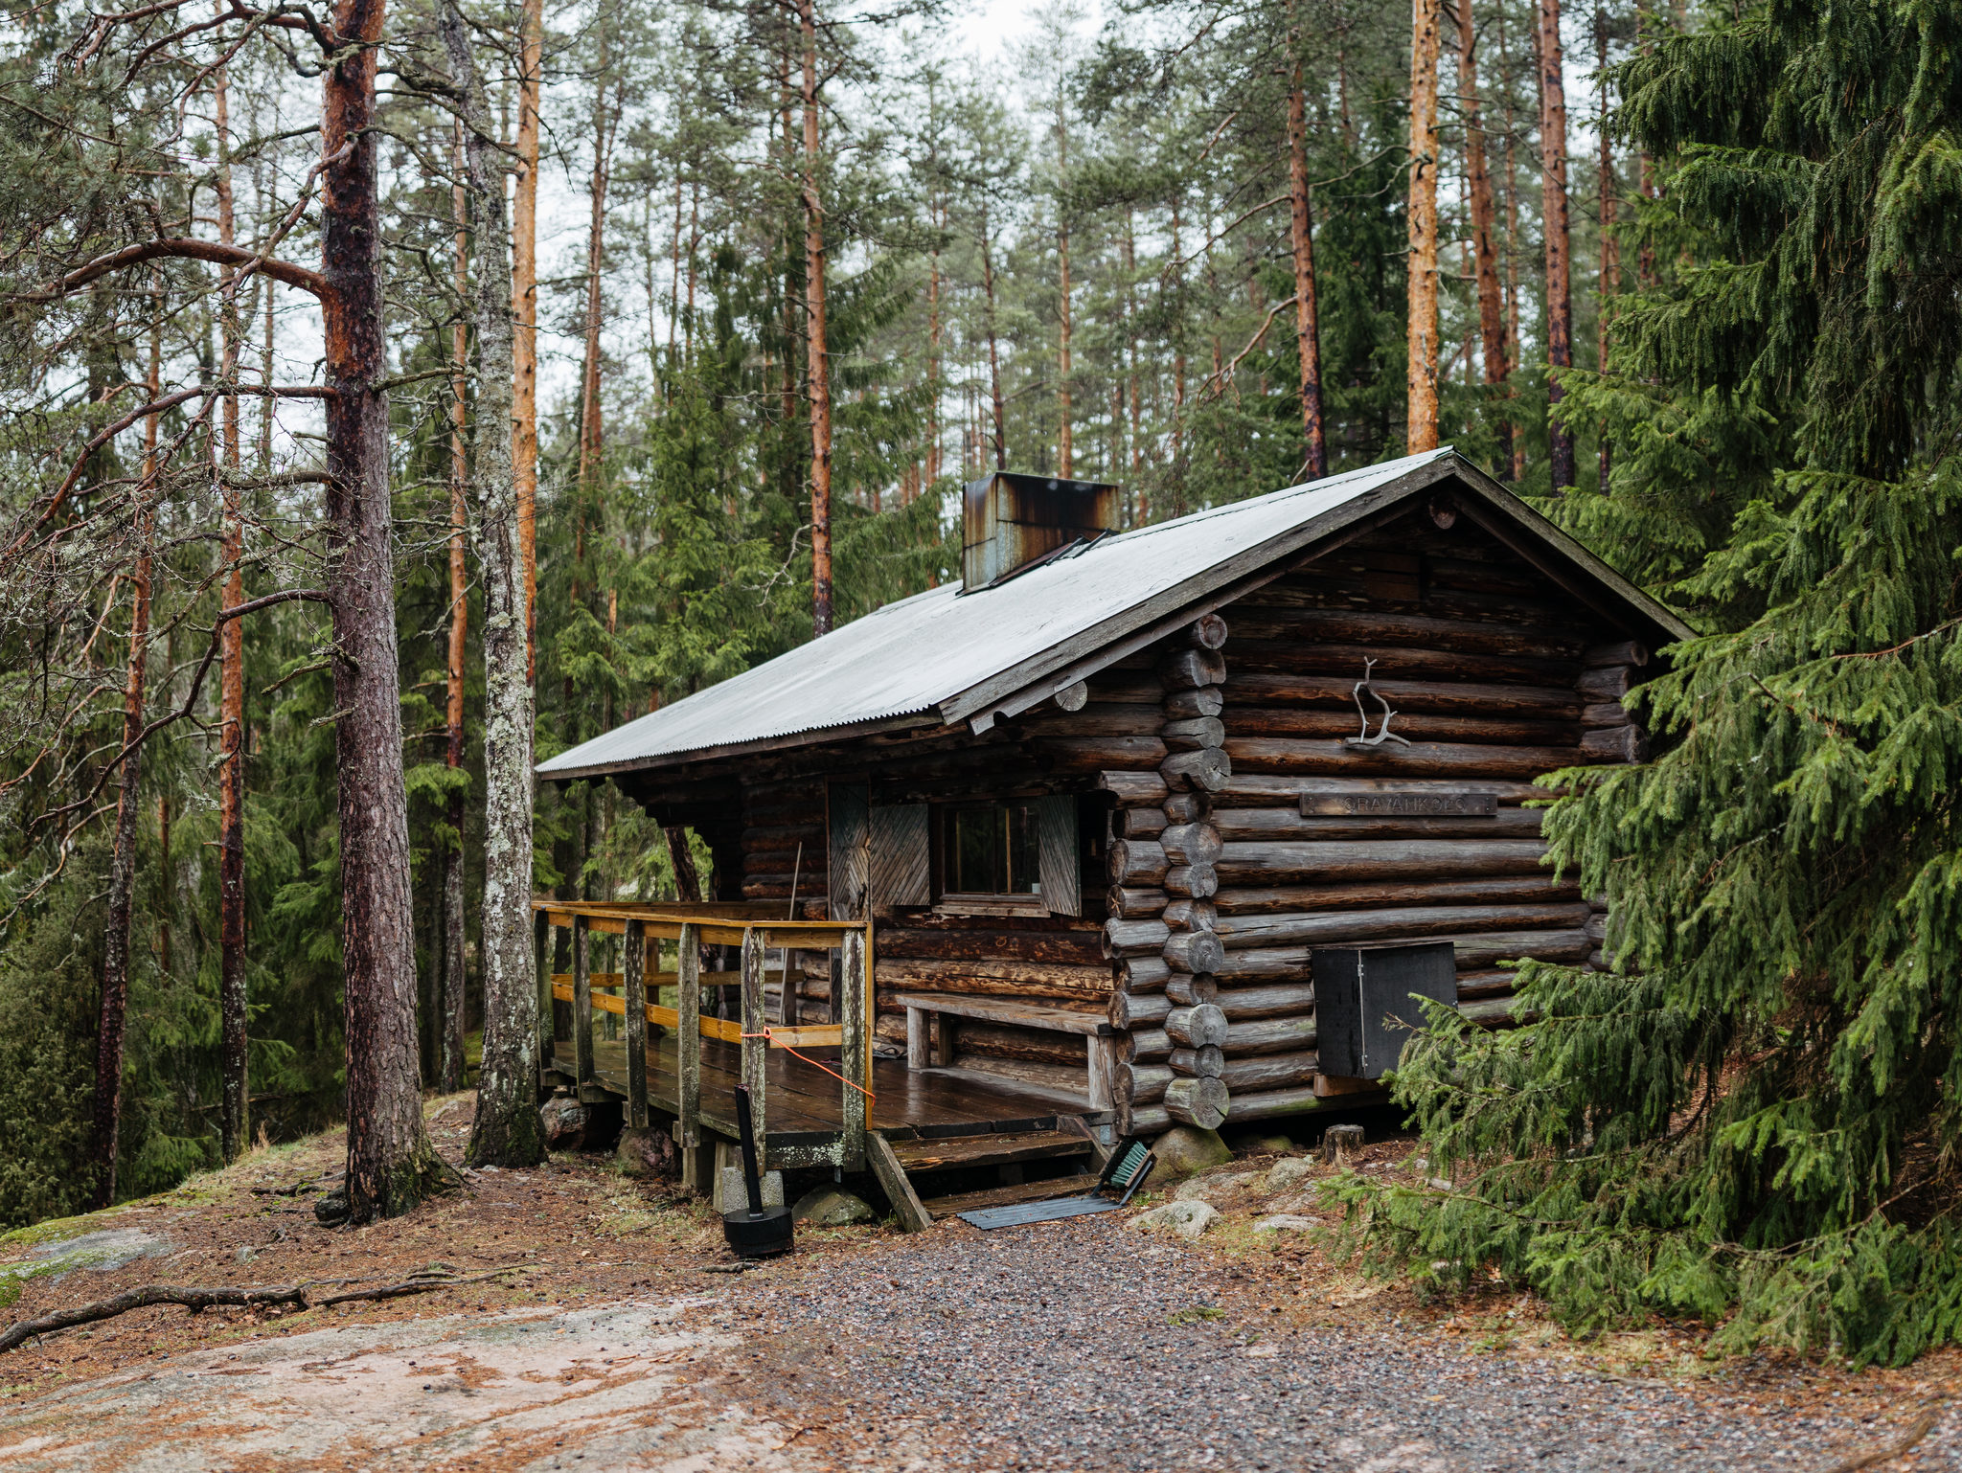
A log cabin in Sweden
A log cabin is a small log house, especially a less finished or architecturally sophisticated structure. Log cabins have an ancient history in Europe, and these types of dwellings were constructed without the use of nails. They were built by laying logs horizontally over top of each other and filling in the gaps with "chips and mud". This technique allowed them to derive their stability from simple stacking.
Such houses have several forms and different methods of corner timbering, and they utilized both round and hewn logs.

Slide 7
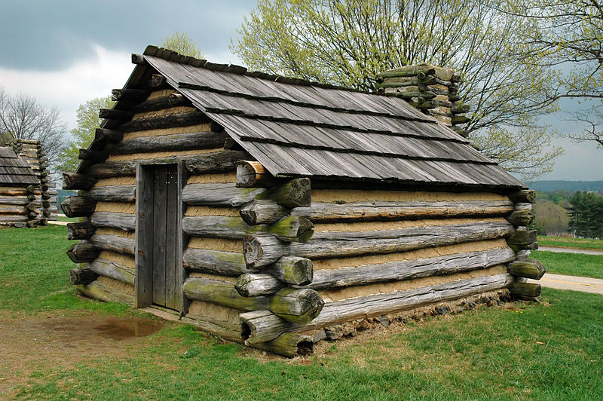
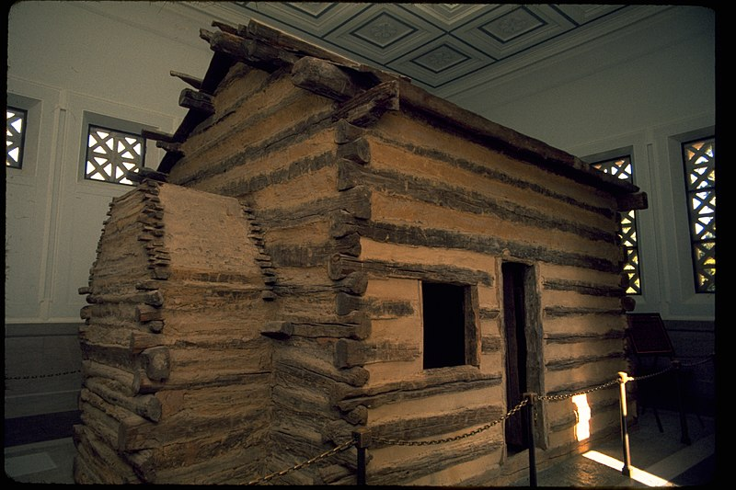
A log cabin in Sweden​
Back in medieval times, log cabins were seen as something you could move around, almost like a piece of furniture. This is shown by what happened with Espåby village in 1557. When they wanted to move the village, they didn't build new houses. Instead, they took apart the existing log cabins, moved them, and then put them back together again. Also, if some of the wood logs got damaged or rotted, they would just replace those specific logs. This kind of thing was common when they moved these cabins to different places in Europe.

Slide 8
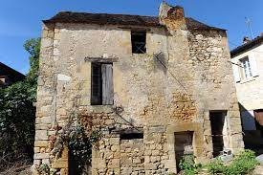
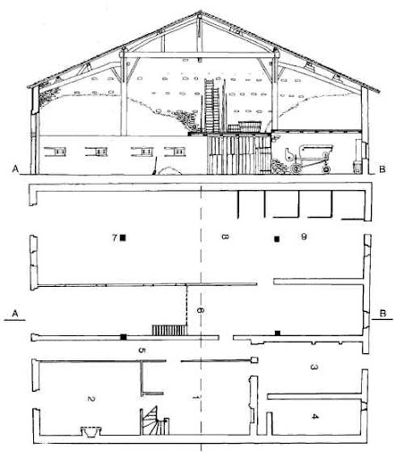
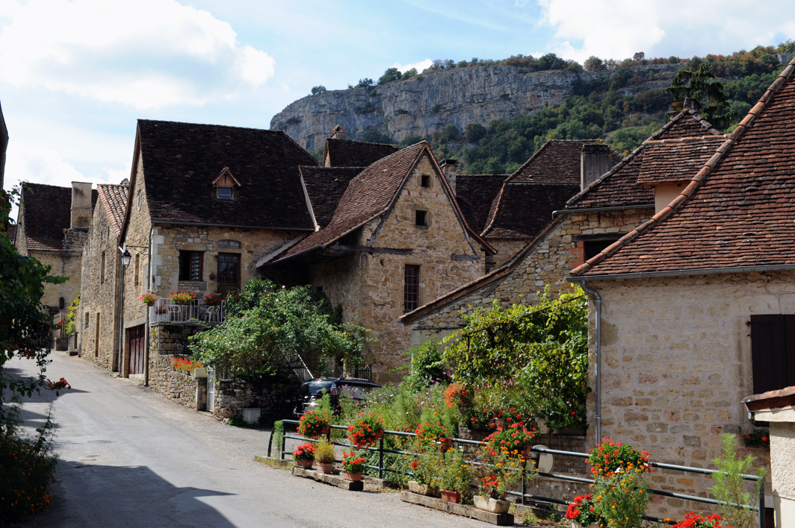
Vernacular architecture in France
Rural Vernacular Diversity
Distinctive Features
Commonality in Plan-Forms
Most of the French vernacular houses can be seen in the French countryside, showcasing the rural vernacular architecture's great diversity. As one travels from one region to another, even within the same region, there is a host of morphological differences.
Differences are evident in the building materials used, the pitches and volumes of roofs, the surrounds and locations of openings, and the decorative features chosen. These elements contribute to the unique character of each house.
"Houses may have diverse styles and appearances externally, but inside, their floor plans often follow similar designs, Showing that inside, many houses have a similar basic layout, despite how different they look from the outside

Slide 9
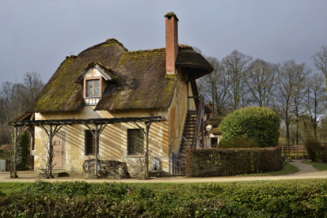
Vernacular Architecture in France
Classification Basis
Distinct House Plan-Types
On the scale of the entire country, house plan-forms may thus serve as a basis for the classification of farmhouses.
According to the most recent publications the Frances vernacular houses can be divided:
The single-room house,
The lengthwise house or "longère",
The upper-floor hall or "salle haute",
The house with central-corridor plan,
The depthwise house with nave and aisles.
All these house-plans exist in elementary as well as derivative
forms.,

Slide 10
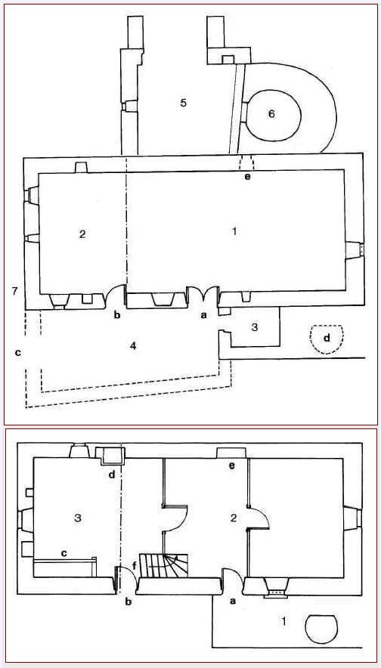
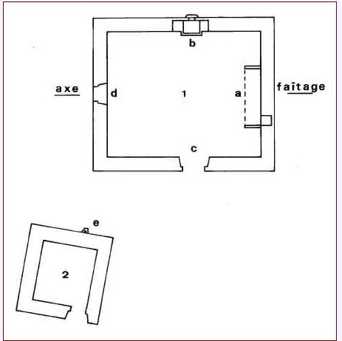
Vernacular Architecture in France
THE SINGLE-ROOM HOUSE
THE LENGTHWISE HOUSE OR "LONGÈRE"
THE UPPER-FLOOR HALL OR "SALLE HAUTE"
Characteristic of Europe's vernacular architecture, the single-room house is a traditional form that reflects simplicity and functionality.
The "longère" is a type of lengthwise house that is symbolic of French rural architecture, often seen stretching across the landscape.
In contrast, the "salle haute" represents an upper-floor hall, a design that denotes a different aspect of vernacular living spaces in France.

Slide 11
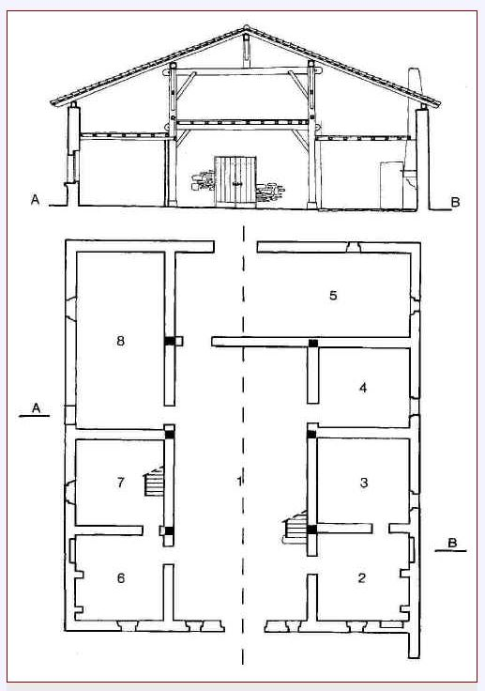
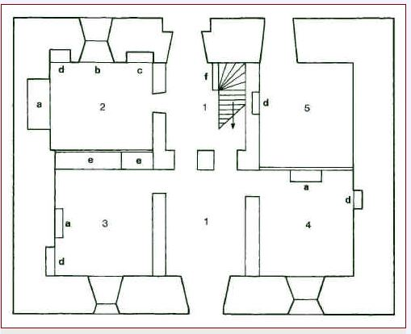
Vernacular architecture in France
The Depthwise House with Nave and Aisles
The House with Central-Corridor Plan
Another is the depthwise house with nave and aisles, which showcases the adaptability and variety present in traditional French building styles.
Europe has a rich tradition of vernacular architecture, which refers to methods of construction that use locally available resources and traditions to address local needs and circumstances.
One notable example is the house with a central-corridor plan, a design that has been a Principle in French vernacular architecture.

Slide 12
The Construction Method and Building Material
These structures, built without modern materials like blocks or cement, use local stone and specially mixed mortars of lime, gypsum, and local sands.
This method, dating back to pre-industrial times, reflects traditional European construction techniques and contributes to their region's distinctive architectural heritage.

Slide 13
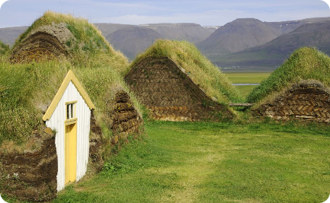
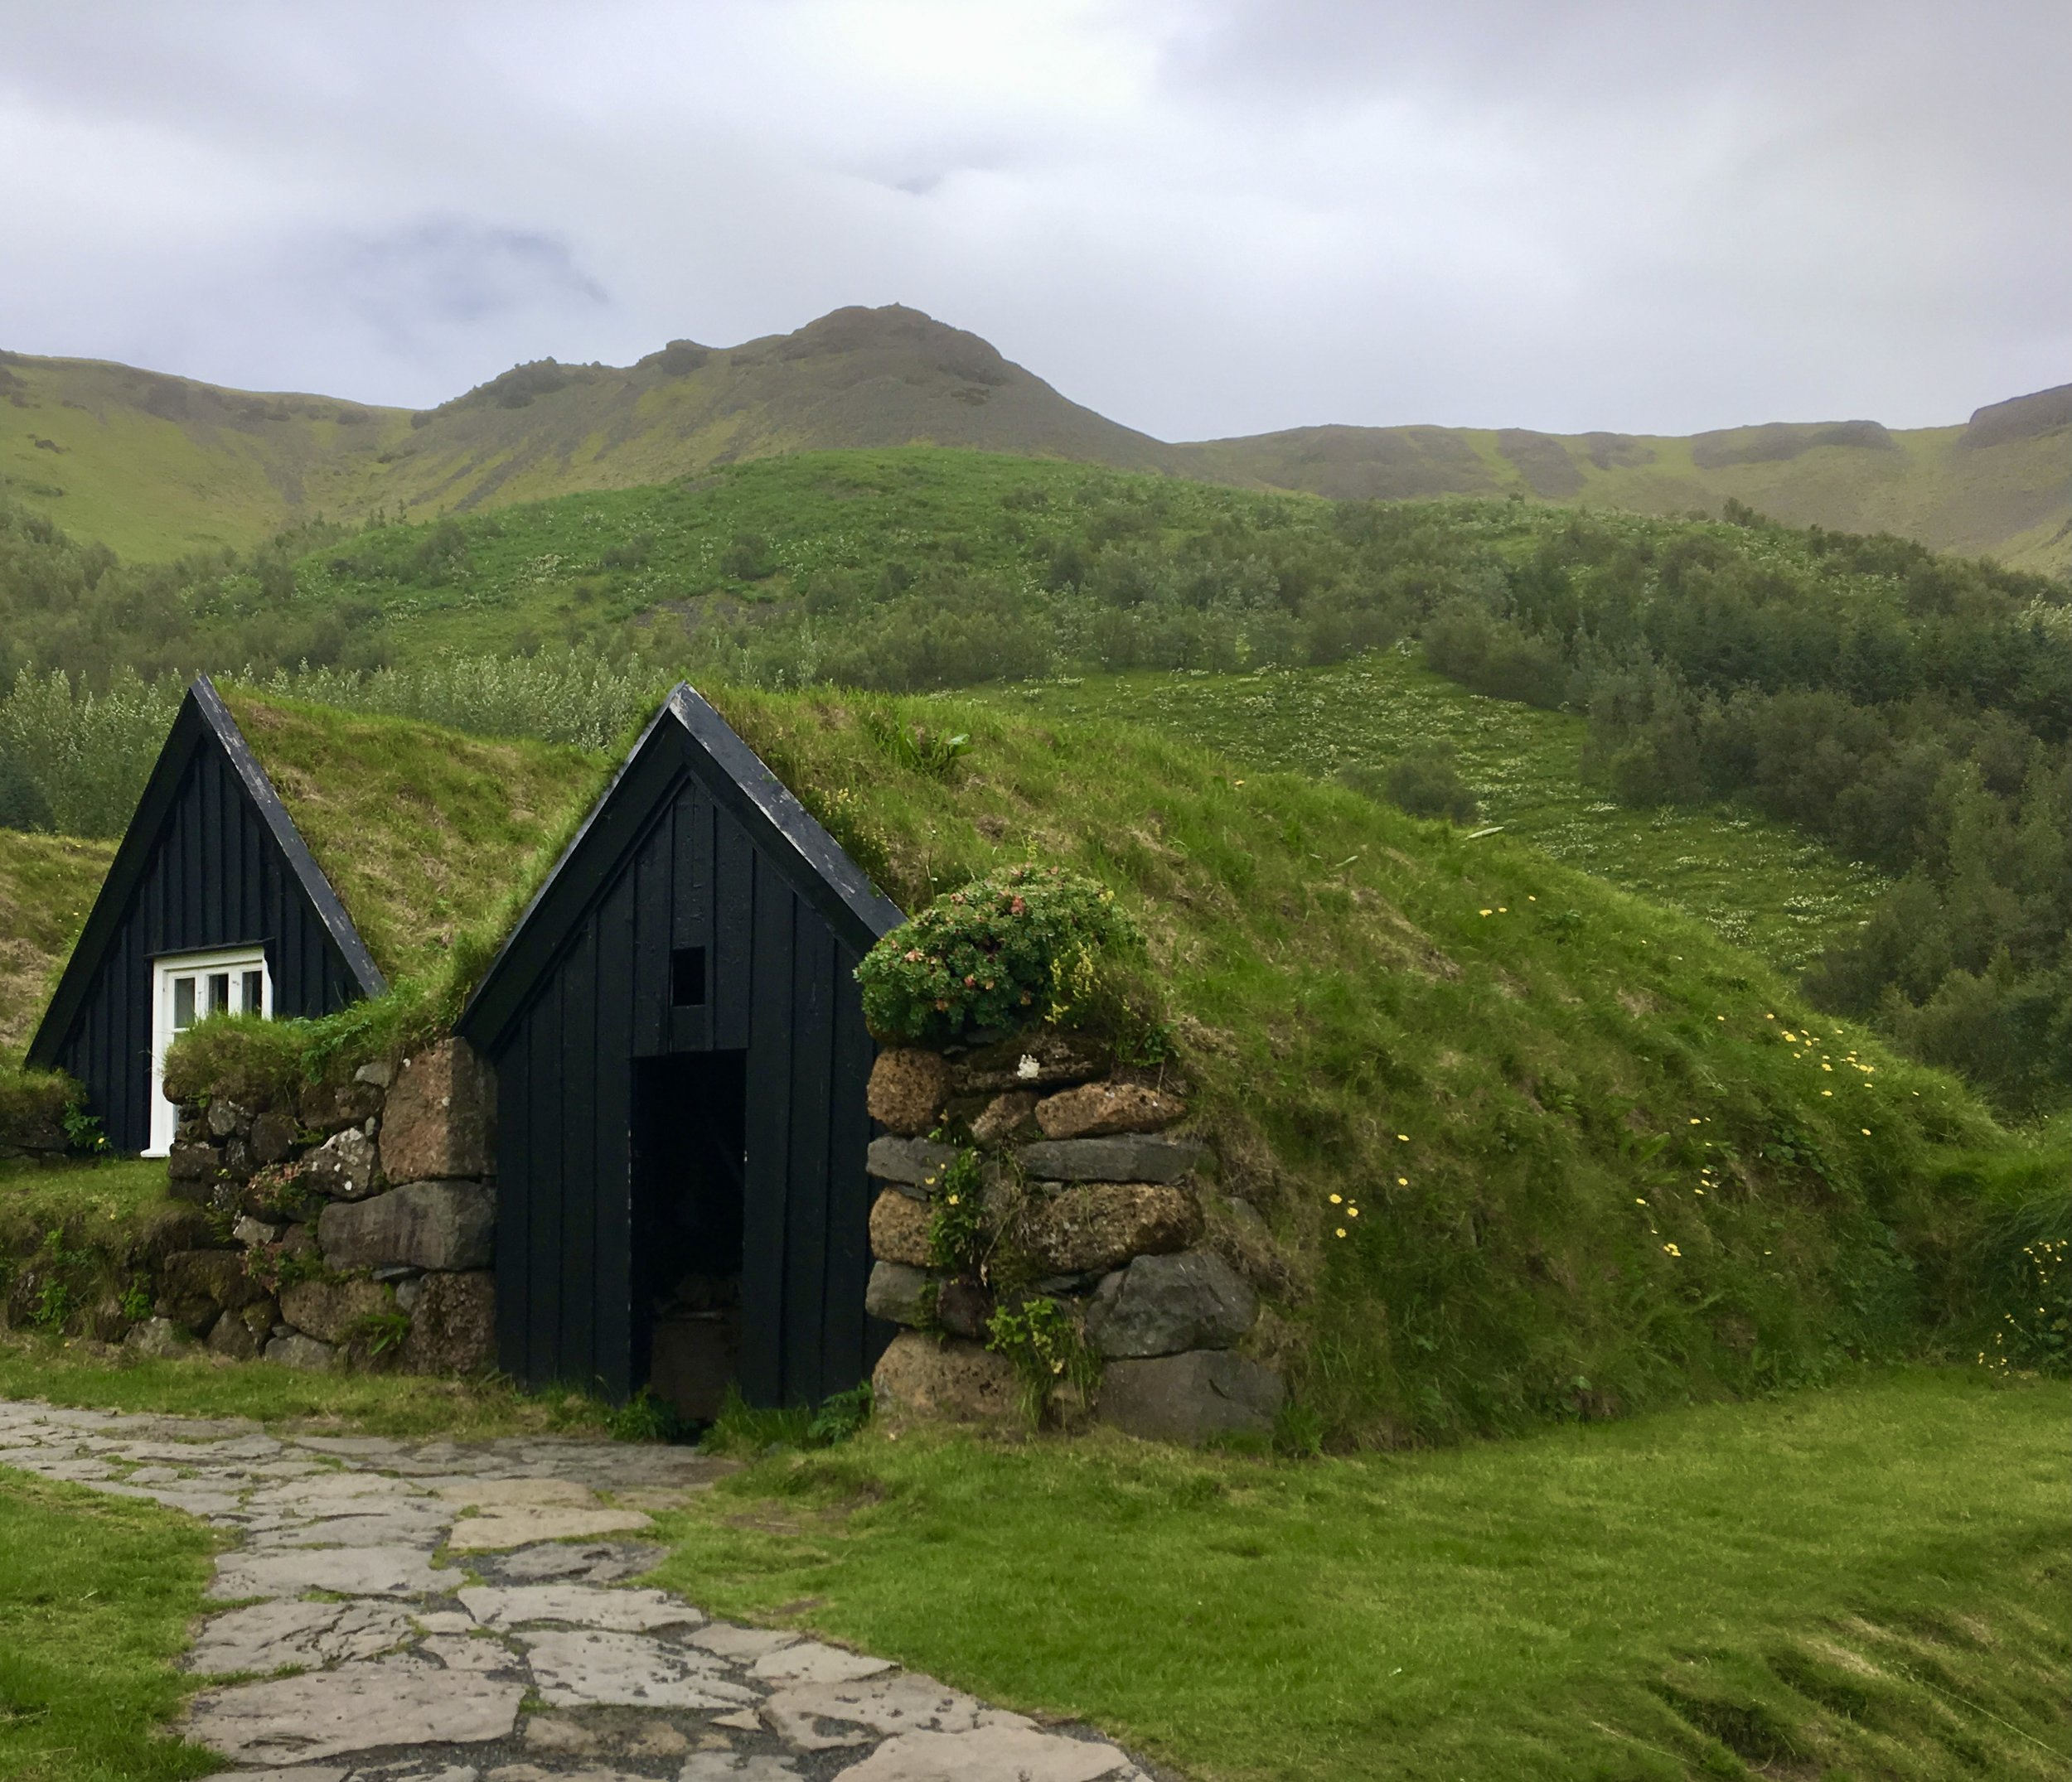
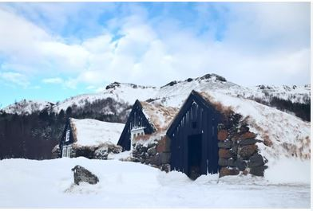
A Traditional Turf House in Iceland
Robust Foundations
Designed for Harsh Winters
The gable (roof) of the house is timber with a double door to keep out the Icelandic winters. The roofs of these types of houses were distinguished by grass.
This is one of the traditional turf homes in Iceland. Turf houses provide good insulation compared to buildings only made from wood or stone.
The houses have a large foundation made of stone with a wooden frame to hold one or two stacks of turf.

Slide 14
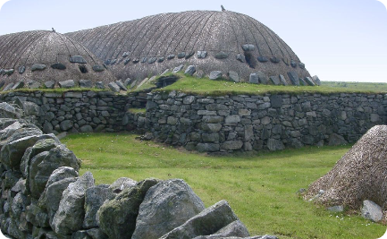
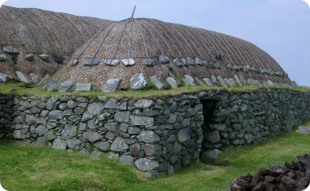
Structural Design
The blackhouse, Scotland
The buildings were generally built with double wall dry-stone walls packed with earth and were made with wooden beams, over which a layer of turf (a type of grass and soil), cereal straw, or reed was laid as a covering.
A blackhouse is a traditional type of house which used to be common in the Scottish Highlands, the Hebrides, and Ireland.

Slide 15
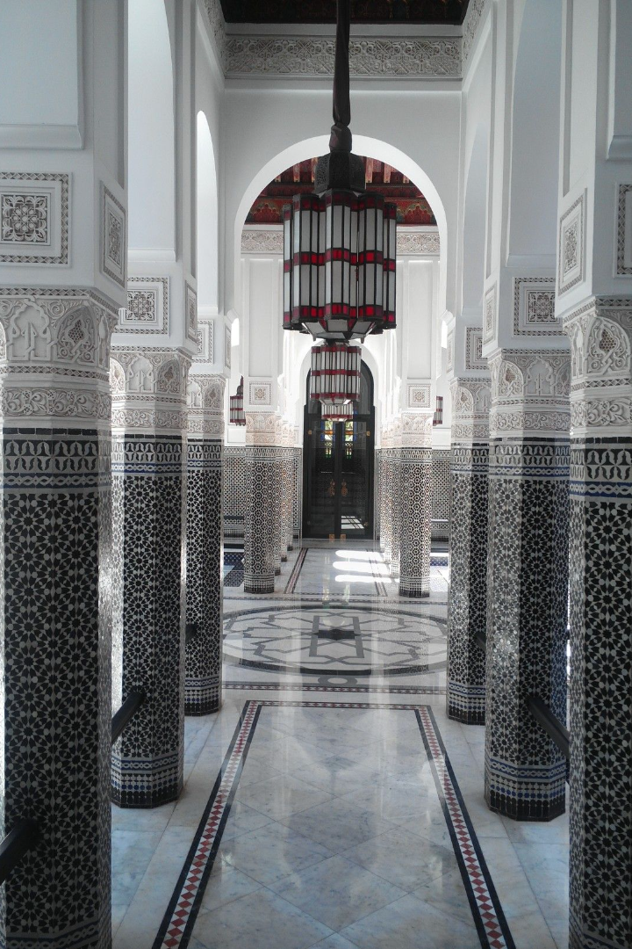
Vernacular architecture in Africa

Slide 16
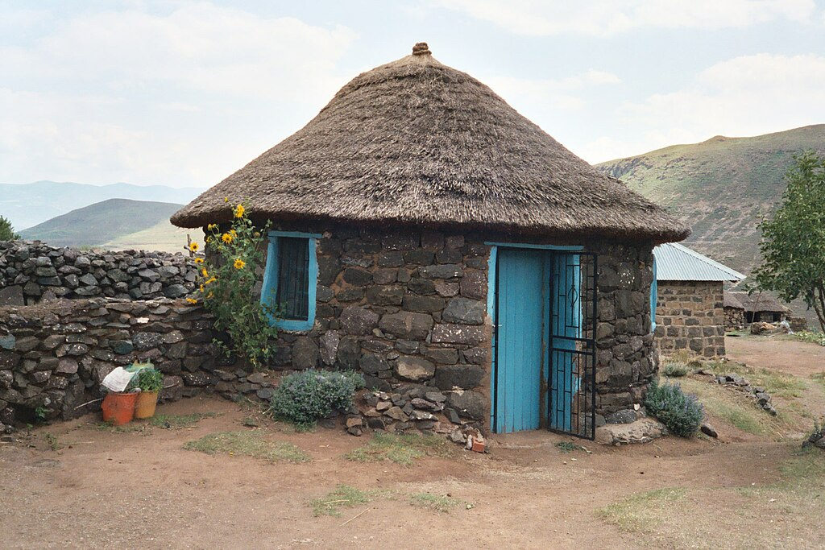
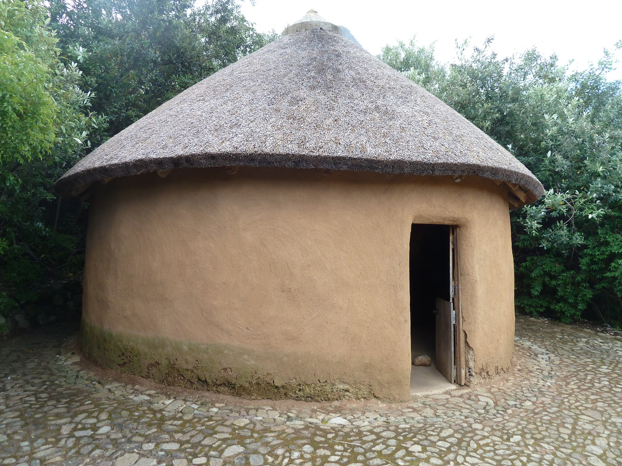
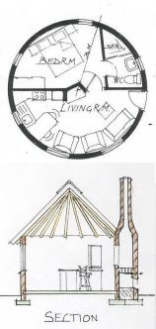
Rondavel, Southern Africa
The Rondavel, a structure with significant cultural value, is predominantly round or oval. This architectural form is deeply rooted in the vernacular traditions of Southern Africa.
Constructed using materials that are readily available in their natural state, The Rondavel serves as an example of environmentally friendly and sustainable construction methods. These indigenous dwellings are a common sight in the countries of South parts of Africa, They integrate perfectly with the surrounding environment.

Slide 17
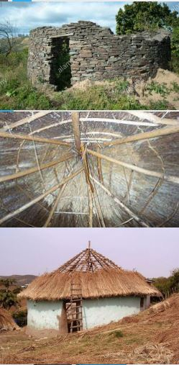
The walls are often constructed from stones. The mortar may consist of sand, soil, or combinations of these, mixed with cow dung.
The floor of a traditional rondavel is finished with a dung mixture to make it hard and smooth.
The main roofing elements of a rondavel are spars or poles taken from tree limbs, which have been harvested and cut to length.
The roof covering is of thatch that is sewn to the poles with grass rope.

Slide 18
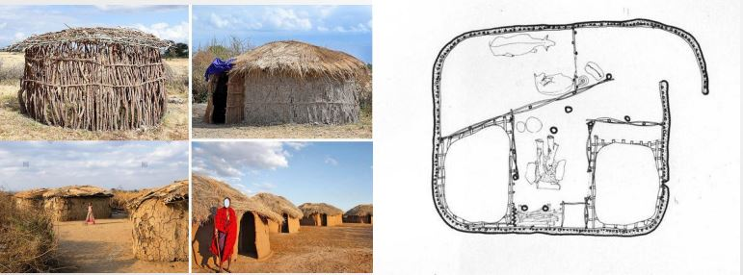
Maasai House Construction
The Maasai houses are designed to be circular or oval shaped.
Constructed as temporary abodes, these houses cater to the Maasai's need to move at
any given time.

Slide 19
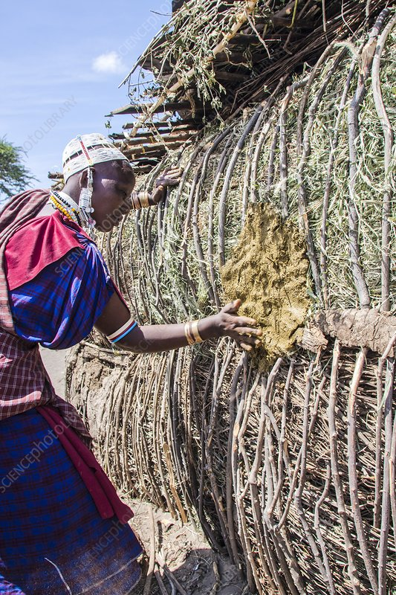
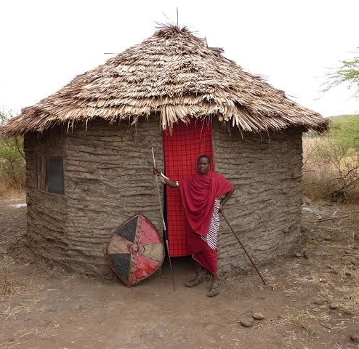
All materials used for building are natural and collected from nearby areas.
The method of construction begins with erecting the frame by fixing gathered timber poles into the ground. This is followed by interlacing the poles with a lattice of smaller branches, which are then plastered with a mixture of water, mud, cow dung, and even human urine.
Finishing touches on the Maasai house are applied using a mix of cow dung and water.
Given the Maasai's need for mobility, their houses are designed to be temporary structures.

Slide 20
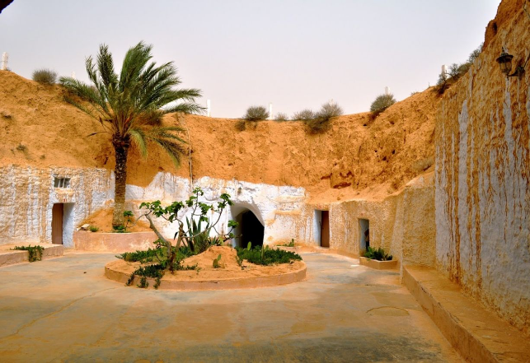
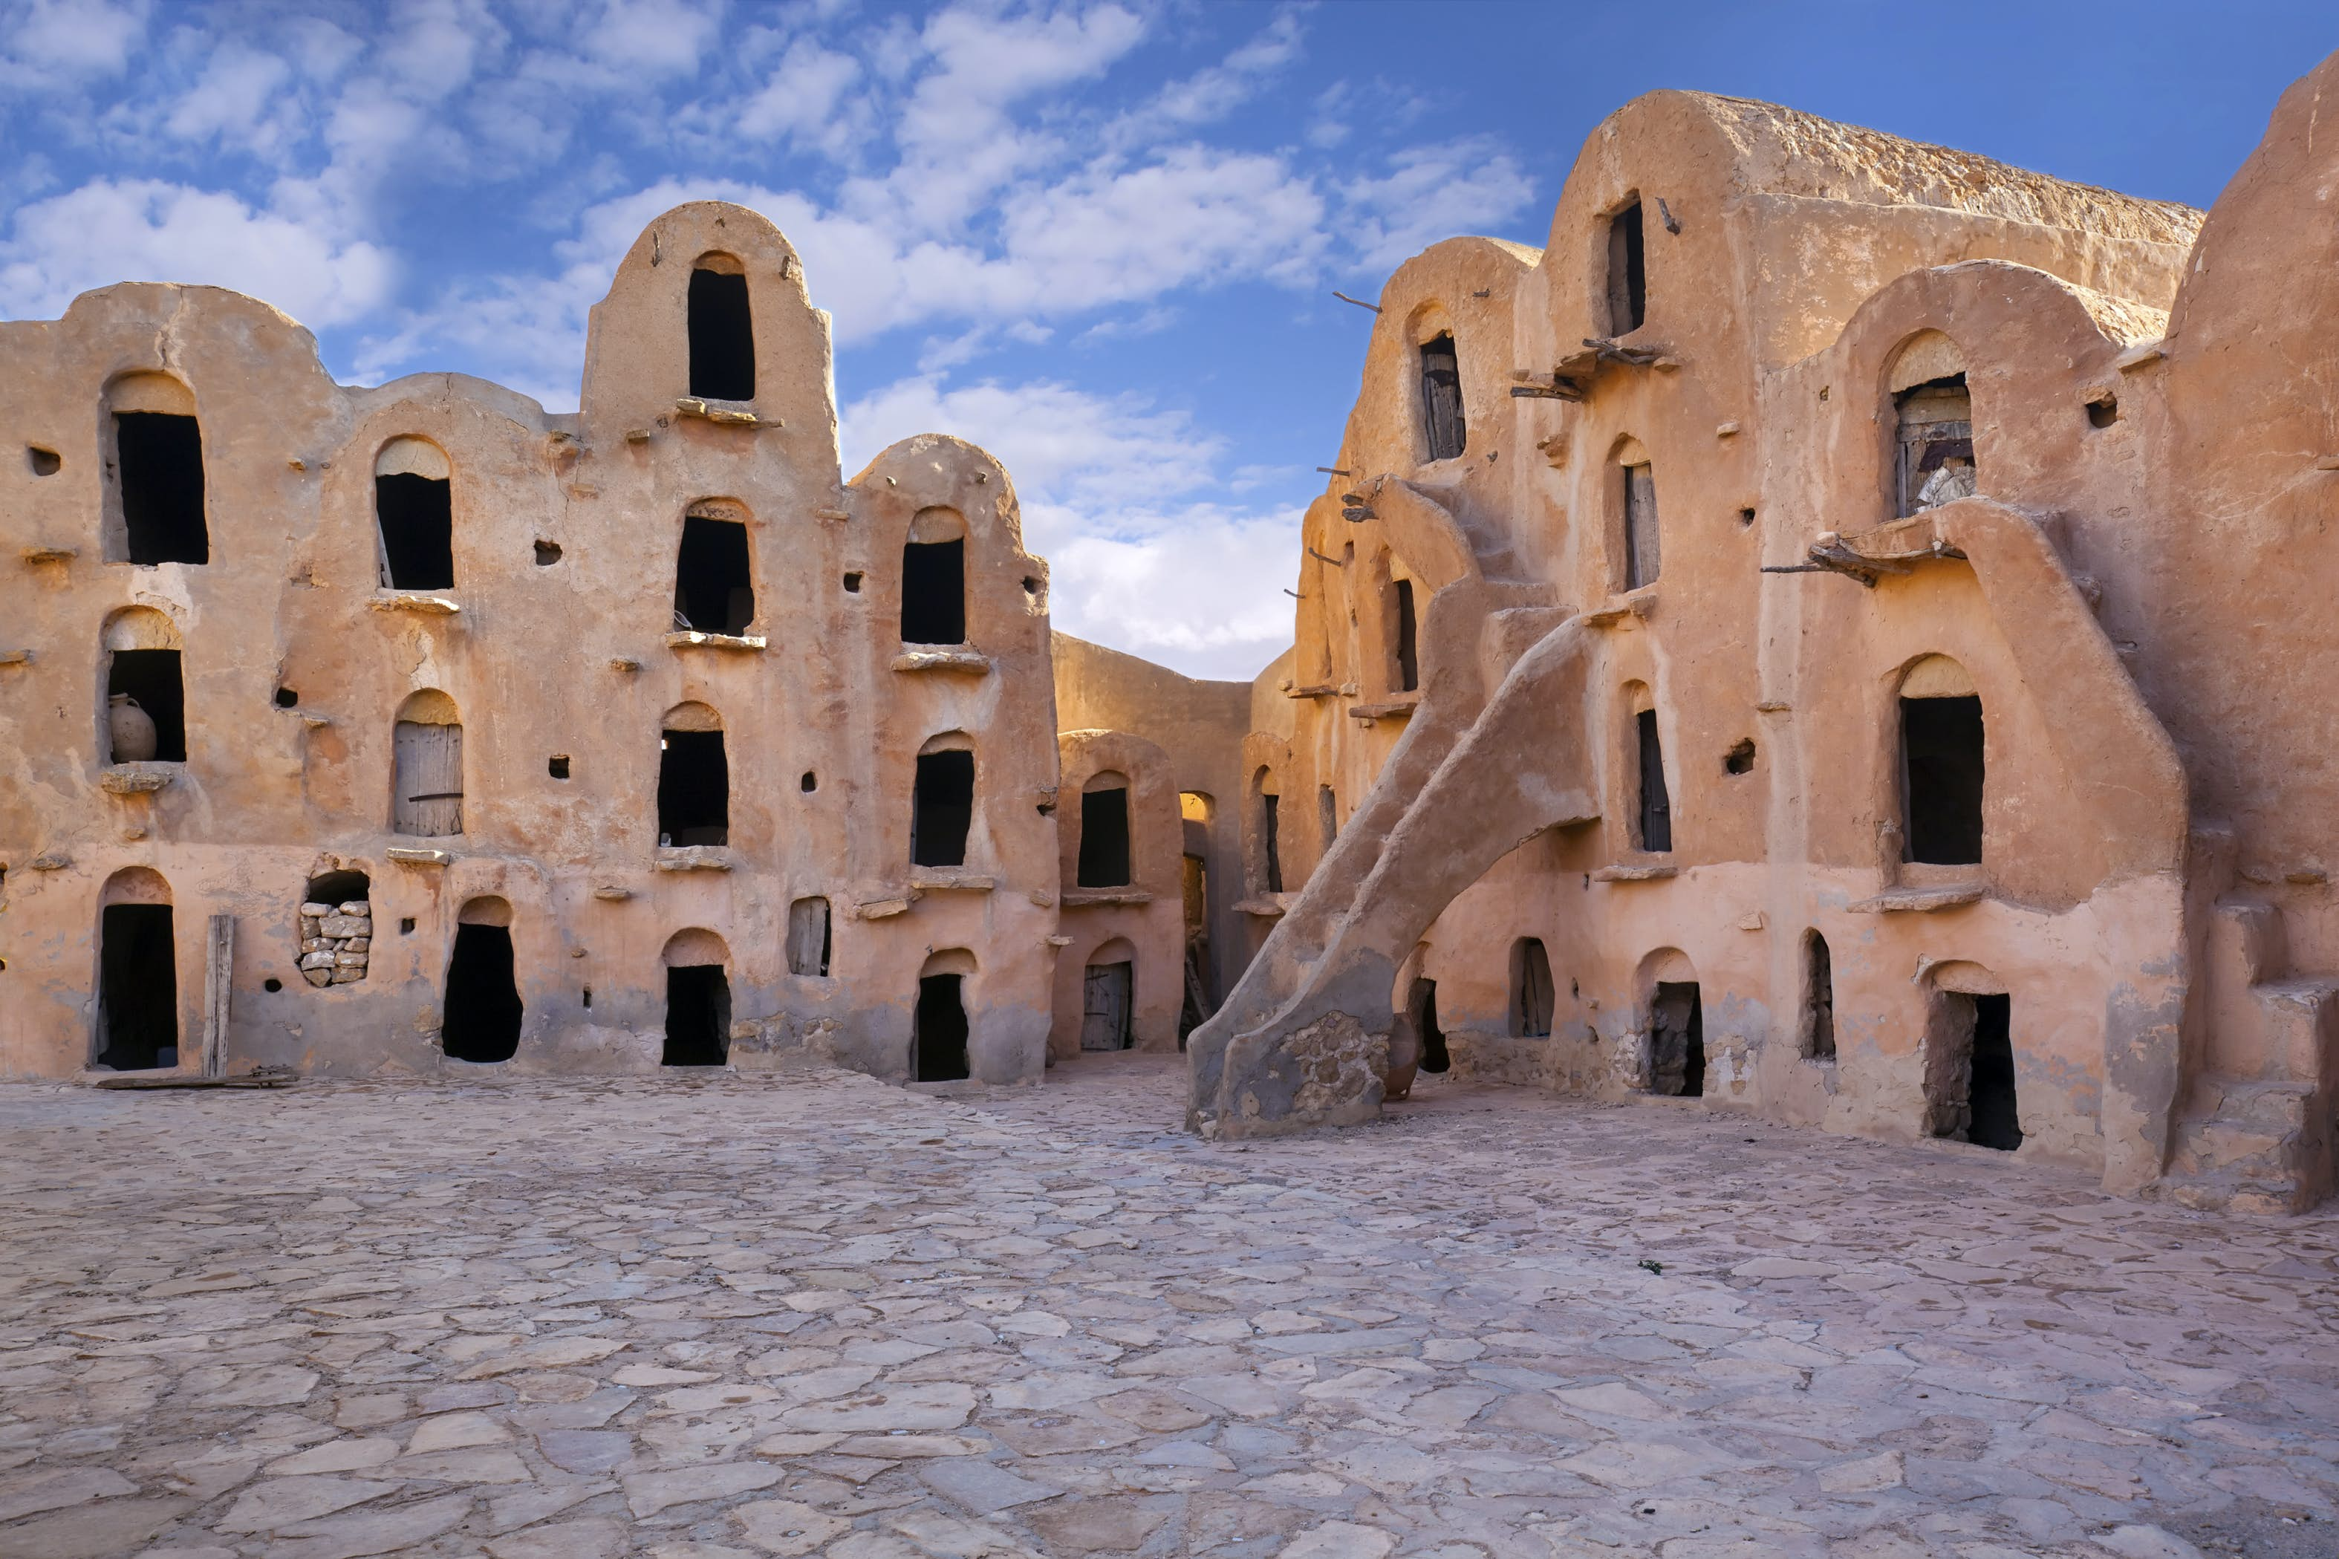
The Fortified Ksar Ouled Debbab of Tataouine, Tunisia
These are the vaulted adobe homes of the 15th century Ksar Ouled Debbab, located in southwest of the city of Tataouine, Tunisia.
The walls of these homes are constructed from thick mud bricks, complemented by palm wood doors.
These specific architectural features were instrumental in helping to keep food cool within the homes.

Slide 21
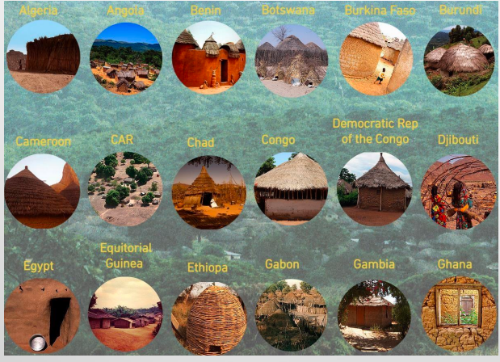
African Vernacular Architecture
African vernacular architecture data base

Slide 22
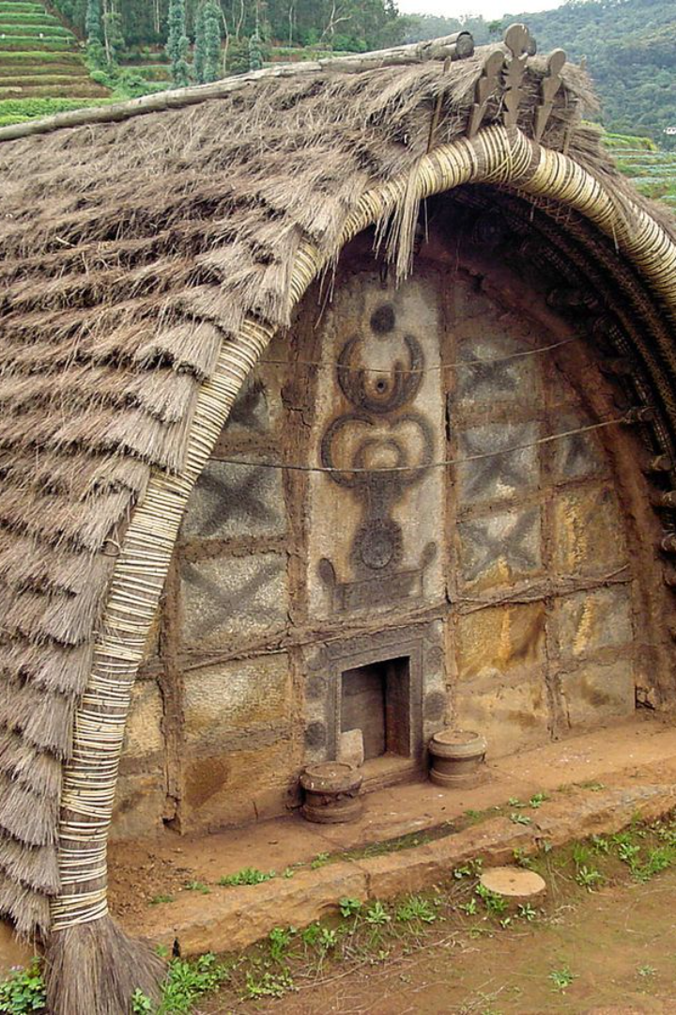
Vernacular architecture in Australia
Exploring the unique number of traditional dwellings that are designed based on local needs, availability of construction materials, and reflecting local traditions.

Slide 23
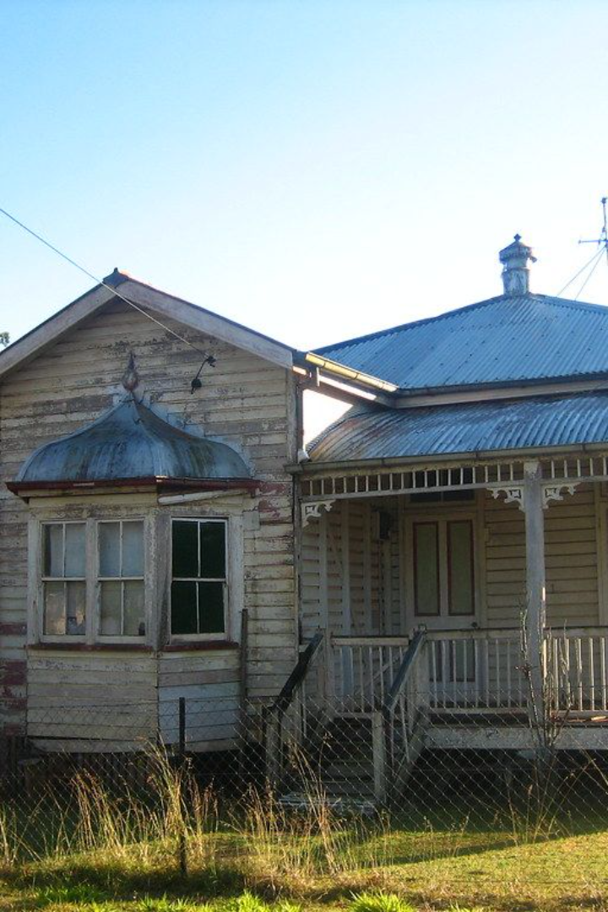
Typical Queenslander, Australia
The typical "Queenslander" house in Australia is a unique, single-story home made mostly of timber with a corrugated iron roof. Set on individual land plots, these houses contribute to the region's distinct streetscape.
Characterized by their elevated design and iconic verandas that partially extend around the house, they are aesthetically pleasing and functional, especially in the Australian climate.

Slide 24
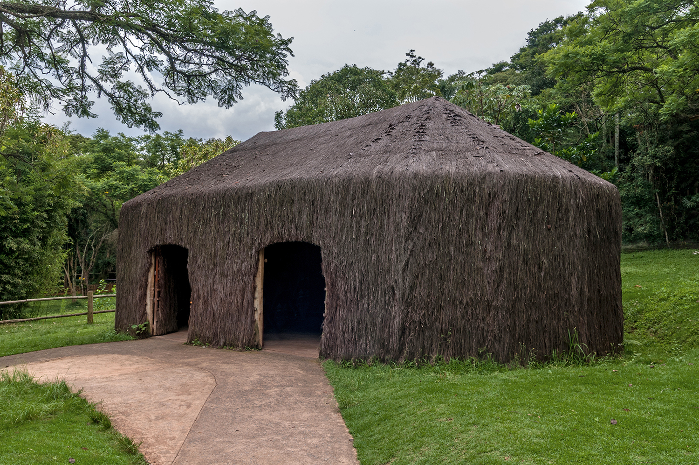
Vernacular architecture in South America
Brazilian Houses, Brazil
South America: Vernacular
Collective Living
Daily Activities Hub
The vernacular architecture of South America is exemplified by structures such as the Oca (or Oga), which are integral to the formation of villages.
Constructed primarily from straw and timber, the Oca serves as a collective living space without interior separations, fostering a sense of community.
This traditional dwelling is not only a residence but also a central hub for daily activities, including cooking and the creation of artisanal objects.

Slide 25
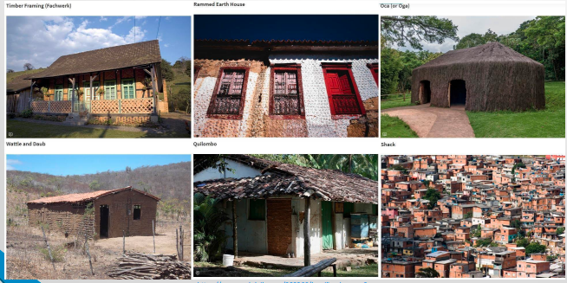
Timber Framing (Fachwerk)
Rammed Earth House
Oca (or Oga)
Wattle and Daub
Quilombo
Shack
Brazilian Houses: 9 Examples of Residential Vernacular Architecture | ArchDaily

Slide 26
Vernacular architecture in North America
North America : vernacular North America has a wonderful array of vernacular architecture, from the indigenous native forms to the imported European styles that have overlaid the landscape

