Slide 1
Introduction to Endocrinology
Zhikal O. Khudhur
Endocrinology BIO
Spring Semester
Week number:
Date: 1/ 2024

Slide 2
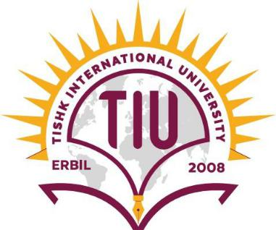
Objectives
Glands and types of glands
Endocrine system and target tissues
Endocrine glands
Chemistry of hormones
Endocrinology Terms.

Slide 3
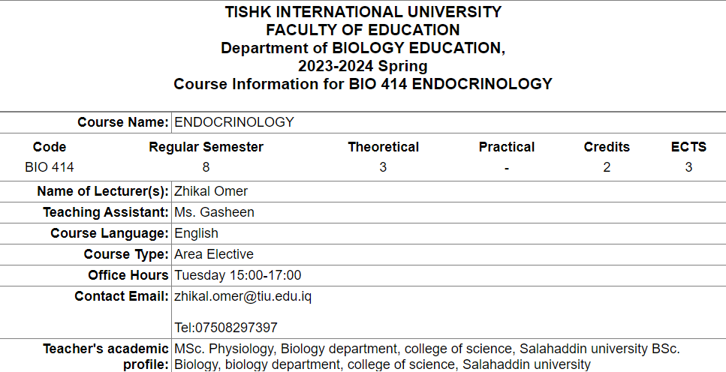

Slide 8
Types of glands
Gland: an organ that makes one or more substances, such as hormones, digestive juices, sweat, tears, saliva, or milk.
Exocrine glands: release their cellular secretions through a duct which empties to the outside or into the lumen (empty internal space) of an organ. These include sweat glands, salivary and pancreatic glands, and mammary glands. They are not considered a part of the endocrine system.
Endocrine glands: are ductless. This means that they do not have ducts to take their secretions to specific sites. Instead, hormones are secreted directly into capillaries and circulate in the blood throughout the body.

Slide 9
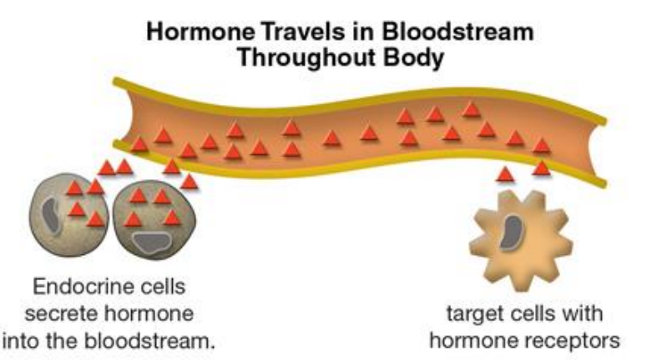
Endocrine system, hormones and target tissues
Endocrine system consists of endocrine glands that secrete chemicals called hormones and produces long-term responses.
Hormones are chemical messengers that stimulate specific cells or tissues into action.
Each hormone exerts very specific effects on certain organs, called target organs or target tissues
Receptor is a molecule inside or on the surface of a cell (target cell) that binds to hormone
Some hormones, such as insulin and thyroxine, have many target
organs. Other hormones, such as calcitonin and some pituitary gland
hormones, have only one or a few target organs.

Slide 10
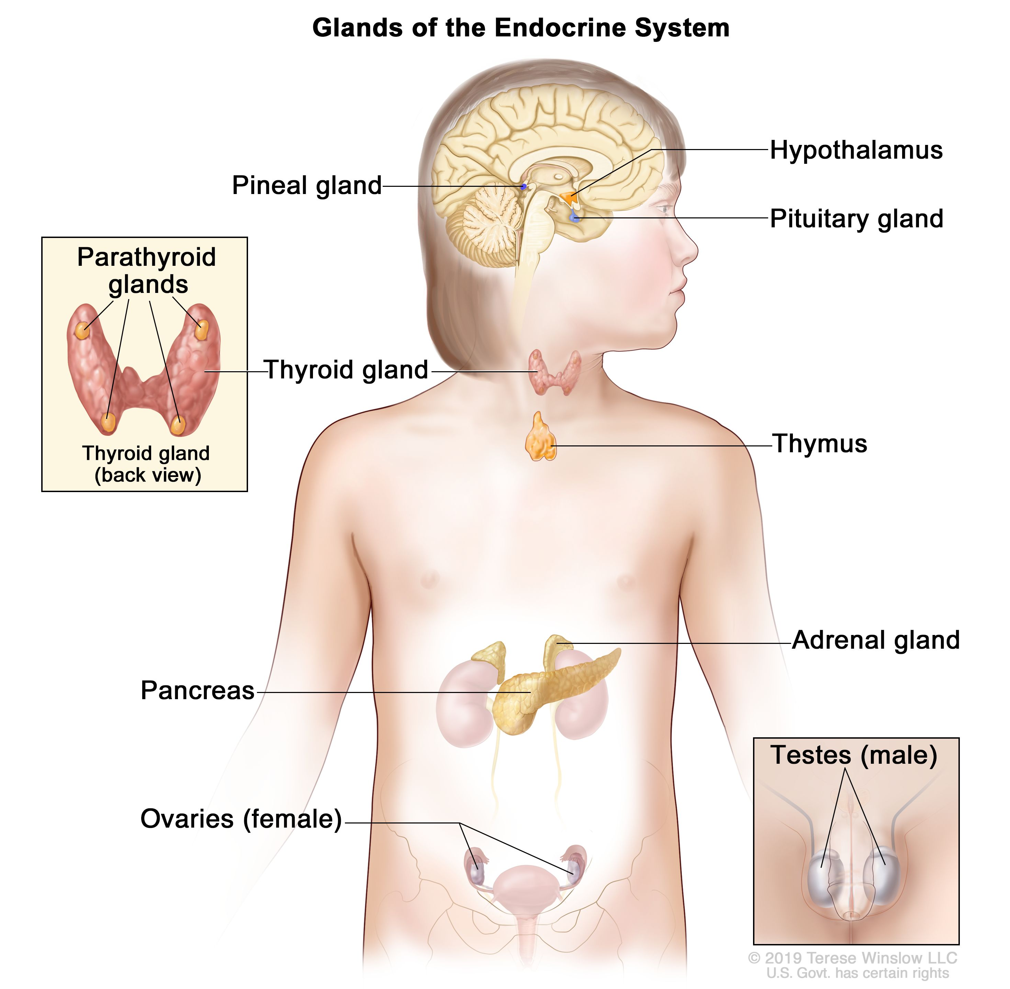
Endocrine glands
Figure 1: The Endocrine System. Location of endocrine glands

Slide 11
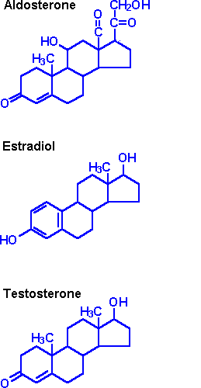
Chemistry of the hormones
Hormones are organized into three main classes based on their chemical structure:
1. Steroid hormones are synthesized from cholesterol
Steroid hormones are lipid-soluble, so they can pass through cell membranes to reach receptor molecules located inside their target cells.
Example of steroid hormones: aldosterone, estrogen, and testosterone.

Slide 12
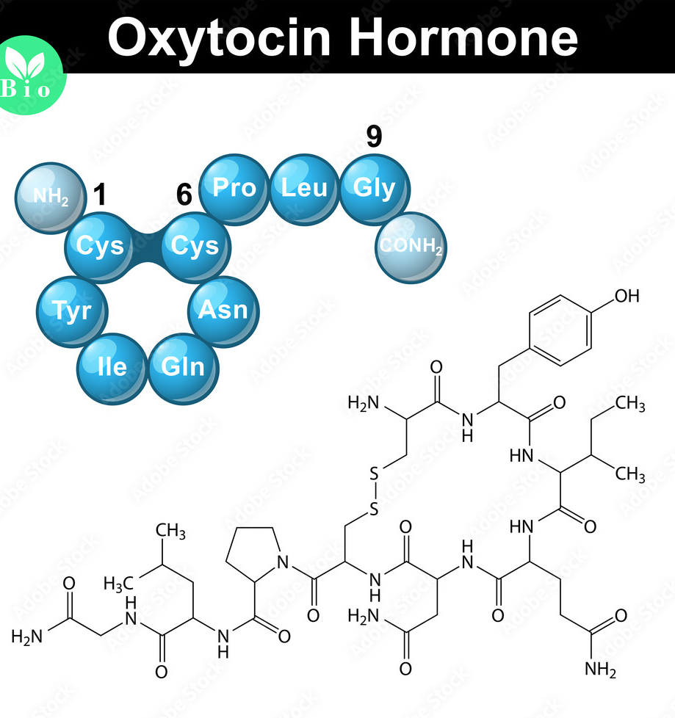
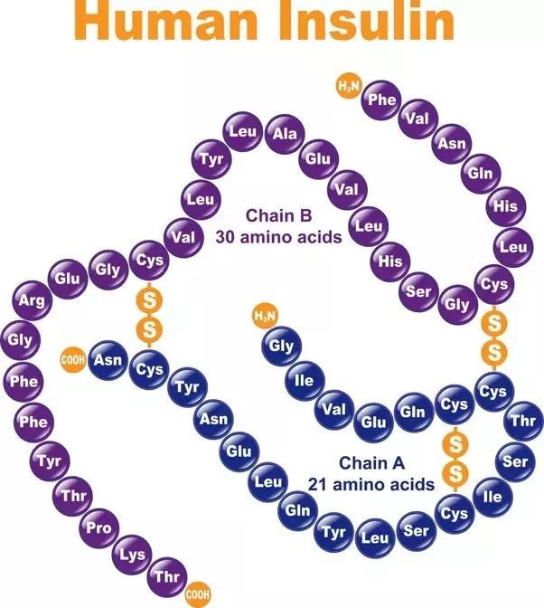
Chemistry of the hormones
2. Peptide and protein hormones are structured from chains of amino acids
These hormones are chains of amino acids
Short chains of amino acids called peptides
Oxytocin is peptide hormone
Long chains of amino acids called proteins.
Insulin is protein hormone.

Slide 13
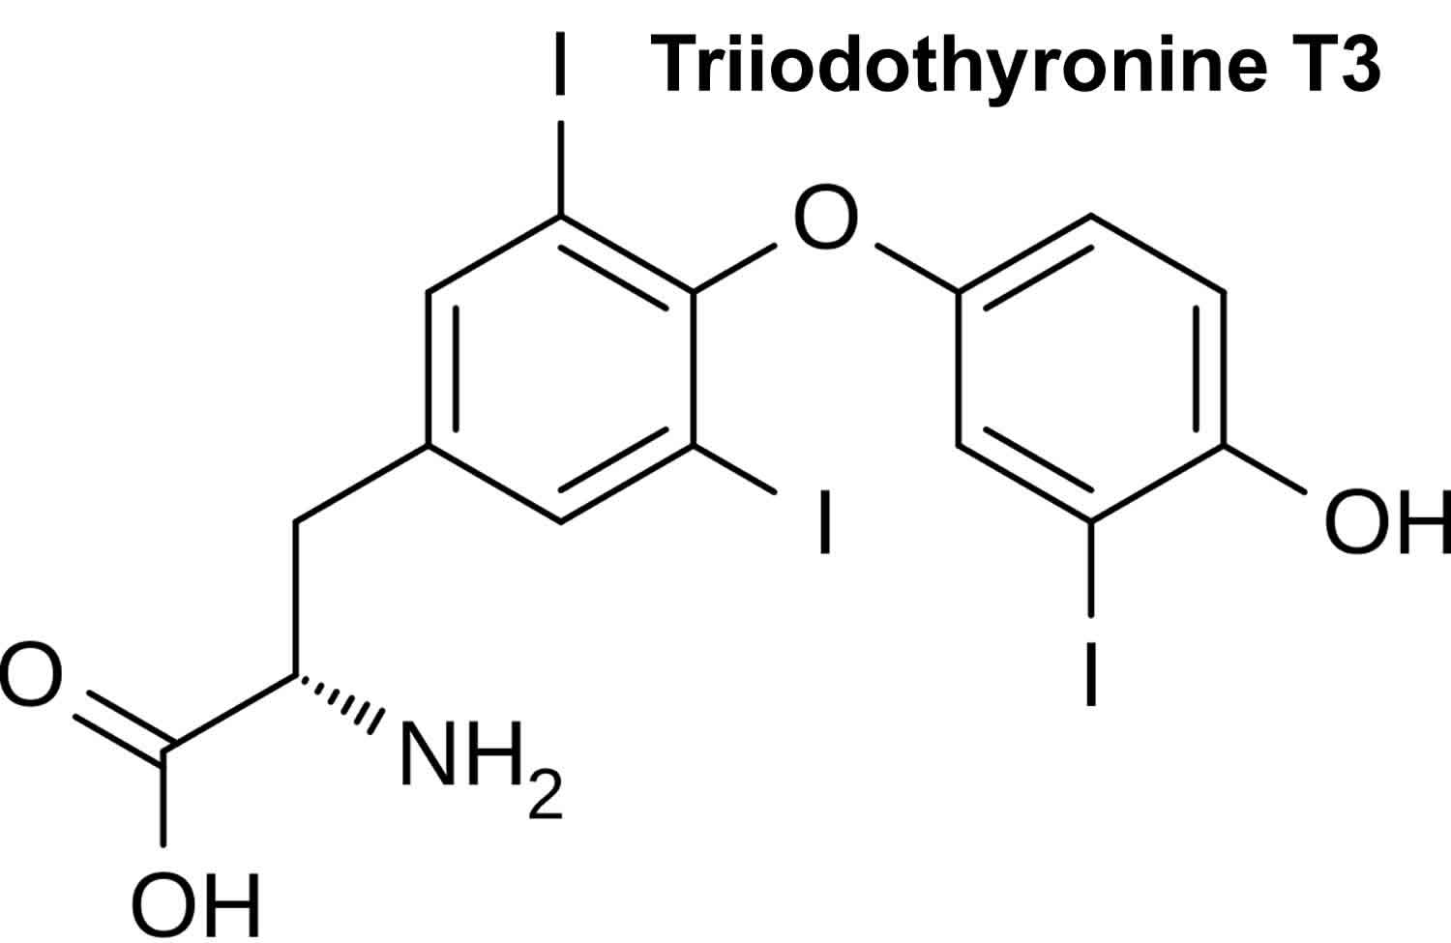
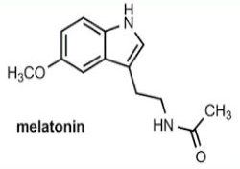
Chemistry of the hormones
3. Amine hormones are modified amino acids (Amino acid derivatives)
These simple hormones are structural variations of the amino acids.
The derivatives of tyrosine, such as the thyroid hormones released by the thyroid gland.
Melatonin, secreted by the pineal gland, is derived from tryptophan.

Slide 14
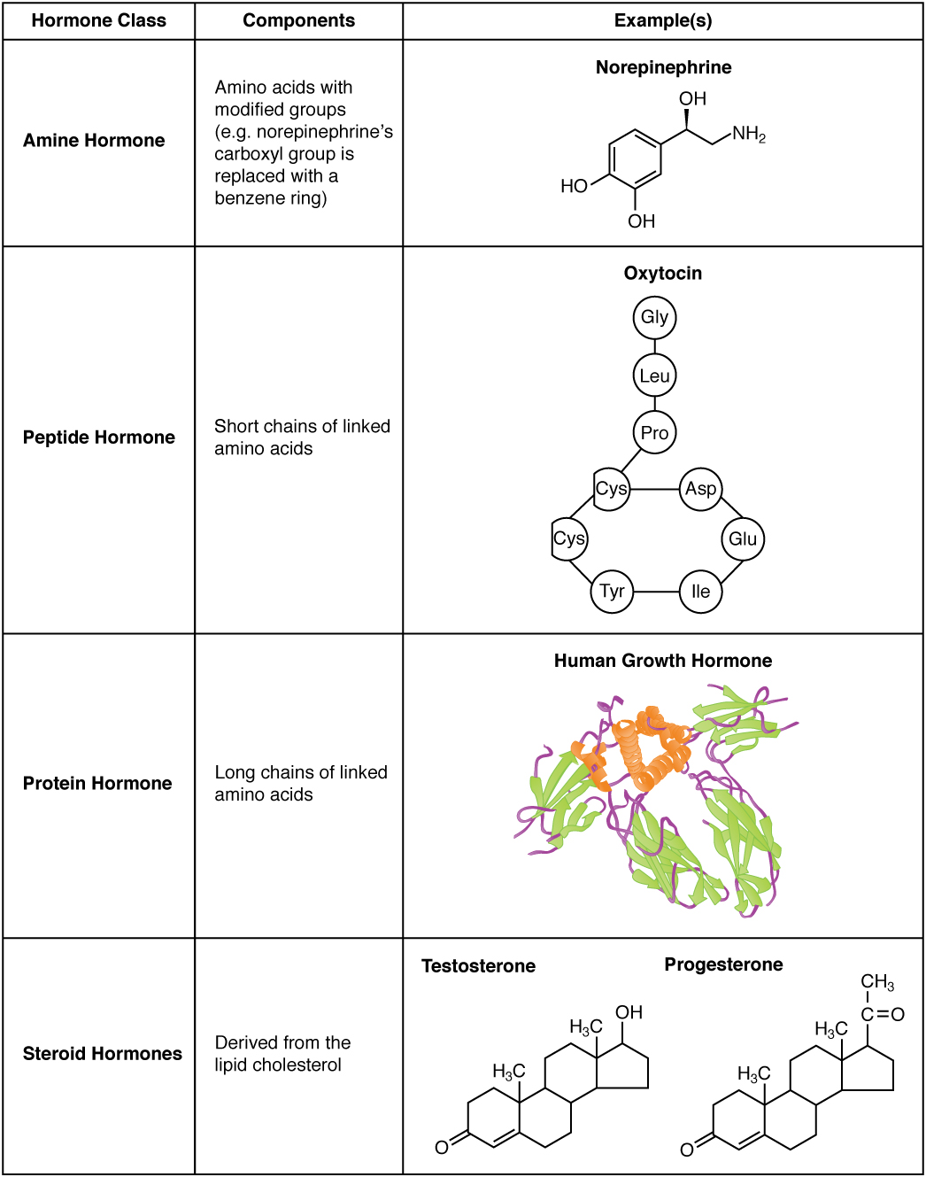
Chemistry of the hormones

Slide 15
Endocrine terminology
Acromegaly is a hormonal disorder where the pituitary gland produces excess amounts of growth hormone.
Adrenal Cortex—The adrenal cortex is the outer portion of the adrenal gland and it produces steroid hormones, which regulate carbohydrate and fat metabolism, and mineralocorticoid hormones, which regulate salt and water balance in the body.
Adrenal glands are triangle-shaped glands that sit on top of the kidneys. They regulate stress response through the synthesis of hormones, including cortisol and adrenaline.
Adrenaline is a hormone that triggers the body’s fight-or-flight response. It is produced in the medulla in the adrenal glands as well as some of the central nervous system’s neurons.
Adrenocorticotropin (ACTH)—Adrenocorticotropin is a hormone produced by the anterior pituitary gland that stimulates the adrenal cortex.
Androgens are hormones that help to develop sex organs in men. They also contribute to sexual function in men and women.
Andropause is a biological change characterized by a gradual decline in androgens experienced by men during and after their mid-life. Andropause is sometimes inaccurately described as male menopause.
Angiotensin is the common name of four hormones: angiotensin I-IV, which play an important role in the body’s overall health and blood pressure regulation.
Antiandrogens are substances that inhibit the biological effects of androgenic hormones.

Slide 16
Benign prostatic hyperplasia is non-cancerous enlargement of the prostate gland, a common occurrence in older men.
Diabetes is a disease in which blood glucose levels are above normal. The body of a person with diabetes either doesn't make enough insulin or can't use its own insulin as well as it should.

Slide 17
Calcitonin is a protein hormone secreted by cells in the thyroid gland. It inhibits cells that break down bone and helps to regulate the blood’s calcium and phosphate levels.
Cholecystokinin, otherwise known as CCK or CCK-PZ, is able to improve digestion and affects appetite.
Cholesterol is a white crystalline substance found in animal tissues and various foods that is normally synthesized by the liver. Cholesterol levels can be a risk factor for heart disease.
Congenital adrenal hyperplasia refers to a group of inherited adrenal gland disorders. People with this condition do not produce enough of the hormones cortisol and aldosterone, and produce too much of androgen.
Cortisol is a hormone produced by the adrenal gland. It is involved in the stress response and increases blood pressure and blood sugar levels.
Cushing syndrome is a hormonal disorder caused by prolonged exposure of the body's tissues to high levels of the hormone cortisol. Sometimes called "hypercortisolism," it is relatively rare and most commonly affects adults aged 20 to 50.

Slide 18
Endocrinologists are specially trained physicians who diagnose diseases related to the glands. Because these doctors specialize in these conditions, which can be complex and have
hard-to-spot symptoms, an endocrinologist is your best advocate when dealing with hormonal issues.
Erythropoietin is a hormone directly connected to red blood cell production and maintenance. Low levels of this hormone occur when someone has chronic kidney diseases.
Estradiol, a type of estrogen, is a female sex hormone produced mainly by the ovaries. It is responsible for growth of breast tissue, maturation of long bones, and development of the secondary sexual characteristics.
Estrogens are a group of steroid compounds that are the primary female sex hormones. They promote the development of female secondary sex characteristics and control aspects of regulating the menstrual cycle.
Estrogen therapy is a hormone therapy treatment program in which women take estrogen orally, transdermally, or vaginally to treat certain menopausal symptoms.

Slide 19
Free Testosterone—Free testosterone is testosterone in the body that is biologically active and unbound to other molecules in the body, such as sex hormone binding globulin.
Follicle Stimulating Hormone (FSH)—In women, FSH helps control the menstrual cycle and the production of eggs by the ovaries. The amount of FSH varies throughout a woman's menstrual cycle and is highest just before she ovulates. Problems with FSH release can contribute to female infertility. In men, FSH helps control the production of sperm.

Slide 20
Gastrin is a hormone the stomach produces. When you eat, gastrin stimulates the release of gastric acid, an important part of the digestive process.
Ghrelin is central to appetite and the release of growth hormone. Produced in the stomach and small intestine, ghrelin has been called the "hunger hormone" because of its role in controlling appetite.
Glands produce and secrete hormones that the body uses for a wide range of functions. These control many different bodily functions, including respiration, metabolism, reproduction, sensory perception, movement, sexual development, and growth.
Glucagon is a hormone that works with other hormones and bodily functions to control glucose levels in the blood. It comes from alpha cells found in the pancreas and is closely related to insulin-secreting beta cells, making it a crucial component that keeps the body’s blood glucose levels stable.
Glucagon-like peptide 1 (GLP-1) helps regulate your appetite, especially after eating. It also helps enhance the production of insulin.
A gonad is an organ that produces sperm and egg cells known as gametes. The gonads in males are the testes, and the gonads in females are the ovaries.
Graves disease is the most common form of hyperthyroidism. It occurs when your immune system mistakenly attacks your thyroid gland and causes it to overproduce the hormone thyroxine.
Growth hormone is a substance that controls your body’s growth. Growth hormone is made by the pituitary gland, located at the base of the brain. Growth hormone helps children grow taller, increases muscle mass, and decreases body fat.
Gynecomastia is breast enlargement in boys or men due to a benign increase in breast tissue. This condition results from an imbalance between the hormones testosterone and estrogen.

Slide 21
Hirsutism is excessive "male" pattern hair growth that appears on the face, back, chest, abdomen, and thighs in women.
Hormones—Made by endocrine glands, hormones are chemical messengers that travel in the bloodstream to tissues or organs. They affect many processes, including growth, metabolism, sexual function, reproduction, and mood.
Hormone therapy is the use of hormones in medical treatment. For example, doctors may use hormone therapy to boost estrogen levels in menopausal women. Other examples include thyroid hormone replacement for thyroid deficiency, insulin therapy for diabetes
Hot flashes refer to the sudden wave of mild or intense body heat caused by dilation of capillaries in the skin resulting from decreased levels of estrogen. Hot flashes affect about 75 percent of women as they go through menopause.
The human chorionic gonadotropin (hCG) hormone is important in the early stages of pregnancy. It is produced by cells that are surrounding a growing embryo, which eventually forms the placenta.
Hypoglycemia, also called low blood sugar, occurs when your blood glucose level drops too low to provide enough energy for your body's activities. Patients with severe hypoglycemia may experience unconsciousness or seizures due to low blood sugar.
Hypogonadism, or low testosterone, occurs when a man’s testes fail to produce sufficient quantities of testosterone and/or sperm quality is impaired.
The hypothalamus is an area of the brain that regulates vital autonomic centers and produces hormones that control thirst, hunger, body temperature, sleep, moods, sex drive, and the release of hormones from various glands, primarily the pituitary gland.

Slide 22
Insulin is a protein pancreatic hormone involved in the metabolism of carbohydrates and the regulation of glucose levels in the blood. Diabetes occurs when the body doesn’t produce enough insulin or use the hormone effectively.
IGF-1, or insulin-like growth factor 1, is a polypeptide protein hormone similar in molecular structure to insulin. It plays an important role in childhood growth and continues to have anabolic effects in adults. IGF-1 has been identified as a

Slide 23
References
Greenstein B. & Wood D. F. (2011). The endocrine system at a glance (3rd ed.). Wiley-Blackwell
Melmed S. Auchus R. J. Goldfine A. B. Koenig R. Rosen C. J. & Williams R. H. (2020). Williams textbook of endocrinology (14th ed.). Elsevier. Boron W. F. & Boulpaep E. L. (2021).
Boron & boulpaep concise medical physiology. Elsevier. Barrett K. E. Barman S. M. Yuan J. X.-J. & Brooks H. (2019).
Ganong's review of medical physiology (review questions) (26th ed.). McGraw-Hill Education LLC Molina P. E. (2018). Endocrine physiology (Fifth). McGraw-Hill Education.

Slide 24
Thank you

