Slide 1
Hypothalamus
Zhikal O. Khudhur
Endocrinology BIO 414
Spring Semester
Week number: 3
Date: 2/ 2024

Slide 2
Objectives
Hypothalamus
Hypothalamic hormones
The Hypophyseal Portal System
Posterior pituitary
oxytocin

Slide 3
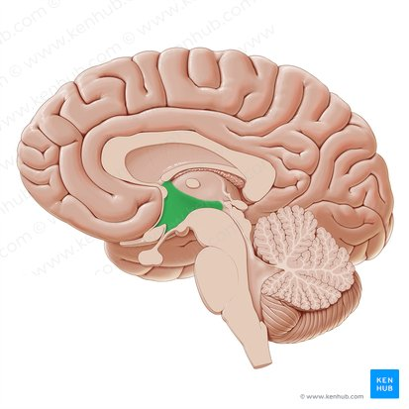
Hypothalamus
The hypothalamus is a gland in human brain that controls human hormone system.
The hypothalamus, shaped like a flattened funnel, forms the floor and walls of the third ventricle of the brain
The hypothalamus connects the nervous system to the endocrine system. It receives and processes signals from other brain regions and pathways and translates them into hormones, the chemical messengers of the endocrine system.

Slide 4
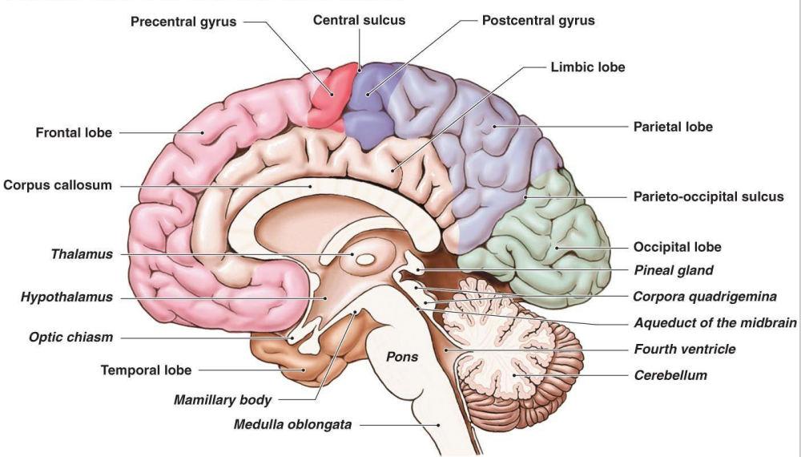
Hypothalamus

Slide 5
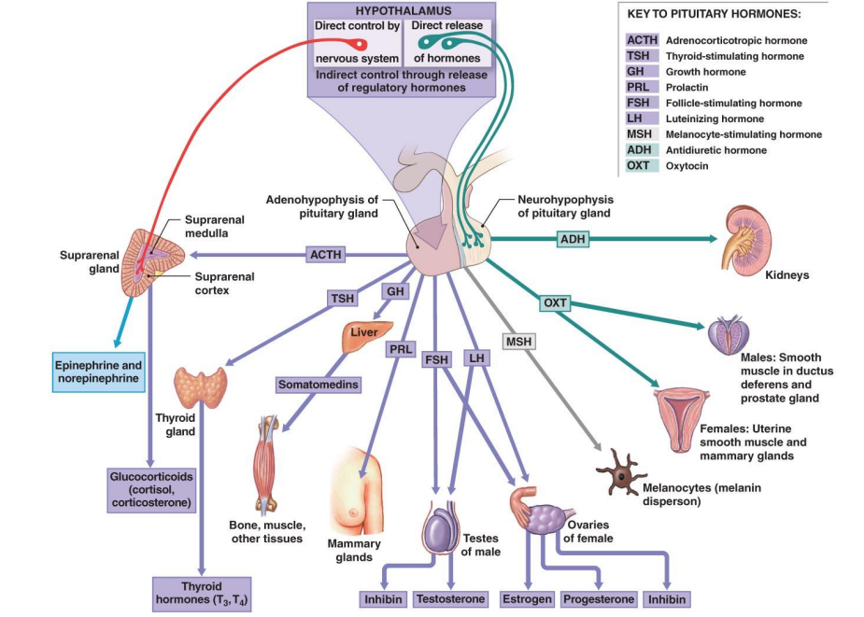
Hypothalamus

Slide 6
Hypothalamus regulates primitive functions of the body ranging from water balance and thermoregulation to sex drive and childbirth.
Hypothalamus releases hormones to another part of human brain called the pituitary gland, which sends hormones out to different organs.
Many of its functions are carried out by way of the pituitary gland, which is closely associated with it both anatomically and physiologically.
Hypothalamus

Slide 7
The hypothalamus produces nine hormones.
Seven of them, as shown, regulates the anterior pituitary and two that are stored in the posterior pituitary and released on demand.
Hypothalamic hormones

Slide 8
Hypothalamic hormones
The seven hormones travel through the hypophyseal portal system and regulate the activities of the anterior pituitary.
Five of these are releasing hormones that stimulate the anterior pituitary to secrete its hormones, and
Two are inhibiting hormones that suppress pituitary secretion.
Most of these hypothalamic hormones control the release of just one anterior pituitary hormone. However, Gonadotropin-releasing hormone, controls the release of both follicle-stimulating hormone and luteinizing hormone.

Slide 9
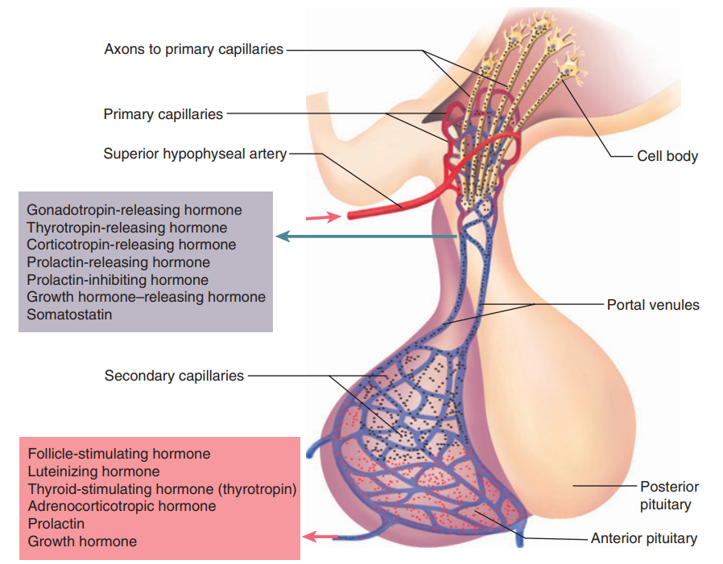
Hypothalamic hormones
Somatostatin is also called growth hormone–inhibiting hormone. Its name derives from somatotropin, a synonym for growth hormone (GH).

Slide 10
The other two hypothalamic hormones are stored in posterior pituitary gland and secreted by way of the posterior pituitary gland.
These are oxytocin (OT) and antidiuretic hormone (ADH).
OT is produced mainly by neurons in the paraventricular nuclei of the hypothalamus, so called because they lie in the walls of the third ventricle.
ADH also called vasopressin is produced mainly by the supraoptic nuclei, named for their location just above the optic chiasm.
Hypothalamic hormones

Slide 11
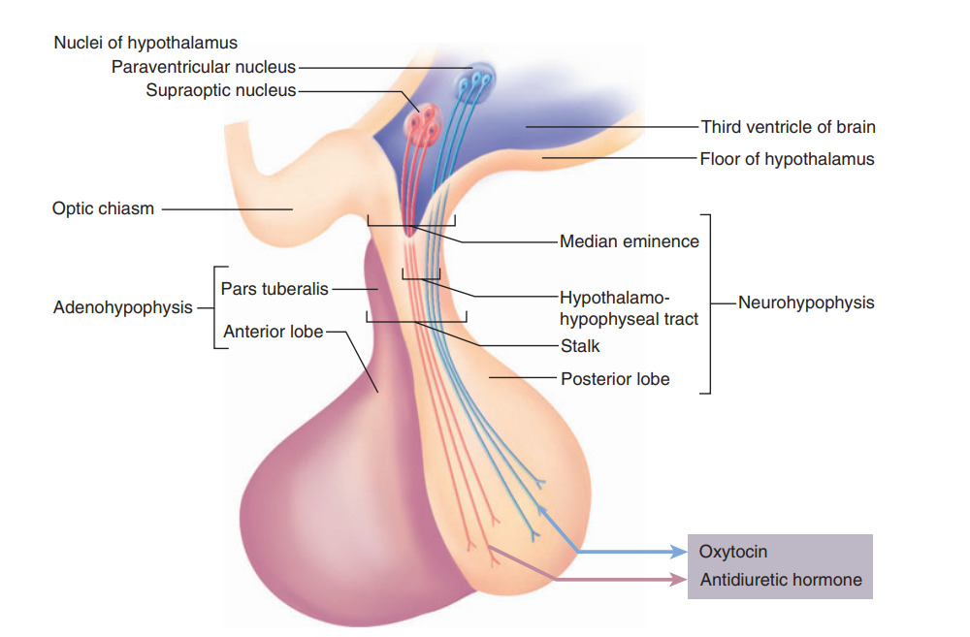
Hypothalamic hormones

Slide 12
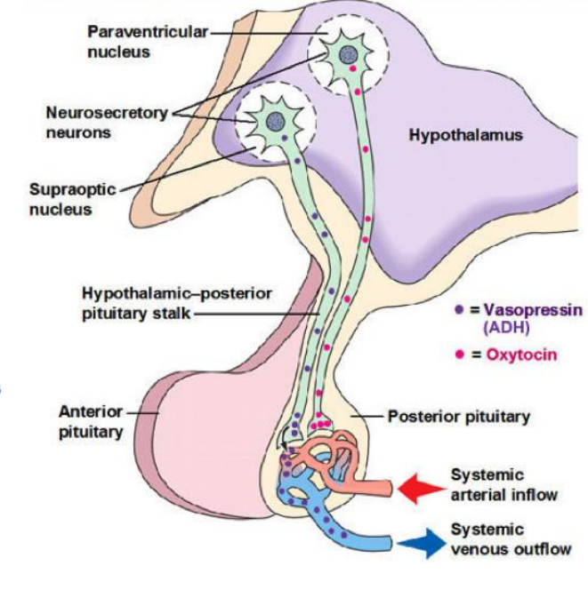
Hypothalamic hormones

Slide 13
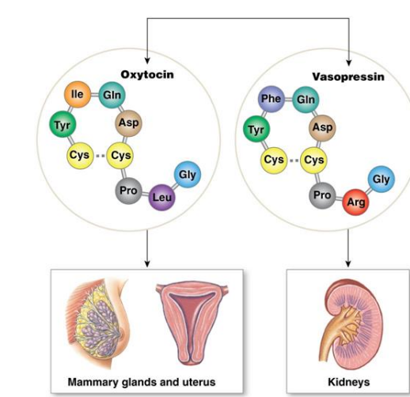
Hypothalamic hormones
Structure of OT and ADH
Target organs of OT and ADH

Slide 14
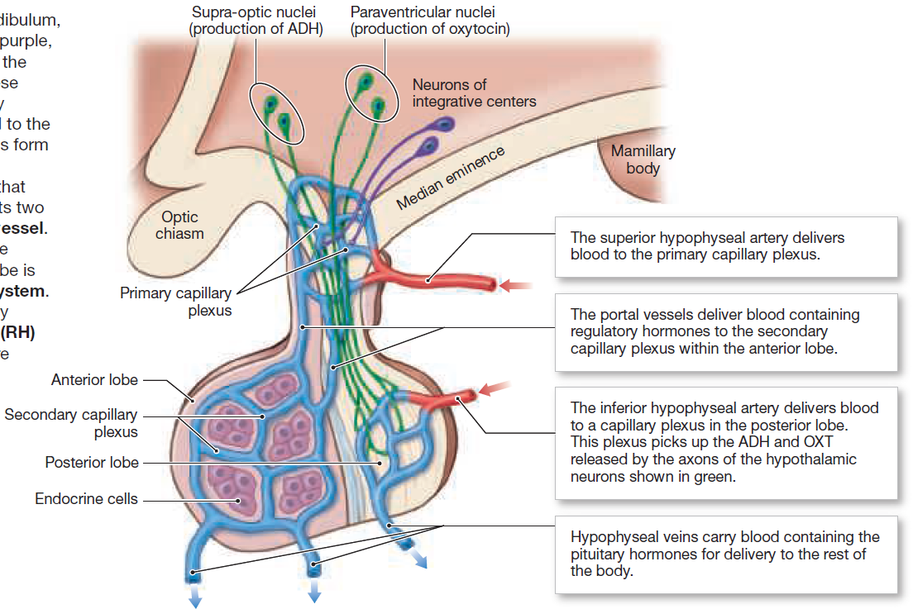
Regulatory hormones of hypothalamus diffuse into the primary capillary plexus and are delivered to anterior pituitary gland.
These blood vessels form a secondary capillary plexus that surrounds the endocrine cells in anterior pituitary gland.
The Hypophyseal Portal System

Slide 15
The Hypophyseal Portal System
A blood vessel that connects two capillary beds (plexuses) is called a portal vessel.
The entire network connecting the hypothalamus and the anterior lobe is called the hypophyseal portal system.
Two different classes of regulatory hormones, releasing hormones (RH) and inhibiting hormones (IH), are delivered this way.

Slide 16
Axes physiologically link pituitary function to the function of other endocrine glands
The hormonal relationship between the hypothalamus, pituitary, and a more remote endocrine gland is called an axis.
There are three such axes:
The hypothalamic-pituitary-gonadal axis involving GnRH, FSH, and LH
The hypothalamic-pituitary-thyroid axis involving TRH and TSH
The hypothalamic-pituitary-adrenal axis involving CRH and ACTH.

Slide 17
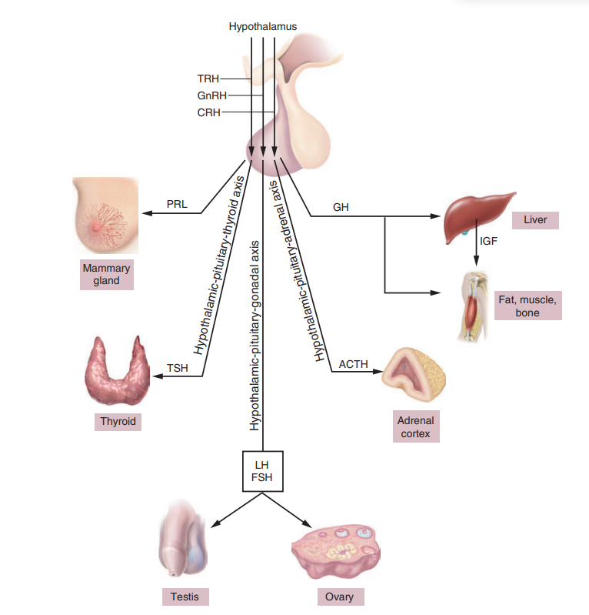

Slide 18
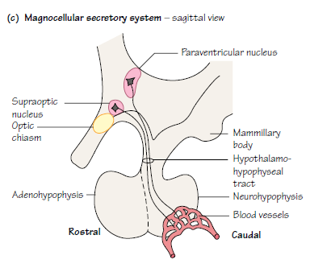
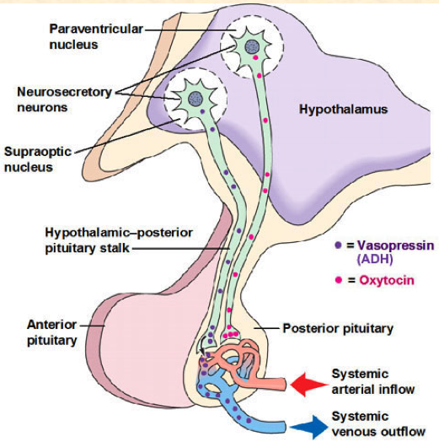
Oxytocin

Slide 19
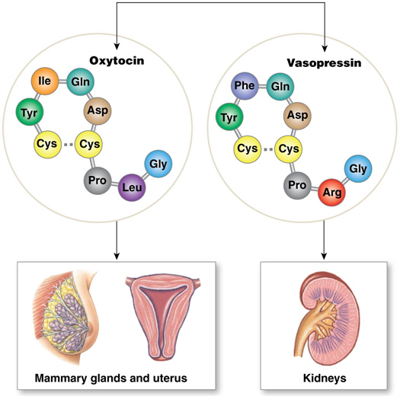
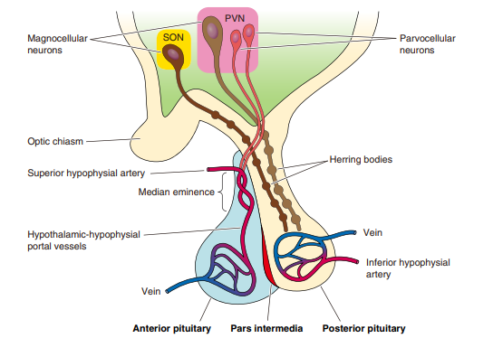

Slide 20
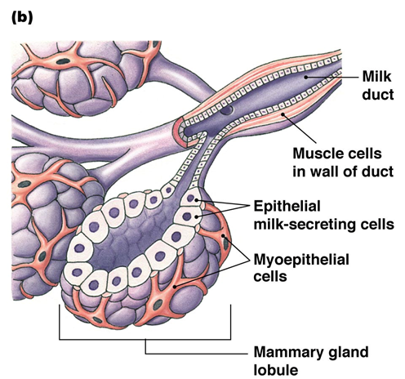
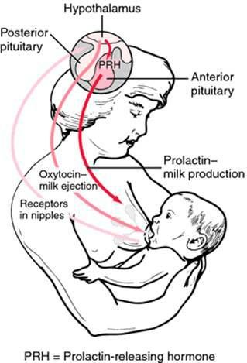
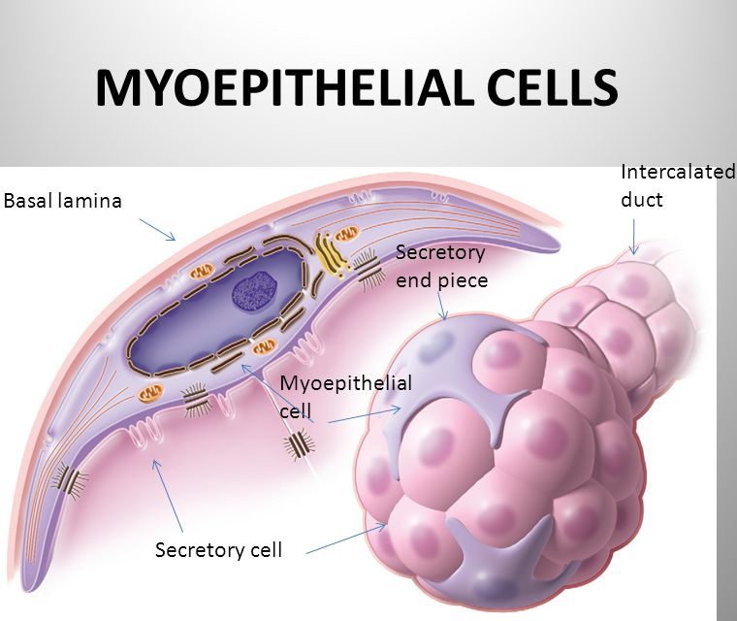
OXYTOCIN

Slide 21
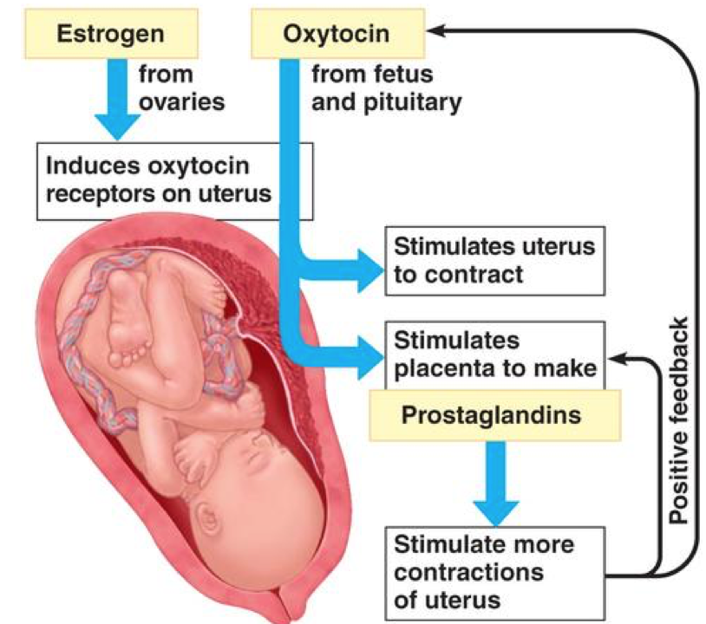
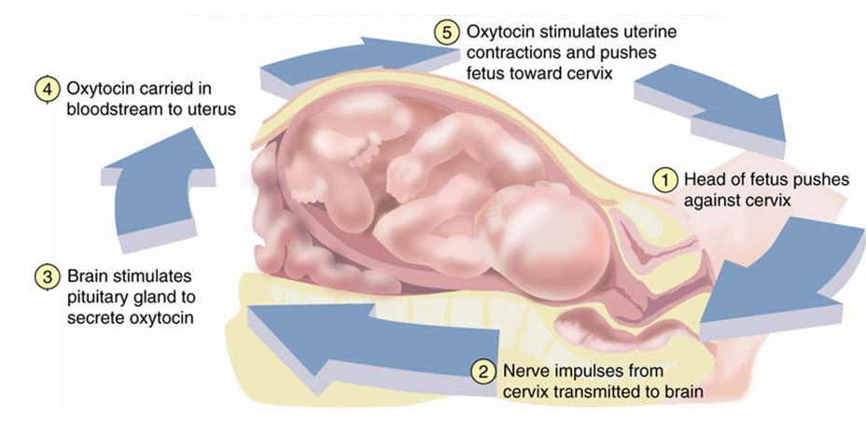

Slide 22
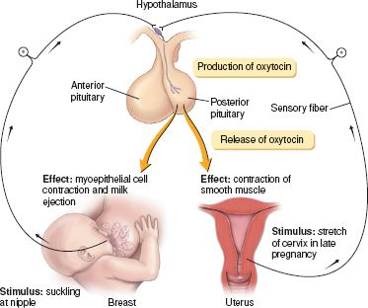

Slide 23
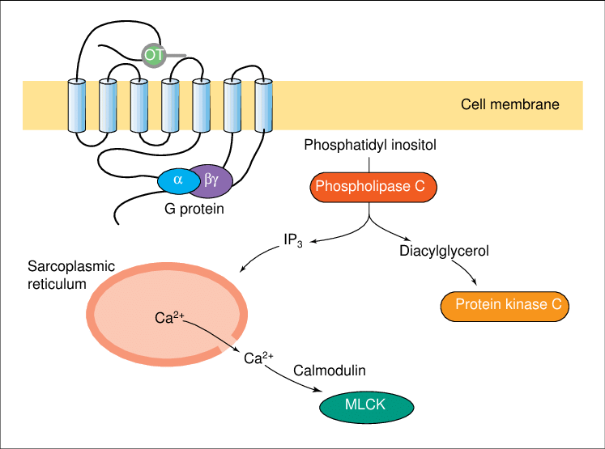
OXYTOCIN RECEPTOR

Slide 24
References
Greenstein B. & Wood D. F. (2011). The endocrine system at a glance (3rd ed.). Wiley-Blackwell
Melmed S. Auchus R. J. Goldfine A. B. Koenig R. Rosen C. J. & Williams R. H. (2020). Williams textbook of endocrinology (14th ed.). Elsevier. Boron W. F. & Boulpaep E. L. (2021).
Boron & boulpaep concise medical physiology. Elsevier. Barrett K. E. Barman S. M. Yuan J. X.-J. & Brooks H. (2019).
Ganong's review of medical physiology (review questions) (26th ed.). McGraw-Hill Education LLC Molina P. E. (2018). Endocrine physiology (Fifth). McGraw-Hill Education.

Slide 25
Thank you

