Slide 1
Anterior pituitary
Zhikal O. Khudhur
Endocrinology BIO 414
Spring Semester
Week number: 4
Date: 2/ 2024

Slide 2
Objectives
Pituitary glands
Anterior and posterior pituitary glands
Anterior and posterior pituitary gland hormones
Anterior and posterior pituitary gland hormone's target tissues
Anterior and posterior pituitary gland hormone's function
Anterior and posterior pituitary gland hormone’s regulation

Slide 3
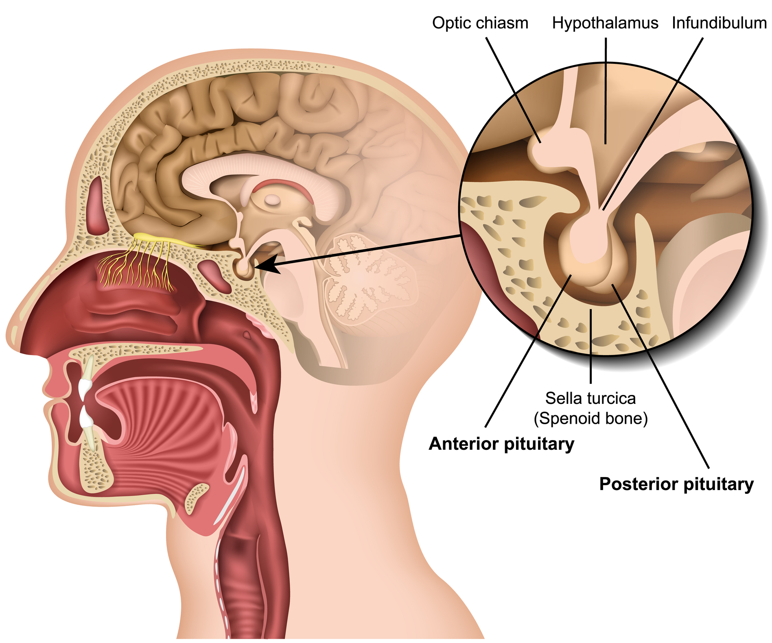
The pituitary gland
The pituitary gland also called hypophysis
Hypophysis is suspended from the floor of the hypothalamus by a stalk (infundibulum) and is enclosed by the sella turcica of the sphenoid bone.

Slide 4
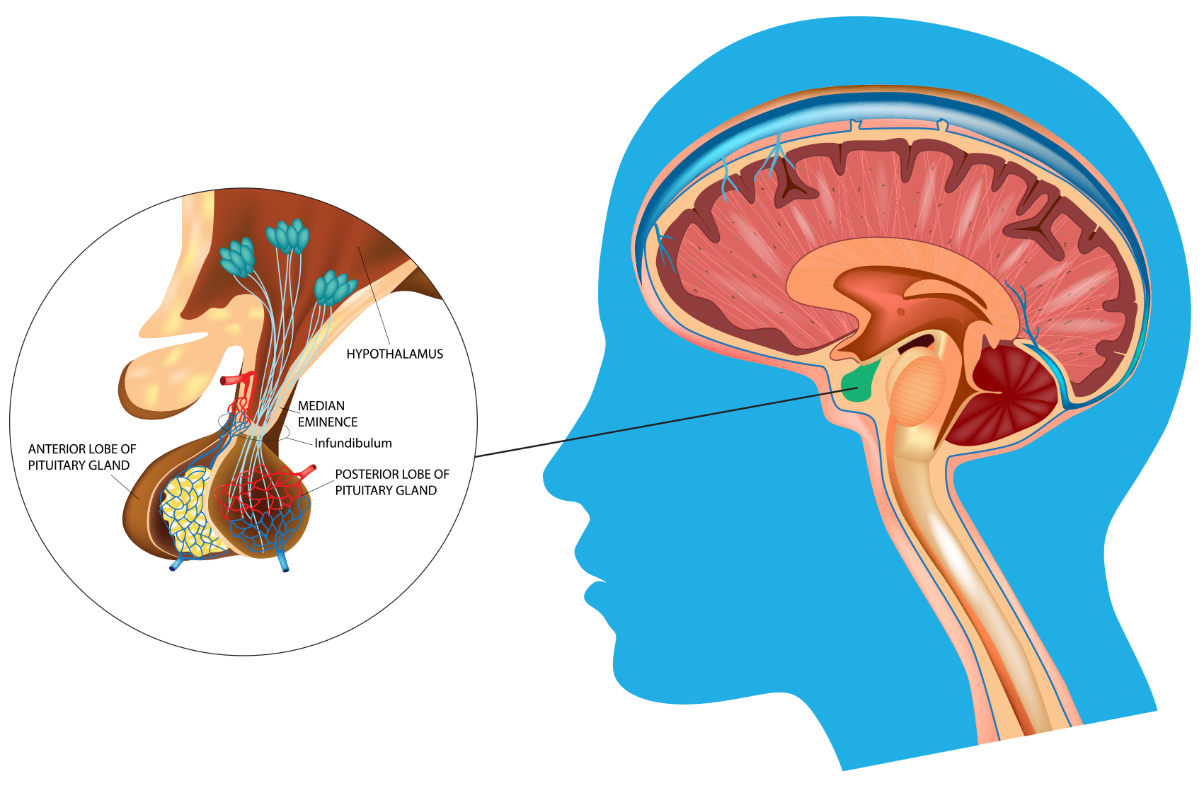
The pituitary gland
Despite its small size, the pituitary gland regulates many body functions.
Pituitary gland is composed of two major portions which include anterior pituitary gland (adenohypophysis) which is separate glandular tissue, and the posterior pituitary gland (neurohypophysis), which is an extension of the nerve tissue of the hypothalamus.

Slide 5
Anterior pituitary gland
Anterior pituitary gland also called adenohypophysis
Hormones of anterior pituitary gland are regulated by releasing and inhibiting hormones from the hypothalamus.
Releasing and inhibiting hormones are secreted into primary capillaries in the hypothalamus and pass through the hypophyseal portal veins to another capillary network in the anterior pituitary gland. Here
The releasing hormones are absorbed and stimulate secretion of the anterior pituitary hormones. While, inhibiting hormones suppress anterior pituitary gland to secrete hormones.
The hormones of the anterior pituitary gland regulate many body functions.

Slide 6
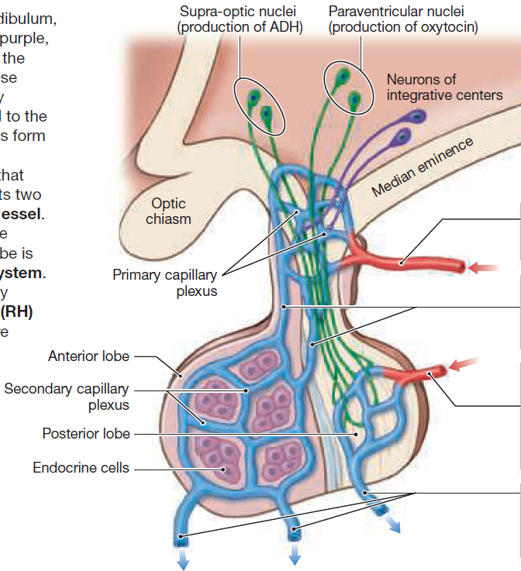
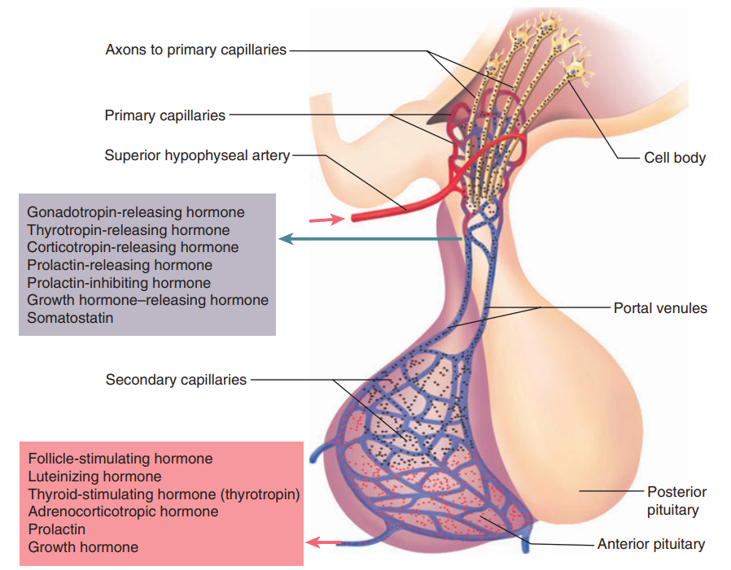
Anterior pituitary gland

Slide 7
Posterior pituitary gland
The two hormones (ADH and OT) of the posterior pituitary gland are produced by the hypothalamus and simply stored in the posterior pituitary gland until needed.
Their release is stimulated by nerve impulses from the hypothalamus.
Hormones of the posterior pituitary are made by certain neuroendocrine cells in the hypothalamus.
Their axons pass down the stalk as a bundle called the hypothalamic-hypophysial tract and end in the posterior lobe.
Hormones are made in the neuron cell bodies (soma) and move down the nerve fiber to the posterior pituitary.
Here they are stored in the nerve endings until a nerve signal coming down the same axons triggers their release.

Slide 8
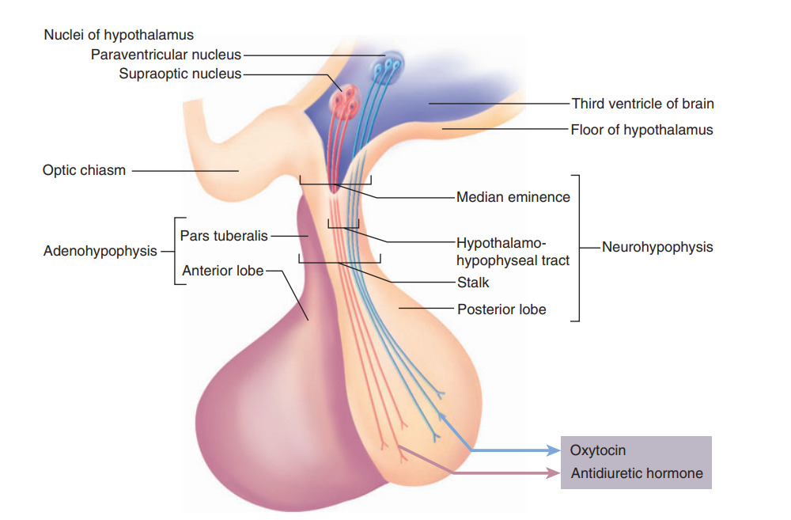
Posterior pituitary gland

Slide 9
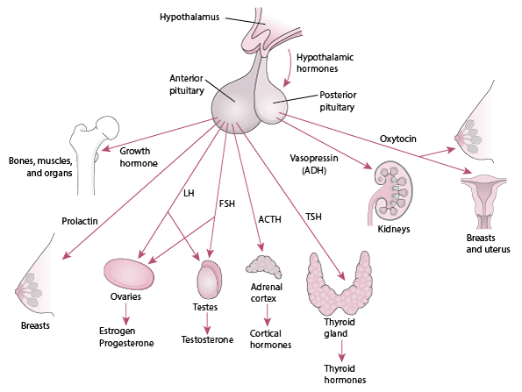
Pituitary gland hormones and their target tissues

Slide 10
Pituitary gland hormones, their target tissues and functions

Slide 11
Anterior pituitary gland hormone -Follicle-stimulating hormone
Follicle-stimulating hormone (FSH) is one of the gonadotropic hormones.
FSH has effects on the gonads: the ovaries or testes.
FSH is named for one of its functions in women. Within the ovaries are ovarian follicles that contain potential ova (egg cells). FSH stimulates the growth of ovarian follicles; that is, it initiates egg development. FSH also stimulates the secretion of estrogen by the ovaries.
In men, FSH initiates sperm production within the testes.
The secretion of FSH is stimulated by the hypothalamus, which produces gonadotropin-releasing hormone (GnRH).
FSH secretion is decreased by inhibin, a hormone produced by the ovaries or testes.

Slide 12
Anterior pituitary gland hormone -Luteinizing hormone
Luteinizing hormone (LH) is another gonadotropic hormone.
In women, LH is responsible for ovulation, the release of a mature ovum from an ovarian follicle. LH then stimulates that follicle to develop into the corpus luteum, which secretes progesterone.
In men, LH stimulates the interstitial cells of the testes to secrete testosterone.
The secretion of LH is stimulated by the hypothalamus, which produces gonadotropin-releasing hormone (GnRH).

Slide 13
Anterior pituitary gland hormone -Thyroid-stimulating hormone
Thyroid-stimulating hormone (TSH) is also called thyrotropin
The target organ for TSH is the thyroid gland.
TSH stimulates the normal growth of the thyroid gland and the secretion of thyroxine (T4) and triiodothyronine (T3).
The secretion of TSH is stimulated by thyrotropin-releasing hormone (TRH) from the hypothalamus. When metabolic rate (energy production) decreases, TRH is produced.

Slide 14
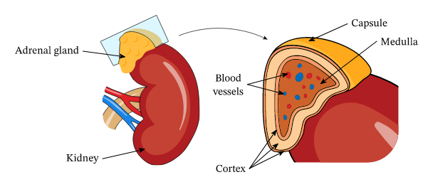
Anterior pituitary gland hormone -Adrenocorticotropic hormone
Adrenocorticotropic hormone (ACTH) stimulates the secretion of cortisol and other hormones by the adrenal cortex.
Secretion of ACTH is increased by corticotropin-releasing hormone (CRH) from the hypothalamus. CRH is produced in any type of physiological stress situation

Slide 15
Anterior pituitary gland hormone –Prolactin hormone
Prolactin, as its name suggests, is responsible for lactation. More precisely, prolactin initiates and maintains milk production by the mammary glands.
The regulation of secretion of prolactin is complex, involving both prolactin-releasing hormone (PRH) and prolactin-inhibiting hormone (PIH) from the hypothalamus.
The mammary glands must first be acted upon by other hormones such as estrogen and progesterone, which are secreted in large amounts by the placenta during pregnancy. Then, after delivery of the baby, prolactin secretion increases, and milk is produced.
If the mother continues to breast-feed, prolactin levels remain high.

Slide 16
Anterior pituitary gland hormone -Growth hormone
Growth hormone (GH) is also called somatotropin.
The anterior pituitary gland produces at least a thousand times as much GH as any other hormone.
The general effect of GH is to stimulate mitosis and cellular differentiation and thus to promote tissue growth throughout the body.
The secretion of GH is regulated by two hormones from the hypothalamus. Growth hormone-releasing hormone (GHRH), which increases the secretion of GH, is produced during hypoglycemia and exercise. Another stimulus for GHRH is a high blood level of amino acids; the GH then secreted will ensure the conversion of these amino acids into protein. Somatostatin may also be called growth hormone inhibiting hormone (GHIH), and, as its name tells us, it decreases the secretion of GH. Somatostatin is produced during hyperglycemia.

Slide 17
Posterior pituitary gland hormone –Antidiuretic hormone
Antidiuretic hormone (ADH, also called vasopressin) increases the reabsorption of water by kidney tubules, which decreases the amount of urine formed. The water is reabsorbed into the blood, so as urinary output is decreased, blood volume is increased, which helps maintain normal blood pressure. ADH also decreases sweating, but the amount of water conserved is much less than that conserved by the kidneys.
The stimulus for the secretion of ADH is decreased water content of the body. If too much water is lost through sweating or diarrhea, for example, osmoreceptors in the hypothalamus detect the increased “saltiness” of body fluids. The hypothalamus then transmits impulses to the posterior pituitary to increase the secretion of ADH and decrease the loss of more water in urine.

Slide 18
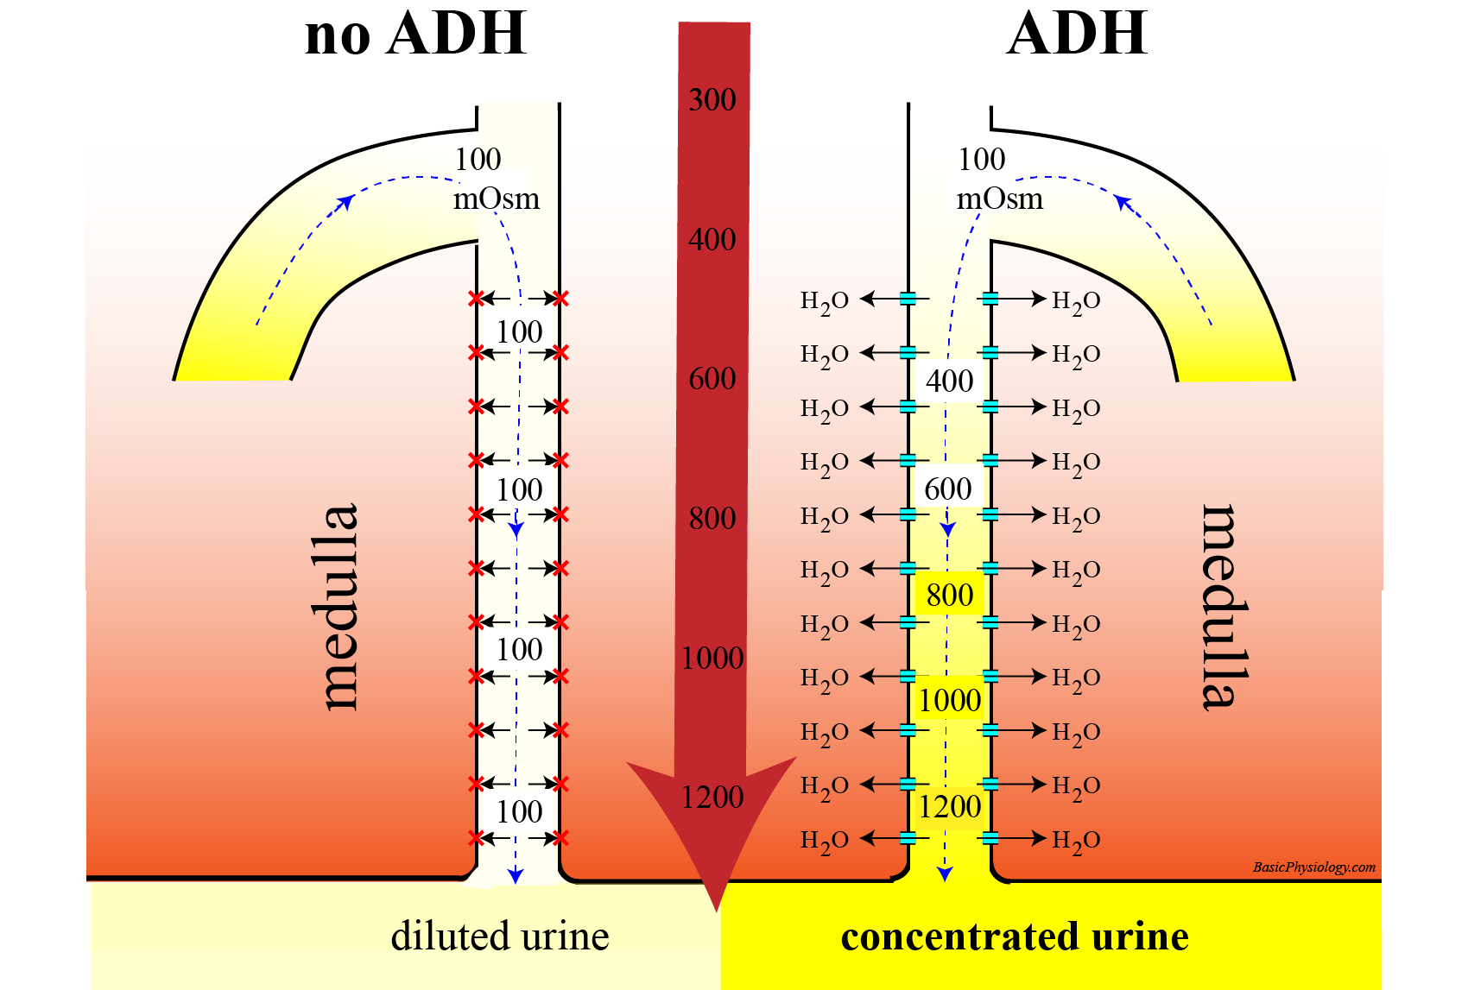
Posterior pituitary gland hormone –Antidiuretic hormone

Slide 19
Posterior pituitary gland hormone –Oxytocin
Oxytocin stimulates contraction of the uterus at the end of pregnancy and stimulates the release of milk from the mammary glands.
As labor begins, the cervix of the uterus is stretched, which generates sensory impulses to the hypothalamus, which in turn stimulates the posterior pituitary to release oxytocin. Oxytocin then causes strong contractions of the smooth muscle (myometrium) of the uterus to bring about delivery of the baby and the placenta.
In addition, when a baby is breast-fed, the sucking of the baby stimulates sensory impulses from the mother’s nipple to the hypothalamus. Nerve impulses from the hypothalamus to the posterior pituitary cause the release of oxytocin, which stimulates the contraction of the smooth muscle cells around the mammary ducts to release milk.

Slide 20
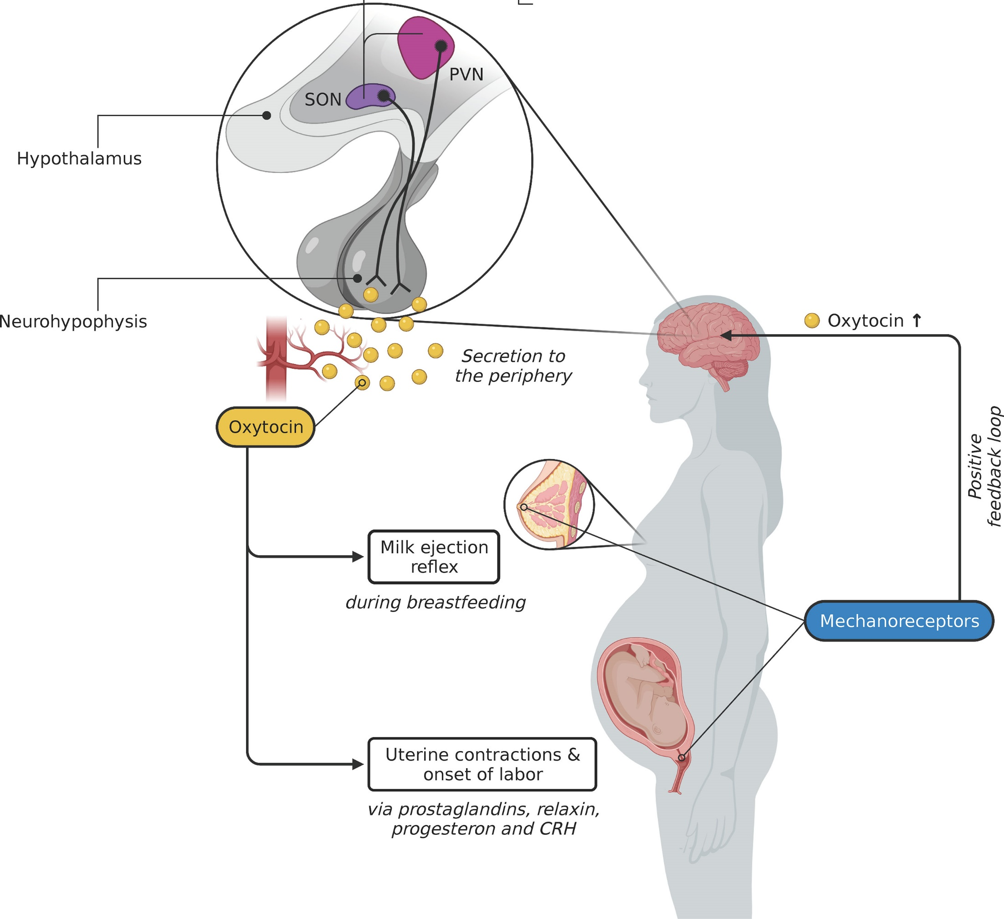
Posterior pituitary gland hormone –Oxytocin

Slide 21
References
Greenstein B. & Wood D. F. (2011). The endocrine system at a glance (3rd ed.). Wiley-Blackwell
Melmed S. Auchus R. J. Goldfine A. B. Koenig R. Rosen C. J. & Williams R. H. (2020). Williams textbook of endocrinology (14th ed.). Elsevier. Boron W. F. & Boulpaep E. L. (2021).
Boron & boulpaep concise medical physiology. Elsevier. Barrett K. E. Barman S. M. Yuan J. X.-J. & Brooks H. (2019).
Ganong's review of medical physiology (review questions) (26th ed.). McGraw-Hill Education LLC Molina P. E. (2018). Endocrine physiology (Fifth). McGraw-Hill Education.

Slide 22
Thank you

