Slide 1

Regulation of gene Expression in bacteria
Dr. Salah Tofik Balaky
Course: Molecular Biotechnology
MA Code408
Semester 8: Week 4
Date 22/2/2024

Slide 2
Protein Folding
Translating the information in an mRNA into a polypeptide chain is only the first step in making an active protein. To be an active protein, the polypeptide must fold into its final conformation. This is the most stable state of the protein and is determined by the primary structure of its polypeptides.

Slide 3
Protein Chaperones
Proteins called chaperones help other proteins fold into their final conformations. Some chaperones are dedicated to the folding of only one other protein, while others are general chaperones that help many different proteins to fold.

Slide 4
Bacterial genomes
Bacterial genomes usually contain several thousand different genes. Some of the gene products are required by the cell under all growth conditions and are called house- keeping genes. However, some gene products such as enzymes that break down specific sugars, or respond to a specific environmental conditions are only required under specific growth conditions.

Slide 5
Bacterial genomes regulation
The E. coli genome contains over 3000 genes. Some of these are active all the time because their products are in constant demand. But some of them are turned off most of the time because their products are rarely needed. For example, the enzymes required for the metabolism of the sugar arabinose would be useful only when arabinose is present and glucose is absent.

Slide 6
Regulation of gene expression
Bacterial cells can look or act differently depending on the conditions under which the cells find themselves, because the genes of a cell are not always expressed at the same levels. The process by which the expression of genes is turned on and off at different times and under different conditions is called the regulation of gene expression.

Slide 7
Repression and Activation
Regulatory proteins can bind to their control region and prevent transcription, This is known as repression. Regulatory proteins can promote RNA polymerase binding to the promoter. This effect is known as activation.

Slide 8
Gene regulation by inducers
An inducer is a substance whose presence results in the formation, or increase in the amount, of an enzyme. Such enzymes are called inducible enzymes; this genetically controlled response is termed enzyme induction. Transcription activator proteins accelerate the rate of RNA synthesis from promoter sites. Lactase production in response to lactose is an example.

Slide 9
Gene regulation by repressors
Genetic regulation that decreases enzyme synthesis is enzyme repression. Proteins that mediate this are repressors. Repression occurs if cells are exposed to an overabundance of a particular endproduct of a metabolic pathway. One example is the repressor of the tryptophan biosynthesis operon TrpR.

Slide 10
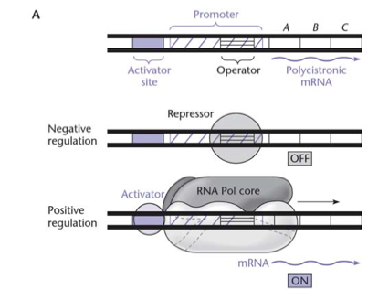
Gene regulation by inducers & repressors

Slide 11
Operon & Regulon
An operon is a group of genes physically linked on the chromosome and under the control of the same promoter. In an operon, the linked genes give rise to a single mRNA that is translated into the different gene products. This type of mRNA is called a polycistronic mRNA. A regulon is a group of genes all needed for the same process but physically located in different parts of the chromosome and containing their own promoter.

Slide 12
Operon consists of:
Promoter: Where RNA polymerase initiates transcription.
Operator: Serves as stop/go signal for transcription.
Genes: all the ORFs for all the enzymes in the pathway; each has its own start and stop codon.
Terminator: region of DNA where RNA polymerase ends transcription

Slide 13
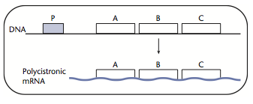
PolycistronicmRNA
Polycistronic mRNAs are translated into more than one protein. In this example, gene A, gene B, and gene C are encoded on one mRNA.

Slide 14
Operon model of gene expression
Protein synthesis in bacteria is controlled by a system called the operon model. For example, three enzymes are involved in uptake and utilization of the sugar lactose in E. coli. The genes for these enzymes and operator site are close together on the bacterial chromosome. The operator and promoter sites plus the structural genes are the operon.

Slide 15
lac Operon
The metabolism of the sugar, lactose, requires at least two proteins in E. coli. The lactose permease, encoded by the lacY gene, transports lactose into the cell. The enzyme b-galactosidase, encoded by the lacZ gene, catalyzes the cleavage of lactose resulting in the monosaccharides, galactose and glucose in a process called catabolic.

Slide 16
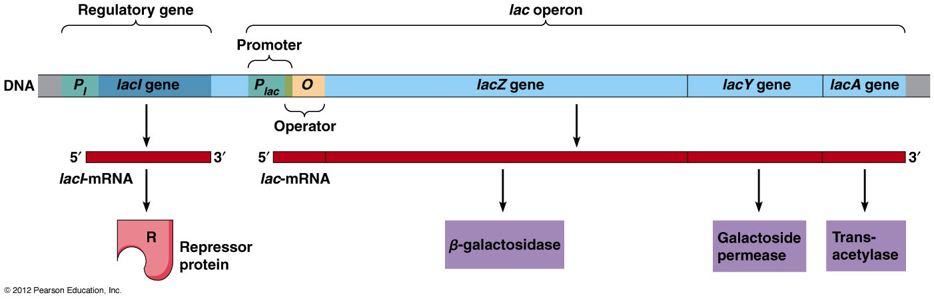
lac Operon

Slide 17
Negative Control of the lac Operon
This is to prevent RNA polymerase from binding to the promoter and transcribing the operon. Because its genes are not transcribed, the operon is off, or repressed. The lac repressor protein by default is bound to the operator sequence, thus blocking part of the promoter and preventing RNA polymerase from binding and initiating transcription of the genes.

Slide 18
When lactose is present
When lactose is present inside the cell, it is converted to allolactose and binds to the LacI, repressor protein. This will prevent its interaction with the lac O operator site. The operator then induces the structural genes (lacZ, lacY, and lacA) to produce enzymes to utilize lactose.

Slide 19
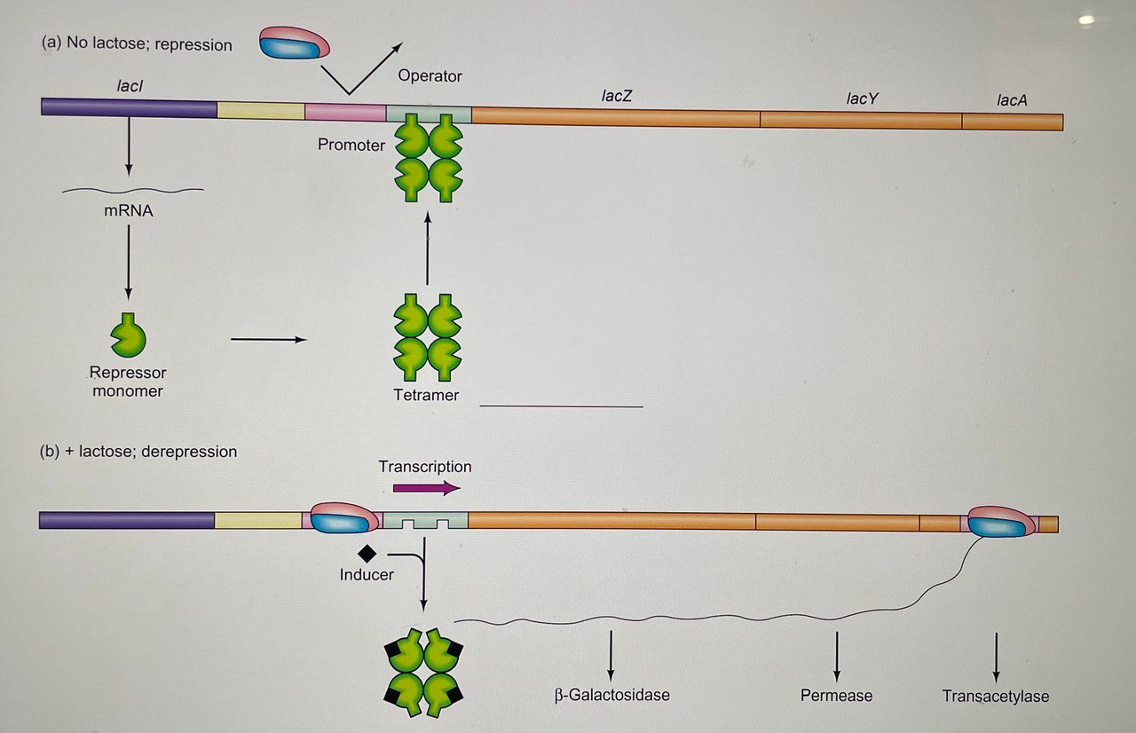
Regulation of the lac operon In the absence and presence of lactose

Slide 20
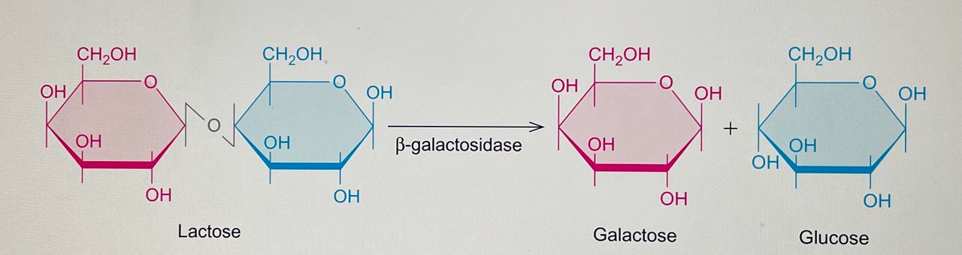
B-Galactosidase

Slide 21
Tryptophan trp Operon
The E. coli trp operon contains the genes for the enzymes that the bacterium needs to make the amino acid tryptophan. The trp operon, on the other hand, codes for anabolic enzymes—those that build up a substance. Such operons are generally turned off by that substance. When the tryptophan concentration is high, the products of the trp operon are not needed any longer, and the trp operon is repressed. The trp operon also exhibits an extra level of control, called attenuation, not seen in the lac operon.

Slide 22
Tryptophan trp Operon
The trp operon of E. coli is an example of a negative repressible system. The enzymes encoded by the trp operon are responsible for synthesizing the amino acid L-tryptophan, which is a constituent of most proteins and so must be synthesized if none is available in the medium. The products of five structural genes in the operon are required to make tryptophan from chorismic acid.

Slide 23
Presence and absence of tryptophan
In the case of the trp operon, different from lac operon, a plentiful supply of tryptophan means that the cell does not need to spend any more energy making this amino acid. In other words, a high tryptophan concentration is a signal to turn off the operon. How does the cell sense the presence of tryptophan? In essence, tryptophan helps the trp repressor bind to its operator. Here is how that occurs: In the absence of tryptophan, no trp repressor exists, only an inactive protein called the aporepressor.

Slide 24
Presence and absence of tryptophan ……
When the aporepressor binds tryptophan, it changes to a conformation with a much higher affinity for the trp operator. The combination of aporepressor plus tryptophan is the trp repressor; therefore, tryptophan is called a corepressor. When the cellular concentration of tryptophan is high, plenty of corepressor is available to bind and form the active trp repressor. Thus, the operon is repressed. When the tryptophan level in the cell falls, the amino acid dissociates from the aporepressor, causing it to shift back to the inactive conformation.

Slide 25
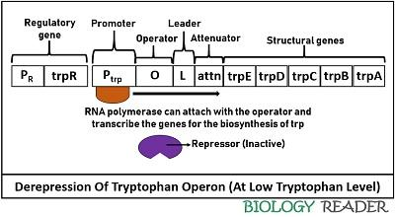
Low TRP level

Slide 26
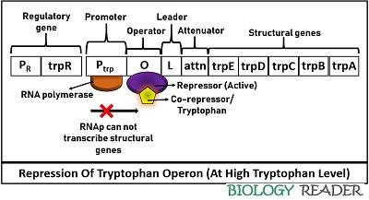
High TRP level

Slide 27
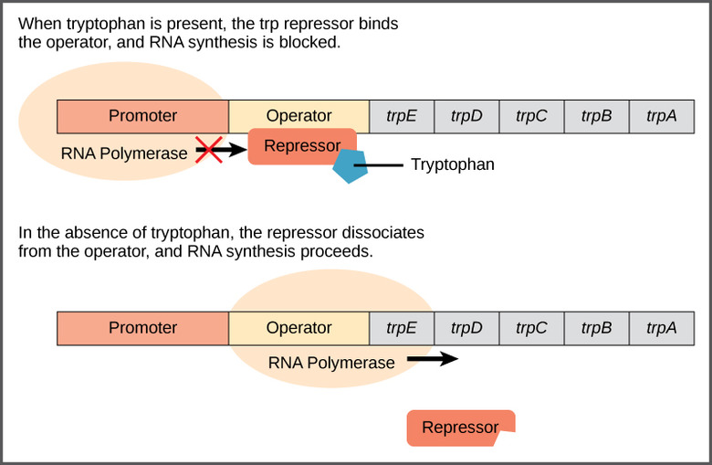

Slide 28
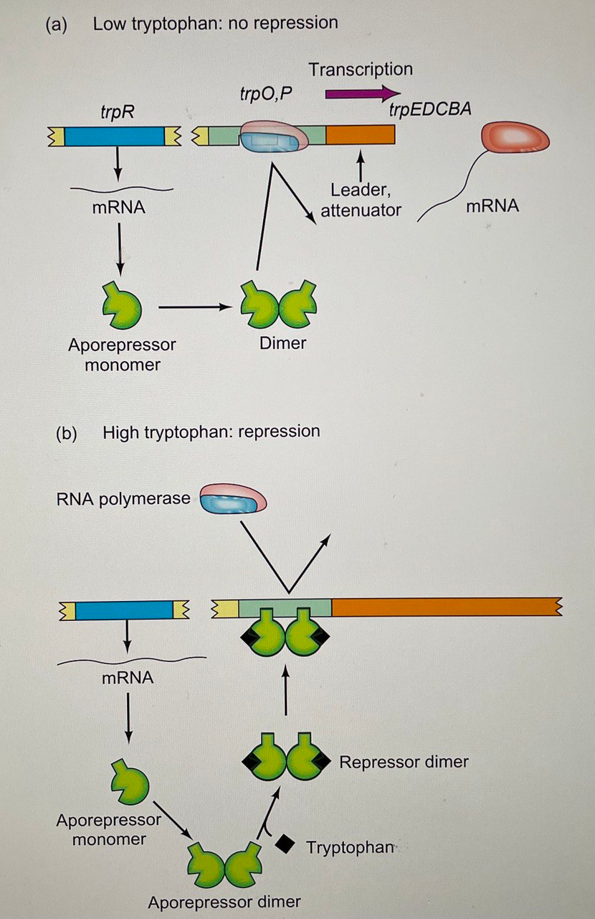

Slide 29
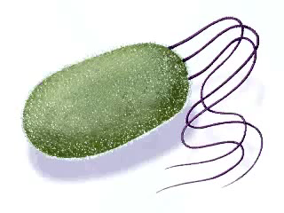

Slide 30
Attenuation
It is the second regulatory region of the trp operon controlled by the trpL gene or attenuator. A leader sequence controls the gene expression via an attenuation mechanism. It comprises a polypeptide sequence plus an attenuator (contains palindromic sequences).
There are four domains in the leader sequence, in which domain-3 can pair with either domain-2 or domain-4, and domain-1 can pair with domain-2. Besides, it comprises two trp residues.

Slide 31
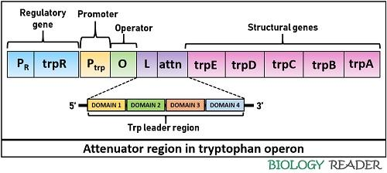
Attenuation

Slide 32
Attenuation
The pairing of domain-2 and 3 results in antitermination. Conversely, the pairing of domain-3 and 4 causes a termination of trp biosynthesis. The presence of domain-4 (also called attenuator) is important to terminate the transcription because it only can facilitate stem-loop formation. The attenuation mechanism depends upon the pairing of the ribosome and the level of tryptophan inside a bacterial cell.

Slide 33
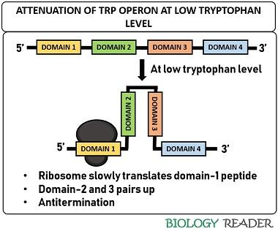
Attenuation at low TRP level

Slide 34
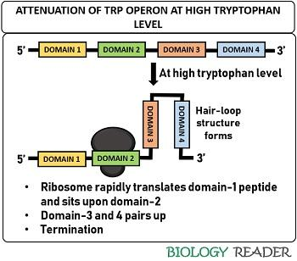
Attenuation at high TRP level

Slide 35
Next Lecture
Molecular Typing of Bacteria

Slide 36
Questions and comments?

