Slide 1
posterior pituitary
Zhikal O. Khudhur
Endocrinology BIO 414
Spring Semester
Week number: 5
Date: 2/ 2024

Slide 2
Objectives
Posterior pituitary
Antidiuretic hormone
oxytocin

Slide 3
Posterior pituitary gland hormone –Antidiuretic hormone
Antidiuretic hormone (ADH, also called vasopressin) increases the reabsorption of water by kidney tubules, which decreases the amount of urine formed. The water is reabsorbed into the blood, so as urinary output is decreased, blood volume is increased, which helps maintain normal blood pressure. ADH also decreases sweating, but the amount of water conserved is much less than that conserved by the kidneys.
The stimulus for the secretion of ADH is decreased water content of the body. If too much water is lost through sweating or diarrhea, for example, osmoreceptors in the hypothalamus detect the increased “saltiness” of body fluids. The hypothalamus then transmits impulses to the posterior pituitary to increase the secretion of ADH and decrease the loss of more water in urine.

Slide 4
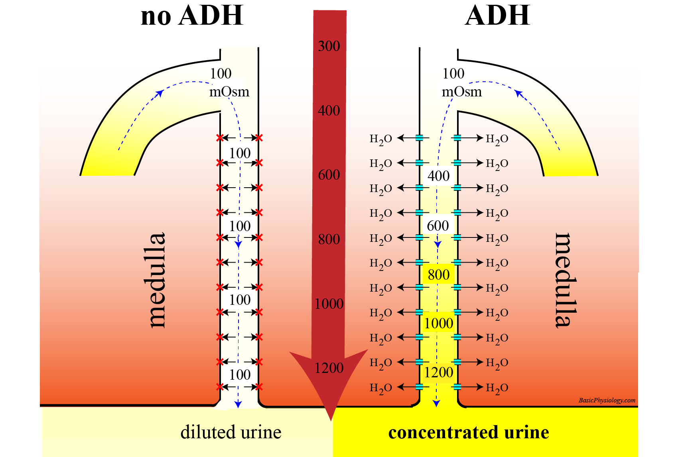
Posterior pituitary gland hormone –Antidiuretic hormone

Slide 5
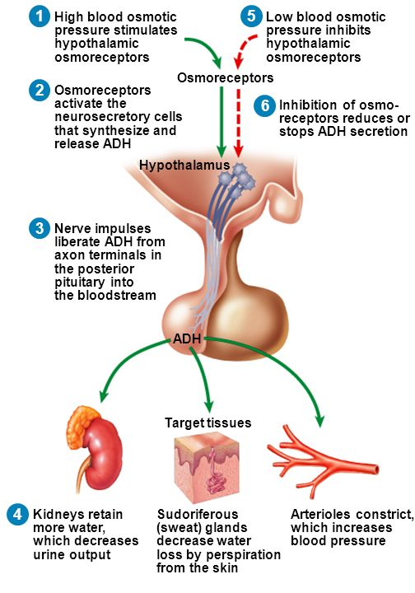
ANTIDIURETIC HORMONE

Slide 6
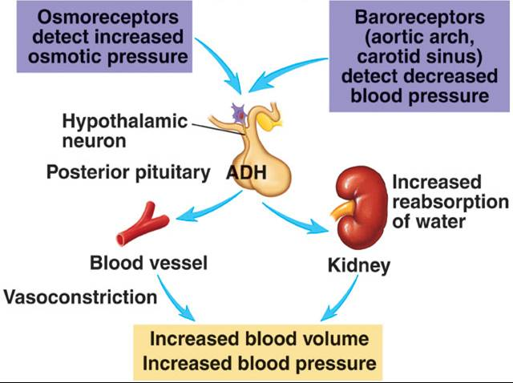
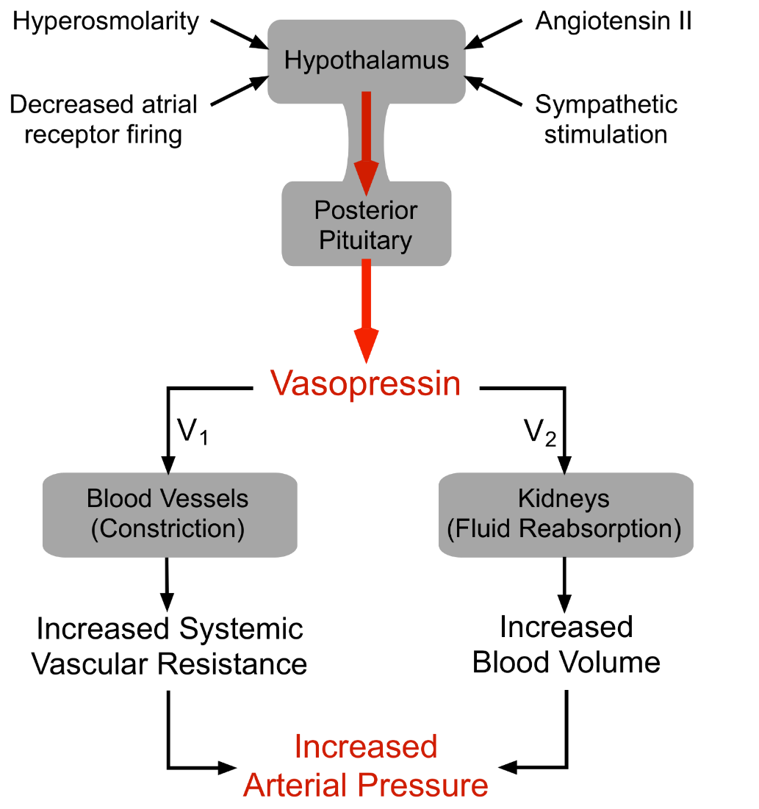
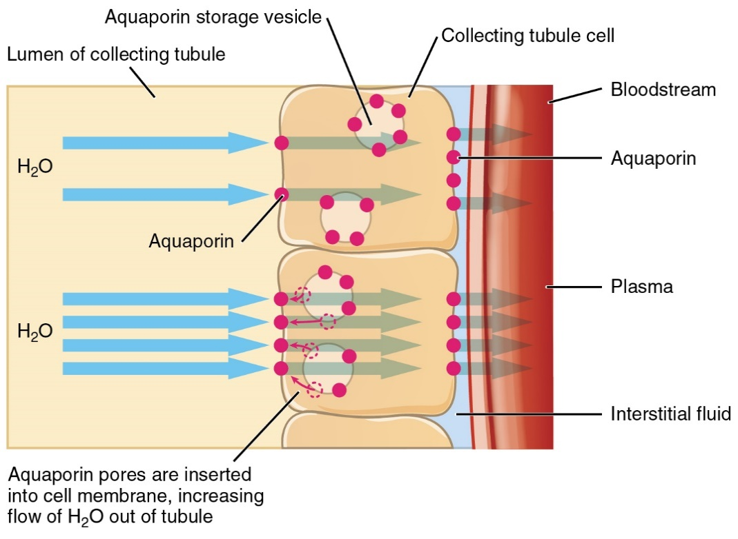

Slide 7
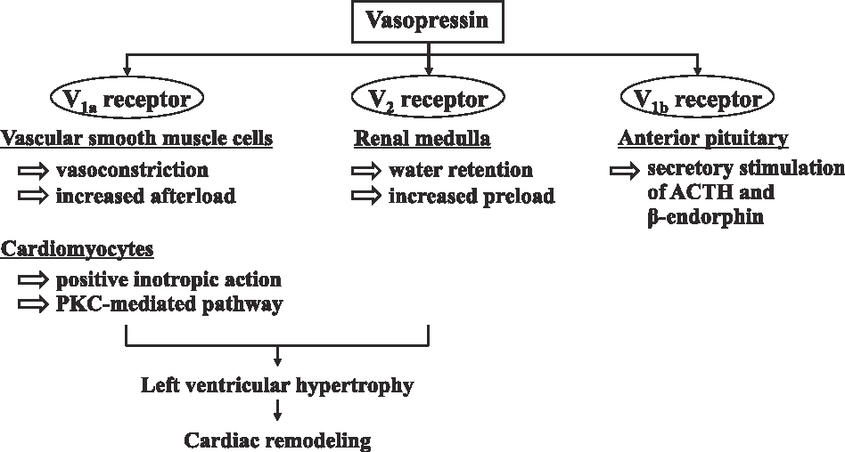
ADH RECEPTOR

Slide 8
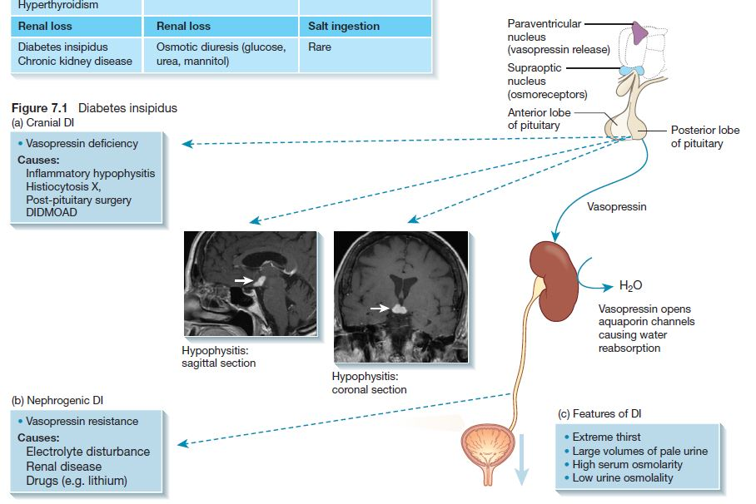

Slide 9
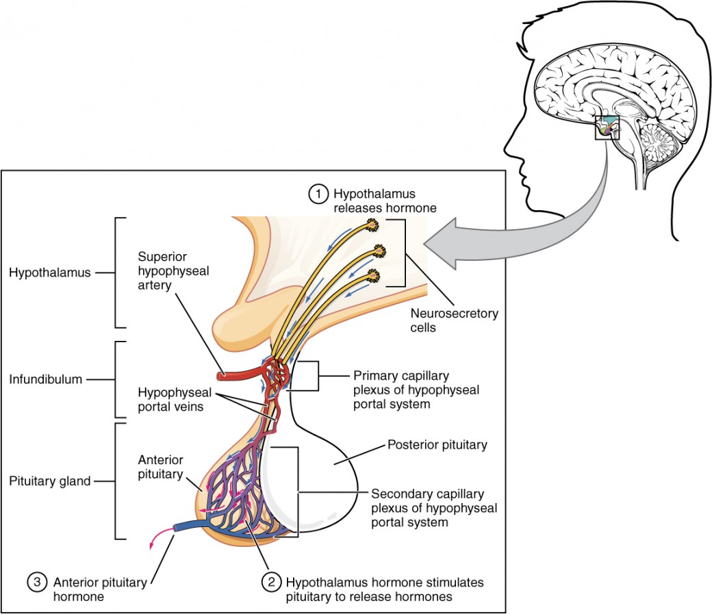
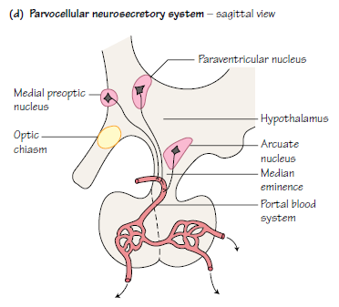

Slide 10
Posterior pituitary gland hormone –Oxytocin
Oxytocin stimulates contraction of the uterus at the end of pregnancy and stimulates the release of milk from the mammary glands.
As labor begins, the cervix of the uterus is stretched, which generates sensory impulses to the hypothalamus, which in turn stimulates the posterior pituitary to release oxytocin. Oxytocin then causes strong contractions of the smooth muscle (myometrium) of the uterus to bring about delivery of the baby and the placenta.
In addition, when a baby is breast-fed, the sucking of the baby stimulates sensory impulses from the mother’s nipple to the hypothalamus. Nerve impulses from the hypothalamus to the posterior pituitary cause the release of oxytocin, which stimulates the contraction of the smooth muscle cells around the mammary ducts to release milk.

Slide 11
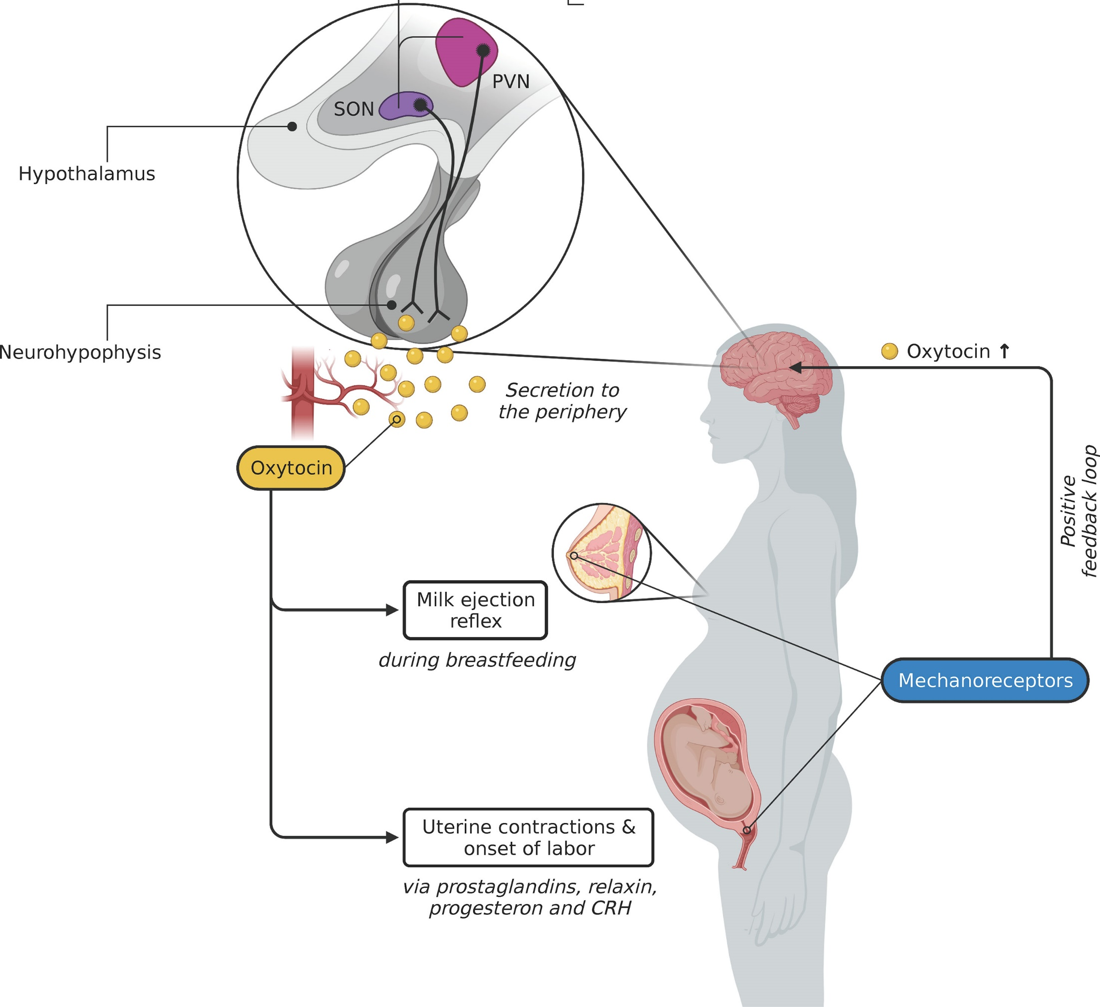
Posterior pituitary gland hormone –Oxytocin

Slide 12
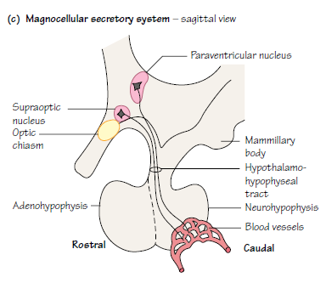
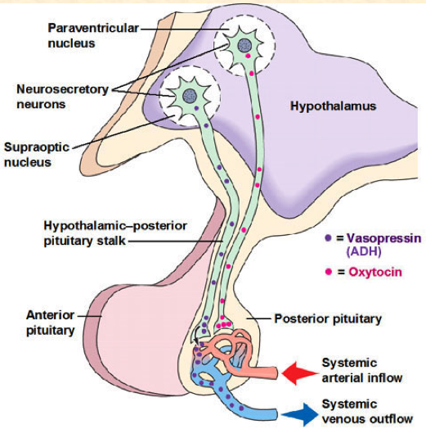
Oxytocin

Slide 13
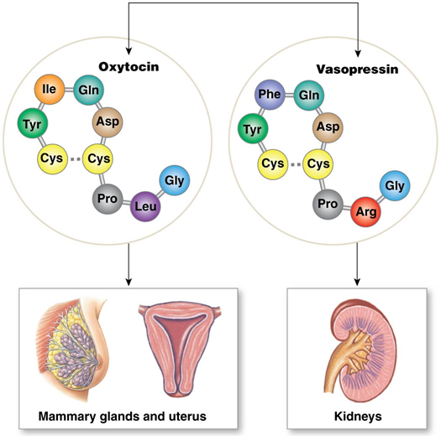
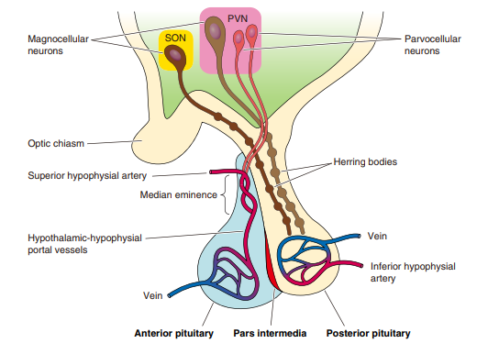

Slide 14
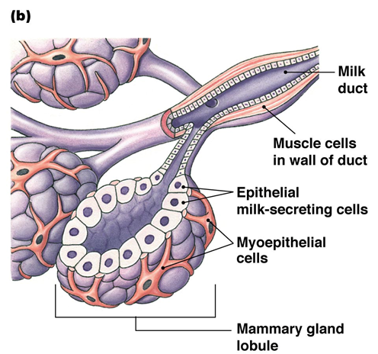
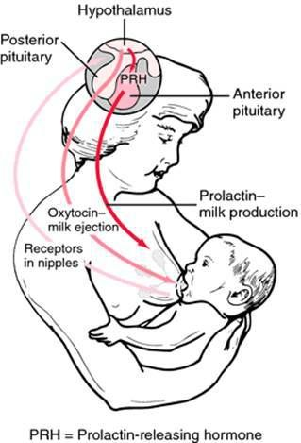
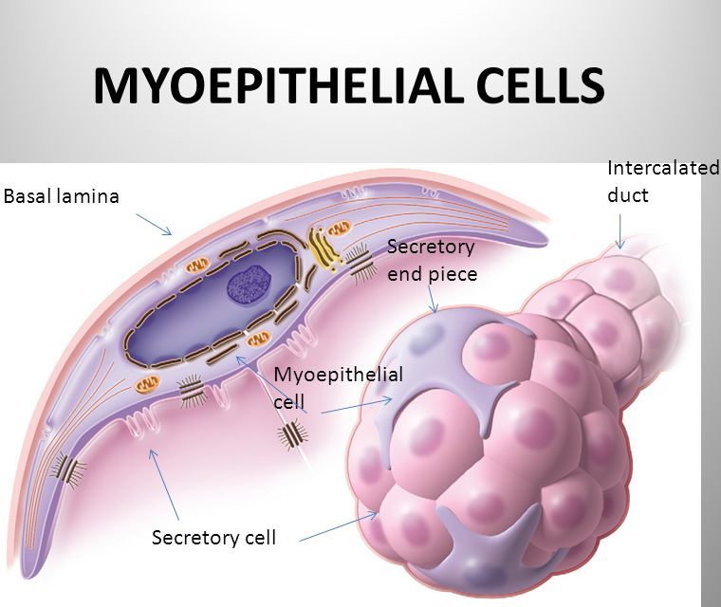
OXYTOCIN

Slide 15
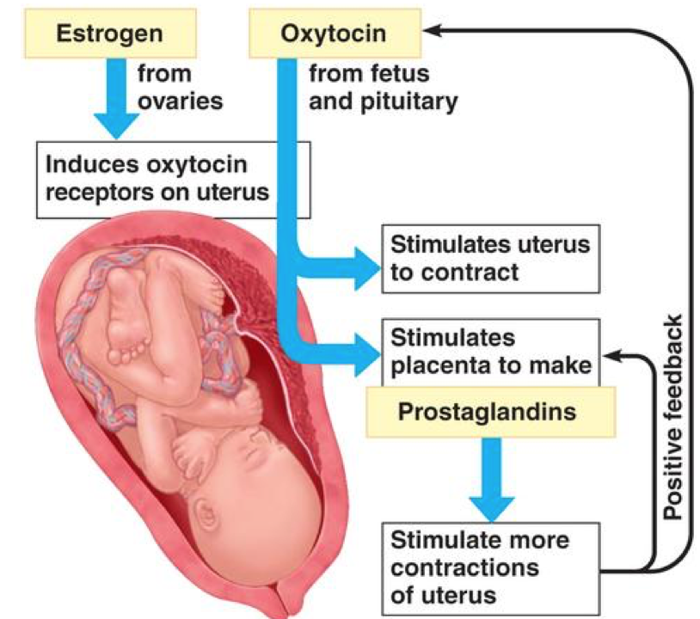
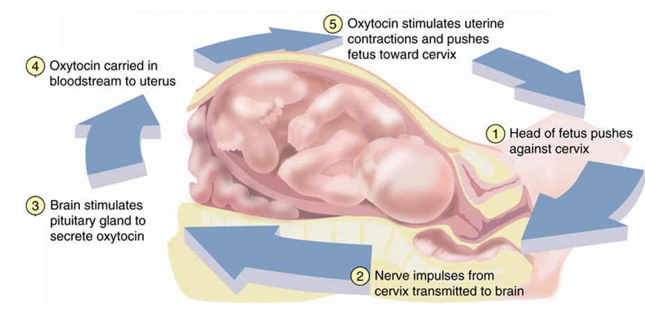

Slide 16
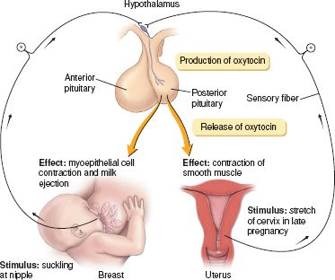

Slide 17
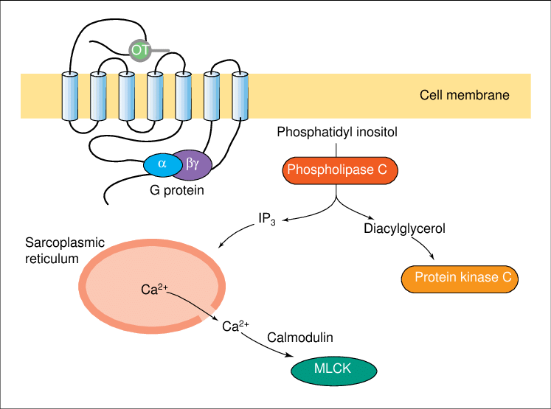
OXYTOCIN RECEPTOR

Slide 18
References
Greenstein B. & Wood D. F. (2011). The endocrine system at a glance (3rd ed.). Wiley-Blackwell
Melmed S. Auchus R. J. Goldfine A. B. Koenig R. Rosen C. J. & Williams R. H. (2020). Williams textbook of endocrinology (14th ed.). Elsevier. Boron W. F. & Boulpaep E. L. (2021).
Boron & boulpaep concise medical physiology. Elsevier. Barrett K. E. Barman S. M. Yuan J. X.-J. & Brooks H. (2019).
Ganong's review of medical physiology (review questions) (26th ed.). McGraw-Hill Education LLC Molina P. E. (2018). Endocrine physiology (Fifth). McGraw-Hill Education.

Slide 19
Thank you

