Slide 1

Regulation by trp Operon
Dr. Salah Tofik Balaky
Course: Molecular Biotechnology
MA Code408
Semester 8: Week 5
Date 29/2/2024

Slide 2
Tryptophan trp Operon
The E. coli trp operon contains the genes for the enzymes that the bacterium needs to make the amino acid tryptophan. The trp operon, on the other hand, codes for anabolic enzymes—those that build up a substance. Such operons are generally turned off by that substance. When the tryptophan concentration is high, the products of the trp operon are not needed any longer, and the trp operon is repressed. The trp operon also exhibits an extra level of control, called attenuation, not seen in the lac operon.

Slide 3
Tryptophan trp Operon
The trp operon of E. coli is an example of a negative repressible system. The enzymes encoded by the trp operon are responsible for synthesizing the amino acid L-tryptophan, which is a constituent of most proteins and so must be synthesized if none is available in the medium. The products of five structural genes in the operon are required to make tryptophan from chorismic acid.

Slide 4
Presence and absence of tryptophan
In the case of the trp operon, different from lac operon, a plentiful supply of tryptophan means that the cell does not need to spend any more energy making this amino acid. In other words, a high tryptophan concentration is a signal to turn off the operon. How does the cell sense the presence of tryptophan? In essence, tryptophan helps the trp repressor bind to its operator. Here is how that occurs: In the absence of tryptophan, no trp repressor exists, only an inactive protein called the aporepressor.

Slide 5
Presence and absence of tryptophan ……
When the aporepressor binds tryptophan, it changes to a conformation with a much higher affinity for the trp operator. The combination of aporepressor plus tryptophan is the trp repressor; therefore, tryptophan is called a corepressor. When the cellular concentration of tryptophan is high, plenty of corepressor is available to bind and form the active trp repressor. Thus, the operon is repressed. When the tryptophan level in the cell falls, the amino acid dissociates from the aporepressor, causing it to shift back to the inactive conformation.

Slide 6
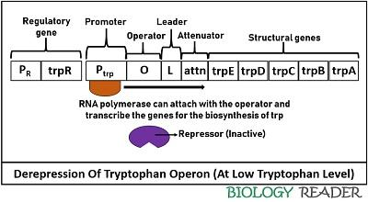
Low TRP level

Slide 7
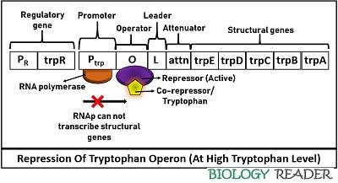
High TRP level

Slide 8
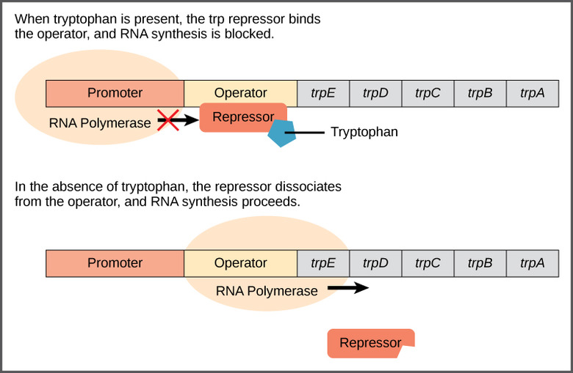

Slide 9
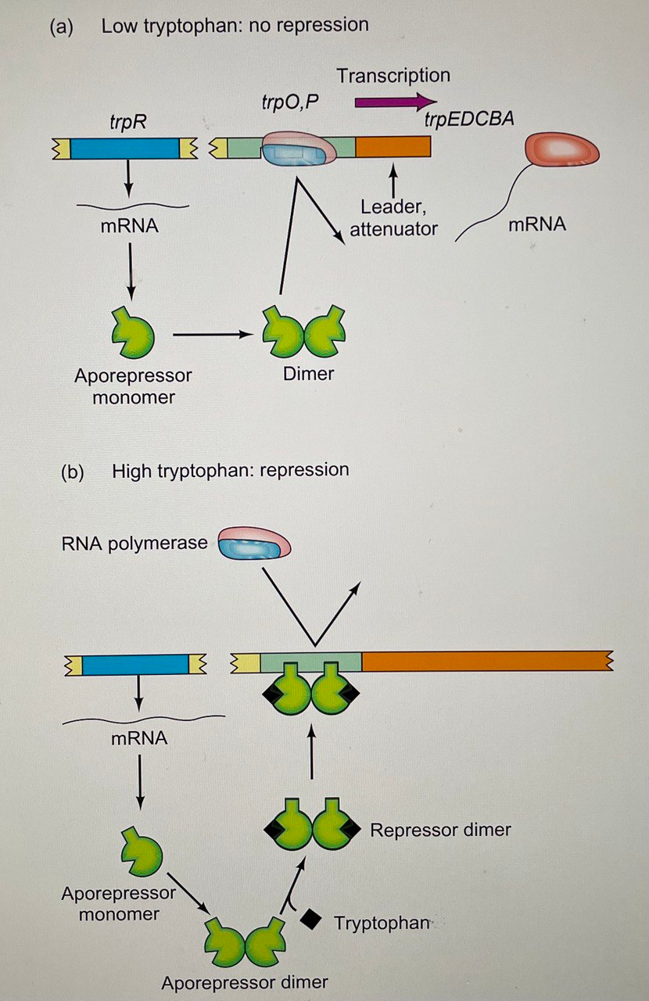

Slide 10
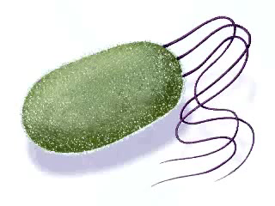

Slide 11
Attenuation
It is the second regulatory region of the trp operon controlled by the trpL gene or attenuator. A leader sequence controls the gene expression via an attenuation mechanism. It comprises a polypeptide sequence plus an attenuator (contains palindromic sequences).
There are four domains in the leader sequence, in which domain-3 can pair with either domain-2 or domain-4, and domain-1 can pair with domain-2. Besides, it comprises two trp residues.

Slide 12
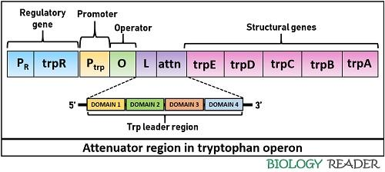
Attenuation

Slide 13
Attenuation
The pairing of domain-2 and 3 results in antitermination. Conversely, the pairing of domain-3 and 4 causes a termination of trp biosynthesis. The presence of domain-4 (also called attenuator) is important to terminate the transcription because it only can facilitate stem-loop formation. The attenuation mechanism depends upon the pairing of the ribosome and the level of tryptophan inside a bacterial cell.

Slide 14
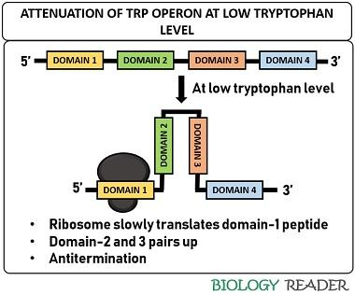
Attenuation at low TRP level

Slide 15
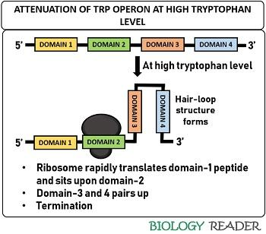
Attenuation at high TRP level

Slide 16
Next Lecture
Molecular Typing in Molecular Biotechnology

Slide 17
Questions and comments?

