Slide 1
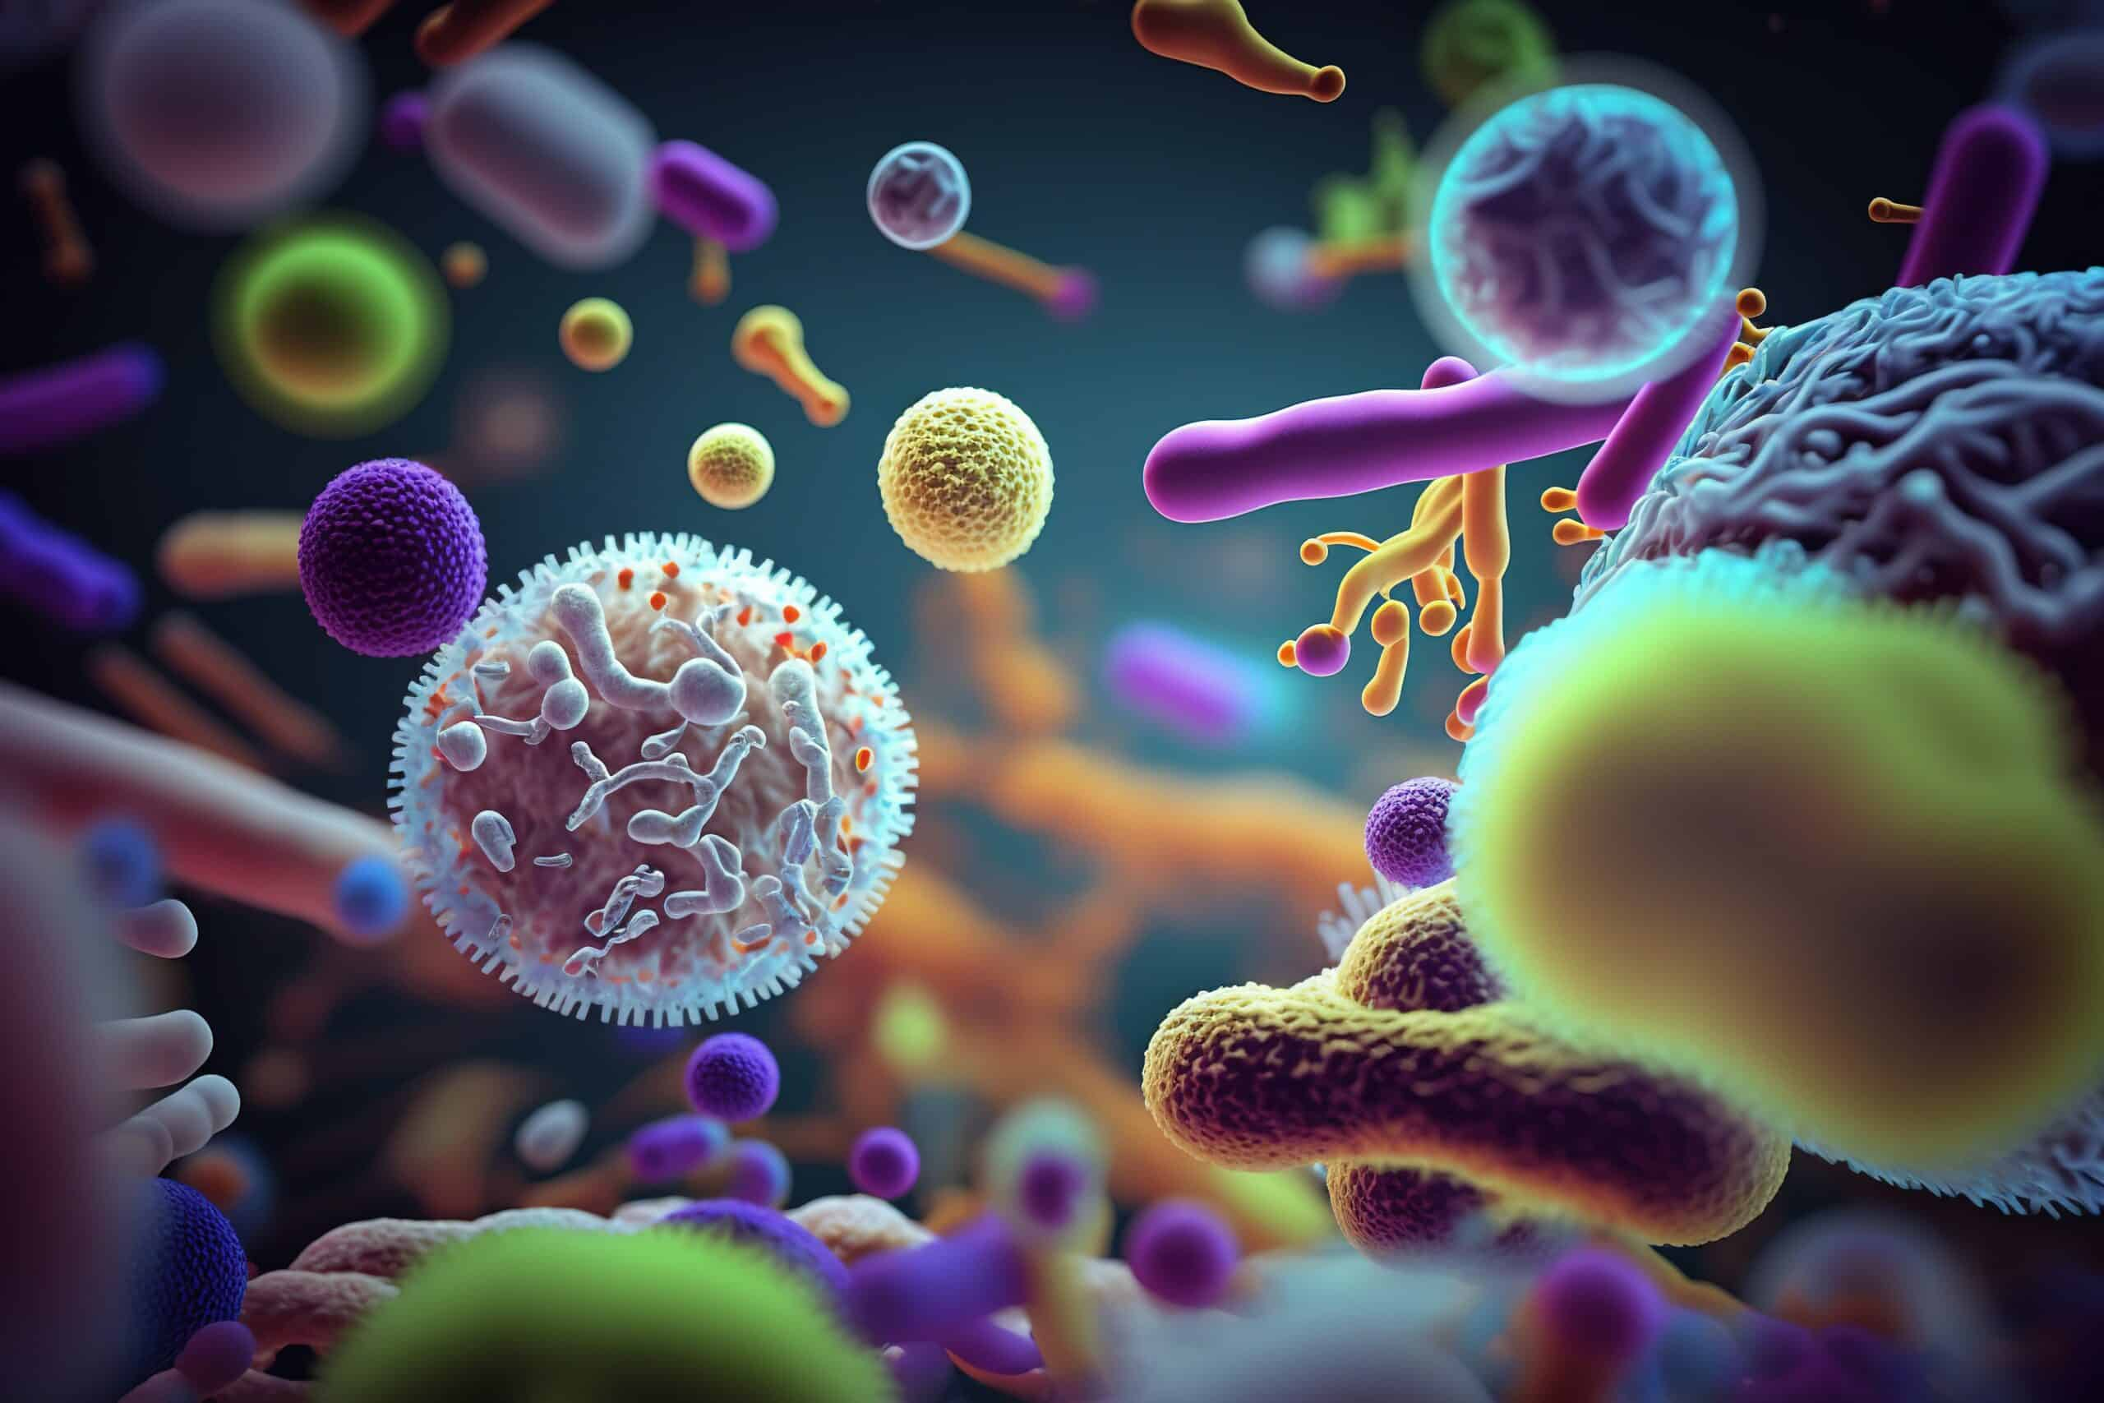
Mycobacteria
Ms. Heshu J. Ahmed
PhD Candidate
Medical Bacteriology 423
Spring Semester
Week Six

Slide 2
Outline
Characteristics of the bacteria
Epidemiology
Pathogenesis
Immunity
Manifestations
Diagnosis
Treatment

Slide 3
Objectives
1. Introduce Mycobacteria characteristics.
2. Explore species and mechanisms of pathogenesis.
3. Discuss MTB manifestations.
4. Examine MTB diagnostic methods.

Slide 4
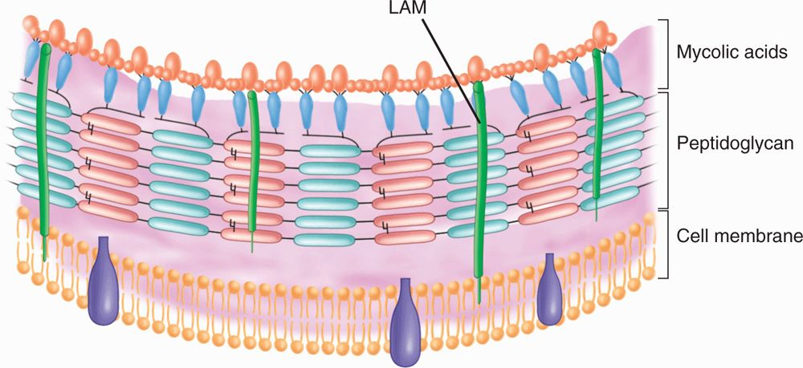
Characteristics
Mycobacterium is a genus of gram-positive bacilli
which all demonstrate the staining characteristic of acid-fastness.
The important species, Mycobacterium tuberculosis, is the etiologic agent of tuberculosis.
nonmotile, obligate aerobes that do not form spores
The cell wall contains peptidoglycan similar to that of other gram-positive organisms,

Slide 5
Characteristics
Specific to mycobacteria is the presence of:
long-chain fatty acids called mycolic acids (for which the mycobacteria are named) and
lipoarabinomannan (LAM), a lipid polysaccharide complex extending from the plasma membrane to the surface.
LAM is structurally and functionally analogous to
the LPS of G-.
These elements give the mycobacteria a cell wall with unusually high lipid content.

Slide 6
Characteristics
The high lipid content accounts for many of their biologic characteristics.
It can be thought of as a waxy coat that makes them hardy, impenetrable, and hydrophobic.
The staining characteristic of acid-fastness is the most frequently observed of these features.
The mycobacterial cell wall can be stained only through the use of extreme measures (prolonged time, heat, and penetrating agents) but once in, the stain is fast. Even the strongest of decolorizing agents (acid and alcohol) do not wash it out

Slide 7
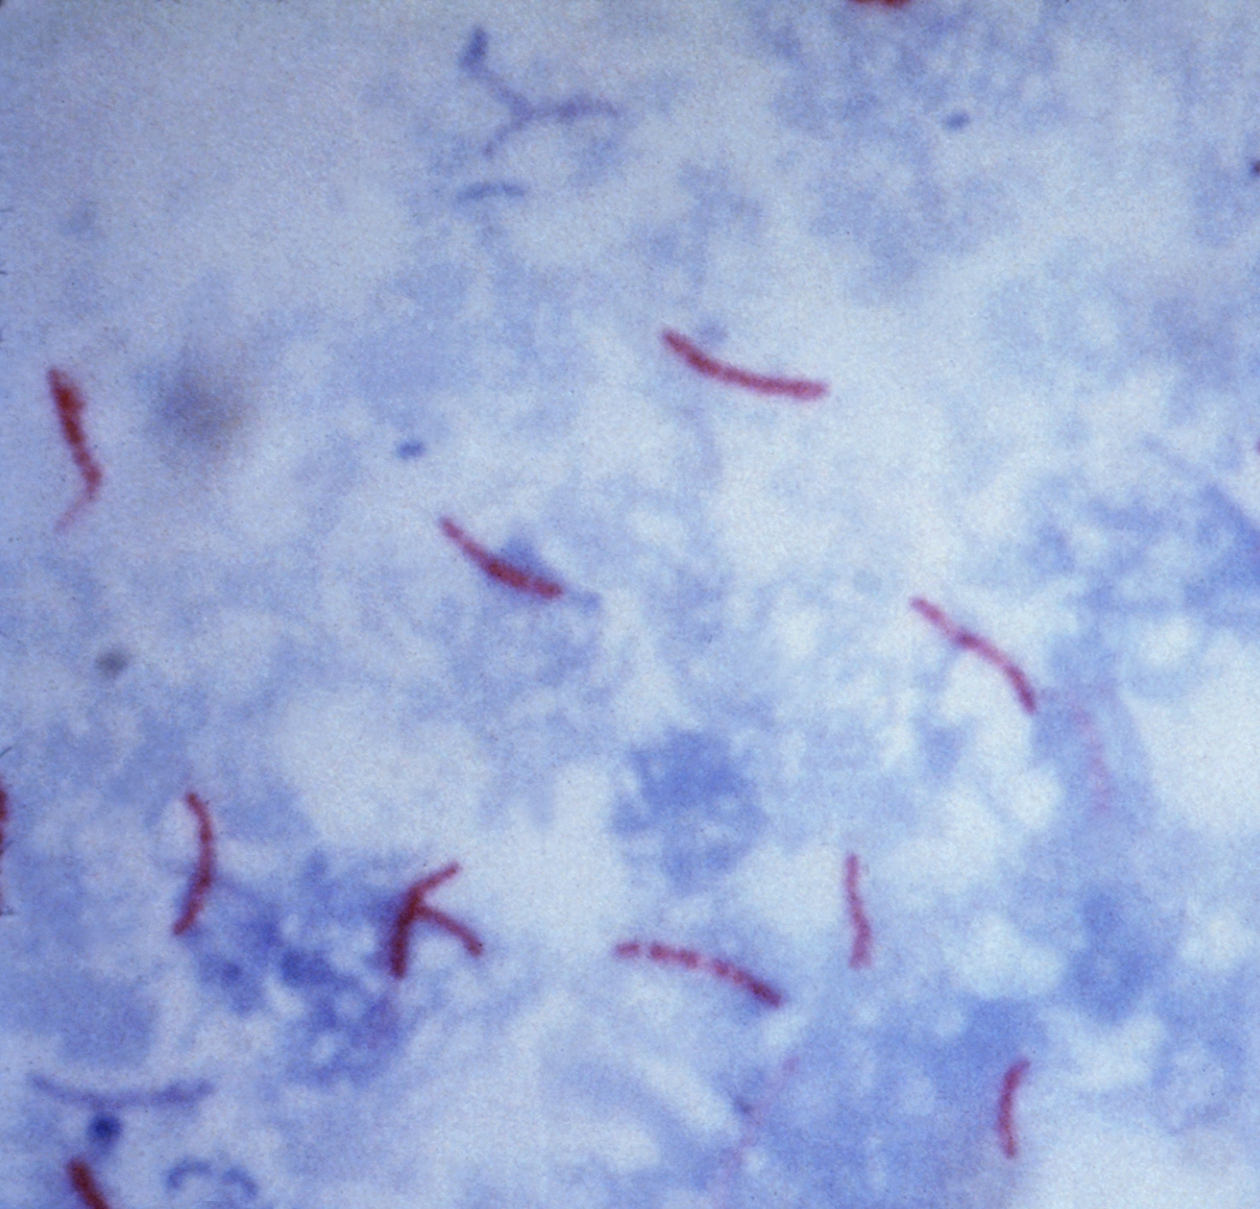
Mycobacterium Tuberculosis
MTB is a slim, strongly acid–alcohol–fast rod.
It frequently shows irregular beading in its staining.
It grows at 37°C, but not at room temperature,
The classic medium, Löwenstein-Jensen, contains homogenized egg in nutrient base with dyes to inhibit the growth of non-mycobacterial contaminants.
Because of its lipid surface, MTB is unusually resistant to: drying, disinfectants, and to acids and alkalis.
Tubercle bacilli are sensitive to heat, including pasteurization, and ultraviolet light

Slide 8
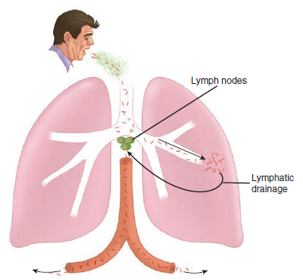
Pathogenesis
Primary Tuberculosis
MTB is a facultative intracellular pathogen.
Primary tuberculosis is the initial infection in which inhaled tubercle bacilli are deposited in the peripheral respiratory alveoli,
most frequently it targets the midlung zones of the middle and lower lobes.
At the earliest stages surface proteins may facilitate binding to the basement membrane of alveolar epithelial cells.
In the alveoli the bacteria are recognized by alveolar macrophage complement receptors and phagocytosed.
This initiates a two-stage battle within the macrophage, which may be resolved in weeks or last for decades.

Slide 9
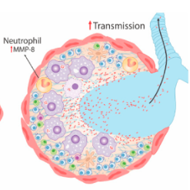
Pathogenesis
A. Primary Tuberculosis
The first stage: In this process, MTB has the upper hand by stopping the fusion of lysosome with the phagosome. These actions allow the bacteria to multiply freely in the phagosome of the nonactivated macrophage
The second stage is the triggering of TH1 immune responses, beginning with digestion and surface presentation of mycobacterial components and ending with cytokine activation of the macrophages.

Slide 10
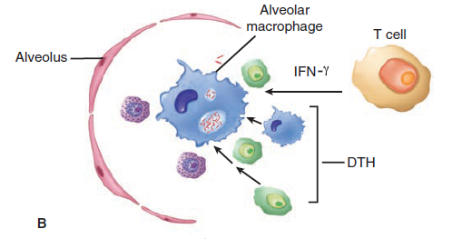
A. Primary Tuberculosis
In the primary lesion as MTB cells multiply, macrophages and dendritic cells release cytokines:
(tumor necrosis factor,
interleukin 12 [IL-12],
interferon gamma [IFN-γ]),
which attract T cells and other inflammatory cells to the site.
This initiates the TH1-type immune response over the following 3 to 9 weeks in which:
IFN-γ is the primary activator of macrophages.
This includes CD8+ cytotoxic T cells which recognize and destroy MTB-infected macrophages.

Slide 11
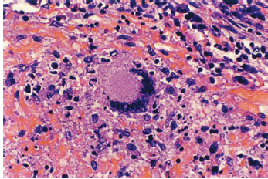
A. Primary Tuberculosis
MTB multiplication also triggers a delayed-type hypersensitivity (DTH) response with its phagocytes, fluid, and release of digestive enzymes.
The mixture of the TH1 immune and DTH responses is manifest in a microscopic structure called a granuloma,
which is composed of lymphocytes, macrophages, epithelioid cells (activated macrophages), fibroblasts, and multinucleated giant cells
As the granuloma grows, the destructive nature of the hypersensitivity component leads to necrosis usually in the center of the lesion. This is termed caseous necrosis because of the cheesy, semisolid character of material at the center of large gross lesions

Slide 12
B. Latent Tuberculosis
Primary infections are handled well once the TH1 immune response halts the intracellular growth of MTB. Bacterial multiplication ceases, the lesions heal by fibrosis, and the organisms appear to slowly die.
In tuberculosis, some of the organisms, when faced with oxygen and nutrient deprivation, instead of dying enter a prolonged dormant state called latency.
Specific factors facilitating survival are not known but the waxy nature of the MTB cell wall must be of aid as it is in the environment.

Slide 13
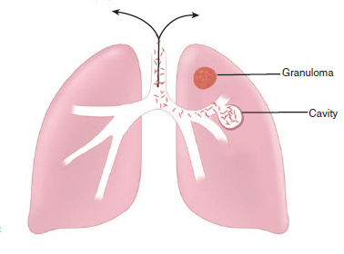
C. Reactivation (Adult) Tuberculosis
It's hypothesized that the relatively high oxygen tension that would favor growth of the aerobe MTB.
The upper part of the lung is the most common, with spreading, clusters of granulomas, and large areas of caseous necrosis.
Necrosis often involves the wall of a small bronchus from which the necrotic material is discharged, resulting in a pulmonary cavity and bronchial spread. Frequently, small blood vessels are also eroded.
The damage is due to the failure of the host to control growth of MTB and thus the rising load of mycobacterial proteins which stimulate the auto-destructive DTH response.

Slide 14
MANIFESTATIONS
A. Primary Tuberculosis
Primary tuberculosis is either asymptomatic or manifest only by fever and malaise.
Radiographs may show infiltrates in the mid-zones of the lung (Ghon focus)
B. Reactivation Tuberculosis
Reactivation is associated with a period of immunosuppression precipitated by malnutrition, alcoholism, diabetes, old age.
In areas in which tuberculosis is more prevalent, reactivation is more frequently seen in young adults experiencing the immunosuppression that accompanies puberty and pregnancy.
Recently, reactivation and progressive primary tuberculosis among younger adults have increased as a complication of AIDS.
Cough is the universal symptom of tuberculosis. It is initially dry, but as the disease progresses sputum is produced, which even later is mixed with blood (hemoptysis). Fever, malaise, fatigue, sweating, and weight loss all progress with continuing disease.

Slide 15
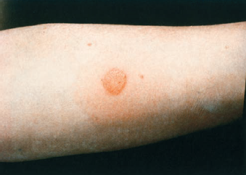
DIAGNOSIS
1. Tuberculin Test
The tuberculin skin test measures DTH to an international reference tuberculo-protein preparation called PPD.
The test involves an intradermal injection that is read 48 to 72 hours later.
An area of induration of 15 mm or more accompanied by erythema constitutes a positive reaction, and no induration indicates a negative reaction

Slide 16
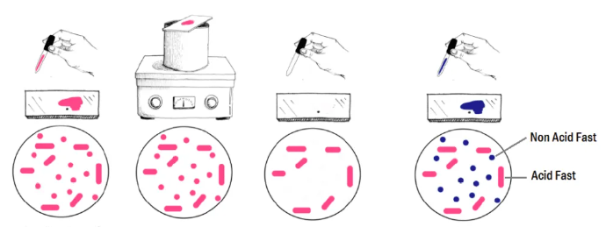
Diagnosis
2. Acid-fast Smears
MTB can be detected microscopically in smears of clinical specimens using one of the acid-fast staining procedures.
specimens such as sputum and cerebrospinal fluid are concentrated by centrifugation before staining to improve the sensitivity of detection.
3. Culture
Whether the AFB smear is positive or not, culture of the organism is essential for confirmation and for antimicrobial susceptibility testing.
Specimens from sites, such as cerebrospinal fluid, bone marrow, and pleural fluid, can be seeded directly to culture media used for MTB isolation.
Cultures on solid media usually take 3 weeks or longer to show visible colonies

Slide 17
References
Sherris Medical Microbiology: An Introduction to Infectious Diseases.
Jawetz, Melnick & Adelberg's Medical Microbiology by Geo. F. Brooks, Karen C. Carroll, and Janet S. Butel
Prescott's Microbiology by Joanne Willey, Linda Sherwood, and Christopher J. Woolverton

