Slide 1
Derivatives
Name of teacher :Dr. Mazin R Khalil
Advanced Mathematics2 –ME212
Semester 4
Week 7
Date: 26/3/2024

Slide 2
Objectives
To teach students the following opinions through out the lecture:
Rules of differentiation

Slide 3
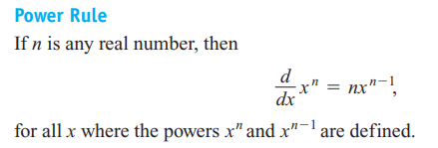

Slide 4
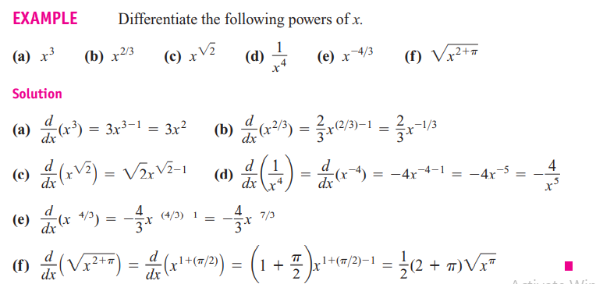

Slide 8
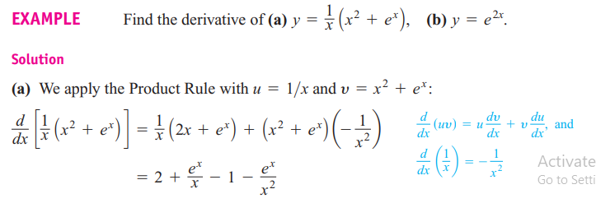

Slide 13
Examples

Slide 14
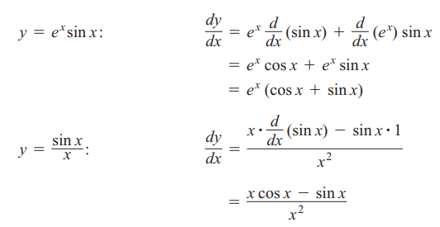

Slide 15
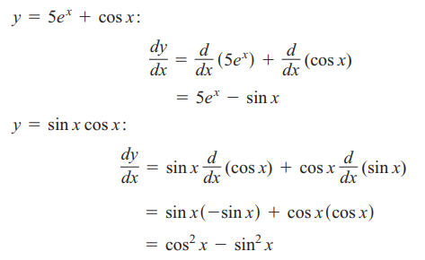

Slide 16
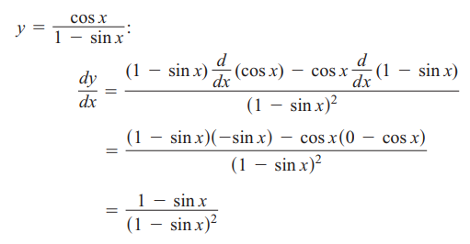

Slide 18
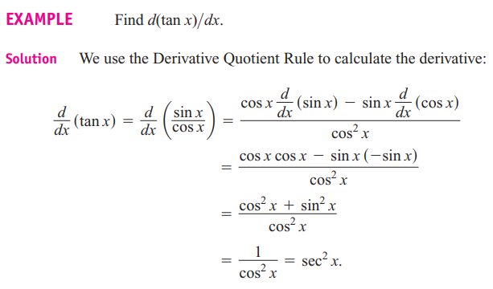

Slide 19
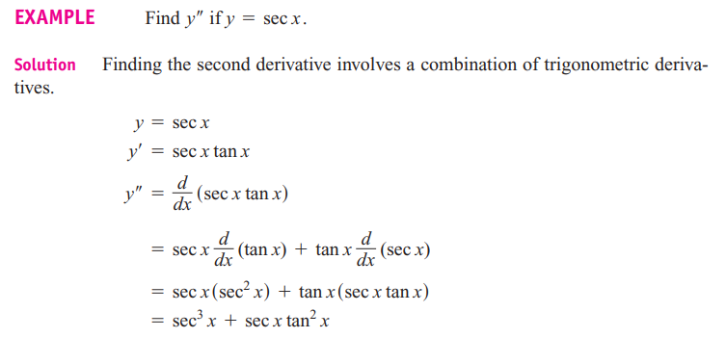

Slide 20
References
1. Thomas' Calculus" 11th edition
2. Calculus Early Transcendental Functions" by Ron Larson and Bruce Edwards

