Slide 1
Question Bank-1
Name of teacher :Dr. Mazin R Khalil
Advanced Mathematics2 –ME212
Semester 4
Week 8
Date :2/4/2024

Slide 2
Objectives
To teach students the following opinions through out the course

Slide 3
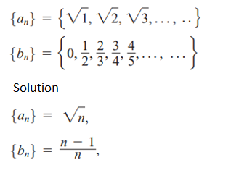
Example: Describe the formula for the following sequences
Solution:
a_{n} = 2n
Example: Describe the formula for the following sequences

Slide 4
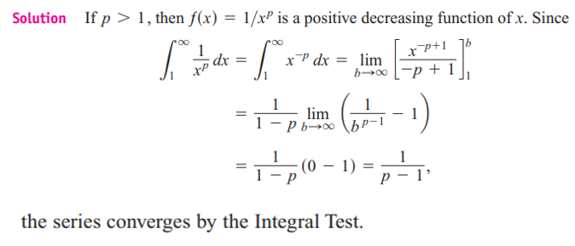
Example: Find the values of the following functions as n ∞.
Example: show that the following series converge if p>1.

Slide 8
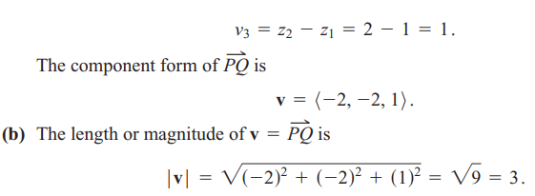

Slide 10
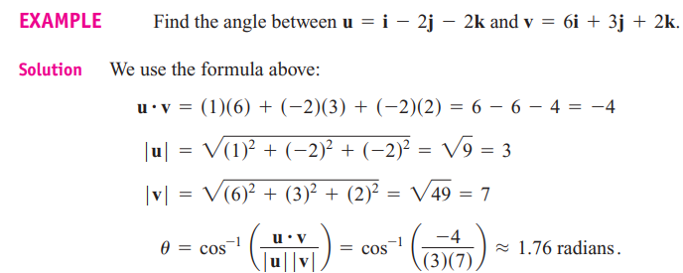
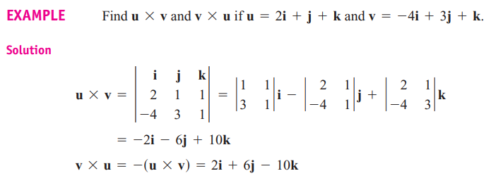

Slide 11
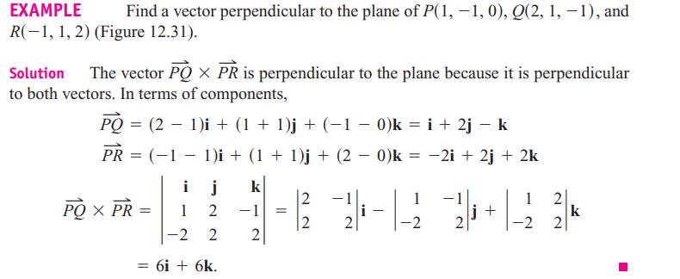
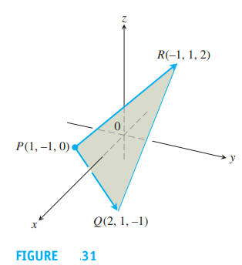

Slide 12
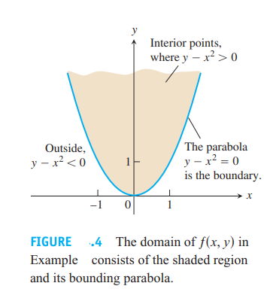

Slide 13
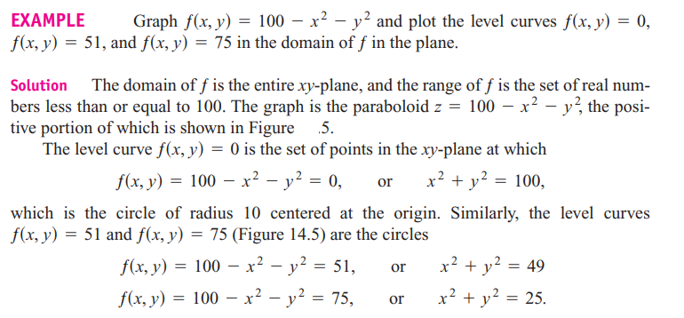

Slide 14
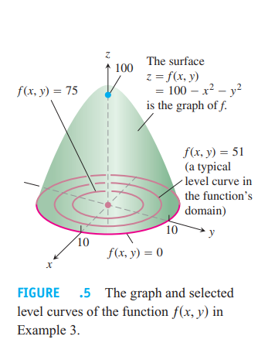

Slide 15
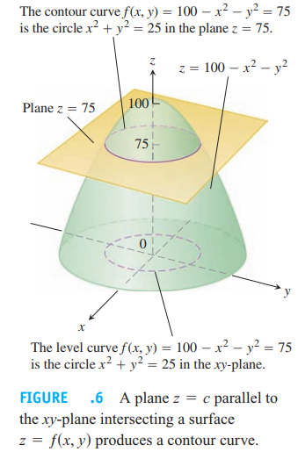

Slide 18
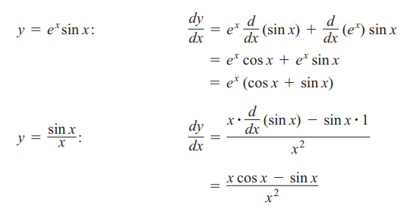

Slide 20
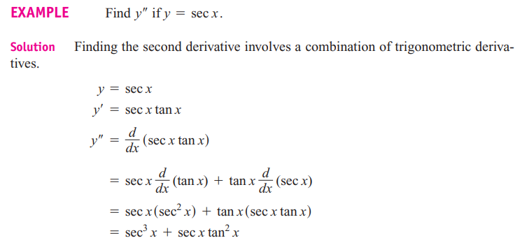

Slide 21
References
1. Thomas' Calculus" 11th edition
2. Calculus Early Transcendental Functions" by Ron Larson and Bruce Edwards

