Slide 1
\
Dr. Muslih S. Kareem
Psychiatric nurse and Senior psychotherapist
Suicidality

Slide 2
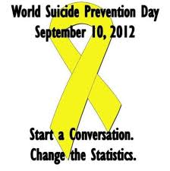

Slide 3
بِسْمِ اللَّهِ ٱلرَّحْمـٰنِ ٱلرَّحِيمِ
يَا أَيُّهَا ٱلَّذِينَ آمَنُواْ لاَ تَأْكُلُوۤاْ أَمْوَالَكُمْ بَيْنَكُمْ بِٱلْبَاطِلِ إِلاَّ أَن تَكُونَ تِجَارَةً عَن تَرَاضٍ مِّنْكُمْ وَلاَ تَقْتُلُوۤاْ أَنْفُسَكُمْ إِنَّ ٱللَّهَ كَانَ بِكُمْ رَحِيماً (29) النساء

Slide 4
Facts About Suicide
Suicide is the intentional act of killing oneself.
A suicide attempt is when someone harms themselves with any intent to end their life, but they do not die as a result of their actions (CDC).

Slide 5
One death recorded every 40 seconds globally due to suicide. (WHO, 2020).
In USA one death every 11 minutes
(CDC).

Slide 6
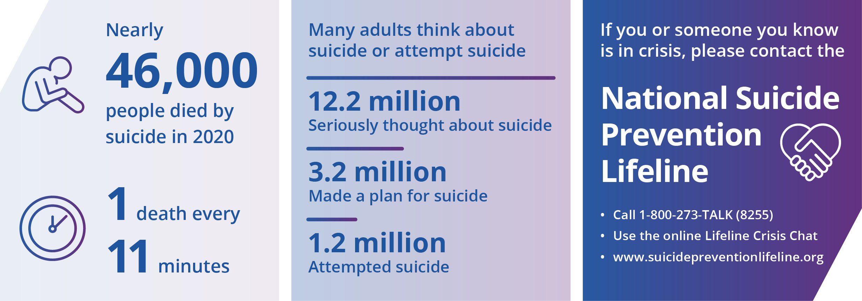
(CDC ) this data in USA

Slide 7
Globally, 800,000 people die yearly due to suicide (WHO, 2020).

Slide 8
Facts About Suicide
Suicidal thoughts are common in people with mood disorders, especially depression.
Each year, more than 30,000 suicides are reported in the United States.
Men commit approximately 72% of suicides, although women are four times more likely than men to attempt suicide.

Slide 9
In Iraq
Over 590 people died in 2019 due to suicide, and 1112 attempted it in Iraq; 80% of them were women which translates to an average of one death per day due to suicide, and three people per day to have attempted suicide. The number of suicide cases reported in 2019 is higher than those reported in 2018 (519) and 2017 (422) .
(WHO, 2020).

Slide 10
Steps of suicidality
Suicidal ideation
Suicide plan
Suicide attempt

Slide 11
Types of Suicidal ideation
Active suicidal ideation is when a person thinks about and seeks ways to commit suicide. People with active suicidal ideation are considered more potentially lethal.
Passive suicidal ideation is when a person thinks about wanting to die or wishes he or she were dead but has no plans to cause his or her death.

Slide 12
Risk factors of suicide
Psychiatric disorders, especially depression, bipolar disorder, schizophrenia, substance abuse, posttraumatic stress disorder, and borderline personality disorder.

Slide 13
Risk factors of suicide
Environmental factors: include isolation, recent loss, lack of social support, unemployment, critical life events, and family history of depression or suicide, violence, child abuse, or sexual violence, relationship break-ups, and lack of social support, family/ loved one’s, Financial or legal problems, any problem that they can't see a solution.

Slide 14
Risk factors of suicide
Chronic medical illnesses: include cancer, HIV or AIDS….
Sexual orientation (LGBT).
Behavioral factors: include impulsivity, and unstable lifestyle.

Slide 15
:The risk of suicide is increased when
A plan is formulated
The client has the ability to carry out the plan
There is a history of suicide attempts or a family history of suicide
The client is white, male, adolescent, or older than 55 years
The client is divorced, widowed, single, or living without family

Slide 16
Clinical manifestations
• Hopelessness
Lack of impulse control • Feeling of anger or hostility • Aggressive behavior •

Slide 17
Message of suicide direct to kill
Most people with suicidal ideation send either direct or indirect signals to others about their intent to harm themselves. (Warnings of Suicidal Intent)
Direct message verbally (kill myself)
Non verbally message (death is better of life)
Direct message Non verbally (try to prepare weapons, drugs & petrol )
Indirect message non verbally (visit all relatives, friends, organized the equipment in the home, loan & charity) (Dr. Afram, 2012)

Slide 18
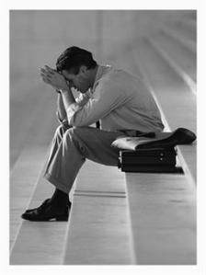
• Sleep disturbance • Social isolation • Anxiety and Depression • Guilt

Slide 19
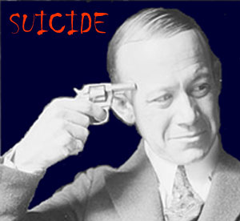
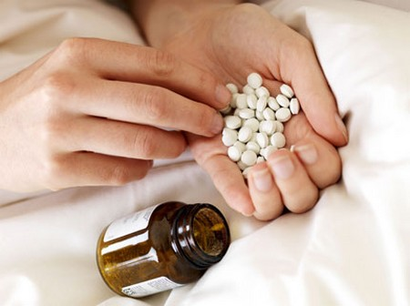
Methods of suicide
Weapons
drugs

Slide 20
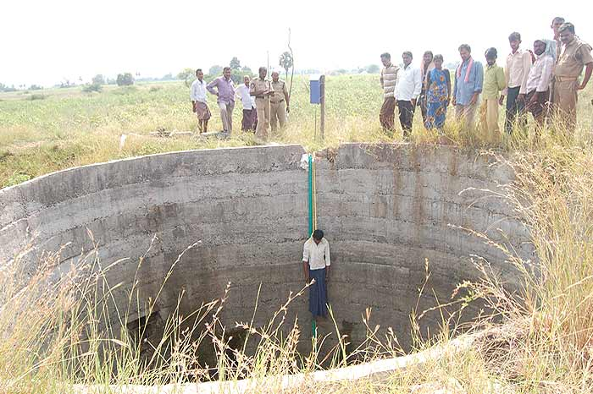
Suffocation
Fire
Fall from high

Slide 22
Risk assessment of suicide
Assess the steps of suicide (wish, plan, and attempt)
Previous attempt
Methods
Family history about suicide

Slide 23
Suicide risk as a spectrum
Passive suicidal ideation
Active suicidal ideation
– needs safety plan and
contact every 2-3 days
Thoughts that they would be better off dead e.g. I pray God will take me soon.
No self-harm
Has considered a method of suicide e.g. I could take all my tablets but I won’t.
No specific plan to
end life – good reason to live
Specific suicidal plan/ intent
- Needs safety plan & daily contact. Consider hopsital-ization
No suicidal
ideation
Occasional thoughts about death but not preoccupied; does not believe he is better off dead
Has method and specific plan e.g. I will take all the pills on Friday night.
Very impulsive & little support
High suicide risk – do not leave alone or allow to go home
No suicidal risk
Notes:
Safety plan orange and red

Slide 24
Like most public health problems, suicide is preventable.

Slide 25
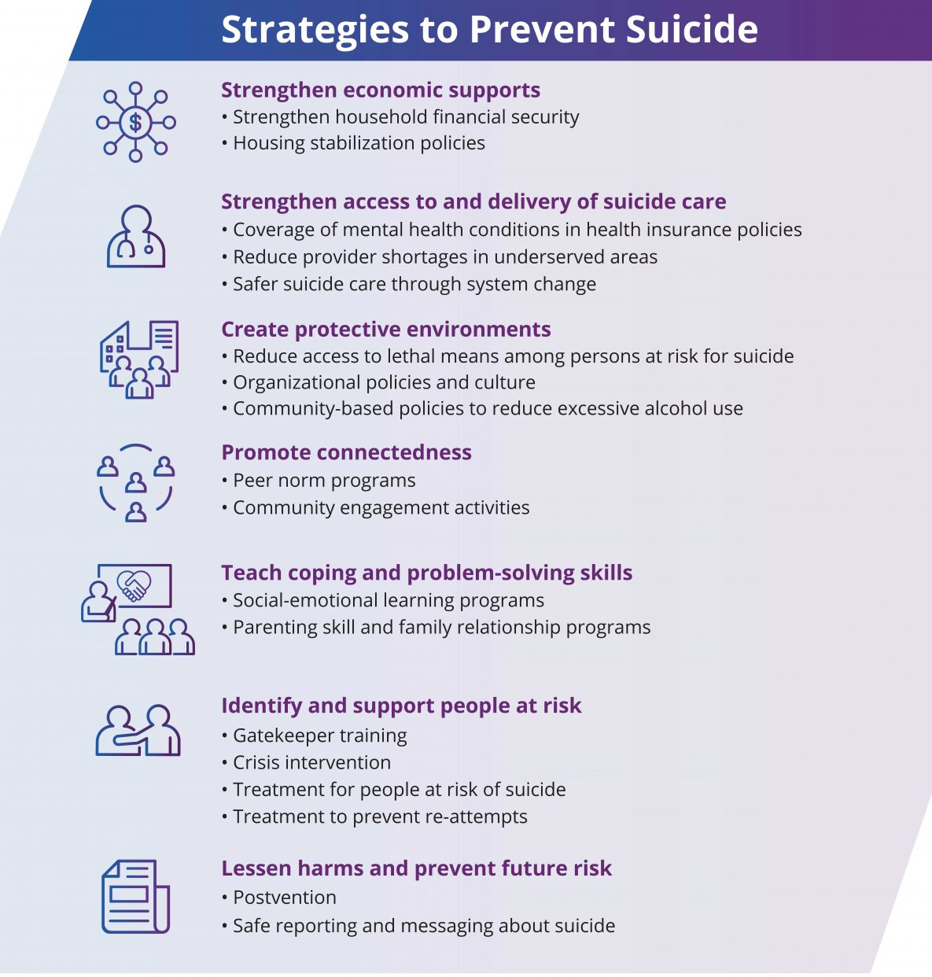

Slide 28
Suicide Prevention
Suicide is a serious but preventable public health problem that can have lasting harmful effects on individuals, families, and communities. While its causes are complex, the goals of suicide prevention are simple reduce factors that increase risk and increase factors that promote resilience or coping.

Slide 29
3steps to prevent suicide
1. Ask
If you think someone might be suicidal, ask them directly "Are you thinking about suicide, it a show you care and will actually decrease their risk because it shows someone is willing to talk about it..
2. Listen and stay with them
If they say 'yes', they are suicidal, listen to them and allow them to express how they are feeling. Don’t leave them alone. Stay with them or get someone else reliable to stay with them.

Slide 30
3steps to prevent suicide
3. Get help
Get them appropriate help. Call a crisis line like Lifeline 720 if life is in danger. If you can get in straight away visit a GP or psychologist. Even if the danger is not immediate they may need longer term support for the issues that led to them feeling this way.

Slide 31
Safety plan to give to client
Patient Name: ………………….. Date: ………………….
Risk assessment part (2 pages) in Client File. Safety Plan to give to client
Please record the following:
What are your triggers?
1. …………………………………
2…………………………………..
3. …………………………………
What are the warning signs? What changes will you notice in your thoughts, feelings, body and behaviour?
1……………………………….
2……………………………….
3……………………………….
What is the worst outcome?
What can you do to help yourself?
1.Self care (Breathing, relaxation, other exercises)……………………………………………………………
2. Distraction …………………………………………………………………………………………………………………….
3. Remove methods …………………………………………………………………………………………………………
4. Other …………………………………………………………………………………………………………………………..
Who can you contact to help you?
People to call or visit:
If necessary, what is the plan for the next 24 hours?
…………………………………………………………………………………………………………………………………………………
Tel nr Jiyan……………………………………………………………………..
Tel nr. doctor…………………………………………………………….

Slide 32
Example of Safety plan to give to client
Safety Plan
Patient Name: Asma Khalid Date: 14/03/2017
What are your triggers?
1. Arguments with my mother
2. Reminders of Daesh which makes me have bad thoughts
3. Feeling trapped like I have no choice
What are the warning signs? What changes will you notice in your thoughts, feelings, body and behaviour?
1. I get very upset, crying one minute, angry next, then sitting quietly rocking
2. I don’t want to eat and I cannot sleep and I am restless
3. I keep thinking I cannot do this any more and I want to die
What is the worst outcome?
I will set myself on fire.
__________________________________________________________________________
What can you do to help yourself?
1.Self care (Breathing, relaxation, other exercises): I can try to listen to music as it helps me stay calm. My family can give me quiet space but keep an eye on me so that I am safe. I can try muscle relaxation or some other stretches to help my body calm down.
2. Distraction: I can go for a walk to help distract me.
3. Remove methods: my family can take away or keep in a safe place, any matches, kerosene, oil or anything I could use to burn myself.
4. Other: I can draw or write about how I am feeling
Who can you call to help you?
I can speak to my sister about how I am feeling for support. I can ask my brother to come and visit.
Tel nr Jiyan……………………………………………………………………..
Tel nr. doctor…………………………………………………………….
Therapist signature: ________________________________ Patient signature: ______________________________

Slide 33
Treatment of suicidality
Psychotropic medications
Psychotherapy
ECT

Slide 34
Nursing care for suicidality
1. Close observation of pt. & alert the family.
2. Fill out the Safety Plan form for the patient.
3. Assess the pt. suicidal potential, and evaluate the level of suicide precautions at least daily.

Slide 35
Nursing care ……
4. If the pt. is attempting to harm him/herself, it may be necessary to restrain or in a secluded place.
5. Stay with the pt. when he/she is meeting hygienic needs like bathing, shaving, & cutting nails.

Slide 36
Nursing care……..
6. Medication; period of action, side effects and taper.
7. Tell the pt. You are a worthwhile human being, mention the things that give hope again
8. Refer the patient to a mental health professional.

Slide 37
Nursing care ……..
9. The nurse uses a nonjudgmental tone of voice and monitors his or her body language and facial expressions to make sure not to convey disgust or blame. or reinforce the pt. feelings of guilt or sin.
10. Provide opportunities for the pt. to express emotions and release tension in non-self-destructive ways such as discussions, recreational activities,& exercise.

Slide 38
Nursing care ……..
11. The nurse should consider the information provided to clients about antidepressants who may have a continuing or increased risk for suicide in the first few weeks of treatment. They may experience an increase in energy from the antidepressant but remain depressed. This increase in energy may make clients more likely to act on suicidal ideas and make them capable of carrying them out. Also, because antidepressants take several weeks to reach their peak effect, clients may become discouraged and act on suicidal ideas because they believe the medication is not helping them. For these reasons, it is extremely important to monitor the suicidal ideation of depressed clients until the risk has subsided.

Slide 39
Nursing care ……..
12. Protective factors include close parent–child relationships, academic achievement, family-life stability, and connectedness with peers and others outside the family.

Slide 40
References
1. Sheila et.al (2017) psychiatry and mental health nursing . 7 edition . P. 522-533.
2. CDC, 2020
3. WHO.2020. https://reliefweb.int/sites/reliefweb.int/files/resources/WHO%20PR%209%20Dec%202020%20EN.pdf
4. Eby.L,&Brown.N.J,(2005),mental health nursing care published by julie,printed in U.S.A.P 147.
5.Kathrine M.Fotinatash,MSN,(2000),Psychtric Mental Health Nursing,second edition by Mosby,P(653-662)
6. Schultz J. & Videbeck S.(2009) Psychiatric Nursing Care plans. 5th ed., p.193.

Slide 41
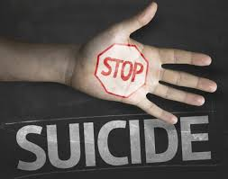

Slide 42
هێمن بە
و
ئەرکی ماڵەوەت
ئەنجام
بدە

Slide 43
THANKS
زؤر سوثاس

