Slide 1
Schizophrenia
Prepared by
Lecturer: Muslih S. Kareem
MSc. in Psychiatric Nursing

Slide 2
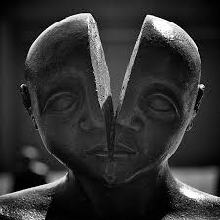

Slide 4
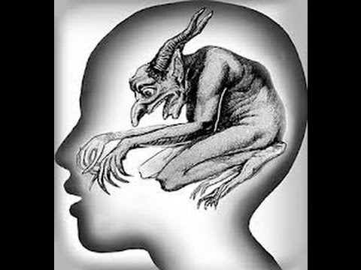

Slide 5
SCHIZOPHRENIA

Slide 6
Schizophrenia
Is a functional psychosis characterized by disturbances in thinking, emotion, mood, behavior and perception.
Finally, it leads on to personality deterioration and distortion of reality, for at least 6 months.

Slide 7
Historical background
The term schizophrenia was coined in 1908 by the Swiss psychiatrist Eugen Bleuler. The word was derived from the Greek “skhizo” (split) and “phren” (mind).
Kurt Schneider: He emphasized the role of psychotic symptoms, as hallucinations, delusions and gave them the privilege of „the first rank symptoms” even in the concept of the diagnosis of schizophrenia.

Slide 8
Etiology:
Internal factors – genetic, inborn, biochemical
External factors – trauma, infection of CNS, stress

Slide 9
Epidemiology:
Is a common disease prevalent in all cultures and in all parts of world. 3-4 per 1000 in any community suffer from schizophrenia.
1% of general population have risk of disease in their life time.
Two-thirds of cases are in the 15-30 years age group.
the disease is more common in lower social classes.

Slide 10
Typical stages of schizophrenia:
Phase I: The schizoid personality
Phase II: The Prodromal phase
Phase III: The Active or schizophrenia
Phase IV: The Residual phase

Slide 11
Phase I: The schizoid personality
(aloof, cold, limited of emotional expression and lack of social relationships)
Phase II: The Prodromal phase
(peculiar behavior, neglect of personal hygiene and grooming, functional, social and communication impairment, bizarre idea, lack interests and energy, length of this phase may last for many years before deteriorating to the schizophrenic state ).

Slide 12
Phase III: The Active or schizophrenia
(two or more of the following symptoms for 6 months period must be include at least 1 month of symptoms : positive symptoms {Delusion, hallucination, disorganized speech and behavior} and negative symptoms {affective flat or loss of emotional expression, alogia or poverty of speech and avolition or lack of motivation} ).
Phase IV: The Residual phase
(is traits by period of remission and exacerbation, are similar to the prodromal phase, with flat affect and impairment in role functioning).

Slide 13
Types of schizophrenia:
1-Paranoid Schizophrenia
2-Disorganized Schizophrenia(Hebephrenic)
3-Residual Schizophrenia
4-Catatonic Schizophrenia
5-Undifferentiated Schizophrenia

Slide 14
Paranoid Schizophrenia
is characterized mainly by
delusions (persecution or grandeur).
Hallucinations(auditoryHallucination ).
Argumentative, guarded, suspicious, hostile and aggressive.

Slide 15
Hebephrenic (disorganized) Schizophrenia
is characterized by disorganized thinking with blunted and inappropriate emotions. It begins mostly in adolescent age, the behavior is often bizarre. There could appear mannerisms, grimacing, inappropriate laugh and joking, personal neglected and social isolation.
Usually the prognosis is poor because of the rapid development of "negative" symptoms, particularly flattening of affect and loss of volition. Course is commonly chronic, communication is incoherent,

Slide 16
Residual Schizophrenia
A chronic stage in the development of schizophrenia with clear succession from the initial stage with one or more episodes characterized by general criteria of schizophrenia to the late stage with long-lasting negative symptoms and deterioration).

Slide 17
Catatonic Schizophrenia
Catatonic schizophrenia is characterized mainly by motoric activity, which might be strongly increased (catatonic excitement)or decreased (catatonic stupor).
We recognize two forms:
productive form (catatonic excitement) extreme and often aggressive activity. Treatment by neuroleptics or by electroconvulsive therapy.
stupor form (catatonic stupor) characterized by general inhibition of patient’s behavior or at least by retardation and slowness, followed often by mutism, negativism(motiveless) and waxy flexibility.

Slide 18
Undifferentiated (atypical) Schizophrenia
Psychotic conditions meeting the general diagnostic criteria for schizophrenia but not conforming to any of the subtypes, or exhibiting the features of more than one of them without a clear predominance of a particular set of diagnostic characteristics.
This subgroup represents also the former diagnosis of atypical schizophrenia.

Slide 19
Simple Schizophrenia
Simple schizophrenia is characterized by early and slowly developing initial stage with growing social isolation, withdrawal, small activity, passivity, avolition and dependence on the others.
The patients are indifferent, without any initiative and volition. There is not expressed the presence of hallucinations and delusions.

Slide 20
Clinical features:
1-Positive symptoms:
Delusion
Hallucination
Disorganized speech
Bizarre behavior
2-Negative symptoms
Blunted affect (reduced range of emotion).
Anhedonia (inability to experience pleasure).
Alogia (reduced fluency and productivity of language and thought).
Avolition (Loss of motivation)
Attentional impairment

Slide 21
Diagnosis of schizophrenia
A: two or more of the following, each for significant period of time (1 month)
1- delusions
2-hallucinations
3- disorganized speech
4- grossly disorganized behavior
5- negative symptoms

Slide 22
Dx.Schio.Cont…………………
B- socio-cultural dysfunction( work, interpersonal, or self care) for a significant period of time
* whole duration is 6 month

Slide 23
Prognosis
Good prognosis | Poor prognosis
Later onset | Younger onset
Acute onset | Insidious onset
Good social, sexual and work history | Poor social, sexual and work history
Depression | Withdrawn behavior
Catatonic or paranoid features | Disorganized
Married | Single, divorced, widowed
Good support systems | Poor support systems
Positive symptoms | Negative symptoms

Slide 24
Treatment:
Hospitalization
Antipsychotic medication
ECT
Psychotherapy
Education about disease for patient and family
Rehabilitation.

Slide 25
Nursing care of schizophrenia
1-try to decrease stimuli of surrounding rooms (T.V, stereo)
2- giving small responsibilities to the patient
3- use concrete, specific verbal communications, avoid gestures, abstract ideas
4- avoid asking the client to make chioces, don’t ask” would like to talk or be alone”
5- encourage the client to tell staff members about hallucination

Slide 26
6- protect the client from harming himself or others
7-remove the client from the group, if his behavior becomes disturbing,too bizarre,or dangerous to others
8- reorient the client to person,place and time.
9-make only promises that you can keep
10- stay with the client when she or he is frightened. touching the client can sometime be theraputic.

Slide 27
References
Townsend, C., Mary DSN. And APRN, BC. (2008). Essentials of Psychiatric Mental Health Nursing. 4th ed. Philadelphia. F.A. Davis Company. USA. P.305-309.
Varcarolis, E. M., et al.(2006). Foundations of Psychiatric Mental Health Nursing A Clinical Approach. 5th ed. Saunders Elsevier. P.390.

Slide 28
thank you..

