Slide 1
Thyroid gland
Zhikal O. Khudhur
Endocrinology BIO 414
Spring Semester
Week number: 6
Date: 2/ 2024

Slide 2
Objectives
Thyroid gland
Thyroid hormone synthesis
Thyroid hormone function
Calcitonin function and regulation
Thyroid hormone regulation

Slide 15
NEXT LECTURE
Parathyroid hormone and calcitonin.

Slide 17
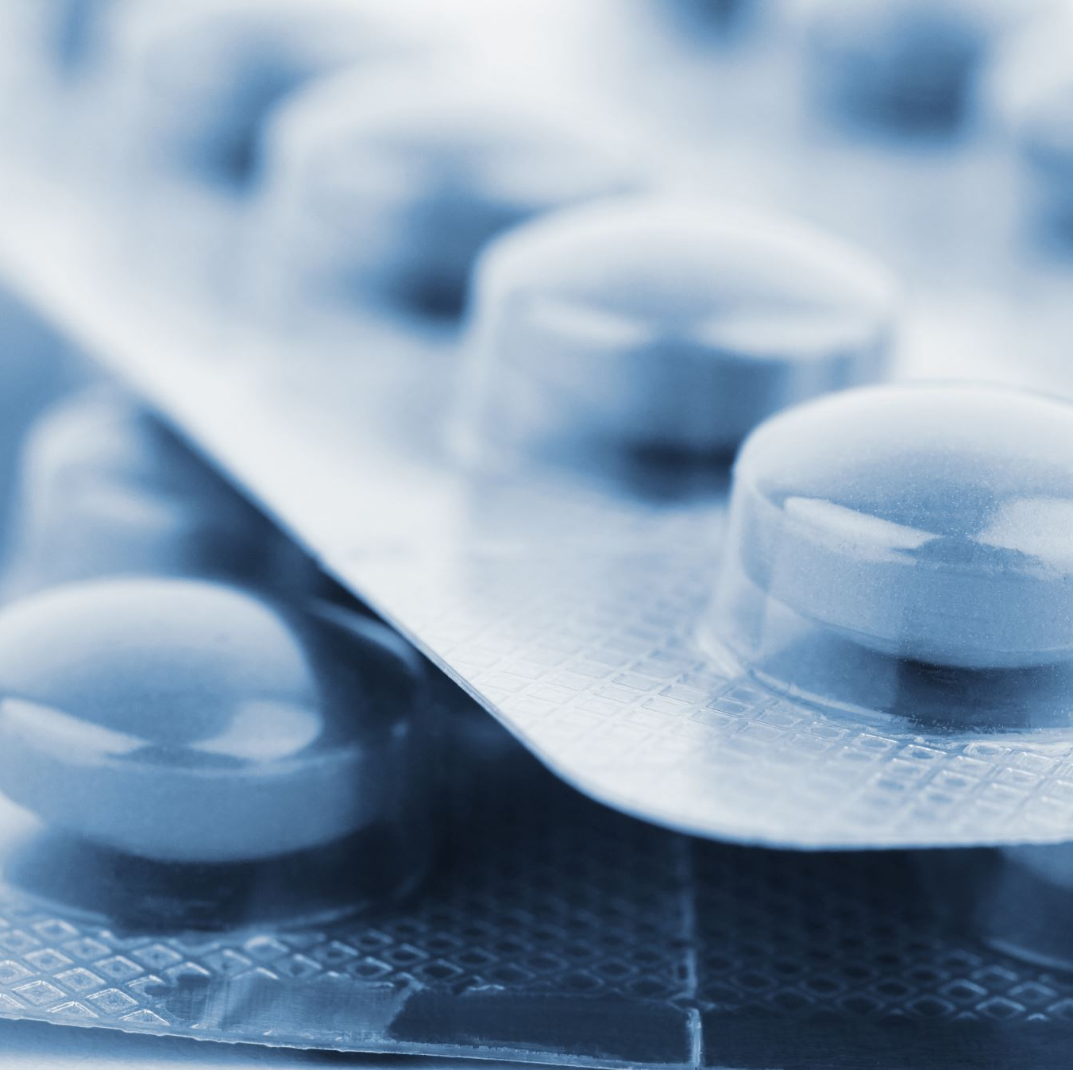
ASSIGNMENT
PREPARE POST ABOUT HORMONAL DISORDERS (HYPOTHYRODISM, HYPERTHYRODISM, DIABETES........
.

Slide 18
References
Greenstein B. & Wood D. F. (2011). The endocrine system at a glance (3rd ed.). Wiley-Blackwell
Melmed S. Auchus R. J. Goldfine A. B. Koenig R. Rosen C. J. & Williams R. H. (2020). Williams textbook of endocrinology (14th ed.). Elsevier. Boron W. F. & Boulpaep E. L. (2021).
Boron & boulpaep concise medical physiology. Elsevier. Barrett K. E. Barman S. M. Yuan J. X.-J. & Brooks H. (2019).
Ganong's review of medical physiology (review questions) (26th ed.). McGraw-Hill Education LLC Molina P. E. (2018). Endocrine physiology (Fifth). McGraw-Hill Education.

Slide 19
Thank you

