Slide 1

Molecular Typing of bacteria
Dr. Salah Tofik Balaky
Course: Molecular Biotechnology
MA Code408
Semester 8: Week 6
Date 7/3/2024

Slide 2
Molecular typing
Molecular typing, can be defined as strain-specific identification. The objective of typing studies is to ascertain if two or more strains are derived from a single parent organism. Such investigations are usually performed to clarify whether two isolates from different sources represent the same strain or distinct ones.

Slide 3
Applications of molecular typing
Microbial identification beyond species level.
To relate individual cases to an outbreak of infectious disease in both global or local epidemiology
To study variations in the pathogenicity, virulence and antibiotic resistance of individual strains.
Microorganisms with important industrial applications in Molecular Biotechnology

Slide 4
Molecular typing Main Methods
1. Band-based typing, such as PFGE
2. Sequence-based typing, such as MLST

Slide 5
Pulsed-field gel electrophoresis (PFGE)
PFGE is a technique that allows the electrophoretic separation of low numbers of large DNA restriction fragments produced using restriction enzymes called molecular scissors to cut bacterial DNA and generate a highly discriminatory genetic fingerprint.
By comparing the fingerprints of any two isolates, one can investigate if they belong to the same strain (i.e. the two isolates are clonal) or if they are genetically unrelated. PFGE is relatively costly and requires at least three days to obtain a result. The degree of discrimination also depends on the choice of restriction enzymes.

Slide 6
PFGE methodology steps
1. Bacterial samples are loaded into an agarose suspension to release the DNA.
2. The agarose and DNA suspension, also known as a plug, is treated with restriction enzymes.
3. The treated plugs are then loaded onto an agarose gel and fragments are separated based on size using an electric field.
4. Result patterns will be analyses.

Slide 7
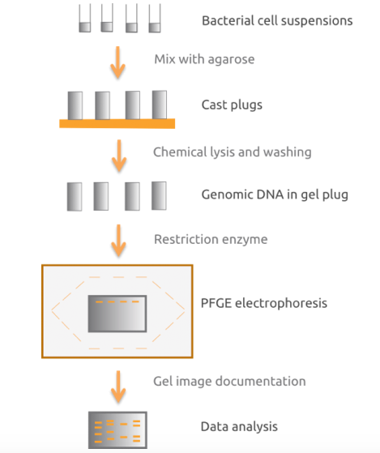
PFGE Methodology

Slide 8
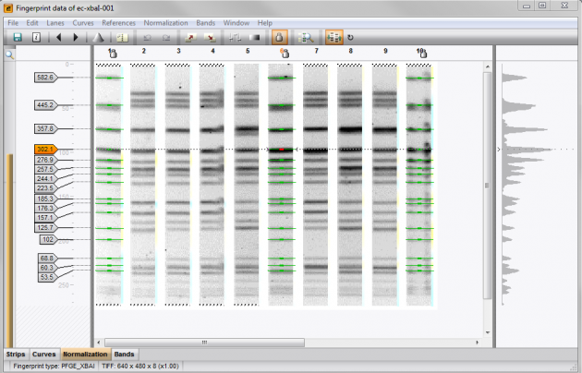
Example of PFGE data

Slide 9
Multilocus sequence typing (MLST)
MLST is a technique in which sequencing of 400-500 base pair fragments of DNA at seven different conserved genes performed. This allow small variations within a species to be detected. Quite time consuming and costly, but can be highly discriminatory if the genes are correctly chosen.

Slide 10
Multilocus sequence typing (MLST)
Each sequence for a given locus then screened for identity with already known sequences for that locus. If the sequence is different, it is considered to be a new allele and is assigned a unique allele number. The allelic profiles can be considered as a character set of 7 digit number.

Slide 11
S. aureus genes used in MLST
Gene | Amplicon size
Carbamate kinase (arcC) | 456 bp
Shikimate dehydrogenase (aroE) | 456 bp
Glycerol kinase (glpF) | 465 bp
Guanylate kinase (gmk) | 429 bp
Phosphate acetyltransferase (pta) | 474 bp
Triosephosphate isomerase (tpi) | 402 bp
Acetyl coenzyme A acetyltransferase (yqiL) | 516 bp

Slide 12
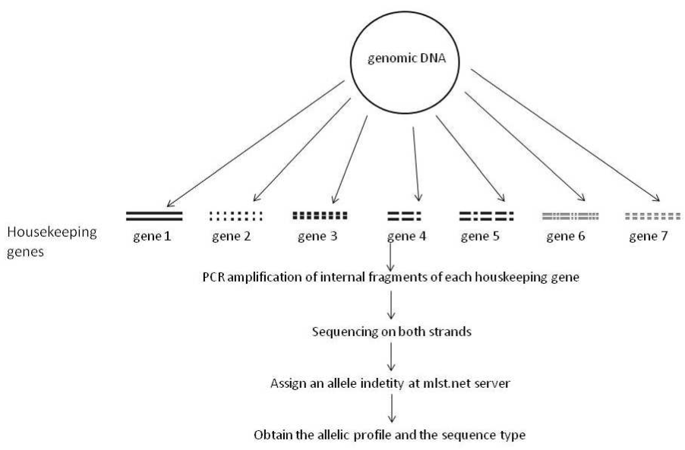

Slide 13
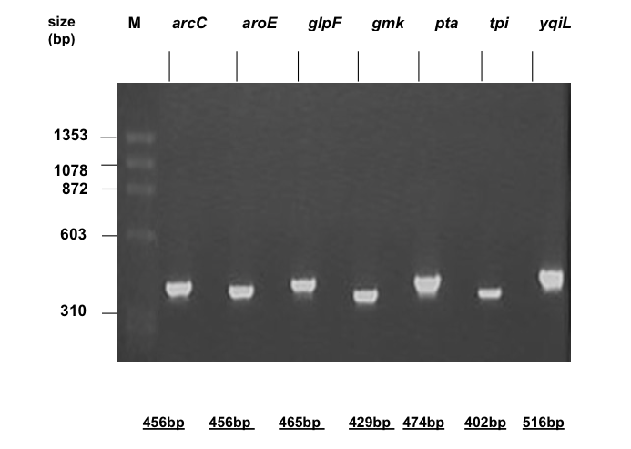
PCR of seven house keeping genes

Slide 14
Sequencing the PCR product
The first and most important factor in automated DNA sequencing is clean, pure template. For a sequencing reaction to be successful all excess primers, dNTPs, salts and residual RNA and proteins must be removed from the sample. A cycle sequencing reaction is very similar to a PCR reaction. Note that only one primer is used for a sequencing reaction.

Slide 15
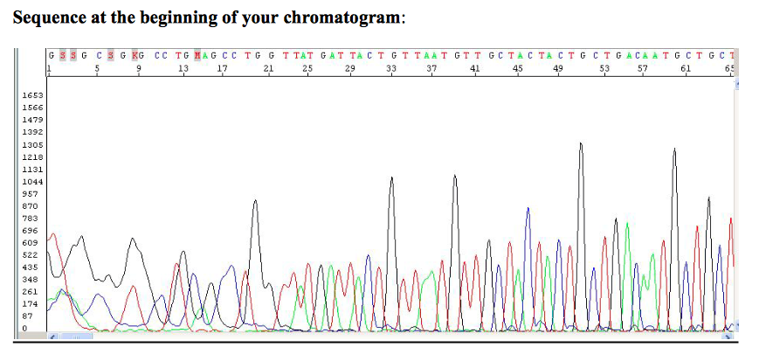
Sequencing the PCR product
Text

Slide 16
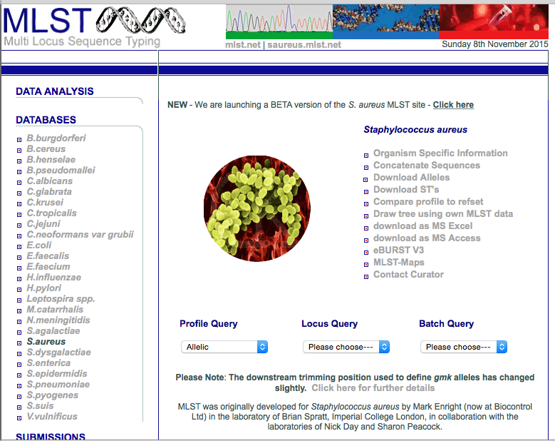

Slide 17
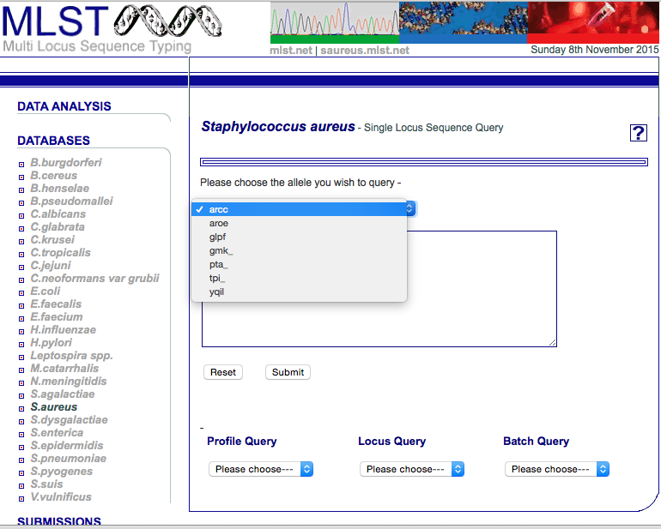

Slide 18
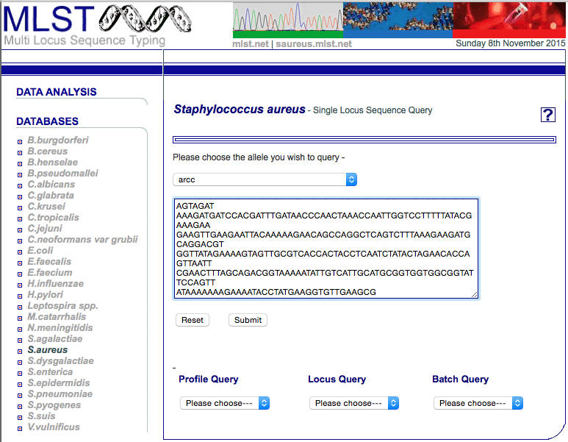

Slide 19
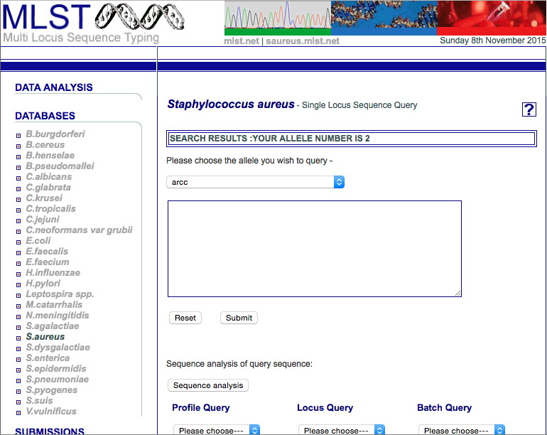

Slide 20
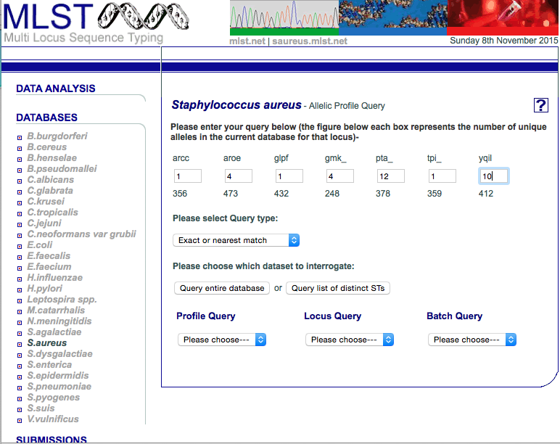

Slide 21
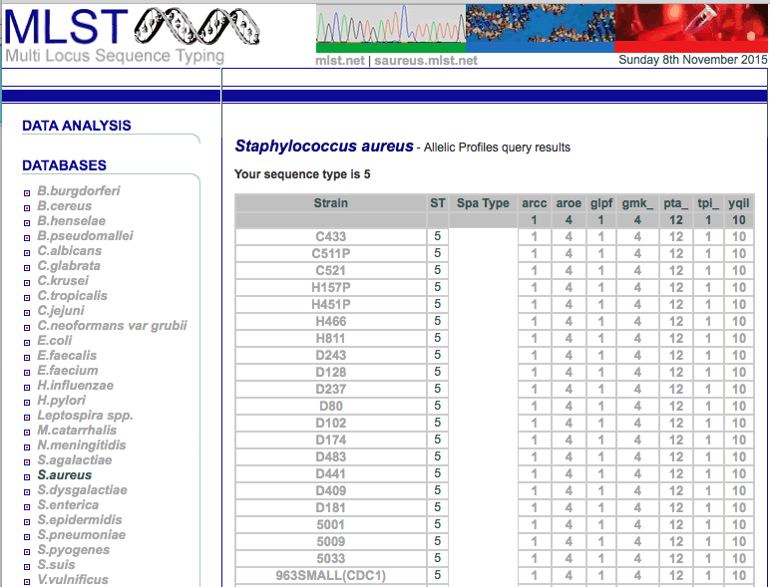

Slide 22
Advantages and applications of MLST
The technique suitable for global and local epidemiology of many bacterial pathogens.
The ability to compare sequence data between laboratories via the MLST website.
MLST has already been used to characterize a number of pathogenic bacteria such as S. aureus.
The data obtained by MLST permits investigation of the population structure and evolutionary hypotheses.

Slide 23
Questions and comments?

