Slide 1

Personality Disorder
Muslih.S.Kareem

Slide 2
Objectives:
To know:
what are the specific types of PD.
How to differentiate between the PD from their behaviours.
How to deal with & manage PD.

Slide 3
Why we study personality?
- It is important for teachers, students & others to Know the best way to deal & interact with others.
-No two individuals have the same personality. Each individual has his own way of interacting with others and with his environment.

Slide 4
Why we study personality? ….Cont…
-Our personality traits determine how we adjust to our environment and how we react in specific situations.
- Our personalities are relatively stable enough to be recognized by our friends and relatives.

Slide 5
Definition of personality:
Enduring patterns of thinking, feeling and behavior, which make one individual distinguishable from another.
What is personality disorder?
Enduring pattern of inner experience and behavior that deviates markedly from cultural expectations.

Slide 6
Onset and Clinical Course
Personality disorders occur in 10% to 13% of the general population
Incidence is even higher in lower socioeconomic groups
40% to 45% of people with a primary diagnosis of major mental illness.

Slide 7
DSM-IV General criteria for personality disorder
A. Enduring pattern of inner experience and behavior that deviates markedly from cultural expectations. Manifested in two or more of the following areas:
  Cognition
  Affectivity
  Interpersonal functioning
  Impulse control
B. Pattern is inflexible and pervasive across a broad range of personal and social situations
C. Pattern leads to clinically significant impairment or distress
D. Pattern is stable and of long duration and onset can be traced to adolescence or early childhood
E. Not due to substance or GMC (e.g., head trauma)

Slide 8
DSM-IV Clusters:
Cluster A: odd (Schizoid, Schizotypal, Paranoid)
Cluster B: dramatic (Antisocial, Borderline, Histrionic, Narcissistic)
Cluster C: anxious (Avoidant, Dependent, Obsessive-Compulsive)

Slide 9
Cluster A: odd
(Schizoid, Schizotypal, Paranoid)

Slide 10
Schizoid Personality Disorder:
Pervasive indifference toward others
Restricted range of emotional expression
Unaffected by praise or criticism
Few friends or confidants
Maintains superficial connections with relatives; even these are aloof and cool
No sense of humor
Lacks social skills

Slide 11
Schizotypal Personality Disorder:
Acutely uncomfortable around others; esp. those who are unfamiliar
Deficient in social relationships
Bizarre fantasies and preoccupations
mismatched, prefer to dress in strange clothing
vague in speech
Use words differently than others: neologisms

Slide 12
Paranoid Personality Disorder:
A pervasive belief that others intend to harm
Distrust and suspiciousness of even family and friends
Taking remarks out of context and interpreting them to support own frame of reference
Extreme jealousy
Hypersensitivity to criticism
quick to anger

Slide 13
Cluster B: dramatic
(Antisocial, Borderline, Histrionic, Narcissistic)

Slide 14
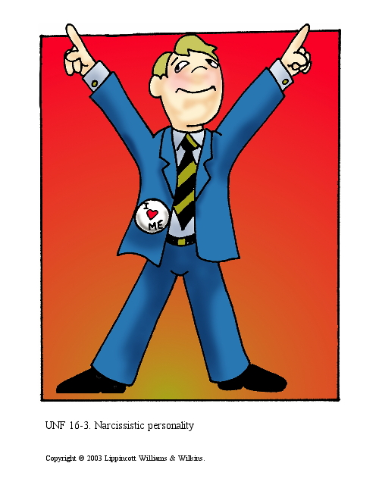
Cluster B (dramatic, emotional, or erratic) PD:
(Antisocial, Histrionic, Narcissistic, Borderline)

Slide 15
Antisocial Personality Disorder:
Longstanding irresponsible behavior
Lying, stealing, vandalizing, bullying as a child
Initiating fights, running away from home
Crimes; drugs; fights; violation of the rights of others
Unstable work history
Incapable of sustaining relationships with family members or friends
Expresses no remorse; feels justified in hurting

Slide 16




Slide 17

  Histrionic Personality Disorder:
  Features :
  - Wants to be the center of attention, & often interrupt others to be the center of conversation
  - Rapidly shifting, & shallow but excessive expression of emotion.
  - life of the party , but difficulty in relationships,
  Attention (uncomfortable when not the center)

Slide 18

3-Histrionic Personality Disorder Features :
- Shows self-dramatization, & exaggerate illnesses & friendships.
- Suggestible, i.e. easily influenced by others or circumstances.
- Consider relationships to be more intimate than they actually are.
- Common defenses include repression, regression, identification, somatization, conversion, dissociation, denial, & externalization. prevalence: 2%-3% of the general population

Slide 19
Narcissistic Personality Disorder:
Pervasive grandiosity about self
Sees self as unique
Excessive and constant need for admiration
Lacks empathy

Slide 20
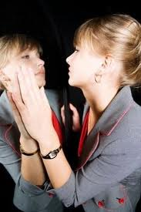
Narcissistic Personality Disorder
Features:
- Inflated sense of their own importance with boastfulness.
- Believes that they should associate with high-status people ( or institutions) as they perceive themselves to be.
- Unable to see that others may not appreciate them, but hyper-sensitive to criticism

Slide 21
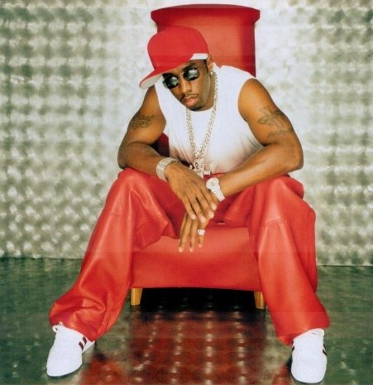

Prevalence: 1% of the general population

Slide 22
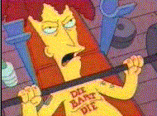
Borderline PD:
Features:
- Feelings of emptiness & boredom.
- Fragile identity with poor self-image
- Unpredictable, impulsive, irritable
Anger may directed toward themselves. Suicide threats & action may happen

Slide 23
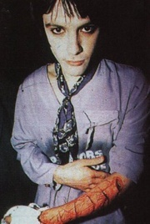
Borderline PD: Features:
- Rapidly changing mood & behavior with intense unstable relationships
- Splitting: divide persons into those who like & those who hate them.
-
Prevalence:
- 75% are female
- 2% of the general population.-

Slide 24
Cluster C: anxious
(Avoidant, Dependent, Obsessive-Compulsive)

Slide 25
Avoidant Personality Disorder:
Shy, distant; exaggerates risk that people pose
Hypersensitivity to evaluation
Avoid social activities that involve contact with others
Always expecting to say something foolish
No close friends or confidants

Slide 26

Avoidant Personality Disorder
Features:
- Extreme sensitivity to criticism and disapproval, so avoid situations in which criticism may be given otherwise feel anxious & get tachycardia, sweating, flushing…etc. due to chronic feeling of inadequacy.
-Hypersensitivity to evaluation
-No close friends or confidants
- avoid social interaction for fear of being ridiculed or humiliated.

Slide 27
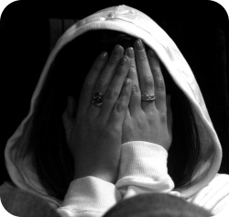
Features:
- Inhibited, introverted with low self-esteem.
- Shy and restrained.
- Avoidance of intimacy.
- Only involved if sure of praise.
Prevalence: 0.5%-1% of the general population

Slide 28
Dependent Personality Disorder:
longstanding dependency on and submissiveness to others
Even routine daily decisions require advice and reassurance
Complete passivity; letting others decide
Difficulty initiating projects
Discomfort, fear, and helplessness about being alone
Willingness to go along with others even it conflicts with their own wishes or values

Slide 29
Dependant PD:

Slide 30



Obsessive-compulsive PD:
Features:
- Inflexibility, stubbornness and desire for perfection
- Tend to stress perfectionism above all else, and feel anxious when they perceive that things aren't "right".
- A sense of their being only one way to do things
.

Slide 31


Features:
- Failure to get things done as a result of excessive attention to detail.
- A tendency to check and re-check, but absence of obsessional thoughts and compulsive behaviours
Prevalence: 1% of the general population

Slide 32
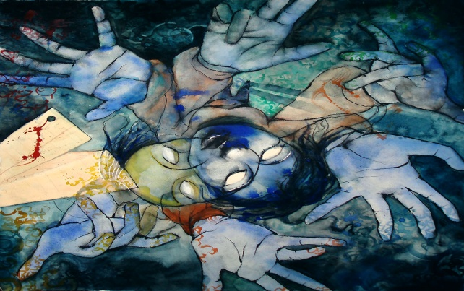
PD not otherwise specified:
Do not meet full criteria for any specific PD, but the diagnostic criteria for PD are present
- As the presence of features of more than one PD that do not meet the full criteria for anyone PD ("mixed PD"), but together cause clinically significant distress or social or occupational impairment.
- Or a specific PD that is not included in the classification of PD as depressive PD & passive-aggressive PD.

Slide 33
Depressive personality disorder:
Features:
A pervasive pattern of depressive cognitions and behaviors start in early adulthood, & indicated by presence of most of the followings:
Pessimistic, gloominess & unhappiness
Beliefs of inadequacy, worthlessness, & low self esteem
Critical, blaming toward self & worry
Negativistic,
guilty

Slide 34
Passive aggressive PD:
Features:
- Outwardly compliant but inwardly hostile, which may alternate with regret.

Slide 35
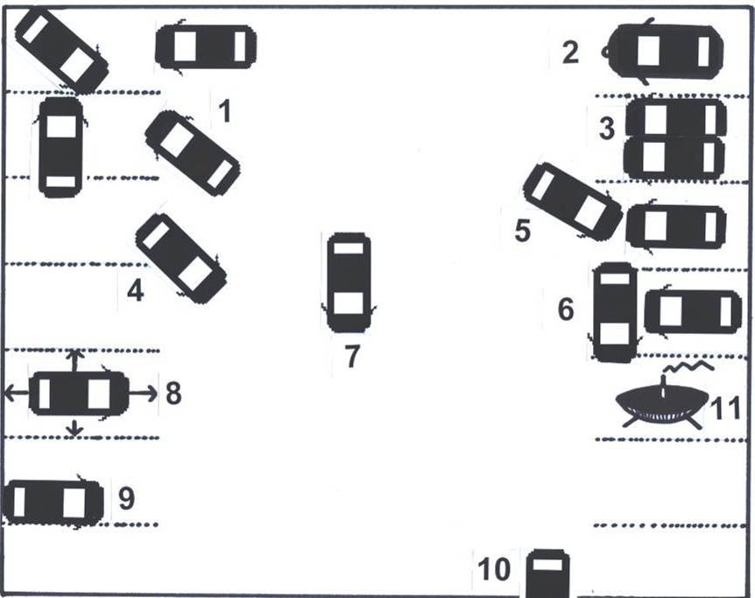
Parking a Lot of the Personality Disordered
7
1
9
5
11
4
6
10
3
8
2
PARANOID Cornered again
SCHIZOID Can’t tolerate closeness
SCHIZOTYPICAL Intergalactic (odd) parking
ANTI-SOCIAL Obstructs other cars
BORDERLINE Rams into car of ex-lover
HISTRIONIC Parks in centre for dramatic effect
NARCISSIST Largest car, prominent decoration
AVOIDANT Hides in the corner
DEPENDANT Needs other cars to feel safe
OBSESSIVE Perfect alignment in parking spot
PASSIVE AGGRESSIVE Angled across two bays (fields)

Slide 36
Management of PD:
Many people with personality disorder do not seek treatment because they don’t believe they have a problem,
PD have no insight & lack awareness that they are the cause of their own relationship problems, so they rarely seek psychological help unless compelled by others.
Individual, group & family psychotherapies, may be beneficial.
Improvement in relationships, improved basic living skills.
Cognitive-behavioral techniques such as thought-stopping, positive self-talk.

Slide 37
Medication:
pharmacological treatment has no proven usefulness in PD.
Antipsychotics, antidepressants , Mood Stabilizers & antianxiety drugs can however be used when there is psychotic, depressive or anxiety features or disorders.

Slide 38
……So:
Everyone has specific personality traits but if these traits lead to continuous personal distress or problems in social or occupational functioning, the person may have a personality disorder.

Slide 39

Questions

Slide 40
Allah
bliss you

