Slide 1
BENIGN AND MALIGNANT TUMORS OF
THE ORAL CAVITY L 19&20

Slide 2
BENIGN TUMORS OF
EPITHELIAL TISSUE ORIGIN
L19

Slide 3
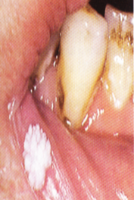
SQUAMOUS PAPILLOMA
The oral squamous papillomas are seemed to be associated with papilloma virus, the one commonly incriminated as causative in skin warts or verruca vulgaris.
Clinical features.
- An exophytic growth made up of numerous, small finger like projections which result in a lesion with a roughened, verrucous or ‘cauliflower like’

Slide 4
-. It is nearly always a well circumscribed pedunculated tumor, occasionally sessile.
It is painless, usually white but sometimes pink in colour.
Intraorally it is found most commonly on the tongue, lips, buccal mucosa, gingiva and palate.
The size of the lesion varies from few millimeters to about one centimeter in diameter,
Occurs at any age and seen even in young children.

Slide 5
.
Histopathological features.
It consists of many long, thin, finger-like projections extending above the surface of the mucosa,
Each projection made up of a continuous layer of stratified squamous epithelium and containing a thin, central connective tissue core which supports the nutrient blood vessels.
Some papillomas exhibit hyperkeratosis, although this finding is probably secondary to the location of the lesion and the amount of trauma or frictional irritation to which it has been subjected.

Slide 6
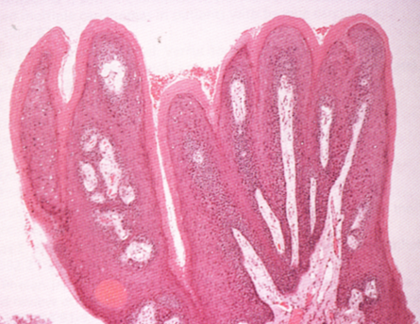
.
The presence of chronic inflammatory cells may be variably noted in the connective tissue.
Treatment of the papilloma consists of excision, including the base of the mucosa into which the pedicle or stalk inserts.
The connective tissue processes are covered by hyperkeratinized stratified squamous epithelium.

Slide 7
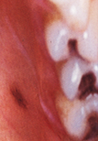
ORAL NEVI (Oral melanocytic nevus)
Oral melanocytic nevus is developmental tumor like malformation, usually asymptomatic, raised or flat area with a dark brown colour,
Usually seen in the hard palate or in the gingiva.

Slide 8
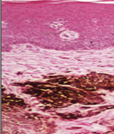
On the basis of the histologic location of the nevus cells, it can be classified into:
Intramucosal nevus (common mole): The nest of nevus cells are situated within the connective tissue and are separated from the overlying epithelium by a well defined band of connective tissue.

Slide 9
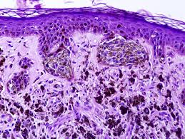
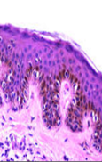
Junctional nevus: The nest of nevus cells are situated at the basilar region of the epithelium.
Occasionally it may undergo malignant transformation and gives rise to malignant melanoma.
Compound nevus: Nevus cells are distributed both in the basal layer of the epithelium as well as in the adjacent superficial connective tissue.

Slide 10
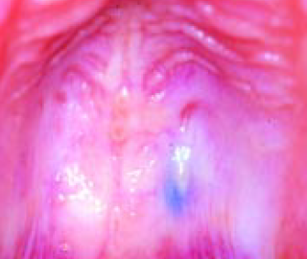
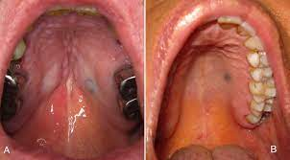
BLUE NEVUS:
Clinically
Appears raised or flat area, usually blue in colour .
Intraorally mostly appear in the hard palate.
The melanin producing cells morphologically differ from those of other nevi.

Slide 11
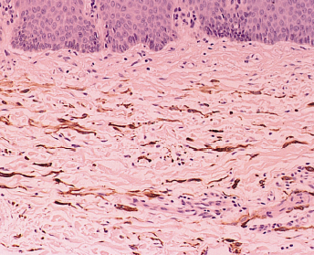
Instead of being round in shape, the cells of blue nevus are usually spindle in shape and well separated from underlying epithelium.
The elongated nevus cells are arranged parallel to the surface epithelium.
Pigmented cells in connective tissue.

Slide 12
MALIGNANT TUMORS OF EPITHELIAL TISSUE ORIGIN

Slide 13
BASAL CELL CARCINOMA (BCC, rodent ulcer)
The most common malignancy in humans is basal cell carcinoma .
- It is slowly growing and rarely metastasizes.
It arises from either basal layer of epidermis or from the hair follicles.
Ultraviolet radiation is the most important and common cause of BCC, X-ray exposure as well as chemical like arsenic has been associated with basal cell carcinoma development.
- Nevoid BCC syndrome is an autosomal dominant condition characterized by appearance of many BCCs

Slide 14
Clinical features.
Basal cell carcinoma occurs most frequently in persons in the fourth decade of life or later, but it has been reported as occurring in younger persons.
The male-to-female ratio is approximately 3:2.
It is a disorder of white individuals, especially those with very fair skin.
Most frequently seen in the middle third of the face, but may occur anywhere on the sun-exposed part of skin.

Slide 15
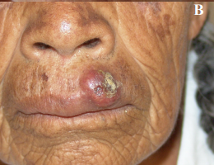
Initiated as a slow growing small nodule, and eventually develops into a central crusted ulcer with an elevated smooth-rolled border.
This form of carcinoma does not arise from oral mucosa and thus is never seen in the oral cavity unless it arrives there by invasion and infiltration from a skin surface.

Slide 16
Histopathological features:
There is considerable variability in the morphology of basal cell carcinomas, and as a consequence a number of histopathological subtypes have been defined.
Basal cell carcinomas are composed of islands or nests of basaloid cells, with palisading of the cells at the periphery and a haphazard arrangement of polyhedral cells in the centers of the islands.
The tumor cells have a hyperchromatic nucleus with relatively little cytoplasm.

Slide 17
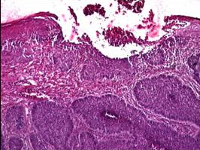
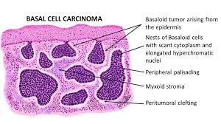
There are numerous mitotic figures.
The fibrous connective tissue stroma reveals varying degrees of cellularity.
Islands of tumor cells in the connective tissue.

Slide 18
EPIDERMOID CARCINOMA (Squamous cell carcinoma)
Squamous cell carcinoma is the most common malignant epithelial neoplasm of the oral cavity.
The etiological factors are:
Use of tobacco in its various forms, including smokeless tobacco particularly when associated with the use of excess alcohol.
High exposure to ultraviolet light increases the chance of developing cancer of the lip.
Betel nut chewing.
Vitamin deficiency like vitamins A and C.

Slide 19
Infections like viral (herpes simplex virus, human papilloma virus, Epstein –Barr virus, and HIV), candidal, and bacterial infection and patients who are immune suppressed have a higher incidence of subsequent cancer development.
Pre-existing oral diseases (like lichen planus, oral submucous fibrosis, leukoplakia, and discoid lupus erythematosus).
Trauma and dental irritation were not found to be significant etiologic factors in oral cancer, trauma, in combination with other factors, may act as a co-carcinogen.

Slide 20
Evidence suggests that oral cancers are results from genetic damage.
When the oncogenes are stimulated to over produce proteins that stimulate the process of mitosis, the result is neoplastic growth.
Deactivation of tumor suppressor gene can result in neoplastic growth.
An oncogene is a gene that has the potential to cause cancer.

Slide 21
Clinical features:
Mostly affect old ages
male mostly effected, specially the white.
It appears as white, red, or mixed white and red patch, or appear as a nodule or large exophytic or invasive ulcer with induration and elevated border.
The clinical features depend on the location.
It may cause fixation of tongue, mobility of teeth, paresthesia, and lymphadenopathy which may appear hard and sometimes fixed.

Slide 22
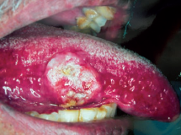
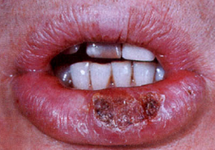
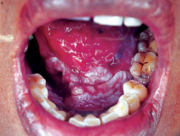
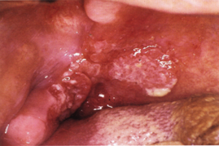
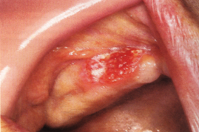
A
B
C
D
E
F
: Squamous cell carcinoma in (A) Tongue. (B) Lip. (C) Floor of mouth.(D)Retromolar region and soft palate. (E) Alveolar ridge

Slide 23
- Carcinoma of the gingiva usually is manifested initially as an area of ulceration, erosive lesion, or may exhibit an exophytic, granular or verrucous type of growth.
It may or may not be painful.
The proximity of the underlying periosteum and bone usually invites early invasion of these structures, and exhibit irregular infiltration of the bone.
In the maxilla, gingival carcinoma often invades into the maxillary sinus, or it may extend onto the palate.
In most series of cases, metastases to either the submaxillary or the cervical nodes eventually occur.

Slide 24
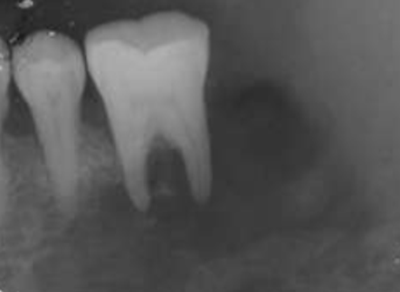
Radiographical features:
-Variable degree of bone destruction may be seen.
-This occurs when primary tumor or metastatic carcinomas affect the jaw bones.
The involved bone often exhibits large irregular and ill defined radiolucent areas with typical moth eaten appearance.
-Destruction of interdental bone
occurs and cause displacement or
exfoliation of the teeth.
Irregular and ill defined radiolucent areas in the mandible.

Slide 25
Histopathological features:
Considerable histologic variation is presented in intraoral epidermoid carcinomas.
The well-differentiated epidermoid carcinoma consists of
- sheets and nests of cells with obvious origin from squamous epithelium.
- These cells are generally large and hyperchromatic and can be found actively invading the connective tissue.
Mitotic figures often do not appear to be numerous.

Slide 26
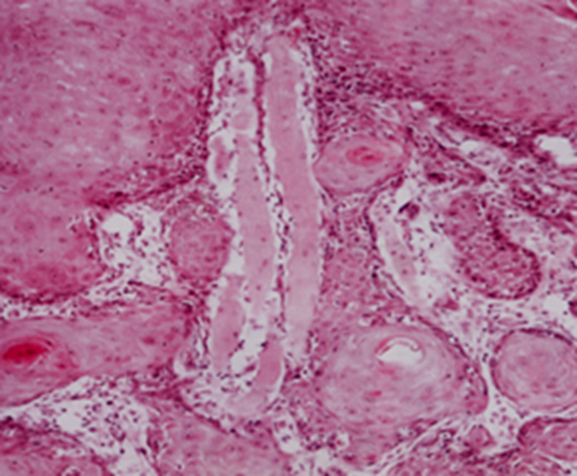
- One of the most prominent features of the well-differentiated epidermoid carcinoma is the presence of individual cell keratinization and the formation of numerous epithelial, or keratin pearls of varying sizes.

Slide 27
Less well-differentiated epidermoid carcinomas lose certain features, so that their resemblance to squamous epithelium is less pronounced.
- The characteristic shape of the cells and their arrangement may be altered.
- The growth rate of the individual cells is more rapid, and this is reflected in the greater numbers of mitotic figures, the even greater variation in sizes and shape with the failure to carry out the function of a differentiated squamous cell, the formation of keratin.

Slide 28
- The poorly differentiated carcinomas bear little resemblance to their cell of origin and will often present diagnostic difficulties because of the primitive and uncharacteristic histologic appearance, highly anaplastic and showed practically no keratin.
These cells are rapidly dividing and even show greater lack of cohesiveness, such lesions tend to metastasize early and cause death quickly.
The well-differentiated epidermoid carcinoma tends to have better long-term prognosis.

Slide 29
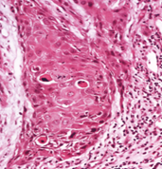
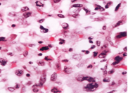
.(A)
.(B)
.(A) Moderately differentiated. (B) Poorly differentiated.

Slide 30
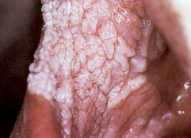
VERRUCOUS CARCINOMA
This variant of squamous cell carcinoma is a low-grade papillary neoplasm.
-It is more frequent in the elderly, particularly males
- It has a characteristic white, warty growth, forming a well-circumscribed mass raised above the level of the surrounding mucosa .
If small, it may easily be mistaken for a papilloma.
It is slow-growing and spreads laterally
rather than deeply.
It can be excised relatively easily unless
it is extensive.

Slide 31
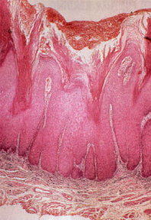
Microscopically
–Verrucous carcinoma consists of well-differentiated squamous epithelium which is heavily keratinized.
The hyperplastic epithelium exhibit papillary surface which is covered by thick layer of parakeratin.
Massively enlarged bulb-like, acanthotic rete-ridges are seen which often invaginate into underlying connective tissue.
The lower border of the lesion is well defined,
and there is typically chronic inflammation in
the stroma.

Slide 32
MALIGNANT MELANOMA
Malignant neoplasm arising from the melanocytes of the skin or mucous membrane.
-Intraoral malignant melanomas are usually dark brown or black.
The peak age incidence is between 40 and 60.
The hard palate and maxillary alveolar ridge are the most common sites.
They are macular or nodular and may ulcerate.
They are typically asymptomatic at first and may remain unnoticed until they cause soreness, bleeding, or a neck mass.

Slide 33
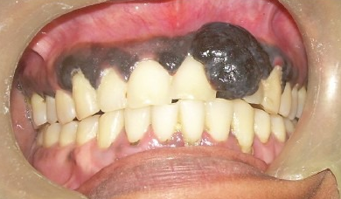
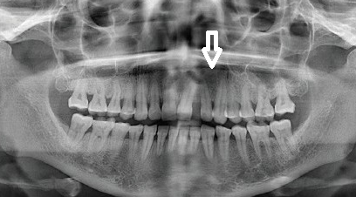
Melanomas are usually invasive, unless recognized early.
- Early diagnosis by biopsy is essential.

Slide 34
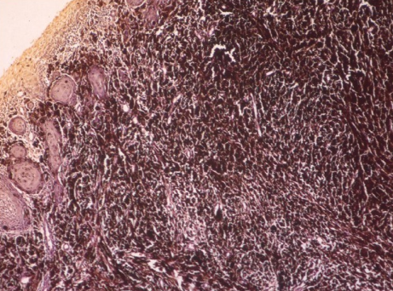
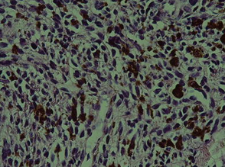
Microscopically
It reveals excessive proliferation of neoplastic melanocytes in the form of large masses within the epithelium and invading deeper tissues
These cells show extensive cellular pleomorphism and nuclear hyperchromatism.
Mitotic activity is numerous and these cells often produce huge amount of melanin pigments.
The prognosis of intraoral melanomas is poor.
Malignant spindle or ovoid melanocytes with hyperchromatic and pleomorphic nuclei.

Slide 35
BENIGN TUMORS OF CONNECTIVE TISSUE ORIGIN

Slide 36
ORAL FIBROMA
Oral fibroma is the most common benign soft tissue neoplasm occurring in the oral cavity.
Clinical features
It is nearly always a well-defined, firm, slowly growing elevated nodule with a smooth surface and a sessile or occasionally pedunculated base
Few millimeters to several centimeters in diameter.
It’s occurred at any age, but is most common in the third, fourth and fifth decades.

Slide 37
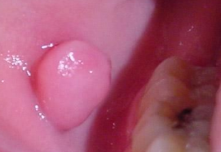
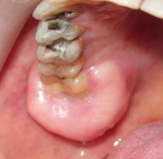
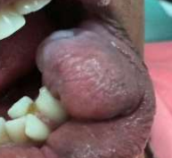
Females are affected twice as frequently as males
Occur at any oral site, most commonly it is seen on the buccal mucosa.
Other frequent sites are the gingiva, the tongue, lips and the palate.
The tumor sometimes becomes irritated and inflamed and may even show superficial ulceration or hyperkeratosis.

Slide 38
Microscopically
The fibroma consists of bundles of interlacing collagenous fibers interspersed with varying numbers of proliferating fibroblasts in large number and small blood vessels.
The surface of the lesion is covered by a layer of stratified squamous epithelium which frequently appears stretched and shows shortening and flattening of the rete pegs.
If trauma to the tissue has occurred, vasodilatation, edema and inflammatory cell infiltration are variably present.

Slide 39
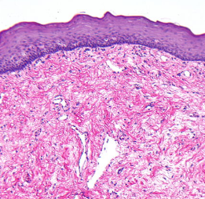
It is interesting to note that the fibroma, a true neoplasm of connective tissue origin, is microscopically similar to the fibrous hyperplasia.
Hyperplasia is usually considered to be a self limiting process and sometimes, but not invariably, regresses after the removal of the stimulus or irritant.
Neoplastic tissue shows no such
regression.
Interlacing collagenous fibers interspersed with varying numbers of proliferating fibroblasts.

Slide 40
LIPOMA
Benign, slow-growing neoplasm composed of mature fat cells
It appears that the cells of the lipoma differ metabolically from normal fat cells even though they are histologically similar.
Thus a person on a starvation diet will lose fat from normal fat depots in the body, but not from the lipoma.
Clinically
It is usually found in adults and there is no gender predilection.
In most cases the size of the lesion is less than 3 cm at the time of diagnosis, but can increase up to 5–6 cm over a period of years.

Slide 41
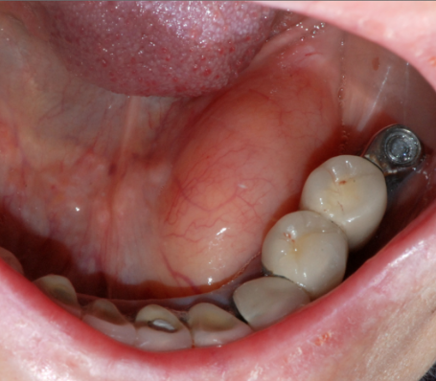
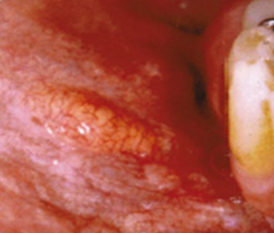
-The tumor has been reported to occur in a variety of locations in oral cavity, and appears as a yellow, soft, single or lobulated, painless lesion attached by either a sessile or a pedunculated base.
- The epithelium is usually thin, and the superficial blood vessels are readily visible over the surface.
Floor of mouth. Cheek

Slide 42
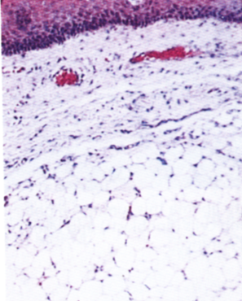
Microscopically
- lipoma is composed predominantly of proliferating mature adipocytes which are round with peripherally located nuclei.
- Lobules of fat cells are often separated by fibrous tissue.
Microscopic picture shows mature adipocytes.

Slide 43
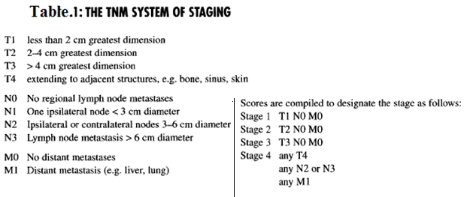
Clinical staging of carcinomas of head and neck (TNM system).
It is used to designate the extent of the disease, and to determine the most appropriate treatment necessary to the patient, and finally it is used to evaluate the prognosis of the disease.
Table-1 shows the TNM clinical staging.

Slide 44
L20

Slide 45
ORAL HEMANGIOMAS
Hemangiomas that occur in infants and children are mostly considered as congenital developmental defect
usually raised red or blue.
Initially enlarged, then become static, and then resolve slowly and in some cases disappear.
It is about three times more common in females than in males.
Intramuscular hemangiomas in the oral region are most commonly seen in the tongue.

Slide 46
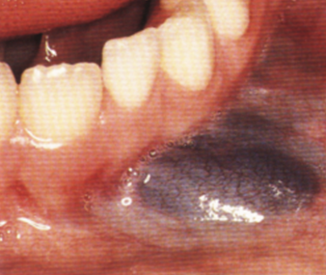
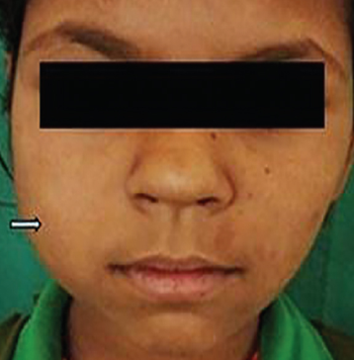
In the jaws, the peak incidence of central hemangiomas is in the second decade of life.
The most commonly affected facial bones are the mandible. Here the tumor is a bone-destructive lesion which may be of varying size, and appear as painful, slowly enlarging expansile lesion.
Peripheral. Central

Slide 47
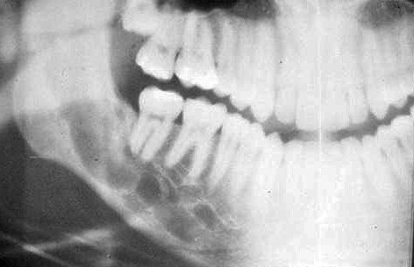
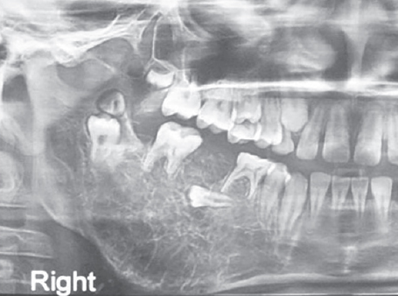
. Radiographically
central hemangiomas may present a honeycombed appearance on the radiograph with expansion of cortical plate in the affected area.
multilocular radiolucency with numerous radiopaque trabeculations

Slide 48
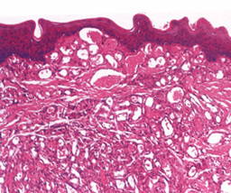
Microscopically
- The capillary hemangioma is composed of many small capillaries lined by a single layer of endothelial cells supported by a connective tissue stroma of varying density.
It bears considerable resemblance to young granulation tissue and is nearly identical with some cases of pyogenic granuloma.
Some cases show rather remarkable endothelial cell proliferation.

Slide 49
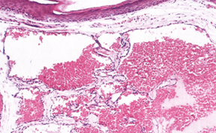
- The cavernous form of hemangioma consists of large dilated blood sinuses with thin walls, each showing an endothelial lining.
- The sinusoidal spaces usually are filled with blood.

Slide 50
LYMPHANGIOMA
Lymphangioma is thought to be a developmental malformation of vessels which have poor communication with the normal lymph system.
The majority of cases of lymphangioma had arisen before the age of 10 years.
In the gender distribution of the lymphangioma is nearly evenly divided.

Slide 51
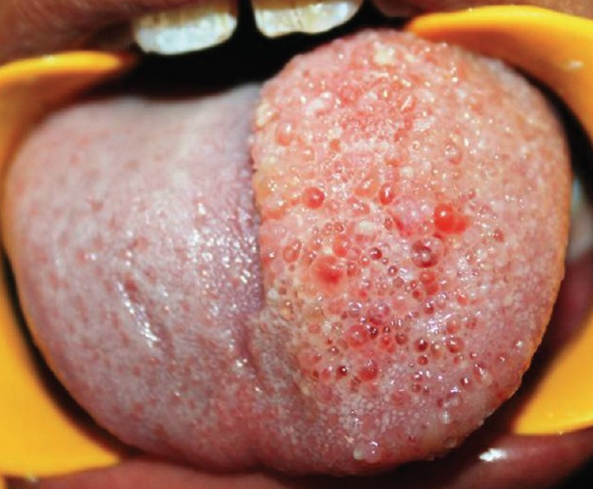
-The intraoral lymphangioma most commonly occurs on the tongue and considerable enlargement may occur
The superficial lesions are manifested as papillary lesions which may be of the same color as the surrounding mucosa or of a slightly redder hue.
Occasional cases of central lymphangioma of bone are also known to occur in the jaw, but are rare.

Slide 52
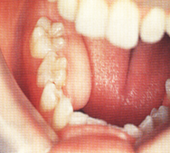
OSTEOMA
The osteoma is a slow-growing benign neoplasm characterized by a proliferation of either compact or cancellous bone, usually in periosteal or endosteal location.
Although it may arise at any age, it seems to be somewhat more common in the young adult.
The lesion of periosteal origin manifests itself as a circumscribed swelling on the jaw producing obvious asymmetry, but it must not be confused with Garre’s nonsuppurative
sclerosing osteomyelitis.

Slide 53
. The osteoma of endosteal origin is slower to present clinical manifestations, since considerable growth must occur before there is expansion of the cortical plates.
There is seldom any pain associated with this tumor.
Multiple osteomas of the jaws, as well as of long bones and skull, are a characteristic manifestation of Gardner syndrome.

Slide 54
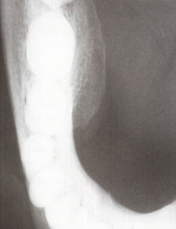
. Radiographically, usually appears as a well circumscribed radiopaque mass.

Slide 55
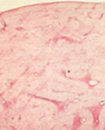
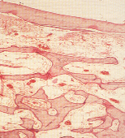
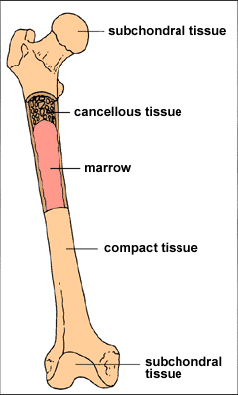
Microscopically
-The osteoma is composed either of extremely dense, compact bone or of coarse cancellous bone.
In any given area the bone formed appears nearly similar to normal.
- The lesion is most often well circumscribed, but not encapsulated.
compact osteoma Cancellous osteoma.

Slide 56
CHONDROMA
Chondroma is a benign central tumor composed of mature cartilage.
- It may develop at any age
Shows no apparent gender predilection.
Usually arises as a painless, slowly progressive swelling of the jaw which, like many other neoplasms, may cause loosening of the teeth.
The overlying mucosa is seldom ulcerated.
The anterior portion of the maxilla is the most frequent site of involvement by this tumor because it is here that vestigial cartilage rests are found.

Slide 57
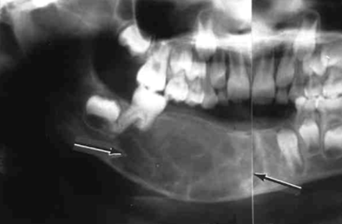
-. In the mandible the most common site of occurrence is posterior to the cuspid tooth, involving the body of the mandible, or the coronoid or condylar processes.
The radiograph shows
- An irregular radiolucent or mottled area in the bone.
The chondroma is a destructive lesion and, in addition, has been shown to cause root resorption
of teeth adjacent to it.

Slide 58
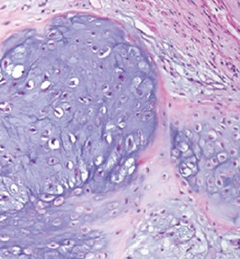
Microscopically
The distinction between chondroma and chondrosarcoma is a narrow one.
- The chondroma is made up of a mass of hyaline cartilage which may exhibit areas of calcification.
- The cartilage cells appear small, contain only single nuclei and do not exhibit great variation in size, shape or staining reaction.
Hyaline cartilage contain mono nuclear chondrocytes.

Slide 59
MALIGNANT TUMORS OF CONNECTIVE TISSUE ORIGIN

Slide 60
FIBROSARCOMA
Fibrosarcoma is a tumor of mesenchymal cell origin, can occur as a soft tissue mass or as a primary or secondary bone tumor.
-The sarcomas as a group differ from malignant epithelial neoplasms by their typical occurrence in relatively younger persons and their greater tendency to metastasize through the blood stream rather than the lymphatics, thereby producing more widespread foci of secondary tumor growth.

Slide 61
- Current research indicates that many sarcomas are associated with genetic mutations.
- Fibrosarcoma also has been noted to arise from preexisting lesions, such as fibrous dysplasia, Paget’s disease, and in previously irradiated areas of bone.

Slide 62
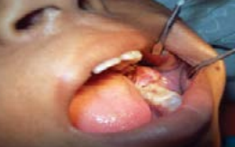
Clinically
- In the oral cavity the major symptoms are pain, swelling, paresthesia, loosening of teeth and ulceration of the overlying mucosa.
Nodular mobile red lesion in the gingiva.
Another patient with central type of fibrosarcoma causing displacement tongue

Slide 63
. Radiological imaging of fibrosarcomas
Reveals radiolucent lesions with a geographical moth-eaten pattern of bone destruction.

Slide 64
. Microscopically
Fibrosarcomas are tumors of malignant fibroblasts, and are graded from low to high malignancy depending on the number of mitotic figures, tumor differentiation and the presence of tumor-necrosis.
Mitosis and nuclear pleomorphism in fibroblast cells.

Slide 65
LIPOSARCOMA
- Is a malignancy of fat cells occurs most frequently in adults.
- Slightly more common in males than in females.
-The most commonly affected site was the tongue; other sites are the submandibular area, cheek, floor of mouth and soft palate.
Most cases present as a slowly growing, painless, non ulcerated submucosal mass.
But some lesions grow rapidly
and become ulcerated early.

Slide 66
Microscopically
The recognition of lipoblasts is the key finding in the diagnosis of liposarcoma.( Lipoblasts are immature form of adipocytes)
- It is recognized by an extreme cellularity and multivacuolation.
In contrast to lipoma this tumor is highly cellular, and the fat is present in the lipoblast and also in the nuclei, giving a foamy appearance.
.

Slide 68
KAPOSI’S SARCOMA
Kaposi’s sarcoma now considered being a viral-induced or viral-associated tumor.
This tumor is currently incriminated with HIV/AIDS and its clinical stage depends greatly on the immune status of the patient.
Kaposi’s sarcoma has different major clinical presentations.
- Approximately 40% of homosexual AIDS patients will develop Kaposi’s sarcoma, often as an early sign of the disease.
- Affected patients are usually early middle-aged males

Slide 69
Oral lesions can occur on any mucosal surface but have a strong predilection for palatal and gingival mucosa.
Early oral mucosal sarcomas are flat and slightly blue, red or purple, either focal or diffuse, and may be completely asymptomatic.
-With time, lesions become more deeply discolored and soft nodules develop which may become ulcerated and may bleed.

Slide 70
- Cervical lymph nodes enlargement may be seen.
The patient may have AIDS-related oral symptoms.
Microscopically
- Kaposi’s sarcoma show increased numbers of small capillaries or dilated vascular channels interspersed with proliferating sheets of sarcomatous or atypical spindle cells.
Spindle cells with cytological atypia and frequent mitoses. Many of the small holes are a result of formation of capillaries.

Slide 71
OSTEOGENIC SARCOMA
Osteosarcoma is a bone tumor that can occur in any bone.
-Incidence is slightly higher in males than in females.
- Osteosarcoma occurs chiefly in young persons, the majority between 10–30 years with decreasing incidence as the age advances.
- In numerous occasions trauma to the site involved, exposure to radiation and the presence of bone dysplasia (including Paget’s disease and fibrous dysplasia) increase the risk of osteosarcoma.

Slide 72
Oral manifestations are
Swelling of the involved area, often producing facial deformity and pain, followed by loose teeth
Paresthesia, toothache, bleeding, nasal obstruction and a variety of other manifestations.
Mandibular tumors are more common than those in the maxilla.
Extra oral swelling on right side of mandible.
CT scan of the case A showing extent of bon destruction

Slide 73
The radiographic appearance is variable and depends on the amount of tumor bone synthesized by the malignant osteoblasts.
In those tumors with little tumor bone, the radiographic appearance will be radiolucent lesion with widening of the periodontal ligament
-Whereas those tumors with much tumor bone will be radiodense.
-Mixed lucent-dense lesions indicate an intermediate degree of tumor bone formation.

Slide 74
Small streaks of bone radiate outward from approximately 25% of these tumors. This produces a sunray pattern.

Slide 75
Microscopically
A number of distinct histologic types of osteosarcoma exist and has been subdivided on the basis of the predominant features of the cells (i.e. osteoblastic, chondroblastic, fibroblastic).
In the osteoblastic type of osteosarcoma atypical, neoplastic osteoblasts exhibit considerable variation in size and shape, show large, deeply staining nuclei and are arranged in a disorderly fashion about trabeculae of bone.
In addition, there is a great deal of new tumor osteoid and bone formation, mostly in an irregular pattern and sometimes in solid sheets rather than in trabeculae.

Slide 76
-Varying degrees of proliferation of anaplastic fibroblasts are also found, and in the absence of significant amounts of tumor osteoid or bone, when these cells predominate, the lesion is designated as a fibroblastic type of osteosarcoma.
Some tumors show occasional areas of neoplastic myxomatous tissue and cartilage tissue and this is termed chondroblastic type of osteosarcomas.
Pleomorphic osteoblast and tumor bone.

Slide 77
CHONDROSARCOMA
The chondrosarcoma can occur at any age
More often in males
Appear as an expanding lesion which is frequently painless.
-Resorption and exfoliation of teeth sometimes occur.
- In general, these lesions are invasive and destructive and metastasize readily.
Enlargement of alveolar ridge

Slide 78
Radiographically
-The long standing lesion has produced considerable destruction of bone.
Occasional tumors will appear with radiopacities because of calcification of the neoplastic cartilage.
Irregular radiolucent lesion interspersed with radiopacities with resorption of the mesial root of first molar tooth and thinning of the lower border

Slide 79
Chondrosarcoma characterized by the presence of many cells with plump nuclei, and more than an occasional cell with two such nuclei.
Cellular cartilage with pleomorphic chondrocytes, many of which have multiple nuclei (arrows).

Slide 80
MALIGNANT LYMPHOMA
Lymphomas are heterogenous malignancies of the lymphatic system characterized by lymphoid cell proliferation.
They can broadly be divided into
- Non-hodgkin’s lymphoma
- African jaw lymphoma (burkitt’s lymphoma)
- Hodgkin’s lymphoma

Slide 81
Non-Hodgkin’s Lymphoma
- The non-Hodgkin’s lymphomas are a heterogeneous group of lymphoproliferative malignancies which can involve lymph nodes and lymphoid organs as well as extra nodal organs and tissues.
- Lymphadenopathy is the most common manifestation of lymphoma and the lymph nodes appear firm and rubbery in consistency.
- Systemic symptoms like fevers, night sweats, weight loss, and fatigue are noticed.

Slide 82
Organ-specific symptoms such as shortness of breath, chest pain, cough, abdominal pain and distention, or bone pain, may lead to identification of specific sites of involvement
The oral lesions are characterized by swellings which may grow rapidly and then ulcerate.
In some cases, these become large, fungating, necrotic, foul-smelling masses.
When underlying bone is involved,
tooth mobility and pain may develop.

Slide 83
Microscopically
- The non-Hodgkin’s lymphomas present a histologic pattern which is described as either nodular or diffuse.
- In the nodular pattern, the neoplastic cells tend to aggregate in such a way that large clusters of cells are seen.
- In contrast, the diffuse pattern shows no evidence of nodularity or germinal center formation.
- The nodular pattern is associated with a more favorable prognosis than the diffuse type.

Slide 84
Sheets of atypical lymphoid cells with hyperchromatic nuclei and scant cytoplasm.
CT scan– Paranasal sinuses: a larg homogenous
soft tissue lesion in the left masticator space with extension of the mass lesion into the left maxillary sinus

Slide 85
AFRICAN JAW LYMPHOMA (Burkitt’s lymphoma)
Burkitt’s lymphoma is a highly aggressive mature B-cell non-Hodgkin’s lymphoma, occurs endemically in parts of Africa and also occurs sporadically throughout the world.
Burkitt’s lymphoma is a childhood tumor but it is observed in adult patients too.
The exact causes and mechanisms of Burkitt’s lymphoma are not known.
Epstein-Barr virus (EBV) is closely associated with the African form.

Slide 86
Patients most often present with
swelling of the affected jaw or other facial bones
loosening of the teeth
swelling of the lymph nodes, which are non tender and rapidly growing in the neck or below the jaw.
Fever, anemia, bleeding, and abdominal masses and ascites may be seen.
An extraoral appearance
An intraoral appearance

Slide 87
Microscopically
- Burkitt’s lymphoma is a proliferation of B lymphocytes.
Burkitt cells are homogeneous in size and shape, with round to oval nuclei, multiple nucleoli, and with basophilic cytoplasm.
Frequent mitotic figures usually are observed.
A characteristic starry sky appearance is imparted by scattered macrophages with an abundant clear cytoplasm, often containing phagocytic cellular debris.

Slide 88
radiolucent lesion causing teeth displacement and resorption of cortical bone.
Characteristic starry sky appearance.

Slide 89
HODGKIN’S LYMPHOMA
- Hodgkin’s disease is primarily a disease of lymph nodes, and for this reason, seldom occurs as a disease primarily in the oral cavity.
-It is conceivable that the oral cavity could be involved secondarily, but this appears to be an exceedingly rare happening.
The etiology of HD is unknown. Infectious agents, especially the Epstein-Barr virus (EBV), may be involved in the pathogenes
Palpable painless lymphadenopathy occurs in the cervical area in (60–80%) of cases, and the other lymph nodes in the body can also be affected.

Slide 90
peak incidence occurs in adults.
The nodes are usually firm and rubbery in consistency, and the overlying skin is normal.
-Constitutional symptoms such as unexplained weight loss, fever, night sweats, chest pain, cough, and/or shortness of breath may be present.
- Back, abdomen or bone pain may occur rarely due to splenomegaly, hepatomegaly, and pressure from enlarged lymph nodes, or involvement of bone or vertebrae.

