Slide 1
ORAL ULCERATIONS AND
VESSSICULOBULLOUS DISEASES
L 21

Slide 2
The causes of oral ulcerations are:
1. INFECTIVE: Viral, bacterial, and fungal infections.
2. TRAUMATIC (Figure-1):
A- Mechanical trauma from biting, sharp cusps, or ill fitting intraoral appliances is
a common cause of oral ulceration.
Three criteria should be fulfilled:
. A cause of trauma must be identified.
.The cause must fit the site, size, and shape of ulcer,
. And on removal of the cause the ulcer must show signs of healing within 10 days.

Slide 3
Biopsy is indicated when the ulcer does not shown signs of healing within 10 days.
B-Chemicals trauma may cause oral ulcerations like caustic agents used in dental
practice or due to aspirin misused.
C-Thermal trauma after taking hot food or drink may cause oral ulcerations mostly
in the palate.
D- Radiotherapy for patients with head and neck cancer can cause oral mucositis.

Slide 4
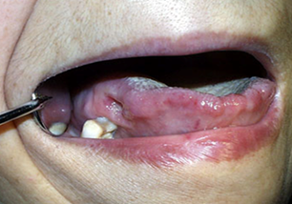
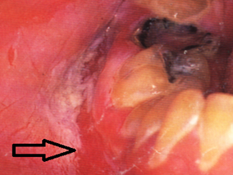
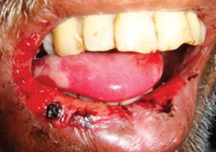
Traumatic ulceration due to.
(A) Sharp tooth (B) Aspirin burn (C) Radiotherapy for cancer patient

Slide 5
3. ASSOCIATED WITH SYSTEMIC DISEASES
Like hematological diseases, gastrointestinal tract diseases, Behcet’s disease, HIV infection and others.
4. IDIOPATHIC:
Recurrent aphthous ulcer : Painful type of oral ulcer, the prodromal symptoms described as soreness, burning, or prickling sensation is recognized by many patients 1-2 days before the onset of ulceration.
Ulcer appears with an erythematous margin and yellowish whitish floor.

Slide 6
The cause of this ulceration remains unclear. But there is increasing evidence that damaging immune responses are involved.
In addition a number of local and general factors play a contributing factors and these include:
Hereditary, trauma, emotional stress, allergic disorders, bacterial or viral infection, hormonal disturbance, gastrointestinal disease (like malabsorption diseases), and hematological and deficiency disorders (like iron and B12 deficiency).

Slide 7
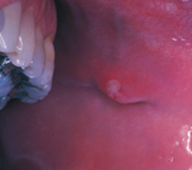
The types are:
Minor aphthous ulceration:
The most common type.
- Non-keratinized mucosa affected.
- Ulcers are shallow, about 5 mm across.
- One or several ulcers may be present (1-5).
- Individual minor aphthous persist for 7 to 10 days then heal without scarring.
- Tend to recur at 1-4 month intervals.

Slide 8
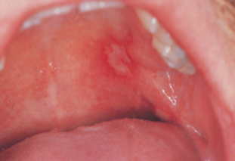
2. Major aphthous ulceration:
Uncommon, anywhere in oral mucosa, masticatory mucosa such as the dorsum of the tongue or occasionally the gingiva may be involved.
- Ulcers are deep, larger than 1 cm in diameter.
- One or several ulcers may be present (1-10).
- Scarring may follow healing after 4-6 weeks.
- Tend to recur at less than monthly intervals
causing severe discomfort.

Slide 9
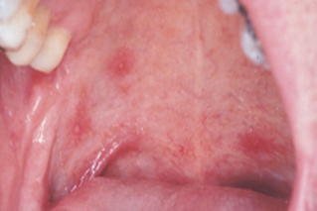
3. Herpetiform aphthous ulceration:
- Uncommon, anywhere in oral mucosa,
- painful shallow ulcerations, about 1 mm across.
- Dozens or hundreds may be present.
- Heal without scaring after 2-3 weeks.
Called herpetiform because they resemble ulcers caused by the herpes simplex virus.
Aphthae are not preceded by vesiculation and smears readily distinguish herpetiform aphthae from herpetic ulceration.

Slide 10
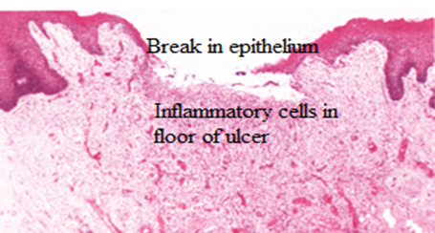
The histopathological features of aphthous ulceration
In the preulcerative stage show infiltration of the lamina propria and the epithelium by inflammatory cells predominantly lymphocytes.
In ulcerative stage increases in lymphocytes occur specially in epithelium with edema and damage to epithelial cells occur leading to their death and the formation of an ulcer.

Slide 11
Behcet’s disease
Is a multisystem disorder of unknown cause with a varied manifestation.
- Patients are usually young adult males between 20 and 40 years old.
- Patients suffer one of four patterns of disease, namely:
mucocutaneous lesions (oral aphthae which occur anywhere in oral mucosa)
- Genital ulceration
- Eye lesion
- Skin lesion
- And arthritis.

Slide 12
5. VASCULAR ISCHEMIA
Necrotizing sialometaplasia is ulcerative lesion
The ulcer is deep well-circumscribed, usually located towards the back of the hard palate.
It is thought to be caused by ischemic necrosis (death of tissue due to lack of blood supply) of minor salivary glands in response to trauma.
Often painless, the condition is self-limiting and should heal in 6–10 weeks.

Slide 13
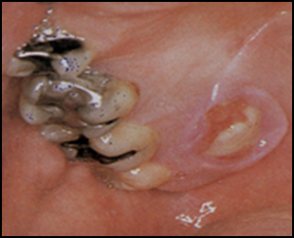
Although entirely benign and requiring no treatment, due to its similar appearance to oral cancer, it is sometimes misdiagnosed as malignant. Therefore, it is considered an important condition, despite its rarity.
Differentiation between this and squamous cell carcinoma ulcer would be based on a history of recent trauma or dental treatment in the area like local anesthetic injections

Slide 14
6. ASSOCIATED WITH DERMATOLOGICAL DISEASES:
Like lichen planus, chronic discoid lupus erythematosis, and vesiculobullous diseases.
VESICULOBULLOUS DISEASES:
Vesiculobullous diseases are classified histologically into intraepithelial or subepithelial collections of clear fluid, present as oral ulceration following rupture of the vesicle or bullae. The term bulla is generally applied to a lesion greater than 5mm in diameter.
The causes of vesiculobullous diseases are either traumatic, viral infections, autoimmune, inherited or unknown causes.

Slide 15
Pemphigus vulgaris- PV :
Pemphigus is a group of autoimmune diseases of which PV is the most common.
- PV is more common in middle age, and in women
- characterized by the rapid intraepithelial appearance of fragile vesicles and bullae, varying in diameter from a few millimeters to several centimeters
- large areas of the skin surface may be affected.
- Rupture of these leaves painful ragged erosions and they readily become secondarily infected.

Slide 16
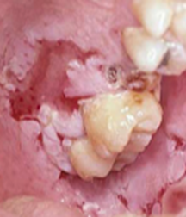
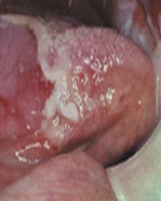
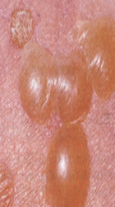
Autoantibodies react against the intercellular protein of desmosome and responsible for inducing acantholysis(means loss of coherence between epidermal cells due to the breakdown of intercellular bridges.
The bullae are produced as a result of this acantholysis, and this process extend laterally into surrounding epithelium, gentle lateral pressure to the mucosa in an involved area can lead to the formation of a bulla ( Nikolsky ’s sign).
Oral lesion Skin lesion

Slide 17
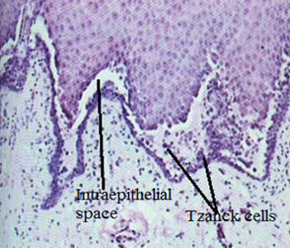
Histologic examination shows
. characteristic intraepithelial vesicles or bullae between stratum spinosum cells just above the basal cell layer.
The epithelial cells which lose their attachments become rounded in shape and the cytoplasm contracts around the nucleus.
Small groups of these rounded-up acantholytic (Tzanck) cells can often be seen histologically in the contents of a vesicle or in a smear
from a recently ruptured vesicle.
Biopsy is important

Slide 18
Mucous membrane pemphigoid (Cicatricial pemphigoid):
An autoimmune blistering disease that predominately affects the mucous membranes of old women.
It is associated with autoantibodies directed against the hemidesmosomes and epithelial basement membrane.
Nikolsky's sign is positive.
Typically, the vesiculobullous lesions are tense and occur on the oral mucous membranes and conjunctiva.
Other surfaces may be involved such as larynx, pharynx, esophagus, and vagina

Slide 19
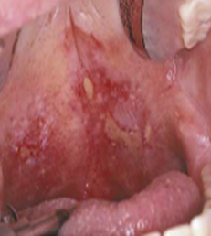
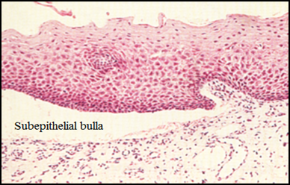
. Sometimes present as desquamative gingivitis.
It is rarely affect the skin.
When they rupture they give rise to ulcerations which heal slowly, sometimes with scaring.
The histologic findings in cicatricial pemphigoid are nonspecific.
The vesicles and bullae are subepidermal and there is no evidence of acantholysis.

Slide 20
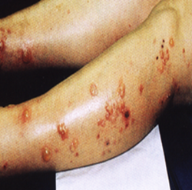
Bullous pemphigoid: It is also a chronic, autoimmune, in which subepidermal, blistering occur in the skin and rarely involves mucous membranes.
The cutaneous lesions begin commonly on the limbs
Oral lesions occur far less frequently in bullous pemphigoid than in cicatricial pemphigoid.

Slide 21
Erythema multiform-EM :
Mucocutaneous disease of abrupt onset, may present with a wide range of clinical presentation and severity.
Unknown pathogenesis, although many precipitating factors have been implicated including drugs (like sulphonamide) and preceding infection (like herpes simplex infection).
It occurs mainly in young adults and more common in males.
Fever, headache and systemic upset may be associated.
A concentric ring like appearance of the lesions occurs in some cases and has given rise to ‘target’, or iris’ lesion, most common on the hands, wrists and ankles.

Slide 22
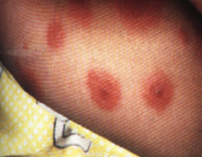
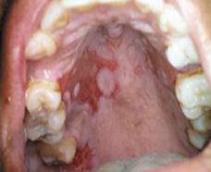
. Mucous membrane involvement, including the oral cavity is common.
Mucosal vesicles or bullae rupture and leave surfaces covered with a thick white or yellow exudate.
Lips may exhibit ulceration with bloody crusting and are painful.
In the most severe cases erosions of the pharynx and ocular damage may occur.
Erythema multiform- in the skin in the palate

Slide 23
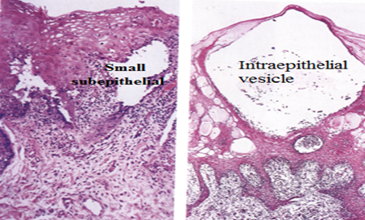
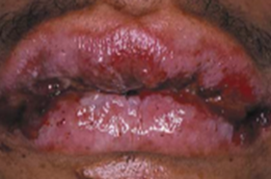
Stevens-Johnson syndrome is now recognized as
a very severe bullous form of EM with widespread involvement including the skin, oral cavity, eyes and genitalia.
The microscopic appearance of EM is not diagnostic, either intraepithelial or subepithelial vesicle with a varying degree of inflammatory cell infiltration in the connective tissue, chiefly lymphocytes, but often neutrophils is also present.
Stevens-Johnson syndrome
subepithelial & intraepithelial vesicle of EM

Slide 24
Epidermolysis bullosa–EB :
It is a group of inherited bullous disorders
. Inherited as an autosomal dominant characteristic
. Manifests itself at birth or shortly thereafter
. Characterized by the formation of vesicles and bullae either intraepithelial or subepithelial. . .Skin lesions are characterized by the formation of bullae, followed by ulcerations and scarring, particularly in areas exposed to low-grade chronic trauma.
Deformities of hands and feet, and involvement of the larynx, pharynx, and esophagus are common.

Slide 25
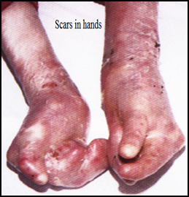
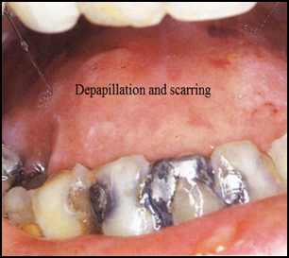
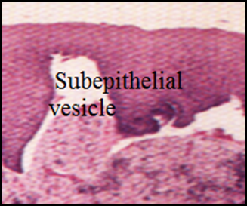
Oral lesions present as bullae, usually in areas of friction, which rupture, leaving ulcers followed by scarring, causing difficulty in opening the mouth, movement of the tongue and lips
(A),
(B).
C
Epidermolysis bullosa with scarring of hands (A), and tongue (B). (C)Microscopical picture of EB.

