Slide 1

Ministry of Higher Education and Scientific Research
Tishk International University
Faculty of Education
Department of Physics
Introduction to Biology
Lab.4/ Introduction to Botany
3rd Grade
(2023 – 2024)
By: Dana Luqman
dana.luqman@tiu.edu.iq

Slide 2
Outline
Introduction
Branches of Botany

Slide 3
Objectives
Students will be able to define Botany
Students will be able to explain branches of Botany

Slide 4
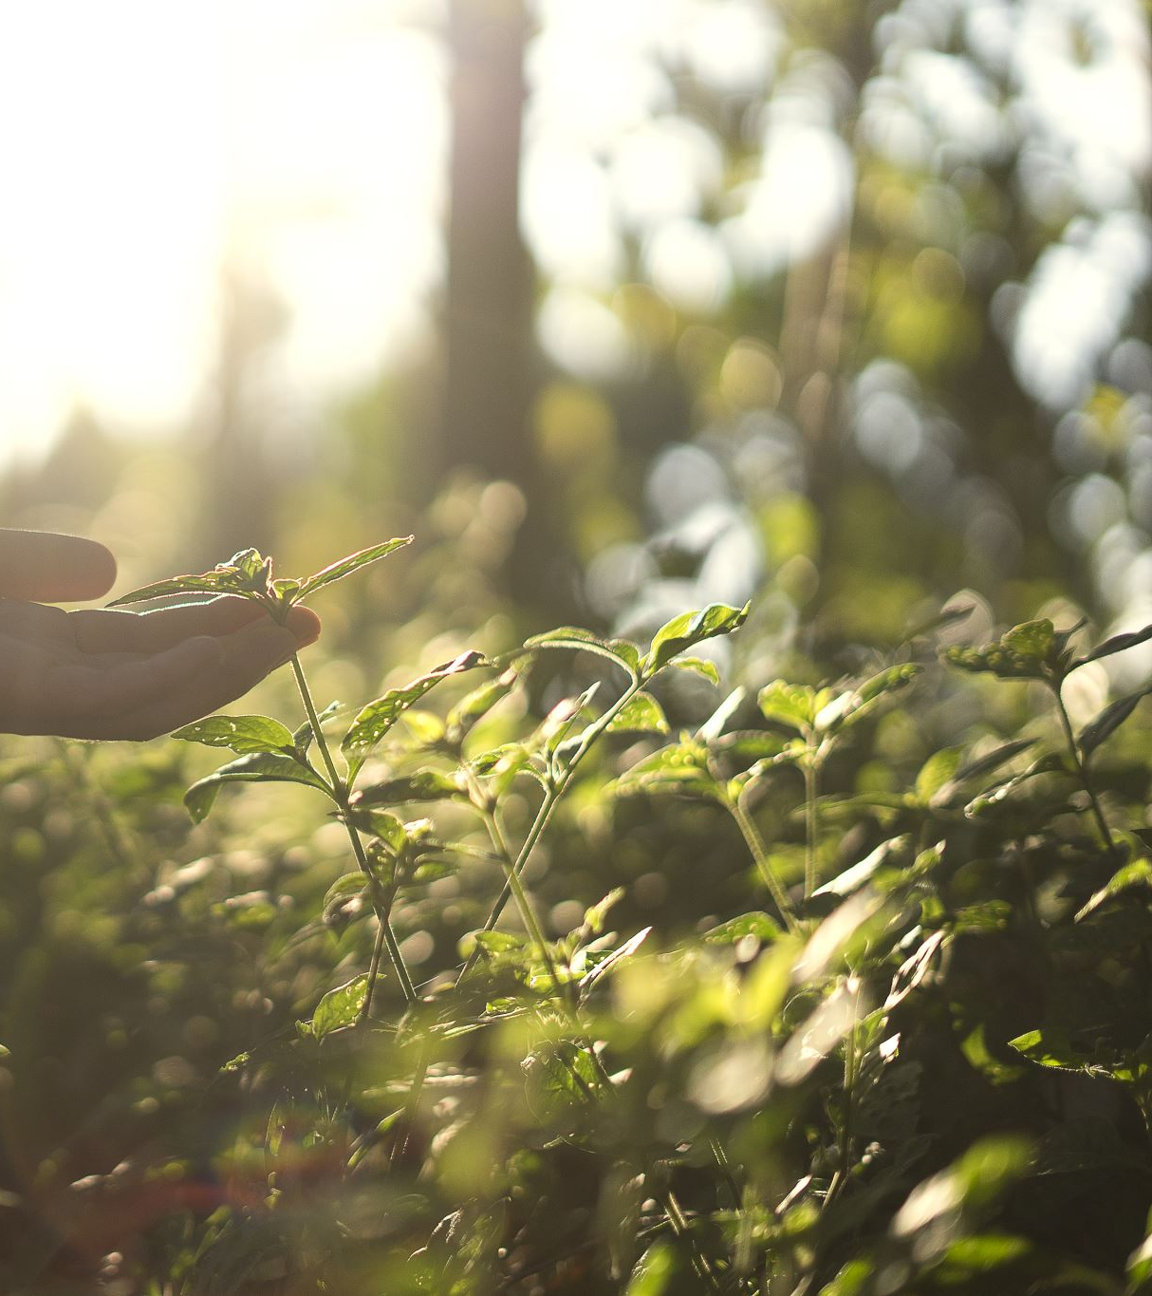
Introduction to Botany
Botany: is the scientific study of plants, including their structure, growth, reproduction, metabolism, development, diseases, and evolution.
It is a crucial discipline that helps us understand the role of plants in ecosystems and their importance to human life.

Slide 5
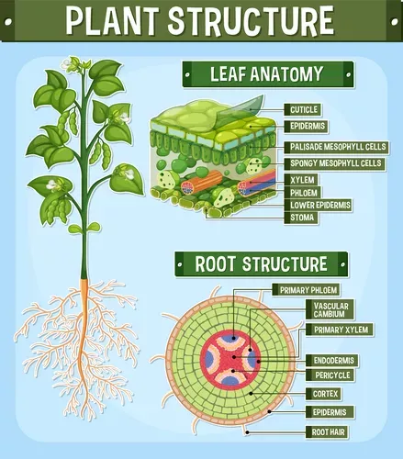
Branches of Botany
Plant Anatomy
it examines the internal structure of plants, including cells, tissues, and organs.
For example, the layers, type of cells, and tissues that can be found in a plant type.

Slide 6
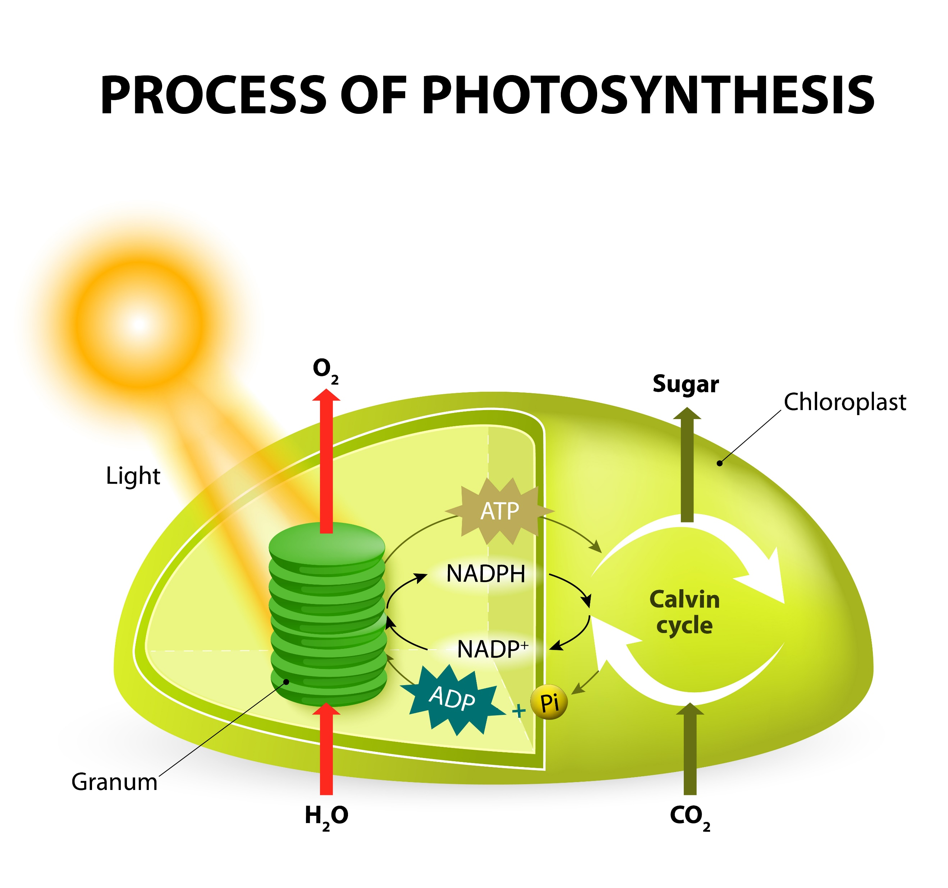
Branche of Botany
Plant Physiology
Plant physiology studies the biochemical and physical processes that occur in plants.
Photosynthesis converts light energy into chemical energy, providing plants with glucose for growth.

Slide 7
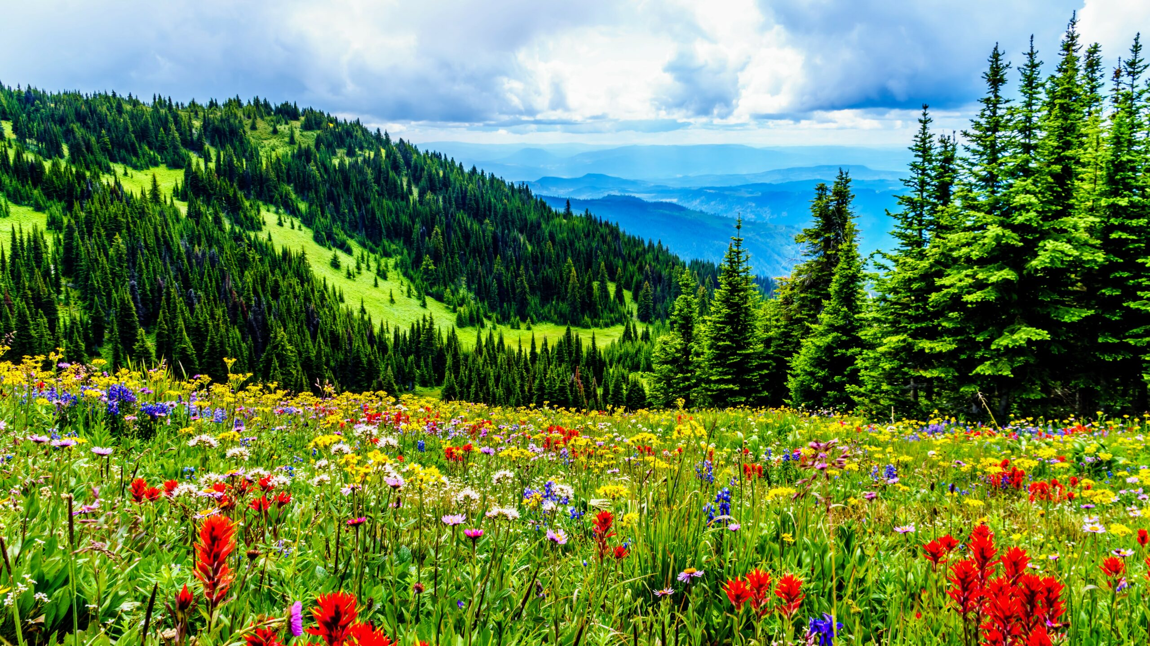
Branches of Botany
Plant Diversity
Plant diversity encompasses a vast array of species, ranging from microscopic algae to towering trees.
Plants have adapted to diverse environments, from deserts to rainforests, exhibiting a wide range of forms and functions.

Slide 8
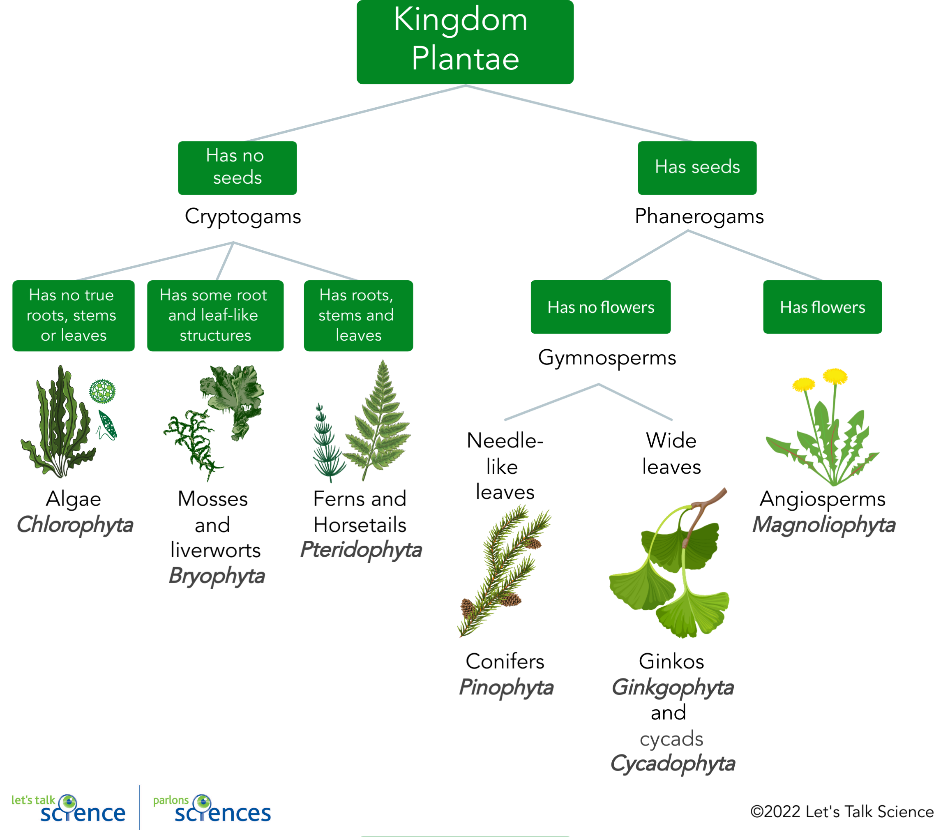
Branches of Botany
Plant Classification
Plant classification organizes plants into hierarchical groups based on shared characteristics.
Algae are diverse photosynthetic organisms found in aquatic environments.
Bryophytes, including mosses and liverworts, lack vascular tissues.

Slide 9
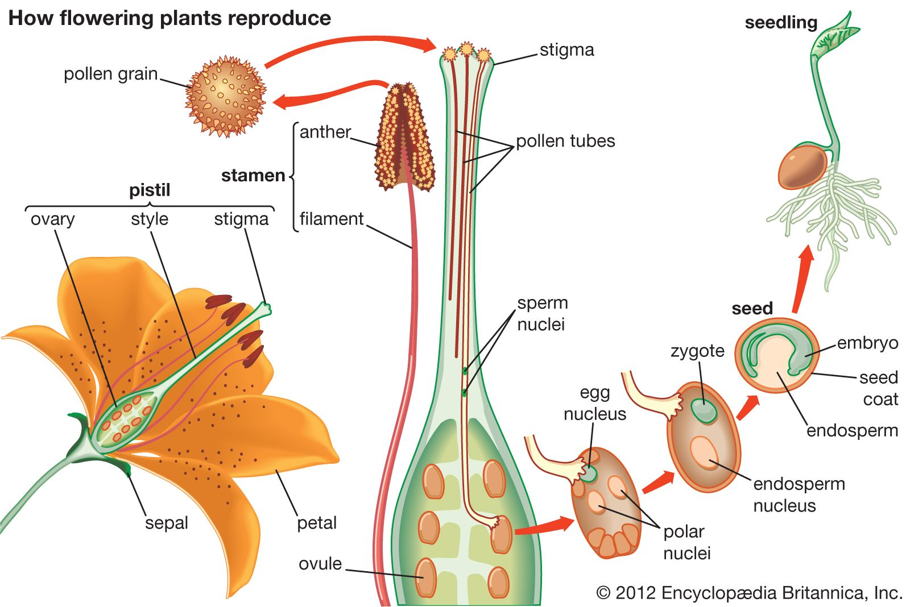
Branches of Botany
Plant Reproduction
Plants reproduce through sexual and asexual mechanisms. Sexual reproduction involves the fusion of gametes to form seeds.
Asexual reproduction occurs through vegetative propagation, such as runners, bulbs, or cuttings.

Slide 10
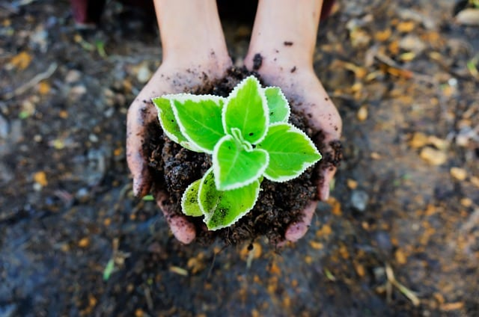
Branches of Botany
Plant Ecology
Plant ecology examines the interactions between plants and their environment.
Plants play vital roles in ecosystems, including carbon sequestration, oxygen production, and habitat creation.

Slide 11
Working Time

Slide 12
Thank You

