Slide 1
Anesthesia
Dr. Muhammad Abdullah Shwani
Assistant professor/Consultant urologist
Kurdistan Higher Council of Medical Specialties (KHCMS)
drmalshwani@mail.com

Slide 2
Types of anesthesia
GENERAL ANESTHESIA
REGIONAL ANESTHESIA
TOPICAL ANESTHESIA
INFILTRATION BLOCK
FIELD BLOCK
NERVE BLOCK
INTRAVENOUS REGIONAL ANESTHESIA
SPINAL ANESTHESIA
SADDLE BLOCK
EPIDURAL ANESTHESIA
CAUDAL ANESTHESIA

Slide 3
GENERAL ANESTHESIA (GA)
It means abolition of all the sensations, i.e. touch, pain, posture, and temperature with a state of reversible loss of consciousness.
GA needs :
Anesthetic drugs for induction and maintenance.
Oxygen.
Muscle relaxant drugs.
Endotracheal tube.
Antidotes.

Slide 4
Induction and maintenance drugs
1-VOLATILE ANESTHETICS They vaporize in room air.
Agents used are:
Ether, Halothane, Enflurane , Isoflurane Trichloroethylene, Sevoflurane.
Ether which is irritant, unpleasant, and flammable, is a commonly used agent in developing countries.
Enflurane and isoflurane are noninflammable, nonexplosive, nonirritant, and stable. Here anesthesia is rapid with faster recovery.

Slide 5
2-GASEOUS ANESTHETICS
Nitrous oxide: It is noninflammable, nonirritant, good analgesics but a weak anesthetic agent. It is given along with 30–50% oxygen for balanced anesthesia.
Cyclopropane is highly flammable.

Slide 6
3-INTRAVENOUS ANESTHETICS
Thiopentone: It is ultrashort acting, and causes hypnosis during induction of anesthesia with rapid recovery.
Ketamine: It can lead to hypertension, apnea, and laryngospasm.
Propofol: It is a widely used induction agent that has got predictable onset and recovery.
Fentanyl: It causes sedation, hypotension and is preferred in asthmatics.

Slide 7
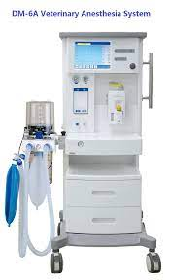
OXYGEN
• Oxygen is given through Boyle’s apparatus (33.3%).
• Oxygen in high concentration is a respiratory depressant and also affects eyes.
• A 5% CO2 mixture in oxygen is called as carbogen.
• Oxygen is available in black and white colored cylinders.

Slide 8
MUSCLE RELAXANTS
1- Depolarizing muscle relaxants: They act on the acetylcholine receptors.
Suxamethonium chloride (Scoline).
b. Suxthonium bromide.

Slide 9
2.Nondepolarizing Muscle Relaxants
They block the channels of entry of acetyl choline. They are long-acting relaxants.
Tubocurarine: It lasts for 45 minutes.
2. Gallamine : It is cheaper. It is contraindicated in renal diseases.
3. Pancuronium bromide (Pavulon): It lasts for 45 minutes.
4. Vecuronium bromide: It is a steroid muscle relaxant.
5. Rocuronium is a short-acting steroid muscle relaxant. It starts its action in one minute.
6. Atracurium: It lasts for 20–30 minutes

Slide 10
REVERSAL AGENTS(Antidotes)
Neostigmine (2.5 mg) is used commonly along with atropine (1.2 mg).
Endrophonium (short-acting) and pyridostigmine (long-acting).

Slide 11
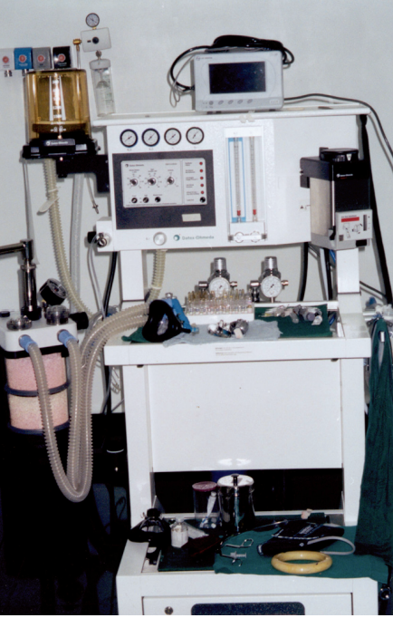
Complications of Endotracheal tube
These are tubes inserted into the trachea and is used to conduct gases and vapors to and from the lungs.
Postoperative sore throat.
2. Hoarseness after intubation.
3. Upper airway edema.

Slide 12
COMPLICATIONS IN GENERAL ANESTHESIA
• Intraarterial injection of the drug.
• Myocardial depression and cardiac arrest.
• Hypertension.
• Laryngeal and bronchial spasm.
• Cardiac arrhythmias.
• Respiratory failure.
• ARDS.
• Hypoxia.
• Pneumothorax.
• Anaphylaxis.
• Malignant hyperthermia: It is an inherited myopathic disorder occurs under anesthesia due to drugs like halothane, scoline. There is marked increase in metabolic rate with rise of temperature
• Hypothermia.
• Mendelson’s syndrome: It is due to regurgitation of the acid from the stomach causing aspiration of acid leading into bronchospasm, pulmonary edema and circulatory failure

Slide 13
REGIONAL ANESTHESIA
Mode of action: It causes temporary conduction block of the nerve, thus preventing the propagation of nerve impulse.
Local anesthesia:
Advantages of local anesthetic agent:
• Technically simpler.
• General anesthesia is avoided.
• Consciousness is retained.
• Patient can have food earlier after surgery.

Slide 14
TOPICAL ANESTHESIA
It is used for minor surgeries of :
Eye
Laryngoscopy
bronchoscopy
cystoscopy
gastroscopy
submucus injection.
It is available as :
Instillation
Spray
Viscous
Ointment
gel

Slide 15
INFILTRATION BLOCK
Direct injection of local anaesthetic under the skin for small procedures.
FIELD BLOCK :
It is achieved by blocking the entire field of excision where lesion is located.
SADDLE BLOCK :
• It is used for surgeries in perineal and anorectal region.
• It is spinal anesthesia using Xylocaine or bupivacaine given in sitting position.

Slide 16
NERVE BLOCK
• Block of inferior dental nerve and lingual nerves in the region of the mental foramen for extraction of teeth.
• Finger block of digital nerves. Here plain xylocaine is used. (without adrenaline).
• Intercostal block.
• Ankle block.
• Median and ulnar nerve block.
• Brachial plexus block.

Slide 17
SPINAL ANESTHESIA
It is the injection of local anesthetic into the subarachnoid space causing loss of sympathetic tone, sensation and motor function.
Drugs used:
Lignocaine 5% in 6% dextrose 2 ml.
Bupivacaine 0.5% in 5% dextrose 3 ml.
Cinchocaine 0.5% in 6% dextrose 2 ml.

Slide 18
Advantages
• Economical.
• Hypotension reduces the bleeding.
• Adequate relaxation is achieved.
• Respiratory complications are less.
Disadvantages and Complications:
• CSF leak causing headache.
• Meningism.
• Infection.
• Paraplegia. It is very rare.

Slide 19
EPIDURAL ANESTHESIA
It is a potential space between dura anteriorly and ligamentum flavum posteriorly which has got negative pressure inside.
Advantages :
• It can be used for continuous repeated prolonged anesthesia.
• It can be used for postoperative analgesia.
• It can be kept for several days

Slide 20
CAUDAL ANESTHESIA
Caudal space is the sacral component of epidural space and access is through the sacral hiatus.
Indications :
• Hemorrhoidal surgery.
• Circumcision.
• Small, procedures like cystoscopy.
Complications :
• Trauma to the anal canal.
• Intravascular injection.
• Failure of caudal block.

Slide 21
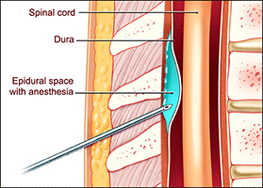

Slide 22
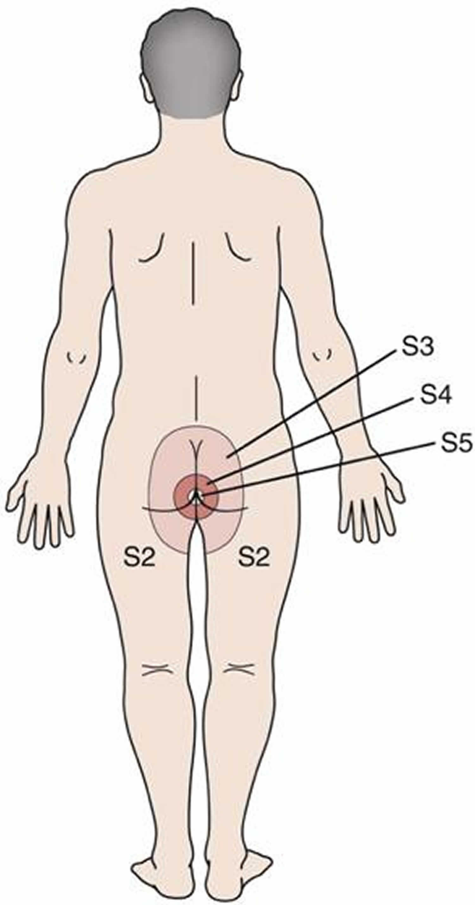
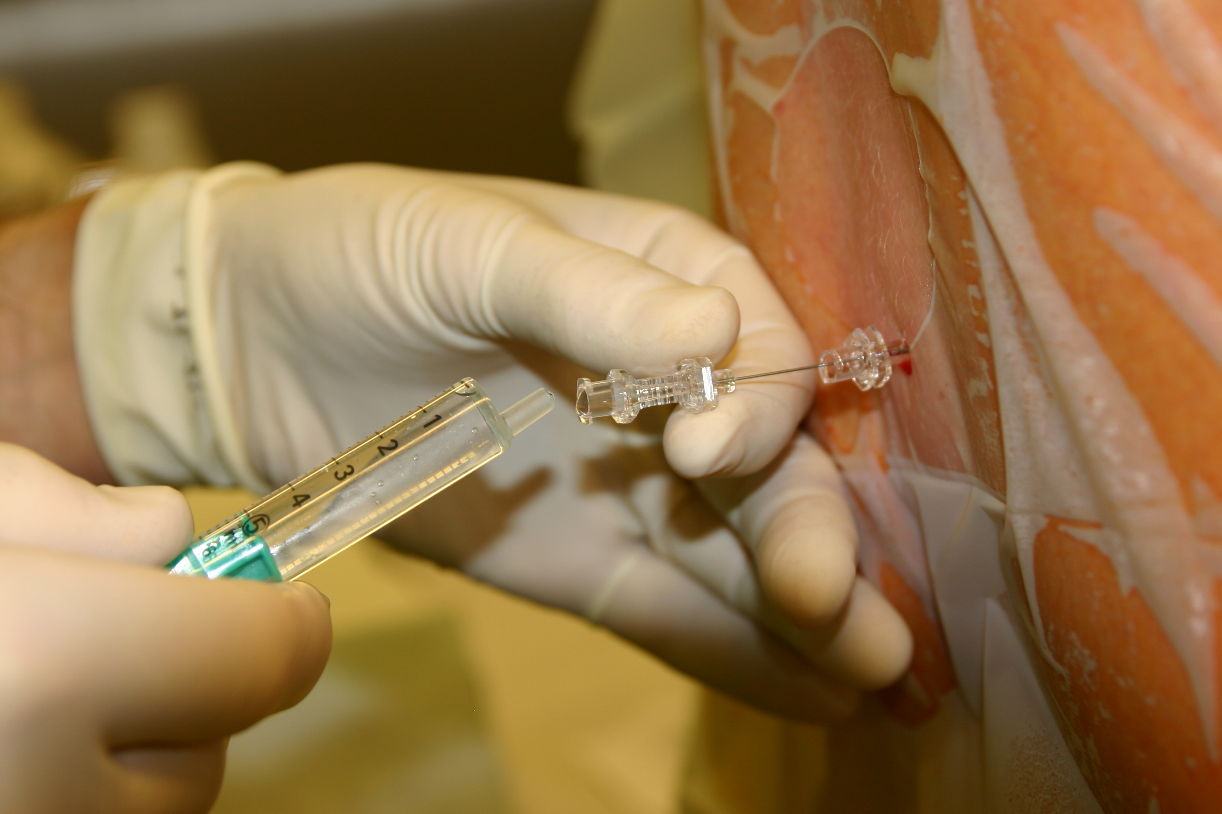

Slide 23
Thank you

