Slide 1
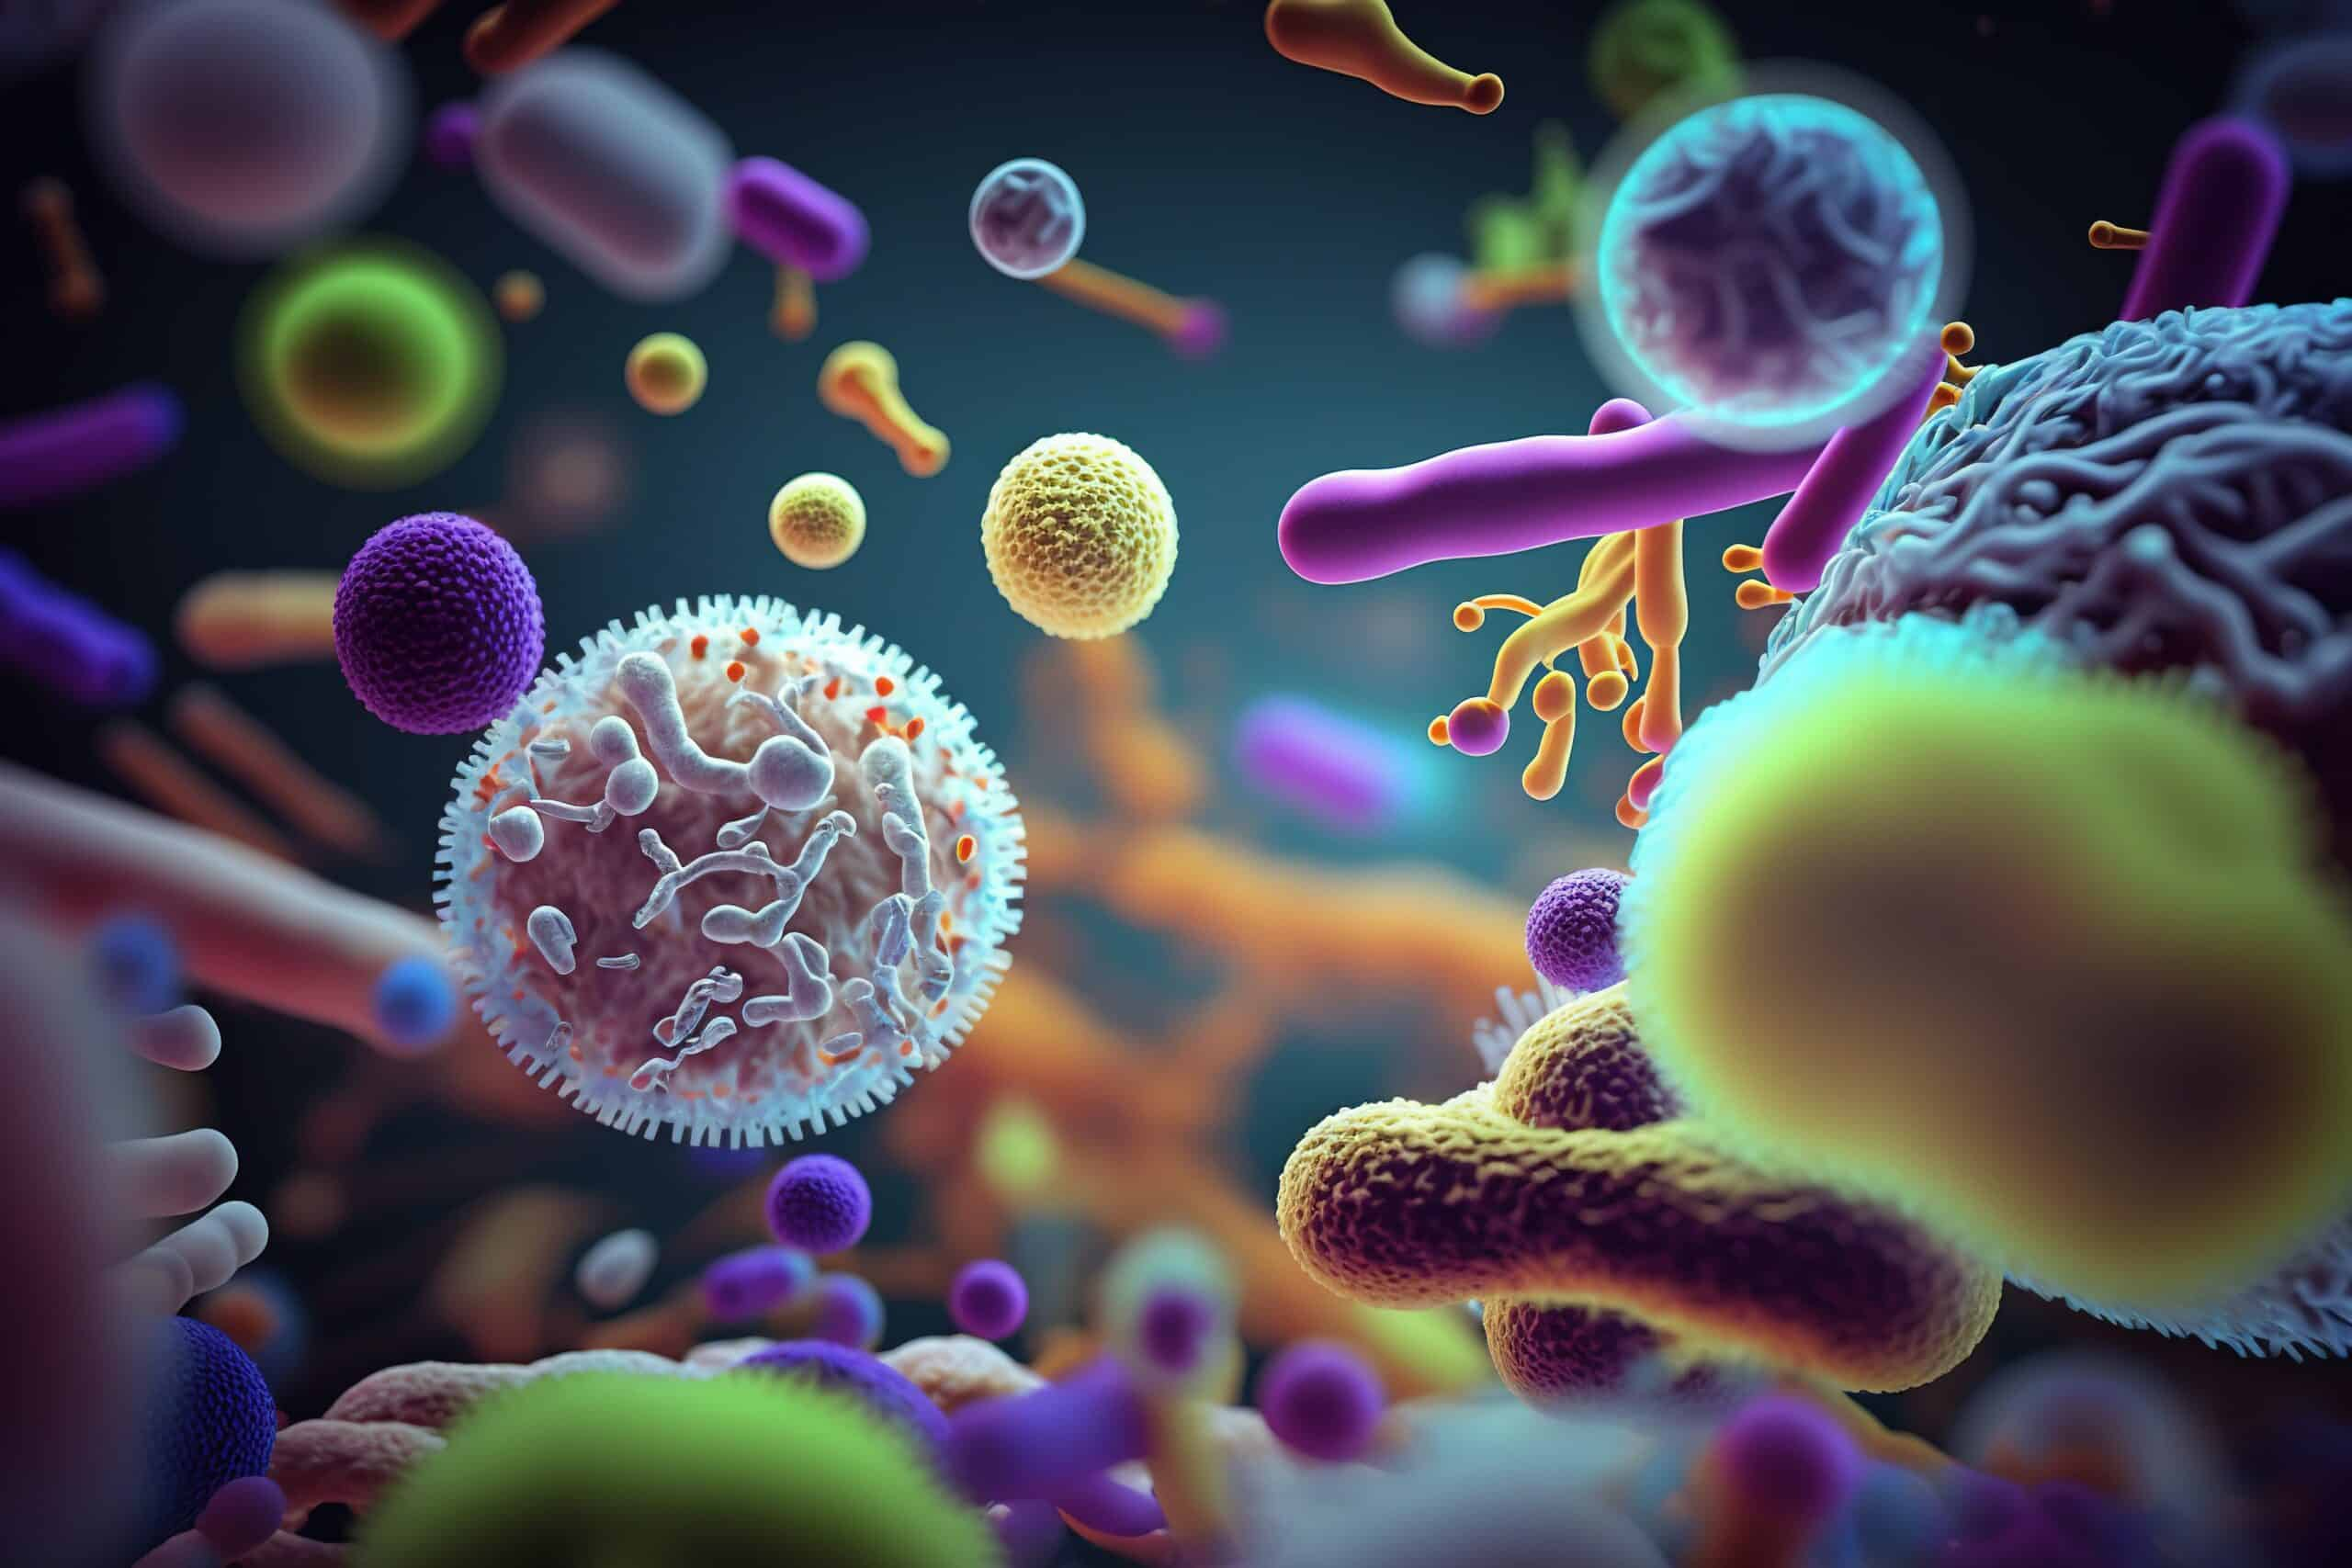
Clostridium, and Other Anaerobes
Ms. Heshu J. Ahmed
PhD Candidate
Medical Bacteriology 423
Spring Semester
Week Seven

Slide 2
Outline
Anaerobic infections
Clostridium Tetanus
Clostridium botulinum
pathogenesis
Manifestations

Slide 3
Objectives
1. Understanding Anaerobic Infections Pathogenesis
2. Identifying Manifestations of Clostridial Infections
3. Assessing pathogenesis of species

Slide 4
ANAEROBIC INFECTIONS
Despite our constant immersion in air, anaerobes are able to colonize the many oxygen deficient or oxygen-free microenvironments of the body.
These conditions are created by the presence of resident microbiota whose growth reduces oxygen and decreases the local oxidation–reduction potential.
Such sites include the sebaceous glands of the skin, the gingival crevices of the gums, the lymphoid tissue of the throat, and the lumina of the intestinal and urogenital tracts.

Slide 6
Pathogenesis
The anaerobic microbiota normally lives in a harmless commensal relationship with the host. However, when displaced from their environment on the mucosal surface into normally sterile tissues, these organisms may cause life-threatening infections.
This can occur as the result of:
trauma (gunshot, surgery),
disease (diverticulosis, cancer),
or isolated events (aspiration).
Host factors such as malignancy or impaired blood supply increase the probability that the dislodged flora will eventually produce an infection

Slide 7
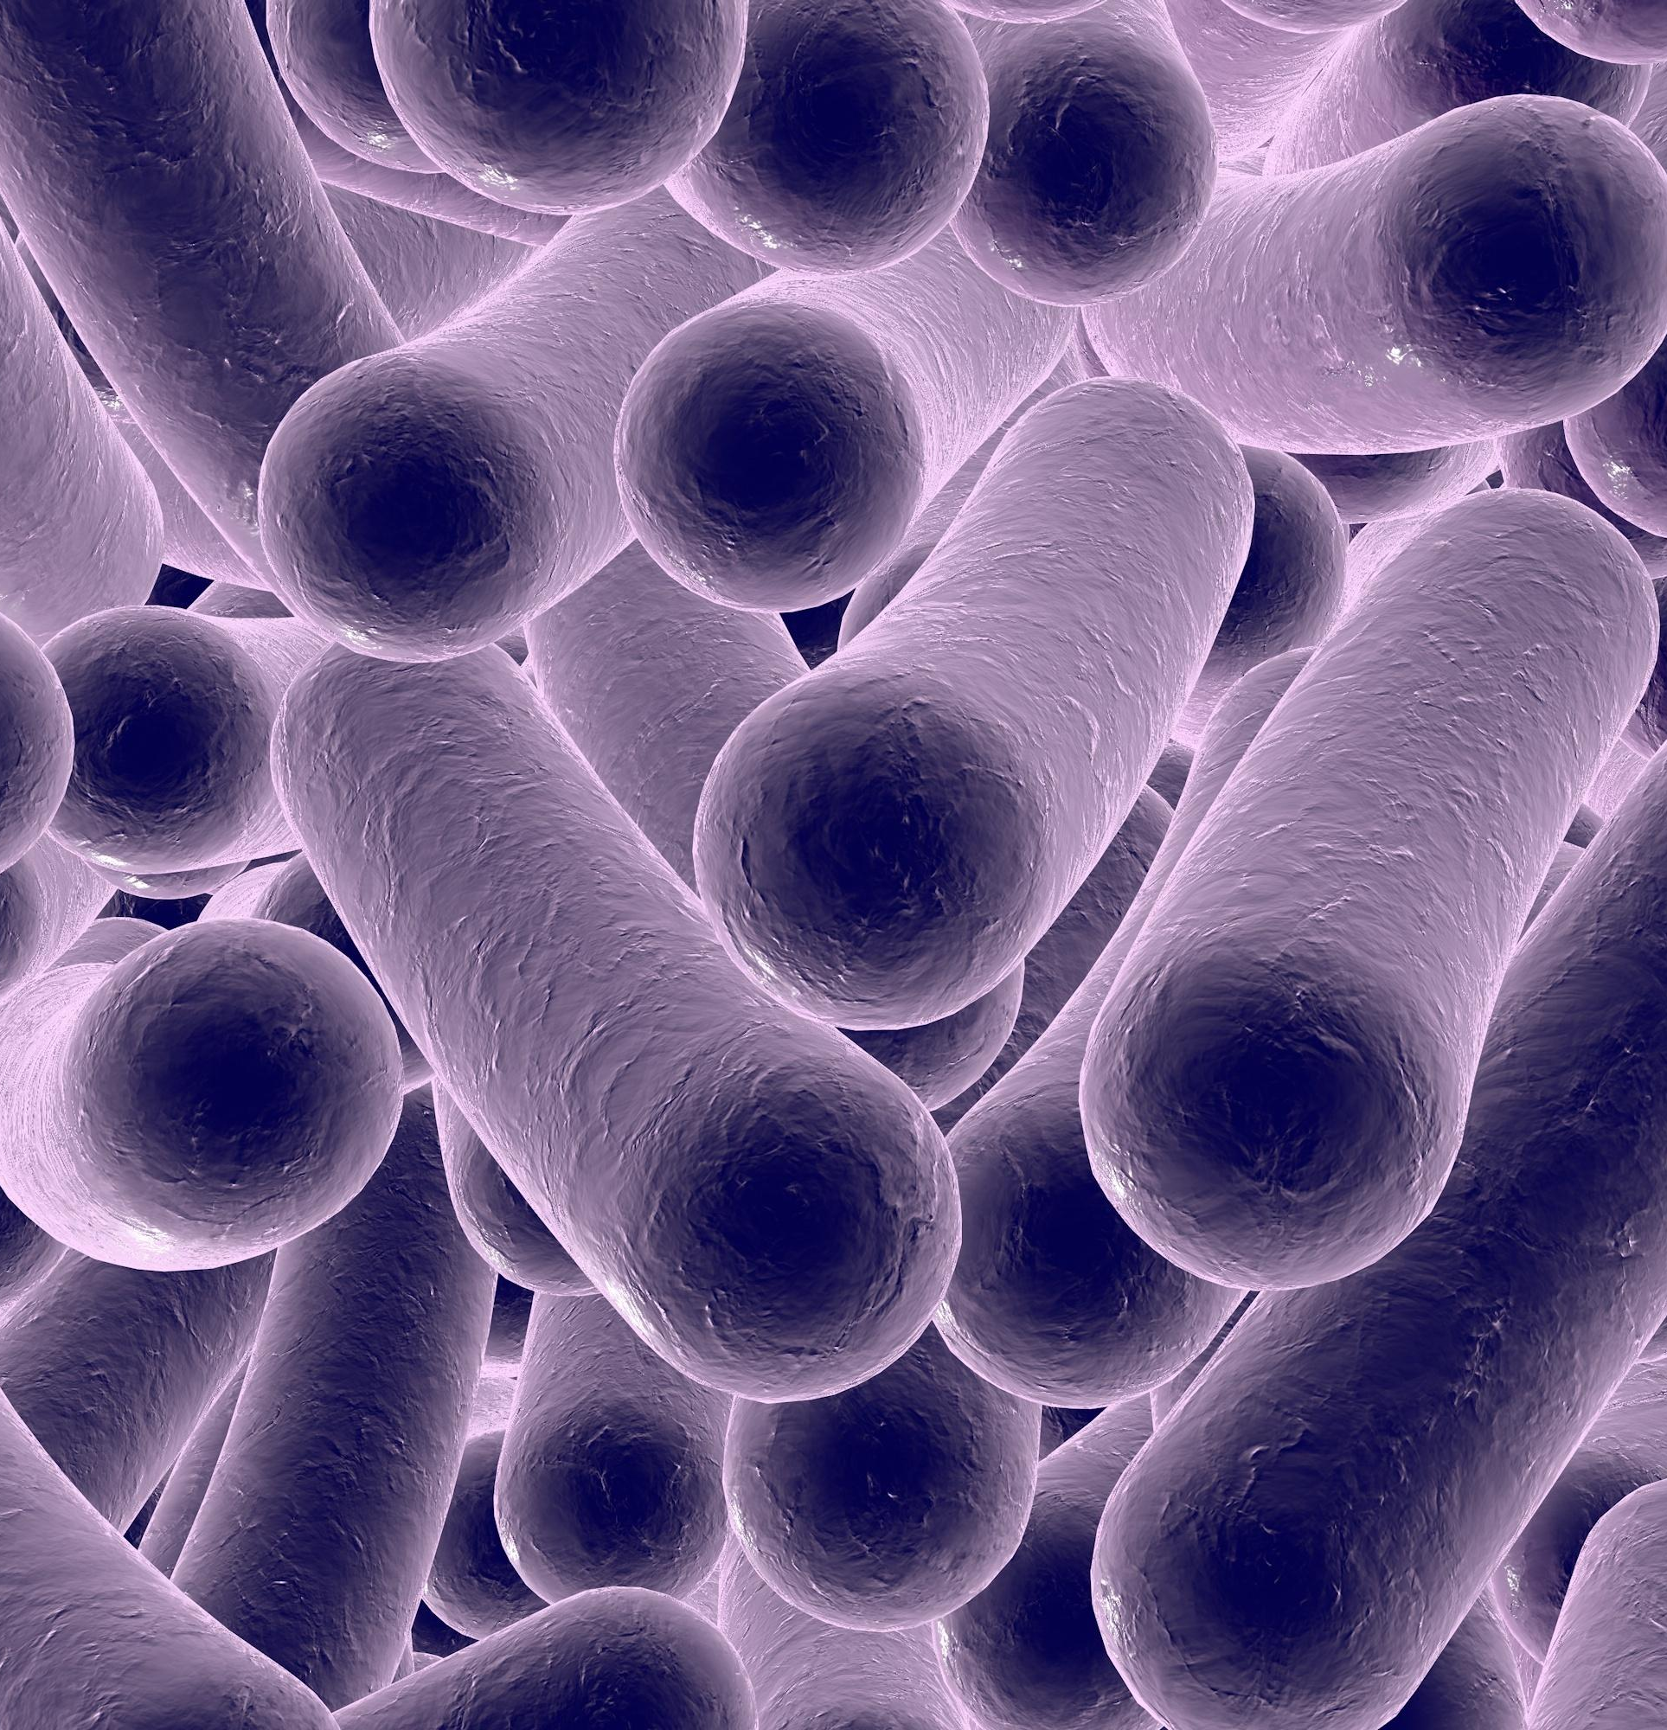
Clostridium genus
The clostridia are large, spore-forming, gram-positive bacilli.
Clostridia have spores that are resistant to heat, desiccation, and disinfectants.
They are able to survive for years in the environment and return to the vegetative form when placed in a favorable environment.
The histotoxic group including Clostridium perfringens and five other species produces hemolysins at the site of acute infections that have lytic effects on a wide variety of cells.
The neurotoxic group including Clostridium tetani and Clostridium botulinum produces neurotoxins that exert their effect at neural sites remote from the bacteria.
Clostridium difficile produces enterotoxins and disease in the intestinal tract.

Slide 8
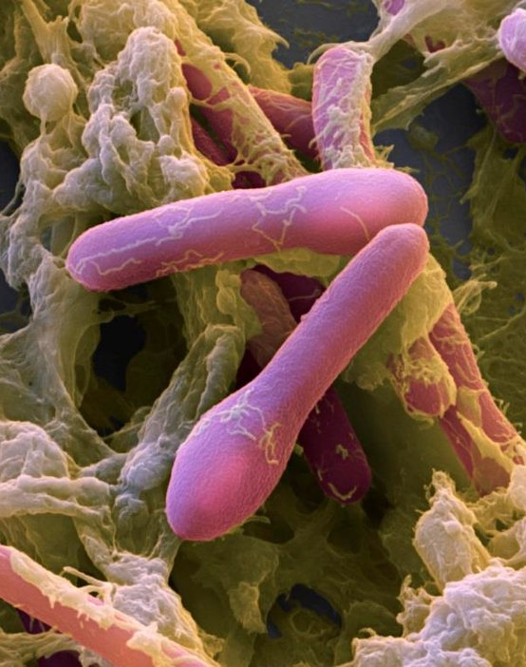
CLOSTRIDIUM BOTULINUM
Clostridium botulinum is a large gram-positive rod much like the rest of the clostridia.
Its spores resist boiling for long periods, and moist heat at 121°C is required for certain destruction.
Germination of spores and growth of C botulinum can occur in a variety of alkaline or neutral foodstuffs when conditions are sufficiently anaerobic.

Slide 9
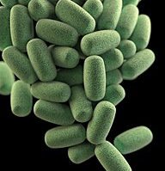
CLOSTRIDIUM PERFRINGENS
Clostridium perfringens is a large, gram-positive, nonmotile rod with square ends.
It grows overnight under anaerobic conditions, producing hemolytic colonies on blood agar.
In the broth containing fermentable carbohydrate, growth of C perfringens is accompanied by the production of large amounts of hydrogen and carbon dioxide gas, which can also be produced in necrotic tissues; hence the term gas gangrene.
Clostridium perfringens produces multiple exotoxins that have different pathogenic significance type (A to E).

Slide 10
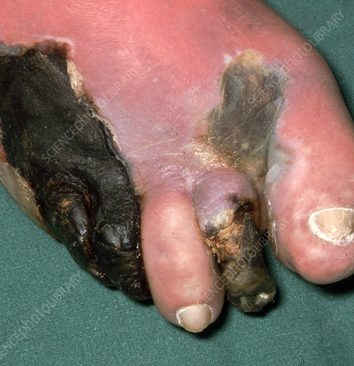
Pathogenesis
1. Gas Gangrene
If the oxidation–reduction potential in a wound is sufficiently low, C perfringens spores can germinate and then multiply, elaborating α-toxin.
The process passes along the muscle bundles, producing rapidly spreading edema and necrosis as well as conditions that are favorable for growth of the anaerobes.
As the disease progresses increased vascular permeability and systemic absorption of the toxin leads to shock.
α-Toxin is the major cause of both local destruction and shock.

Slide 11
Pathogenesis
2. Clostridial Food Poisoning
The spores of some C perfringens strains are often particularly heat-resistant and can withstand temperatures of 100°C for an hour or more.
Thus, spores that survive initial cooking can convert to the vegetative form and multiply when food is not refrigerated or is rewarmed.
After ingestion, the enterotoxin is released into the upper gastrointestinal tract, causing a fluid outpouring in which the ileum is most severely involved.

Slide 13
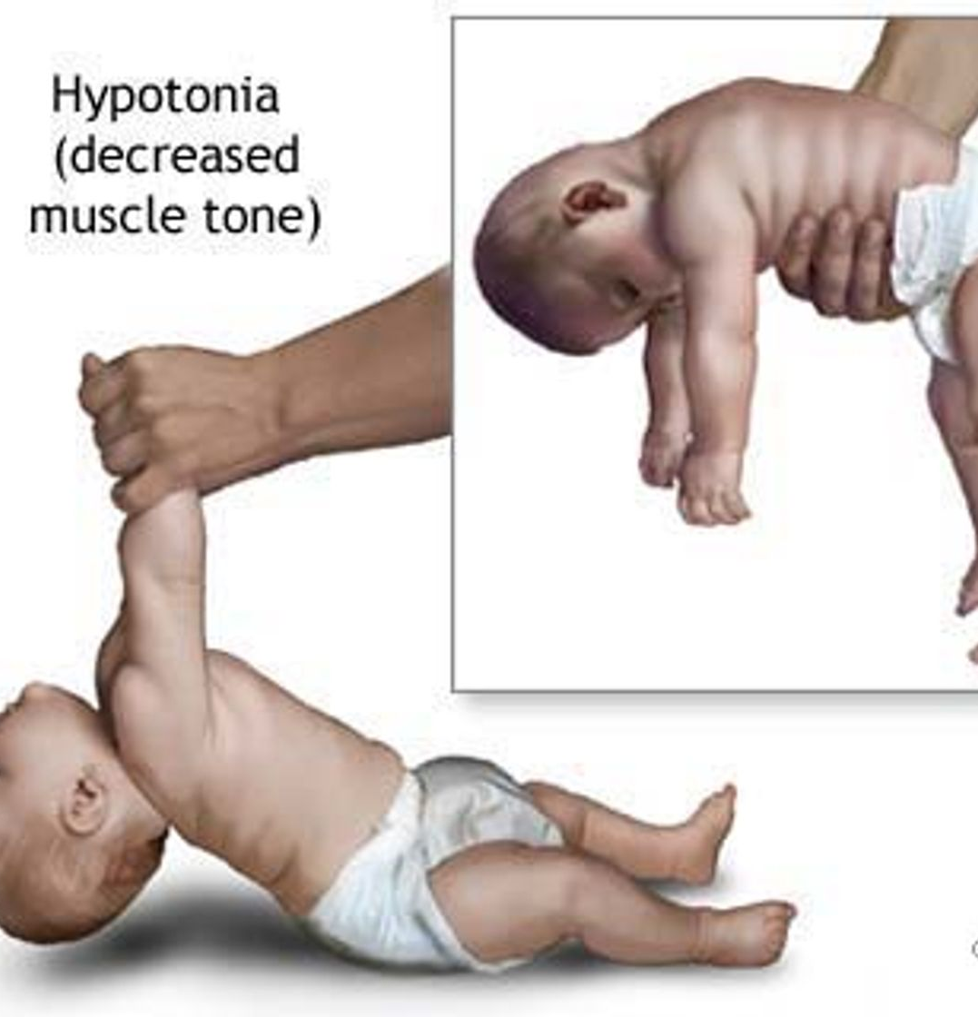
Manifestations
1. Infant Botulism
A syndrome associated with C botulinum that occurs in infants between the ages of 3 weeks and 8 months.
The organism is apparently introduced on weaning or with dietary supplements, especially honey, which is virtually impossible to sterilize.
Ingested spores yield vegetative bacteria, which multiply and produce small amounts of toxin in the infant’s colon.
The infant shows constipation, poor muscle tone, lethargy, and feeding problems and may have ophthalmic and other paralyses similar to those in foodborne botulism.
2. Wound Botulism
Very rarely, wounds infected with other organisms may allow C botulinum to grow.
Wound botulism in parenteral users of cocaine and maxillary sinus botulism in intranasal users of cocaine has been reported.
Botulism without an obvious food or wound source is occasionally reported in individuals beyond infancy. It is

Slide 14
References
Sherris Medical Microbiology: An Introduction to Infectious Diseases.
Jawetz, Melnick & Adelberg's Medical Microbiology by Geo. F. Brooks, Karen C. Carroll, and Janet S. Butel
Prescott's Microbiology by Joanne Willey, Linda Sherwood, and Christopher J. Woolverton

