Slide 1
Tishk International University (TIU) Vernacular architecture
Vernacular Architecture
Lecturer : Darbaz Pirot
2023-2024
Lecture 3: Vernacular architecture Asia

Slide 2
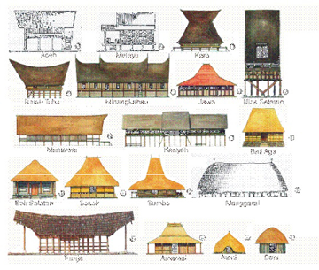
CONTENT
• Vernacular architecture Asia
• The factors influencing vernacular architecture
• Techniques in vernacular buildings

Slide 3
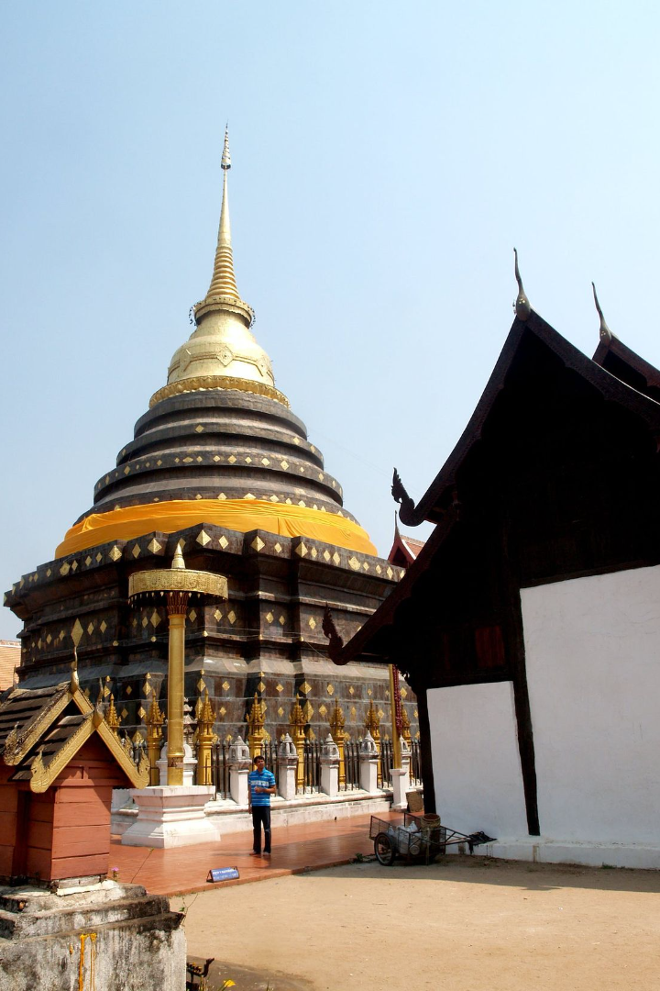
Exploring Vernacular Architecture in Asia
This section delves into the unique characteristics of vernacular architecture across Asia, examining the various factors that influence its design and construction. Drawing from global experiences, and explore the techniques employed in these traditional buildings .

Slide 4
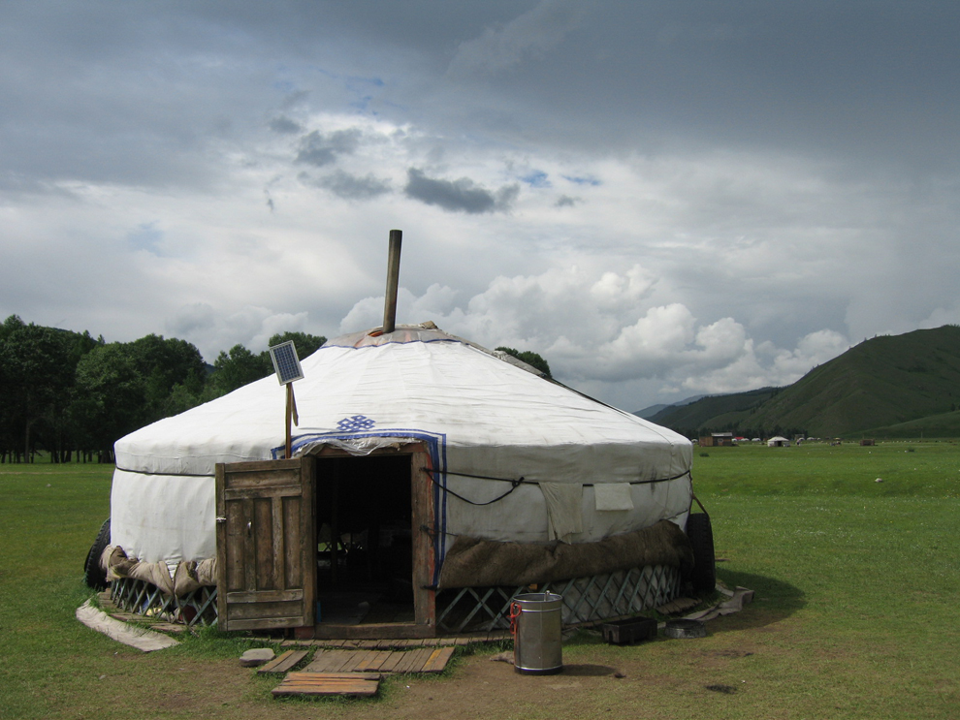
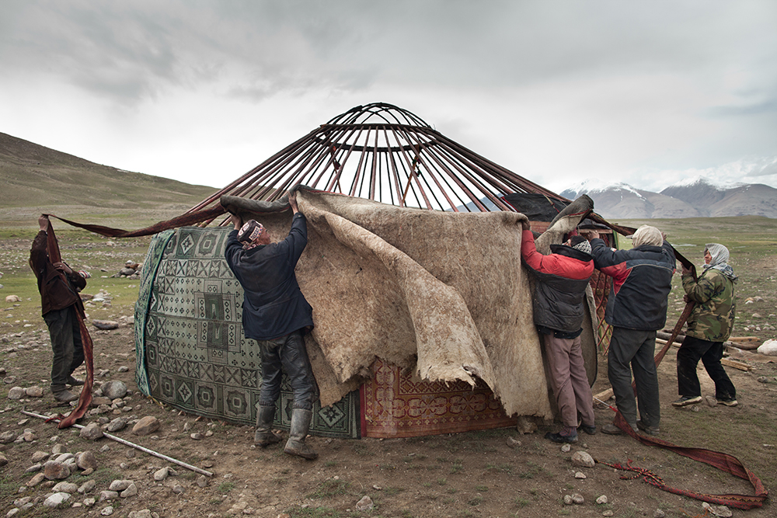
Yurt, Asia
Portable Dwellings
Traditional Construction
Cultural Significance
Usually found in Central Asia, a Yurt is a portable, round tent, which allows for easy transportation and assembly.
Consisting of a wood or bamboo frame, the structure of a Yurt is both sturdy (strongly ) and flexible, covered in skins, canvas, or felt.
As a dwelling that is closely associated with the nomadic cultures of Central Asia, Yurts are a symbol of the region's heritage.

Slide 5
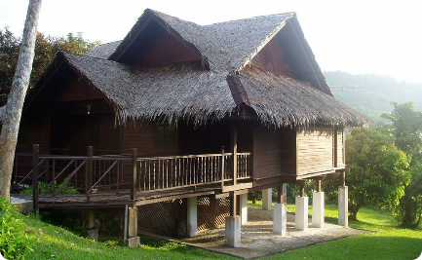
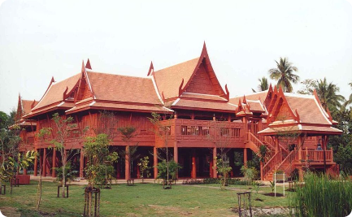
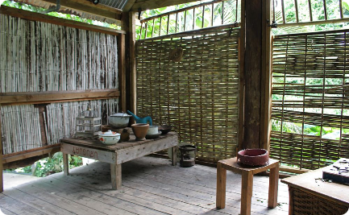
Malay House, Malaysia
Southern Style
Architectural Elegance
Interior
the interior of a Malay house blends functionality with aesthetics.
The Malay house in the southern region of Malaysia showcases a distinctive architectural style.
Characterized by its elegance(atractive), the southern Malay house is a symbol of cultural heritage.

Slide 6
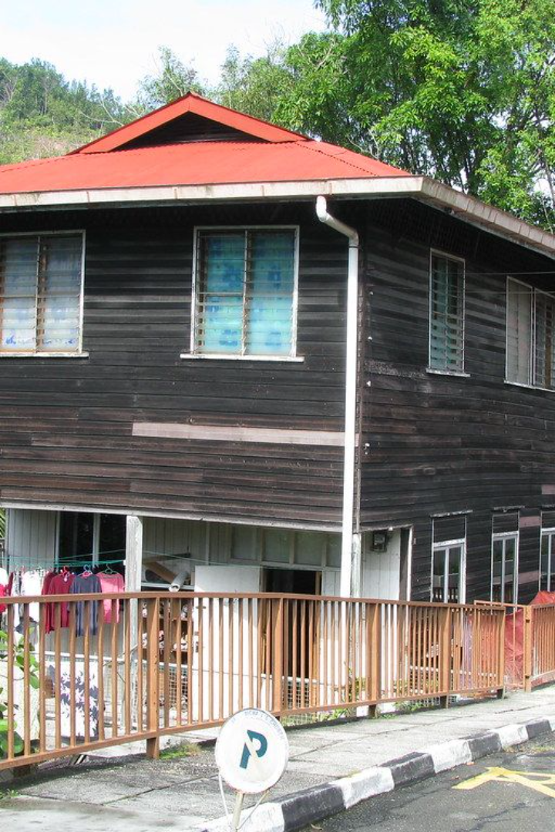
Malay House, Malaysia
Throughout South-Eastern Asia, the traditional Malay houses are a testament to architectural ingenuity and cultural heritage. These homes are raised on timber stilts and are primarily constructed of materials which were easily available from the tropical forests, such as timber, bamboo, rattan(palm), tree roots, and leaves.

Slide 7
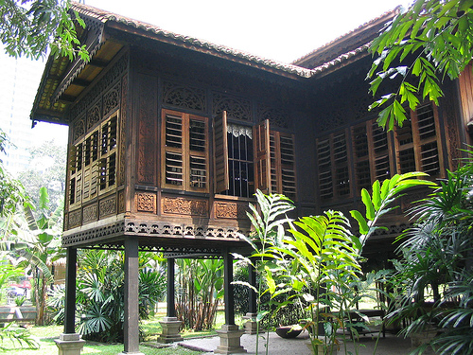
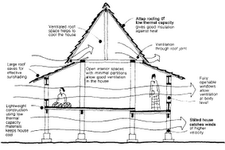
Malay House, Malaysia
Typically, Malay houses feature pitched roofs, verandahs or porches in front, high ceilings, and numerous large openings to facilitate air circulation for ventilation purposes. While these characteristics are common in all Malay houses throughout Peninsular Malaysia, it is interesting to note that their shapes and sizes differ from state to state, giving each home a unique identity.

Slide 8
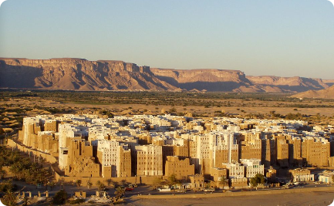
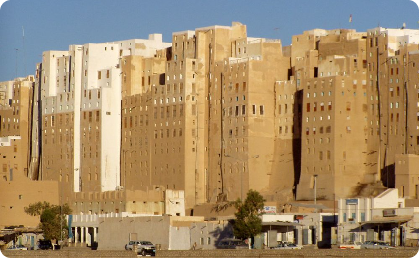
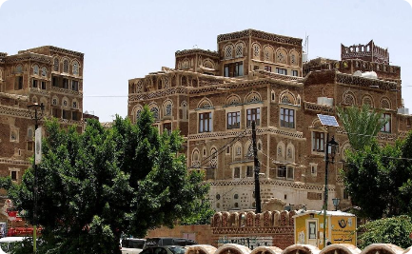
Adobe homes of Shibam, Yemen
Western Asia
Architectural Marvel
Historical Significance
Adobe homes of Shibam, Yemen, stand tall as a testament to the region's architectural heritage.
These towering structures are a defining feature of the city, showcasing the ingenuity of ancient construction techniques.
Recognized as a UNESCO World Heritage Site, Shibam's adobe homes are a window into the past of Western Asia.

Slide 9
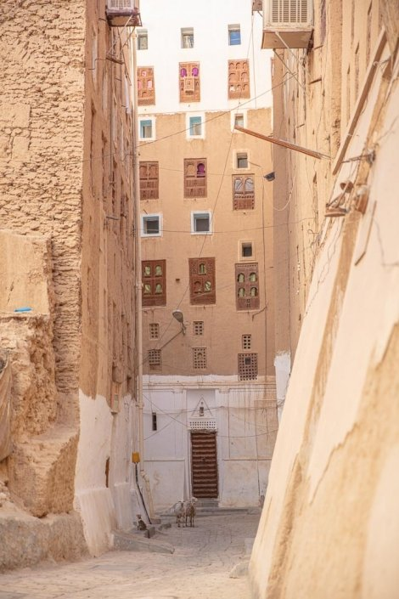
Adobe Homes of Shibam, Yemen
Located in Western Asia, the city of Shibam is renowned for its adobe homes which are considered the world's first skyscrapers. These towering structures are made from clay, a testament to the ingenuity necessitated by the geographic constraints of the site.
Shibam's exterior is characterized by its mud walls, which have historically limited outward urban expansion. Consequently, Shibam developed vertically, forming a dense urban fabric of about 500 homes.

Slide 10
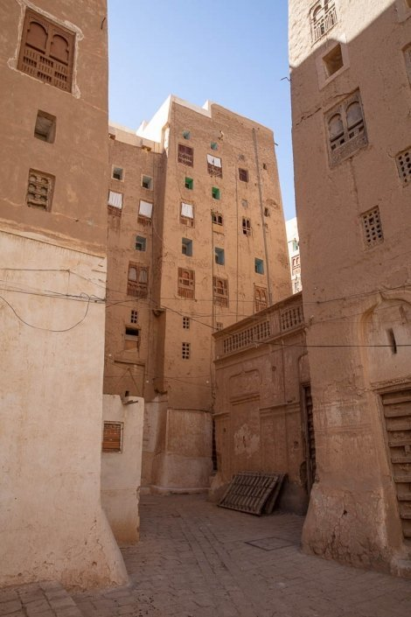
Adobe Homes of Shibam, Yemen
The adobe brick walls, crafted from the river's clay mud, are designed to get thinner towards the top of the building. This ingenious design reduces the pressure on the lower walls, ensuring stability.
To protect these historic structures from water damage, residents apply a whitewash to the rooftops and the exterior facades of the buildings. This protective covering is made from crushed limestone, which serves as a shield against the elements.

Slide 11
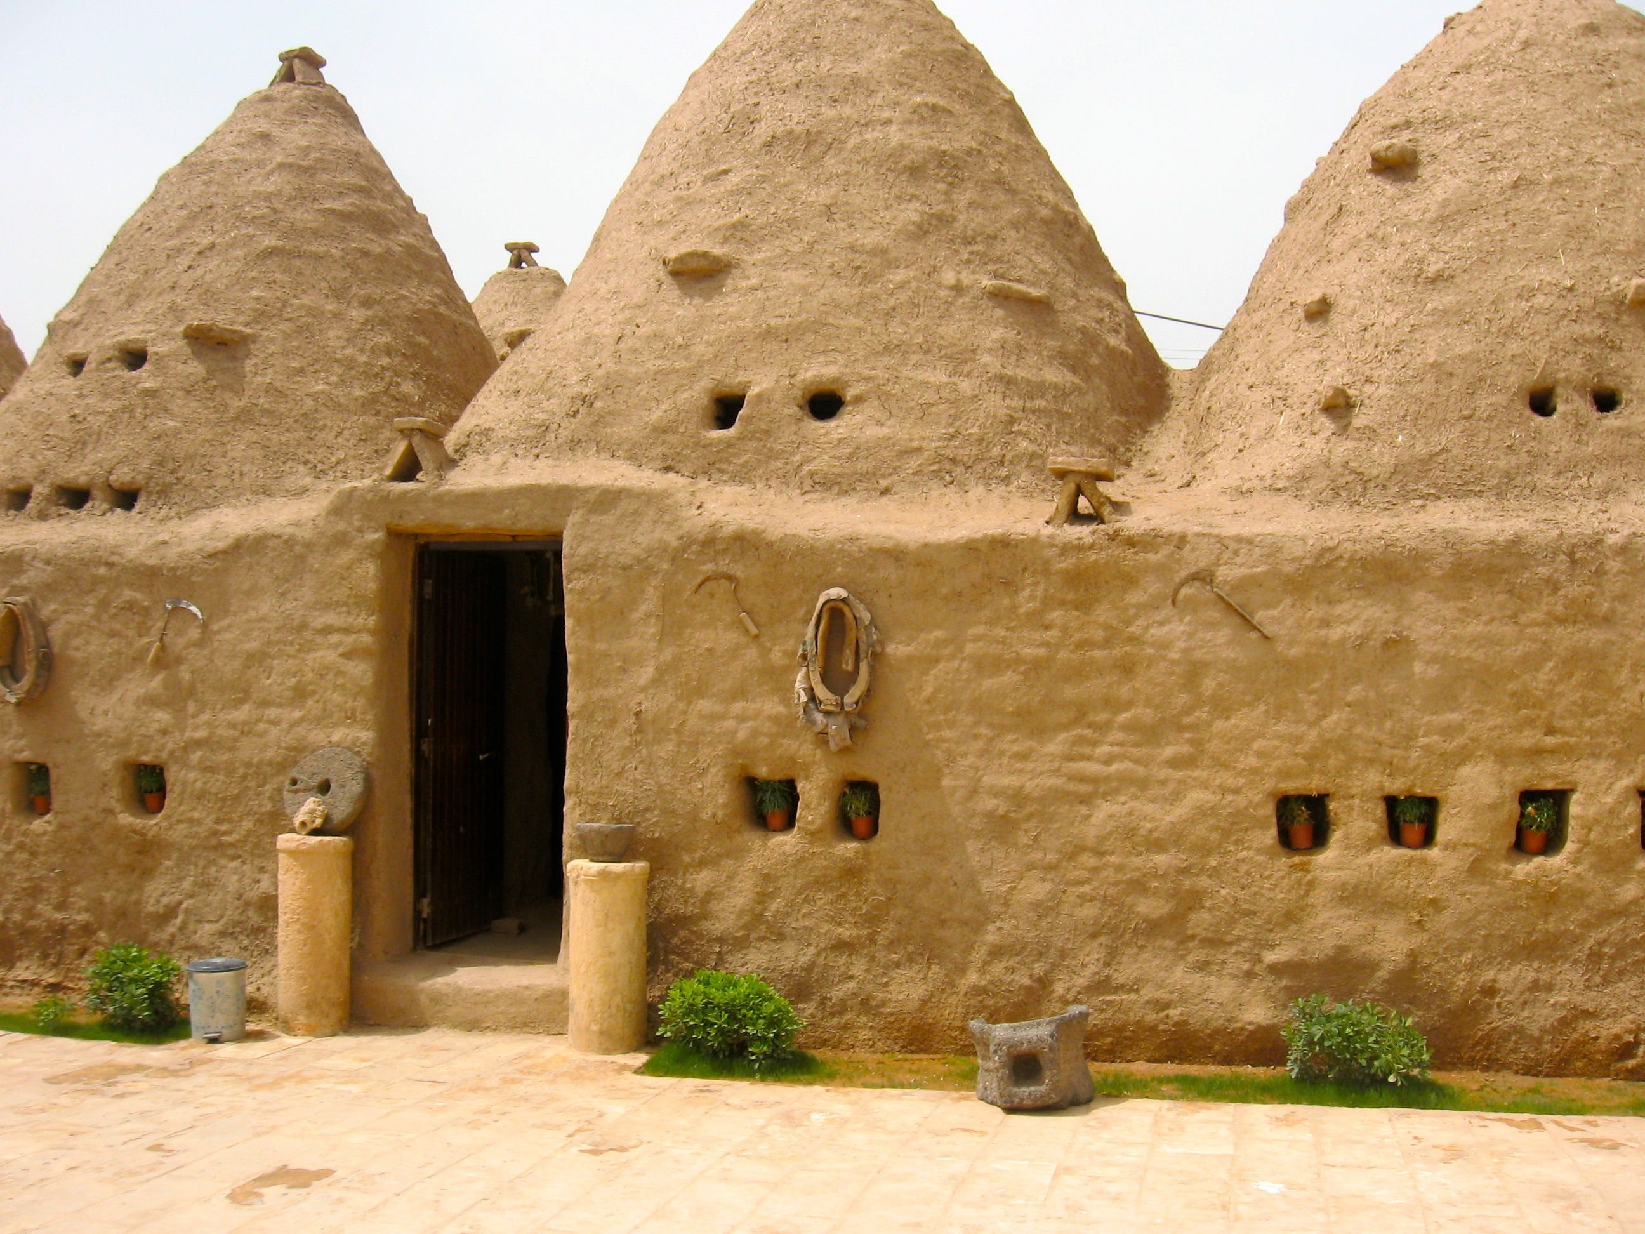
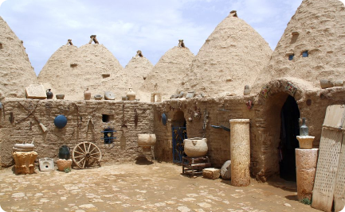
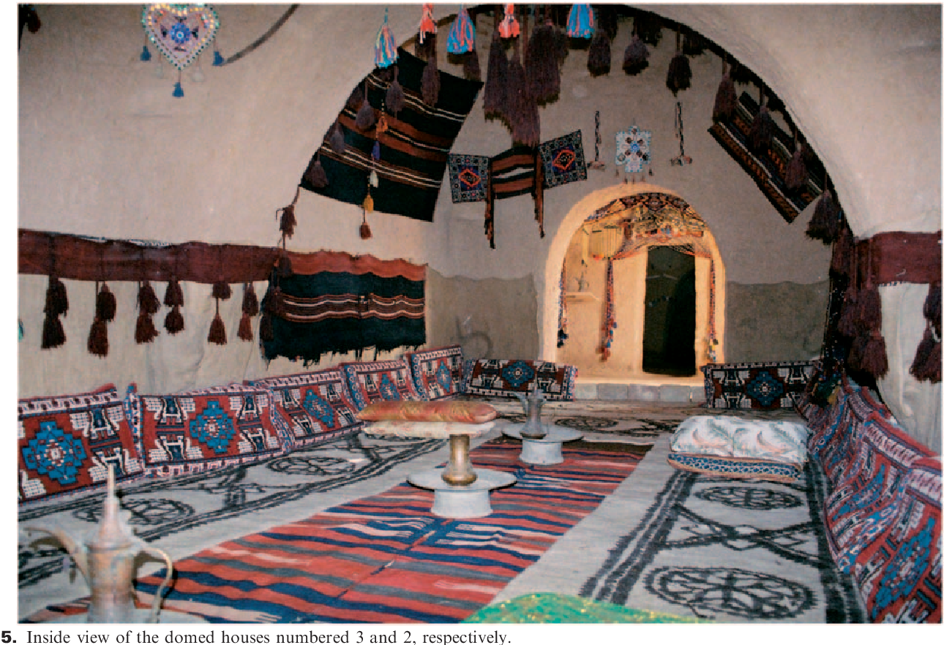
The adobe beehive homes of Harran, Turkey
Western Asia
Architectural Heritage
Cultural Significance
The adobe beehive homes of Harran, Turkey, are a distinctive feature of this region in Western Asia.
These unique structures are a testament to the architectural heritage of Harran, Turkey.
The beehive homes hold significant cultural importance in the history of Western Asia.

Slide 12
The Adobe Beehive Homes of Harran, Turkey
Unique Architecture
Climatic Adaptation
Efficient Design
The high domes are not just for show; they collect the hot air, moving it away from the living spaces. Remarkably, the interior remains around 24°C, a stark contrast to the outside temperature extremes ranging from 35°C to 0°C.
These are beehive homes in Harran, located in Western Asia. Characterized by their distinctive shape, beehive homes are a prime example of vernacular architecture, designed to stay cool in the desert heat.
Their thick mud brick (adobe) walls trap the cool air and keep the sun out, while having few windows. This design helps maintain a consistent and comfortable interior temperature.

Slide 13
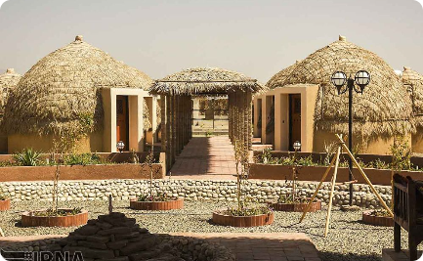
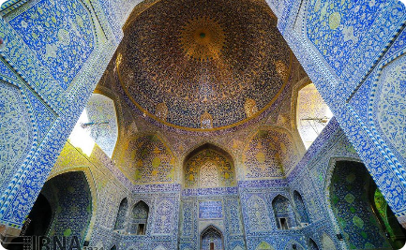
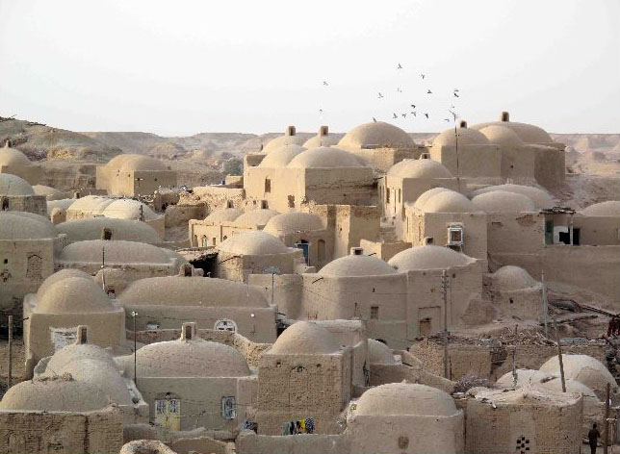
Iranian home Southern Asia
Earthen Materials
Vernacular Architecture
Adaptation to Climate
The common factors creating the vernacular architecture in Iranian are climate (harshly hot or cold) and accessible constructional materials. Ceilings are mostly built in the form of domes and vaults.
The major materials used for constructing various structures in Iran are mud and brick because the earth can be found everywhere quite easily and inexpensively.
Walls in Iranian homes are usually thick, and windows have to be made in small sizes to adapt to the harshly hot or cold climate.

Slide 14
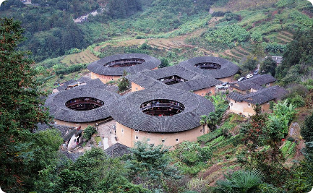
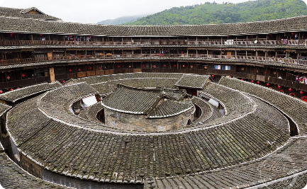
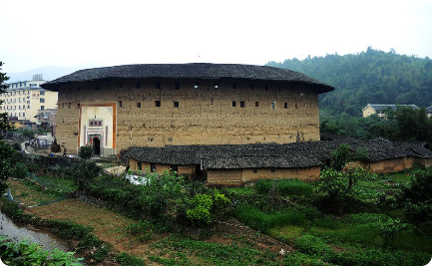
Tulou residences, China
Communal Living
Vernacular Architecture
Eastern Asia Heritage
Reflecting the communal living of the region, Tulou residences provide a glimpse into the social fabric that has defined communities in Eastern Asia.
These traditional communal homes are not just residences but also a testament to the unique way of life that has been preserved in Eastern Asia.
The Tulou residences of China are a stunning example of vernacular architecture, deeply rooted in the cultural and historical context of Eastern Asia.

Slide 15
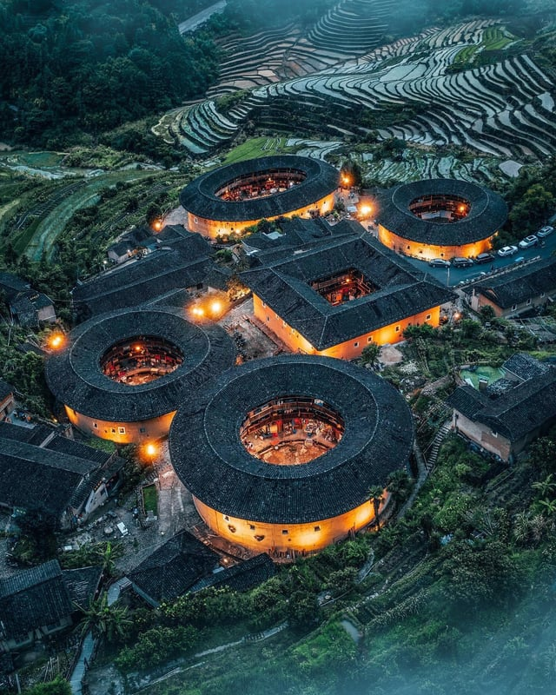
Tulou Residences in China
Eastern Asia is home to the unique Tulou residences, which were built by the Hakka people. These architectural marvels are characterized by their compounded earth and wooden beams that form thick, cylindrical walls reaching several stories high.
This construction was a strategic choice in a once-necessary effort to protect the interior from attack.

Slide 16
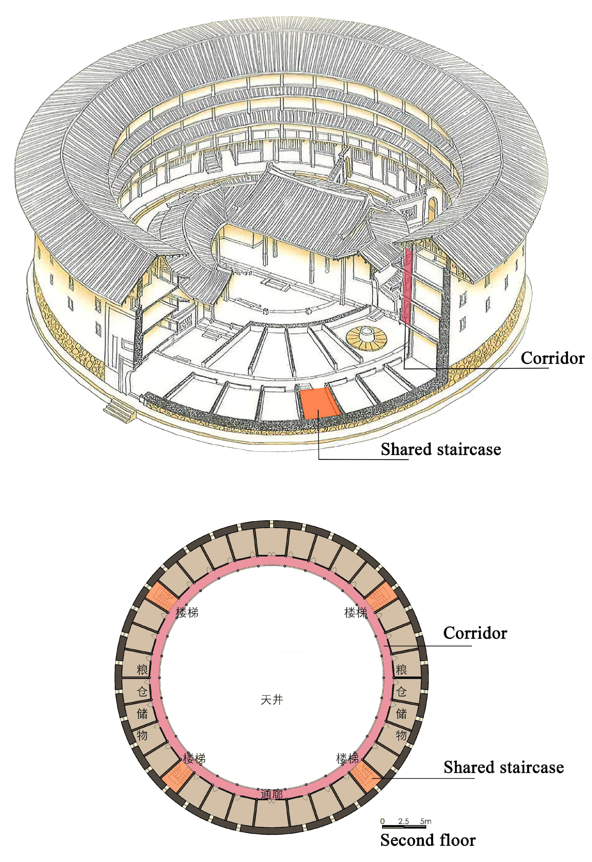
Tulou Residences in China
The design of Tulou residences is distinctive for its defensive features. The outward facing walls have only one entrance and are devoid of windows, a deliberate design to safeguard the inhabitants. Conversely, all balconies, doorways, and openings face inwards, creating an additional layer of protection from potential danger.
Each Tulou structure is not just a building; it is a self-contained community. It houses hundreds of people—an entire clan—and functions as a small village. The large, open interior provides space for communal activities, reinforcing the sense of unity and shared purpose among the residents.

Slide 17
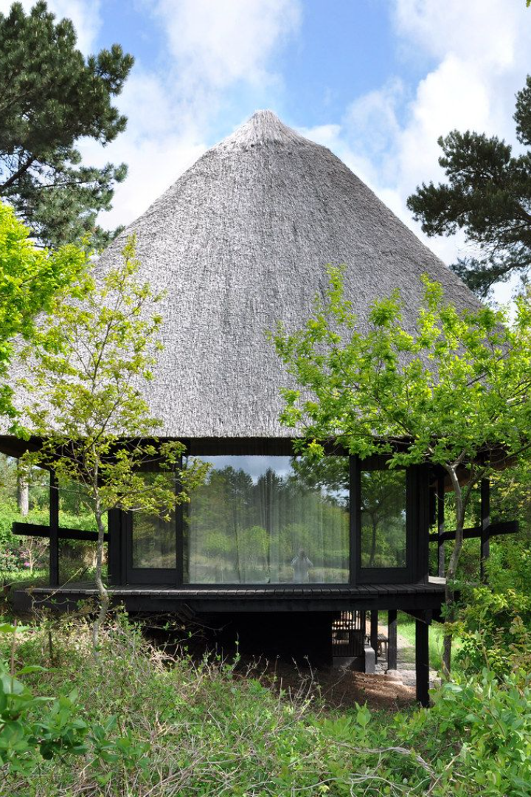
The Factors Influencing Vernacular Architecture
Exploring the rich tapestry of vernacular architecture around the globe reveals a variety of factors that shape its development. These influences are deeply rooted in the cultural, environmental, and social experiences unique to each region.

Slide 18
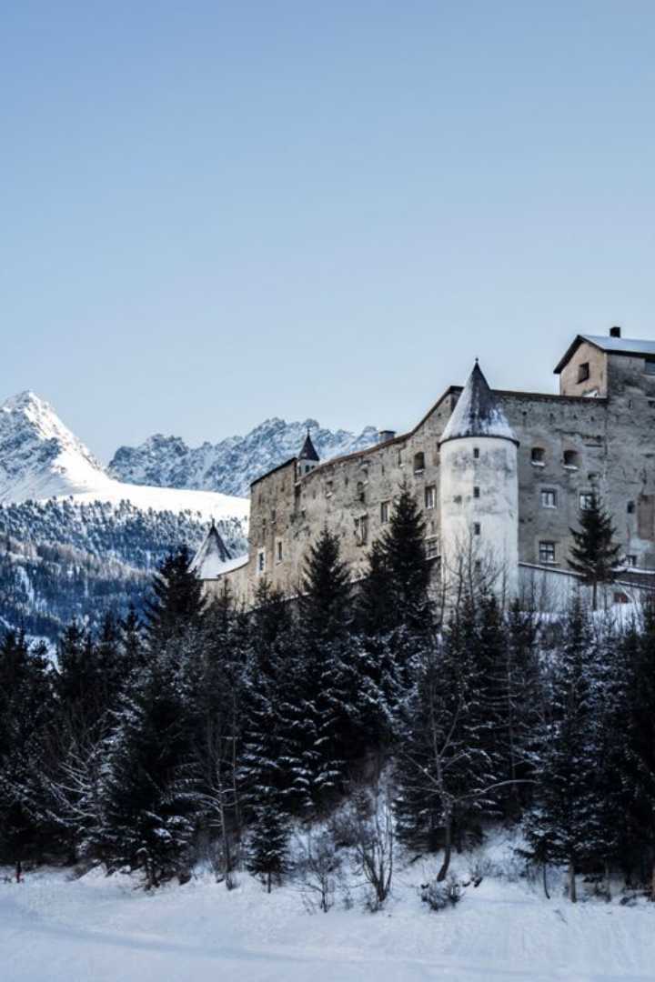
CLIMATE
Buildings in cold climates are characterized by a high thermal mass or significant amounts of insulation. They are usually sealed in order to prevent heat loss, and openings such as windows tend to be small or non-existent.
One of the most significant influences on vernacular architecture is the macro climate of the area in which the building is constructed. Accordingly, the design of the vernacular buildings varies depending on the climate type.

Slide 19
CLIMATE
Cold climates region: This area's architectural design is heavily influenced by the need to retain (saving)heat and minimize energy consumption due to the harsh weather conditions.

Slide 20
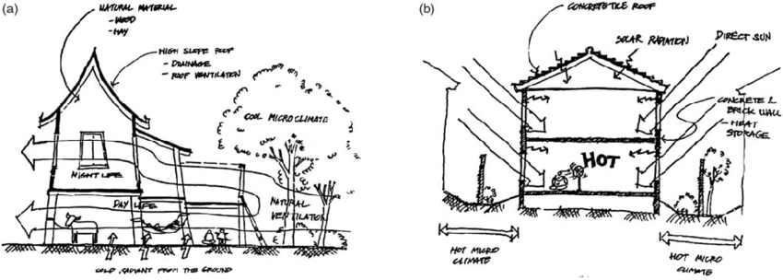
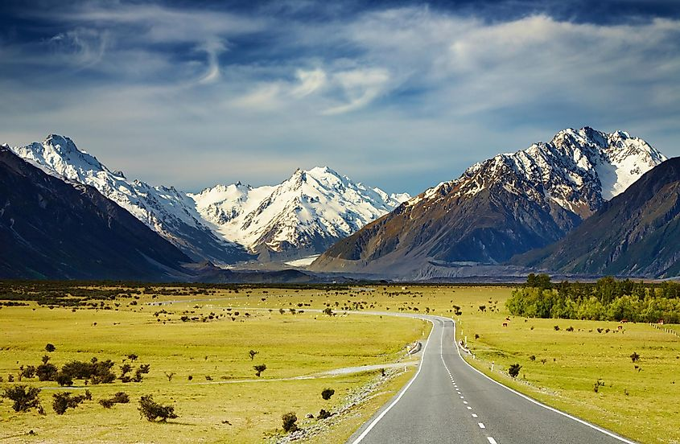
Adapting Architecture to Climate
Warm climate region: Buildings are typically made of lighter materials and designed to enhance cross-ventilation through various openings.
Continental climate region: Structures must withstand significant temperature fluctuations and are often seasonally adapted by occupants.

Slide 21
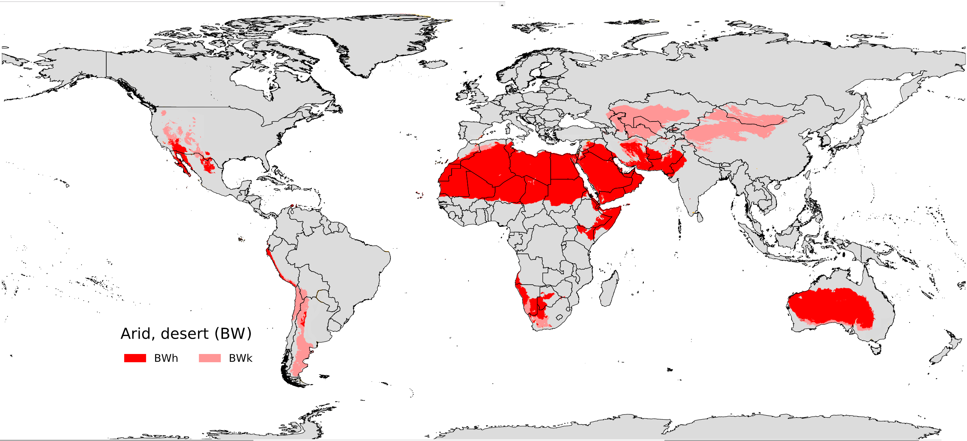
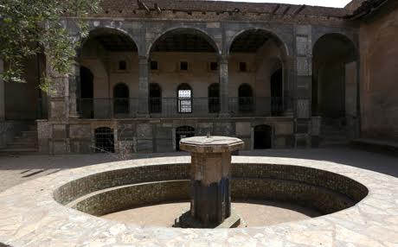
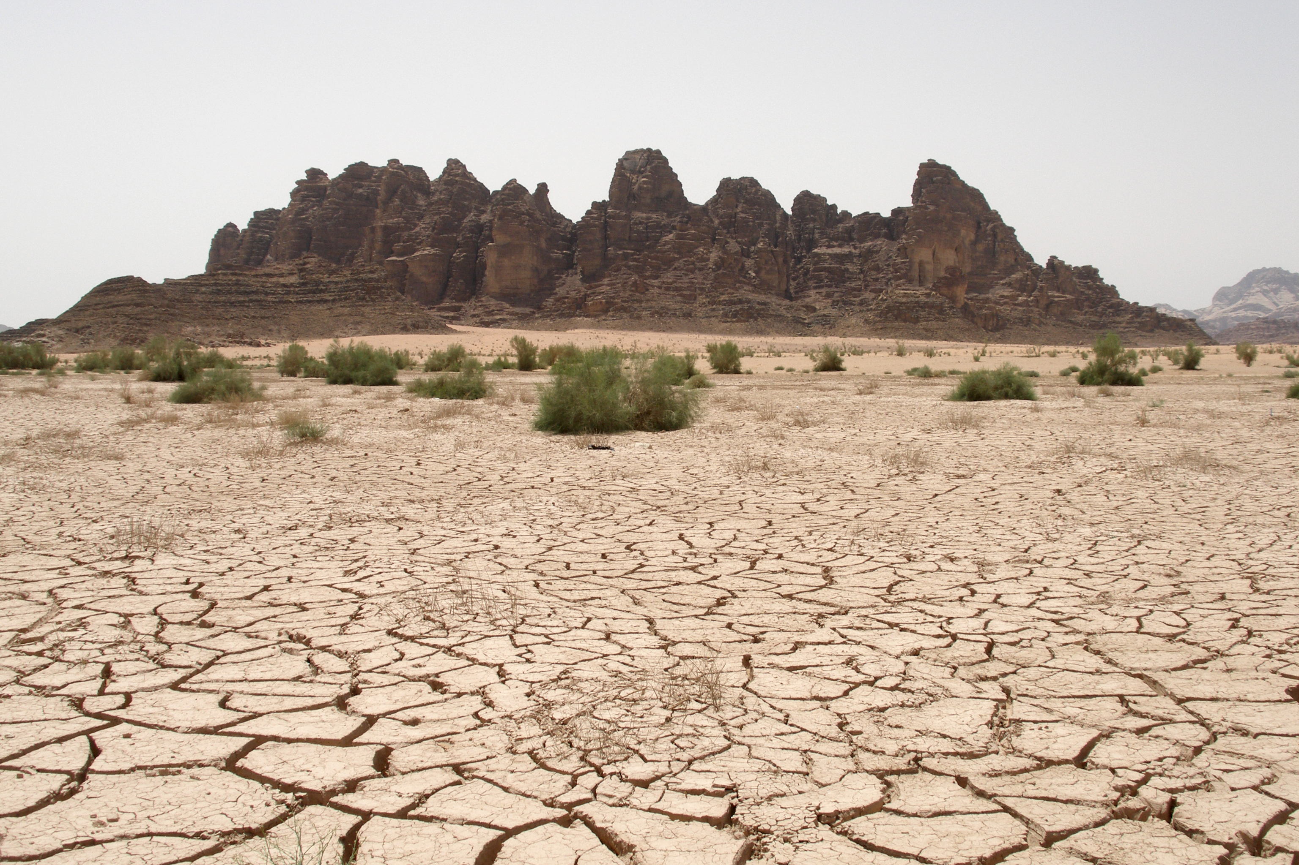
Adapting Architecture to Climate: Hot Dry Regions
Very high daytime temperatures, with very little precipitation, characterize these areas.​ In response, Mediterranean vernacular, and that of much of the Middle East, often includes a courtyard with ​a feature such as a fountain or pond.​ The presence of water serves to cool the air - air cooled by water mist and evaporation​ is drawn through the​ building by natural ventilation encouraged by the building's design.​ Hot dry region architecture leverages these elements to create a comfortable living environment despite the​ harsh climate.​

Slide 22
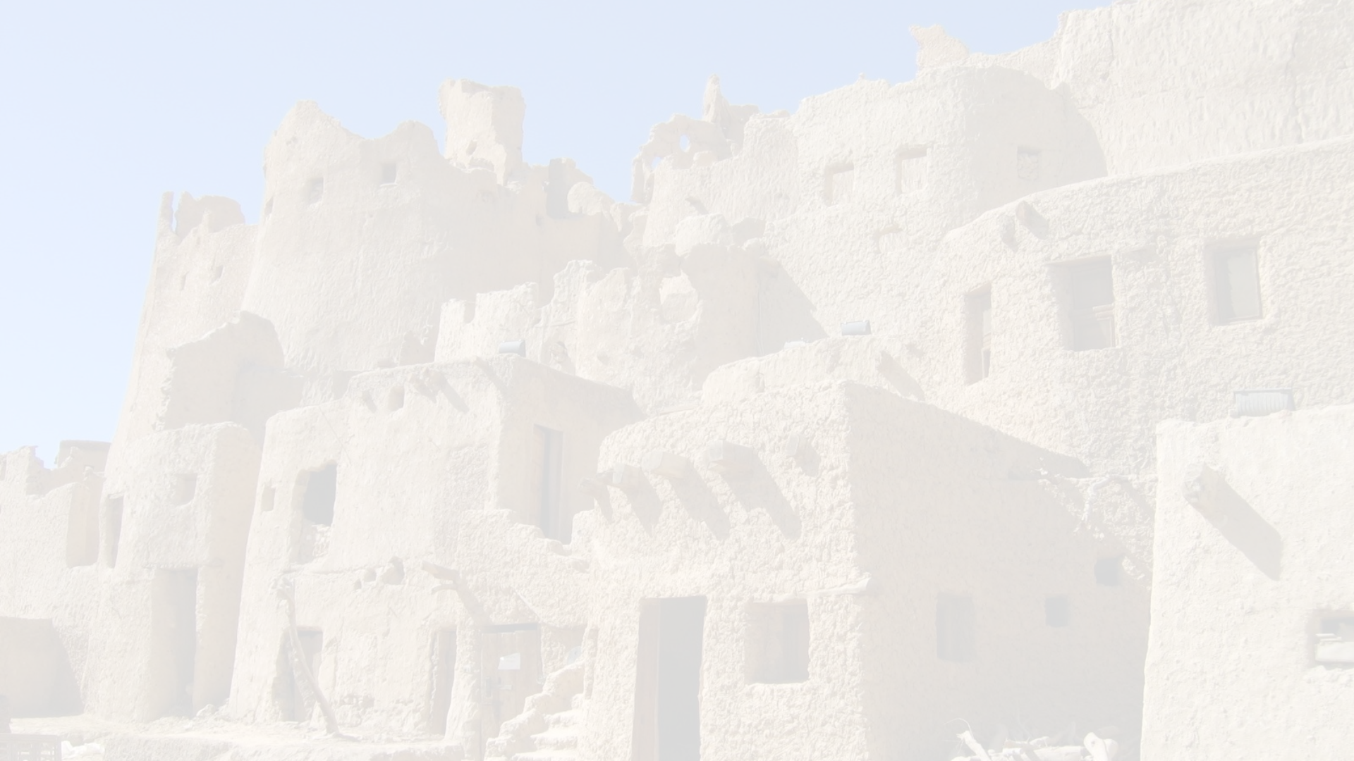
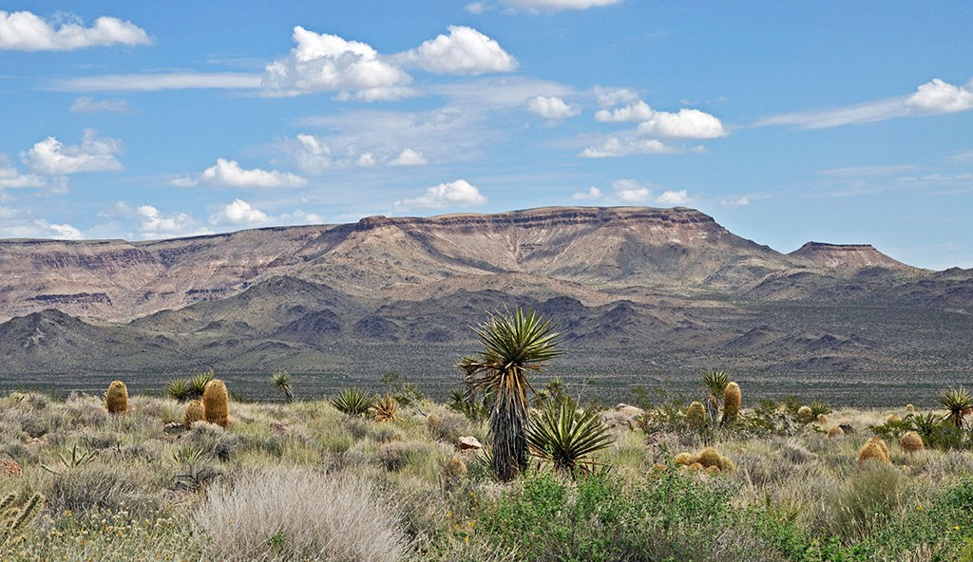
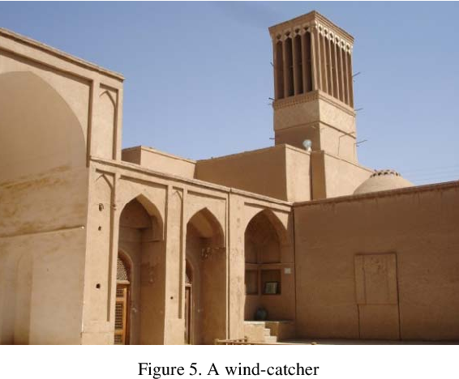
Architectural Features in Arid Climates
Buildings in arid desert climates are designed with high thermal mass to maintain cooler internal temperatures.​
Such structures often feature small windows, which help in reducing heat intake from the harsh sun.​
Interestingly, many include chimneys—not for fires, but to draw air through the living spaces for natural ventilation.​

Slide 23
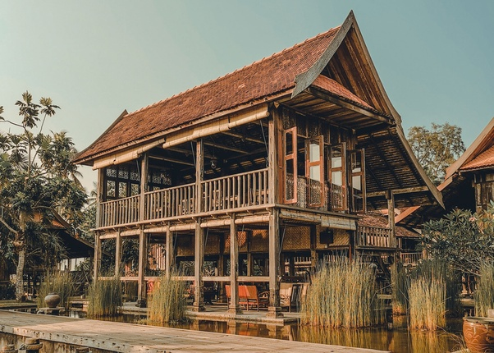
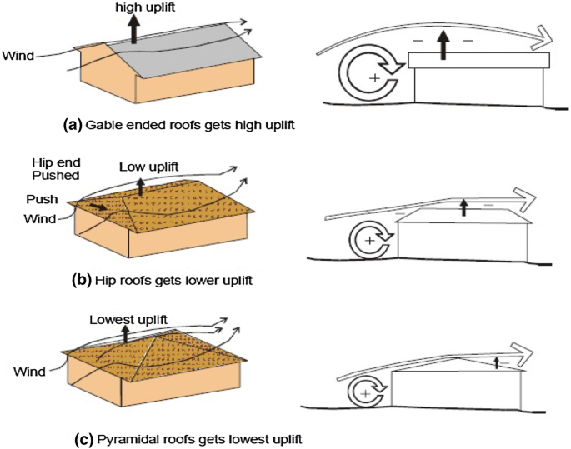
Regional Architectural Adaptations
High precipitation region: Dwellings on stilts are a common sight in regions with frequent flooding or rainy monsoon seasons, as buildings take different forms to adapt to precipitation levels.​
Flat roofs become a rarity in areas with high levels of precipitation, as the architectural design must accommodate for the weather conditions.​
High wind region: Specialized buildings designed to withstand high winds are a testament to the ingenuity of construction in such areas.​
Orientation of buildings is crucial, with structures often positioned to present minimal area to the direction of prevailing winds, reflecting the impact of wind on architectural decisions.​

Slide 24
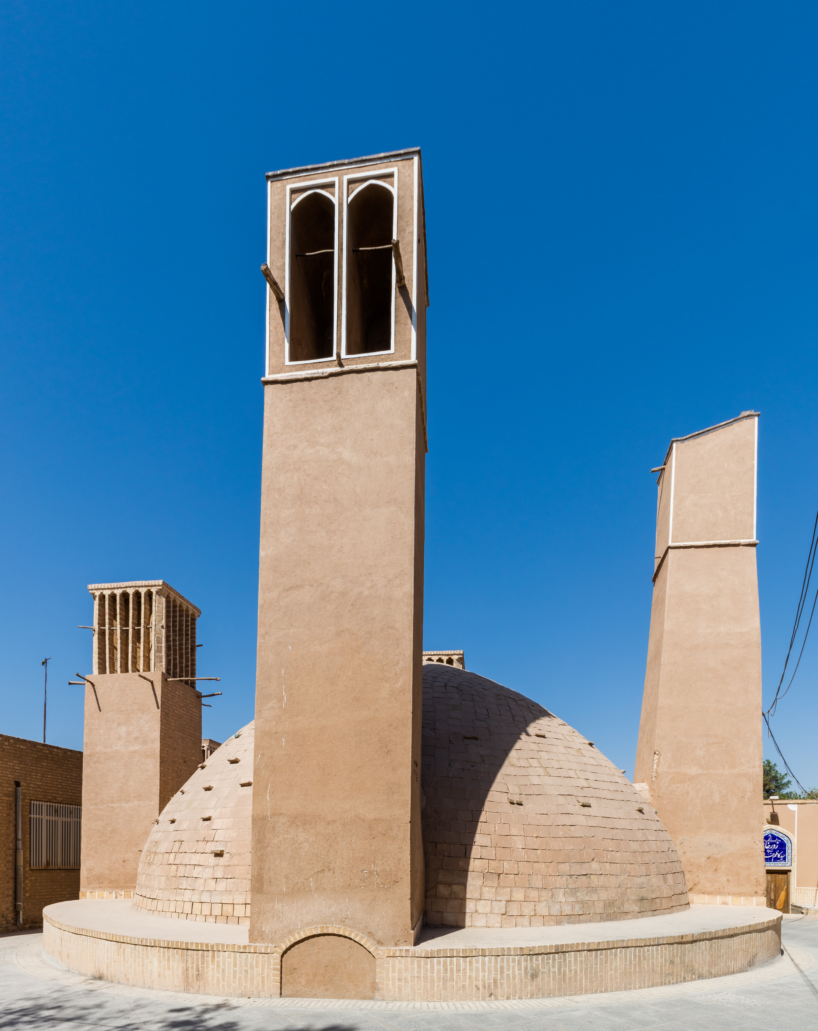
Are Such Specializations of Each Region Designed?
Specializations not designed: Such specializations are not designed,​
Learnt by trial and error: but learnt by trial and error over generations of building construction,​

Slide 25
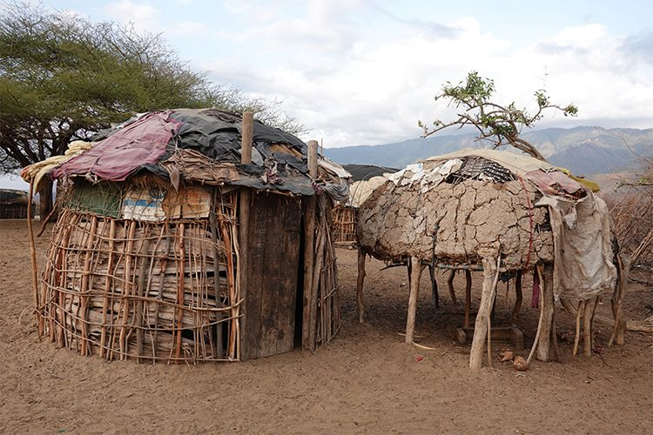
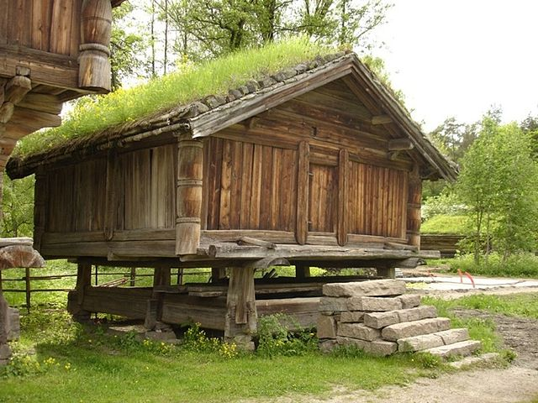
2- CULTURE
Cultural factors play a crucial role in shaping vernacular architecture. The daily lifestyle and usage of shelters by inhabitants, including the size and dynamics of family units, influence the layout and size of dwellings. How spaces are shared, methods of food preparation and consumption, and the nature of social interactions all contribute to the architectural design.
Additionally, local customs, beliefs, and cultural practices greatly affect the appearance and decoration of vernacular buildings. The contrast between nomadic lifestyles, which necessitate simple and transportable constructions, and permanent settlements with more stable structures, further highlights the diversity in vernacular architecture driven by cultural nuances.

Slide 26
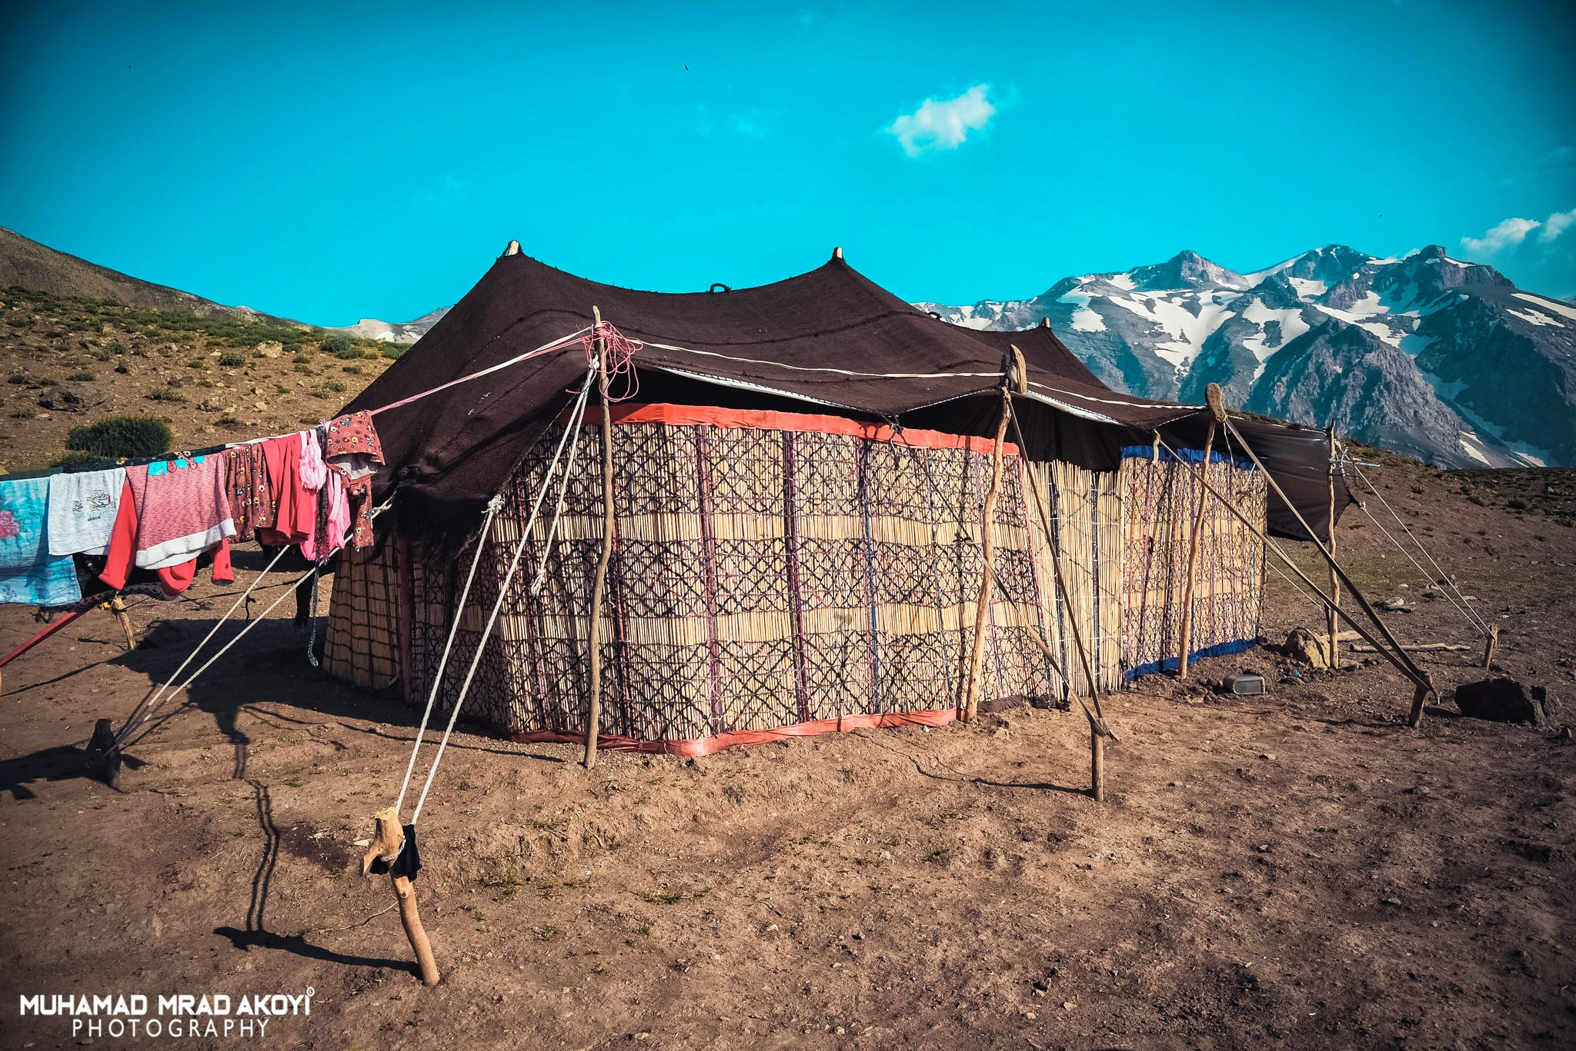
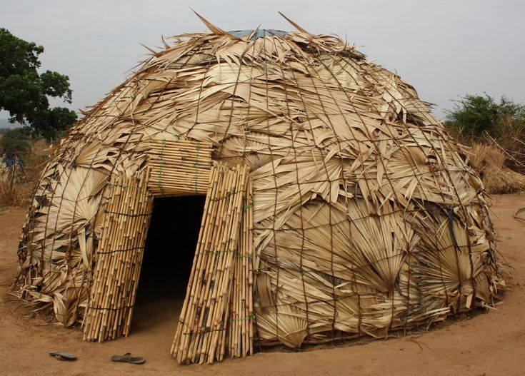
2-1- CULTURE : NOMADS
Vernacular architecture worldwide has evolved to meet the need for shelter, adapting to local climate and customs. This includes simple construction methods and, in the case of nomadic lifestyles, the need for transportable structures like huts and tents.
Nomadic cultures prioritize simplicity and mobility in their shelters, reflecting their way of life and the need to respond effectively to environmental and cultural factors.

Slide 27
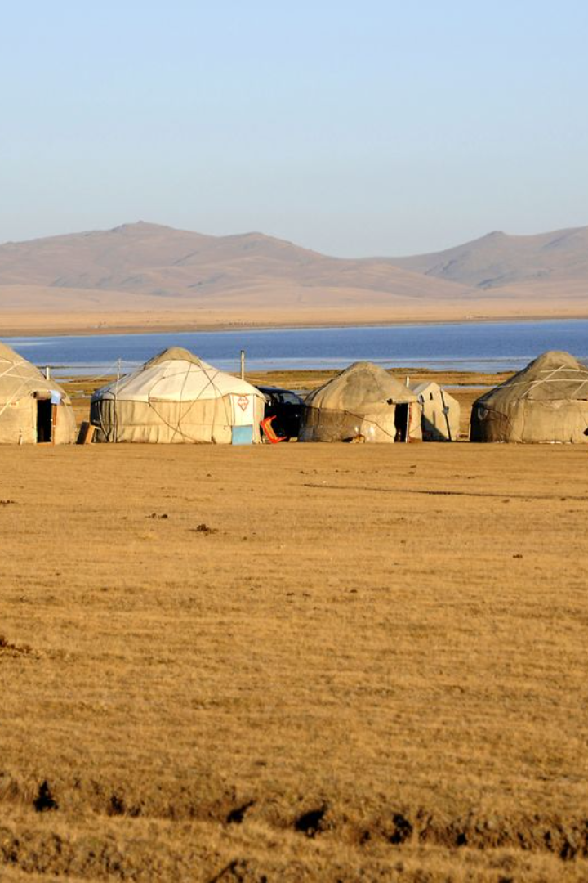
Nomadic Dwellings: Adaptation and Reuse
Adaptation to the environment: Nomadic groups often construct temporary homes using materials readily available in their surroundings, such as palm fronds, leaves, animal skins, and reeds.
Resourcefulness in motion (movement): Some cultures practice the reuse of materials, carrying them along during their travels to establish their dwellings wherever they move.

Slide 28
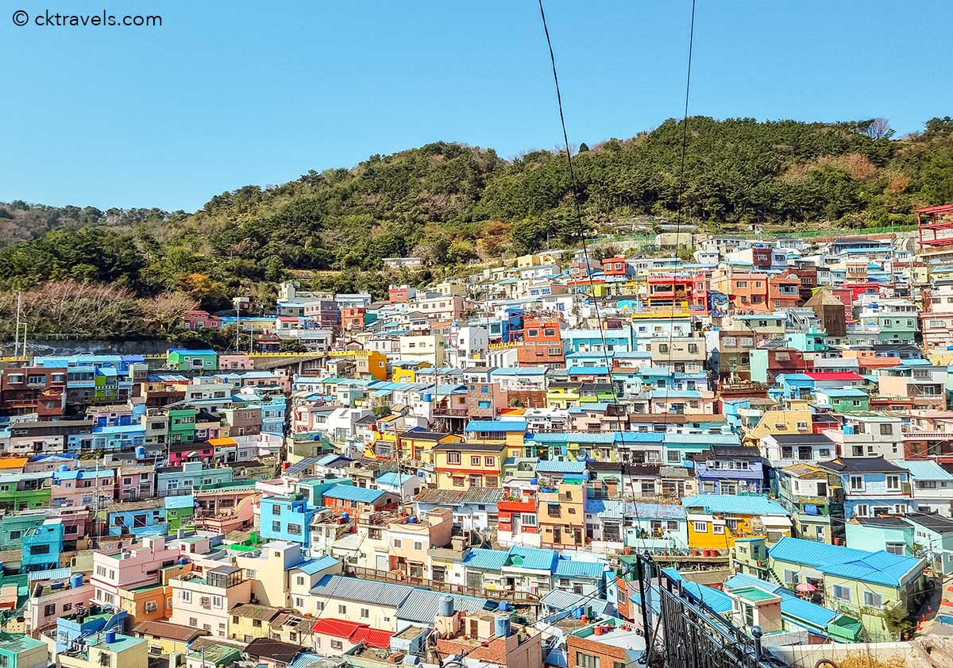
2-2- CULTURE : PERMANENT DWELLING
To meet the needs of a permanent dwelling, there is a set of properties that characterized the buildings, as a following required to construct them is a one-time cost.
Materials used will become heavier, more solid and more durable.
They may also become more complicated and more expensive, as the Permanent dwellings often offer a greater degree of protection and shelter from the elements.
In some cases, however, where dwellings are subjected to severe weather conditions such as frequent flooding or high winds.
Dwellings' architecture come to reflect a very specific geographical locale

Slide 29
3- ENVIRONMENT, CONSTRUCTION ELEMENTS AND MATERIALS
Areas abundant in trees typically develop a wooden vernacular, whereas regions lacking timber may resort to mud or stone.
The local environment heavily influences the construction materials utilized in a region.
In the Far East, timber is a prevalent building material, providing a distinct aesthetic to vernacular architecture.
It is common to use bamboo in tropical climates as it is both versatile (different type) and readily available.
Key building materials that have significantly shaped the form of vernacular buildings include clay, stone, and various local woods.

Slide 30
Material to Give Added Strength
Adobe - (mud brick)- are made of earth with a fairly high clay content and straw.)
Badgirs (wind catchers)- a type of chimney used to provide natural ventilation, commonly found in Iran, Iraq and other parts of the Middle-East
Cob - a type of plaster made from subsoil with the addition of fibrous
Mashrabiya - (also known as shanashol in Iraq) - a type of oriel window with timber lattice-work, designed to allow ventilation, commonly found in Iraq and Egypt in upper-class homes.
Mud bricks - sand mixed with water and vegetable matter such as straw.
Rammed earth often used in foundations
Thatch - dry vegetation used as roofing material
Wychert (witchert)- a blend of white earth and clay

Slide 31
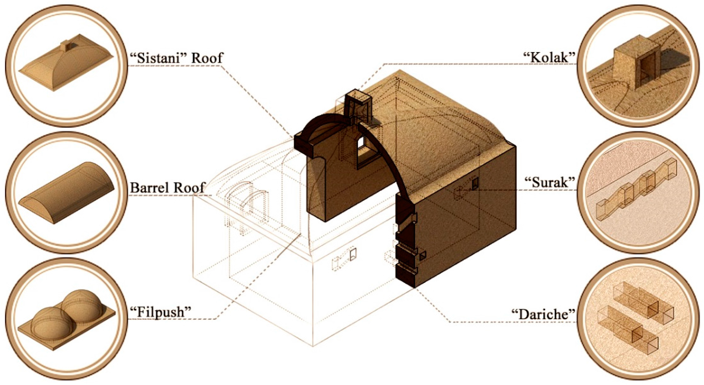
Roof Construction Techniques in Vernacular Architecture
Flat roofs: The simplest with timber beams resting
on the two walls at the end. They are usually seen
in regions where precipitation is very low.
Conical roofs: Constructed in areas exposed to rains, conical roofs may be constructed to radial poles raised on a cylindrical wall structure.
Pitched roofs: The most popular form of vernacular roof is the pitched roof sloping on two sides with gables at each end.

Slide 32
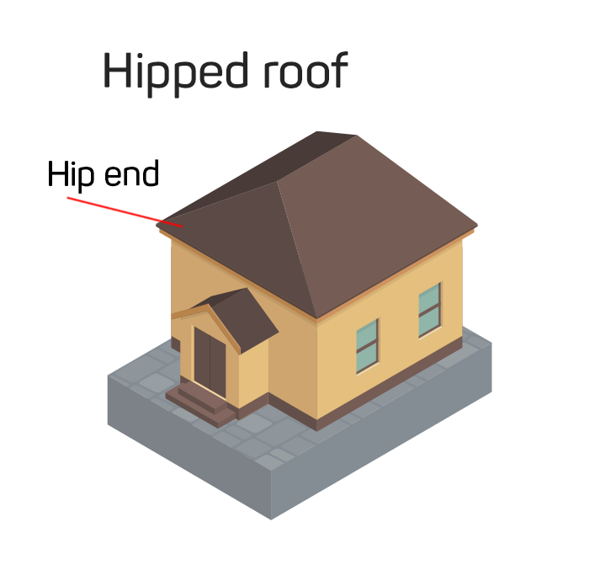
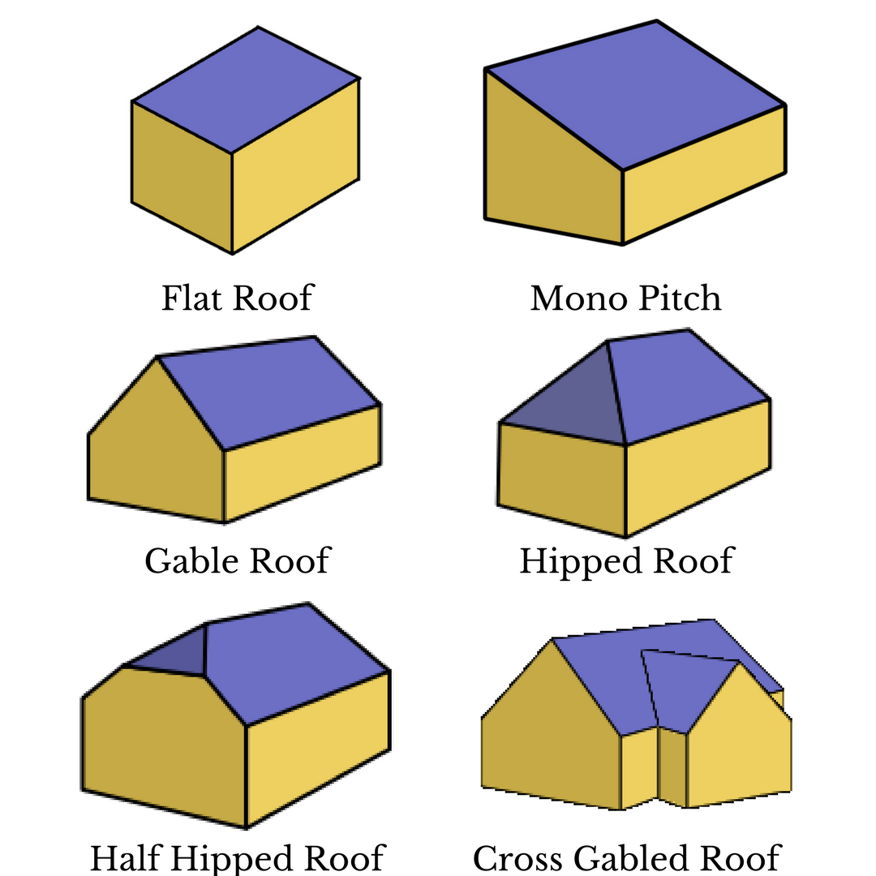
From Rain and Sun
Pitched roofs are found where wood is plentiful
Pitched roofs sometimes have large overhangs to protect the wall
Hipped roofs are popular in courtyards and with rectangular building plans. Hipped roof allows all the walls of the building to be built to the same height before the construction of roof framework without the necessity of shaping a gable and wall.
Vault roofing (dome or arched) is also popular in the middle eastern countries where it is hot and dry

Slide 33
Floors Construction Techniques in Vernacular Architecture
Compaction for Durability: Floors are made with compacted, stable materials for longevity.
Moisture Prevention: Waterproofing is applied to protect against moisture.
Practical Design: Focus on ease of cleaning and practical usage.
Natural Finish: Floors often have a natural finish using dung, water, and clay.
Activity-Specific Design: Floor designs cater to human and animal activities.
Soil Removal: Top soil layer is often removed for ground floor treatments.
Rural Practices: Rural floors frequently use dung and clay plastering.
Aesthetic and Thermal Aspects: Considerations include look and temperature regulation.
Composition: Floors typically consist of earth or mud, smoothed with a plaster top layer.

Slide 34
References
Barstow, D., & Bassett, T. J. (1986). Coober Pedy: Underground opal town. Rigby Publishers. (Specific look at Coober Pedy, Australia, and its dugout dwellings)
Beck, H., & Cooper, J. (2014). Underground dwellings and storage in Cappadocia, Turkey. Left Coast Press. (Focuses on the historical and contemporary use of underground spaces in Cappadocia)
Danby, M. (1989). The simple home: The beauty of the vernacular. Thames and Hudson. (Celebrates the beauty of vernacular homes, including many with courtyards)
Edwards, B., Sibley, M., Hakmi, M., & Land, P. (Eds.). (2006). Courtyard housing: Past, present, and future. Taylor & Francis.
Golany, G. (1988). Earth-sheltered dwellings in Tunisia: Ancient lessons for modern design. University of Delaware Press. (Examines traditional underground architecture in Tunisia)
Oliver, P. (Ed.). (1997). Encyclopedia of vernacular architecture of the world. Cambridge University Press.
Smith, J. (2010). Underground dwellings in ancient times. Journal of Vernacular Architecture, 25(1), 20-35.
Rapoport, A. (1969). House form and culture. Prentice-Hall. (A classic work examining the relationship between culture and house design, including courtyard houses)

