Slide 1
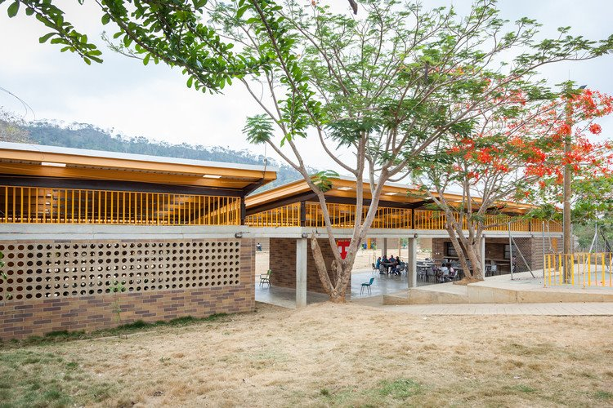
Tishk International University (TIU) Vernacular architecture
Vernacular Architecture
Lecturer : Darbaz Pirot
2023-2024
Lecture 4: Introduction to Vernacular Architecture

Slide 2
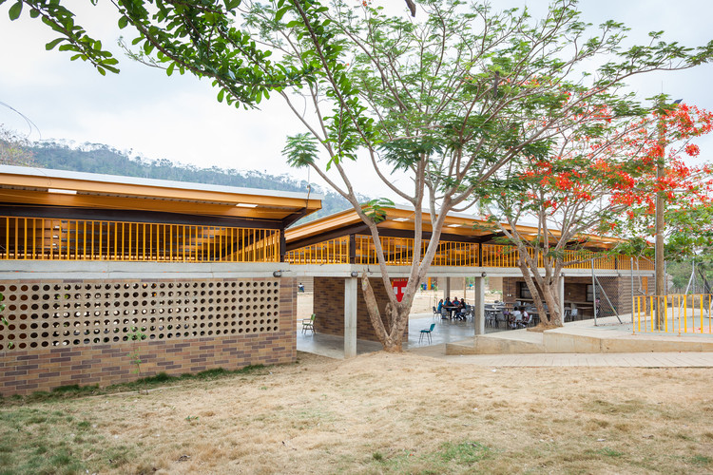
Outlines
Vernacular architecture in hot and arid climatic zone
Vernacular Architecture of Mediterranean House
Vernacular Architecture of Underground House
Vernacular Architecture of Courtyard Houses
Conclusion

Slide 3
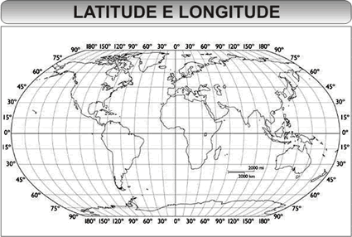
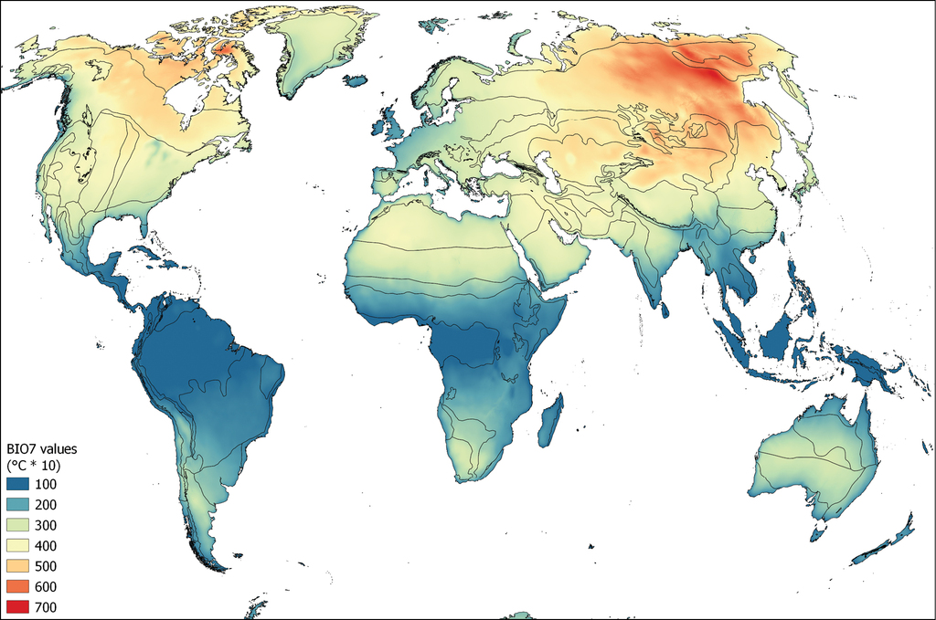
Vernacular Architecture according to Hot and dry climatic zones.
In order to understand all the design features of the vernacular architecture in this climate zone, we must know the climatic features of that region.
Hot and dry climatic zones generally occur at a latitude between 15 degrees to 30 degrees on both the hemispheres, The general characteristics of this climate are as follows:
Hot dry weather in summer and cold in winter, High temperature difference between night and day, Very little rainfall,
Very low humidity, Sandy or rocky ground with very low vegetation cover, Hot winds & frequent dust storms
High summer daytime temperatures, High solar radiation
Clear sky most of the year

Slide 4
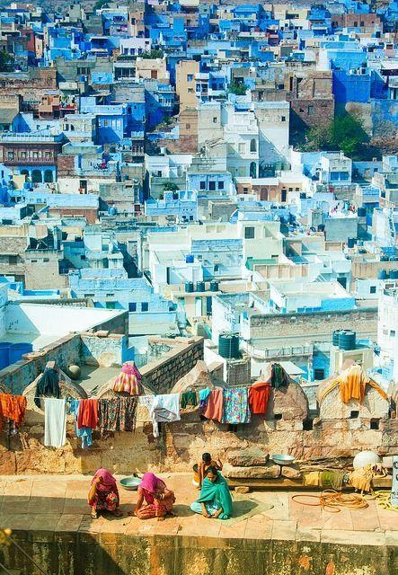
Elements of Vernacular Architecture
Main Objective: The main objective of the building design in this climate zone is to protect the structure from weather conditions with an aim to provide comfortable living conditions.
1. Mediterranean House: The Mediterranean house is the typical building found all around the Mediterranean sea, like in Greece, South Italy, Spain, and South France.
The climate in this region is so hot and dry, and the vegetation consists of little shrubs, so wood is not a good material to build.

Slide 5
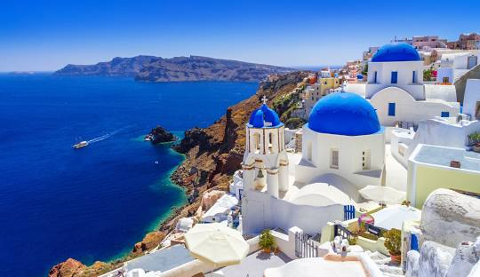
One of the most prominent Mediterranean cities that have distinguished vernacular architecture is Santorini island in Greece
The main approach for the Santorini building designs came from the ancient Greek philosophers “the very essence of nature are four key elements in various configurations & interactions” :
Fire (e.g. the sunlight or volcanoes)
Earth (e.g. the soil and most materials)
Air (e.g. the wind or oxygen)
Water (e.g. the sea or rain)
The philosophical aspects of these four elements were utilized as a systematic tool to look at architecture in relation to nature.

Slide 6
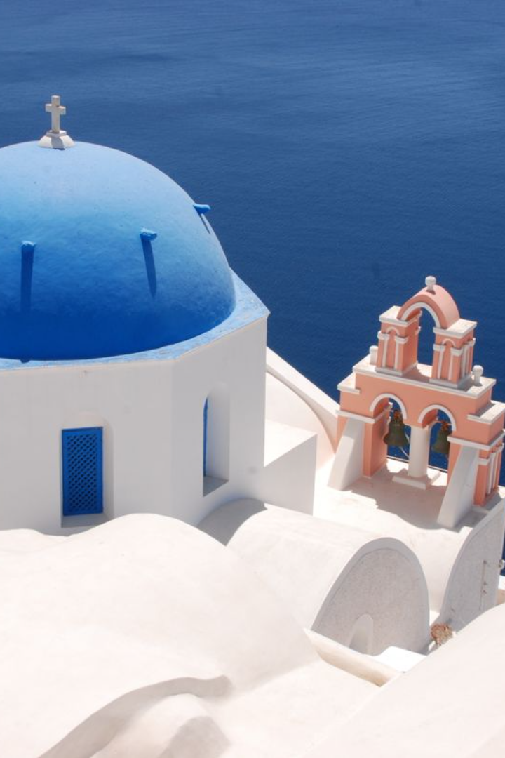
The buildings of Santorini resample those in the rest of Cycladic islands
Solid volumes,
Thick masonry walls with small openings,
Made in raw earth bricks,
burnt brick,
Stone or Rock,
The whitewashed plaster skin covering almost everything with an integrative power.
50 cm - 100 cm thick walls accordingly to the construction materials.

Slide 7
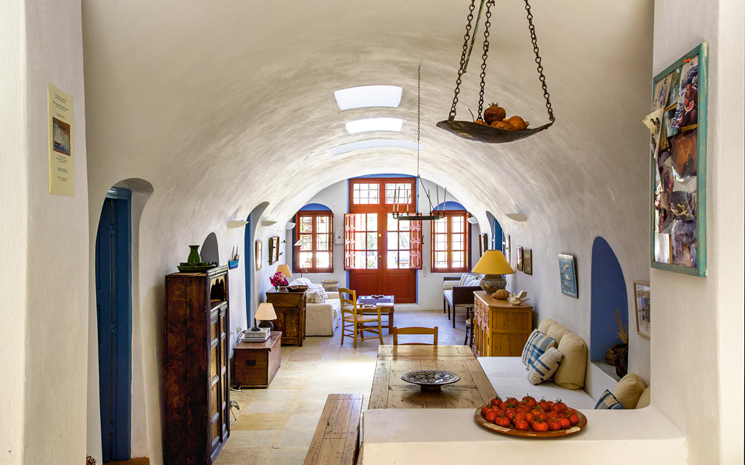
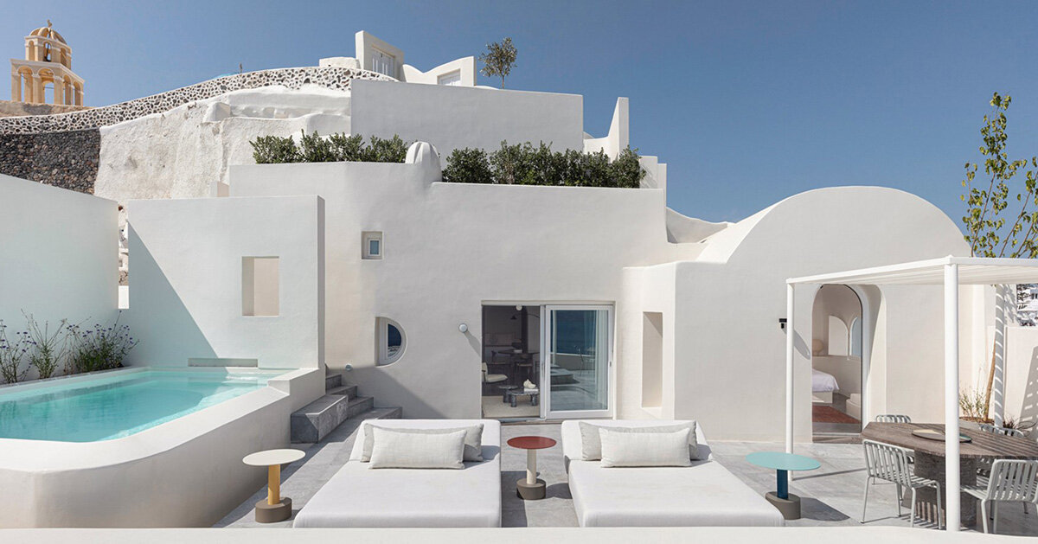
how urban and building forms have naturally developed?
Over time in response to specific climatic conditions and the use of local resources, while also reflecting the social changes in the region.
This evolution has resulted in unique architectural styles that blend function and aesthetics, addressing the climatic challenges of hot and dry zones. The architecture stands as a symbol of the creativity and resilience of the communities living in these areas.

Slide 8
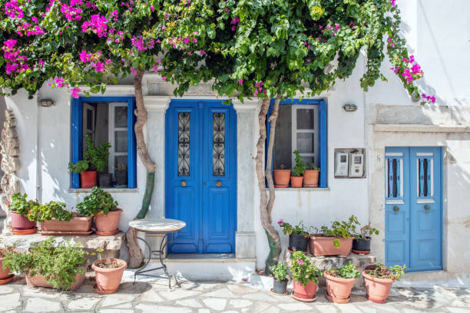
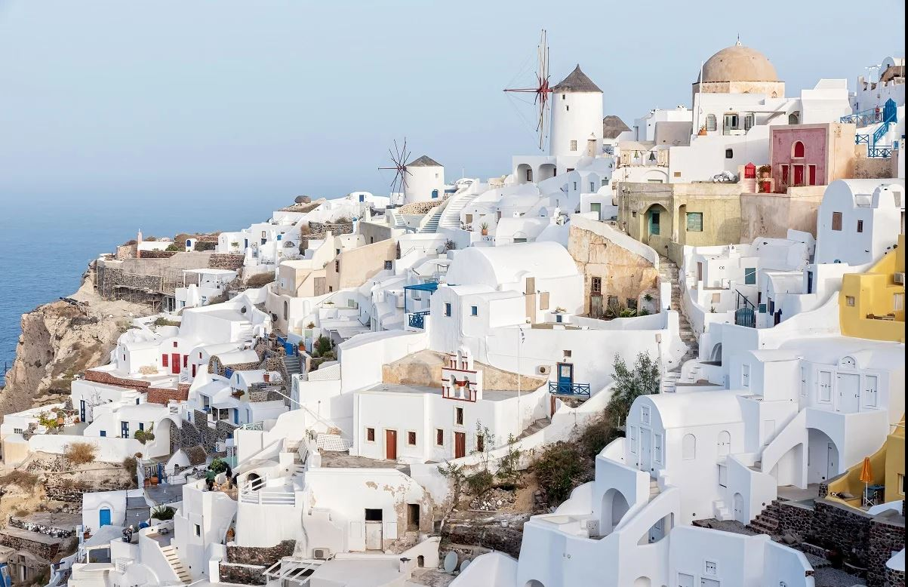
Specifications for Doors, Windows, and Roof Design
The doors and windows: windows, stairs, and spaces is focused on using as little material and space as possible. So, you might see doors that are shorter than usual, stairs that are narrow and steep, and rooms that are small, both inside and outside. This approach is all about saving materials and space minimalism.
The roof shape and design: Roof characterized by light wood structure, more often in bricks and lime. There isn’t roof projection, but often there are stairs outside to reach the flat terraced roof.

Slide 9
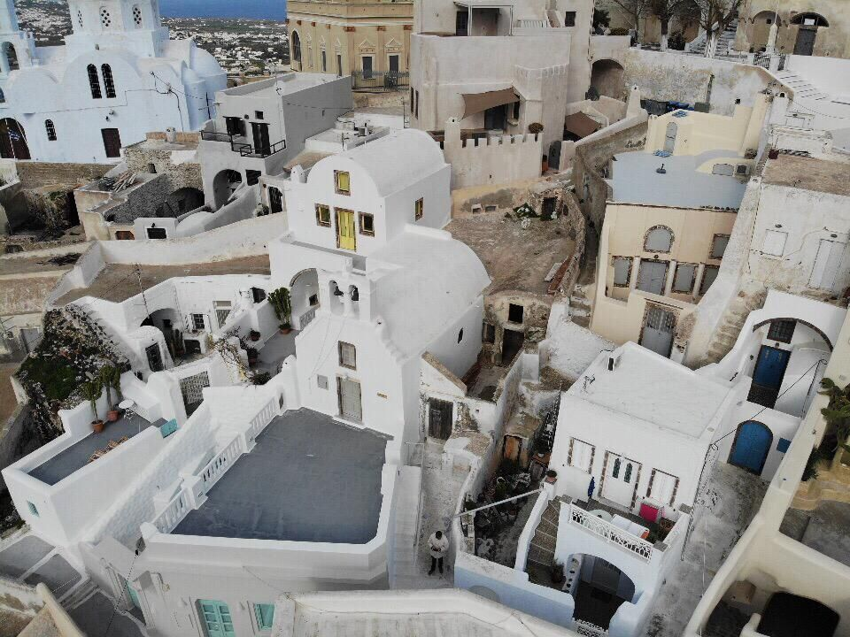
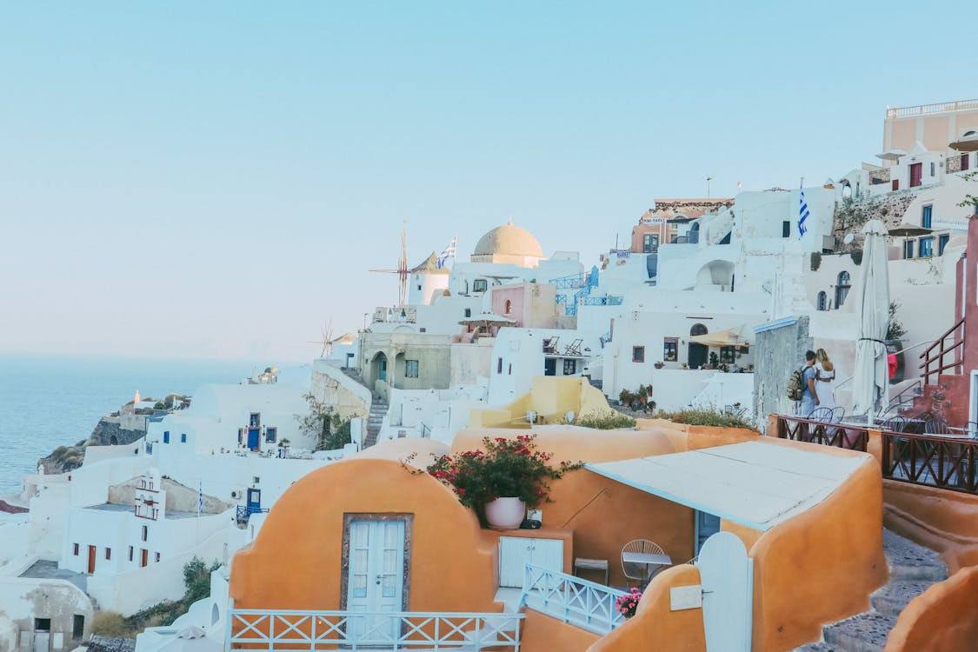
Nature's Influence on Architectural Design
Nature is the chief designer of that architectural style, imposing its whims on the local builders, i.e. the dwellers themselves in most cases.
Climate, earthquakes, materials scarcity, and topography had been the primary design parameters, and were respected with integrity.
Tradition resulting from long experience was dictating the building specifications from layout to decoration.

Slide 10
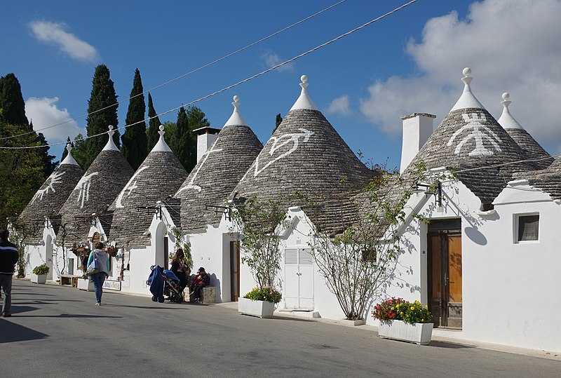
Mediterranean house: Trulli, south Italy
These structures, dating from as early as the mid-14th century, characteristically feature pyramidal, domed or conical roofs built up of corbelled limestone slabs.

Slide 11
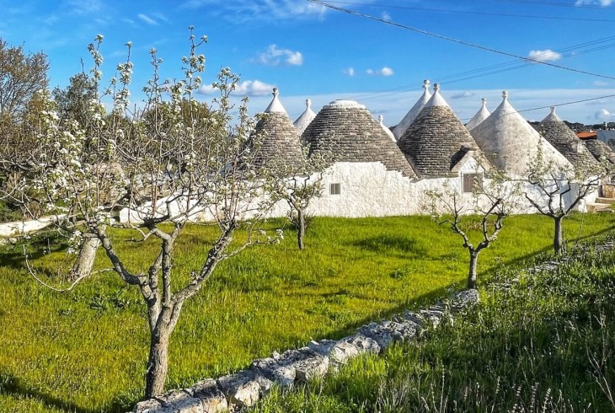
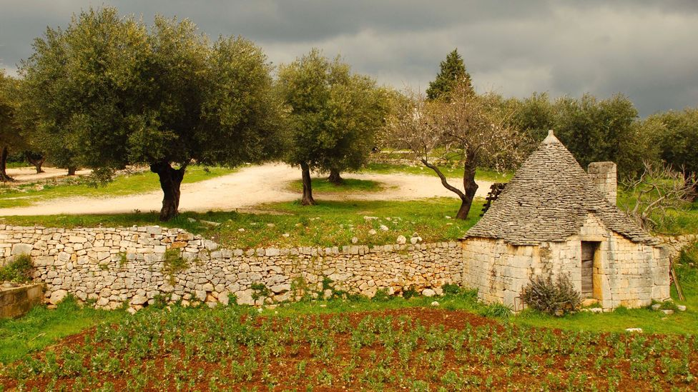
Trulli were generally constructed as temporary field shelters and storehouses or as permanent dwellings by small-scale landowners or agricultural laborers(worker)
After a while the Trulli became permanent residential buildings and recently they are built using new technologies as bricks and concrete.

Slide 12
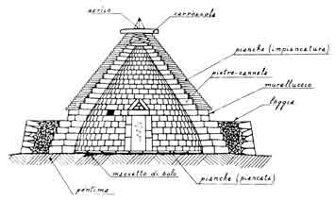
“Walls”​
The whitewashed walls of the Trulli are built directly onto limestone using a dry-stone wall technique (that is, without use of mortar or cement).
The walls comprise a double skin with a rubble core.

Slide 13
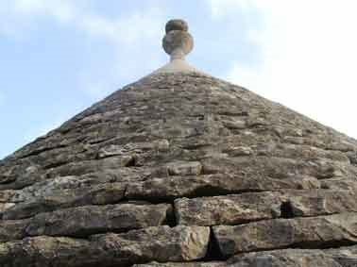
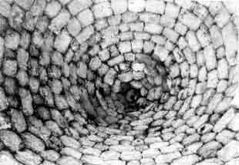
“Roof”
The roof can be referred to as a false-dome, characterized by its lightness and a thickness that decreases from the base to the top, usually ending in a sphere.
The roofs have two layers: an inner dome of wedge-shaped stones topped with a capstone, and an outer waterproof cone of overlapping limestone slabs called chianche or chiancarelle.
Additionally, the roofs of buildings often have symbols related to myths or religion drawn with white ash and end with a special decorative point. This design is meant to protect the building from bad influences or luck.

Slide 14
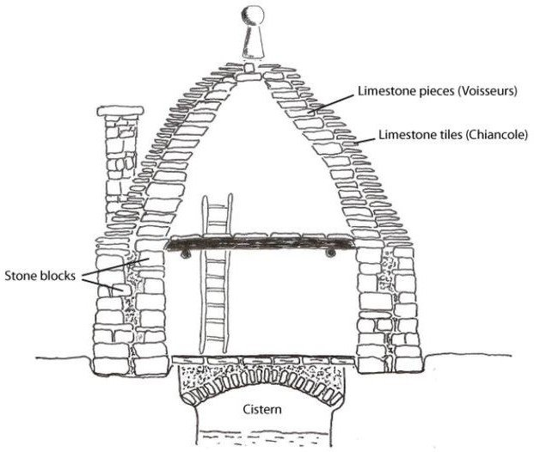
“Cistern”
Water is gathered by the extended edges of the roof, which direct the water into a special pathway on the slab leading to a storage tank under the house.

Slide 15
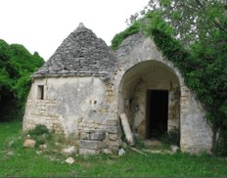
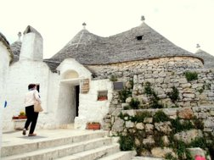
“Doorways and windows”
The walls have a door and a few small windows. Inside, there's a fireplace and built-in shelves in the thick walls.

Slide 16
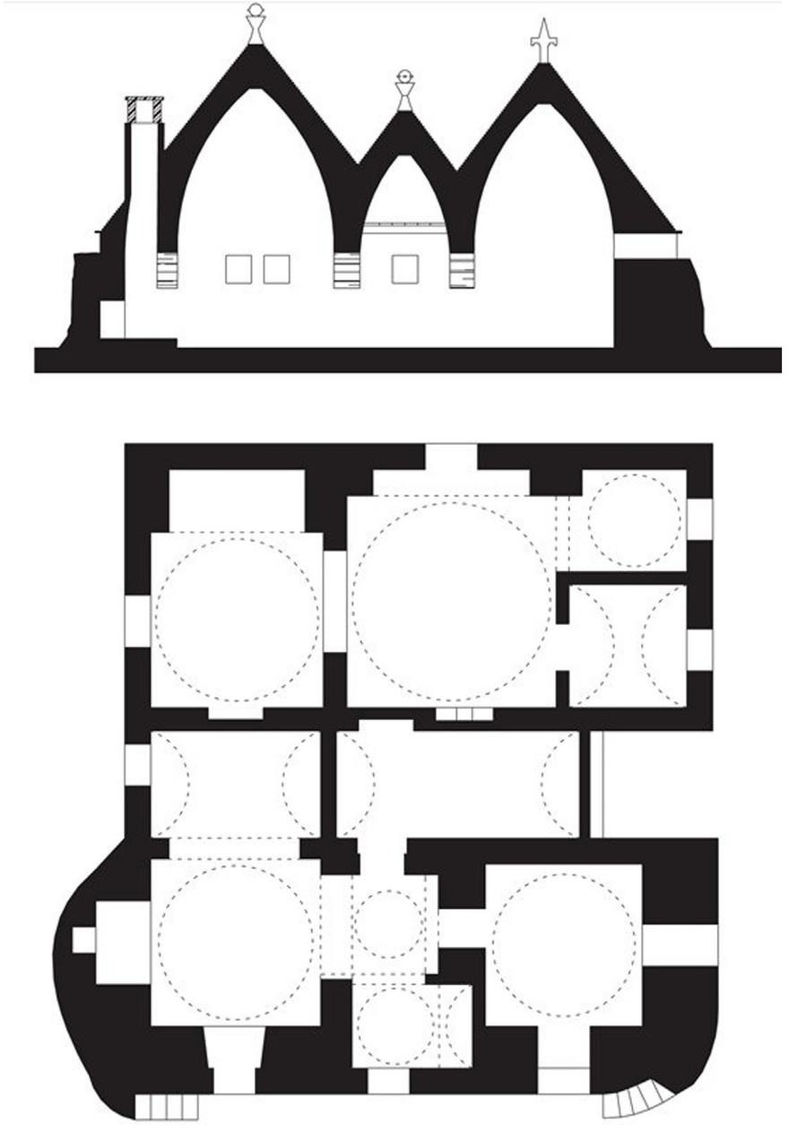
Trulli Shape Design
The plan is compact and almost square-shaped, while the roofs are cone-shaped.
The entire shape of the TRULLI is a mix between a cube and a cone. The roof is domed, and usually, there is a sphere.
The central space is the living room, and the service spaces are placed around it in smaller rooms. The interior is really dark because the only opening is the entrance door. An internal fireplace and alcoves are recessed into the thick walls.

Slide 17
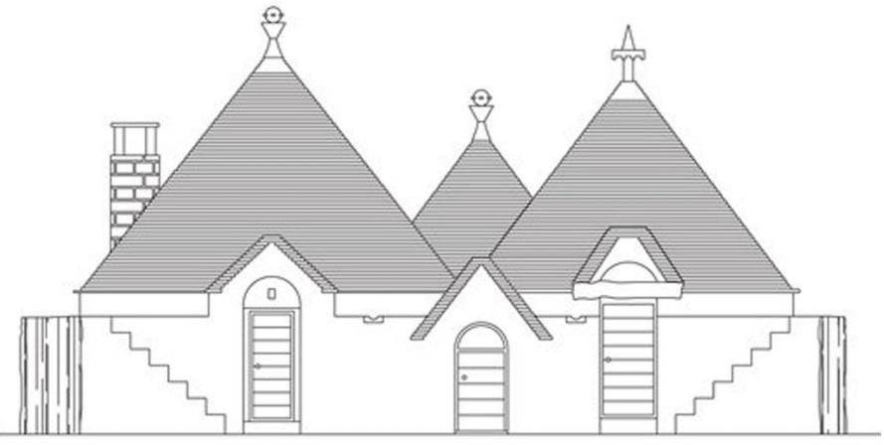
Trulli Shape Design
Trulli houses have a special design that combines shapes to look unique and attractive.
They have a neat(tidy), square layout and pointy roofs that make them stand out.
Inside, there's a main room with smaller rooms around it, making it feel comfortable and private.
The inside is a bit dark because there's only one door for light, which makes these houses intriguing.
They also have a fireplace and built-in shelves in the thick walls, showing how smart and useful their design is.

Slide 18
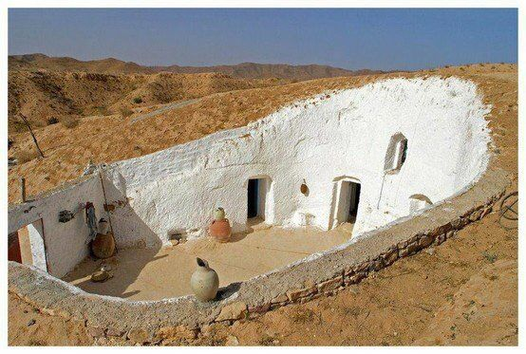
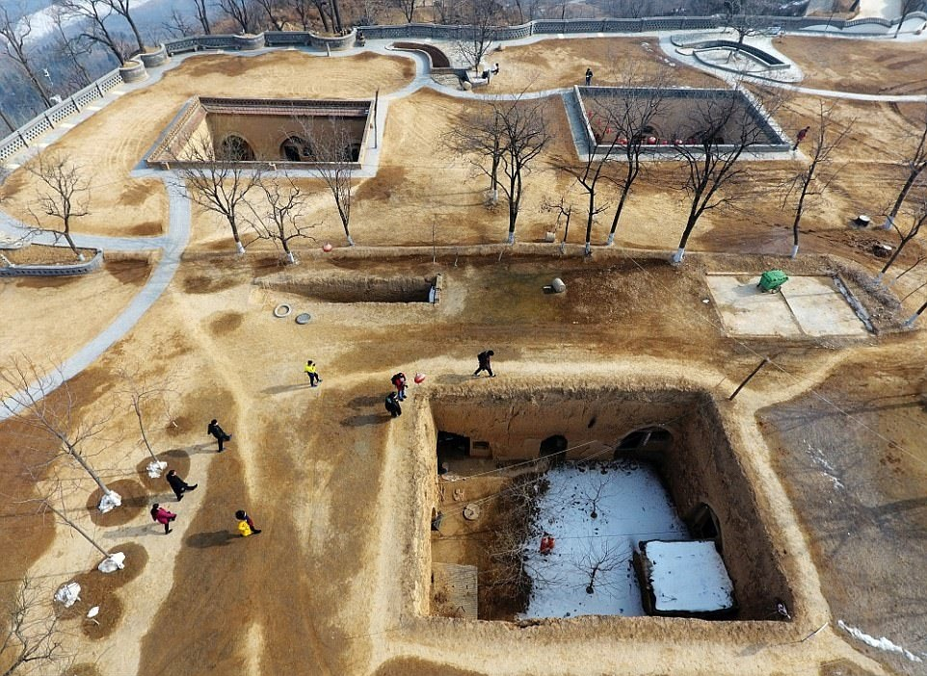
Underground architecture
The underground constructions are typical of the dry hot climate and they use the soil constant temperature to have a better indoor comfort.
The most famous underground settlements in the Mediterranean area are: Cappadocia and Hassankevi in Turkey, Matmata in Tunisia, and the typical Italian and Spanish underground settlements.
This architecture was born not only to answer climate features, but also for social reasons and defense necessities.

Slide 19
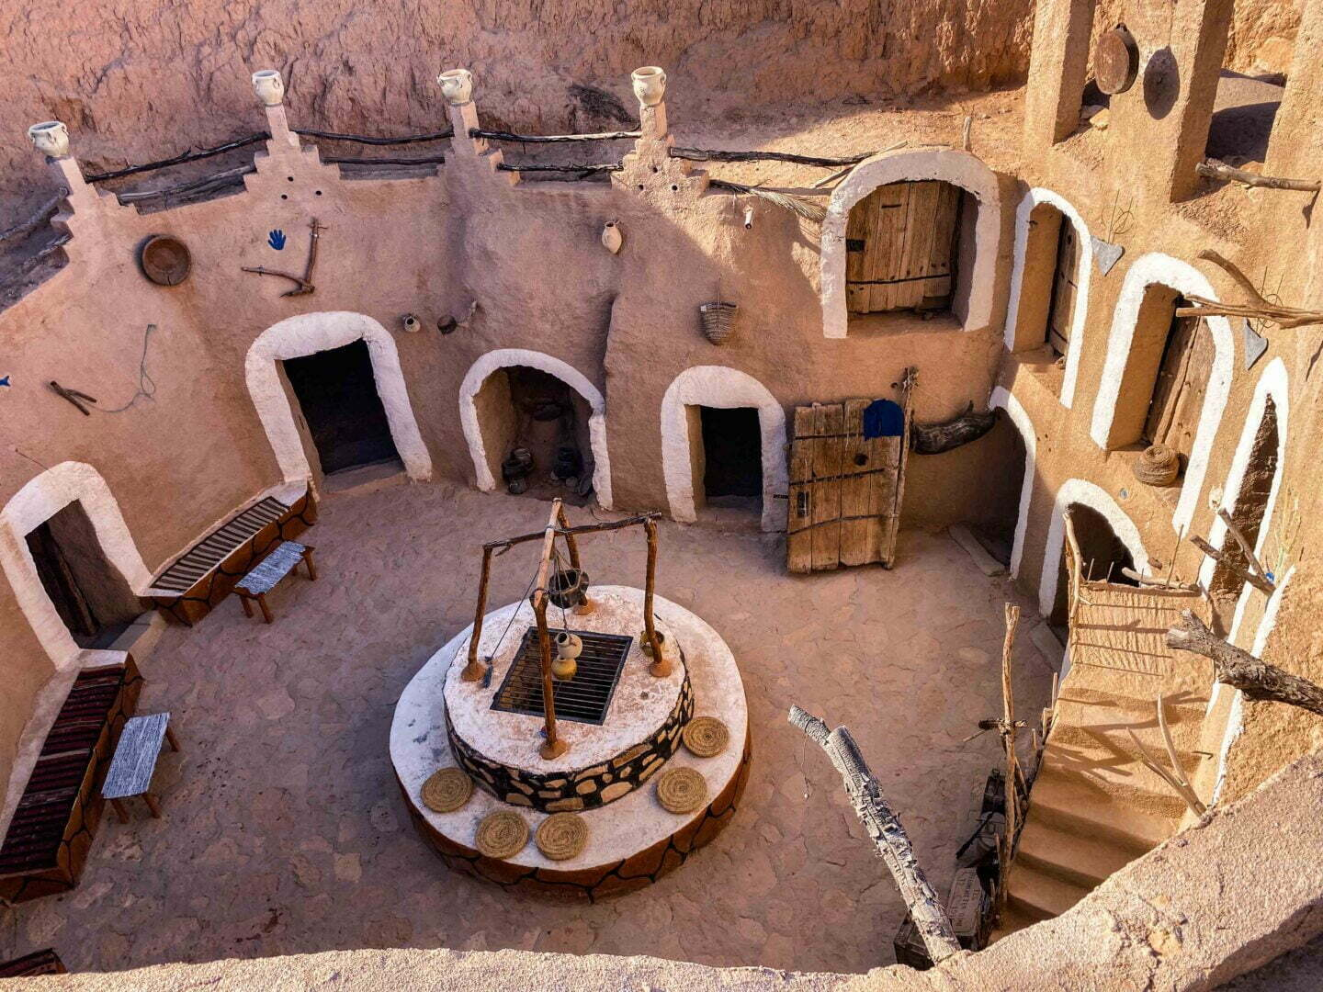
Underground architecture: Matmata in Tunisia
As Matmata is an arid region with harsh climatic conditions, and temperatures regularly exceed 50 degrees in summer. It is also distinguished by the dusty and sandy desert winds.
Matmata's terrain is hilly and a small valleys between the limestone mountains contain deposits of loess (the accumulation of wind-blown silt), almost 20 meters deep.

Slide 20
Underground architecture: Matmata in Tunisia
Matmata Troglodytes are unique underground homes designed to reduce extreme climates, benefiting from the soil's natural insulating properties.
These dwellings maintain consistent temperatures year-round, reflecting their builders' socio-cultural and economic backgrounds and environmental factors. They exemplify innovative underground architecture for comfortable living in harsh climates.

Slide 21
Underground architecture: Matmata in Tunisia​
The Matmata dwellings --- Why do cave houses (troglodytes) ?
-The Matmata Troglodyte is a very common type of the various types of subterranean dwellings these dwellings were the inhabitants approach to escape the harsh climatic conditions, and their abundance was due to the favorable soil conditions.
The thermal behavior
-The troglodytes are isothermal; their temperatures are warm in winter and cool in summer, and stay relatively constant year round, as earth as a building material stabilizes the extreme temperature swings, both daily and seasonally.
The shape, size
-In spite of the shape, size, and other design details of a sunken courtyard dwelling vary between regions and even among households in the same region depending on the socio-cultural background, financial standard, and environmental features such as soil type, climatic pattern, and hydrological System However, the overall basic design remains similar.

Slide 22
Underground architecture: Matmata in Tunisia
Building materials such as stone and gypsum are available from the ambient environment. As a binding agent, composed of clay with enough gypsum was used.
These types of materials also were used for the finishing coats of the internal walls and some of the fixed furniture (beds and storage cabinets). While olive trees, which are widely planted in Matmata, are used for doors and some simple furniture. It is also used for supporting the roof of rooms and subterranean entrance tunnel.

Slide 23
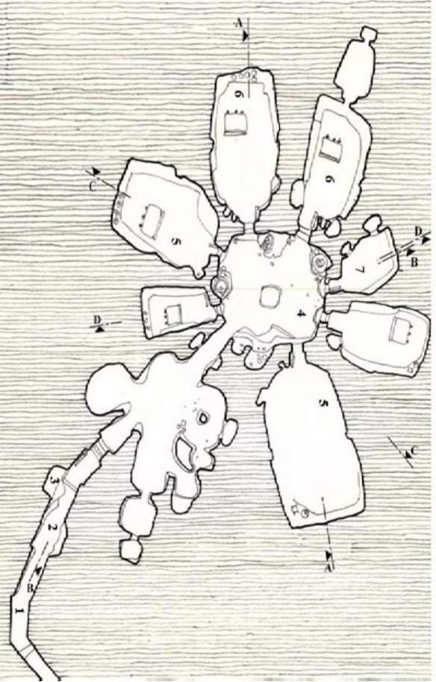
The Dwellings Layout
Any house in Matmata has a number of rooms around the courtyard that varies depending on the size of the family and its way of living, which may dictate a certain number of storage and utility rooms.
There are also granary rooms(storehouse), which are high rooms excavated at a height of 2.5 to 4 meters from the ground of the courtyard.

Slide 24
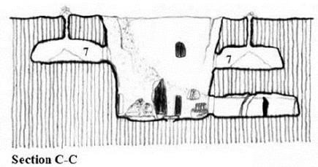
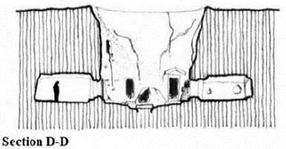
Room design
In the context of architectural design, room layout and design play a significant role in determining the flow of movement, natural light penetration, and overall user experience within a built environment.

Slide 25
Room design
Considering Architects and designers prioritize occupant needs and preferences, merging comfort, functionality, and aesthetics in room design.
This approach ensures spaces meet unique demands, enhancing life quality and well-being.
Room design combines artistry, ergonomics(Comfort design), and practicality for attracting interiors.

Slide 26
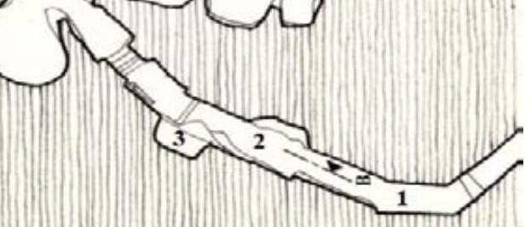
The entrance of the dwelling
After this curved entrance, there is a storage room for storing agricultural instruments and sometimes for sheltering sheep and goats.
The entrance to the dwelling leads to a storage area where agricultural tools are kept, and it also serves as a shelter for sheep and goats at times.

Slide 27
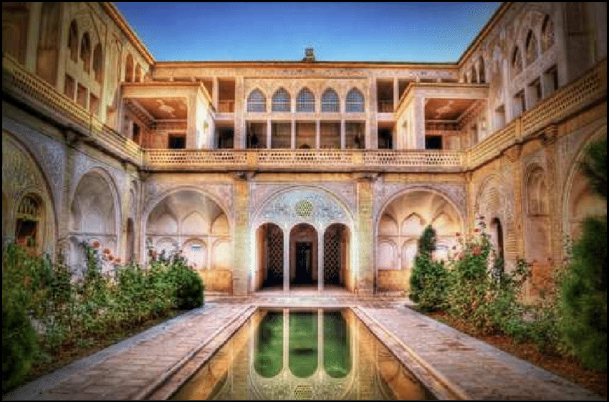
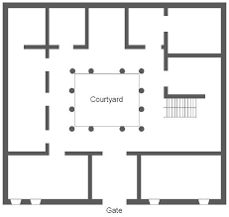
3- Courtyard vernacular houses
In most courtyard countries located in the hot dry region, the climate is so dry, the temperature range is so high, there's a strong solar radiation and the winds can transport huge amount of dust and sand.
Therefore, all the characteristics of this vernacular house was developed following tradition, culture, religion, climate answers. As well as following the principles of thermal control through the proper use of structure and materials, therefore, the vernacular techniques employed in these types of buildings are rarely costly in terms of materials or energy.

Slide 28
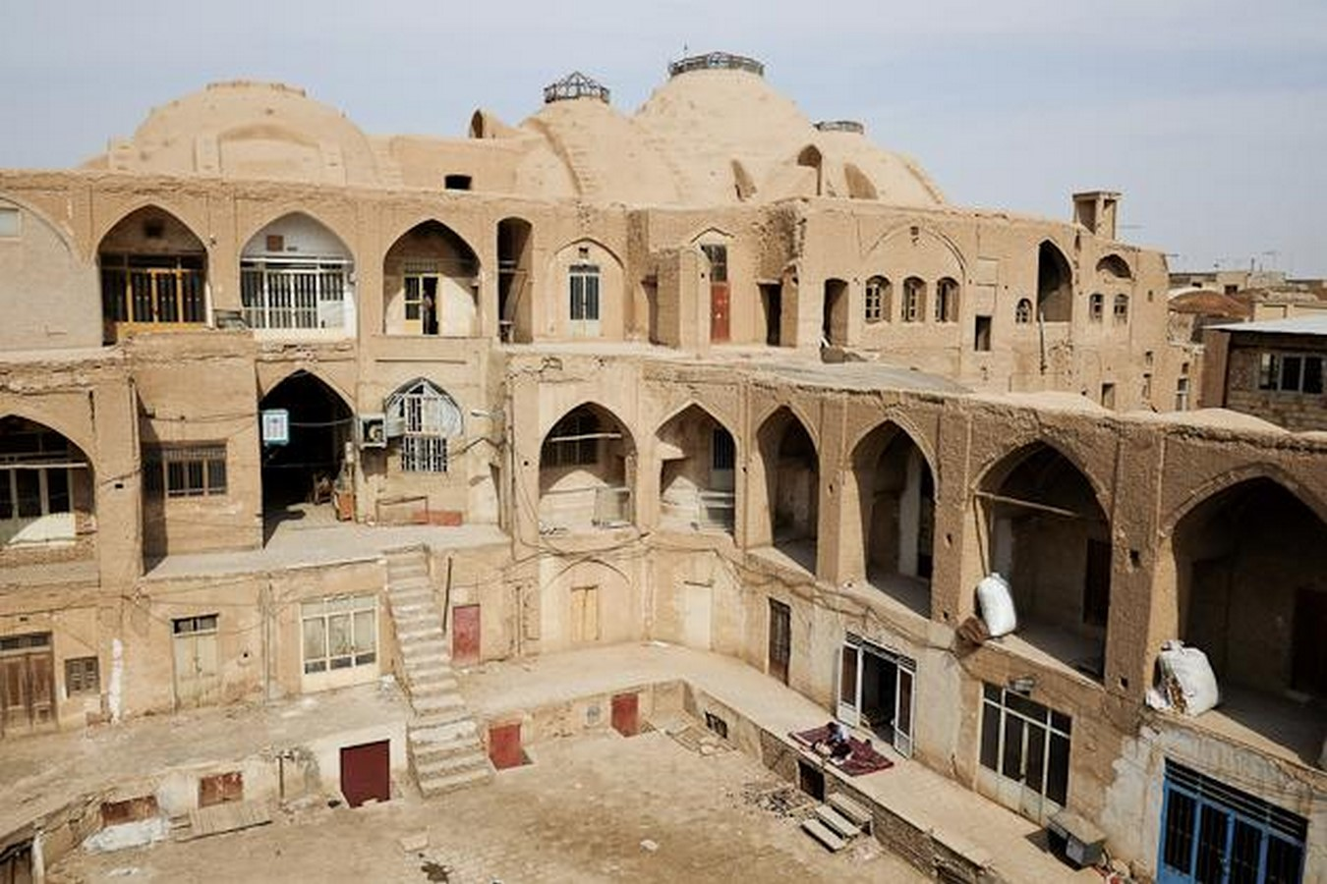
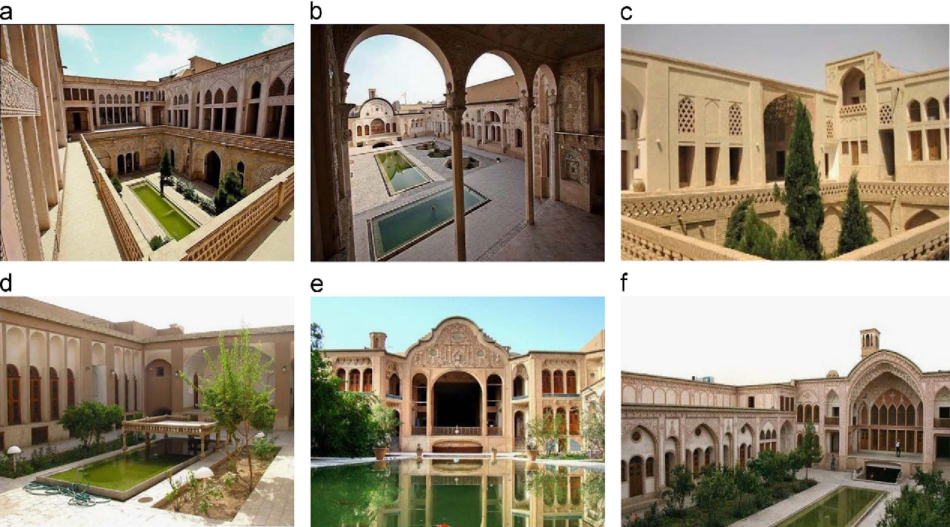
In regions with very hot climates, it's essential that the design of buildings and their materials are chosen to suit the surrounding environment.
This adaptation is important to make sure buildings can handle the problems caused by the hot, dry weather, like very high temperatures and lack of moisture.
It's very important to carefully design the structure and shape of houses so they fit well with the surrounding environment, especially in places with hot weather. This means thinking about how to deal with the challenges that come from being in a hot climate.
These adaptations are essential for creating living spaces that are comfortable and sustainable in the face of the severe climate conditions.

Slide 29
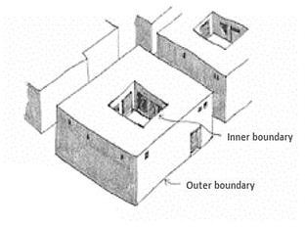
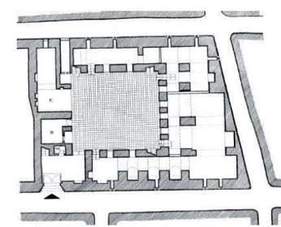
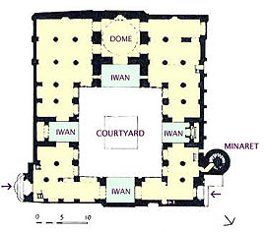
The courtyard houses layout
The whole design is focused around the central square-shaped courtyard: an empty space where all the rooms face to.
Around the courtyard often there are porches on one or more sides and one or more store.​
Then passageways and rooms were to be arranged around
the courtyard.
The irregular parts and undesirable angles were modified by changing the walls depth that may be used as shafts, service areas, cabinets, or fixed furniture.
Usually, there is a special space on one side of the courtyard called the Iwan, usually vaulted, walled on three sides, with one end entirely open.

Slide 30
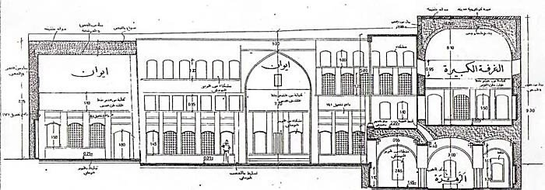
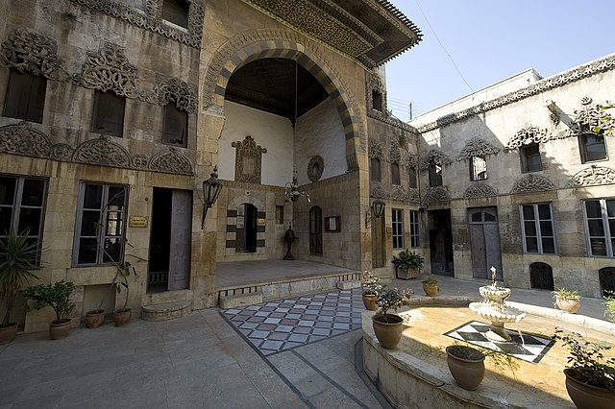
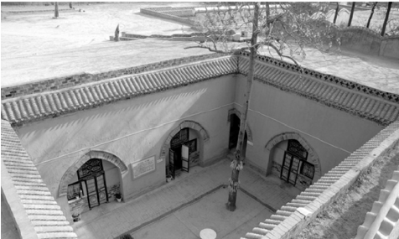
Philosophy of the Courtyard House
Courtyard vernacular house philosophy is based on achieving two aims:
Privacy and
Protection
These two aims influenced the house layout, spatial relations , and architectural details.
A central interior courtyard onto which all the rooms opened was restricted (limited)to family use.
Courtyard provided an adequate climatic and social solution;
it provided shading and privacy in an open space.
Most of daily facilities were located at the courtyard.

Slide 31
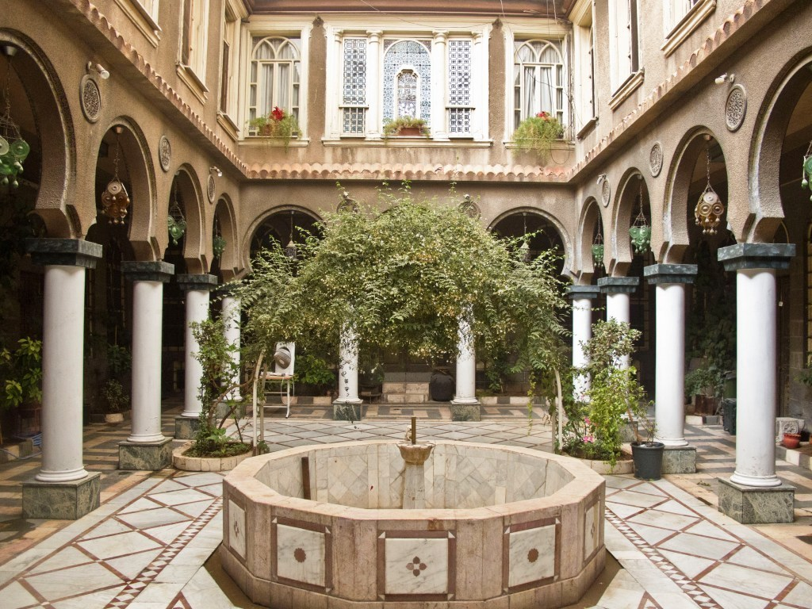
Building Envelope
The building envelope (shell) of a courtyard house forms an effective barrier against the worst extremes of the external climate. It provides a filtering which modifies the climate sufficiently conditions to be more acceptable.
The main function of the house envelope is to resist the transference of heat, reflecting sun rays as much as possible, and minimize the heat and solar gain to create cool conditions inside the house.

Slide 32
OVERVIEW OF DESIGN PRINCIPLES
Courtyard or Patio
White Colored walls (“cool” colours reduce heat reflection )
Arrangement of the houses in is very closely packed to each other.
Vegetation (reduces the temperature, filters the dust in and around the house, elevates the humidity
level)
Small openings
Double roof or white single roof
Thick walls
Big basin to collect rainwater
Louvered windows

Slide 33
Conclusion
Religious and social considerations: Factors that influenced the shape and layout of buildings in hot and dry regions.
Taking advantage of local materials and resources: Utilizing available resources like limestone in Trulli houses.
Providing a vital connection between humans and the environment: Designing buildings to harmonize with the natural surroundings.
Designed specially to be compatible with hot and dry region conditions: Architectural designs tailored(fitted) to suit the climate.
Thick walls with small openings: Construction features adapted to the climate.
Reducing the exterior surface area exposed to direct solar radiation: Using compact urban fabric or underground houses to minimize solar exposure.

Slide 34
References
Barstow, D., & Bassett, T. J. (1986). Coober Pedy: Underground opal town. Rigby Publishers. (Specific look at Coober Pedy, Australia, and its dugout dwellings)
Beck, H., & Cooper, J. (2014). Underground dwellings and storage in Cappadocia, Turkey. Left Coast Press. (Focuses on the historical and contemporary use of underground spaces in Cappadocia)
Danby, M. (1989). The simple home: The beauty of the vernacular. Thames and Hudson. (Celebrates the beauty of vernacular homes, including many with courtyards)
Edwards, B., Sibley, M., Hakmi, M., & Land, P. (Eds.). (2006). Courtyard housing: Past, present, and future. Taylor & Francis.
Golany, G. (1988). Earth-sheltered dwellings in Tunisia: Ancient lessons for modern design. University of Delaware Press. (Examines traditional underground architecture in Tunisia)
Oliver, P. (Ed.). (1997). Encyclopedia of vernacular architecture of the world. Cambridge University Press.
Smith, J. (2010). Underground dwellings in ancient times. Journal of Vernacular Architecture, 25(1), 20-35.
Rapoport, A. (1969). House form and culture. Prentice-Hall. (A classic work examining the relationship between culture and house design, including courtyard houses)

