Slide 1


DESTILATION TOWER IN THE PETROLIUM INDUSTRY
Dr Hassan Hassoon ALDelfi
Semester 1
Week 8
Date

Slide 2
Outline
What is DESTILATION TOWER IN THE PETROLIUM INDUSTRY

Slide 3
Objectives
When completed this lecture, student is expected to:
1- Understand what is distillation colum in petroleum industry
2-The operation and how separation taking place for different components of oil products.

Slide 4
https://www.youtube.com/watch?v=OPXudQ0_q8g

Slide 5
DISTILATION TOWER
HEATED CRUDE OIL is pumped into distillation tower to reduce the raw crude oil into its products of hydrocarbons, the process of separation takes place as result of the crude oil fractions are having different boiling temperature as shown in the link bottom is of high temp. and as we go up the temperature is less as shown
fraction Pet. Gas
                Naphtha 70C
                Kerosine 120C
                reheater
                Diesel 220C
                Lube Oil 400C
                Fuel Oil 600C
                wax, asphalt, vitamin tab, soup………..
furnace
feed
reheater

Slide 6
https://www.youtube.com/watch?v=OPXudQ0_q8g

Slide 7
Input crude oil called feed
Output called fraction
Fractionators
Fractions
Overlaps
External reflux is referd to the returned fraction to the tower
Increase purity
reboiling

Slide 8
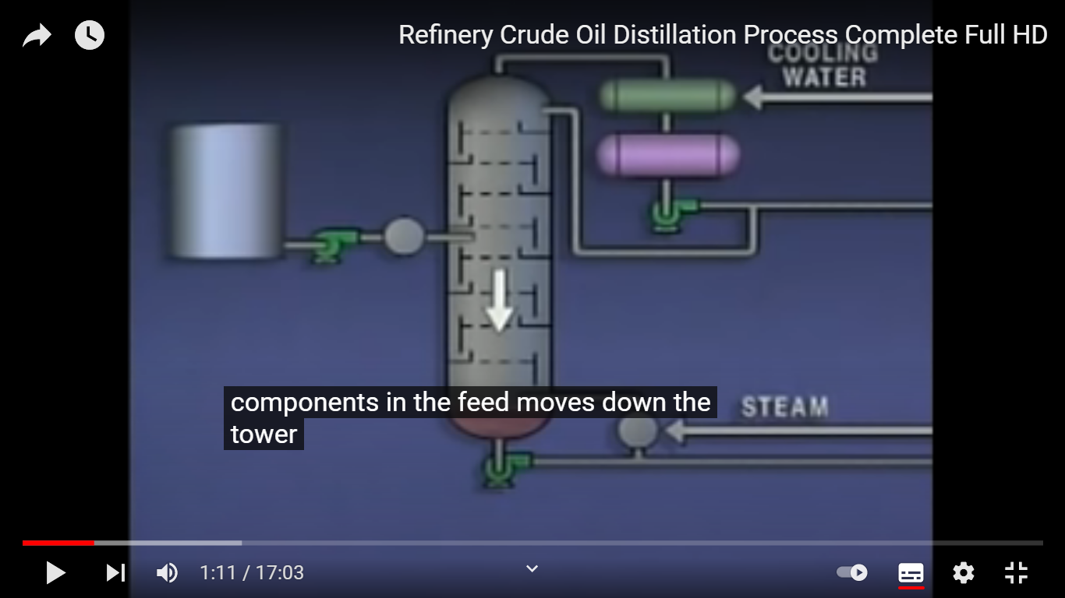

Slide 9
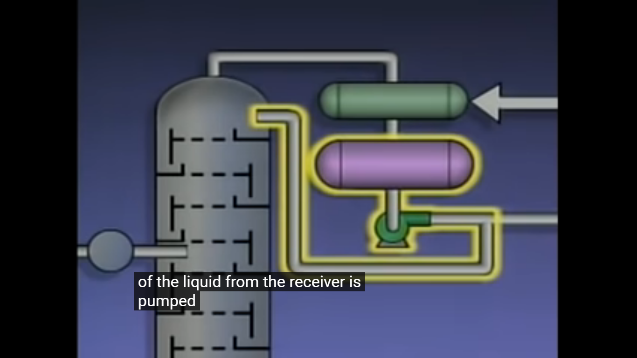
Temperature control
Pressure control gas release
Pressure differential between bottom and top of the tower.

Slide 10
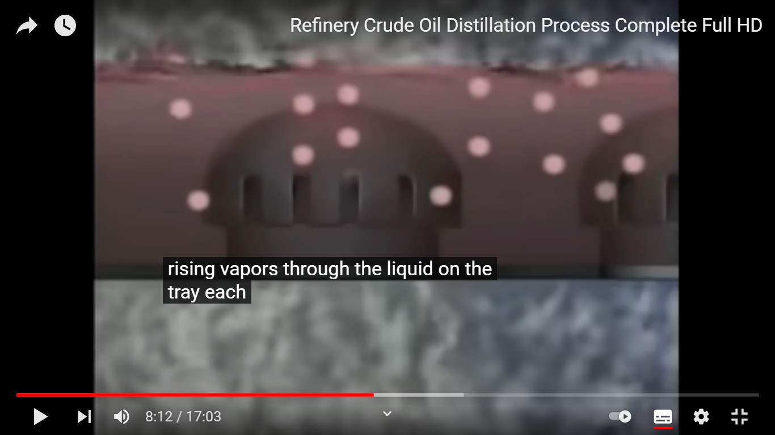

Slide 11
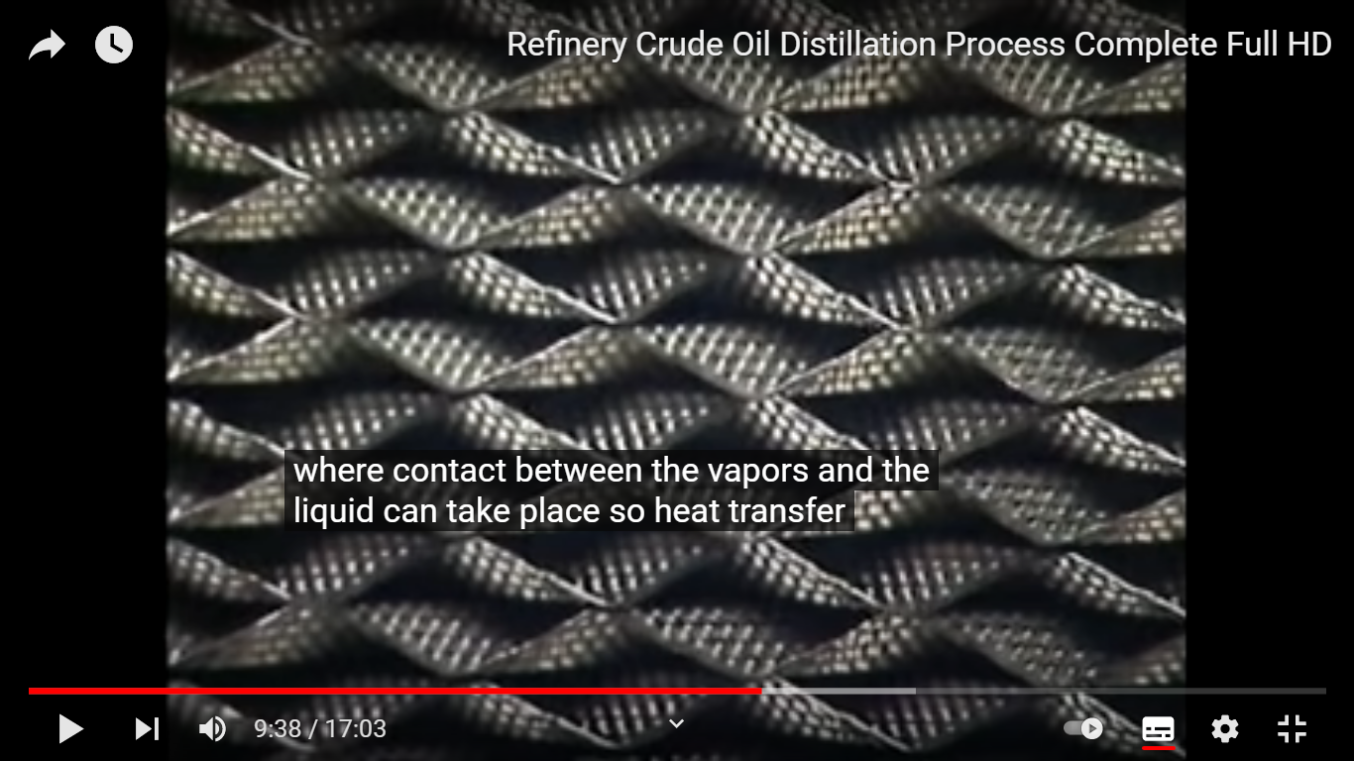

Slide 13
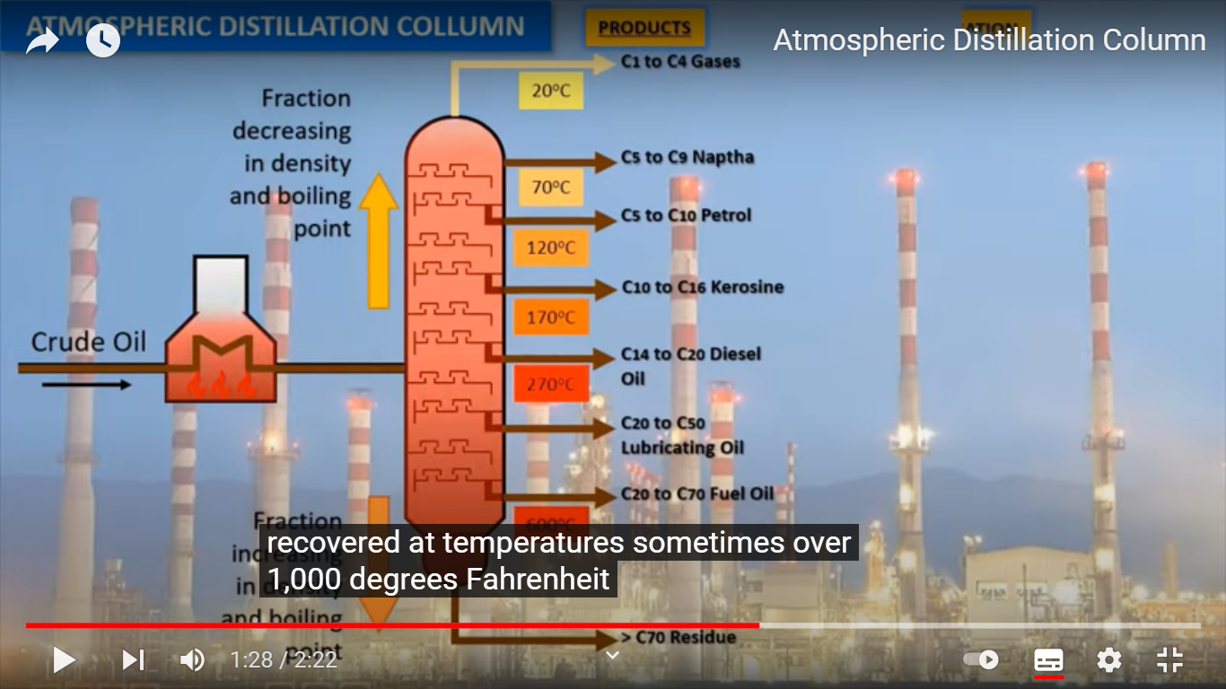

Slide 14
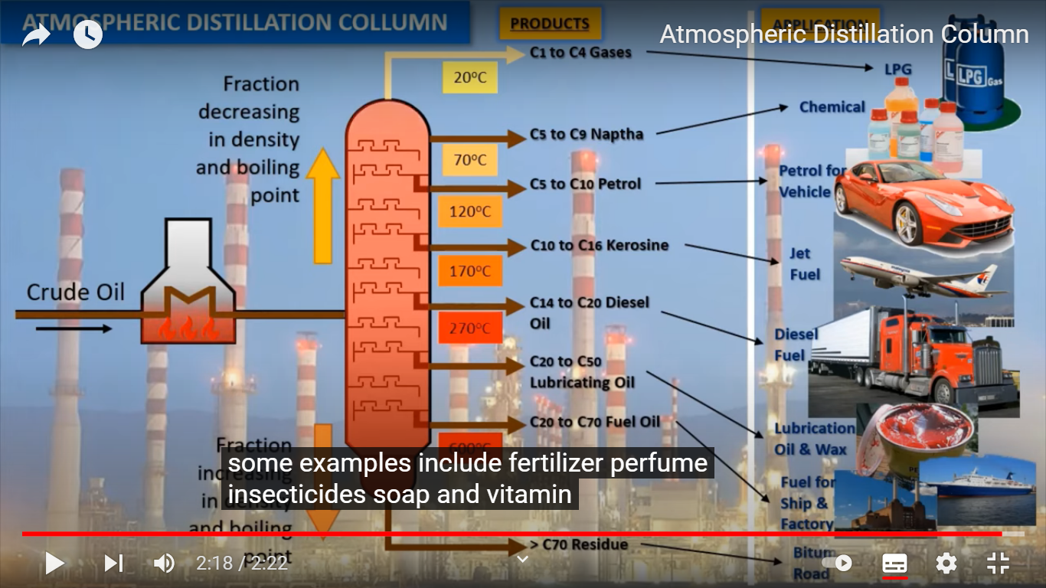

Slide 15
Oil reservoir and fire fighting scenario
https://www.youtube.com/watch?v=3RFDKpwdbEA
https://www.youtube.com/watch?v=cRl-nMzZjr4
https://www.youtube.com/watch?v=ZnLyD7sbhRk
https://www.youtube.com/watch?v=ZnLyD7sbhRk
https://www.youtube.com/watch?v=GqzMkNPioXM
Fire fighting scenario…….
https://www.youtube.com/watch?v=YpAqUYSdBOU

