Slide 1
Derivatives2
Name of teacher :Dr. Mazin R Khalil
Advanced Mathematics2 –ME212
Semester 4
Week 7
Date :23/4/2024

Slide 2
Objectives
To teach the students the derivatives of the most common functions

Slide 3
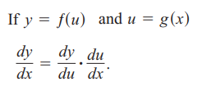

Slide 4
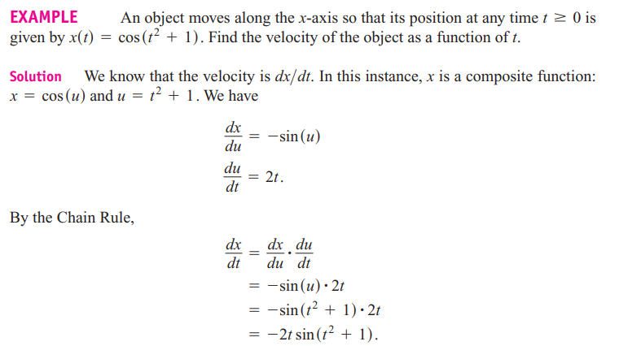

Slide 8
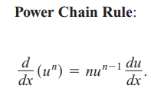
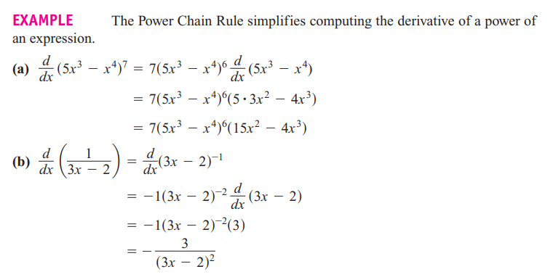

Slide 9
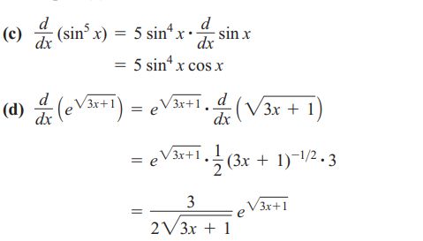

Slide 10
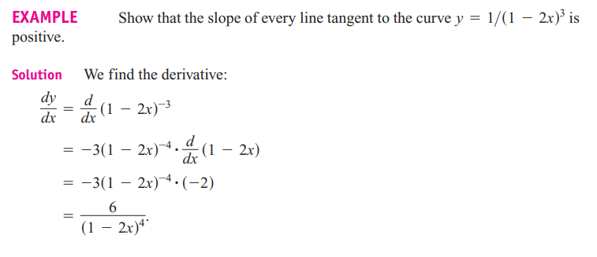

Slide 11
Implicit differentiation is used to differentiate functions like

Slide 12
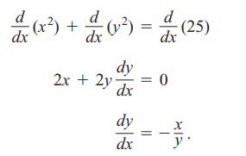

Slide 13
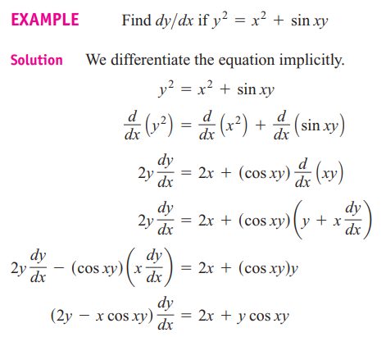

Slide 15
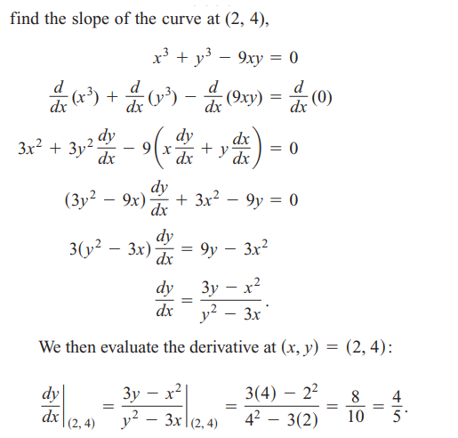
Example

Slide 16
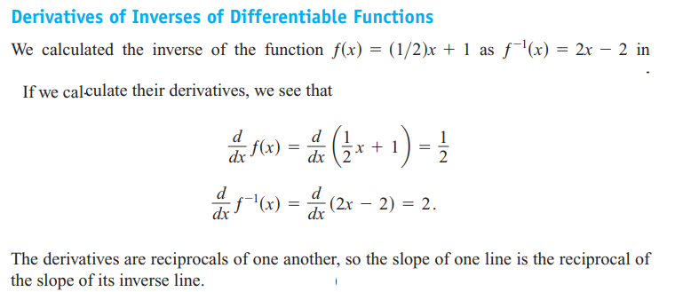
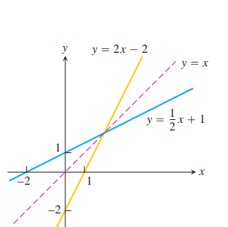

Slide 17
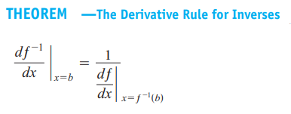
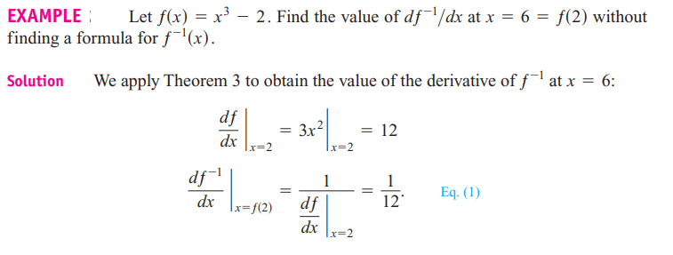

Slide 19
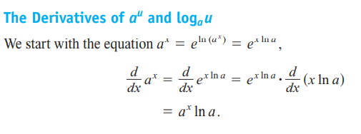

Slide 20
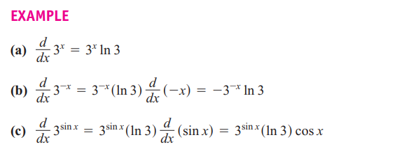

Slide 21
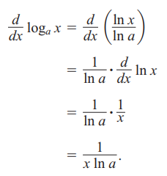

Slide 24
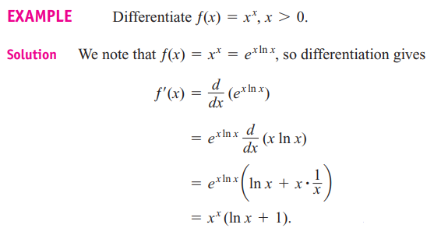

Slide 26
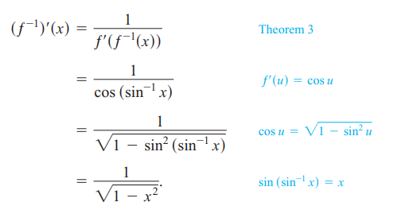
Derivatives of inverse trigonometric functions
proof

Slide 27
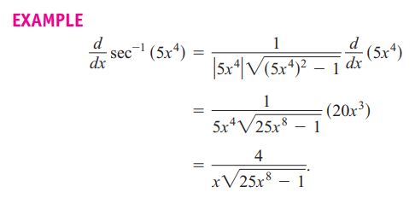

Slide 29
References
1. Thomas' Calculus" 11th edition
2. Calculus Early Transcendental Functions" by Ron Larson and Bruce Edwards

