Slide 1

Pancreas
Zhikal O. Khudhur
Endocrinology BIO 414
Spring Semester
Week number: 9
Date: / 2024

Slide 2

Objectives
pancreas
Describe the location and structure of the pancreas
the morphology and function of the pancreatic islets
Compare and contrast the functions of insulin and glucagon
Diabetes
Zhikal Omar Khudhur
4/21/2024
2

Slide 3
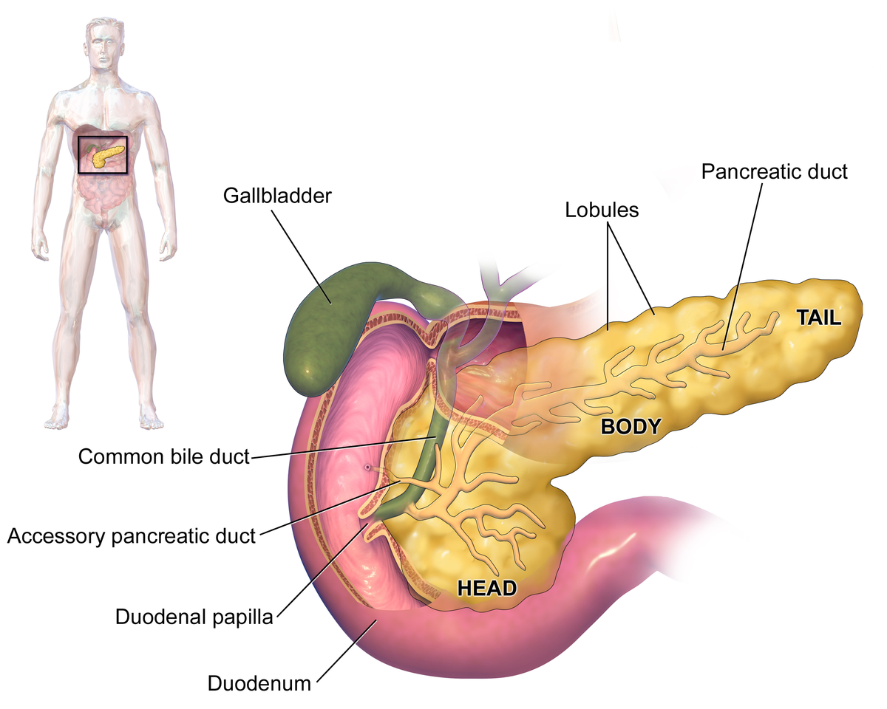
The pancreas is a long, slender organ, most of which is located posterior to the bottom half of the stomach. Although it is primarily an exocrine gland, secreting a variety of digestive enzymes, the pancreas has an endocrine function.
Its pancreatic islets—clusters of cells formerly known as the islets of Langerhans—secrete the hormones glucagon, insulin, somatostatin, and pancreatic polypeptide (PP).
Pancreas

Slide 4
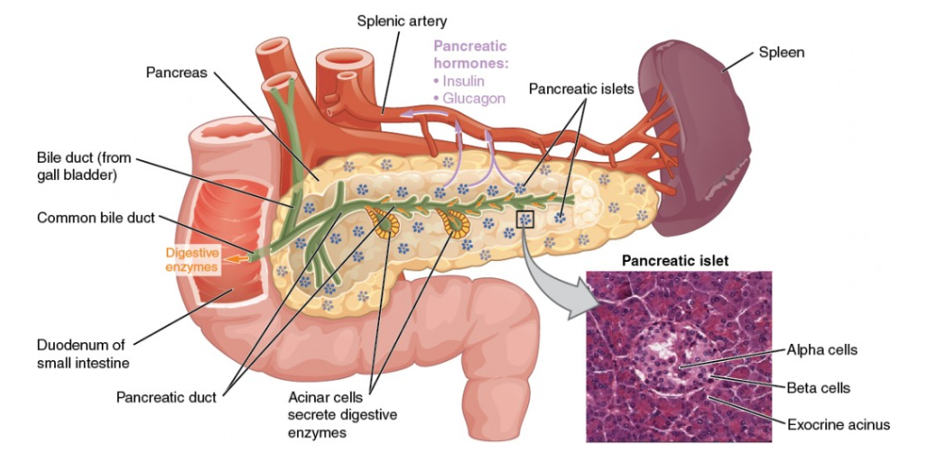
The pancreatic exocrine function involves the acinar cells secreting digestive enzymes that are transported into the small intestine by the pancreatic duct. Its endocrine function involves the secretion of insulin (produced by beta cells) and glucagon (produced by alpha cells) within the pancreatic islets. These two hormones regulate the rate of glucose metabolism in the body.

Slide 5
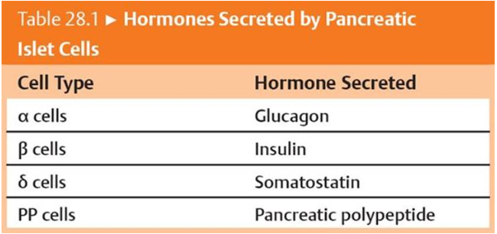

Slide 6
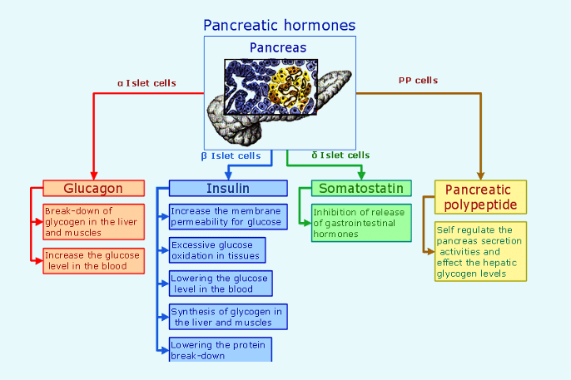

Slide 7
Cells and Secretions of the Pancreatic Islets
The pancreatic islets each contain four varieties of cells:
The alpha cell produces the hormone glucagon and makes up approximately 20 percent of each islet. Glucagon plays an important role in blood glucose regulation; low blood glucose levels stimulate its release.
The beta cell produces the hormone insulin and makes up approximately 75 percent of each islet. Elevated blood glucose levels stimulate the release of insulin.
The delta cell accounts for four percent of the islet cells and secretes the peptide hormone somatostatin. Recall that somatostatin is also released by the hypothalamus (as GHIH), and the stomach and intestines also secrete it. An inhibiting hormone, pancreatic somatostatin inhibits the release of both glucagon and insulin.
The PP cell accounts for about one percent of islet cells and secretes the pancreatic polypeptide hormone. It is thought to play a role in appetite, as well as in the regulation of pancreatic exocrine and endocrine secretions. Pancreatic polypeptide released following a meal may reduce further food consumption; however, it is also released in response to fasting.

Slide 8
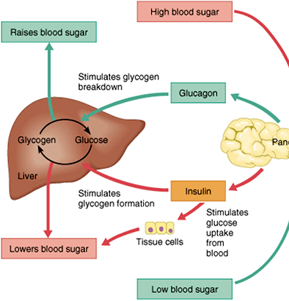
Regulation of Blood Glucose Levels by Insulin and Glucagon
Glucose is required for cellular respiration and is the preferred fuel for all body cells. The body derives glucose from the breakdown of the carbohydrate-containing foods and drinks we consume.
Hormones regulate both the storage and the utilization of glucose as required. Receptors located in the pancreas sense blood glucose levels, and subsequently the pancreatic cells secrete glucagon or insulin to maintain normal levels.

Slide 9
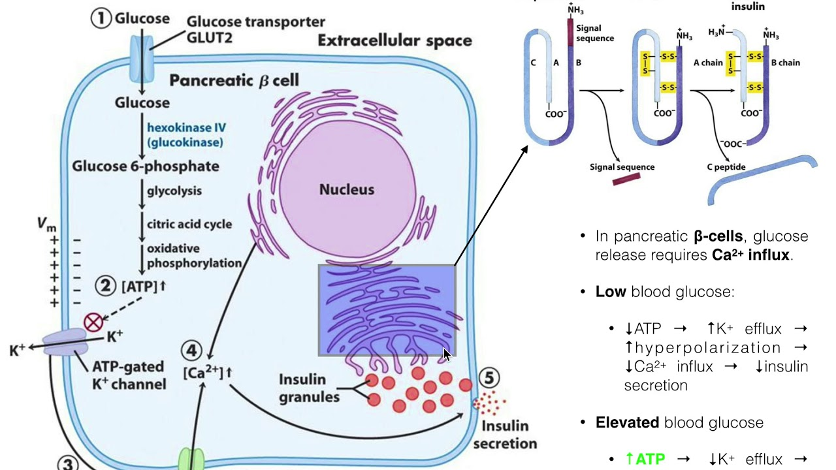
Insulin biosynthesis

Slide 10
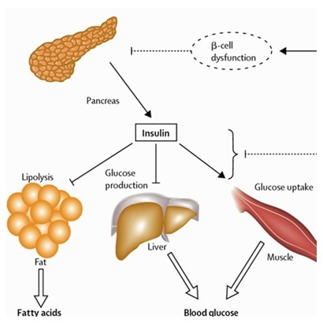
Insulin mechanism of action

Slide 11
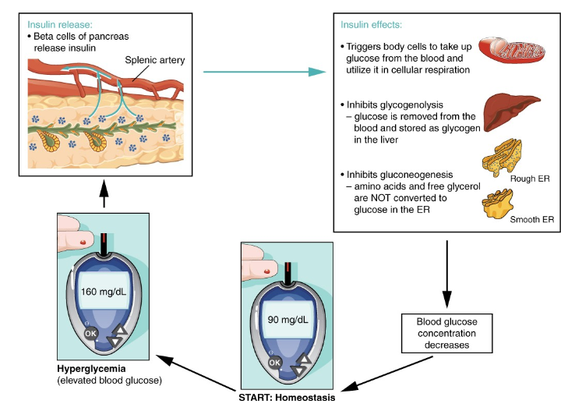

Slide 12
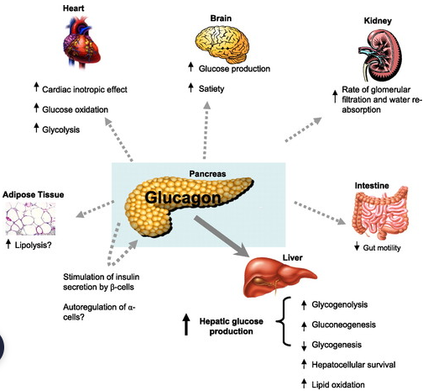
Glucagon
Receptors in the pancreas can sense the decline in blood glucose levels, such as during periods of fasting or during prolonged labor or exercise. In response, the alpha cells of the pancreas secrete the hormone glucagon, which has several effects:
It stimulates the liver to convert its stores of glycogen back into glucose. This response is known as glycogenolysis. The glucose is then released into the circulation for use by body cells.
It stimulates the liver to take up amino acids from the blood and convert them into glucose. This response is known as gluconeogenesis.
It stimulates lipolysis, the breakdown of stored triglycerides into free fatty acids and glycerol. Some of the free glycerol released into the bloodstream travels to the liver, which converts it into glucose. This is also a form of gluconeogenesis.
Taken together, these actions increase blood glucose levels. The activity of glucagon is regulated through a negative feedback mechanism; rising blood glucose levels inhibit further glucagon production and secretion.

Slide 13
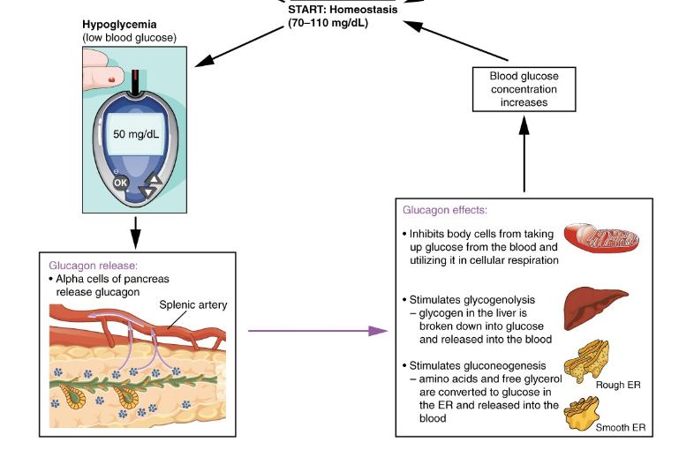

Slide 14
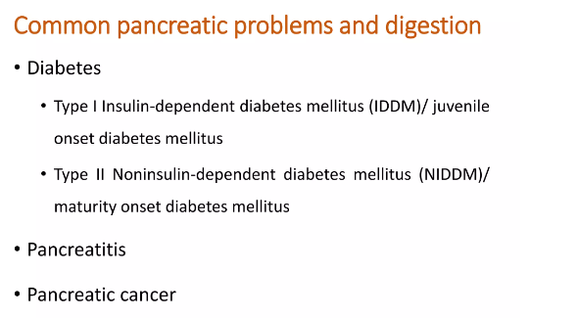

Slide 15
References
Greenstein B. & Wood D. F. (2011). The endocrine system at a glance (3rd ed.). Wiley-Blackwell
Melmed S. Auchus R. J. Goldfine A. B. Koenig R. Rosen C. J. & Williams R. H. (2020). Williams textbook of endocrinology (14th ed.). Elsevier. Boron W. F. & Boulpaep E. L. (2021).
Boron & boulpaep concise medical physiology. Elsevier. Barrett K. E. Barman S. M. Yuan J. X.-J. & Brooks H. (2019).
Ganong's review of medical physiology (review questions) (26th ed.). McGraw-Hill Education LLC Molina P. E. (2018). Endocrine physiology (Fifth). McGraw-Hill Education.

Slide 16

Thank you

