Slide 1
Fluid and electrolytes
By
Dr. Muhammad Abdullah Shwani
Assistant professor/Consultant urologist
Kurdistan Higher Council of Medical Specialties (KHCMS)
drmalshwani@mail.com

Slide 2
60% of Total body water(TBW) is water, it depends on the amount of fatty tissue.
The standard 70kg male body contains about 42 liters of water (60% of the TBW).
55% of a standard 70kg female body is water due to higher fatty tissue.

Slide 3
Body Fluid Compartments
The water in the body is divided into two compartments:
Intracellular water is inside the cell. Most of the body water is here (60%)
Extracellular water is outside the body(40). They are three types :
1. Interstitial fluid (between and around cells ) (30%).
2. Plasma fluid ( the water inside blood vessels) (9%).
3. Transcellular fluid ( the water enclosed in chambers lined by epithelial membranes, including the GI tract and synovial joints (1%).

Slide 5
Types of IV fluid in general
1-Crystalloid solutions are used to:
resuscitate patients who are hypovolemic or dehydrated
correct free water deficits
replace ongoing fluid losses
meet the fluid requirements of patients who cannot take fluids enterally.
2- Colloidal:The use of solutions is controversial and should be reserved for special situations (e.g., severe cases of low oncotic pressure).

Slide 9
IV solutions can also be classified based on their purpose:
Nutrient solutions. May contain dextrose glucose to make up the carbohydrate component - and water.
Examples of nutrient solutions include D5W, D5/NSS.
2. Electrolyte solutions. Contains varying amounts of cations and anions that are used to replace fluid and electrolytes for patients with continuing losses. Examples of electrolyte solutions include 0.9 NaCl and Ringers Lactate Solution.

Slide 10
3. Alkalinizing solutions. Are administered to treat metabolic acidosis. Examples: Lactated Ringers Solution (LRS).
4. Acidifying solutions. Are used to counteract metabolic alkalosis. D51/2NS, 0.9 NaCl.
5. Volume expanders. Are solutions used to increase the blood volume after a severe blood loss, or loss of plasma? Examples of volume expanders are dextran, human albumin, and plasma.

Slide 11
Crystalloids
Crystalloid IV solutions contain small molecules that flow easily across semipermeable membranes. They are categorized according to their relative tonicity ( solute concentration): to plasma.
There are three types:
Isotonic solutions that have the same concentration of solutes as blood plasma
hypotonic have a lesser concentration of solutes than plasma.
hypertonic have a greater concentration of solutes than plasma.

Slide 12
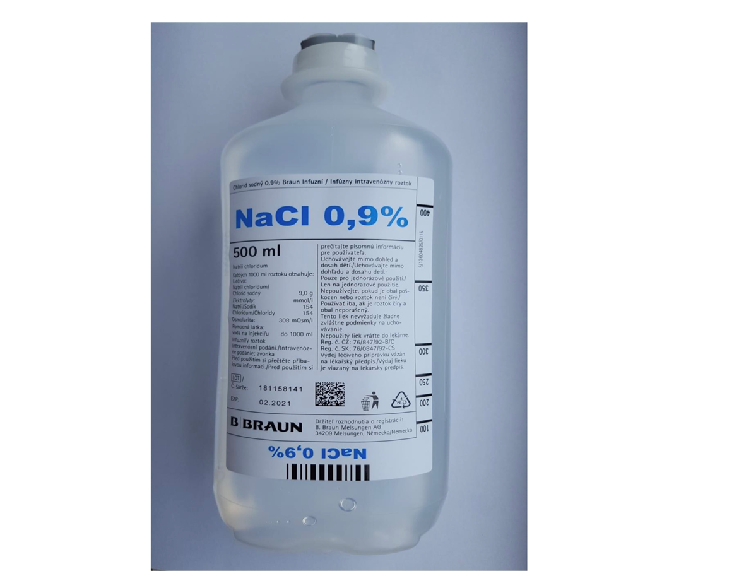
Isotonic IV Fluids
0.9% NaCl (Normal Saline Solution) is a crystalloid isotonic IV fluid that contains water, sodium (154 mEq/L), and chloride (154 mEq/L).
It has an osmolality of 308 mosm/L and gives no calories.

Slide 13
Use of N/S
Normal saline is the isotonic solution of choice for expanding the extracellular fluid (ECF) volume because it does not enter the intracellular fluid (ICF).
Normal saline is the IV fluid used alongside the administration of blood products.
Used to replace large sodium losses such as in burn injuries and trauma.
It should not be used for :
heart failure
pulmonary edema
renal impairment
conditions that cause sodium retention
As in these conditions it may cause fluid volume overload.

Slide 14
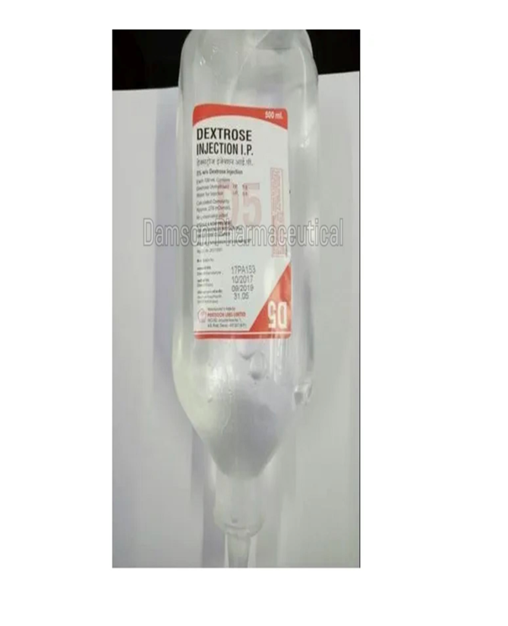
Dextrose 5% in Water (D5W)
D5W (dextrose 5% in water) is a crystalloid isotonic IV fluid with a serum osmolality of 252 mosm/L.
Use of D5W:
It is administered to supply water and to correct an increase in serum osmolality.
A liter of D5W provides fewer than 200 kcal and contains 50g of glucose.
It should not be used for fluid resuscitation because hyperglycemia can result

Slide 15
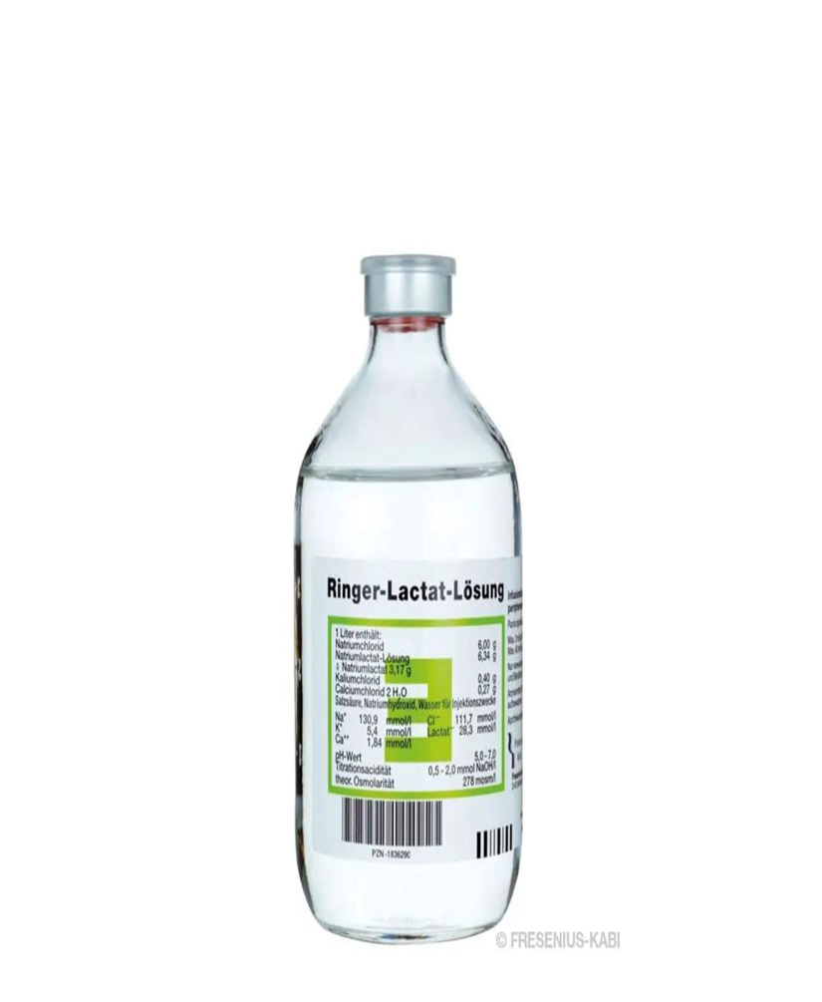
Lactated Ringer’s 5% Dextrose in Water (D5LRS)
Lactated Ringers Solution (also known as Ringers Lactate or Hartmann solution) is a crystalloid isotonic IV fluid designed to be the near-physiological solution of balanced electrolytes.
It is the most physiologically adaptable fluid because its electrolyte content is most closely related to the composition of the body’s blood serum and plasma.

Slide 16
Uses
Lactated Ringers are used to correct dehydration, and sodium depletion, and replace GI tract fluid losses.
It can also be used in fluid losses due to burns, fistula drainage, and trauma.
It is often administered to patients with metabolic acidosis.
It should be used with caution for patients with heart failure and renal failure.

Slide 17
Hypotonic IV Fluids
Hypotonic IV solutions have a lower osmolality and contain fewer solutes than plasma.
They cause fluid shifts from the ECF into the ICF to achieve homeostasis, therefore, causing cells to swell and may even rupture.
IV solutions are considered hypotonic if the total electrolyte content is less than 250 mEq/L.
Hypotonic IV fluids are usually used to :
Supply free water for the excretion of body waste products
treat cellular dehydration
replace the cellular fluid

Slide 18
0.45% Sodium Chloride (0.45% NaCl)
Sodium chloride 0.45% (1/2 NS), also known as half-strength normal saline, is a hypotonic IV solution used for replacing water in patients who have hypovolemia with hypernatremia.

Slide 19
2.5% Dextrose in Water (D2.5W)
Another hypotonic IV solution commonly used is 2.5% dextrose in water (D2.5W).
This solution is used to treat dehydration and decreased levels of sodium and potassium.
It should not be administered with blood products as it can cause hemolysis of red blood cells.

Slide 20
Hypertonic IV Fluids
Hypertonic IV solutions have a greater concentration of solutes than plasma and cause fluids to move out of the cells and into the ECF to normalize the concentration of particles between two compartments.
This effect causes cells to shrink and may disrupt their function.
They are also known as volume expanders as they draw water out of the intracellular space, increasing extracellular fluid volume.

Slide 21
1. Hypertonic Sodium Chloride IV Fluids :
3% sodium chloride (3% NaCl)
5% sodium chloride (5% NaCl)
2. Hypertonic Dextrose Solutions :
Dextrose 10% in Water (D10W)
Dextrose 20% in Water (D20W)
Dextrose 50% in Water (D50W)

Slide 22
Colloids
Colloids contain large-size molecules that do not pass through semipermeable membranes.
They are useful for expanding the intravascular volume and raising blood pressure.
Colloids are indicated for patients in malnourished states and patients who cannot tolerate large infusions of fluid.

Slide 23
Human Albumin
Human albumin is a solution derived from plasma. It has two strengths: 5% albumin and 20% albumin.
5% Albumin is a solution derived from plasma and is a commonly utilized colloid solution.
It is used to increase the circulating volume and restore protein levels in conditions such as burns, pancreatitis, and plasma loss through trauma.
20% Albumin is used together with sodium and water restriction to reduce excessive edema.

Slide 24
The use of albumin is contraindicated in patients with the following conditions:
severe anemia
heart failure
known sensitivity to albumin.
Additionally, angiotensin-converting enzyme inhibitors should be withheld for at least 24 hours before administering albumin because of the risk of atypical reactions, such as hypotension and flushing.

Slide 25
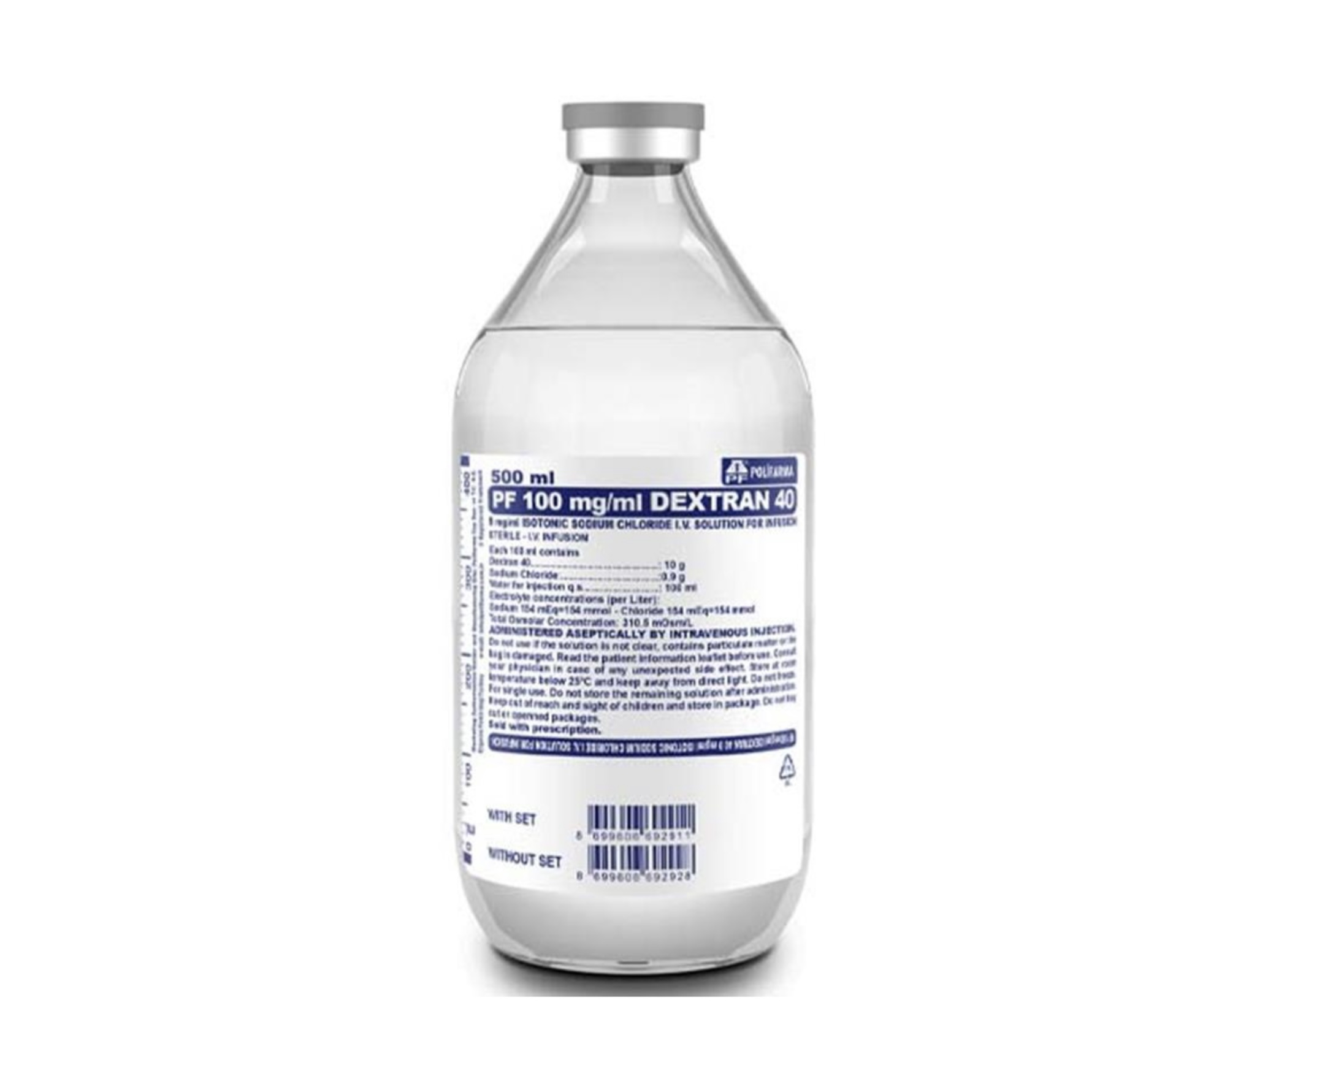
Dextrans
Dextrans are polysaccharides that act as colloids. They are available in two types:
low-molecular-weight dextrans (LMWD)
high-molecular-weight dextrans (HMWD).
They are available in either saline or glucose solutions.
Dextran interferes with blood crossmatching, so draw the patient’s blood before administering dextran, if crossmatching is anticipated.

Slide 26
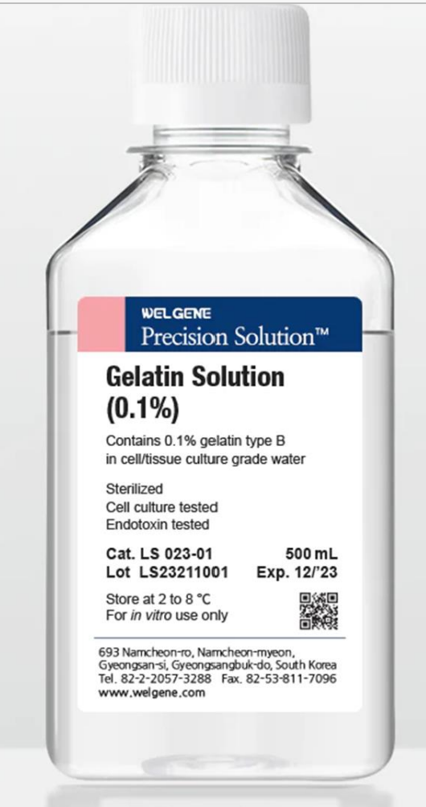
Gelatin
Gelatins have lower molecular weight than dextrans and therefore remain in circulation for a shorter period of time.

Slide 27
THANK YOU

