Slide 1
WHITE AND RED LESIONS OF ORAL MUCOSA
L 22

Slide 2
WHITE AND RED LESIONS OF ORAL MUCOSA
The color of normal oral mucosa depends on the interplay between four factors
. Vascularity
. melanin pigmentation
. epithelial thickness
. keratinization.
The term white patch is often due to hyperkeratosis; any excess keratin, becoming sodden or hydrated with saliva, appears white.

Slide 3
White patches can be grouped clinically into:
1. white lesion can be separated or wiped away due to accumulation of epithelial debris or an inflammatory exudate on the surface.
2. white lesion that cannot be wiped away.
White patches can be grouped histologically into
1.Those which show epithelial dysplasia and
2. Those which do not show epithelial dysplasia

Slide 4
The etiological classification is:
1. HEREDITARY:
Leukoedema :
. A racial pigmentation, mostly in black people, appear as grayish-white milky translucent surface of oral mucosa
. occur bilaterally in the majority of cases and frequently involve most of the buccal mucosa extending onto the oral surfaces of the lips
It disappear when the mucosa is stretched, which helps to differentiate it from other white lesions in the mouth

Slide 5
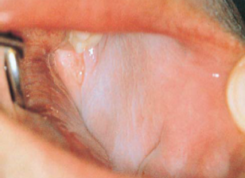
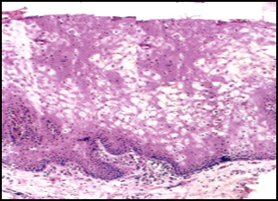
Histologically
. The epithelium is thicker than normal with broad rete ridges.
. The epithelium shows acanthosis and intracellular edema.
. It is regarded as a variation from normal.
Leukoedema appear grayish-white milky translucent. Intracellular edema of prickle cells in leukoedema

Slide 6
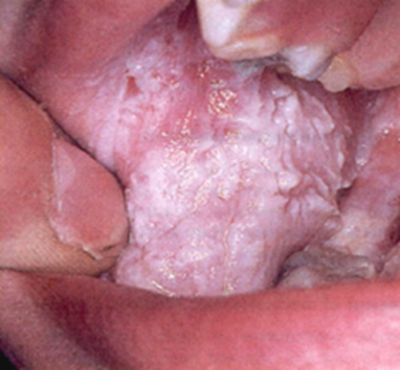
White Sponge Nevus (oral epithelial naevus):
The disease follows a hereditary pattern as an autosomal dominant trait, may be widespread, and may be apparent in infancy or early childhood.
The mucosa appears white thickened and folded or corrugated with a soft or spongy texture. In occasional cases, the oral lesions were accompanied by similar lesions of other mucosal surfaces, including the vagina and, anus, rectum and nasal cavity.
There is no treatment for the condition, and it is not premalignant.

Slide 7
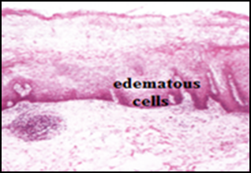
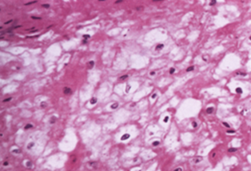
Histologically
. The epithelium is acanthotic and the surface shows marked hyperparakeratosis.
. A characteristic feature is marked intracellular edema of the of the prickle cell layers. . .There is no inflammatory changes in the lamina propria and there is no cellular atypia, and not considered as premalignant lesion.
microscopical picture.

Slide 8
2. INFECTION: Like
. Candidal (ex: acute pseudo membranous and chronic hyperplastic candidiasis)
. Bacterial (ex: syphilitic leukoplakia),
. Viral infection (ex: hairy leukoplakia).
. Some infections may appear red in color like chronic atrophic candidiasis.

Slide 9
3. TRAUMATIC:
Mechanical trauma (Frictional keratosis):
. It is a chronic rubbing or friction against an oral mucosal surface may result in hyperkeratosis.
. This results in a white appearance of the tissue.
. An example of frictional keratosis is an increase in surface keratin that results from chronic cheek and tongue chewing, and irritation by a sharp tooth.
. Habitual cheek biting causes an area of buccal mucosa to appear red and white with a rough surface.

Slide 10
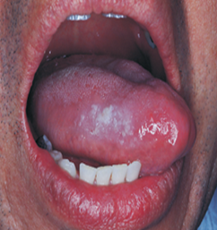
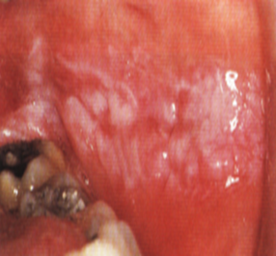
(A)
.(B)
:(A) Focal keratosis caused by tongue chewing.(B)Frictional keratosis related to occlusal line.

Slide 11
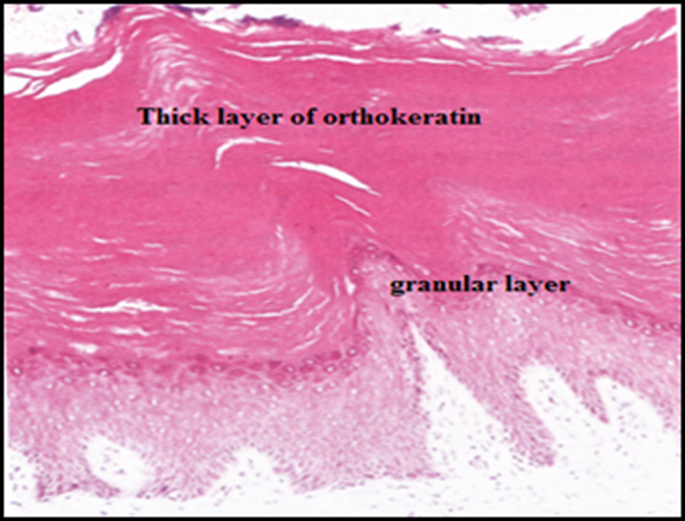
Histologically
. The epithelium shows acanthosis with a prominent granular cell layer and thick hyperkeratosis but no dysplasia.
. There are often scattered chronic inflammatory cells in the connective tissue.
. There may be areas of ulcerations.
The diagnosis of frictional keratosis is made by
identification of the trauma causing the lesion,
elimination of the cause, and observing
resolution of the lesion.

Slide 12
Thermal trauma:
. Oral mucosal thermal burns from hot food or liquid are common.
. They occur most often on the palate and tongue, and can cause white or red lesions in the oral cavity.
. Regular smokers often develop white lesions on their oral mucosa.
. It is likely that both thermal and chemical factors are involved in the development.
.Tobaccos (smoked or chewed) cause a white lesion.
. Individuals who use smokeless tobacco in any of its many forms may develop a white lesion in the area where the tobacco is habitually placed (smokeless tobacco keratosis).

Slide 13
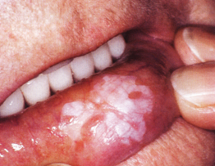
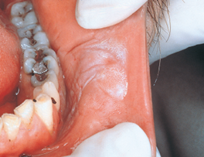
The mucobuccal fold is the most common location.
The epithelium may be opaque white and have a corrugated surface.
Microscopically the epithelium may show changes that vary from hyperplasia and hyperkeratosis to a typical premalignant change that is called epithelial dysplasia.
A
B

Slide 14
Nicotinic stomatitis :
. Is seen among heavy smokers.
. The appearances are distinctive in that the palate is affected, and appear as white lesion and contain scattered red spots represent the orifices of minor salivary glands ducts.
. The white areas show hyperorthokeratosis and acanthosis with keratin plugs in some of the duct orifices associated with mild periductal chronic inflammation.
. If the patient can be persuaded to stop smoking the lesion resolves within weeks. . .Epidemiological evidence suggests that smoking raises the risk of oral cancer.

Slide 15
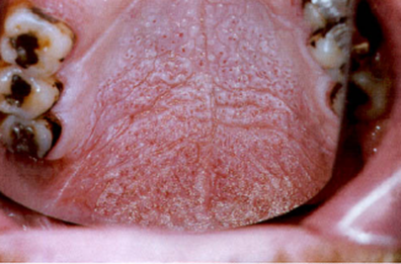
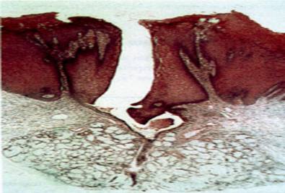
(A)
(B)
(A) Stomatitis nicotina, the inflamed openings of the minor salivary glands form red spots on the white background.(B) The epithelium is hyperplastic and hyperkeratotic, especially around the orifice of the duct where there is a concentration of inflammatory cells.

Slide 16
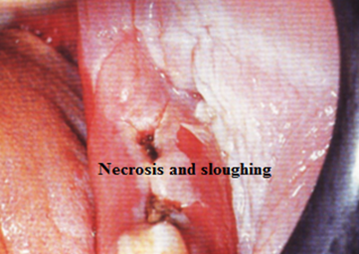
Chemical trauma:
. Aspirin burn generally occurs when a patient with a toothache places an aspirin tablet directly on the painful tooth
. Topical application is a common misuse of aspirin, the tissue becomes necrotic, white, painful, and the necrotic tissue may separate from the underlying connective tissue and slough off, resulting in a large ulcer.
Aspirin burn of buccal mucosa

Slide 17
Phenol, sodium hypochlorite, formocresol, and eugenol are used in dentistry. When comes into contact with the soft tissues, a whitening of the exposed area occurs as a result of tissue destruction.
The surface tissue may slough off; exposing the underlying connective tissue and the resulting ulcer is painful.

Slide 18
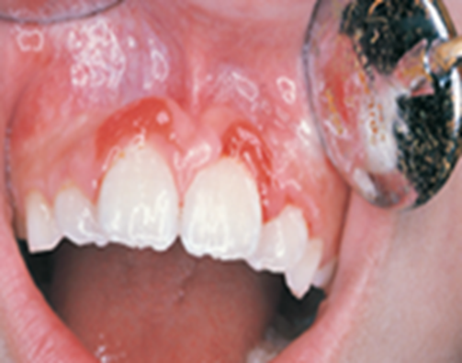
Habits of which the patient may or may not be aware can cause injury.
These lesions range from ulceration to epithelial hyperplasia and hyperkeratosis.
Treatment of self-induced lesions depends on the amount and type of destruction and may involve psychotherapy
Traumatic ulceration causes by irritation of the gingiva by fingernail

Slide 19
4. IDIOPATHIC
Leukoplakia : It is the most common premalignant lesion of the oral mucosa, of unknown cause that cannot be rubbed off, and has recently been redefined as “a white lesion of the oral mucosa that cannot be diagnosed clinically as any other disease of the oral mucosa with white appearance.

Slide 20
The etiological factors are
. Tobacco (smoked or chewed), snuff dipping, and alcohol usage.
. In those patients whose tobacco associated keratosis regresses on cessation of the habit the lesion should not be classified as leukoplakia.
. Candida (ex: chronic hyperplastic candidiasis) and viruses (ex: Human papilloma virus) are the other causes of leukoplakia.
. Small percentage of leukoplakia is premalignant and some are invasive carcinoma at presentation.

Slide 21
Clinical features:
. Oral leukoplakia occurred predominantly in men, and in older people.
. Leukoplakia vary from small to extensive lesion, white or gray, and may have homogeneous, or non homogeneous surface which shows irregular areas of redness, or contain small red areas and called speckled leukoplakia, it may represent carcinoma in situ or even invasive carcinoma.
. In some cases the lesion may take on a warty appearance and described as Verrucous leukoplakia.

Slide 22
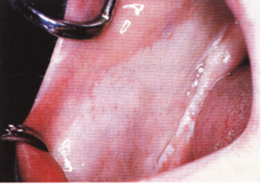
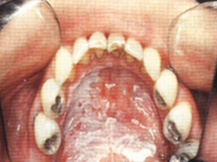
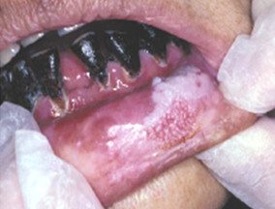
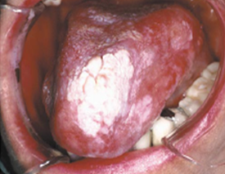
A
B
C
D

Slide 23
Histopathological features:
. There is a wide range in the histological appearance of oral leukoplakia which reflects varying degrees of thickness of keratosis, epithelial thickness, epithelial dysplasia
Chronic Inflammatory cells infiltration in lamina propria.
. Areas of redness within leukoplakia often being associated with epithelial atrophy.
The individual cellular changes (cellular atypia) seen in dysplastic epithelium reflect abnormalities in proliferation, maturation, with nuclear and cellular pleomorphism Disorganization of the epithelial layers, hyperplasia of the basal cells.
. The epithelial cells appear with enlarged and hyper chromatic nuclei, increased nuclear-to-cytoplasmic ratios, abnormal keratinization below the keratin layer, and increased numbers of abnormal mitotic figures.

Slide 24
Microscopically, epithelial dysplasia differs from squamous cell carcinoma in that there is no invasion of the abnormal epithelial cells through the basement membrane into the underlying tissue.
Severe dysplasia involving the full thickness of the epithelium is called carcinoma in situ. Clinically this lesion appears as white plaque, eroded, ulcerated, or red lesion.
More commonly affect old males.
All dysplastic lesions should be excised surgically, and needs close long-term follow-up examinations.

Slide 25
Erythroplakia :
. Erythroplakia is a clinical term used to describe an oral mucosal lesion of unknown cause that appears as a smooth or granular red patch which cannot be classified clinically and pathologically under any other disease.
. This premalignant lesion may be homogenous red or non homogenous or speckled erythroplakia.
. Erythroplakia is much less common than leukoplakia.
. The floor of the mouth, retro molar area, soft palate, and tongue is the most common sites of involvement.
Erythroplakia occurs more frequently between the ages of 50 and 70 years.

Slide 26
. Over 91% of erythroplakias histologically demonstrate severe dysplasia (abnormalities in proliferation, maturation…..etc), carcinoma in situ or early invasive squamous cell carcinoma at the time of diagnosis.
The red areas histologically shows reduction in keratin production and increase in the vascularity of sub mucosal connective tissue, and the underlying connective tissues shows intense chronic inflammatory cell infiltration.
Fixation, induration, ulceration, lymph adenopathy, and bone destruction when the lesion overlies bone are clinical features that may indicate malignant changes of leukoplakia or erythroplakia.

Slide 27
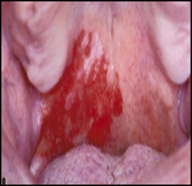
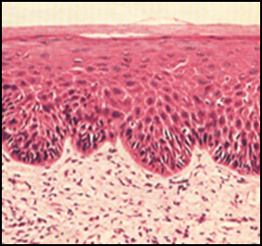
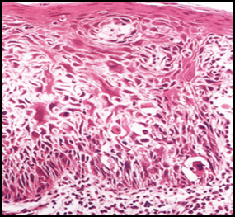
( A)
(B)
(C)
( A) Erythroplakia involving mainly the soft palate. (B) Epithelial dysplasia involving the lower third of the epithelium with drop shaped rete pegs. (C) Carcinoma in situ with severe dysplasia involving the full thickness of the epithelium.

Slide 28
Oral submucous fibrosis :
A premalignant chronic disease involves any part of the oral mucosa and occasionally may extend into the pharynx and esophagus.
The etiology is unknown, may be due to betel quid or betel nut chewing, and genetic susceptibility may also present.

Slide 29
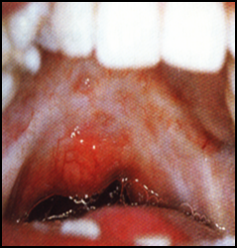
Clinical features:
Occurs mostly among Asiatic Indians, characterized by
Increasing stiffening of the oral mucosa and difficulty in opening the mouth and movement of the tongue due to sub epithelial connective tissue fibrosis.
The mucosa appears blanched white with marble appearance, often with palpable bands of fibrous tissue.
mucosa appears blanched white

Slide 30
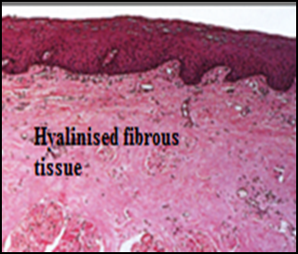
Histopathological features:
. Shows atrophic epithelium with shallow rete pegs.
. The surface is orthokeratinzed or parakeratinized, and epithelial dysplasia found in about 10-15% of biopsy.
. The sub epithelial connective tissue appears fibrotic with few fibroblast cells and scattered chronic inflammatory cells.
. The blood vessels narrowed or completely
obliterated due to fibrosis.
sub epithelial connective tissue appears fibrotic

Slide 31
5. DERMATOLOGICAL
Lichen planus :
. Oral lichen planus (OLP) is a common mucocutaneous disease.
. The condition can affect either the skin or mucosa or both.
. The data available suggests that oral lichen planus is autoimmune disease occur due to formation of auto antibodies against basal cell layer.
. The course of the disease is long, from months to several years, frequently undergoing periods of remission followed by exacerbations which often correspond to periods of emotional upset, overwork, or anxiety.
An interesting association of lichen planus, diabetes mellitus and vascular hypertension, the triad being described as Grinspan’s syndrome

Slide 32
Clinical features:
. It predominantly occurs in adults females.
. Skin lesions of lichen planus appear as small flat-topped papules; its surface is covered by characteristic, very fine grayish-white lines, called Wickham’s striae.
. The majority of patients with dermal lichen planus have associated oral lesions of the disease, usually bilateral; the buccal mucosa is involved in majority of cases with a wide spectrum of clinical presentation.

Slide 33
. The reticular, plaque likes, and papular pattern are usually symptom free, and radiating striae may often be seen on their periphery.
. Atrophic, erosive and ulcerative types are associated with pain and appear red, and more commonly undergo malignant transformation.
. The ulcerative type may preceded by bullae (bullous type of lichen planus).
. Plaque or hypertrophic form of lichen planus generally appearing as a well-circumscribed, elevated white lesion resembling leukoplakia.

Slide 34
. An atrophic form of lichen planus appears as smooth, red, poorly defined areas, often but not always with peripheral striae evident.
. Eroded or ulcerated lesions are irregular in size and shape and appear as raw red painful areas.
. The gingivae are occasionally the only site of lichen planus and present as desquamative gingivitis, the gingivae appear shiny, inflamed and smooth.
. A variety of drugs like non-steroidal anti-inflammatory drugs may cause lesions that appear clinically similar to lichen planus and are termed as lichenoid lesions.

Slide 35
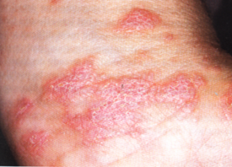
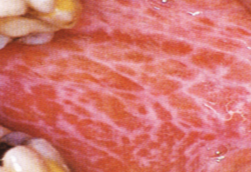
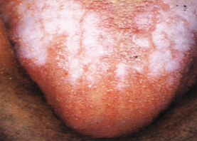
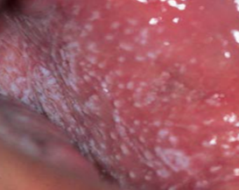
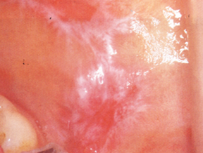
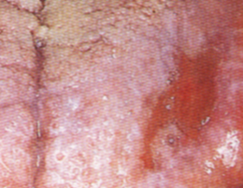
(B)Reticular
(C) Plaque
(A) Dermal lichen planus.
.(E) Atrophic
(D)Papular.
(F)Erosive
Oral types are: (B)Reticular. (C) Plaque. (D)Papular.(E) Atrophic.(F)Erosive

Slide 36
Histopathological features:
. The epithelium is varies in thickness depending on the clinical type.
. It may shows atrophy, hyperparakeratosis or hyperorthokeratosis with thickening of the granular layer, acanthosis, and the development of a ‘saw tooth’ appearance of the rete pegs, with band-like subepithelial mononuclear cells infiltration and degenerating of basal keratinocytes.
. The degenerating cells appear as condensed bodies (Civatte bodies) and represent basal cells undergoing apoptosis.
. Some times subepithelial bullae are seen.

Slide 37
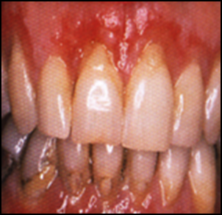
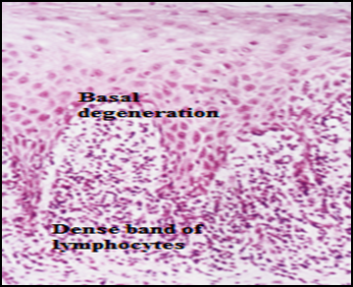
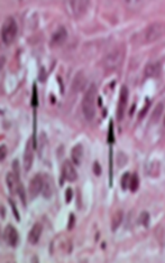
Desquamative gingivitis caused by OLP. Microscopical picture of OLP.(I) Civatte bodies(arrows).

Slide 38
Lupus erythematosus :
. It is a chronic immunologically mediated disease.
. Two main forms of the disease are recognized:
. discoid (DLE) which is localized disease and
. systemic (SLE) which is disseminated and involving almost every organ of the body.
. Auto antibodies to the patient’s DNA (anti-nuclear antibodies) are present in serum.
. Females are affected much more frequently than males.
. Skin lesions are among the most common signs of the disease.

Slide 39
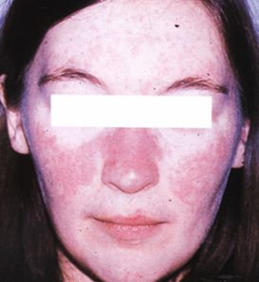
The most common skin lesion is an erythematous rash involving areas of the body exposed to sunlight; the classic “butterfly” rash occurs over the bridge of the nose, and there may be erythematous lesions on the fingertips.
Other skin lesions such as bullae, a discoid rash, or subcutaneous nodules can also occur.
Butterfly rash

Slide 40
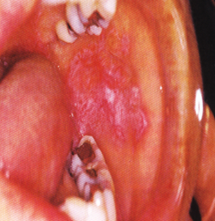
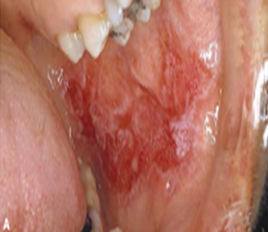
. Oral lesions appear as a white hyperkeratotic plaques, erythematous areas, erosions or ulcerations.
. White striae radiating from the center of the lesion are usually present.
. Oral lesion nearly resembles lichen planus clinically, but is less symmetric in their distribution.
Histologically, the oral lesions shows subepithelial perivascular foci of lymphocytes with liquefactive degeneration of basal cells similar to lichen planus.
Discoid area of erythema with keratotic border.

Slide 41
6. NEOPLASTIC: Like
. carcinoma in situ and
. squamous cell carcinoma.

